Slide 1
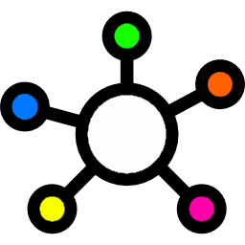
Connect the Dots
News aggregation and matching engine

Slide 2
The problem

Slide 3

This Photo by Unknown Author is licensed under CC BY-NC
Notes:
Too many news sites
Even when trying to be objective, it‘s impossible to guarantee
No simple overview

Slide 4
Our idea: Aggregating and matching articles
Notes:
Source articles
Match automatically by similarity score

Slide 5





Principle & technologies used
… and many more

Slide 6



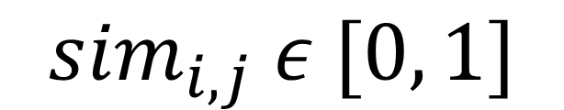
Similarity score calculation
Tag overlap score
Text similarity
$${sim}_{i, j} ε [0, 1]$$
Notes:
Tag overlap score with Open Calais tags
Machine learning on text to identify similar article content

Slide 7
Demo

Slide 8
Let‘s fight fake news with the help of Reuters!

Slide 9
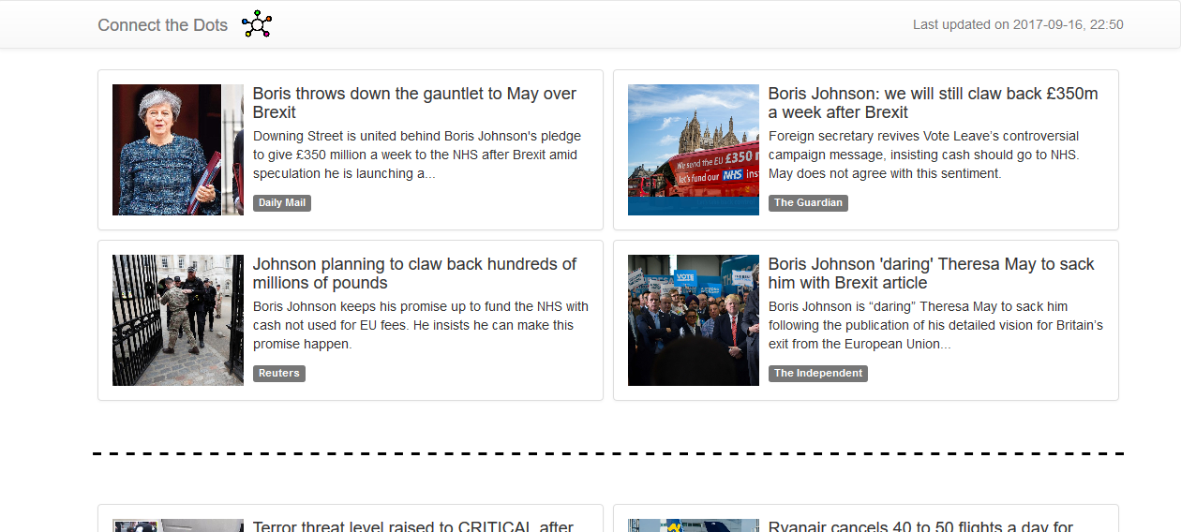
Backup

Slide 10
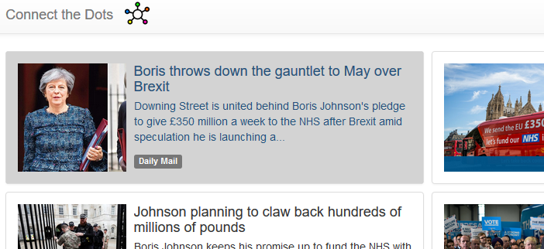
Backup

