Slide 1
Number of limbs vs Size

Slide 2
Does the size of a robot influence the number of limbs?
Understanding important for investigation of morphologies in complex environment

Slide 3
Setup
Representation | Coordinate based mappings
Crossover | None
Mutations | Uniform insertions
Parent Selection | Generated individuals are parents
Survivor Selection | (μ, λ)

Slide 4
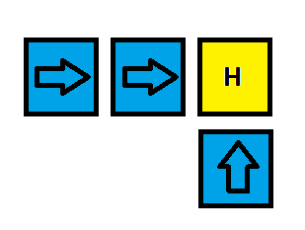

Phenotype
Actual
“Nice”

Slide 5
Genotype
Maps coordinate to a status
(0, 0) -> H
(-1, 0) -> R
(-2, 0) -> R
(0, -1) -> U
Status | Description
H | Head of the robot
U | Block that was attached up
R | Idem right
L | Idem left
D | Idem down

Slide 6
Genotype – Phenotype Mapping
(0, 0) -> H
(-1, 0) -> R
(-2, 0) -> R
(0, -1) -> U

Slide 7
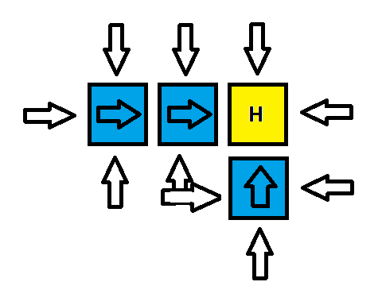
Mutation
Find all attachment points
Select one uniform randomly
Ie in example: p(x) = 1/10

Slide 8
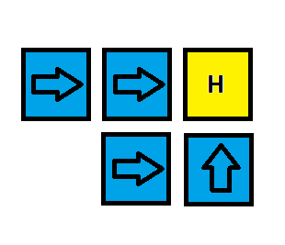
Mutation
Attach block to chosen point
Every generation exactly
one block added

Slide 9
Experiment
Runs | 1
Pop size | 1000
Generations | 1000

Slide 10
Experiment Notes
1 run is sufficient as individuals do not interact
1000 generations of 1000 individuals = 1,000,000 individuals
Generation n only has individuals with abs size n+1
Feasible due to simple system

Slide 11
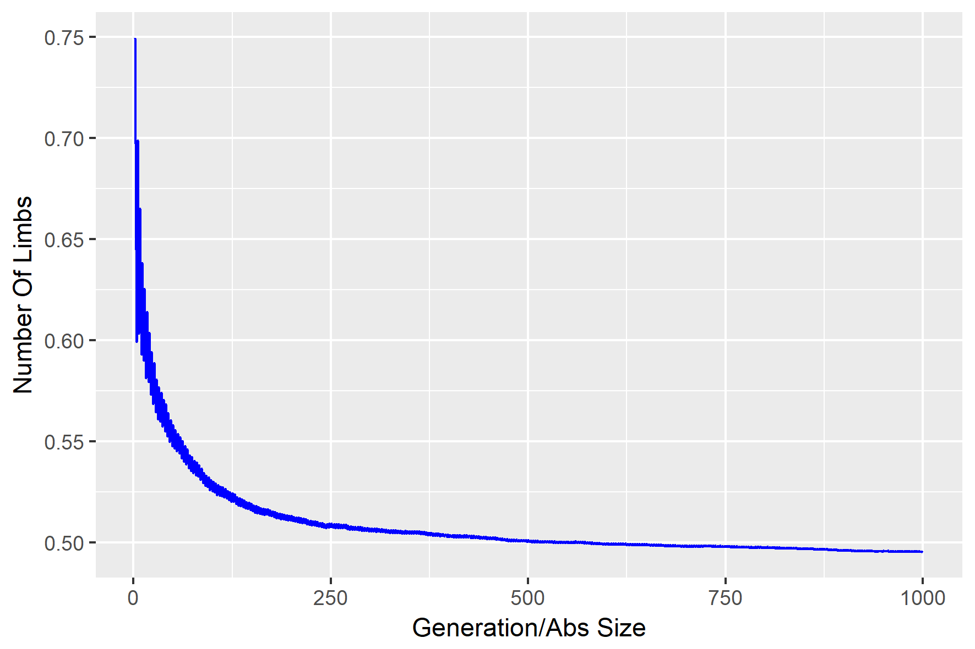
Result - All

Slide 12
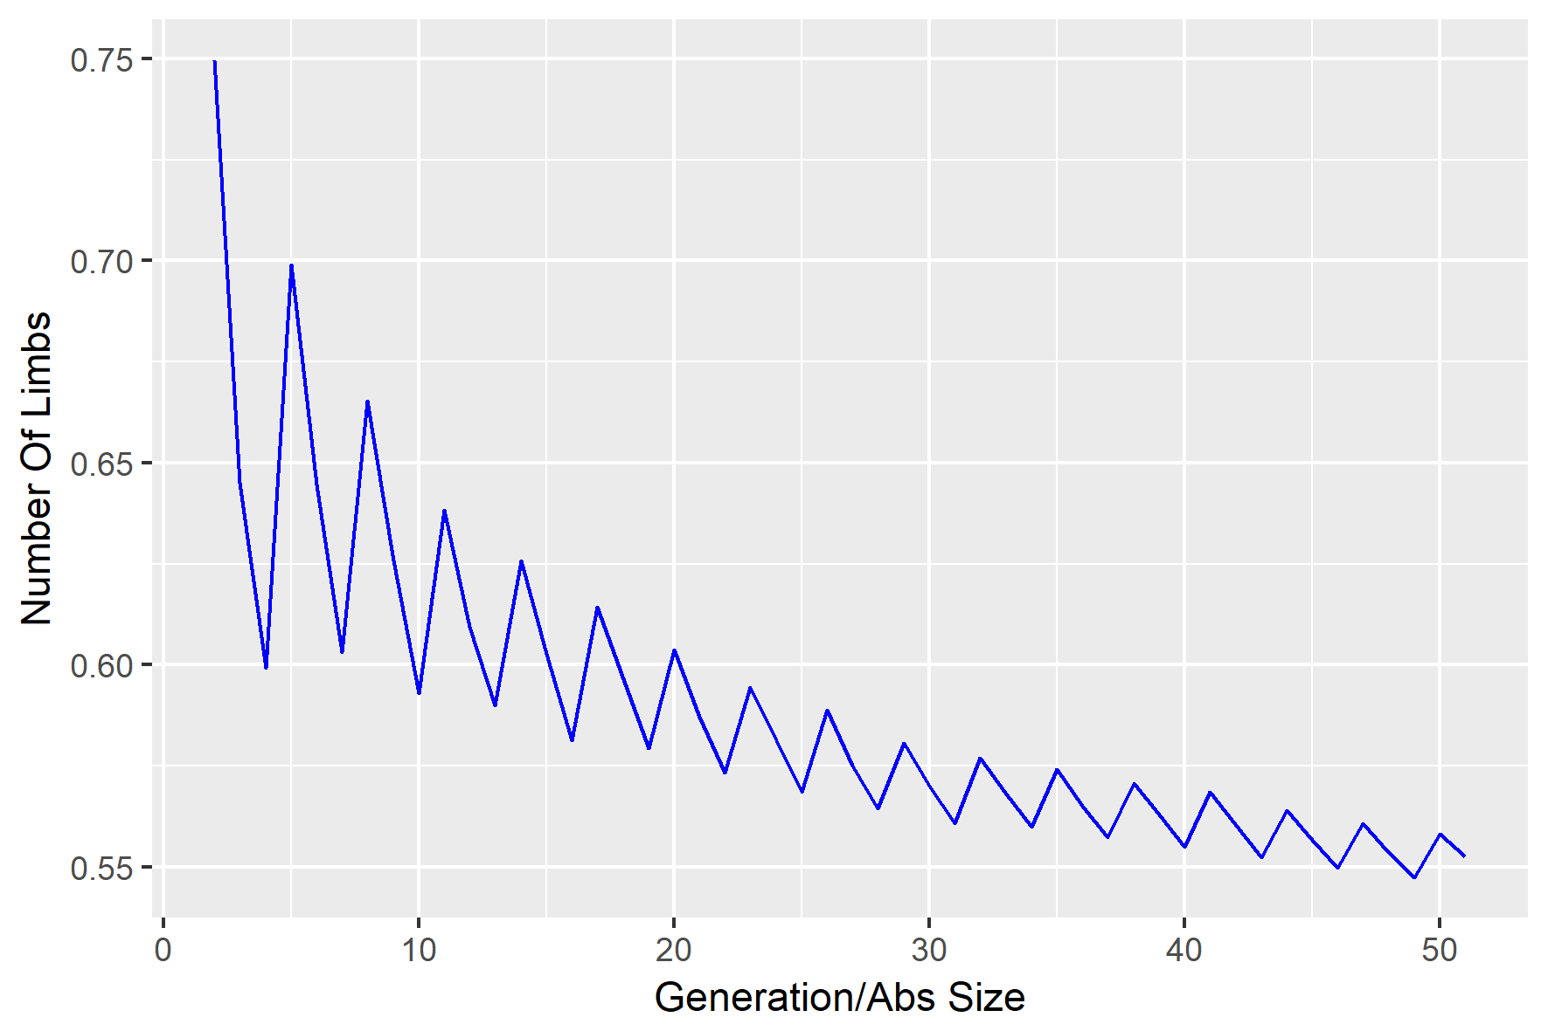
Result – 50 Gens

Slide 13
Observations
Decreasing trend; significant by Mann-Kendall
Alternating higher – lower pattern visibile in 50 gens
Weak observation: even the lowest averages are much higher than found in own experimental set up.

Slide 14
Discussion
The decreasing trend is significant – is it generalizable to our setup?
Can/should we explain the alternating pattern?
Does it say anything that the values are higher than our own experimental setup?

