Slide 1
JSF - Java Server Faces
Lecturer: Ondrej Mihályi

Slide 2
JSF overview
run by FacesServlet mapped in web.xml
configured by faces-config.xml and contex parameters in web.xml
FacesServlet executes several phases in MVC style
  Request -> Execute code in Java Bean -> Create view from Facelet -> Response

Slide 3
JSF lifecycle
Restore view phase
Apply request values phase; process events
Process validations phase; process events
Update model values phase; process events
Invoke application phase; process events
Render response phase
Notes:
http://www.tutorialspoint.com/jsf/jsf_life_cycle.htm

Slide 4
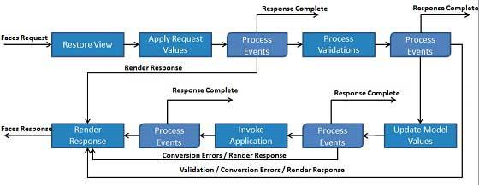
JSF Lifecycle

Slide 5
JSF component tree
logical tree of UI components
created from a definition in facelet
encoded to xhtml at the end of the request
  to bring new state of the view to browser (new page)
recreated at the begining of the request
  to represent the current state of the view before request is processed

Slide 6
JSF Facelets
XHTML based templates for a web page
define components in a component tree
specify binding to Java code
  data
  conditional rendering
  controller methods / listeners

Slide 7
Managed Beans
provide controller methods and data model for facelets
bound to component properties using Expression Language
identified in facelets by textual name
marked by @Named CDI qualifier

Slide 8
Expression language
EL is a script used in facelets to bind values to component properties
Results in a value - primitive values, object, even a method pointer
Fields are converted to getters and setters or to keys in a map
Never throws a Null Pointer -> blank value instead

Slide 9
Usage of Expression language
enclosed in #{ ... }
do not mix with ${ … } used in JSP
  JSP and JSTL tags should not be mixed with JSF
in facelet: rendered="#{ bookView.displayed }
in BookView bean:
@Named class BookView {
public boolean isDisplayed() { return true; }
}

Slide 10
Basic components - display
h:outputText - textual output in <span>
h:outputLabel - <label>
h:outputLink - <a href…>
h:messages - display of JSF messages
h:graphicImage - <img>
h:dataTable - table for collection of rows
Notes:
http://www.jsftoolbox.com/documentation/help/12-TagReference/html/h_panelGroup.html

Slide 11
Basic components - layout
h:panelGroup - container - <span> or <div>
h:panelGrid - grid layout container (table)

Slide 12
Basic components - Forms
h:inputText
h:inputTextarea
h:selectManyListbox, h:selectOneMenu, etc. - selection components, listboxes, checkboxes
h:form - all input components must be in some form to function

Slide 13
Basic components - actions
All action components submit form and call action on web server via javascript
They accept link to a listener method
h:commandButton
h:commandLink

