Slide 1
Windows Authentication Concepts
Ing. Ondřej Ševeček | GOPAS a.s. |
MCSM:Directory2012 | MCM:Directory2008 | MVP:Enterprise Security | CEH: Certified Ethical Hacker | CHFI: Computer Hacking Forensic Investigator | CISA |
ondrej@sevecek.com | www.sevecek.com |
GOPAS: info@gopas.cz | www.gopas.cz | www.facebook.com/P.S.GOPAS

Slide 2
Operating systems
Active Directory domain environment
Windows 2000 DFL+
Windows 2000+ machines
RODC
AD trusts
AAD synchronized accounts (AAD Connect)
Windows Hello for Business (WHB)

Slide 3
Authenticated scenarios
Local (interactive) logon
Remote desktop logon
AD LDAP queries
File sharing
Remote administration over SMB, DCOM
WMI, PowerShell Remoting (WinRM)
AD CS certificate enrollment
DNS secure dynamic update
IIS
SQL server, Exchange, SharePoint, Lync, …

Slide 4
Anonymous scenarios
ping
DNS queries
DHCP queries
NetBIOS name resolution
LLMNR
computer browsing
messenger
enumeration of user accounts and shares on Windows NT 4.0
anonymous LDAP queries if enabled
anonymous SMB access if enabled

Slide 5
SSO (single-sign-on)
Minimize use of secure authentication information
ISO/IEC 27001, NIST 800-53, …
Limits password/PIN exposure
Limits user's incentives to store passwords on local systems
or write them down

Slide 6
Channel protection
TLS/SSL
HTTPS, RDP, LDAPS, …
IPSec
SASL / GSS-API
integrated API for signing (message authenticity) and sealing (encryption) of the channel
keys generated by the authentication method in use
SMB signing, SMBv3 encryption, LDAP signing, DCOM, WMI, PPTP MPPE, SQL, AD CS, Exchange RPC, AD replication
PowerShell
gwmi Win32_LogicalDisk -Comp gps-data1 -Authentication PacketPrivacy
gwmi Win32_LogicalDisk -Comp gps-data1 -Authentication PacketIntegrity

Slide 7
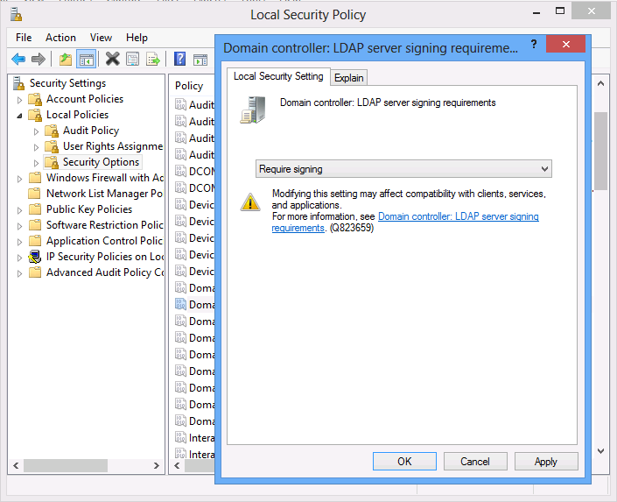
Domain controllers: LDAP server signing requirements

Slide 8
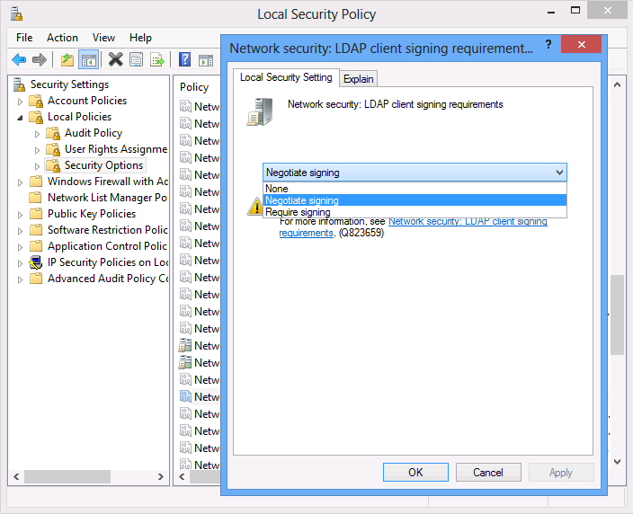
Network security: LDAP client signing requirements

Slide 9
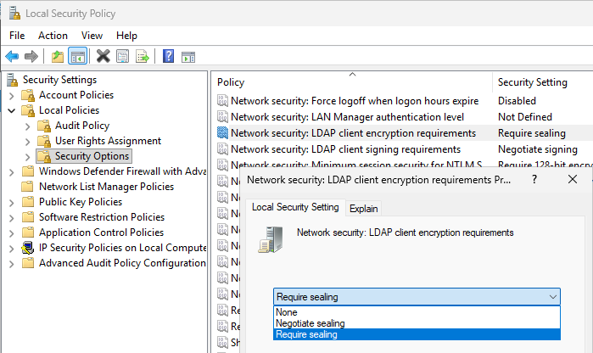
Network security: LDAP client encryption requirements

Slide 10
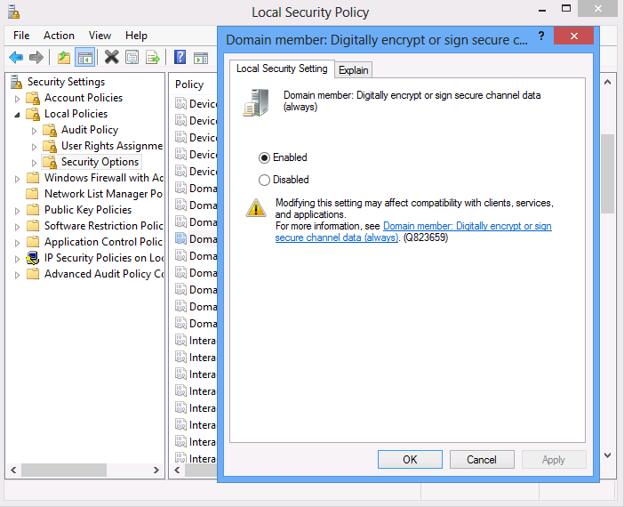
Domain member: Digitally encrypt or sign secure channel data (always)

Slide 11
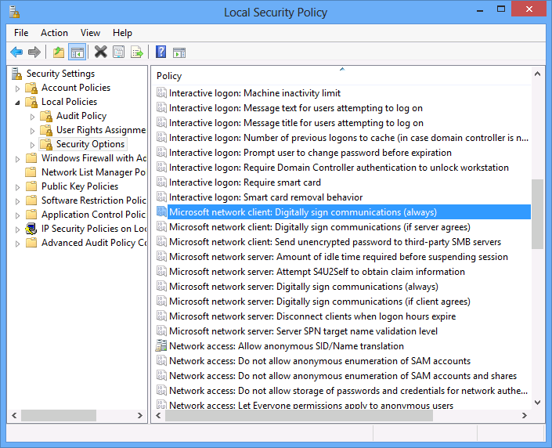
Microsoft network client: Digitally sign communications Microsoft network server: Digitally sign communications

Slide 12
AD DS LDAP notes
Anonymous logon enabled by default with first forest DC 2003 and older
CN=Directory Service,CN=Windows NT,CN=Services,CN=Configuration,DC=gopas,DC=virtual
dSHeuristics = ……2 (seventh 2 = such as 0000002)
Pre-Windows 2000 Compatible Access group contains Anonymous Logon
Simple bind over clear-channel can be disabled
Domain Controller: LDAP server signing requirements = Require signing

Slide 13
Authentication methods in Windows
Password
single factor
stored in AD or local SAM database as hash
NTLM, Kerberos, HTTP basic, AD LDAP simple bind, Digest
Certificate
single factor if not stored in smart card
PKI certificate's private key mapped to AD user account
TLS/SSL client certificate authentication (SCHANNEL)
Smart card (Windows Hello for Business)
smart card / token / TPM
multi factor
PKI certificate's private key mapped to AD user account
AD Kerberos only

Slide 14
Logins are "public" (paste next slide first)
$domainSID = Get-PrimaryDomainSID
(500..10000) | % {
$user = New-Object Security.Principal.SecurityIdentifier $domainSID-$_
$errorActionPreference = 'SilentlyContinue'
$user.Translate([Type]::GetType('System.Security.Principal.NTAccount')).Value
$errorActionPreference = 'Continue'
}

Slide 15
Utility function for the previous script
function global:Get-PrimaryDomainSID ()
{
# Note: this script obtains SID of the primary AD domain for the local computer. It works both
# if the local computer is a domain member (DomainRole = 1 or DomainRole = 3)
# or if the local computer is a domain controller (DomainRole = 4 or DomainRole = 4).
# The code works even under local user account and does not require calling user
# to be domain account. This should also work on any AD domain regardless of language
# mutation because, hopefully, the krbtgt account has always the same name
[string] $domainSID = $null
[int] $domainRole = gwmi Win32_ComputerSystem | Select -Expand DomainRole
[bool] $isDomainMember = ($domainRole -ne 0) -and ($domainRole -ne 2)
if ($isDomainMember) {
[string] $domain = gwmi Win32_ComputerSystem | Select -Expand Domain
[string] $krbtgtSID = (New-Object Security.Principal.NTAccount $domain\krbtgt).Translate([Security.Principal.SecurityIdentifier]).Value
$domainSID = $krbtgtSID.SubString(0, $krbtgtSID.LastIndexOf('-'))
}
return $domainSID
}

Slide 16
Multifactor authentication
Two or more independent things to be used
only smart card logon (PKINIT) in Windows natively
Must know the password (PIN)
Must have the card
cannot be copied
is not flash disk
contains cryptographic processor
must communicated with the processor in order to have
anything de/encrypted
private key im/exported
usually have PIN and "master" PIN

Slide 17
Other multifactor authentication in Windows
Thumprint
RSA SecureId calculator
Retina?
SMS verification
APP verification
Always map to a password or PKINIT in Windows
AD does not authenticate with anything else
SecureId for example synchronizes user passwords from AD to its own central store

Slide 18
Network authentication against AD
Basic
full-text password sent over clear/encrypted channel
HTTP/SMTP/POP3/IMAP4 basic, LDAP simple bind, RDP, RDP SSO, CredSSP, forms-based/cookie-based, RADIUS PAP
does not have SSO and SASL
NTLM
hashed password with random challenge
LM, NTLMv1/MS-CHAP, NTLMv2/MS-CHAPv2
Kerberos
hashed password encrypted timestamp
private key signature of timestamp (PKINIT)
TLS/SSL client certificate authentication
private key signature of server's challenge
HTTPS, EAP-TLS, AD FS
Digest
MD5 hashed password with random challenge
HTTP digest, CHAP, LDAP digest

Slide 19
Network authentication
Client
Server
Secure Channel
DCx
DCy

Slide 20
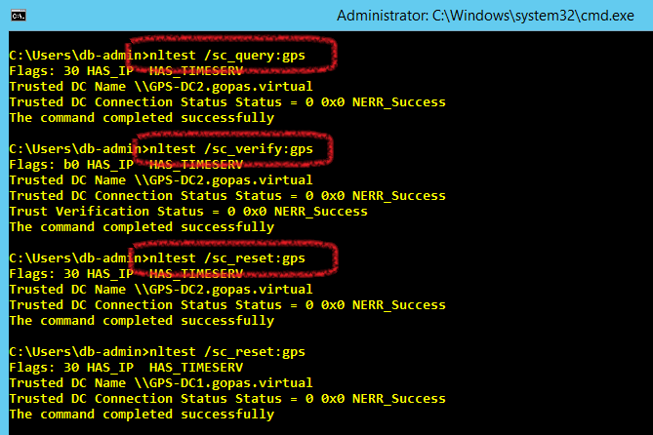
Secure channel and NLTEST

Slide 21
Delegation (double-hop)
Client
Server
Back-end
Server
DC
DC
DC

Slide 22
Network authentication risks
Clear text password?
Client
Server
Weak password hash?
DC
DC

Slide 23
Client tools should not obtain full-text passwords on SSO
Hacked IE?
Client
Server
DC
DC

Slide 24
LSASS (local security authority sub system)
Trusted security subsystem
Accepts logon credentials from CTRL-ALT-DEL
GINA.DLL
Credentials provider .DLL since Windows Vista+
Validates credentials with local SAM or with remote DC
Works as a trusted client-server service
HKLM\System\CCS\Control\LSA
Computes hashes and/or stores full-text credentials and tickets for SSP (Security Support Provider) packages
full-text - wdigest, tspkg
MD4 - NTLM (msv1_0), Kerberos for RC4/DES
SHA-1 - Kerberos for AES

Slide 25
LSAS (local security authority sub system)
LSASS
LSASS
full-text pwd
pwd #
HTTP, SMB, DCOM
Client
Server
Kerberos tickets
In-band transport
IE
SQLSrv
Outlook
SmbSrv
Explorer
WebSrv
Excel
Secure Channel
SMB SAM pipe
DCOM Netlogon
DC
LSASS
AD

Slide 26
Server LSASS caches "basic" passwords
LSASS
LSASS
full-text pwd
HTTP, SMB, DCOM
full-text pwd
Client
Server
In-band transport
IE
SQLSrv
Outlook
SmbSrv
Explorer
WebSrv
Secure Channel
SMB SAM pipe
DCOM Netlogon
DC
LSASS
AD

Slide 27
LSASS default secret storage in RAM
… Windows 2000 Windows XP Windows 2003 | password lm# md4# Kerberos tickets
Windows 2008 Windows Vista Windows 2008 R2 Windows 7 Windows 2012 Windows 8 | password lm# md4#, sha1# Kerberos tickets
Windows 2012 R2 Windows 8.1 Windows 10 Windows 2016/2019 | md4#, sha1# Kerberos tickets
Windows 2025 ... | md4#, sha1#, sha256# Kerberos tickets

Slide 28
Cannot cache NTLM or Schannel
LSASS
LSASS
pwd #
HTTP, SMB, DCOM
nothing
Client
Server
In-band transport
IE
SQLSrv
Outlook
SmbSrv
Explorer
WebSrv
Secure Channel
SMB SAM pipe
DCOM Netlogon
DC
LSASS
AD

Slide 29
Kerberos in detail
LSASS
LSASS
pwd #
HTTP, SMB, DCOM
nothing
Client
Server
Kerberos tickets
In-band transport
IE
SQLSrv
Outlook
SmbSrv
Explorer
WebSrv
Secure Channel
SMB SAM pipe
DCOM Netlogon
Generate tickets
PAC validation
DC1
DC2
LSASS
LSASS
AD
AD

Slide 30
Secure channel
LSASS to LSASS communication
authenticated and signed/sealed by MACHINE$ password
SMB named pipe or DCOM
2003- prefers SMB (TCP 445)
Vista/2008+ prefers DCOM (TCP 135 + DCOM???)
Performs many security related operations
SID translation
NTLM and SChannel pass-through authentication
PAC validation in certain Kerberos scenarios
computer password changes
user password changes in backward compatible scenarios

Slide 31
Secure channel DCOM/TCP port on DC
On DCs
HKLM\System\CCS\Services\Netlogon\Parameters
DCTcpipPort = DWORD
restart DC
MaxConcurrentApi = DWORD
1-10, 2008 R2 SP1 default 100, max. 150 (KB2688798)
40 seconds timeout

Slide 32
IIS basic authentication cache
On IIS web servers
Applies only for basic authentication credentials
By default 15 minutes
HKLM\System\CCS\Services\InetInfo\Parameters
UserTokenTTL = DWORD = seconds
case sensitive!

Slide 33
NTLM network logon performance
Client
2000+
Server 2000+
60 % CPU
55 % CPU
DC 2000+
DC 2000+

Slide 34
Kerberos network logon, no PAC validation
Client
2000+
Server 2000+
60 % CPU
0 % CPU
DC 2000+
DC 2000+

Slide 35
Kerberos network logon with PAC validation
Client
2000+
Server 2000+
60 % CPU
0 % CPU
14 % CPU
DC 2000+
DC 2000+

Slide 36
Basic authentication
Client
2000+
Server 2000+
5 % CPU
0 % CPU
DC 2000+
DC 2000+

Slide 37
Secure channel and NTLM performance issues
Client
Server
Client
Server
Server
Client
Client
Client
Client
Client
7 concurrent
100 2008 r2+
40 sec.
DC

Slide 38
GOPAS trusts BOOKS
Trusting domain
gopas.virtual (GPS)
Resource domain
DATA
Outgoing trust
WFE
Trusted domain
Account domain
Incoming trust
de .gopas .virtual
cz .gopas .virtual
GPS trusts BOOKS
book-vendors.com (BOOKS)
Adrian Voegele

Slide 39
GOPAS trusts BOOKS
gopas.virtual (GPS)
TDO BOOKS
PWD
WFE$
#
book-vendors.com (BOOKS)
TrustAccount GPS$
#
WFE
$MACHINE.ACC
PWD

Slide 40
Trust account and TDO
user object DOMAIN$ in CN=Users
sAMAccountType = 805306370
trustedDomain object in CN=SYSTEM
plus LSASS global secret with full-text password

Slide 41
Trusts within a single forest gopas.virtual
gopas.virtual
skoleni.local
pc.skoleni.local
cz.gopas.virtual
de.gopas.virtual

Slide 42
NTLM trusts (pass-through)
A
D\User
A\Server
DC A
D
C
B
DC D
DC C
DC B

Slide 43
NTLM pass-through trust requirements
TCP and DNS
at least adjacent DCs over the virtual trust-links
RTT (round-trip-time) as fast as possible

Slide 44
Kerberos trusts
A
D\User
A\Server
DC A
D
C
B
DC D
DC C
DC B

Slide 45
Kerberos trust requirements
TCP and DNS
any client vs. any DC from any domain

Slide 46
Slow authentication over multiple trusts
gopas.virtual
skoleni.local
PC\SQLSrv
CZ\Kamil
pc.skoleni.local
cz.gopas.virtual
de.gopas.virtual

Slide 47
Shortcut trusts to speed up authentication
gopas.virtual
skoleni.local
PC\SQLSrv
CZ\Kamil
pc.skoleni.local
cz.gopas.virtual
de.gopas.virtual

Slide 48
Impersonation and Access Token
local groups/SIDs
LSASS
HTTP, SMB, DCOM
Access Token
Kerberos groups
credentials
Client
In-band transport
Server
SmbSrv
IE
WebSrv
Outlook
SQL
Explorer
Exch
NTLM groups
SChannel groups
DC
DB
Registry
NTFS
LSASS
AD

Slide 49
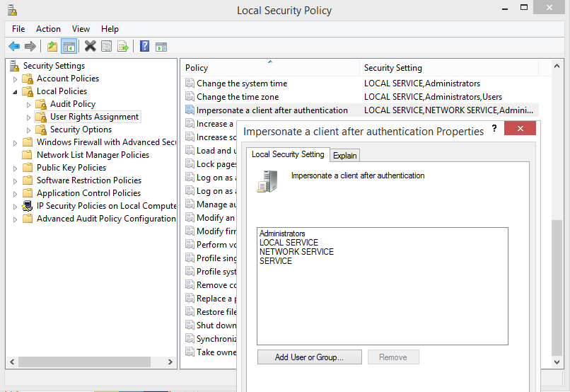
User right: Impersonate client after authentication (SeImpersonatePrivilege)

Slide 50
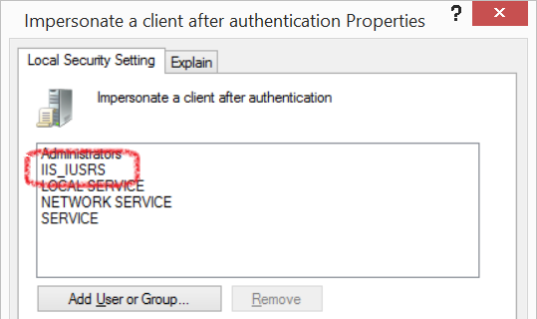
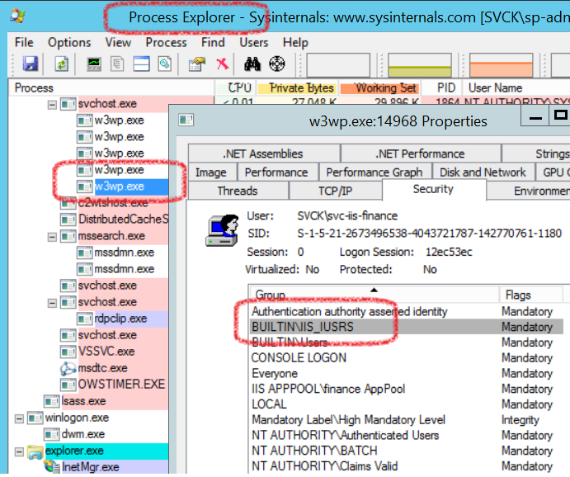
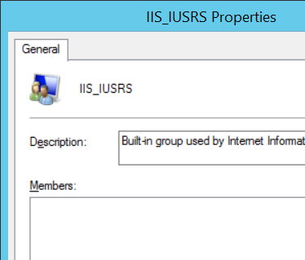
IIS apppools vs. IIS_IUSRS implicit group injection

