Slide 1
User and computer accounts
Ing. Ondřej Ševeček | GOPAS a.s. |
MCSM:Directory2012 | MCM:Directory2008 | MVP:Enterprise Security | Certified Ethical Hacker | CISA |
ondrej@sevecek.com | www.sevecek.com |
GOPAS: info@gopas.cz | www.gopas.cz | www.facebook.com/P.S.GOPAS

Slide 2
User accounts recap
Two logins
sAMAccountName: gps\kamil
20 characters limit
userPrincipalName: rychnovsky.kamil@gopas.cz
can have variable UPN suffixes
64 characters limit on login prefix, and 64 chars UPN suffix
Password stored in AD or local SAM database
hashed form (full-text can be enabled)
Stores hash history
up to 24 hashes
Applies password policies
complexity, length, regular expiration, history

Slide 3
Password modifications
Change (změnit)
LDAP method ChangePassword(), Win32 function NetUserChangePassword()
Everyone as long as the current password is supplied
Reset (nastavit)
LDAP method ResetPassword(), Win32 function NetUserSetInfo()
administrative action, no previous password knowledge
no history constraint (history yet pushed further)
no minimum password age
Interfaces in Secure Channel, LDAPS, Kerberos
SMB TCP 445 named pipes, Netlogon DCOM, TCP 636 (389), TCP/UDP 464

Slide 4
Interesting point about password history #1
Password history check (N-2)
badPasswordCount and badPasswordTime do not update for two previous password attempts
requires password history with at least 2 previous hashes

Slide 5
Interesting point about password history #2
1 hour after a password change
NTLM and LDAP simple bind can use previous password for logon
requires password history enabled
(example - for sure works with IIS NTLM provider)
Does not apply to Kerberos

Slide 6
Password and account expiration
Password expiration
0xC0000071 = STATUS_PASSWORD_EXPIRED
0xC0000224 = STATUS_PASSWORD_MUST_CHANGE
0x17 = KDC_ERR_KEY_EXPIRED
The user account's password has expired
cannot log on at all, visual effect is just different
controlled by pwdLastSet attribute
"Must change password at next logon"
pwdLastSet = 0
Account expiration
0xC0000193 = STATUS_ACCOUNT_EXPIRED
0x12 = KDC_ERR_CLIENT_REVOKED (TGT request)
0x01 = KDC_ERR_NAME_EXP (TGS request)
"The user's account has expired"

Slide 7
Other account authentication failures
incorrect login
0x6 = KDC_ERR_C_PRINCIPAL_UNKNOWN (event ID = 4771, Kerberos Authentication Service)
0xC000006D = STATUS_LOGON_FAILURE (event ID = 4625, Logon)
0xC0000064 = STATUS_NO_SUCH_USER
bad password
0x18 = KDC_ERR_PREAUTH_FAILED (event ID = 4771, Kerberos Authentication Service)
0xC000006D = STATUS_LOGON_FAILURE (event ID = 4625, Logon)
0xC000006A = STATUS_WRONG_PASSWORD
account locked out
0x12 = KDC_ERR_CLIENT_REVOKED (event ID = 4771, Kerberos Authentication Service)
0xC0000234 = STATUS_ACCOUNT_LOCKED_OUT (event ID = 4625, Account Lockout)
account disabled
checking even before trying password
0x12 = KDC_ERR_CLIENT_REVOKED (event ID = 4771, Kerberos Authentication Service)
0xC000006E = STATUS_ACCOUNT_RESTRICTION (event ID = 4625, Logon)
0xC0000072 = STATUS_ACCOUNT_DISABLED
Smart card is required for interactive logon
checking even before trying password
0xC = KDC_ERR_POLICY (event ID = 4771, Kerberos Authentication Service)
0xC000006E = STATUS_ACCOUNT_RESTRICTION (event ID = 4625, Logon)
0xC00002FA = STATUS_SMARTCARD_LOGON_REQUIRED
logon workstations
checking even before trying password
0xC = KDC_ERR_POLICY (event ID = 4771, Kerberos Authentication Service)
0xC000006E = STATUS_ACCOUNT_RESTRICTION (event ID = 4625, Logon)
0xC0000070 = STATUS_INVALID_WORKSTATION
logon hours
checking even before trying password
0x12 = KDC_ERR_CLIENT_REVOKED (event ID = 4771, Kerberos Authentication Service)
0xC000006E = STATUS_ACCOUNT_RESTRICTION (event ID = 4625, Logon)
0xC000006F = STATUS_INVALID_LOGON_HOURS

Slide 8
Different order of checking password vs. account states
Note: Kerberos checks account status first and only then its password, while NTLM may lock even disabled accounts
Note: empty Source Workstation from non-Windows clients

Slide 9
Event filters and logins (SAM login if found, or what the user supplied exactly)
*[
System[Provider[@Name='Microsoft-Windows-Security-Auditing']]
and
System[TimeCreated[timediff(@SystemTime) &lt;= 3600000]]
and
(
EventData/Data[@Name='SubjectUserName'] = 'kamil'
or
EventData/Data[@Name='TargetUserName'] = 'kamil'
or
EventData/Data[@Name='AccountName'] = 'kamil'
or
EventData/Data[@Name='SubjectUserName'] = 'failure.invalid.login@gopas.cz'
or
EventData/Data[@Name='TargetUserName'] = 'failure.invalid.login@gopas.cz'
or
EventData/Data[@Name='AccountName'] = 'failure.invalid.login@gopas.cz'
)
]

Slide 10
Event filters and WEVTUTIL
wevtutil qe Security /r:DC1 /f:XML '/q:*[System[TimeCreated[timediff(@SystemTime)<=3600000]]]' > c:\temp\lastHour.xml

Slide 11
Computer accounts
AD classes
user, computer
userPrincipalName = -
sAMAccountName = comp$
No password policies
never lock out
no complexity enforced
history maintained because of the previous two specials
never expires

Slide 12
Computer account password
Stored locally in registry
HKLM\SECURITY\Policy\Secrets\$MACHINE.ACC
current and previous password
full-text version
Changed regularly every 30 days
does not change if offline

Slide 13
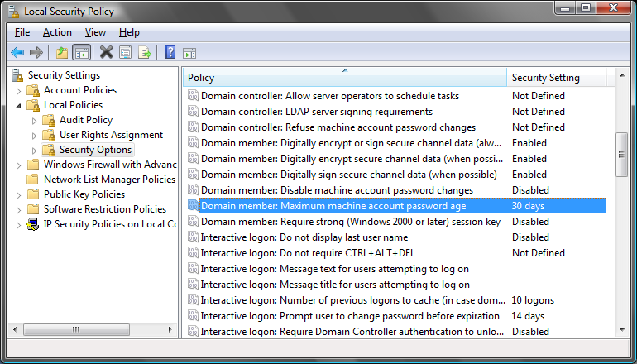
Maximum machine account password age

Slide 14
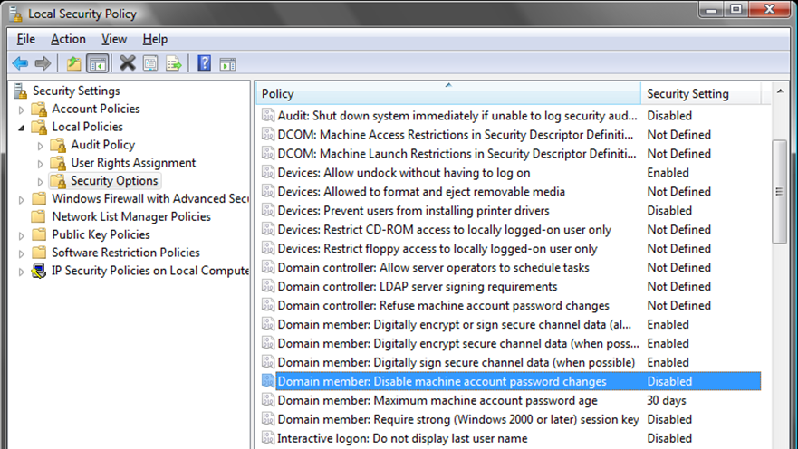
Disable machine account password changes

Slide 15
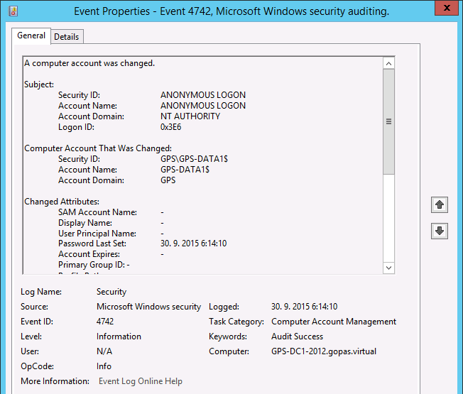
Computer password change event on DC
Audit Success
Event ID: 4742
Source: Microsoft Windows security auditing
Category: Computer Account Management
Password Last Set attribute modified by ANONYMOUS LOGON

Slide 16
Computer password tools
nltest /sc_verify:gps
nltest /sc_reset:gps
netdom resetpwd /Server:dc1 /UserD:gps\domain-admin /PasswordD:Pa$$w0rd
or dis-join and re-join again
Test-ComputerSecureChannel -Repair
Reset-ComputerMachinePassword

Slide 17
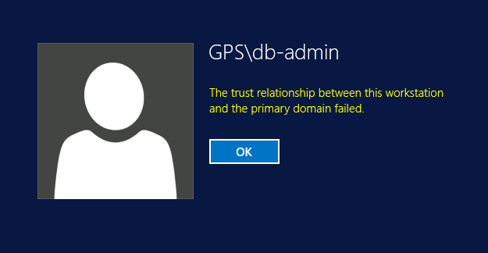
Machine password and secure channel error symptoms on the affected server
Cannot logon locally online (from cache ok)
the trust relationship between this workstation and the primary domain failed

Slide 18
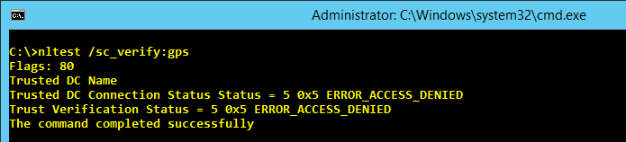
Machine password and secure channel error symptoms on the affected server
nltest /sc_verify:gps
ERROR_ACCESS_DENIED = 0x5

Slide 19
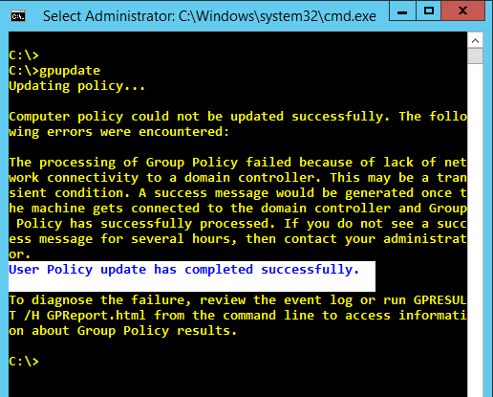
Machine password and secure channel error symptoms on the affected server
gpupdate
computer update fails
user update ok
ipconfig /registerdns
fails

Slide 20
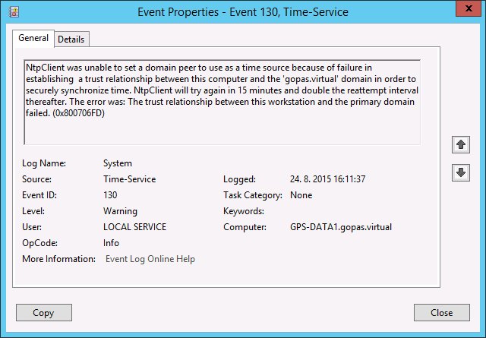
Machine password and secure channel error symptoms on the affected server
Warning, Event ID 130, Time-Service
NtpClient was unable to set a domain peer to use as a time source because of failure in establishing a trust relationship between this computer and the domain in order to securely synchronize time.

Slide 21
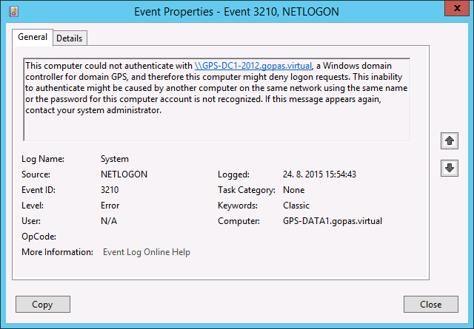
Machine password and secure channel error symptoms on the affected server
Error, Event ID 3210, NETLOGON
This computer could not authenticate with a Windows domain controller for domain, and therefore this computer might deny logon requests. This inability to authenticate might be cause by the password for this computer account is not recognized.

Slide 22
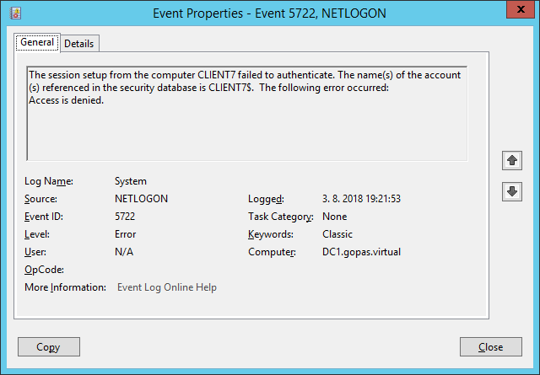
The session setup from computer failed to authenticate when doing NTLM pass-through
Error, Event ID 5722, NETLOGON

Slide 23
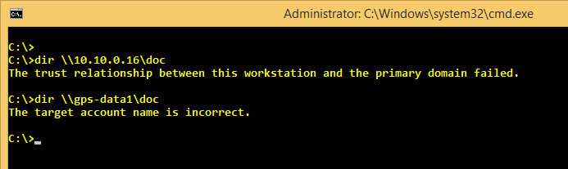
Machine password and secure channel error symptoms from the remote client side
NTLM authentication fails with
the trust relationship between this workstation and the primary domain failed
Kerberos authentication fails with
the target principal name is incorrect

Slide 24
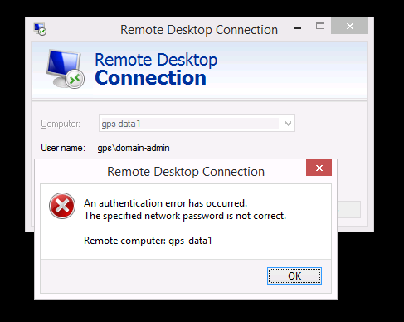
Machine password and secure channel error symptoms from the remote client side
RDP access fails
an authentication error has occurred. The specified network password is not correct

Slide 25
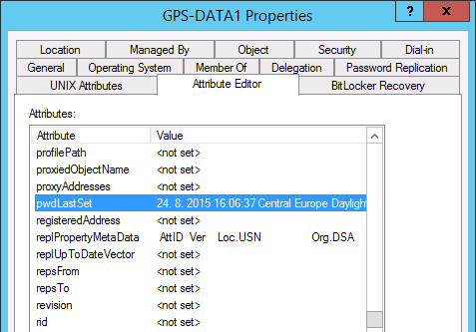
Machine password and secure channel error troubleshooting on DCs
pwdLastSet attribute

Slide 26
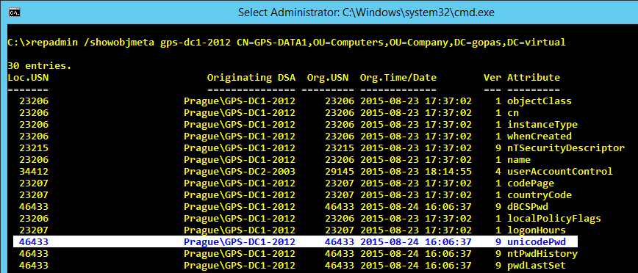
Machine password and secure channel error troubleshooting on DCs
unicodePwd attribute metadata
repadmin /showobjmeta
repadmin /replsummary

Slide 27
Service Accounts
Services, jobs and IIS application pools run under some service identity
NT AUTHORITY\System
NT AUTHORITY\Network Service
NT AUTHORITY\Local Service
NT SERVICE\*
IIS APPPOOL\*
<domain>\*

Slide 28
Service identities on Windows XP+
SYSTEM
local Administrators
uses COMPUTER$ to access network resources
must use Kerberos on 2003- (cannot use NTLM)
2008+ Allow Local System to use computer identity for NTLM
Network Service
local Users
uses COMPUTER$ to access network resources
Local Service
local Users
anonymous network access

Slide 29
Network Service vs. Local Service
DNS Client must register DNS name
NT AUTHORITY\Network Service
dynamic dns update requires Kerberos authentication
DHCP Client although is a networking service, does not require any authentication
NT AUTHORITY\Local Service

Slide 30
Network Service does not even have local isolation
SRV-IIS
SRV-SQL
http://finance
Network Service
GPS\SRV-IIS$
DB_Finance
G:\IIS\finance
http://warehouse
GPS\SRV-IIS$
Network Service
DB_Warehouse
G:\IIS\warehouse

Slide 31
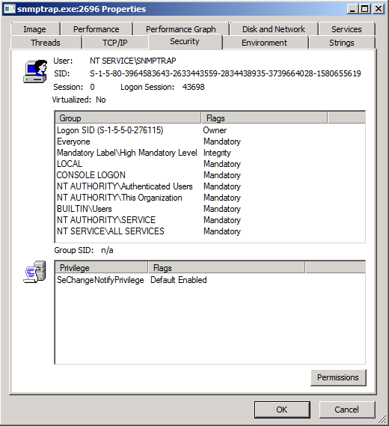
NT SERVICE

Slide 32
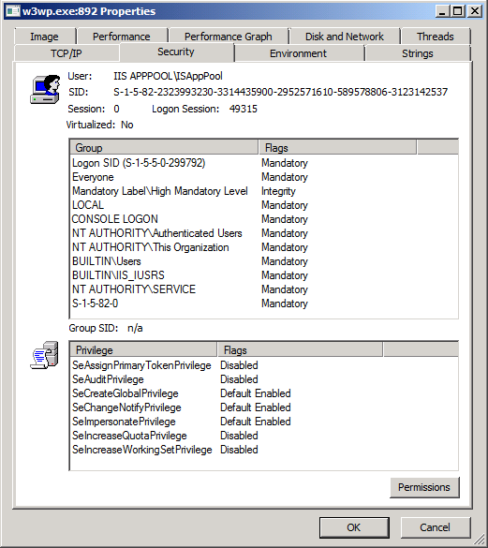
IIS APPPOOL

Slide 33
NT SERVICE and IIS APPPOOL have local isolation only
SRV-IIS
SRV-SQL
http://finance
IIS APPPOOL\fin
GPS\SRV-IIS$
DB_Finance
G:\IIS\finance
http://warehouse
GPS\SRV-IIS$
IIS APPPOOL\wh
DB_Warehouse
G:\IIS\warehouse

Slide 34
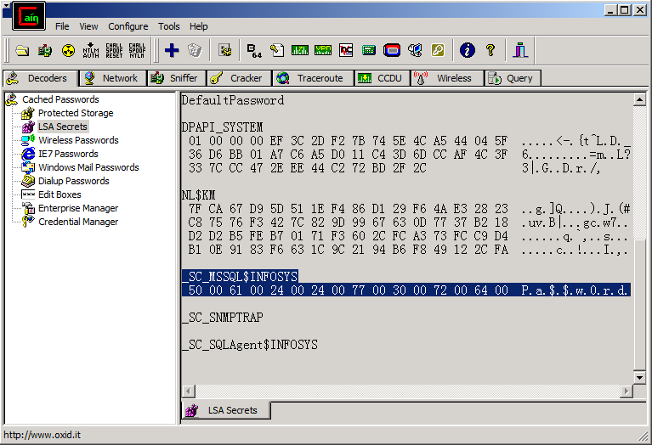
Local administrator can obtain service and scheduled task passwords

Slide 35
AppPool passwords
C:\Windows\System32\InetSrv\APPCMD LIST APPPOOL MyPool /text:*

Slide 36
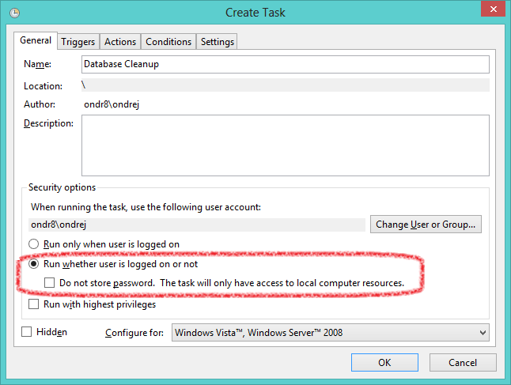
Task scheduler passwords

Slide 37
Isolation
Domain | Account | Network Password | Groups | Local Isolation | Network Isolation | Kerberos PAC Validation | OS
NT AUTHORITY | SYSTEM | automatic 30 days | Administrators | no | MACHINE$ | no | 2000
NT AUTHORITY | Network Service | automatic 30 days | Users | no | MACHINE$ | no | XP
NT AUTHORITY | Local Service | no | Users | no | anonymous | no | XP
NT SERVICE | <serviceName> | automatic 30 days | Users | yes | MACHINE$ | no | Vista 2008
IIS APPPOOL | <appPoolName> | automatic 30 days | Users | yes | MACHINE$ | no | Vista 2008
<domain> | <userName> | manual | Users | yes | yes | yes | 2000
<domain> MSA | <managedSvcAccount> | automatic 30 days | Users | yes | yes | no | 7 2008 R2
<domain> gMSA | <groupSvcAccount> | automatic 30 days | Users | yes | yes | no | 8 2012

Slide 38

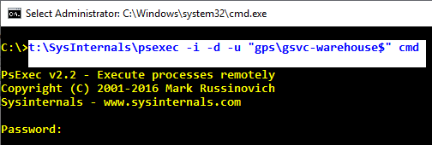
gMSA
New-ADServiceAccount gsvc-warehouse
do NOT configure the web site yet
will use for Kerberos test later
but you can verify logon with psexec (gsvc-warehouse$, empty password)

Slide 39
Task scheduler without password requires S4U
read tokenGroupsGlobalAndUniversal attribute on the service account
or be member of Windows Authorization Access Group (WAAG)
Anonymous access to network resources
or enable Kerberos delegation

Slide 40
Password hashes in Active Directory
Windows 2000 DC
pwd, LM, MD4 (NT hash)
Windows 2003 DC
pwd, LM, MD4 (NT hash), MD5 (advanced digest hash, CHAP)
Windows 2008+ DC
pwd, LM (not by default), MD4 (NT hash), MD5, SHA-1 (Kerberos AES)
Windows 2025+ DC
pwd, LM (not by default), MD4 (NT hash), MD5, SHA-1 (Kerberos AES), SHA256 (Kerberos AES)
MD4 NT hash
NTLM/MS-CHAP, NTLMv2/MS-CHAPv2, Kerberos DES, Kerberos RC4

Slide 41
repadmin /showobjmeta
unicodePwd - NTLM MD4
dBCSPwd - LM
supplementalCredentials - Digest MD5, cleartext, SHA1
pwdLastSet - changed on change, reset, but not on enabling Smart Card is Required for Interactive Logon (SMARTCARD_REQUIRED = 0x40000)

Slide 42
Real pwdLastSet values from replication metadata
# Note: constructed attribute msDS-ReplAttributeMetadata is present since Windows 2008
[object[]] $accounts = Get-ADObject -LDAPFilter '(objectClass=user)' `
-Properties sAMAccountName, msDS-ReplAttributeMetadata
if ($accounts.Length -gt 0) { foreach ($oneAccount in $accounts) {
[DateTime] $lastPwdChange = [DateTime]::MaxValue
[Microsoft.ActiveDirectory.Management.ADPropertyValueCollection] $metadata = `
$oneAccount.'msDS-ReplAttributeMetadata'
if ($metadata.Count -gt 0) { foreach ($oneMeta in $metadata) {
[XML] $xmlMeta = [XML] ($oneMeta -replace '[\x0A\x0D\x00]', '')
if ($xmlMeta.DS_REPL_ATTR_META_DATA.pszAttributeName -eq 'unicodePwd') {
$lastPwdChange = [DateTime]::Parse($xmlMeta.DS_REPL_ATTR_META_DATA.ftimeLastOriginatingChange)
}
}}
Add-Member -In $oneAccount -MemberType NoteProperty -Name pwdLastSetReal -Val $lastPwdChange -Force
}}
$accounts | sort pwdLastSetReal | select sAMAccountName, pwdLastSetReal

Slide 43
Hash propagation in mixed environments
password
MD4
DC 2003
MD4
SHA-1
MD4
DC 2008
MD4
SHA-1
MD4
DC 2008
password
MD4
SHA-1

Slide 44
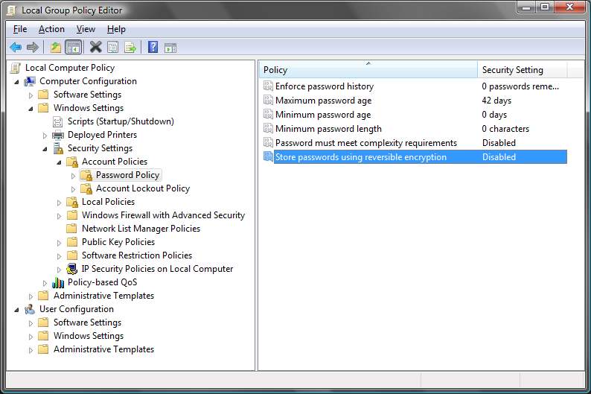
Full-text passwords for digest on 2000

Slide 45
Notes to stored hashes
Regardless of DFL
the hashes are updated only on DC which computes it and replicate
after upgrading DFL, some passwords need change before digest/AES
LM can be disabled
LM is disabled by default if first domain DC is 2008+
LM is not stored if password is 15+ chars
DC can store passwords in full-text

Slide 46
LM hash is extremely weak
64
User’s password
14
UPPERCASE PASSWORD
7
LEFT
7
RIGHT
DES
KGS!@#$%
DES
KGS!@#$%
8
Left part of the hash
8
Right part of the hash
16
LM hash

Slide 47
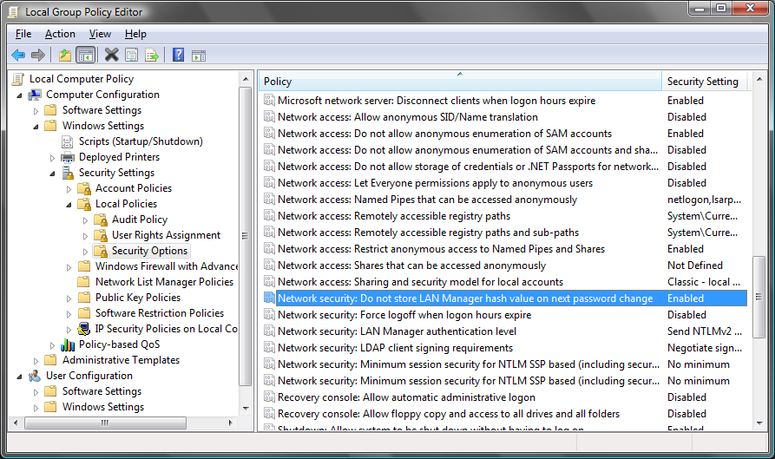
Do not store LM hashes

Slide 48
Password longer than 14 chars
does not generate LM hash at all
since Windows 2000+

Slide 49
Password (confidential attribute) replication permissions
Replication Synchronization
invoke DC's own replication operation, such as trigger the following outside of schedule
repadmin /kcc
repadmin /replicate
repadmin /syncall
Replicate Directory Changes in Filtered Set
contains only the GC/RODC attributes
Replicate Directory Changes
contains everything except for secrets and confidential attributes (such as BitLocker and TPM secrets, KDS secrets etc.)
Replicate Directory Changes All
can download the whole replica from a DC including password hashes etc.
required by Azure AD (AAD) Connect/DirSync for example when syncing passwords to AAD

Slide 50
Cracking hashes
Brute-force MD4
ca 80^N
12+ chars well unbreakable today
hashes from: AD, SAM, LSASS memory, NTLM/Kerberos network authentication
Rainbow table
hash dictionary
very quick
complete LM table 2 GB
120 GB for mixalfanum 8 MD4 character set
4 TB for 9 character set
hashes from: AD, SAM, LSASS memory
SSD vs. RAM ~ 10 000 x slower

Slide 51
Password policies
3 of 4 character classes
a-z, A-Z, 0-9, #!@$%^&*()...
No 3 and more letters from login sequentially
ondrej: #.JaME5-BonD38
Maximum password age
prevents colleagues from guessing the password
does not affect security against remote anonymous attacks
Minimum password age
only to enforce password history

Slide 52
Password changes
Go to DC in full-text
channel encrypted with Kerberos (original password)
Password filters .DLL
policies
identity integration
auditing
HKLM\System\CCS\Control\Lsa
NotificationPackages = MULTI_SZ
.DLL in System32
must be installed on all writable DCs

Slide 53
Password filters
Client
VoIP
Oracle
plain text password
DC with password filter
SAP
custom application password change protocol
hash replication
Unix
Router
DC
DC

Slide 54
Partial secrets DC (RODC)
Physically insecure locations
Caches/replicates only some hashes
Forwards other authentication transparently to writable DCs
Has a local Administrators member who does not need to be member of Domain Admins group

Slide 55
Password caching/forwarding
not cached yet
not cached yet after recent password change
wrong password
expired password
account locked
London 10.10.x.x
DC1
DC2
DC3
2003
2003
2008
GC
Cyprus 10.40.x.x
SRV
RODC
SRV
2008
CL1

Slide 56
Ticket produced by KDC on RODC
Kamil
Client
RODC
Writable DC
Kamil
Pwd
Jitka
Pwd
Writable DC
Tana
-
Writable DC

Slide 57
Ticket produced by KDC on a full DC
Tana
Client
RODC
Writable DC
Kamil
Pwd
Jitka
Pwd
Writable DC
Tana
-
Writable DC

Slide 58
Ticket produced by KDC on a full DC
Kamil
Pwd2
Client
RODC
Writable DC
Kamil
Pwd
Jitka
Pwd
Writable DC
Tana
-
Writable DC

Slide 59
Cached passwords
By default 10 different password and access token caches
interactive logon
service logon
batch logon (scheduled tasks, IIS app pools)
Available only for local logon
Never expires
no regard to password expiration
No network credentials
anonymous access to network resources

Slide 60
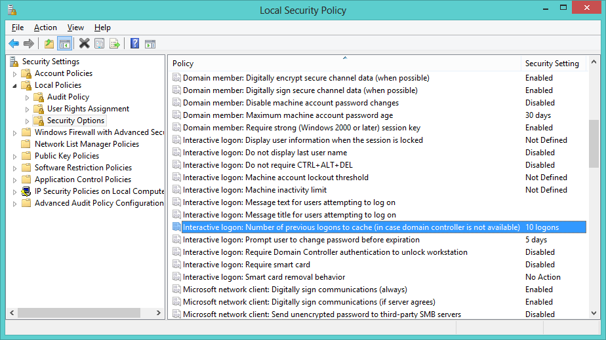
Number of previous logons to cache

Slide 61
Cached hashes
Version 1 (MSCACHEv1)
Windows 2000, XP, 2003
2x MD4 salted with user login
prevents rainbow-table attacks
Version 2 (MSCACHEv2)
Windows Vista, 2008+
1000x SHA-1 salted with user login
prevents rainbow-tables and complicates brute-force attacks

Slide 62
Local access token refresh
Most logons from cache since XP+
speed up access token creation
Log off twice to update local access token
verify always with Process Explorer or WHOAMI

Slide 63
Testing any accounts with /netonly
runas /netonly /user:...
# any account credentials
# not validated locally
# validated only at the time of use
# use @gopas.virtual in order to invoke Kerberos from non-domain machines or non-trusted forests

