Slide 1
NTLM
Ing. Ondřej Ševeček | GOPAS a.s. |
MCSM:Directory2012 | MCM:Directory2008 | MVP:Enterprise Security | Certified Ethical Hacker | CISA |
ondrej@sevecek.com | www.sevecek.com |
GOPAS: info@gopas.cz | www.gopas.cz | www.facebook.com/P.S.GOPAS

Slide 2
NTLM family
LM
OS/2
NTLM
Windows NT 3.51
NTLMv2
Windows NT 4.0 SP4
default since 2008/Vista

Slide 3
The NTLM family cons
Weak cryptography
LM, MD4, DES, HMAC-MD5
No mutual authentication (= MITM)
requires NTLMv2 session security or other channel authentication (TLS, IPSec)
Bad reply protection except for NTLMv2
Reflection attacks
Bad performance especially over trusts
Session security still prone to offline password attacks (no PFS)
yields full transmission data

Slide 4
The NTLM family pros
Works from the internet
MITM prevented with TLS/HTTPS/RDPS
SSO as against basic authentication
Easy, minimum requirements, smooth fallback

Slide 5
When NTLM gets used
Any non-domain account or computer
DCs not available (internet)
Kerberos over KDC Proxy
External domain trusts
non-transitive
do not require DFL 2003
IP address or DNS A alias used by client
CNAME translates usually to the target name
PTR records are not used
IE not in local intranet or trusted sites (IE 7+)
Chrome, Edge, Edge Chromium, WebDAV, …
IE without Enable Windows Integrated Authentication setting
MS-CHAP = NTLM, MS-CHAPv2 = NTLMv2

Slide 6
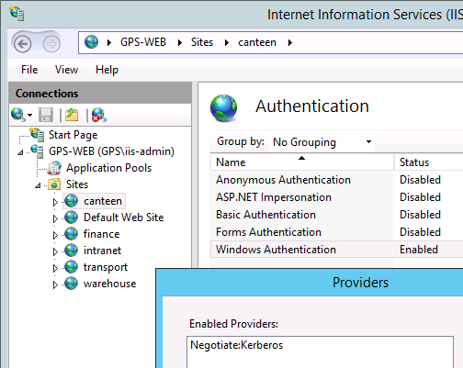
Services which require Kerberos
AD replication
System Center agents
DNS dynamic update
SYSTEM account on Windows Vista/2008-
PS-Remoting
Enter-PSSession
SYSVOL and NETLOGON hardening by default 10/2026+

Slide 7

PS remoting (Enter-PSSession) with NTLM
# comma (,) separated list
Set-Item WSMan:\localhost\Client\TrustedHosts
# must supply explicit credentials
Enter-PSSession -Credential

Slide 8
In-band NTLM with local accounts
SAM
Client
Server
in-band
SMB
SQL
LDAP
HTTP

Slide 9
Pass-through NTLM with domain accounts
Client
Server
in-band
SMB
SQL
LDAP
HTTP
encrypted
secure channel
server$
SMB
DCOM
DC
Active Directory

Slide 10
Pass-through NTLM with domain accounts with non-Windows servers
service account
Client
NAS
printer
Linux web
…
in-band
SMB
SQL
LDAP
HTTP
encrypted
secure channel
service account
SMB
DCOM
DC
Active Directory

Slide 11
LM authentication (ultra weak)
Client
Server ... DC
NEGOTIATE
hello
CHALLENGE
server challenge #
AUTHENTICATE
login
DES (56-bit)
user domain
LM hash
server challenge #

Slide 12
NTLM authentication (weak)
Client
Server ... DC
NEGOTIATE
hello
CHALLENGE
server challenge #
AUTHENTICATE
login
DES (56-bit)
user domain
NT MD4 hash
server challenge #

Slide 13
NTLMv2 authentication (best, yet not ideal)
Client
Server ... DC
NEGOTIATE
hello
CHALLENGE
server challenge #
AUTHENTICATE
login
HMAC-MD5 (128-bit, 112 effectively)
user domain
NT MD4 hash
server challenge #
client challenge #
login
user domain
time
server name
time
server name
client challenge #

Slide 14
NTLM with domain accounts
1
NEGOTIATE
Client
Server
2
CHALLENGE
3
RESPONSE
4
CHALLENGE
RESPONSE
5
OK
groups
DC
Active Directory

Slide 15
Testing authentication with default credentials
Invoke-WebRequest http://intranet -UseDefaultCredentials
# Note: Pooling=False means that the connection is going to be
# reestablished every time you use even the same connection
# string. For our purposes no need then to use the cleanup:
# $conn.Close()
# $conn.Dispose()
# $conn = $null
# [GC]::Collect()
# [GC]::WaitForPendingFinalizers()
$conn = New-Object Data.SqlClient.SqlConnection 'Pooling=False;Server=data\INFOSYS;Database=master;Integrated Security=true'
$conn.Open()
# Note: shared files are going to keep the connection established
# for at least 20seconds or even more, so be slow
net view \\data /all

Slide 16
LM/NTLM/NTLMv2 in HTTP
client
GET
anonymous
server
401
unauthorized
WWW-Authenticate
NTLM
WWW-Authenticate
Negotiate
GET
anonymous
Authorization
NTLM Negotiate
401
unauthorized
WWW-Authenticate
NTLM Challenge
GET
GPS\kamil MD5#
Authorization
NTLM Authenticate
200
OK

Slide 17
Kerberos in HTTP
client
server
GET
anonymous
401
unauthorized
WWW-Authenticate
Negotiate
GET
GPS\kamil TGS ticket
Authorization
AP Request
200
OK

Slide 18
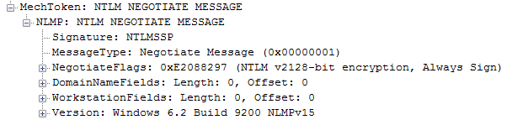
LM/NTLM/NTLMv2 negotiate message (Client to Server)

Slide 19
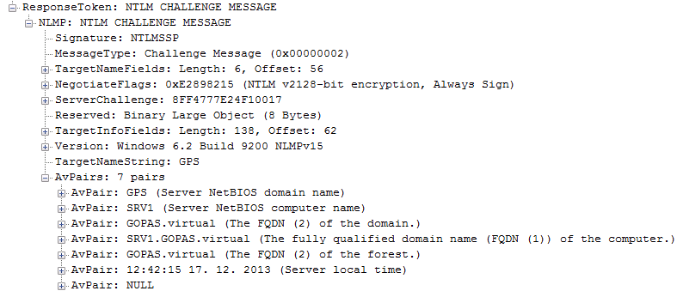
LM/NTLM/NTLMv2 challenge message (Server to Client)

Slide 20
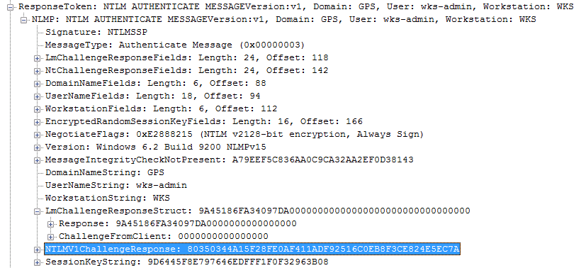
LM and NTLMv1 response (Client to Server)

Slide 21
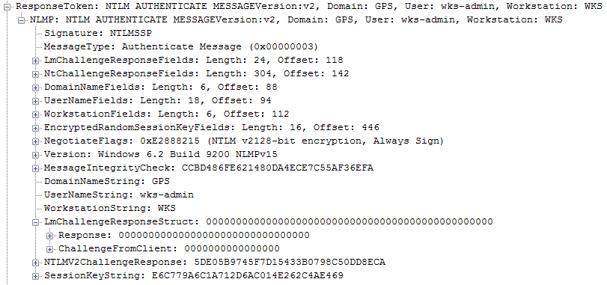
NTLMv2 response (Client to Server)

Slide 22
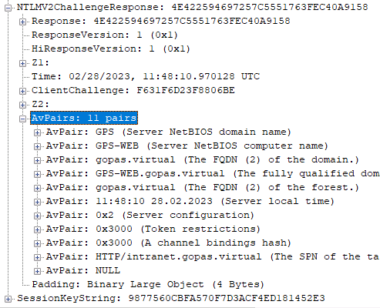
Values hashed together in an NTLMv2 response
note points:
timestamp
channel binding

Slide 23
Fiddler LM+NTLM vs. NTLMv2 (just bigger)

Slide 24
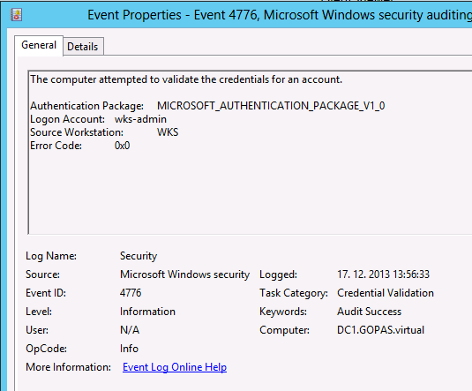
NTLM success audit on DC

Slide 25
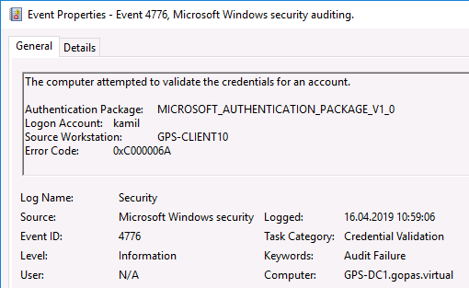
NTLM failure audit on DC

Slide 26
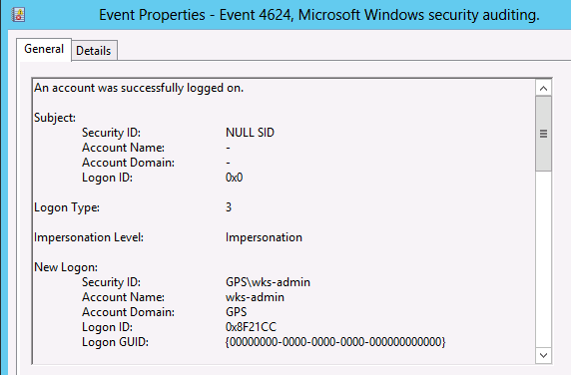
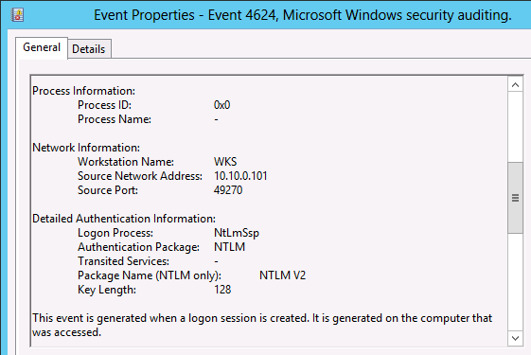
NTLM success audit on resource server

Slide 27
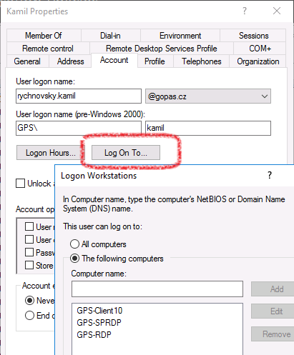
Restricting client computers (userWorkstations attribute)

Slide 28
RDP without NLA (Network Level Authentication)
Client
RDP
RDP TCP 3389 + TLS (certificate)
DC

Slide 29
RDP without NLA (Network Level Authentication)
Client
RDP
RDP TCP 3389 + TLS (certificate)
login + password
full login (RDP/interactive/TGT)
DC
4768 Kerberos Authentication Service

Slide 30
RDP without NLA (Network Level Authentication)
Client
RDP
RDP TCP 3389 + TLS (certificate)
login + password
4624 Logon - type 10
full login (RDP/interactive/TGT)
DC
4768 Kerberos Authentication Service

Slide 31
RDP with NLA (Network Level Authentication)
Client
RDP
RDP TCP 3389 + TLS (certificate) + Nego
NTLM
NTLM
DC
DC
4776 Credential Validation

Slide 32
RDP with NLA (Network Level Authentication)
Client
RDP
RDP TCP 3389 + TLS (certificate) + Nego
NTLM
4624 Logon - type 3
NTLM
DC
DC
4776 Credential Validation

Slide 33
RDP with NLA (Network Level Authentication)
Client
RDP
RDP TCP 3389 + TLS (certificate) + Nego
login + password
NTLM
full login (RDP/interactive/TGT)
NTLM
NTLM
DC
DC
4776 Credential Validation
4768 Kerberos Authentication Service

Slide 34
RDP with NLA (Network Level Authentication)
Client
RDP
RDP TCP 3389 + TLS (certificate) + Nego
login + password
NTLM
4624 Logon - type 3
4624 Logon - type 10
full login (RDP/interactive/TGT)
NTLM
NTLM
DC
DC
4776 Credential Validation
4768 Kerberos Authentication Service

Slide 35
RDP with NLA (Network Level Authentication)
Client
RDP
RDP TCP 3389 + TLS (certificate) + Nego
Kerberos
Kerberos
DC
DC
4768 Kerberos Authentication Service

Slide 36
RDP with NLA (Network Level Authentication)
Client
RDP
RDP TCP 3389 + TLS (certificate) + Nego
login + password
Kerberos
Kerberos
full login (RDP/interactive/TGT)
NTLM
DC
DC
4768 Kerberos Authentication Service
4768 Kerberos Authentication Service

Slide 37
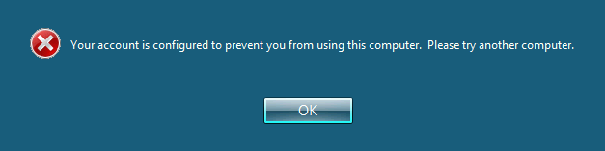
RDP connection - the RDP server missing from the list of the "log on to" (userWorkstations)
your account is configured to prevent you from using this computer

Slide 38
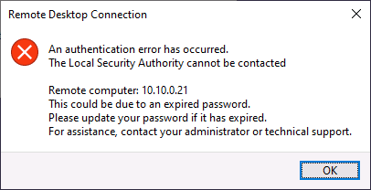
RDP connection - the RDP client missing from the list of the "log on to" (userWorkstations) with NLA required
An authentication error occurred. The Local Security Authority cannot be contacted
NTLM authentication
The system administrator has limited the computers you can log on with. Try logging on at a different computer. Error code 0x1107
Kerberos authentication

Slide 39
Disable NLA on RDP client
enablecredsspsupport:i:0

Slide 40
NTLMv2 time constraints
Response calculated with client's timestamp
Some services check the time against 30 minutes time skew
MS-CHAP, MS-CHAPv2
DCOM, WMI, Exchange, ...

Slide 41
NTLM session security (~ SASL ~ GSSAPI)
LM/NTLM/NTLMv2 has no mutual client/server authentiation capabilities
except for NTLMv2 session security (SASL signature/encryption) connections
No session security in HTTP
must use HTTPS
Client generates random session key and encrypts it with user's password hash (response exactly)
if the DC/server knows the password hash, it can decrypt the session key and use it
mutual authentication of the client and DC + server must be domain member (no server authentication)

Slide 42
NTLMv2 session security
Client
NEGOTIATE
Server ... DC
hello
CHALLENGE
server challenge #
AUTHENTICATE
login
authenticator
user domain
hash
server challenge #
EncryptedRandomSessionKey
by authenticator
NTLMv2 fields if NTLMv2 used

Slide 43
NTLMv2 session security with domain accounts
1
NEGOTIATE
Client
Server
2
CHALLENGE
3
RESPONSE
EncryptedRandomSessionKey
4
CHALLENGE
5
OK
RESPONSE
groups
EncryptedRandomSessionKey
DencryptedRandomSessionKey
DC
Active Directory

Slide 44
NTLMv2 session security and domain based MITM
1
NEGOTIATE
Attacker
Client
Server
2
CHALLENGE
3
RESPONSE
EncryptedRandomSessionKey
4
CHALLENGE
RESPONSE
EncryptedRandomSessionKey is encrypted by "response" authenticator but the response does include server name only with NTLMv2
EncryptedRandomSessionKey
5
OK
4
CHALLENGE
5
OK
groups
RESPONSE
groups
DencryptedRandomSessionKey
EncryptedRandomSessionKey
DencryptedRandomSessionKey
DC
DC
Active Directory
Active Directory

Slide 45
Recap of security parameters
LM, NTLM
weak algorithms
weak protection against replay
no mutual authentication
NTLMv2 + NTLMv2 session security
better algorithms
good protections against replay
MITM must be domain member
We can always combine with TLS/IPSec

Slide 46
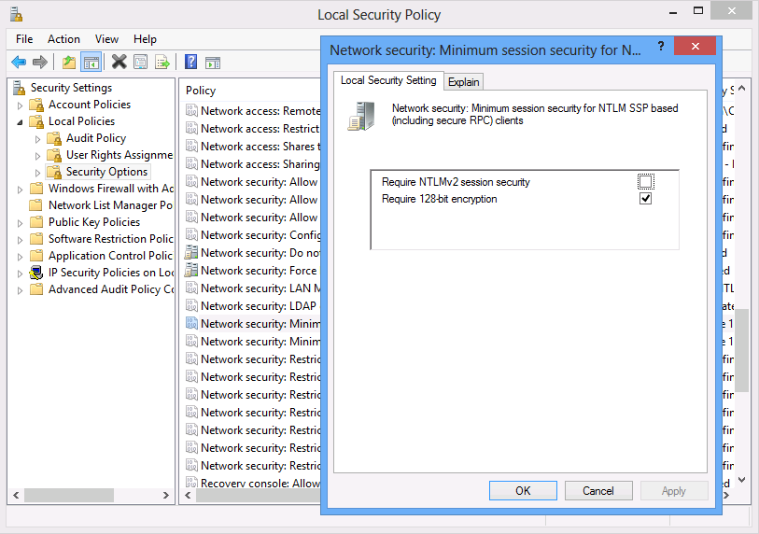
Network security: Minimum session security for NTLM SSP based clients

Slide 47
NTLM compatibility level
No version negotiation
Client is configured statically
Send LM & NTLM response
Send NTLM response only
Send NTLMv2 response
Server can refuse older protocols
... refuse LM
... refuse LM & NTLM

Slide 48
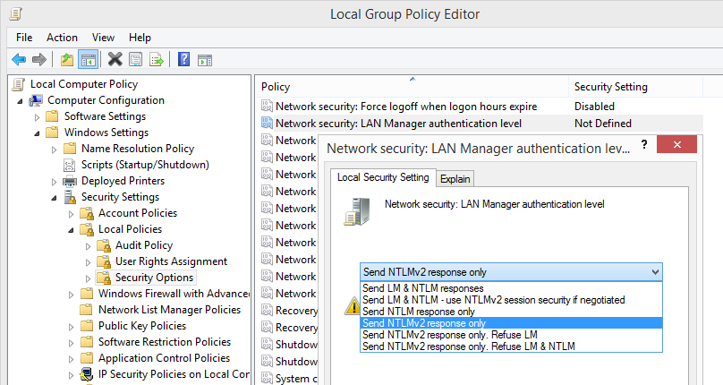
LAN manager authentication level

Slide 49
NTLM compatibility level is client - DC problem
Client
Server
Send LM
pass-through
... refuse LM & NTLM
DC
Active Directory

Slide 50
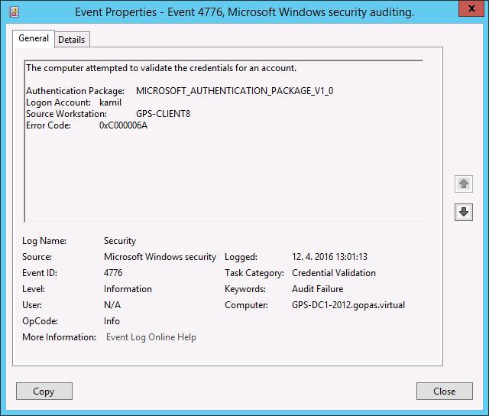
LM compatibility account logon failure on a DC 0xC000006A = STATUS_WRONG_PASSWORD

Slide 51
NTLM compatibility level is client - DC problem
Client
Server
Send NTLMv2
pass-through
... refuse LM & NTLM
DC
Active Directory

Slide 52
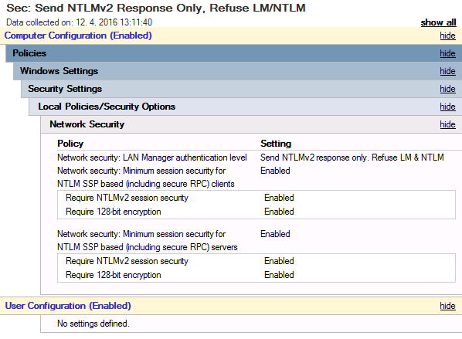
Most secure NTLMv2 and NTLMv2 128bit session security settings

Slide 53
NTLM reflection (loopback) attack
LM/NTLM/NTLMv2 has no mutual client/server authentiation capabilities
except for NTLMv2 session security (SASL signature/encryption) connections
social engineering or cross-site-scripting initiation
relatively limited attack surface
victim is local Administrators member on its workstation
no firewall on the workstation
no SASL session security required on some connection to the workstation
attacker must have direct local access to the victim

Slide 54
NTLM reflection (loopback) attack #1
\\attacker\photos
click here, I have beautiful photos you must take a look at
victim
attacker
\\attacker\photos
http://attacker/photos
gps\kamil
Administrators
PWD#

Slide 55
NTLM reflection (loopback) attack #2
\\attacker\photos
victim
attacker
want access
victim
attacker
only NTLM possible with me
gps\kamil
Administrators
victim
attacker
ok, NTLM NEGOTIATE
PWD#
\\attacker
gps\kamil
victim
some NTLM connection (SMB, SQL, HTTP, WMI)
ok, NTLM NEGOTIATE
\\attacker
gps\kamil

Slide 56
NTLM reflection (loopback) attack #3
attacker
random # challenge
victim
random # challenge
generated challenge
gps\kamil
attacker
Administrators
generate response
NTLMv2 HMAC-MD5 response
victim
\\attacker
gps\kamil
PWD#
NTLMv2 HMAC-MD5 response
\\attacker
gps\kamil

Slide 57
Loopback Check
Loopback access with NTLM on alias
LSASS has the same NTLM token with different server name in cache
HKLM\System\CCS\Control\LSA\MSV1_0
BackConnectionHostNames = MULTI_SZ
always type both short and FQDN
HKLM\System\CCS\Control\LSA
DisableLoopbackCheck = DWORD = 1
do not do this!

Slide 58
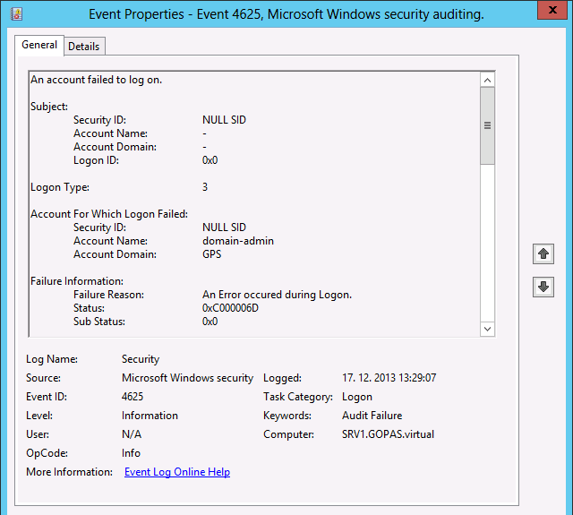
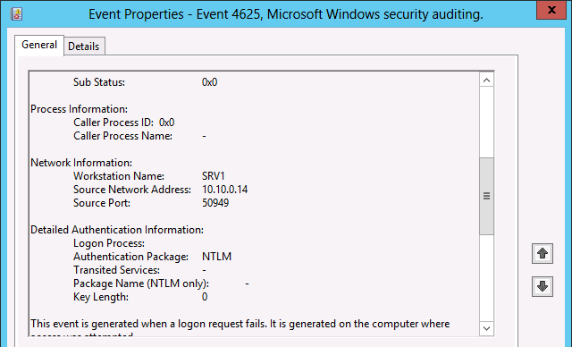
Loopback Check and logon audit failure Sub Status = 0 and Status = 0xC000006D

Slide 59
Alternative computer names
netdom computername localhost
/add:canteen.gopas.virtual
/userD:gps\domain-admin
/passwordD:Pa$$w0rd
Solves automatically
NTLM loopback-check
DNS A record
msDS-AdditionalDnsHostName
Kerberos SPNs
DisableLoopbackCheck for SMBv1

Slide 60
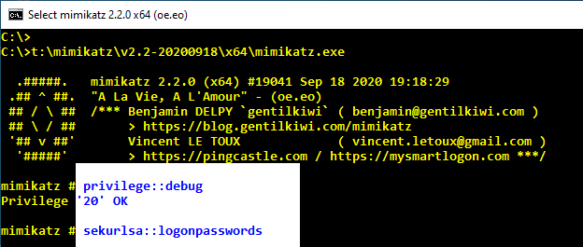
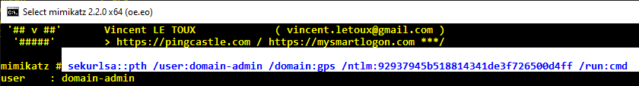
NTLM pass-the-hash

Slide 61
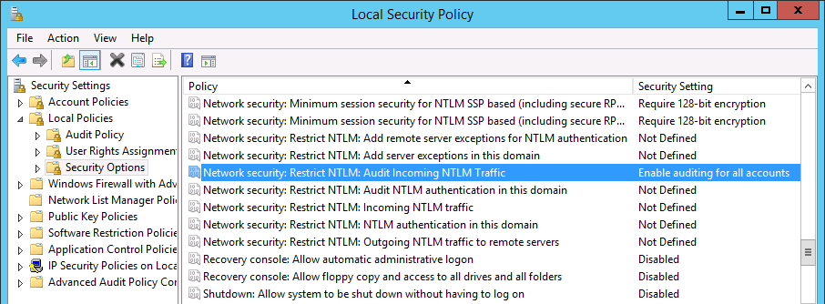
Disabling/auditing NTLM (since 7/2008R2)
Network Security: Restrict NTLM: Outgoing NTLM traffic to remote servers
on the clients from which the connection starts
Network Security: Restrict NTLM: Audit incoming NTLM traffic
on the resource server
Network Security: Restrict NTLM: Audit NTLM authentication in this domain
on the DC or resource server in case of local accounts

Slide 62
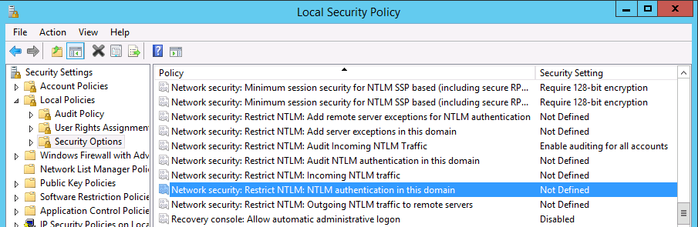
Disabling/auditing NTLM
Network Security: Restrict NTLM: Outgoing NTLM traffic to remote servers
on the clients from which the connection starts
Network Security: Restrict NTLM: Incoming NTLM traffic
on the resource server
Network Security: Restrict NTLM: NTLM authentication in this domain
on the DCs or resource servers in case of local accounts

Slide 63
NTLM auditing or disabling (domain accounts)
Client
incoming
Server
outgoing
pass-through
in this domain
DC
Active Directory

Slide 64
NTLM auditing or disabling (local accounts)
SAM
Client
incoming
Server
in this domain
outgoing

Slide 65
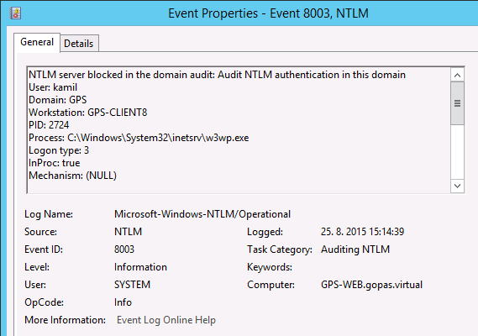
NTLM audit example (EventID 8003)
Log name: Microsoft-Windows-NTLM/Operational, Event ID: 8003, Category: Auditing NTLM, ...

Slide 66
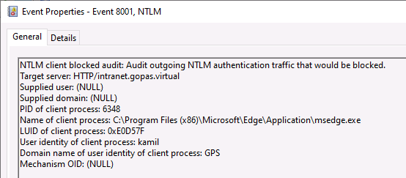
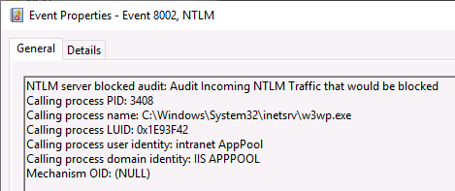
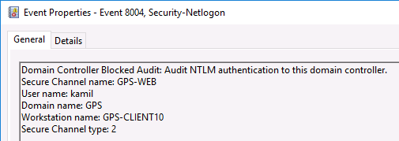
NTLM audit examples (EventID 8001, 8002, 8004)
client (outgoing)
server (incoming)
DC (in this domain)

Slide 67
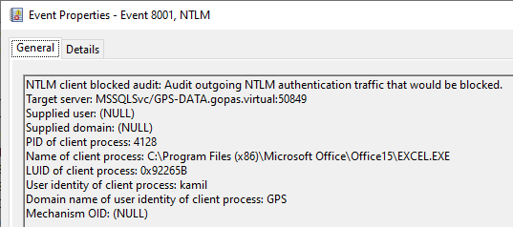
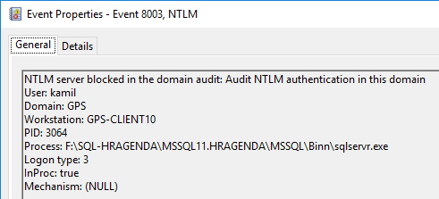
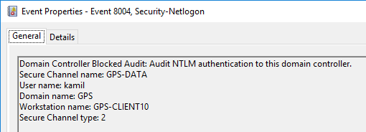
NTLM audit examples (EventID 8001, 8002, 8004)
client (outgoing)
server (incoming)
DC (in this domain)

Slide 68
Allow Cryptographic Algorithms Compatible with Windows NT 4.0
Windows 2008 do not support NT 4.0 secure channel algorithms
0xC0000388 = STATUS_DOWNGRADE_DETECTED

Slide 69
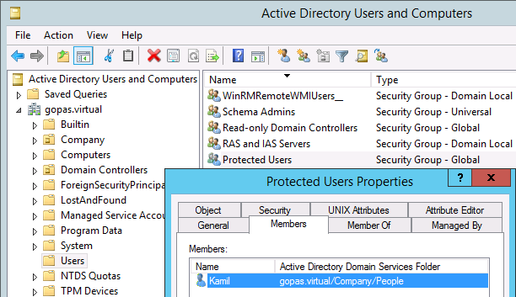
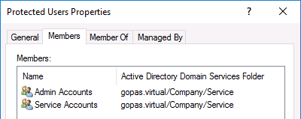

Protected users (since 2012R2/8.1 machines) do not have NTLM credentials

Slide 70
Protected Users (since 2012R2/8.1 machines) cons
Kerberos ticket 4 hours
OK
Kerberos TGT non-renewable
must type credentials every 4 hours
Kerberos delegation disabled
business application
good for admin accounts and service accounts
service accounts will not cache TGS tickets on clients
slower responses with more processing round-trips due to no long-term key on the server side (KRB_AP_ERR_USER_TO_USER_REQUIRED)
possible problems on incorrectly developed GSSAPI software

Slide 71
without Channel binding aka Extended protection for authentication aka Network Level Authentication (NTLM or Kerberos)
cert
session encryption
client
server
authentication
session keys

Slide 72
without Channel binding aka Extended protection for authentication aka Network Level Authentication (NTLM or Kerberos)
attacker
or
SSL inspection
fakecert
cert
session encryption
session encryption
client
server
authentication
session keys

Slide 73
Channel binding aka Extended protection for authentication aka Network Level Authentication (NTLM or Kerberos)
cert
session encryption
client
server
authentication
session keys

Slide 74
no MITM with Channel binding aka Extended protection for authentication aka Network Level Authentication (NTLM or Kerberos)
attacker
or
SSL inspection
fakecert
cert
session encryption
session encryption
client
server
authentication
session keys

Slide 75
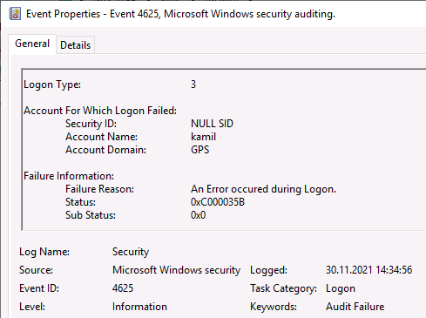
CBT validation failure on the resource server event id 4625, status 0xC000035B = STATUS_BAD_BINDINGS

Slide 76
Browser support for CBT (Channel Binding aka Extended Protection for Authentication aka ExtendedProtectionTokenCheck)
IE
supports in both NTLM and Negotiate providers
Edge old
supports in both NTLM and Negotiate providers
Edge Chromium
supports in both NTLM and Negotiate providers
Chrome
supports in both NTLM and Negotiate providers
Firefox
supports only with NTLM provider

Slide 77
Disabling CBT (channel binding token) on the client side (NTLM or Kerberos)
enabled by default since Windows 7+ and Windows 2008 R2+
disable for testing purposes only
HKLM\System\CurrentControlSet\Control\LSA
SuppressExtendedProtection = DWORD = 3

Slide 78
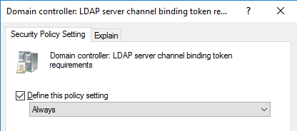
Enforce channel binding for LDAPS
Domain controller: LDAP server channel binding token requirements

Slide 79
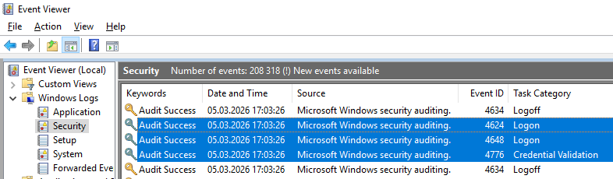
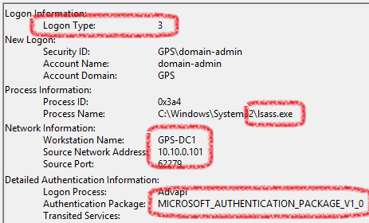
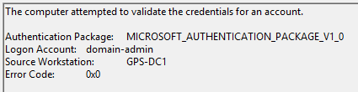
Not everything non-Kerberos is NTLM - LDAP simple bind
LDAP client IP address

Slide 80
Recommendations
disable clear-text passwords stored on DC
disable LM hashes stored on DC
15+ char passwords
may limit logon cache count
enforce NTLMv2
enforce client NTLMv2, consider blocking LM/NTLM
enforce NTLMv2 session security
+ enforce SMB signing
configured loopback aliases on NTLM servers
or assign an alternative DNS host name
enable NTLM auditing
use Protected Users group for sensitive accounts
consider channel binding for any TLS traffic
HTTPS, LDAPS, RDPS with NLA, SQL

