Slide 1
Kerberos
Ing. Ondřej Ševeček | GOPAS a.s. |
MCSM: Directory2012 | MCM: Directory2008 | MVP: Enterprise Security | CEH: Certified Ethical Hacker | CHFI: Computer Hacking Forensic Investigator | CISA | CISM | CISSP |
ondrej@sevecek.com | www.sevecek.com |
GOPAS: info@gopas.cz | www.gopas.cz | www.facebook.com/P.S.GOPAS

Slide 2
Kerberos overview
standards based
developed by academic cryptologists
mutual authentication
user/client, DC/KDC, server/service
negotiable cryptography
DES, RC4, AES-SHA1, AES-SHA256
bases for web SSO such as ADFS, WS-Fed, SAML-P, OAuth/OpenId
cryptographic side-channel protection
anti-reply with timestamps (+/- 5 minutes)
re-keying
limited primary credential exposure (+ticket renewal)
DoS vs. pre-authentication

Slide 3
Compare: pass-through in-band NTLM
Client
Server
in-band
SMB
SQL
LDAP
HTTP
encrypted
secure channel
server$
SMB
DCOM
DC
Active Directory

Slide 4
Compare: pass-through in-band NTLM
offline cracking NTLM authenticator
Client
Server
in-band
SMB
SQL
LDAP
HTTP
encrypted
secure channel
server$
SMB
DCOM
DC
Active Directory

Slide 5
Compare: out-of-band Kerberos
Client
Server
in-band
SMB
SQL
LDAP
HTTP
Kerberos
TCP 88
generate tickets
DC
Active Directory

Slide 6
Compare: out-of-band Kerberos
tickets encrypted with strong random keys
Client
Server
in-band
SMB
SQL
LDAP
HTTP
Kerberos
TCP 88
generate tickets
DC
Active Directory

Slide 7
Tickets
user ticket
ticket-granting ticket (TGT)
produced by authentication service (AS)
service ticket
ticket granting service (TGS)
obtained from TGS service

Slide 8
Kerberos #0
service1
client
service2
kamil
service2
service3
service4
KDC

Slide 9
Kerberos (with pre-authentication) #1
service1
client
service2
service3
primary credentials
service4
pwd
cert
KDC

Slide 10
Kerberos (with pre-authentication) #1
service1
client
service2
service3
primary credentials
TGT
kamil
service4
pwd
cert
KDC

Slide 11
Kerberos (with pre-authentication) #1
service1
client
service2
service3
primary credentials
TGT
kamil
service4
pwd
cert
10 hours
group SIDs
KDC

Slide 12
Kerberos #1
TGT
kamil
10 hours
group SIDs
service1
client
service2
service3
service4
KDC

Slide 13
Ticket-granting ticket (TGT)

Slide 14
Ticket-granting ticket (TGT)

Slide 15
Ticket-granting ticket (TGT) renewal
limitting primary credentials exposure by using yet-valid TGT ticket to obtain a new one
in Windows attempted once 20 minutes before current TGT expiration

Slide 16
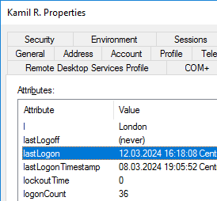
lastLogon and lastLogonTimestamp
lastLogon
updated only on initial TGT issuance (AS)
not on renewal, not on TGS requests
not replicated
lastLogonTimestamp
updated every 9-14 days after lastLogon changed
replicated
msDS-LogonTimeSyncInterval

Slide 17
Kerberos #1
TGT
kamil
service1
client
service2
service3
TGS request for service2
service4
TGT
kamil
KDC

Slide 18
Kerberos #1
TGT
kamil
service1
client
service2
service3
TGS
kamil
service2
TGS request for service2
service4
TGT
kamil
KDC

Slide 19
Kerberos #1
TGT
kamil
service1
client
service2
service3
TGS
kamil
service2
TGS request for service2
<10 hours
group SIDs
service4
TGT
kamil
10 hours
group SIDs
KDC

Slide 20
Kerberos #1
TGT
kamil
service1
client
TGS
kamil
service2
service2
TGS
kamil
service2
service3
service4
KDC

Slide 21
Kerberos #1
TGT
kamil
service1
client
TGS
kamil
service2
service2
TGS
kamil
service2
<10 hours
group SIDs
service3
service4
KDC

Slide 22
Ticket granting service (TGS)

Slide 23
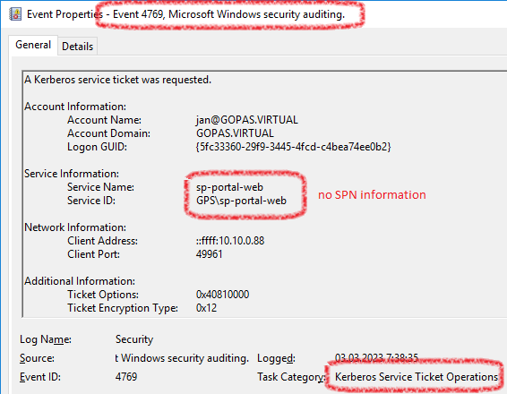
Ticket granting service (TGS)

Slide 24
Kerberos #2
primary credentials
pwd
cert priv
service1
client
service2
service3
service4
KDC
primary credentials
pwd#
cert pub

Slide 25
Kerberos (with pre-authentication) #2
primary credentials
pwd
cert priv
service1
client
service2
service3
encrypted by user's primary credentials
primary credentials
TGT
kamil
service4
pwd
cert
KDC
primary credentials
pwd#
cert pub

Slide 26
Kerberos (without pre-authentication) #2
primary credentials
pwd
cert priv
service1
client
service2
service3
encrypted by user's primary credentials
nothing
TGT
kamil
service4
KDC
primary credentials
pwd#
cert pub

Slide 27
Kerberos with pre-authentication
primary credentials
pwd
cert priv
service1
client
service2
service3
encrypted by user's primary credentials
primary credentials
TGT
kamil
service4
RC4-pwd#
timestamp
AES-pwd#
timestamp
cert-priv-sig
timestamp
KDC
primary credentials
pwd#
cert pub

Slide 28
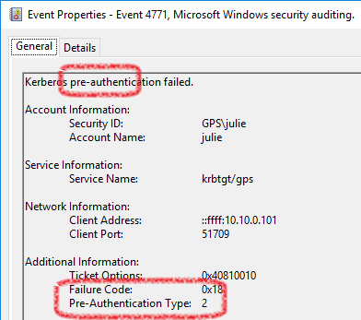
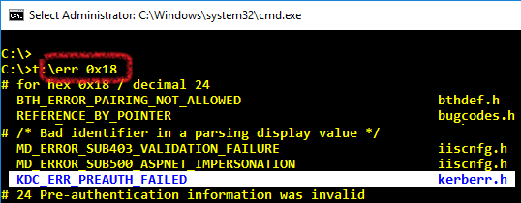
Incorrect password failure audit on DC with pre-authentication enabled
log: Security
source: Microsoft Windows Security Auditing.
event id: 4771
event type: audit failure
category: Kerberos Authentication Service
message: Kerberos pre-authentication failed. Failure code KDC_ERR_PREAUTH_FAILED

Slide 29
Ticket-granting ticket (TGT) without pre-authentication

Slide 30
KRBTGT master key
primary credentials
pwd
cert priv
service1
client
service2
service3
krbtgt encrypted
encrypted by user's primary credentials
TGT
kamil
service4
KDC
KDC
KDC
krbtgt key
primary credentials
pwd#
cert pub

Slide 31
KRBTGT "account" (holder of the KDC secret key)
SID-502
current key + 1 previous in history
to keep already issued TGTs valid
"password" does not change automatically ever
once during upgrade when first 2008+ DC becomes PDC in order to generate AES SHA-1 hash
recommended to reset at least once 6 months
supported to reset once per 8 days
reset operation generates random key regardless of the password supplied
normal reset 1x
and verify replication among DCs
forest recovery reset 2x
making all already issued TGTs invalid

Slide 32
KRBTGT account vs. RODCs
KRBTGT does not replicate to RODCs
every RODC has its own separate KRBTGT_RND
msDS-KrbTgtLink -> msDS-KrbTgtLinkBl
writable DCs know KRBTGT_RND keys
always resets only on a writable DC if needed
can validate RODC issued TGTs but not vice-versa

Slide 33
2x KRBTGT reset - KRB_AP_ERR_BAD_INTEGRITY

Slide 34
2x KRBTGT reset - KRB_AP_ERR_BAD_INTEGRITY

Slide 35
Kerberos #2
machine1$ pwd
TGT
kamil
service1
client
service2 pwd
service2
service3
machine3$ pwd
service4
service4$ pwd
machine1$ pwd #
KDC
service2 pwd #
machine3$ pwd #
service4$ pwd #

Slide 36
Kerberos #2
shared key 1
TGT
kamil
service1
client
shared key 2
service2
service3
shared key 3
service4
shared key 4
shared key 1
KDC
shared key 2
shared key 3
shared key 4

Slide 37
Kerberos #2
shared key 1
TGT
kamil
service1
client
shared key 2
service2
encrypted by shared key 2
service3
TGS
kamil
service2
TGS request for service2
shared key 3
service4
TGT
kamil
shared key 4
shared key 1
KDC
shared key 2
shared key 3
shared key 4

Slide 38
Kerberos #2
shared key 1
TGT
kamil
service1
client
encrypted by shared key 2
shared key 2
TGS
kamil
service2
service2
TGS
kamil
service2
service3
shared key 3
service4
shared key 4
KDC

Slide 39
Kerberos #2
shared key 1
TGT
kamil
service1
client
encrypted by shared key 2
shared key 2
TGS
kamil
service2
service2
TGS
kamil
service2
<10 hours
group SIDs
service3
shared key 3
service4
shared key 4
KDC

Slide 40
Kerberos #3
primary credentials
pwd
cert priv
service1
client
service2
service3
encrypted by user's primary credentials
TGT
kamil
C/TGS session key
service4
KDC
primary credentials
pwd#
cert pub

Slide 41
Kerberos #3
shared key 1
TGT
kamil
service1
client
shared key 2
service2
encrypted by shared key 2 and
C/TGS key
service3
TGS
kamil
service2
C/SVC session key
encrypted by C/TGS key
TGS request for service2
shared key 3
service4
TGT
kamil
shared key 4
shared key 1
KDC
shared key 2
shared key 3
shared key 4

Slide 42
Kerberos #3
TGT
kamil
service1
client
encrypted by shared key 2
TGS
kamil
service2
service2
TGS
kamil
service2
C/SVC session key
service3
service4
KDC

Slide 43
Kerberos TGT (initial, not yet renewed)
user primary credentials
AES-SHA-1(C-pwd)
RC4-MD4-1(C-pwd)
RSA encryption(C-cert-pub)
krbtgt#
per-ticket session key C/TGS
per-ticket session key C/TGS
per-ticket session key C/TGS
kamil
@gopas.virtual
privileged attribute certificate (PAC)
S-1-5-21-GPS-GPS-GPS-kamil
krbtg
@gopas.virtual
S-1-5-21-GPS-GPS-GPS-employees
10 hours valid
S-1-5-21-GPS-GPS-GPS-allpeople
7 days renewal
F: initial
HMAC(krbtgt#)

Slide 44
Kerberos TGS - http/intranet service
per-ticket session key C/TGS from TGT
SVC shared key
per-ticket session key C/SVC
per-ticket session key C/SVC
per-ticket session key C/SVC
kamil
@gopas.virtual
privileged attribute certificate (PAC)
S-1-5-21-GPS-GPS-GPS-kamil
http/intranet
@gopas.virtual
S-1-5-21-GPS-GPS-GPS-employees
9:27 hours valid
S-1-5-21-GPS-GPS-GPS-allpeople
no renewal used
S-1-5-21-GPS-GPS-GPS-crmaccess
F: -
HMAC(krbtgt#)

Slide 45
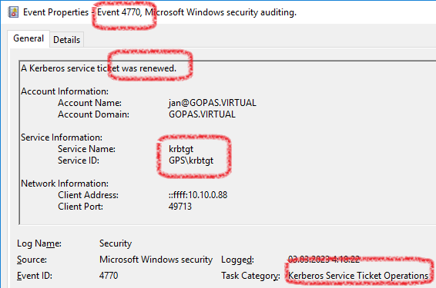
TGT/TGS renewal
yet valid TGT and TGS can be renewed
not using the primary credentials for 7 days (default)
automatically during the last 30 minutes resp. 15 minutes of its lifetime if being used
disabled accounts still renew
group SIDs kept from the original TGT

Slide 46
Kerberos TGT (renewed)
per-ticket session key C/TGS previous
krbtgt#
per-ticket session key C/TGS new
per-ticket session key C/TGS new
per-ticket session key C/TGS new
kamil
@gopas.virtual
privileged attribute certificate (PAC)
S-1-5-21-GPS-GPS-GPS-kamil
krbtg
@gopas.virtual
S-1-5-21-GPS-GPS-GPS-employees
10 hours valid
S-1-5-21-GPS-GPS-GPS-allpeople
5 days renewal
F: initial
HMAC(krbtgt#)

Slide 47
Transporting Kerberos TGT encryption vs. KDC key vs. C/TGS session keys - reality in detail :-)
client
pwd
pwd#
C/TGS
C/TGS
TGT
KDC key
C/TGS
KDC
KDC
KDC
KDC key

Slide 48
Transporting Kerberos TGT encryption vs. KDC key vs. C/TGS session keys - reality in detail :-)
client
TGT
C/TGS
KDC protector
TGT
KDC key
C/TGS
KDC
KDC
KDC
KDC key

Slide 49
Transporting Kerberos TGS encryption vs. SVC key vs. C/SVC session keys - reality in detail :-)
client
pwd
SVC key
C/TGS
C/TGS
C/SVC
C/SVC
TGS
SVC key
C/SVC
KDC
KDC
KDC
SVC key
KDC key

Slide 50
Service Principal Names

Slide 51
Service principal names (SPNs)
case-insensitive
strict format
service/hostname:port/spec
host/gps-client10.gopas.virtual
interactive and RDP logon, does not cache
WMI access
* named wildcard resolution
cifs/gps-data
SMB access, DFSN resolution
http/portal.gopas.virtual
HTTP or HTTPS or WinRM or SQL reporting services
rpcss/gps-client7.gopas.virtual
RPC and DCOM access
ldap/
termsrv/
mssqlsvc/
msolapsvc.3/
exchangeab/, exchangerfr/
dns/

Slide 52
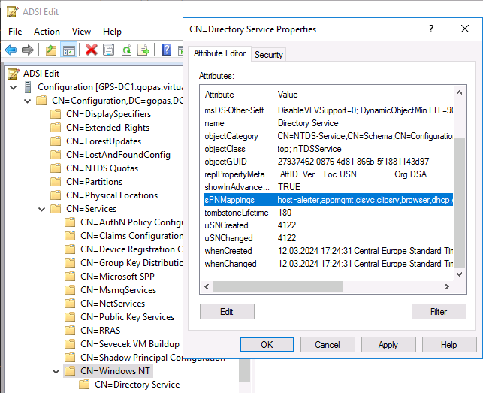
sPNMappings - CN=Directory Services,CN=Windows NT,...

Slide 53
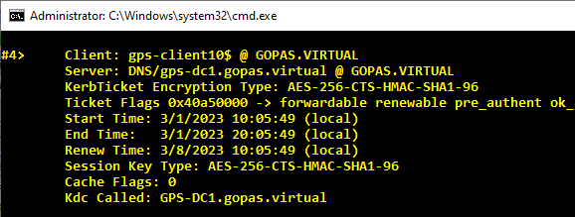
DNS TGS for dynamic update
# first delete the GPS-Client10 DNS A record from DNS server
# re-registration does happen only when the records needs updating
klist purge -li 3e4
klist purge -li 3e5
klist purge -li 3e7
ipconfig /registerdns
klist -li 3e4

Slide 54
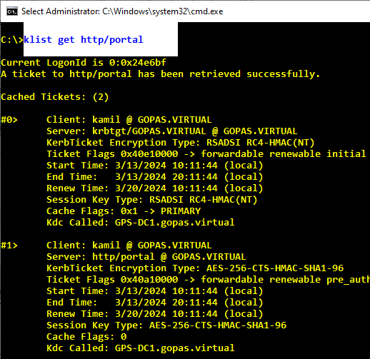
klist get

Slide 55
Basic Kerberos requirements
does it work?
is it SSO already?
local intranet (or maybe trusted sites) zones
about:config -> network.negotiate-auth: trusted-uris, allow-non-fqdn
is it in the local intranet zone?

Slide 56
Local intranet sites (inetcpl.cpl) IE + Edge + Chrome + WebDAV + WinHTTP + NetFX + ...

Slide 57
network.negotiate-auth: trusted-uris, allow-non-fqdn Firefox

Slide 58
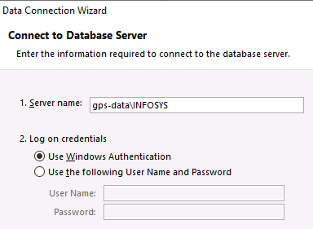
DNS A vs. CNAME vs. short name vs. FQDN
with CNAME you never know :-)
http://warehouse
mstsc /v:warehouse
net view \\warehouse
A FQDN depends :-)
net view \\gps-data
net view \\books-dc (books-client81)
Enter-PSSession gps-web

Slide 59
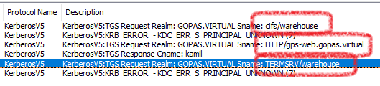

DNS vs. CNAME vs. various clients

Slide 60
SPN muster http://intranet, http://intranet.gopas.virtual
does it work?
is it SSO already?
local intranet or trusted sites zones
about:config -> network.negotiate-auth: trusted-uris, allow-non-fqdn
is it in the local intranet zone?
DNS A or CNAME
A
machine
GPS-WEB
already an existing SPN?
setspn -q "http/intran*"
setspn -a "http/intranet" gps-web$
setspn -a "http/intranet.gopas.virtual" gps-web$

Slide 61
SPN muster http://warehouse, http://warehouse.gopas.virtual
does it work?
is it SSO already?
local intranet or trusted sites zones
about:config -> network.negotiate-auth: trusted-uris, allow-non-fqdn
is it in the local intranet zone?
DNS A or CNAME
CNAME
machine
GPS-WEB
already an existing SPN?
setspn -q "http/gps-web*"
setspn -q "host/gps-web*"
add http/gps-web.gopas.virtual and http/gps-web anyway

Slide 62
HOST/ SPN "wildcard"
CN=Directory Service,CN=Windows NT,CN=Services,CN=Configuration,DC=x
sPNMappings
does not contain
TERMSRV/
MSSqlSvc/

Slide 63
SPN muster https://finance.gopas.cz
does it work?
is it SSO already?
local intranet or trusted sites zones
about:config -> network.negotiate-auth: trusted-uris, allow-non-fqdn
is it in the local intranet zone?
DNS A or CNAME
A
machine
GPS-WEB
service account
gps\svc-iis-finance
already an existing SPN?
setspn -q "http/fin*"
setspn -q "host/fin*"
setspn -a "http/finance.gopas.cz" svc-iis-finance

Slide 64
Alternative UPN and SPN suffixes
CN=Partitions,CN=Configuration,DC=x
uPNSuffixes

Slide 65
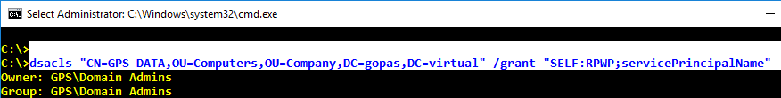
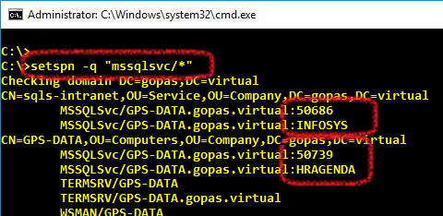
Dynamic SQL server SPN (de)registration
SQL server default instance (TCP port 1433)
mssqlsvc/hostname
SQL server named instance (TCP port ???)
mssqlsvc/hostname:port
mssqlsvc/hostname:INSTANCENAME
dsacls "CN=account..." /grant "SELF:RPWP;servicePrincipalName"

Slide 66
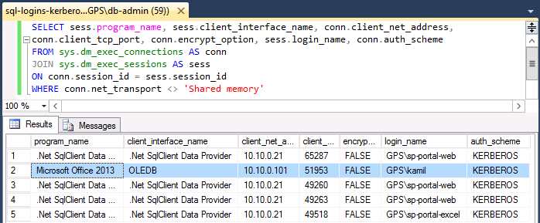
Listing SQL connections/sessions for logins and Kerberos/NTLM
SELECT sess.program_name, sess.client_interface_name,conn.client_net_address, conn.client_tcp_port, conn.encrypt_option, sess.login_name, conn.auth_scheme
FROM sys.dm_exec_connections AS conn
JOIN sys.dm_exec_sessions AS sess
ON conn.session_id = sess.session_id
WHERE conn.net_transport <> 'Shared memory'

Slide 67
SPN muster mstsc /v:rdp.gopas.cz
does it work?
is it SSO already?
local intranet or trusted sites zones
about:config -> network.negotiate-auth: trusted-uris, allow-non-fqdn
is it in the local intranet zone?
DNS A or CNAME
A
machine
GPS-RDP
service account
NT AUTHORITY\Network Service = gps-rdp$
already an existing SPN?
setspn -q "termsrv/rdp.gopas.cz"
setspn -a "termsrv/rdp.gopas.cz" gps-rdp$

Slide 68
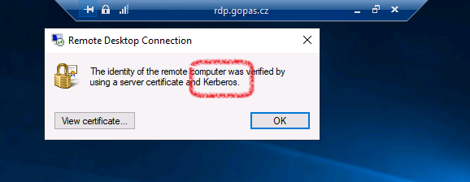
RDP server identity verified by Kerberos TGS

Slide 69
SPN errors

Slide 70
SPN does not exist
no ticket issued
KDC_ERR_S_PRINCIPAL_UNKNOWN = 0x7
no audit event in Security log
normal situation :-)
fallback to NTLM

Slide 71
SPN on a wrong account
ticket issued
encrypted with an incorrect password
usually a stubborn failure on the client

Slide 72
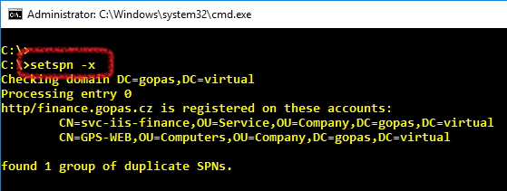
SPN on more than a single account
DCs 2012R2+ check duplicity when writing servicePrincipalName attribute
no ticket issued
KDC_ERR_S_PRINCIPAL_UNKNOWN = 0x7
failure event in Security log with EventId = 4769
fallback to NTLM

Slide 73
SPN muster (duplicate SPN already existing) https://orders.gopas.cz
does it work?
is it SSO already?
local intranet or trusted sites zones
about:config -> network.negotiate-auth: trusted-uris, allow-non-fqdn
is it in the local intranet zone?
DNS or CNAME
A
machine
GPS-SPRDP
service account
gps\svc-iis-orders
already an existing SPN?
setspn -q "http/orders*"
setspn -q "host/orders*"
setspn -x -f
setspn -d "http/orders.gopas.cz" GPS-SPRDP$
setspn -a "http/orders.gopas.cz" svc-iis-orders

Slide 74
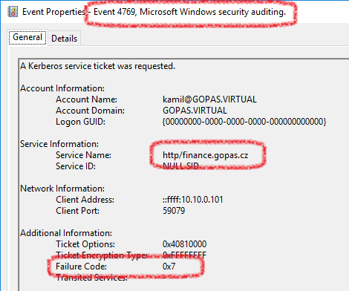
SPN on more than a single account
log: Security
source: Microsoft Windows Security Auditing.
event id: 4769
event type: audit failure

Slide 75
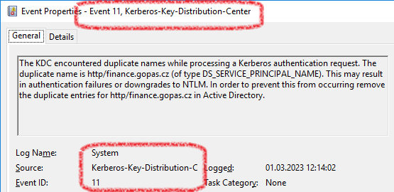
SPN on more than a single account
log: System
source: Kerberos-Key-Distribution-Center
event id: 11
event type: error
message: KDC encountered duplicate names while processing a Kerberos authentication request

Slide 76
Encryption types (etypes)

Slide 77
Encryption types
AES ?
AES ?
RC4 ?
RC4 ?
Client
Service
AES ?
DC
RC4 ?
DC
DC
service#SHA1 ?
service#MD4 ?

Slide 78
msDS-SupportedEncryptionTypes vs. AS/TGS events and etypes in tickets
msDS-SupportedEncryptionTypes (flags)
DES_CRC = 1 = 0x01
DES_MD5 = 2 = 0x02
RC4_HMAC_MD5 = 4 = 0x04
AES128_HMAC_SHA1 = 8 = 0x08
AES256_HMAC_SHA1 = 16 = 0x10
AES256_CTS_HMAC_SHA1_96_SK = 32 = 0x20 (enforces AES whenever it would use RC4 by default for session keys, but leaves RC4 for TGS itself)
RFC4121 etypes
0x01 = 1 = DES-CBC-CRC
0x02 = 2 = DES-CBC-MD4
0x03 = 3 = DES-CBC-MD5
0x11 = 17 = AES128-CTS-HMAC-SHA1-96
0x12 = 18 = AES256-CTS-HMAC-SHA1-96 (default SK since 2022/11 update)
0x17 = 23 = RC4-HMAC-MD5 (default SK/TGS until 2022/11 update, default TGS since 2022/11 update)
0x18 = 24 = RC4-HMAC-EXP (export strength 40bit)
0x80 = 128 = RC4-MD4

Slide 79
SPN+ETYPE muster https://finance.gopas.cz
does it work?
is it SSO already?
local intranet or trusted sites zones
about:config -> network.negotiate-auth: trusted-uris, allow-non-fqdn
is it in the local intranet zone?
DNS or CNAME
A
machine
GPS-WEB
service account
gps\svc-iis-finance
already an existing SPN?
setspn -q "http/fin*"
setspn -q "host/fin*"
setspn -a "http/finance.gopas.cz" svc-iis-finance
msDS-SupportedEncryptionTypes = 24 = 0x18 (AES128+AES256) msDS-SupportedEncryptiontypes = 28 = 0x1C (RC4+AES128+AES256)

Slide 80
SPN+ETYPE muster (backward compatible with RC4) https://orders.gopas.cz
does it work?
is it SSO already?
local intranet or trusted sites zones
about:config -> network.negotiate-auth: trusted-uris, allow-non-fqdn
is it in the local intranet zone?
DNS or CNAME
A
machine
GPS-SPRDP
service account
gps\svc-iis-orders
already an existing SPN?
setspn -q "http/orders*"
setspn -q "host/orders*"
setspn -a "http/orders.gopas.cz" svc-iis-orders
msDS-SupportedEncryptionTypes = 4 = 0x4 (RC4)

Slide 81
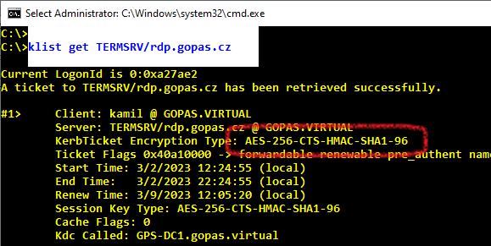
GPS-RDP + mstsc /v:rdp.gopas.cz + AES
# Note: reset the password 2x and restart (a bug probably)
netdom resetpwd /server:gps-dc1 /userD:gps\domain-admin /passwordD:Pa$$w0rd
shutdown /r /t 0 /f
klist get termsrv/rdp.gopas.cz

Slide 82
KDC_ERR_ETYPE_NOSUPP
EventLog: System
EventId: 27
Source: Kerberos-Key-Distribution-Center
Message: While processing a TGS request for the target server, the account did not have a suitable key for generating a Kerberos ticket

Slide 83
2022/11 update KB5021131 default msDS-SupportedEncryptionTypes
HKLM\SYSTEM\CurrentControlSet\Services\KDC
DefaultDomainSupportedEncTypes = DWORD = default = 0x27
DES + RC4 + AES256-SK
DefaultDomainSupportedEncTypes = DWORD = pre 2022/11 = 0x7
without update before 2022/11
msDS-SupportedEncryptionTypes = 0 or <NULL>
resulting TGS
SK: RC4_HMAC_MD5
TGS: RC4_MHAC_MD5
with update after 2022/11
msDS-SupportedEncryptionTypes = 0 or <NULL>
DefaultDomainSupportedEncTypes = <does not exist>
resulting TGS
SK: AES256_CTS_HMAC_SHA1_96
TGS: RC4_MHAC_MD5

Slide 84
IIS kernel mode

Slide 85
IIS and HTTP.SYS
User Mode
SSTP
WinRM
IPHTTPS
Hyper-V Replication
ADFS
Reporting Services
IIS
Kernel Mode
http auth
Certificate
HTTP.SYS

Slide 86
SPN+ETYPE muster https://canteen.gopas.virtual
does it work?
is it SSO already?
local intranet or trusted sites zones
about:config -> network.negotiate-auth: trusted-uris, allow-non-fqdn
is it in the local intranet zone?
DNS A or CNAME
A
machine
GPS-WEB
service account
gps\svc-iis-canteen
IIS Kernel Mode Authentication
yes
already an existing SPN?
setspn -q "http/canteen.gopas.virtual"
setspn -q "host/canteen.gopas.virtual"
setspn -a "http/canteen.gopas.virtual" gps-web$
[ msDS-SupportedEncryptionTypes = 24 = 0x18 (AES128+AES256) ]

Slide 87
SPN+ETYPE muster http://research.gopas.virtual
does it work?
is it SSO already?
local intranet or trusted sites zones
about:config -> network.negotiate-auth: trusted-uris, allow-non-fqdn
is it in the local intranet zone?
DNS or CNAME
A
machine
GPS-WEB
service account
gps\svc-iis-research
IIS Kernel Mode Authentication
yes
useAppPoolCredentials
yes
already an existing SPN?
setspn -q "http/research.gopas.virtual"
setspn -q "host/research.gopas.virtual"
setspn -a "http/research.gopas.virtual" svc-iis-research
msDS-SupportedEncryptionTypes = 24 = 0x18 (AES128+AES256) (+4 = 28 = 0x1C RC4)

Slide 88
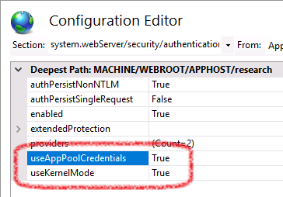
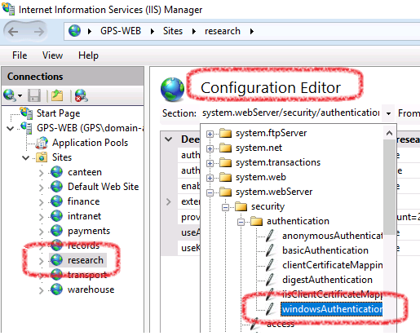
useAppPoolCredentials
<system.webServer>
<security>
<authentication>
<windowsAuthentication
useKernelMode="true"
useAppPoolCredentials="true"
/>

Slide 89
Non-Microsoft services

Slide 90
Service example
shared key
client
DNS? or03.gopas.cz
SPN prefix? oracle/ or http/
oracle
encrypted with a shared key
TGS
oracle/or03.gopas.cz@GOPAS.VIRTUAL
case sensitive?!
gopas.virtual

Slide 91
Service example
shared key
client
DNS? or03.gopas.cz
SPN prefix? oracle/ or http/
oracle
encrypted with a shared key
TGS
oracle/or03.gopas.cz@GOPAS.VIRTUAL
gopas.virtual
password#

Slide 92
Service example
client
DNS? or03.gopas.cz
SPN prefix? oracle/ or http/
oracle
shared key
encrypted with a shared key
TGS
oracle/or03.gopas.cz@GOPAS.VIRTUAL
keytab
gopas.virtual
password#

Slide 93
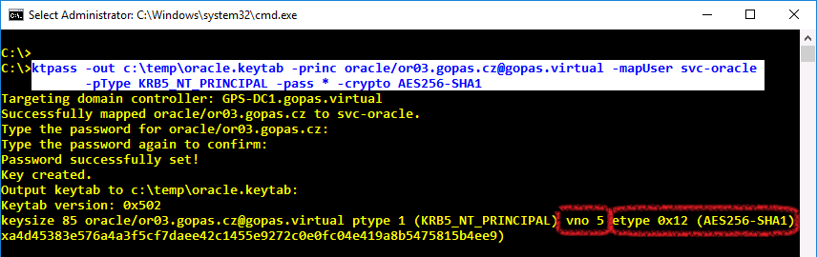
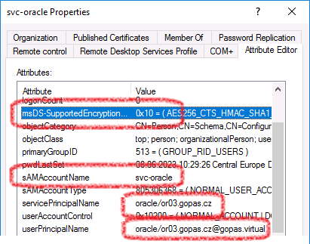
KTPASS + keytab export

Slide 94
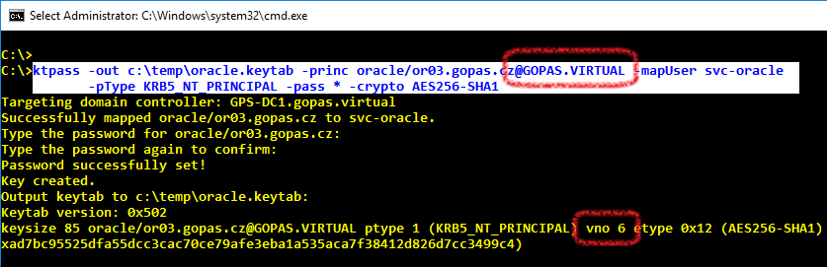
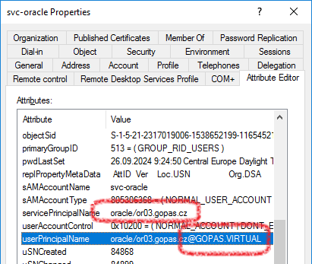
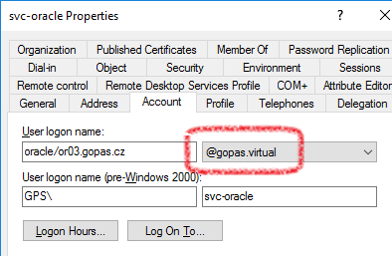
KTPASS + keytab export (case sensitivity?)

Slide 95
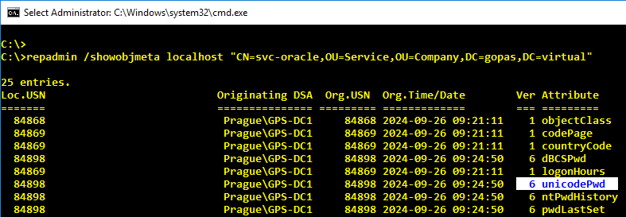
KTPASS notes
-crypt all
-kvno 22
+rndPass –minPass 20 –maxPass 40

Slide 96
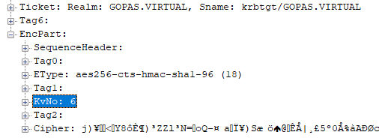
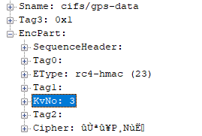
KVNO (key version number) both TGT and TGS
repadmin /showobjmeta
unicodePwd - attribute version

Slide 97
Service example
shared key
client
oracle
own TGT requests + LDAP lookups
gopas.virtual
encrypted with a shared key
TGT
oracle/or03.gopas.cz@gopas.virtual
password#

Slide 98
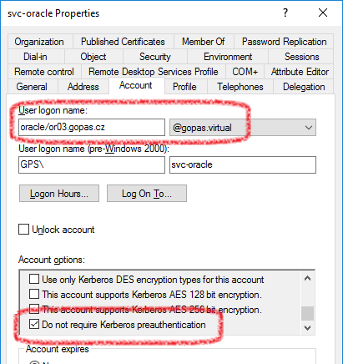
Usually without pre-authentication

Slide 99
Load-balancing

Slide 100
Load-balancing not working to machine$ accounts
nodea$
nodeA
https://webfarm.gopas.cz
nodeb$
L-B device
nodeB
RDP ts.gopas.virtual
nodec$
nodeC

Slide 101
Load-balancing requires a common account to register the single SPN on
svc-account
nodeA
http://webfarm.gopas.cz
svc-account
L-B device
nodeB
RDP ts.gopas.virtual
svc-account
nodeC
IIS no Kernel mode
IIS with useKernelMode + useAppPoolCredentials

Slide 102
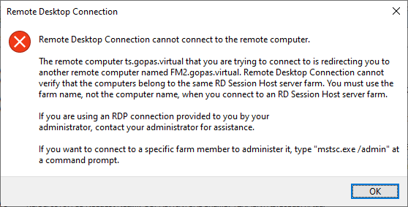
Remote Desktop farm with Kerberos server authentication with A or CNAME DNS name pointing its RD broker(s)
Remote Desktop Connection cannot connect to the remote computer. The remote computer that you are trying to connect is redirecting you to another remote computer. Cannot verify that the computers belong to the same RD Session Host server farm. You must use the farm name, not the computer name, when you connect to an RD Session Host server farm.

Slide 103
Remote Desktop farm with Kerberos server authentication with A or CNAME DNS name pointing its RD broker(s)
# Note: not supported since 2012+
# rely on a trusted TLS server certificate since 2012+
Import-Module RemoteDesktopServices
cd RDS:\RDSFarms\<farm-name>\KerbIdentity
Set-Item EnableKerbIdentity 1
Win32_SessionBrokerFarmAccount

Slide 104
Time constraints +/- 5 minutes by default

Slide 105
KRB_AP_ERR_SKEW during pre-authentication "just try again"
client
12:00
RC4-pwd#
12:00
AES-pwd#
12:00
cert-priv-sig
12:00
11:50
KDC

Slide 106
KRB_AP_ERR_SKEW during pre-authentication "just try again"
client
12:00
RC4-pwd#
12:00
KRB_AP_ERR_SKEW
11:50
AES-pwd#
12:00
cert-priv-sig
12:00
11:50
KDC

Slide 107
Service runs yet in the past "no go since the very start"
11:50
client
service
TGS
12:00
22:00
12:00
KDC

Slide 108
Service runs yet in the past "no go since the very start"
11:50
client
service
TGS
12:00
22:00
TGS
12:00
22:00
12:00
KDC

Slide 109
Service runs a bit in the future "work for some time until not anymore"
12:30
client
service
TGS
12:00
22:00
12:00
KDC

Slide 110
Service runs a bit in the future "work for some time until not anymore"
12:30
client
service
TGS
12:00
22:00
TGS
12:00
22:00
12:00
KDC

Slide 111
Service runs a bit in the future "work for some time until not anymore"
22:06
client
service
TGS
12:00
22:00
21:36
21:36
KDC

Slide 112
Group number limits Ticket size limits and PAC

Slide 113
Group membership limit on access token
local access token (or remote :-)
whoami /all
all nested security groups
excluding domain local groups from other domains
including NT AUTHORITY, BUILTIN, ...
max 1025 SIDs
account SID
group SIDs
sIDHistory SIDs
Kerberos or NTLM or Schannel ...

Slide 114
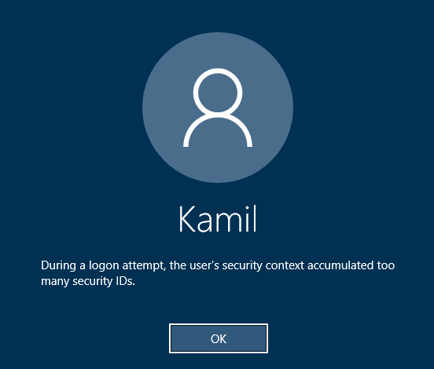
During a logon attempt, the user's security context accumulated too many security IDs
0xC000015A
STATUS_TOO_MANY_CONTEXT_IDS

Slide 115
Local Kerberos ticket size limits
Windows 2000
8 kB
Windows XP SP2, 2003, 2008, Vista, 7, 2008 R2
12 kB
Windows 2012/8+
42500 B
HKLM\System\CurrentControlSet\Control\LSA\Kerberos\Parameters
MaxTokenSize = DWORD = 0-65535

Slide 116
Privilege Attribute Certificate (PAC)
ExtraSIDs field
40 B full SID values
ResourceGroupIds
8 B only RID relative to a common domain SID
DFL invariant behavior
all Windows 2000+ clients understand
Windows 2008 R2- DCs
"compress" only global and universal groups from the account domain into TGT
Windows 2012 DCs
"compress" all SIDs including local groups and all universal group SIDs

Slide 117
TGT vs. TGS
TGT
global group SIDs
universal group SIDs
TGS
global group SIDs
universal group SIDs
domain local group SIDs from the resource domain

Slide 118
Note: no need to disable "compression"
msDS-SupportedEncryptionTypes = 0x80000
HKLM\System\CurrentControlSet\Service\KDC\Parameters
DisableResourceGroupsFields = DWORD = 1

Slide 119
Application limits
HTTP.SYS (IIS + others such as ADFS, SQL RS, ...)
tickets get encoded in Base64 (1.5* size)
HKLM\System\CurrentControlSet\Services\HTTP\Parameters
MaxRequestBytes = DWORD = 16384 (default)
MaxFieldLength = DWORD = 16384 (default)

