Slide 1
Delegation
Ing. Ondřej Ševeček | GOPAS a.s. |
MCSM:Directory2012 | MCM:Directory2008 | MVP:Enterprise Security | CEH: Certified Ethical Hacker | CHFI: Computer Hacking Forensic Investigator | CISA |
ondrej@sevecek.com | www.sevecek.com |
GOPAS: info@gopas.cz | www.gopas.cz | www.facebook.com/P.S.GOPAS

Slide 2
Trusts

Slide 3
Forest trusts
GPS gopas.virtual
BOOKS book-vendors.com
DE de.gopas.virtual
wks
BOOKS\id1234
DE-SRV
cifs/de-srv.de.gopas.virtual
http/auftrage.gopas.de

Slide 4
Forest trusts
GPS gopas.virtual
BOOKS book-vendors.com
id1234
DE de.gopas.virtual
svc-iis-auftrage
DE-SRV$
wks
BOOKS\id1234
DE-SRV
cifs/de-srv.de.gopas.virtual
http/auftrage.gopas.de

Slide 5
Forest trusts
GPS gopas.virtual
BOOKS book-vendors.com
GPS$
DE$
id1234
DE de.gopas.virtual
svc-iis-auftrage
DE-SRV$
wks
BOOKS\id1234
DE-SRV
cifs/de-srv.de.gopas.virtual
http/auftrage.gopas.de

Slide 6
Forest trusts
GPS gopas.virtual
BOOKS book-vendors.com
id1234
DE de.gopas.virtual
TGT
TGS
svc-iis-auftrage
DE-SRV$
wks
BOOKS\id1234
DE-SRV
cifs/de-srv.de.gopas.virtual
http/auftrage.gopas.de

Slide 7
Forest trusts
GPS gopas.virtual
BOOKS book-vendors.com
GPS$
DE$
id1234
DE de.gopas.virtual
TGT
TGS
svc-iis-auftrage
DE-SRV$
wks
BOOKS\id1234
DE-SRV
cifs/de-srv.de.gopas.virtual
http/auftrage.gopas.de

Slide 8
Forest trusts
GPS gopas.virtual
delegate
TGT
delegate
TGT
BOOKS book-vendors.com
GPS$
DE$
id1234
DE de.gopas.virtual
TGT
TGS
svc-iis-auftrage
DE-SRV$
wks
BOOKS\id1234
DE-SRV
cifs/de-srv.de.gopas.virtual
http/auftrage.gopas.de

Slide 9
Forest trusts
GPS gopas.virtual
delegate
TGT
delegate
TGT
BOOKS book-vendors.com
GPS$
DE$
id1234
DE de.gopas.virtual
TGT
TGS
svc-iis-auftrage
DE-SRV$
dns
udp 389
tcp 88
wks
BOOKS\id1234
DE-SRV
cifs/de-srv.de.gopas.virtual
http/auftrage.gopas.de

Slide 10
Forest trusts
GPS gopas.virtual
BOOKS book-vendors.com
id1234
DE de.gopas.virtual
TGT
id1234
TGT
BOOKS
BOOKS
wks
BOOKS\id1234
DE-SRV
cifs/de-srv.de.gopas.virtual
http/auftrage.gopas.de

Slide 11
Forest trusts
GPS gopas.virtual
delegate
TGT
BOOKS book-vendors.com
GPS$
id1234
DE de.gopas.virtual
TGT
id1234
TGT
BOOKS
BOOKS
id1234
delegate
BOOKS
GPS
wks
BOOKS\id1234
DE-SRV
cifs/de-srv.de.gopas.virtual
http/auftrage.gopas.de

Slide 12
Forest trusts
GPS gopas.virtual
delegate
TGT
delegate
TGT
BOOKS book-vendors.com
GPS$
DE$
id1234
DE de.gopas.virtual
TGT
id1234
TGT
BOOKS
BOOKS
id1234
delegate
BOOKS
GPS
id1234
delegate
GPS
DE
wks
BOOKS\id1234
DE-SRV
cifs/de-srv.de.gopas.virtual
http/auftrage.gopas.de

Slide 13
Forest trusts
GPS gopas.virtual
delegate
TGT
delegate
TGT
BOOKS book-vendors.com
GPS$
DE$
id1234
DE de.gopas.virtual
TGT
TGS
svc-iis-auftrage
DE-SRV$
id1234
TGT
BOOKS
BOOKS
id1234
delegate
BOOKS
GPS
id1234
delegate
GPS
DE
id1234
TGS
DE
DE-SRV
wks
id1234
TGS
DE
DE-SRV
BOOKS\id1234
DE-SRV
cifs/de-srv.de.gopas.virtual
http/auftrage.gopas.de

Slide 14
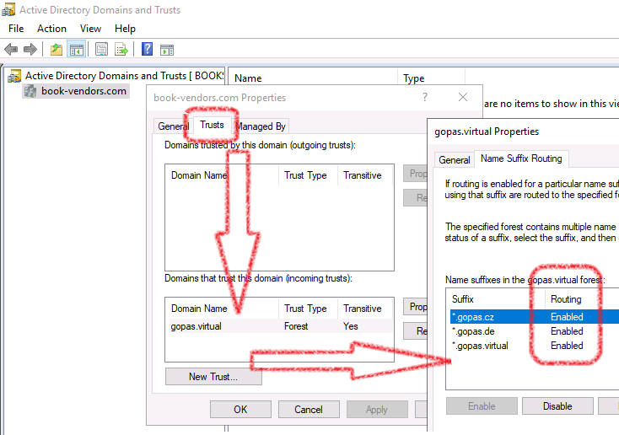
Name suffix routing

Slide 18
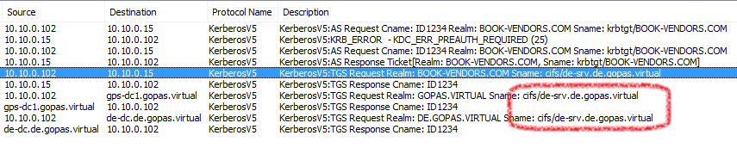
Trust TGT/TGS requests

Slide 19
Multi-hop

Slide 20
Delegation (double-hop)
Client
Server
Back-end
Server
DC
DC
DC

Slide 21
Access under service account
svc-Server
Client
Server
Back-end
Server
Kamil
svc-Server
DC
DC
DC

Slide 22
Access under the front-end client user account
svc-Server
Client
Server
Back-end
Server
Kamil
Kamil
DC
DC
DC

Slide 23
Nothing to forward with NTLM pass-through
svc-Server
Client
Server
Back-end
Server
NTLM
anonymous
DC
DC
DC

Slide 24
Kerberos TGS tickets required
svc-Server
Client
Server
Back-end
Server
Kamil
Kamil
TGS
Kamil
Server
TGS
Kamil
BackEnd
DC
DC
DC

Slide 25
Basic delegation
LSASS
password
Client
password
Server
Back-end
Server
Kerberos
NTLM
DC
DC
DC

Slide 26
Basic delegation
LSASS
password
Client
password
Server
Back-end
Server
Kerberos
normal TGT
Kamil encrypted
TGS:Kamil:BackEnd
DC
DC
DC

Slide 27
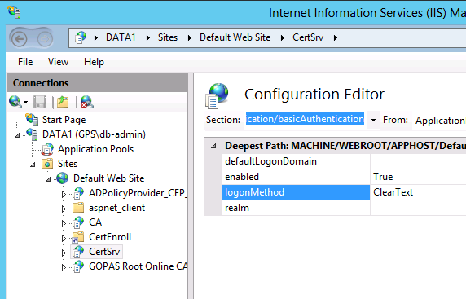
Side note: even basic delegation may sometimes not work Verify the ClearText value of logonMethod is enabled

Slide 28
RDP requires basic delegation
RDP is basic authentication
Kerberos is used only to verify server's identity and not the client identity
normal full TGT generated on RDP server
Problems
Users – must type password on each connect or store password
Admins – clean password transported and stored in memory

Slide 29
RDP RestrictedAdmin mode
Kerberos TGS authentication of client only
No full password transferred
Limited delegation with system tickets injected
mstsc /restrictedAdmin
HKLM\System\CurrentControlSet\Control\Lsa
DisableRestrictedAdmin = 0
DisableRestrictedAdminOutboundCreds = 1

Slide 30
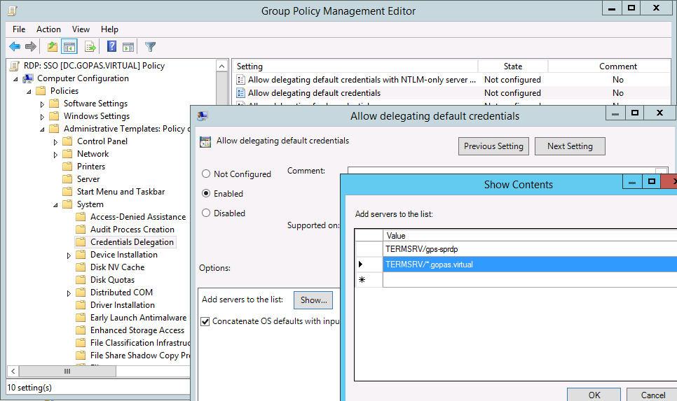
RDP SSO with Credentials Delegation settings for the client side

Slide 31
RDP SSO challenges on client?
Hacked MSTSC?
Hacked IE?
Client
RDP
Server
DC
DC

Slide 32
Credentials Delegation (CredSSP) security LSASS to LSASS encrypted transport
LSASS
LSASS
full-text pwd
TGS
Session Key
TGS
Session Key
RDP TLS
TCP 3389
TGS
Session Key
full-text pwd
full-text pwd
TERMSRV TGS
Client
Server
In-band transport
MSTSC
RDP Srv
Kerberos
TGT, TGS, ...
DC
LSASS
AD

Slide 33
RemoteGuard for business users (10/2016+)
LSASS
LSASS
NTLM #
Kerberos TGT required
RDP TLS
TCP 3389
tickets
Client
RDP Server
MSTSC
RDP Srv
TGS
TGS
DC
LSASS
LSASS
AD
AD

Slide 34
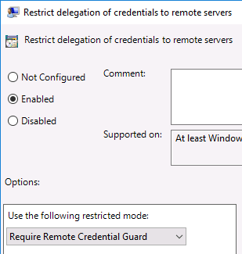
RemoteGuard for business users

Slide 35
Secure RDP usage
user business access to application terminal
must double-hop
RDP SSO
Windows 10/2016+ /remoteGuard (GPO)
admin access to insecure machines
must not double-hop
Windows 7/2008R2+ /restrictedAdmin
Enter-PSSession

Slide 36
Kerberos unconstrained delegation

Slide 37
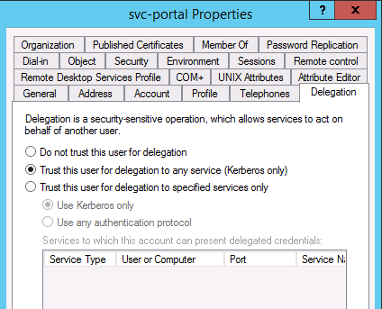
Trust this user/computer for delegation to any service (Kerberos only)
userAccountControl flag
ADS_UF_TRUSTED_FOR_DELEGATION = 524288 = 0x80000

Slide 38
Kerberos unconstrained delegation (DFL 2000+)
LSASS
TGS
F:TGT
Client
F:TGT
Server
Back-end
Server
Kerberos
DC
DC
DC

Slide 39
Kerberos unconstrained delegation (DFL 2000+)
LSASS
TGS
F:TGT
Client
F:TGT
Server
Back-end
Server
TGS:Kamil:BackEnd
F:TGT encrypted
TGS:Kamil:BackEnd
DC
DC
DC

Slide 40
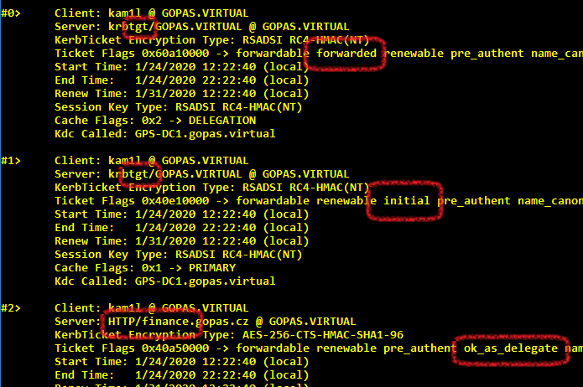
Unconstrained delegation allowed on TGS ticket and the F:TGT

Slide 41
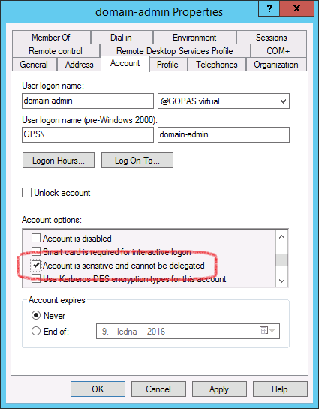
Account is sensitive and cannot be delegated
Always protect all administrative accounts
userAccountControl flag ADS_UF_NOT_DELEGATED = 1048576 = 0x100000
Protected Users
blocks delegation since DFL 2012 R2

Slide 42
Unconstrained delegation for user accounts from different forests
disabled by default since DC 2016+
enable on the trust manually on both sides
netdom.exe trust <localDomain> /domain:<remoteDomain> /EnableTGTDelegation:Yes

Slide 43
Unconstrained delegation with Chrome and Edge (Chromium)
HKEY_LOCAL_MACHINE\SOFTWARE\Policies\Google\Chrome
AuthNegotiateDelegateWhitelist = REG_SZ
comma separated URLs, wildcards allowed
HKEY_LOCAL_MACHINE\Software\Policies\Microsoft\Edge
AuthNegotiateDelegateAllowlist = REG_SZ
comma separated URLs, wildcards allowed
AuthNegotiateDelegateAllowlist case sensitive

Slide 44
Unconstrained delegation with FireFox
about:config
# NEGO (Kerberos) at all
network.negotiate-auth.trusted-uris
gopas.cz,gopas.virtual,canteen
# forward F:TGT to URIs
network.negotiate-auth.delegation-uris
gopas.cz,gopas.virtual,canteen

Slide 45
Double-hop security compared
Delegation form | Notes
basic delegation | no SSO must type on insecure client steal password on client (user) steal password on server SSO injection
RDP SSO CredSSP credential delegation | SSO password kept in LSASS memory steal password on client (admin) steal password on server SSO injection
RDP RemoteGuard | SSO TGT only connected to server steal TGT on client (admin) SSO injection
Kerberos unconstrained delegation | SSO TGT forwarded to server steal TGT on client (admin) steal TGT on server SSO injection block on accounts (Protected Users)

Slide 46
Kerberos constrained delegation

Slide 47
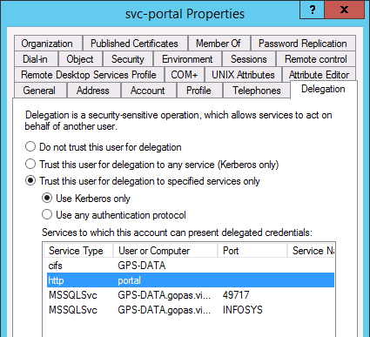
Trust this user/computer for delegation to specified services only (use Kerberos only)
msDS-AllowedToDelegateTo attribute

Slide 48
Kerberos constrained delegation (DFL 2003+)
LSASS
TGS:Kamil:Server
Client
TGS:Kamil:Server
Server
Back-end
Server
Kerberos
DC
DC
DC

Slide 49
Kerberos constrained delegation (DFL 2003+)
LSASS
TGS:Kamil:Server
Client
TGS:Kamil:Server
Server
Back-end
Server
TGS:Kamil:BackEnd
S4U
TGS:Kamil:Server
Server encrypted
TGS:Kamil:BackEnd
DC
DC
DC

Slide 50
Constrained delegation requirements
Server account must read tokenGroupsGlobalAndUniversal attribute
Windows Authorization Access Group (WAAG)
Client user account must not have delegation prohibited userAccountControl attribute
ADS_UF_NOT_DELEGATED = 1048576 = 0x100000
If using IIS Kernel Mode Authentication + AD user account
must enable useAppPoolCredentials

Slide 51
Best practice hints for Kerberos constrained delegation
Full restart of the Server always
Static TCP port for SQL servers
With DFL 2003 explicitly disable AES for the Server
Protect sensitive accounts against being delegated

Slide 52
Constrained delegation to SMB server account
front-end SPN on user/gmsa account
no domain/gmsa account
no domain/gmsa account + Kernel Mode + UseAppPoolCredentials
front-end SPN on computer account
ok domain/gmsa account + Kernel Mode
since 2012+
ok ApplicationPoolIdentity
since 2012+
ok Network Service
since 2012+
ok SYSTEM
since ever

Slide 53
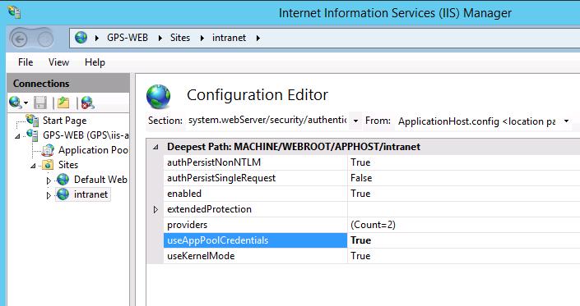
Delegation in IIS with Kernel mode authentication and useAppPoolCredentials
system/webServer/security/authentication/windowsAuthentication

Slide 54
useKernelMode only
user-mode LSASS
w3wp
gps\iis-finance
w3wp
gps\iis-orders
w3wp
gps\iis-canteen
gps\iis-canteen
NT AUTHORITY\System
TGS, session key
TGS session key
TGS, session key
TGS, session key
TGS, session key
HTTP.SYS
access token
HTTP Request

Slide 55
useKernelMode + useAppPoolCredentials
user-mode LSASS
w3wp
gps\iis-finance
w3wp
gps\iis-orders
w3wp
gps\iis-canteen
gps\iis-canteen
TGS, session key
TGS session key
TGS, session key
TGS, session key
TGS, session key
NT AUTHORITY\System
HTTP.SYS
access token
HTTP Request

Slide 56
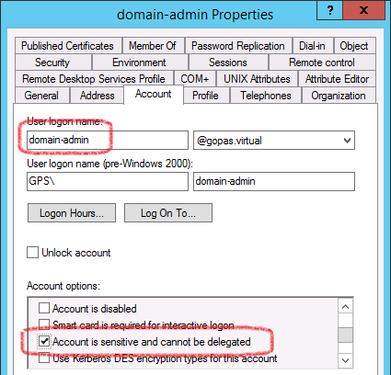
Account is sensitive and cannot be delegated
userAccountControl flag
ADS_UF_NOT_DELEGATED = 1048576 = 0x100000
Protected Users group blocks delegation only since 2012 R2 DFL

Slide 57
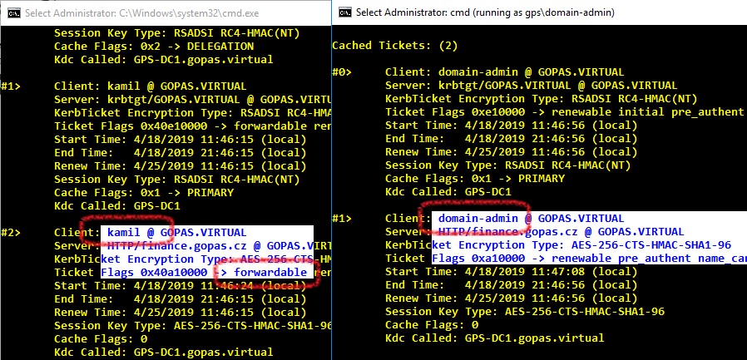
Delegation disabled on sensitive accounts

Slide 58
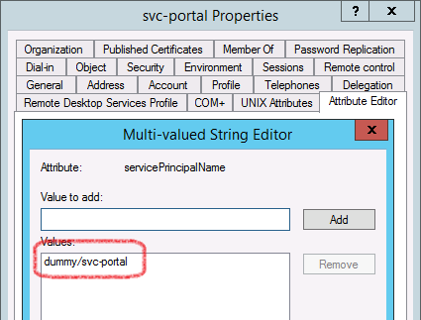
The delegation tab is not visible unless there is at least one SPN of any kind

Slide 59
Kerberos constrained delegation with protocol transition

Slide 60
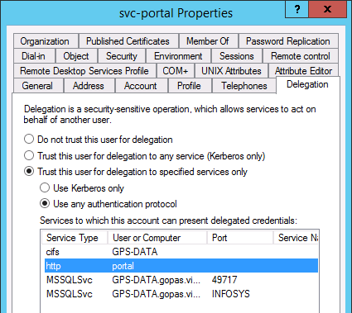
Trust this user/computer for delegation to specifies services only (use any authentication protocol)
msDS-AllowedToDelegateTo attribute
+
userAccountControl flag ADS_UF_TRUSTED_FOR_DELEGATION = 524288 = 0x80000

Slide 61
Kerberos protocol transition (DFL 2003+)
LSASS
nothing
Client
anything
Server
Back-end
Server
NTLM
Kerberos
retina
questions
certificate
DC
DC

Slide 62
Kerberos protocol transition (DFL 2003+)
LSASS
nothing
Client
anything
Server
Back-end
Server
NTLM
TGS:Kamil:BackEnd
retina
questions
Server encrypted
certificate
nothing
TGS:Kamil:BackEnd
DC
DC

Slide 63
Protocol transition to SMB server account
front-end SPN on user/gmsa account
no domain/gmsa account
no domain/gmsa account + Kernel Mode + UseAppPoolCredentials
front-end SPN on computer account
ok domain/gmsa account + Kernel Mode
ok ApplicationPoolIdentity
ok Network Service
ok SYSTEM

Slide 64
Protocol transition requirements
Server must have user right Act as part of operating system (SetTcbPrivilege)
Server must have the Impersonate client after authentication (SeImpersonatePrivilege) user right
C2WTS additional requirements
C2WTS must have the Create global objects (SeCreateGlobalPrivilege) user right
C2WTS must be running under SYSTEM or member of local Administrators group
Server then does not need the SeTcbPrivilege and does not neet to be member of Administrators

Slide 65
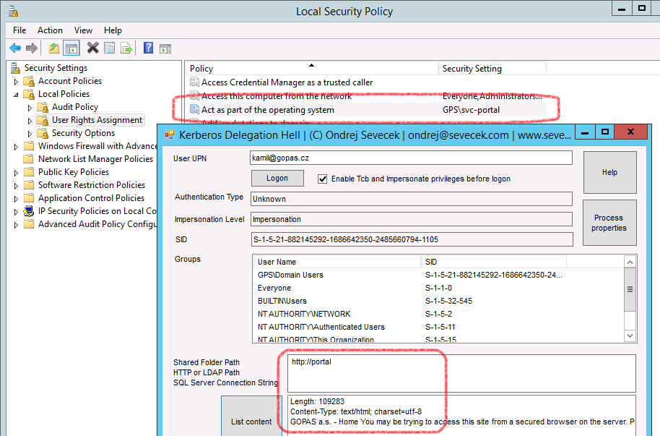
Security implications of protocol transition (use any authentication protocol)

Slide 66
KerbHell note on access to SMB
running under service account (non SYSTEM)
SYSTEM needs to be able to delegate there as well otherwise only SQL and HTTP works

Slide 67
WAP access to Kerberos web servers with protocol transition

Slide 68
SharePoint Excel Services external data access with Kerberos constrained delegation with protocol transition

Slide 69
Basic SharePoint authentication infrastructure
ConentDB
sp-portal-web
service TGS
WFE1
gps\kamil
http/portal
sp-portal-web
gps\julie
WFE2
http/portal

Slide 70
Excel services without external data access
ConentDB
sp-portal-web
service TGS
WFE1
gps\kamil
http/portal
gps\kamil
sp-portal-web
XML Claims
sp-portal-excel
gps\julie
WFE2
WBE1
WBE1
http/portal
WBE1

Slide 71
Requested Kerberos protocol transition
ConentDB
GPS-DATA\HRAGENDA
AdventureWorks
sp-portal-web
service TGS
WFE1
gps\julie
gps\kamil
http/portal
mssqlsvc/gps-data:hragenda
gps\julie
sp-portal-web
XML Claims
sp-portal-excel
gps\julie
WFE2
WBE1
WBE1
http/portal
WBE1

Slide 72
Requested Kerberos protocol transition
ConentDB
GPS-DATA\HRAGENDA
AdventureWorks
sp-portal-web
service TGS
WFE1
gps\julie
gps\kamil
http/portal
mssqlsvc/gps-data:hragenda
gps\julie
non-Admins
sp-portal-web
XML Claims
sp-portal-excel
gps\julie
WFE2
WBE1
WBE1
http/portal
WBE1

Slide 73
Excel Services web service must not be member of Administrators we need Claims to Windows token service (C2WTS)
ConentDB
GPS-DATA\HRAGENDA
AdventureWorks
sp-portal-web
service TGS
WFE1
gps\julie
gps\kamil
http/portal
mssqlsvc/gps-data:hragenda
gps\julie
non-Admins
sp-portal-web
XML Claims
sp-portal-excel
gps\julie
WFE2
WBE1
WBE1
http/portal
WBE1
sp-portal-claims
any/some
Administrators

Slide 74
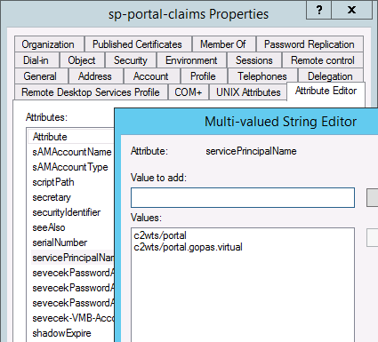
Claims to Windows Token Service (C2WTS) - service account
dummy SPN

Slide 75
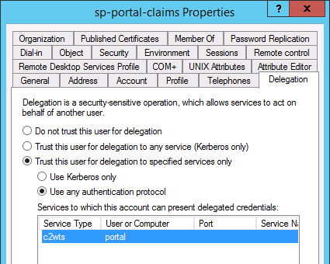
Claims to Windows Token Service (C2WTS) - service account
Protocol transition to itself only

Slide 76
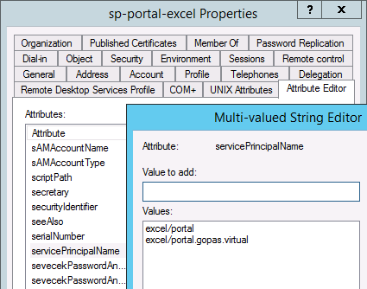
Excel Services, Performance Point Services, Reporting Services - service account
Dummy SPN

Slide 77
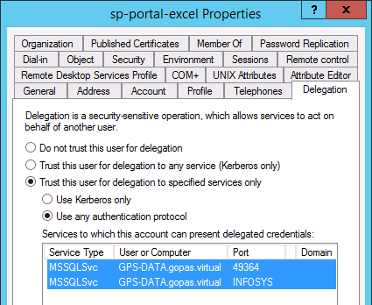
Excel Services, Performance Point Services, Reporting Services - service account
Protocol transition to data sources

Slide 78
Cross-domain Kerberos delegation

Slide 79
Unconstrained delegation works even cross-forest (if enabled on trusts)
netdom trust /EnableTGTDelegation:Yes
yellow.forest
client
F:TGT
Front
End
green.forest
DC
TGS
krbtgt/green.domain
Back End
DC
TGS
backend

Slide 80
Constrained delegation does not work to other domains
yellow.domain
TGS
frontend
client
Front End
green.domain
DC
allowed
spn/backend.green.domain
Back End
DC
TGS
backend

Slide 81
Protocol transition works since 2012+ (aka Resource Based Kerberos Delegation) in a single forest
do not define the spn/backend on FrontEnd account or you get KDC_ERR_POLICY
use msDS-AllowedToActOnBehalfOfAnotherIdentity (PrincipalsAllowedToDelegeteToAccount) on BackEnd account
yellow.domain
client
nothing
Front End
green.domain
TGS
krbtgt/green.domain
allowed
FrontEnd SID
DC
Service Asserted Identity SID
Back End
TGS
backend
DC

