Slide 1
TLS Client Certificate and Smart Card Logon
Ing. Ondřej Ševeček | GOPAS a.s. |
MCSM:Directory2012 | MCM:Directory2008 | MVP:Enterprise Security | CEH: Certified Ethical Hacker | CHFI: Computer Hacking Forensic Investigator | CISA |
ondrej@sevecek.com | www.sevecek.com |
GOPAS: info@gopas.cz | www.gopas.cz | www.facebook.com/P.S.GOPAS

Slide 2
Motivation
Limit use of plaint-text passwords
hardware keyloggers
password sharing
remote access
long time access
Work towards Kerberos
AES encryption
more secure delegation
Kerberos tickets faster expiration (down to 1 hour)
Limit NTLM and pass-the-XXX attacks
nothing else can help you absolutely than best practices
or LSASS credentials in Virtual Server Protection (VSP) in Windows 10

Slide 3
Two certificate authentications
Interactive Kerberos PKINIT logon
produce Kerberos TGT with certificate private key pre-authentication
TLS client certificate authentication (SChannel)
HTTPS, LDAPS, RADIUS EAP/PEAP
web, SSTP, RD Gateway, ADFS, WAP, VPN, WiFi, ...

Slide 4
SChannel TLS client certificate authentication
LSASS
LSASS
TLS Server
Certificate
HTTPS
Client
Certificate
S/C or software
RADIUS
Client
Server
TLS client certificate authentication
IE
Outlook
WebSrv
MSTSC
RADIUS
Secure Channel
SMB SAM pipe
DCOM Netlogon
DC
Certificate
DC
LSASS
AD

Slide 5
Kerberos PKINIT
LSASS
LSASS
HTTP, SMB, DCOM
Client
Certificate
S/C only
Client
Server
In-band transport
normal TGS
IE
normal TGS
Outlook
SmbSrv
Explorer
WebSrv
AnySrv
SqlSrv
ExSrv
Generate TGT
DC
Certificate
DC1
LSASS
AD

Slide 6
Technical requirements
PKI
CAs
DC certificates
user logon certificates

Slide 7
CA requirements
Trusted root CA
NTAuth trusted issuing CA
enterprise (AD integrated) ADCS CAs by default
CN=NTAuthCertificates,CN=Public Key Services,CN=Services,CN=Configuration,DC=x
HKLM\Software\Microsoft\EnterpriseCertificates\NTAuth\Certificates
#thumbprint#
certutil -enterprise -addstore ntauth issuingCA.cer
CRL valid (OCSP)
up-to-date, available, ideally anonymous HTTP

Slide 8
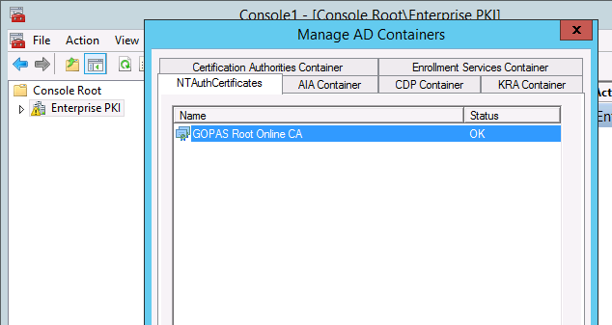
Verify NTAuth CAs for a forest using Enteprise PKI console

Slide 9
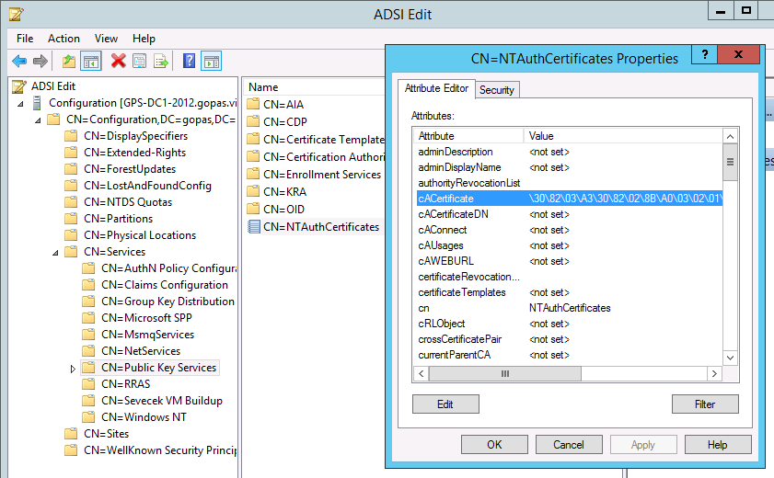
NTAuthCertificates object (CN=Public Key Services,CN=Services,CN=Configuration)

Slide 10
DC certificate requirements (2003+)
EKU (default template Kerberos Authentication)
Server Authentication
Client Authentication
Smart Card Logon
Kerberos Authentication
SAN
DNS domain name
NetBIOS domain name
CRL valid (or OCSP)
up-to-date, available, ideally anonymous HTTP
from client's perspective
certutil -urlfetch -verify
certutil -url

Slide 11
Client certificate requirements
Stored in smart card in case of Kerberos PKINIT
EKU = Smart Card Logon
Stored in S/C or software provider in case of TLS client certificate logon
EKU = Client Authentication
SAN
user principal name (UPN) or dNSHostName
manually mapped SAN or subject
CRL valid (or OCSP)
up-to-date, available, ideally anonymous HTTP
from DC's perspective
certutil -urlfetch -verify
certutil -url

Slide 12
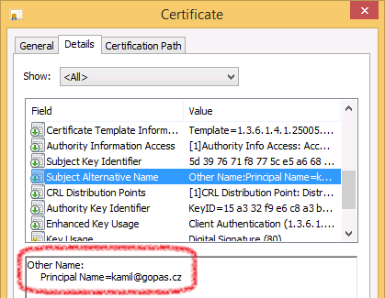
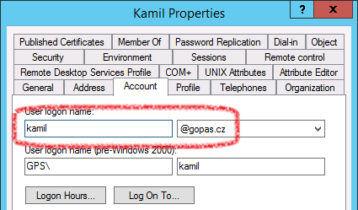
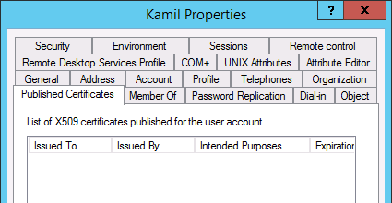
Client certificate SAN vs. Published Certificates on domain user account

Slide 13
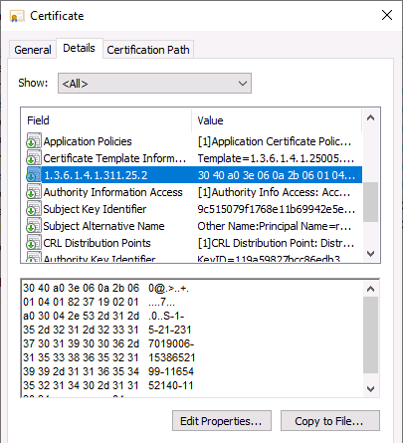
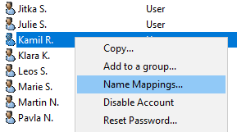
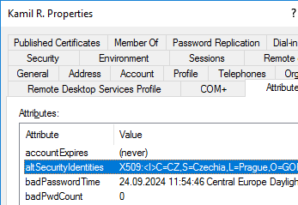
Since May 2023 a SID extension 1.3.6.1.4.1.311.25.2 enforced in logon certificates by the DCs
a) find the account by UPN login
b) verify SID to match
or
c) strong-map certificates to user accounts (altSecurityIdentities)

Slide 14
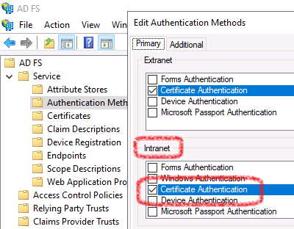
ADFS certificate authentication
https://adfs.gopas.cz/adfs/LS/IdpInitiatedSignOn

Slide 15
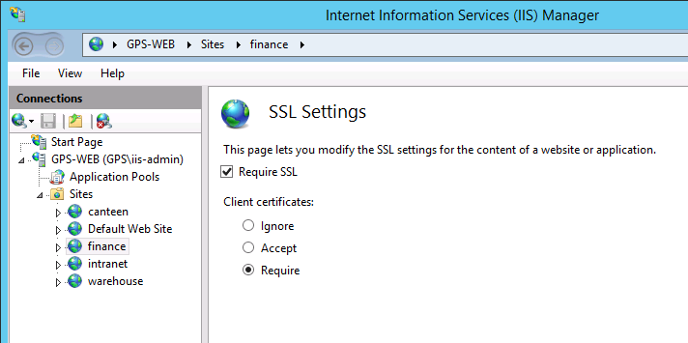
IIS TLS client certificate authentication #1 Enforce TLS and require client certificates

Slide 16
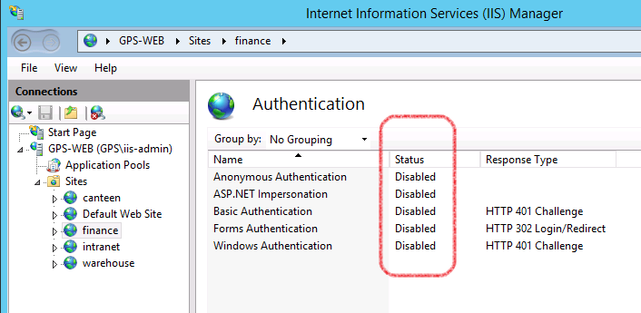
IIS TLS client certificate authentication #2 Disable all HTTP authentication methods

Slide 17
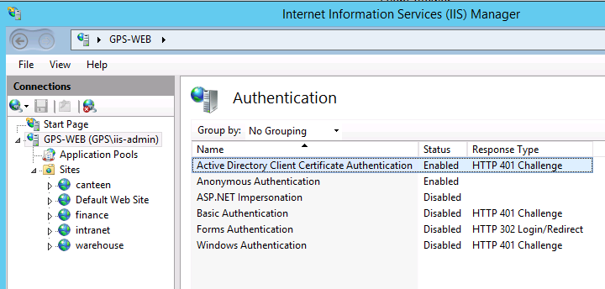
IIS TLS client certificate authentication #3 Install Active Directory Client Certificate Authentication Enable AD mapper server-wide

Slide 18
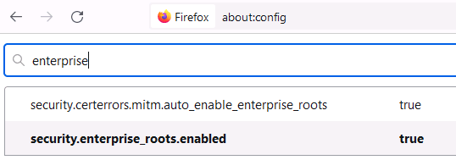
Firefox does not see Windows certificates by default
about:config
security.enterprise_roots_enabled

Slide 19
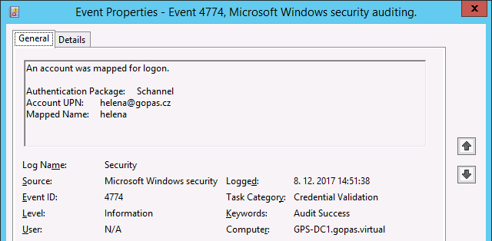
SChannel authentication events on DCs

Slide 20
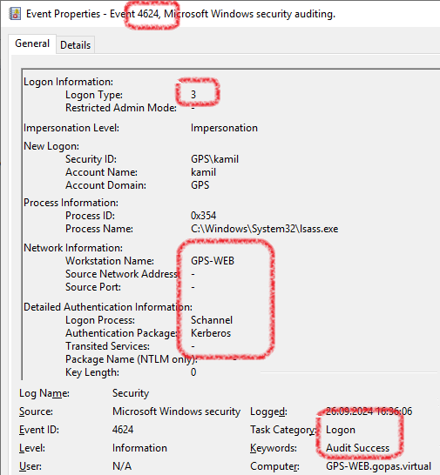
SChannel logon events on resource servers

Slide 21
Hardware requirements
Smart card + reader
Smart card in a reader = token
USB, PCMCIA
TPM on motherboard
Smart card is not a USB flash drive
crypto CPU separate from OS
performs crypto-operations under PIN protection
crypto-memory cannot be "just read"

Slide 22
Hardware drivers
"bus" drivers for reader
crypto-provider for the chip
Cryptographic Services Provider (CSP)
mini-driver DLL for Base Smart Card CSP or Smart Card KSP
certutil -csplist
certutil -scinfo

Slide 23
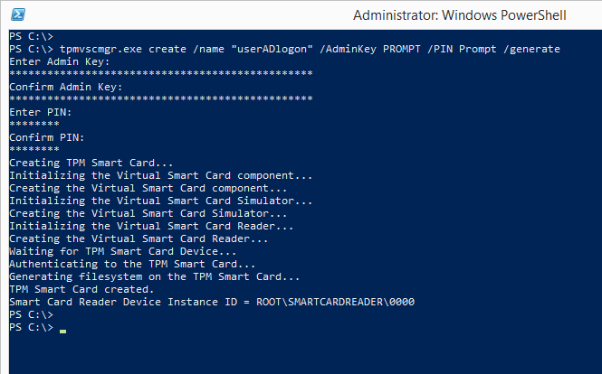
TPM virtual smart-card

Slide 24
Smart card logon (PKINIT)
Client
Client Private key
Client Certificate
UPN
Timestamp
Client Public key
DC’s private key
DC Certificate
TGT
TGT
DC

Slide 25
NTLM credentials in PAC
Client
Client Private key
Client Certificate
UPN
Timestamp
Client Public key
DC’s private key
DC Certificate
TGT
DC
User’s Password hash
NTLM

Slide 26
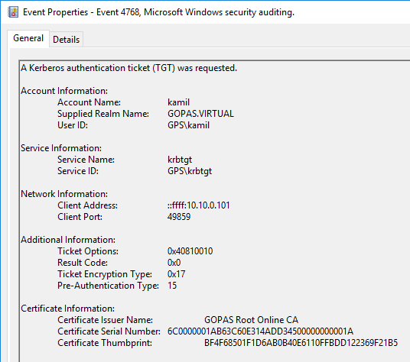
Auditing

Slide 27
Require S/C for interactive logon
Interactive logon only
pre-authentication generate TGT
Per user account in AD
userAccountControl = 262144 (0x40000)
GUI randomizes password
Per computer by GPO
all users on the computer

Slide 28
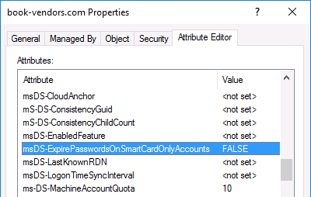
Expired passwords prevent S/C logon as well 2016+ msDS-ExpirePasswordsOnSmartCardOnlyAccounts

Slide 29
S/C removal behavior
Log-off
Lock-out and/or RDP disconnect
Smart Card Removal Policy service must be enabled
GPO

