Slide 1
Modern Kerberos topics
Ing. Ondřej Ševeček | GOPAS a.s. |
MCSM:Directory2012 | MCM:Directory2008 | MVP:Enterprise Security | CEH: Certified Ethical Hacker | CHFI: Computer Hacking Forensic Investigator | CISA |
ondrej@sevecek.com | www.sevecek.com |
GOPAS: info@gopas.cz | www.gopas.cz | www.facebook.com/P.S.GOPAS

Slide 2
Persistent-Auth HTTP response header
setting | behavior
authPersistSingleRequest: true authPersistNonNTLM: true | NTLM: Persistent-Auth: false, 2x401 on every request Kerberos: Persistent-Auth: false, 401 on every request
authPersistSingleRequest: false (default) authPersistNonNTLM: true (default) | NTLM: Persistent-Auth: true Kerberos: Persistent-Auth: true
authPersistSingleRequest: false authPersistNonNTLM: false | NTLM: Persistent-Auth: true Kerberos: Persistent-Auth: false, 401 on every request
Note: IE does not follow the Persistent-Auth header and sends AP-REQ (TGS) on every request with Kerberos

Slide 3
Hash propagation in mixed environments
password
MD4
DC 2003
MD4
SHA-1
MD4
DC 2025
MD4
SHA-1
MD4
DC 2022
password
MD4
SHA-1

Slide 4
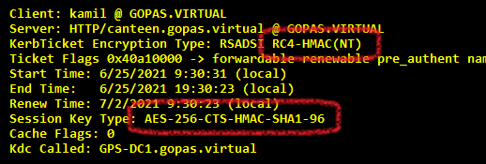
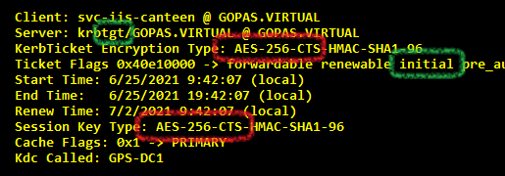
DFL 2008+ mixed algorithm tickets with MD4 password only with msDS-SupportedEncryptionTypes = AES+RC4

Slide 5
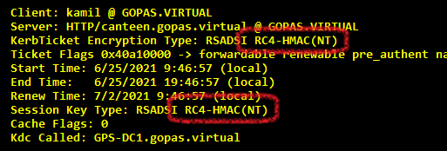
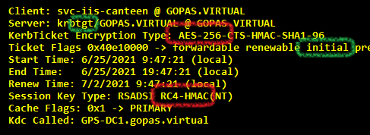
DFL 2008+ mixed algorithm tickets with MD4 password only with msDS-SupportedEncryptionTypes = RC4

Slide 6
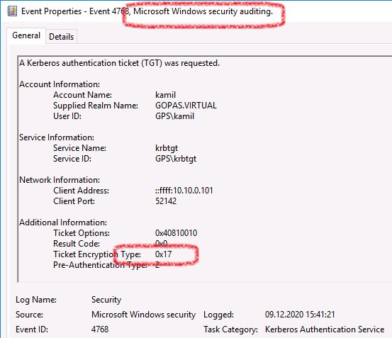
Audit RC4 etype usage
0x01 = DES-CRC
0x03 = DES-CBC
0x17 = RC4
0x11 = AES128-SHA1
0x12 = AES256-SHA1
0xFFFFFFFF = failure

Slide 7
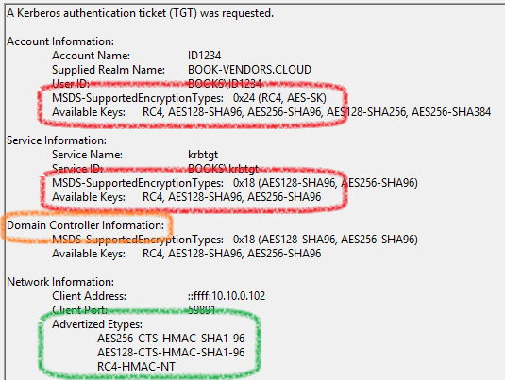
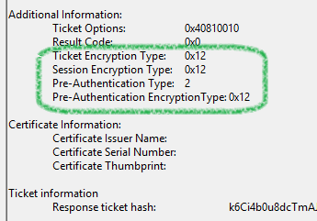
2025-jan update 2016/2019/2022/2025

Slide 8
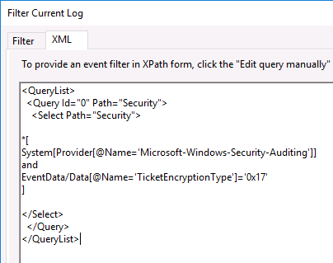
Audit RC4 etype usage
EventData/Data[@Name='TicketEncryptionType'] = 23
EventData/Data[@Name='TicketEncryptionType'] = '0x17'
not: != '0x17'

Slide 9
Get all TGS tickets possible
Get-ADObject -LDAPFilter '(servicePrincipalName=*)' -Server localhost:3268 `
-Properties servicePrincipalName |
select -Expand servicePrincipalName |
% { klist get $_ } > c:\temp\all-tgs-tickets.txt

Slide 10
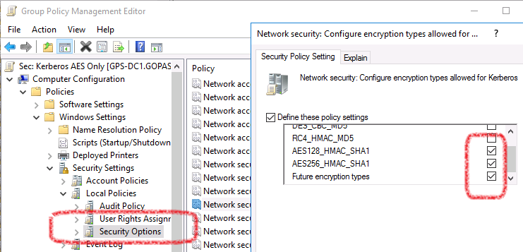
Require (enforce) AES on DCs
everything is AES without any compatibility in mind
as against the same on clients/servers which would just stop accepting RC4 and fail
define explicit contra-policy in order to revert back

Slide 11
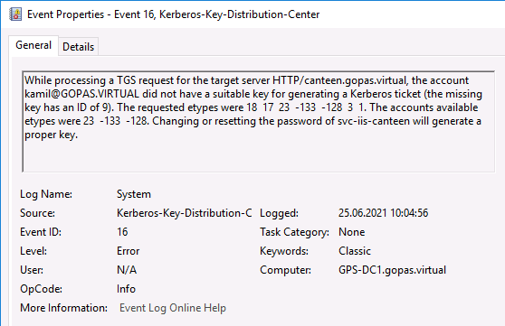
ETYPE_NOTSUPP (0xE)

Slide 12
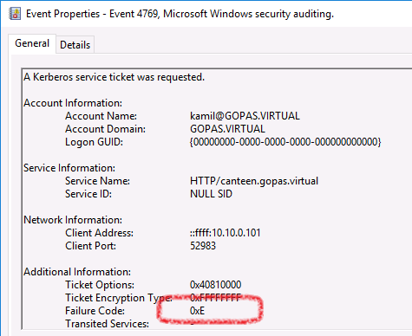
ETYPE_NOTSUPP (0xE)

Slide 13
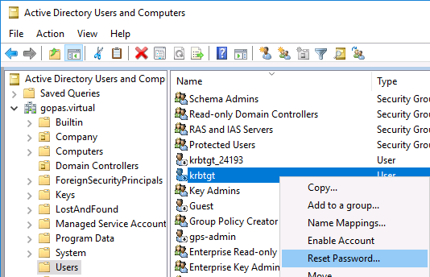
Always reset KRBTGT account on 2008+

Slide 14
How to do it safely - disable RC4 usage carefully
all passwords have been changed/reset 2x
on a 2008+ DC
everything seems to be AES
events
klist get
prepare RC4 disabled policy
for OU=Domain Controllers only
prepare RC4 enabled contra policy
for OU=Domain Controllers only
reset krbtgt account
replicate domain
wait 8 days
reset krbtgt account again
replicate domain again
remove yourself from Protected Users
full logoff/logon 2x
enable RC4 disabled policy
gpupdate
Restart-Service kdc
runas
klist get ...
full restart some other DC and try logging on

Slide 15
Protected Users group
Windows 8.1 and Windows 2012 R2
some local enforcement
no cache, no local NTLM credentials, no credential delegation, TGT renewal only
no client cache for remote service TGS tickets which are themselves members of Protected Users
DFL 2012 R2
no RC4/DES TGT tickets (TGS still possible)
no Kerberos delegation
4 hour TGT lifetime
no Kerberos TGT renewal
no NTLM authentication by DCs

Slide 16
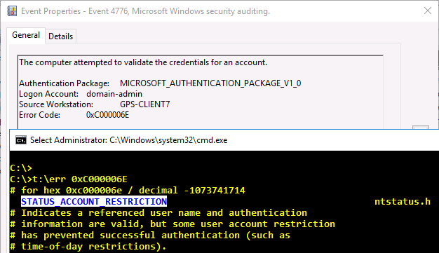
NTLM blocked by DCs (DFL 2012 R2+)

Slide 17
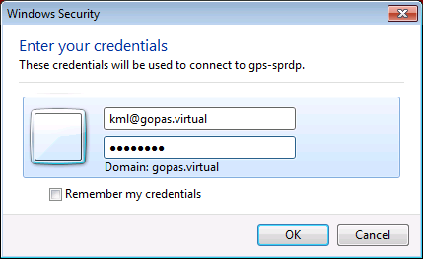
Kerberos from non-domain machines (2008/Vista+ client)
domain DNS (Kerberos realm): gopas.virtual
SAM: gps\kml
UPN: rychnovsky.kamil@gopas.cz
USE1: gopas.virtual\rychnovsky.kamil@gopas.cz
USE2: kml@gopas.virtual

Slide 18
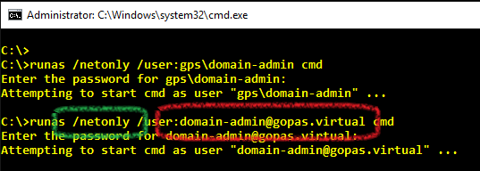
Kerberos for non-domain machines

Slide 19
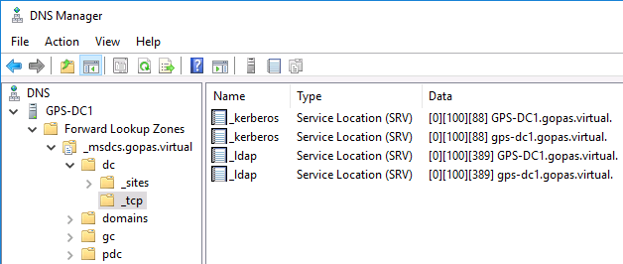
Kerberos from non-domain machines

Slide 20
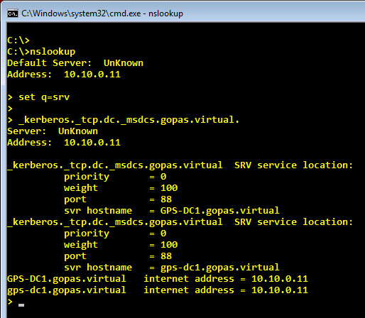
Kerberos from non-domain machines
nslookup
set q=srv
_kerberos. _tcp. dc. _msdcs. gopas.virtual
_ldap. _tcp. dc. _msdcs. gopas.virtual

Slide 21
Firewall ports for Kerberos (client -> DCs)
DNS UDP 53
DNS TCP 53
responses bigger than 512 B or DNSSES
LDAP UDP 389
LDAP ping to determine if a DC is online (600ms timeout)
Kerberos TCP 88
Kerberos TCP 464
change password

Slide 22
Refresh everything Kerberos
klist purge -li 3e4 # Network Service
klist purge -li 3e5 # Local Service
klist purge -li 3e7 # SYSTEM
klist purge
Clear-DnsClientCache # rather than ipconfig /flushdns
klist purge_bind
# on DCs after Kerberos/KDC policy changes
gpupdate
Restart-Service kdc
# on all after some Kerberos policy changes
shutdown /r /t 0 /f

Slide 23
Testing Kerberos even from non-domain or non-trusted forest machines
runas /netonly /user:wks-admin@gopas.virtual cmd
klist get host/anycomputer
# Note: use either err 0xC0000072 or err 0x533 see bellow

Slide 24
RDP with smart card logon from non-domain machines or different forest with NLA required on RDP server
must perform Kerberos PKINIT
no NTLM credentials
non-domain workgroup machines
root CA of the SC cert must be trusted
issuing CA of the SC cert does NOT need to be NTAuth
different forest machines
root CA of the SC cert must be trusted
issuing CA of the SC cert must be NTAuth in local registry
without NLA on RDP server no certificate requirements

Slide 25
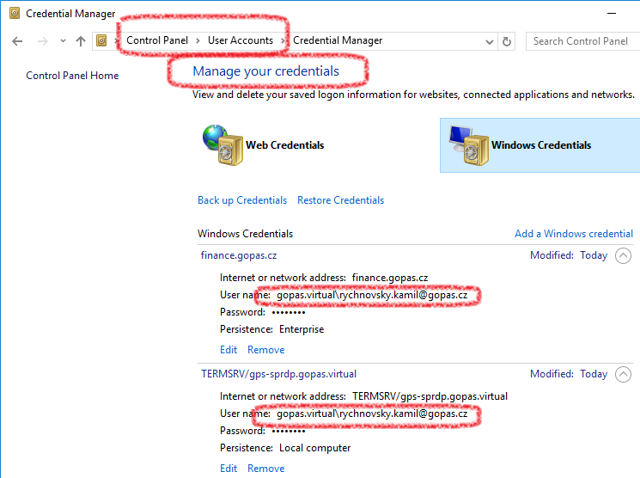

Slide 26
Temporary group membership (FFL 2016)
Enable-ADOptionalFeature 'Privileged Access Management Feature' -Scope Forest -Target book-vendors.com
Add-ADGroupMember Accounting -Member id1234 -MemberTimeToLive ([TimeSpan]::FromMinutes(40))
Get-ADGroup Accounting -Property Member -ShowMemberTimeToLive

Slide 27
Limiting pass-the-credentials attacks
Pass-the-password
never appears in memory
Pass-the-hash
block NTLM with GPO (7/2008 R2+)
and/or use Protected Users group (2012/8+)
sometimes reset the passwords
Pass-the-TGT
shorten ticket expiration
10 hours default, 1 hour tested by me in 5k machines, all MS products since Windows XP :-)
use Armoring since 2012/8

Slide 28
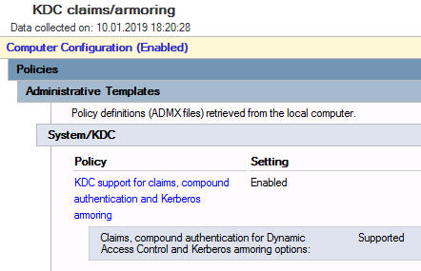
Armoring support for KDC with DFL 2012+

Slide 29
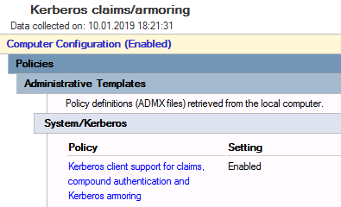
Armoring support for clients 8/2012+

Slide 30
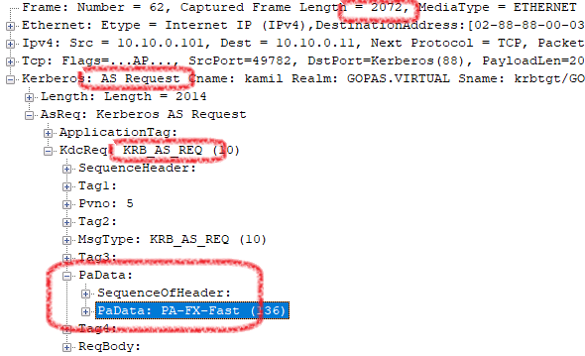
Kerberos AS request with FAST

Slide 31
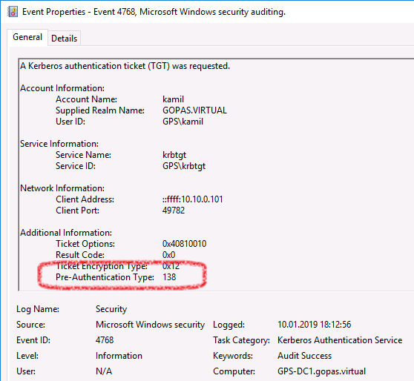
Armoring FAST

Slide 32
Pre-authentication types
password = 2
smart card (PKINIT) = 15
FAST(password) = 138
FAST(PKINIT) = 15 (yes, the same)

Slide 33

Authentication Policies (DFL 2012 R2+)
requires Kerberos armoring in place in order to limit TGT issuance
not necessary for TGS restrictions
msDS-AssignedAuthNPolicy msDS-AssignedAuthNPolicySilo
assigned directly from user/computer/gmsa account
cannot use groups
device rules require CompoundID (see later)

Slide 34
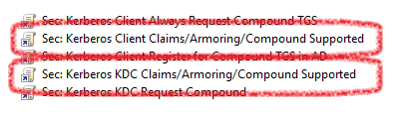
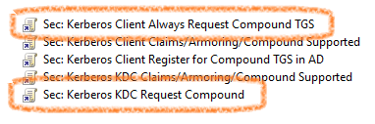
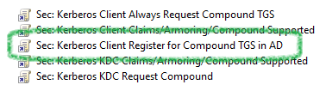
Different policies effects (details later)
TGT requests will be armored (FAST)
TGS requests will be compound
TGS tickets will be compound

Slide 35
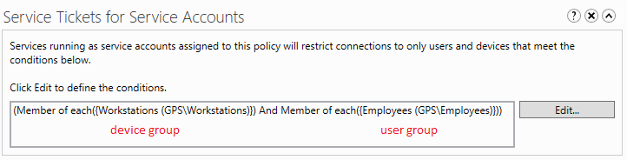
Device rules for TGS authentication policies (service tickets for user accounts, service tickets for service accounts)
TGS requests must come to KDC with compound ID directly from clients
not by default, only AS requests are compounded by default
enable 2 GPOs - see next slides
KDC must encourage clients to send TGS requests with compound ID
clients must be configured to use this functionality

Slide 36
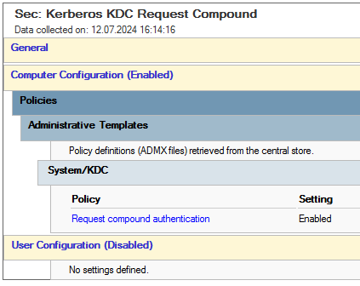
KDC's AS reply may contain flag for clients to encourage compound TGS requests
PA-FX-FAST in PADATA of AS reply from KDC
Request compound authentication

Slide 37
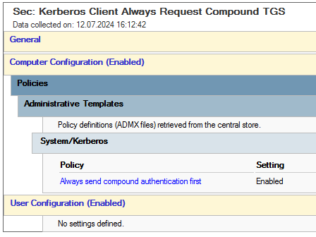
Every Client's TGS request will contain compound ID
PA-FX-FAST in PADATA of TGS requests from client to KDC
does not work without the previous setting encouraging clients to do it with a flag inside AS reply
Always send compound authentication first

Slide 38
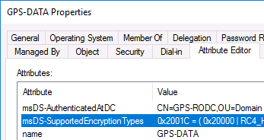
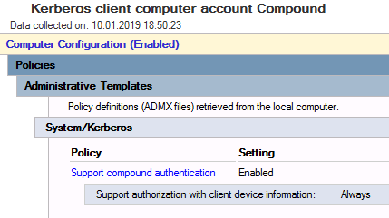
Compound authentication to servers must be enabled on target accounts (TGS)

Slide 39
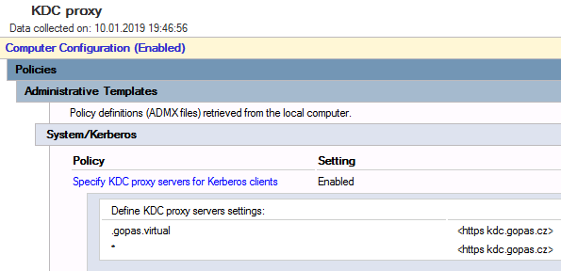
KDC proxy for Kerberos clients (8/2012+)
simple trusted HTTPS required on KDC Proxy
Windows Server 2012+
netsh http add urlacl https://+:443/KdcProxy "user=Network Service"
netsh http add sslcert ...

Slide 40
GOLD production forests and RED forest
gold1.forest
red.forest
one-way forest PIM trust
RED admin accounts
gold2.forest
admin
gold3.forest
GOLD1 admin accounts
GOLD2
admin accounts
GOLD3 admin accounts
servers
administration
business accounts
services
low-level privileged accounts

Slide 41
Shadow principals / groups
GOLD1 Domain Admins
GOLD1 Domain Admins
GOLD1 admin accounts
gold1.forest
red.forest
gold2.forest
GOLD2 Enterprise Admins
GOLD2
admin accounts
GOLD2 Enterprise Admins
gold3.forest
RED admin accounts
GOLD3 admin accounts
S-3-1
GOLD3
App Admins
S-3-1
GOLD3
Data Admins
GOLD3 App Admins
servers
business accounts
GOLD3
Data Admins
S-3-2
services
low-level privileged accounts
S-3-2

Slide 42
SIDs overview
built-in SIDs
S-1-1-0 Everyone
S-1-5-11 Authenticated Users
S-1-5-4 Interactive
S-1-5-2 Network
S-1-5-6 Service
S-1-5-18 SYSTEM
S-1-5-20 Network Service
S-1-5-32-544 Administrators (the group)
S-1-5-32-550 Print Operators
S-1-5-32-548 Account Operators
...
well-known SIDs (S-1-5-21-domain-domain-domain-5xx)
-500 Administrator (the user)
-512 Domain Admins
-519 Enterprise Admins
-513 Domain Users
-515 Domain Computers
-516 Domain Controllers
-520 Group Policy Creator Owners
...

Slide 43
Notes on SID filtering (external trust)
external outbound trust (default)
netdom trust gold.forest /domain:red.forest /add /oneSide:trusting '/passwordT:TPa$$w0rdT'
# trustedDomain.trustAttributes = 0x4 = QUARANTINED_DOMAIN
# trustedDomain.trustType = 0x2 = UPLEVEL
all SIDs except for those of the trusted domain filtered out always
external outbound trust (no quarantine)
netdom trust gold.forest /domain:red.forest /add /oneSide:trusting '/passwordT:TPa$$w0rdT'
netdom trust gold.forest /domain:red.forest /quarantine:no
# trustedDomain.trustAttributes = 0x0
# trustedDomain.trustType = 0x2 = UPLEVEL
built-in and well-known SIDs filtered out always
local forest SIDs allowed
any other SIDs allowed

Slide 44
Notes on SID filtering (forest trust)
forest outbound trust (default)
$forest = [System.DirectoryServices.ActiveDirectory.Forest]::GetCurrentForest()
$forest.CreateLocalSideOfTrustRelationship('red.forest', 'Outbound', 'TPa$$w0rdT')
# trustedDomain.trustAttributes = 0x8 = FOREST_TRANSITIVE
# trustedDomain.trustType = 0x2 = UPLEVEL
all SIDs except for those of the trusted forest filtered out always
forest outbound trust (no quarantine)
$forest = [System.DirectoryServices.ActiveDirectory.Forest]::GetCurrentForest()
$forest.CreateLocalSideOfTrustRelationship('red.forest', 'Outbound', 'TPa$$w0rdT')
netdom trust gold.forest /domain:red.forest /enableSIDhistory:yes
# trustedDomain.trustAttributes = 0x48 = FOREST_TRANSITIVE | TREAT_AS_EXTERNAL
# trustedDomain.trustType = 0x2 = UPLEVEL
built-in and well-known SIDs filtered out always
local forest SIDs allowed
any other SIDs allowed

Slide 45
PIM trusts and RED forests (FFL 2016)
Privileged Identity Management (PIM) by RED forest
unrestricted foreign identity SID injection into Kerberos tickets
shadow principals
shadow groups
SID history

Slide 46
PIM trust requirements on the GOLD forest
forest functional level (FFL) 2012 R2+
if ((Get-ADDomain -Identity gold.forest).DomainMode -lt 'Windows2012R2Domain') { Set-ADDomainMode -DomainMode Windows2012R2Domain -Identity gold.forest -Confirm:$false }
if ((Get-ADForest -Identity gold.forest).ForestMode -lt 'Windows2012R2Forest') { Set-ADForestMode -ForestMode Windows2012R2Forest -Identity gold.forest -Confirm:$false }
outbound trust only
$forest = [System.DirectoryServices.ActiveDirectory.Forest]::GetCurrentForest()
$forest.CreateLocalSideOfTrustRelationship('red.forest', 'Outbound', 'TPa$$w0rdT')
netdom trust gold.forest /domain:red.forest /enableSIDhistory:yes
netdom trust gold.forest /domain:red.forest /enablePIMtrust:yes
# trustedDomain.trustAttributes = 0x48 = FOREST_TRANSITIVE | TREAT_AS_EXTERNAL | PIM_TRUST
# trustedDomain.trustType = 0x2 = UPLEVEL
# trustedDomain.trustDirection = 0x2 = OUTBOUND
built-in SIDs filtered out always
other SIDs including well-known SIDs allowed

Slide 47
PIM trust requirements on the RED forest
forest functional level (FFL) 2016+
if ((Get-ADDomain -Identity red.forest).DomainMode -lt 'Windows2016Domain') { Set-ADDomainMode -DomainMode Windows2016Domain -Identity red.forest -Confirm:$false }
if ((Get-ADForest -Identity red.forest).ForestMode -lt 'Windows2016Forest') { Set-ADForestMode -ForestMode Windows2016Forest -Identity red.forest -Confirm:$false }
PAM feature enabled
Enable-ADOptionalFeature 'Privileged Access Management Feature' -Scope ForestOrConfigurationSet -Target red.forest -Confirm:$true
incoming forest trust only + name suffix routing
[Collections.ArrayList] $routing = @()
[string[]] $allNames = 'gold.forest' | % { Get-ADForest $_ } | % { @() + $_.SPNSuffixes + $_.UPNSuffixes + $_.Domains } | select -Unique | ? { $_ -like '?*' } | % { $_.ToLower() } | sort Length
$allNames | % { $oneName = $_ ; [void] $routing.Add($oneName); $allNames | ? { $oneName -like ('*.{0}' -f $_) } | % { [void] $routing.Remove($oneName) } }
$routing | % { netdom trust red.forest /domain:gold.forest /addTLN:$_ }
# trustedDomain.trustAttributes = 0x8 = FOREST_TRANSITIVE
# trustedDomain.trustType = 0x2 = UPLEVEL
# trustedDomain.trustDirection = 0x2 = INBOUND
enable AES on the trust (not necessary if Protected Users group used)
no command line tool, undocumented Win32 LSASS API only

Slide 48
Shadow principals on the RED forest
function global:New-ADShadowPrincipal ([string] $goldDomain, [string] $goldPrincipalSAM, [string] $mapToRedPrincipalSAM)
{
$errorActionPreferenceBackup = $global:errorActionPreference
try { $global:errorActionPreference = 'Stop'
$redRootDSE = [ADSI] 'LDAP://RootDSE'
$redConfigDN = $rootDSE.configurationNamingContext.Value
$redPrincipalsDN = 'CN=Shadow Principal Configuration,CN=Services,{0}' -f $redConfigDN
Write-Host ('Open the shadow principals container: {0}' -f $redPrincipalsDN)
$redPrincipalsDE = [ADSI] ('LDAP://{0}' -f $redPrincipalsDN)
$redPrincipalsDN = $redPrincipalsDE.Properties['distinguishedName'].Item(0)
Write-Host ('Connect to the GOLD domain: {0}' -f $goldDomain)
$goldRootDSE = [ADSI] ('LDAP://{0}/RootDSE' -f $goldDomain)
$goldDomainDN = $goldRootDSE.defaultNamingContext.Value
Write-Host ('Prepare search for GOLD principal in the GOLD domain: {0} | {1}' -f $goldDomainDN, $goldPrincipalSAM)
$goldSearcher = [ADSISearcher] ('(sAMAccountName={0})' -f $goldPrincipalSAM)
$goldSearcher.SearchRoot = ([ADSI] ('LDAP://{0}' -f $goldDomainDN))
$goldSearcher.SearchScope = 'Subtree'
$goldSearcher.PropertiesToLoad.AddRange(('distinguishedname', 'samaccountname', 'objectsid'))
Write-Host ('Find the GOLD principal in the GOLD domain: {0} | {1}' -f $goldDomainDN, $goldSearcher.Filter)
$goldPrincipalFound = $goldSearcher.FindOne()
[string] $goldPrincipalSAM = $goldPrincipalFound.Properties['sAMAccountName'].Item(0)
[string] $goldPrincipalDN = $goldPrincipalFound.Properties['distinguishedName'].Item(0)
[byte[]] $goldPrincipalSIDBIN = $goldPrincipalFound.Properties['objectSID'].Item(0)
[string] $goldPrincipalSID = (New-Object System.Security.Principal.SecurityIdentifier $goldPrincipalSIDBIN, 0).Value
Write-Host ('GOLD principal found: {0} | {1} | {2}' -f $goldPrincipalSAM, $goldPrincipalDN, $goldPrincipalSID)
$redPrincipalFound = Get-ADObject -LDAPFilter ('(sAMAccountName={0})' -f $mapToRedPrincipalSAM) -Properties sAMAccountName
$redPrincipalDN = $redPrincipalFound.DistinguishedName
Write-Host ('RED principal found: {0} | {1}' -f $redPrincipalFound.SamAccountName, $redPrincipalDN)
$existingShadowName = '{0}-{1}' -f $goldDomain, $goldPrincipalSAM
$existingShadowDN = 'CN={0},{1}' -f $existingShadowName, $redPrincipalsDN
[object] $existingShadow = $null
Write-Host ('Try opening an existing shadow principal: {0}' -f $existingShadowDN)
try { $existingShadow = Get-ADObject -Identity $existingShadowDN } catch { $error.Clear() }
if ([object]::Equals($existingShadow, $null)) {
Write-Host ('Create a new shadow principal: {0}' -f $existingShadowName)
$existingShadow = New-ADObject -Name $existingShadowName -Path $redPrincipalsDN -Type 'msDS-ShadowPrincipal' -OtherAttr @{ 'msDS-ShadowPrincipalSid' = $goldPrincipalSID} -PassThru
}
Write-Host ('Map the red principal to the gold principal: {0}' -f $redPrincipalDN)
Set-ADObject -Identity $existingShadow.DistinguishedName -Add @{ member = $redPrincipalDN }
} finally { $global:errorActionPreference = $errorActionPreferenceBackup
$goldSearcher.SearchRoot.Dispose()
$goldSearcher.Dispose()
$goldRootDSE.Dispose()
$redPrincipalsDE.Dispose()
$redRootDSE.Dispose()
}
}

Slide 49
Windows Hello for Business

Slide 50
Windows Hello for Business (WHB)
mostly single-machine business user scenarios
credentials bound to TPM locally
not available over RDP
Kerberos PKINIT SC logon with ADDS
NTLM# available through PAC TGT extension
does not depend on passwords in AAD or password-less
password write-back not necessary
key trust
DFL 2008+ and DCs 2012+
certificate trust
DFL 2008R2+ and FFL 2008R2+
ADFS

Slide 51
Azure AD joined machines or hybrid joined machines
dsregcmd /status

Slide 52
AAD account logged on a workgroup machine

Slide 53
AAD account logon provider and cache

Slide 54
WHB user certificate

Slide 55
WHB msDS-KeyCredentialLink

Slide 56
WHB msDS-KeyCredentialLink
$keys = Get-ADUser -Identity tana `
-Properties msDS-KeyCredentialLink |
select -Expand msDS-KeyCredentialLink
foreach ($oneKey in $keys) { Write-Host $oneKey }

Slide 57
msDS-KeyCredentialLink vs. msDS-Device

Slide 58
WHB certificate private key
CSP: Microsoft Passport Key Storage Provider

Slide 59
WHB certificate private key in base S/C CSP
CSP: Microsoft Base Smart Card Crypto Provider (or KSP)

Slide 60
AS_REQ

Slide 61
AS_REQ

Slide 62
Trust DC certificate CAs on non-domain machines
root CA
certutil -f -addstore root c:\temp\rootca.crt
subordinate CA
issuing CA
certutil -f -enterprise -addstore ntauth c:\temp\issuingca.crt
DC
DC
certutil -urlfetch -verify dc.cer
DC

Slide 63
Normal TGT/TGS issued by WHB S/C logon

Slide 64
WHB with normal SC AS event 4768

Slide 65
WHB gets NTLM MD4 NT hash from TGT PAC normally
not available until first TGT obtained after every logon

Slide 66
WHB issues from non-domain computers
using short names
mind the DNS suffix per NIC or computer wide
\\SMB
ok
Excel
you must type FQDN or the client requests short name SPN
mssqlsvc/gps-data:53087
IE/Edge/Chrome
do not forget about Local Intranet zone
RDP
does not work with NLA (no attempt on requesting TGS)
without NLA the RDP server does not see the certificate as usable
/restrictedAdmin works with NLA ok
/remoteGuard works with NLA ok

Slide 67
Cloud Kerberos trust
DFL 2008 only, DC 2008+ only
no PKI for DC certificates
no waiting for initial AAD Connect sync

Slide 68
Cloud Kerberos trust
Install-Module AzureADHybridAuthenticationManagement -Scope AllUsers
Set-AzureADKerberosServer -Domain gps -UserPrincipalName
# Note: no domain admin credentials => SSO with Kerberos
# Note: UserPrincipalName => GUI web page logon dialog with MFA

Slide 69
Cloud Kerberos trust
HKLM\Software\Policies\Microsoft\PassportForWork
UseCloudTrustForOnPremAuth = DWORD = 1

Slide 70
Cloud Kerberos trust

Slide 71
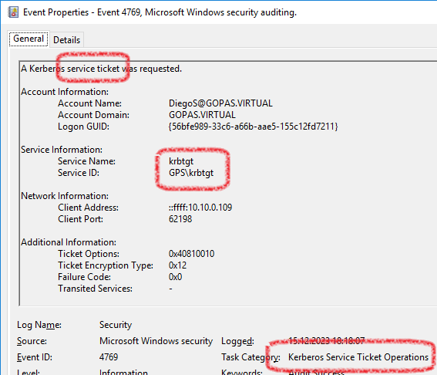
Cloud trust
non-initial "TGT" obtained as TGS request

Slide 72
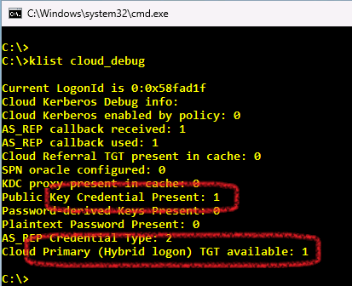
Cloud Kerberos trust
Cloud primary TGT invisible, stored in LSASS memory encrypted with TPM

Slide 73
Thank you
My training in GOPAS
GOC161 - Cryptography
GOC166 - Advanced ADFS
GOC167 - Troubleshooting Remote Access, VPN and DirectAccess
GOC169 - ISO/IEC 2700x in Windows environment
GOC171 - Active Directory Troubleshooting
GOC172 - Kerberos Troubleshooting
GOC173 - Enterprise PKI Deployment
GOC175 - Advanced Windows Security

