Slide 1
IPDC
Kevin Yen-Kuan Lee

Slide 2
IPDC
IPDC(InterPlanetary Distributed Computing) is a Distributed Computation service, A peer-to-peer hypermedia protocol to make the computation faster, flexible, and more scalable.

Slide 3
Abstract
IPDC is a decentralized computing system (or service) built on IPFS.
The traditional IPFS is an InterPlanetary distributed file system, users can quickly and easily add their own computers to IPFS environment. After joining IPFS, people can upload their own files (or directory), download, sync ... and so on.
IPFS is actively integrating with Ethereum with the goal of becoming the storage of the blockchain.

Slide 4
Abstract
Even though IPFS looks highly forward-looking, it seems that most people's point of view are purely in terms of storage. However, when a large number of users join the IPFS to contribute storage space, the computing resources of these devices are also very valuable. IPDC hopes to make full use of these computing resources.
IPDC is built on IPFS and communicates with M2M through MQTT technology. IPDC is divided into five kinds of architecture currently.

Slide 5
Outline
Introduction
Projects
MR : Map-Reduce
TF : Tensorflow Cluster
CL : Big Crawler
ER : Ethereum
EM : Edge Computing
Advantages

Slide 6
Introduction
Distributed computing system have been developed for many years, and one of the most famous is Hadoop.
In recent years, there have been several hot topics in the information industry :
Deep Learning
Blockchain
IoT
However, each topics was not built on Hadoop even if all of them are distributed computing problems.

Slide 7
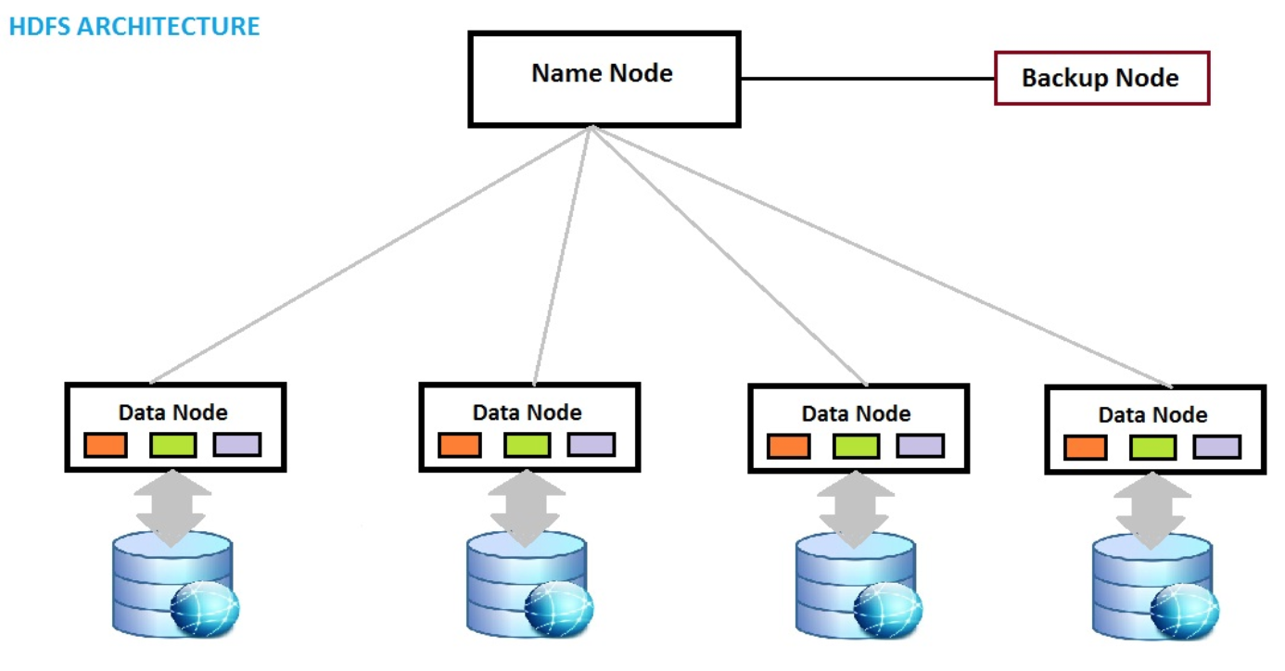
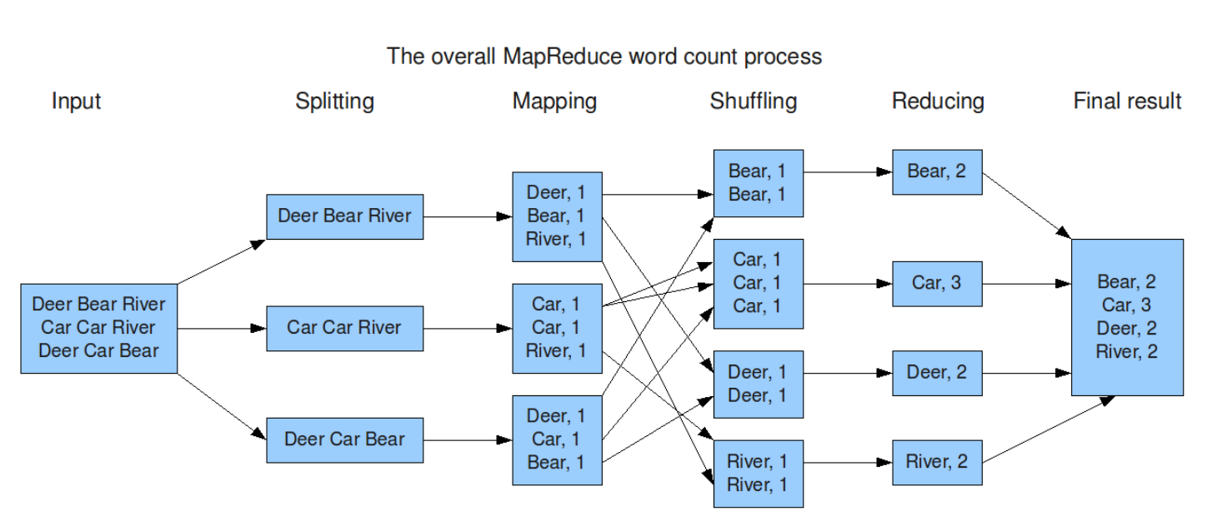
Introduction
Hadoop is a centralized distributed computing system
Storage : HDFS
Master-Slaves cause restriction of scalability
Computing Framework : Map-Reduce
No flexibility

Slide 8
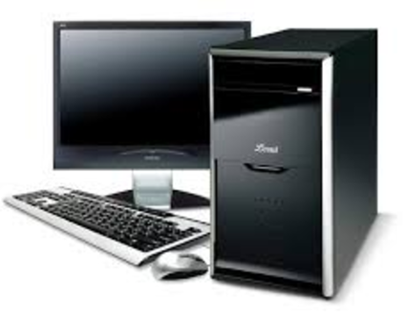


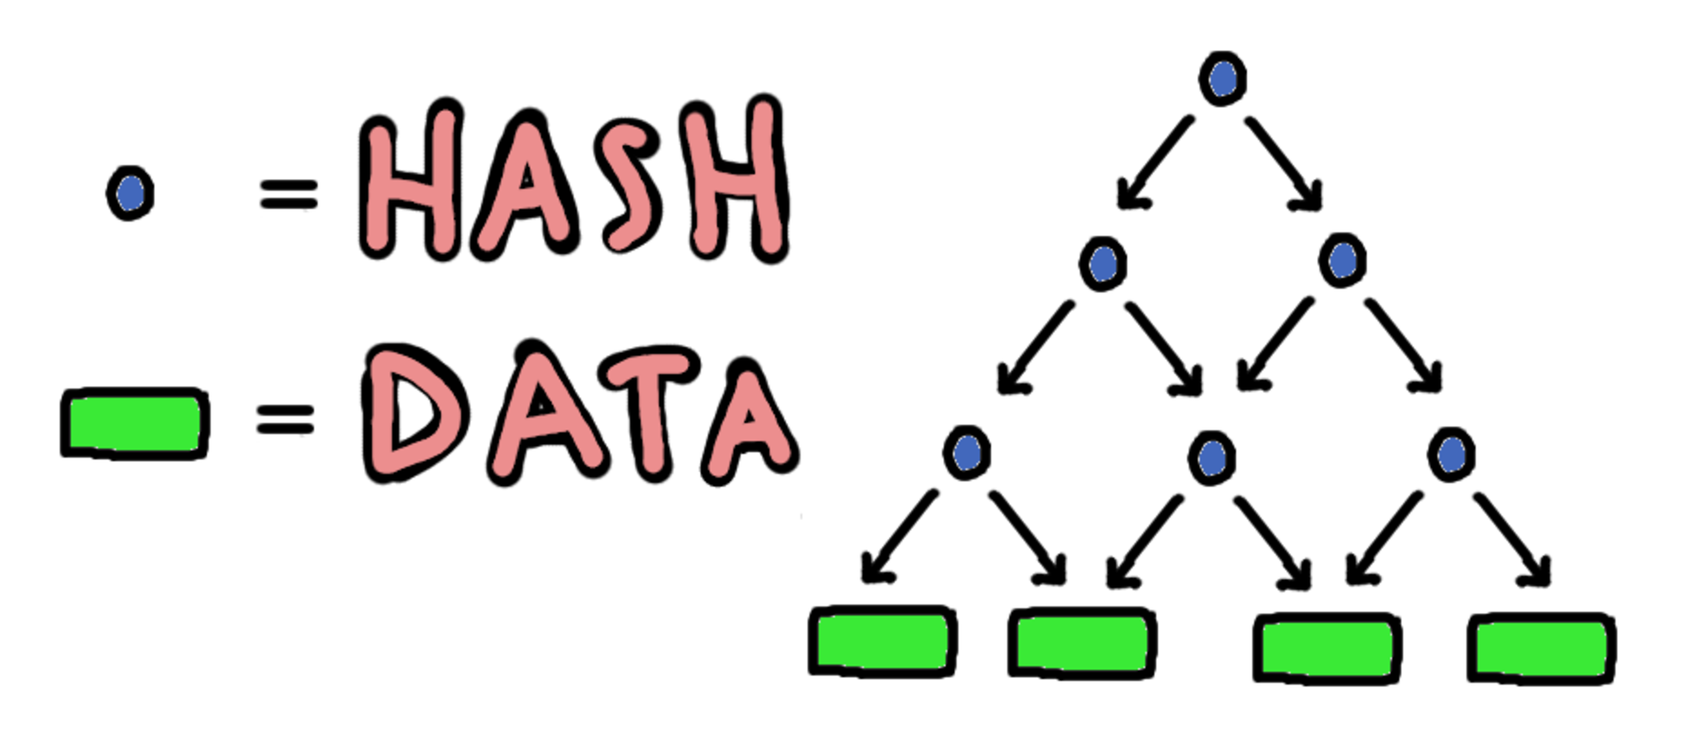
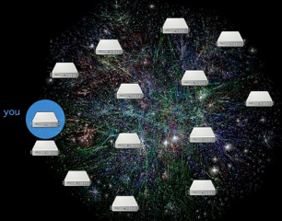
Introduction
IPDC is a de-centralized distributed computing system
Storage : IPFS
Faster, safer, and more scalable
Computing Framework :
Map-Reduce
Tensorflow Cluster (Deep Learning)
Big Crawler
Ethereum (Blockchain)
Edge Computing (IoT)
Every distributed computing framework
Everything as a service
MQTT

Slide 9
Easy to Join
Git
$ git clone https://github.com/yenkuanlee/IPDC
Modify ipdc.conf
$ python deploy.py init
$ python deploy.py start
Docker

Slide 10
IPDC Projects
Everything as a service
Every distributed computing framework can be implement
IPDC is divided into five kinds of architecture currently :
MR (Map-Reduce)
TF (Tensorflow)
CL (Big Crawler)
ER (Ethereum)
EM (Edge Computing)

Slide 11
IPDC MR
Map-Reduce

Slide 12
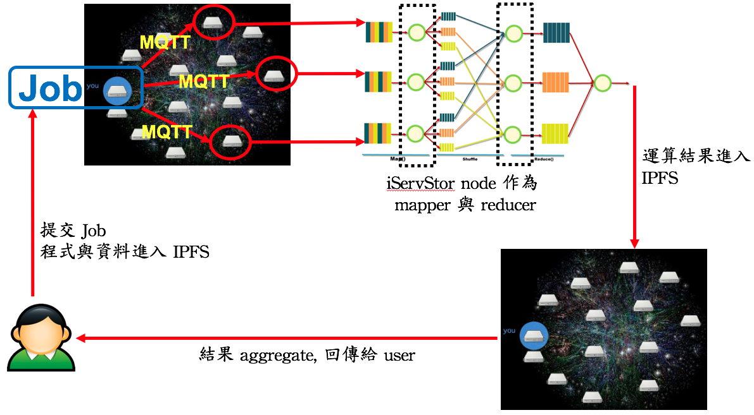
IPDC MR
IPDC MR is based on Map-Reduce framework with characteristic of decentralized, multi-master and extremely light.
Users can write logic in Map.py and Reduce.py .
All peers in IPFS can be compute nodes for IPDC (can set the distributed number).

Slide 13
Theorem of IPDC MR
The controller determines and chooses K (distributed number) workers through the peerID hash of each node in IPDC.
The controller will upload the input file, Map.py, Reduce.py to IPFS and notify K workers through MQTT to download the file.
The controller call each workers by MQTT to start the Mapper. By using worker's peerID and line number of input file as key, we can assign a worker several keys to map.
As with Hadoop, mapper eventually throws the result as Key-Value pair into the corresponding buffer.

Slide 14
Theorem of IPDC MR
Each worker's Buffer finish to collect Key-Value pair and starting reduce job .
After the end of each reducer, the results will be written into local disk and upload to IPFS. Through the MQTT, output hash will be passed to master who triggered the MR job.
MR master collected and download all output hash of each workers,and finish the entire MR job.

Slide 15
IPDC TF
Tensorflow Cluster

Slide 16
IPDC TF
IPDC TF is the framework of distributed tensorflow.
https://learningtensorflow.com/lesson11/
Users fill in the virtual cluster specification file (ClusterSpec.conf).
Then IPDC picks compute nodes from IPFS peers and produces real cluster specs (ClusterSpec.json) to upload to IPFS, so the controller can notify all compute nodes through MQTT to complete the establishment of distributed tensorflow cluster.
{"local": [0, 1]}
virtual cluster specification
{"local": ["140.92.143.140:2222", ”140.92.143.212:2222"]}
real cluster specs

Slide 17
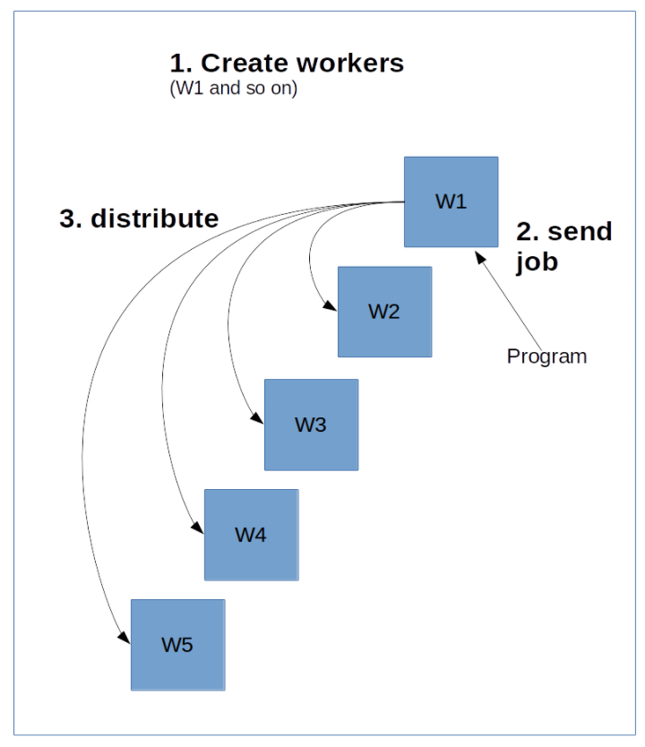
Runnung IPDC TF
Set Cluster Spec
virtual specs to real specs
Generate create_worker.py
Cluster deploy
Upload create_worker.py and ClusterSpec.json to IPFS.
Message queue to workers
Dmqtt of worker received the message
Download create_worker.py and ClusterSpec.json
Configure the task index and run create_worker.py

Slide 18
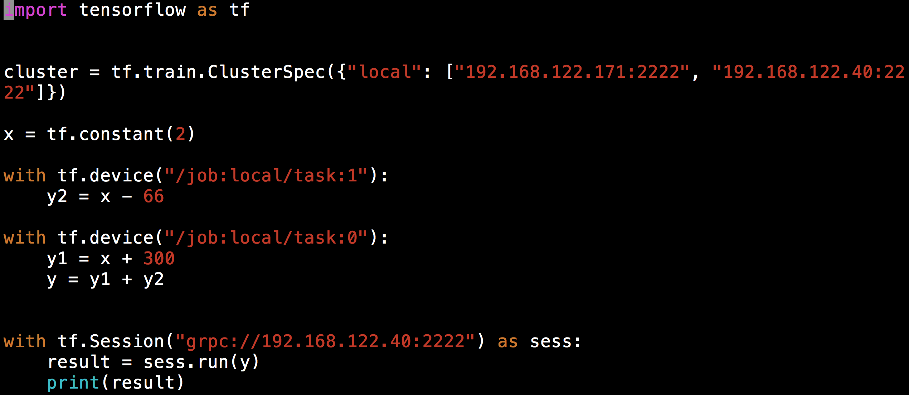
Runnung IPDC TF
User coding
cluster = tf.train.ClusterSpec({"local": ["140.92.143.140:2222", "140.92.143.212:2222"]})
Execution

Slide 19
IPDC CL
Big Crawler

Slide 20
IPDC CL
IPDC CL is a simple distributed framework. Each compute node will do a independent operation.
The idea comes from TAAI 2015's paper:
https://drive.google.com/file/d/0B_NX2TXJp4ItVlV0Z1ZfZkVoYzA/view?usp=sharing
Through the Apache Pig's UDF, let each node in the Cluster operate independently, and then complete the results
In this project, we use a crawler to be a CL example, which can be distributed by target url and crawl independently.

Slide 21
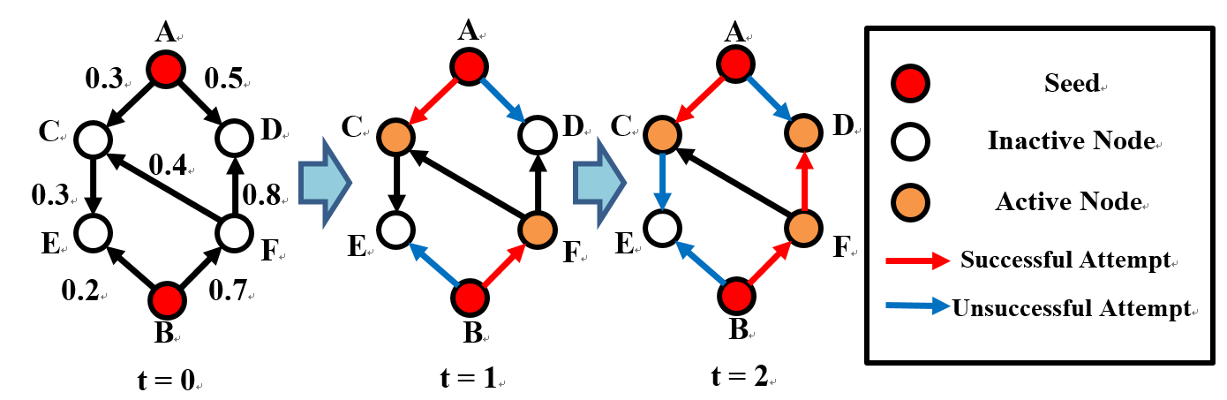

IPDC CL
MQTT
Job
MQTT
MQTT
Results to IPFS
Independent Cascade Model
Submit Job
Push codes and data to IPFS
Aggregate to user

Slide 22
IPDC ER
Ethereum

Slide 23
IPDC ER
IPDC ER combines IPFS node with private ethereum node. There are several benefits
Users can save files to IPFS, and put the file hash into ethereum
Users can provide their devices for building some private chain by IPDC
Chain owner can ask resource to build a private chain through IPDC so that he can manage some blockchain application
The blockchain architecture is 100% suitable for IPDC
Merkle Dag

Slide 24
IPDC ER
There are three roles of IPDC ER users
Resource owner : IPDC node, people who contribute his devices to IPDC
Chain owner : IPDC node, people who want to use some IPDC nodes to build his private chain for some purpose
Chain user : Non IPDC node, people who just use the specific chain, and need not to know anything about IPDC
IPDC ER is just a blockchain platform. The important thing is that we can run many Dapps on IPDC.
Filesign is a wonderful example of Dapp in project ER

Slide 25
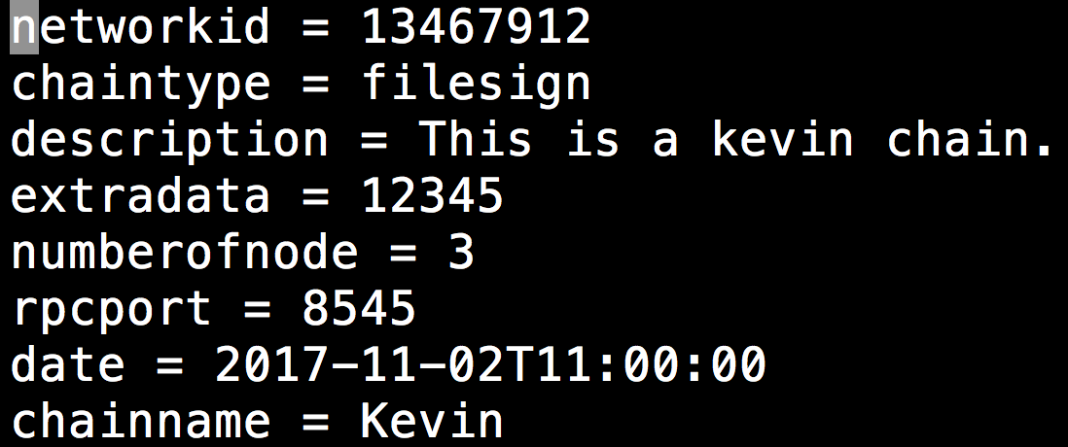
Running IPDC ER
set description.conf
When the chain owner want to create a chain, he needs to create a file named description.conf under IPDC ER project.
ask resource
There are an parameter in chain.py is "AskResource"
if AskResource is False, IPDC will skip the step and build a chain directly
if AskResource is True, IPDC will ask resource from IPDC ER node before building a chain
Start a chain
description.conf

Slide 26
Filesign : a Dapp example
Filesign is a command line tool built on IPDC ER.
It is an application about sending the certificate and verify the certificate. There are three roles in the filesign application:
Sender : people or organization who send the certificate to someone
Receiver : people who receives the certificate
Varifier : people who want to verify someone's certificate
Filesign command line tool is put on every IPDC ER node, each IPDC ER node is a filesign sender.

Slide 27
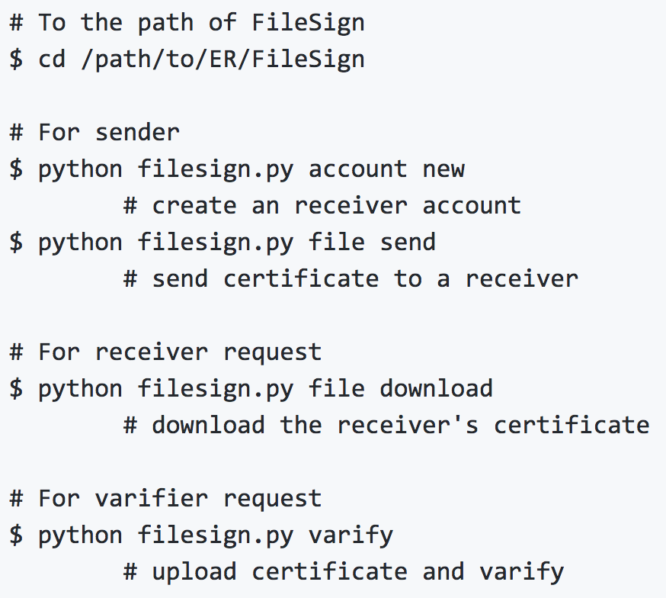
Filesign : a Dapp example
Execution
學校
取得證書
驗證證書
學生
公司
交付證書

Slide 28
IPDC EM
Edge Computing

Slide 29
IPDC EM
IPDC EM is not a clear architecture. It is an attitude !
There are three level of Edge Computing:
Sensors / Devices
Gateway
IPDC node
Cloud
IPDC
IPDC EM node can become a gateway of edge computing.

Slide 30
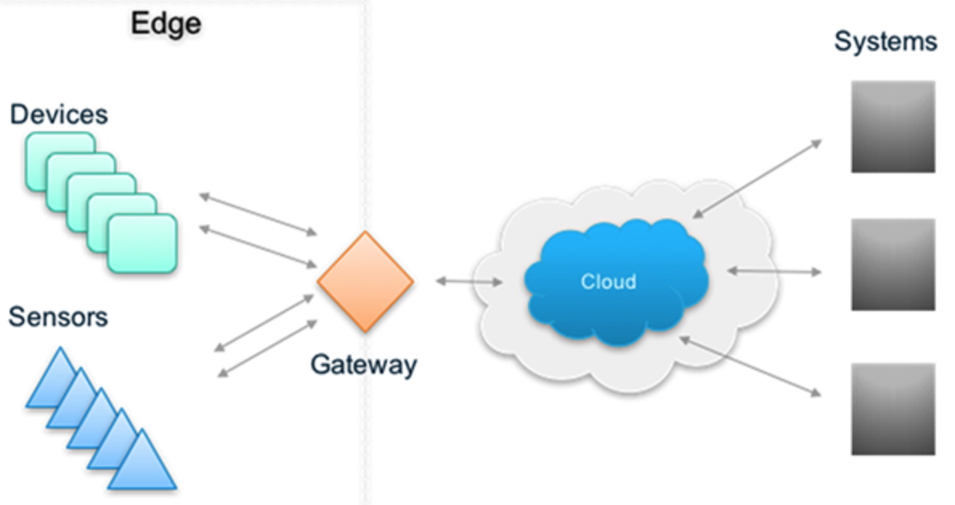
IPDC EM
IPDC node
IPDC node
IPDC
IPDC node
IPDC node

Slide 31
Advantage of IPDC
Extremely light
IPFS and MQTT can be installed on a variety of devices.
Extremely flexible
IPDC is a very flexible framework that enables a wide range of decentralized architectures by making the Dmqtt.py channel and modifying the logic of control.py and adding the necessary code.
Scalable
cross domains growing up

Slide 32
Advantage of IPDC
Open and fast
IPDC inherits the advantages of IPFS, so that data and code exist in the IPFS
Hash passed through MQTT to make data and code more open
IPDC also has the advantage of MQTT
high speed to publish message
M2M conforms to the advantages of IPFS decentralization, increasing computing efficiency
enhance IPFS from storage to computing
Multi-Master architecture
solve the problem of unbalanced load of Master-Slaves
Completely decentralized and minimize the redundant transmission

Slide 33
Q&A

Slide 34
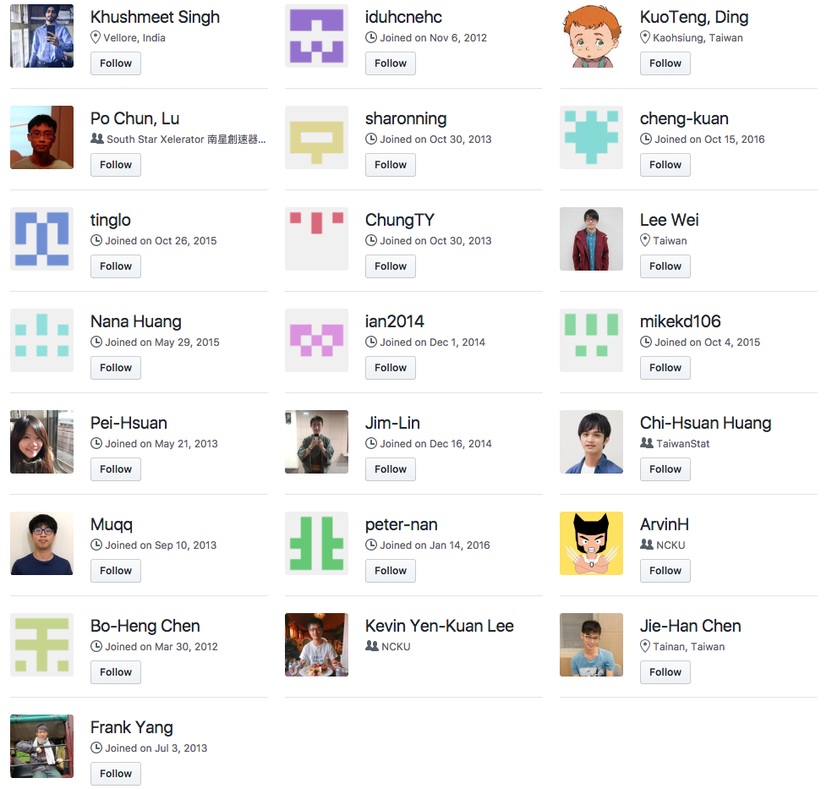
Acknowledgements

