Slide 1
Grover's Algorithm

Slide 2
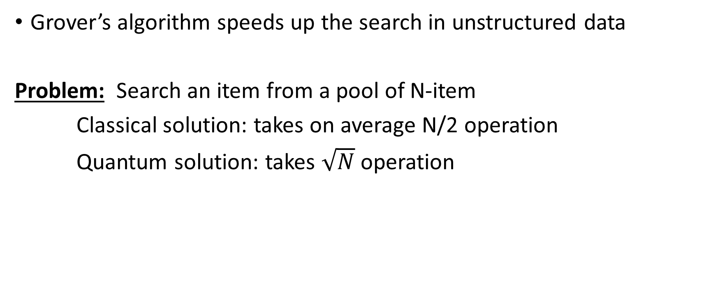
Grover's Algorithm
Grover’s algorithm speeds up the search in unstructured data
Problem: Search an item from a pool of N-item
Classical solution: takes on average N/2 operation
Quantum solution: takes $\sqrt{N}$ operation

Slide 3
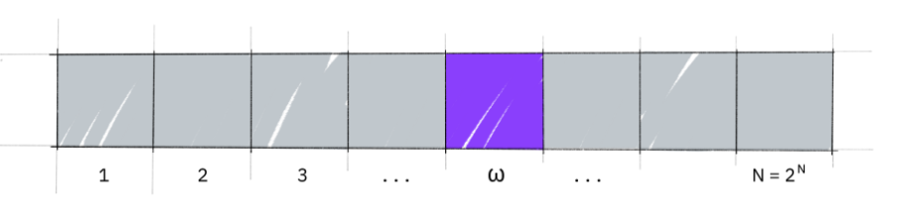
Unstructured Search
For a large list of N items, there exist one item with a unique property that we wish to locate
Say, w is the item that we are looking for

Slide 4
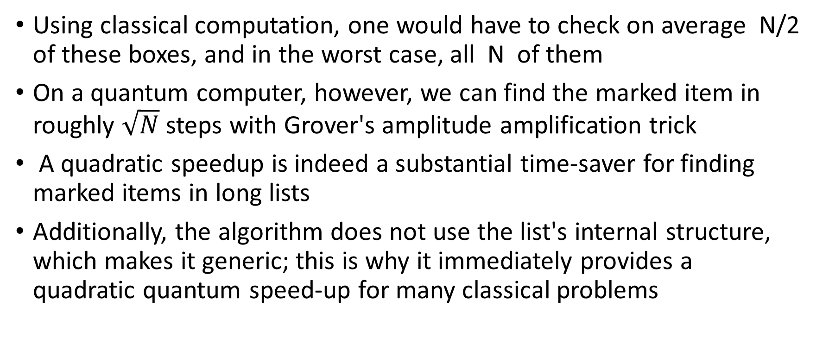
Unstructured Search
Using classical computation, one would have to check on average N/2 of these boxes, and in the worst case, all N of them
On a quantum computer, however, we can find the marked item in roughly $\sqrt{N}$ steps with Grover's amplitude amplification trick
A quadratic speedup is indeed a substantial time-saver for finding marked items in long lists
Additionally, the algorithm does not use the list's internal structure, which makes it generic; this is why it immediately provides a quadratic quantum speed-up for many classical problems

Slide 5

Creating an Oracle
Say, our 'database' is comprised of all the possible computational basis states of our qubits
For example, if we have 3 qubits, our list is the states are |000⟩, |001⟩, …|111⟩ (i.e, the states |0⟩→|7⟩)
Grover’s algorithm solves oracles that add a negative phase to the solution states (i.e., for any state |x⟩) in the computational basis:

Slide 6
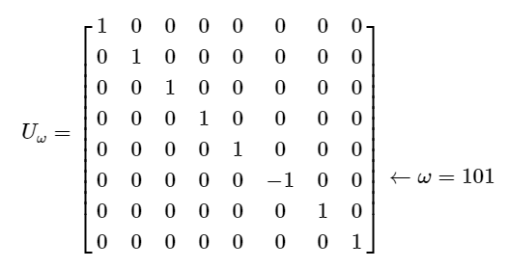

Creating an Oracle
This oracle will be a diagonal matrix, where the entry that correspond to the marked item will have a negative phase
For example, if we have three qubits and $ω=101$, our oracle will have the matrix:

Slide 7

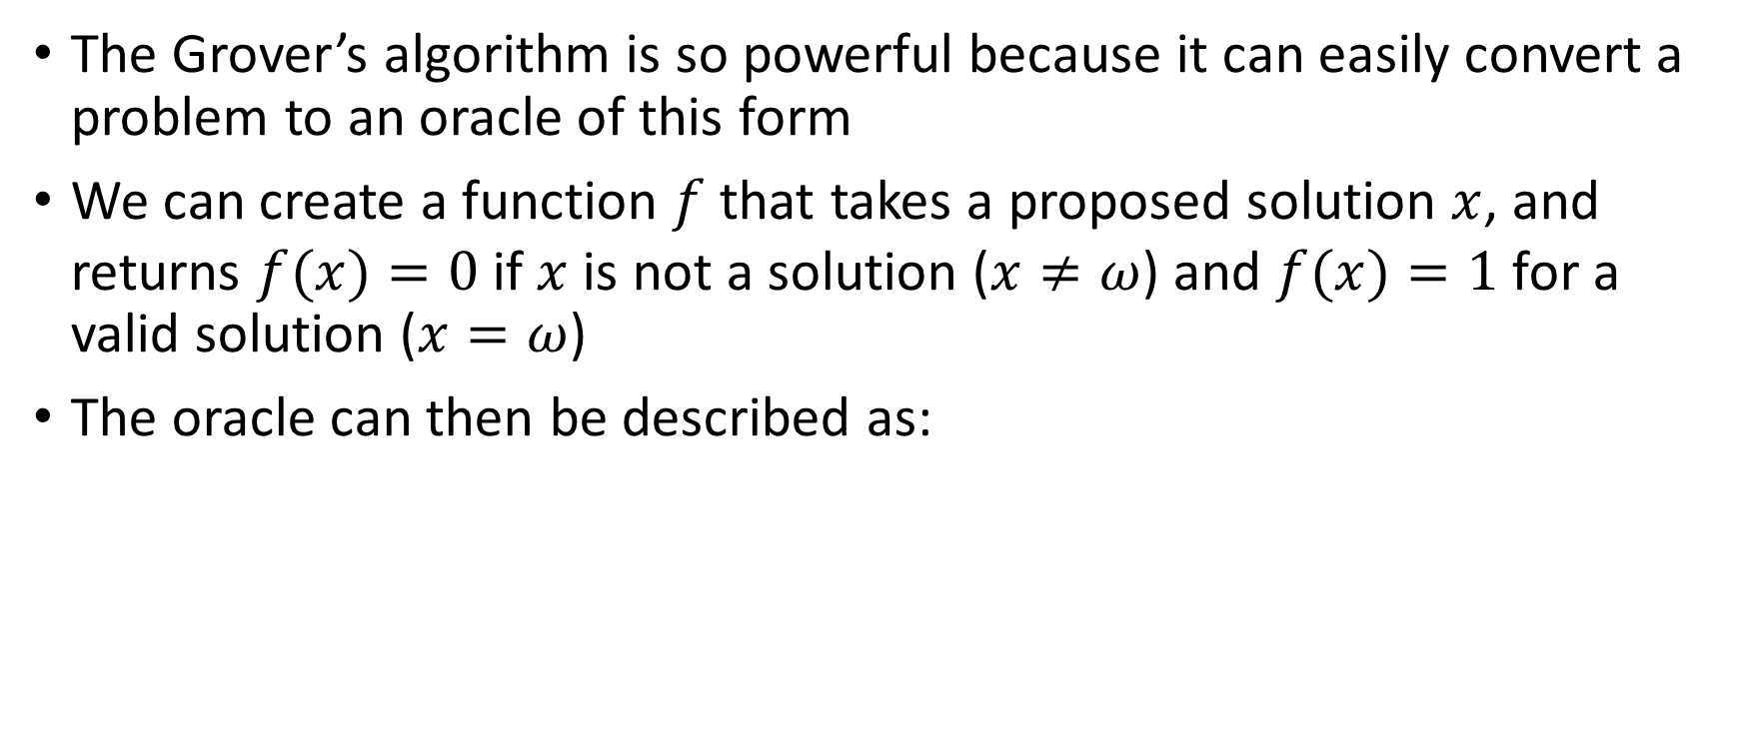
Creating an Oracle
The Grover’s algorithm is so powerful because it can easily convert a problem to an oracle of this form
We can create a function $f$ that takes a proposed solution $x$, and returns $f(x)=0$if $x$ is not a solution ($x≠ω$) and $f(x)=1$ for a valid solution ($x=ω$)
The oracle can then be described as:

Slide 8
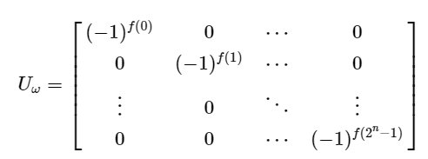
Creating an Oracle
The oracle's matrix will be a diagonal matrix of the form:

Slide 9
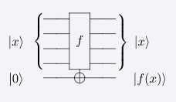
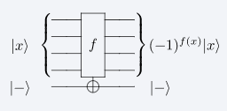
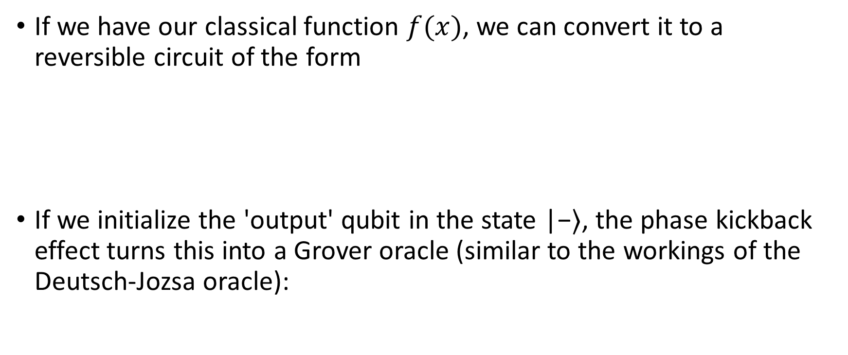
Circuit Construction
If we have our classical function $f(x)$, we can convert it to a reversible circuit of the form
If we initialize the 'output' qubit in the state |−⟩, the phase kickback effect turns this into a Grover oracle (similar to the workings of the Deutsch-Jozsa oracle):

Slide 10
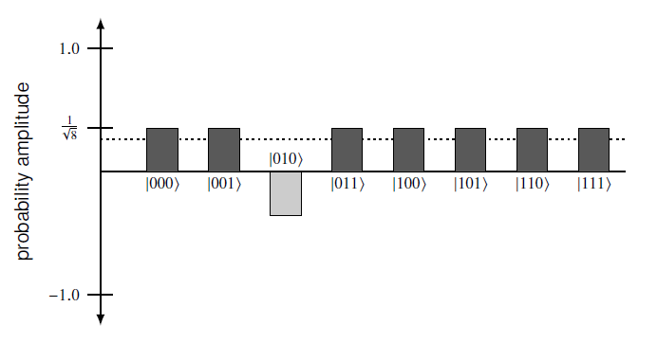
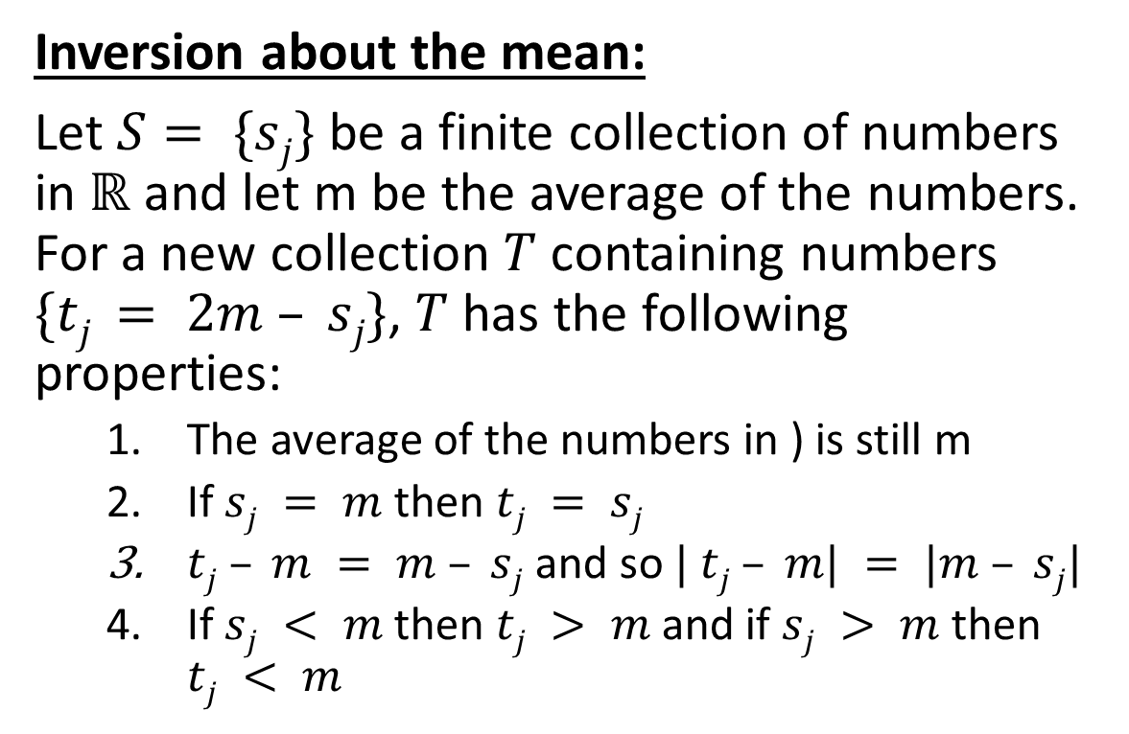
Amplitude Amplification
Inversion about the mean:
Let $S= \{sj\}$be a finite collection of numbers in $ℝ$ and let m be the average of the numbers. For a new collection $T$ containing numbers $\{tj = 2m – sj\}$, $T$has the following properties:
The average of the numbers in ) is still m
If $sj = m$then $tj = sj$
$tj – m = m – sj$ and so $| tj – m| = |m – sj|$
If $sj < m$then $tj > m$and if $sj > m$then $tj < m$

Slide 11
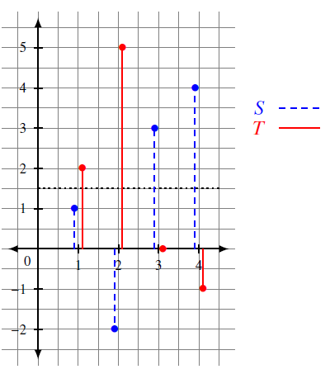
Amplitude Amplification

Slide 12
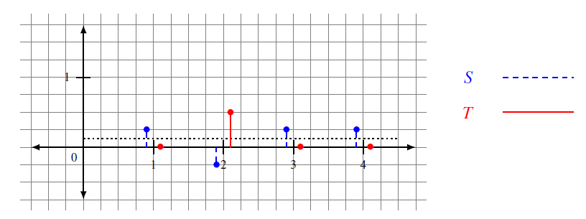
Amplitude Amplification

Slide 13

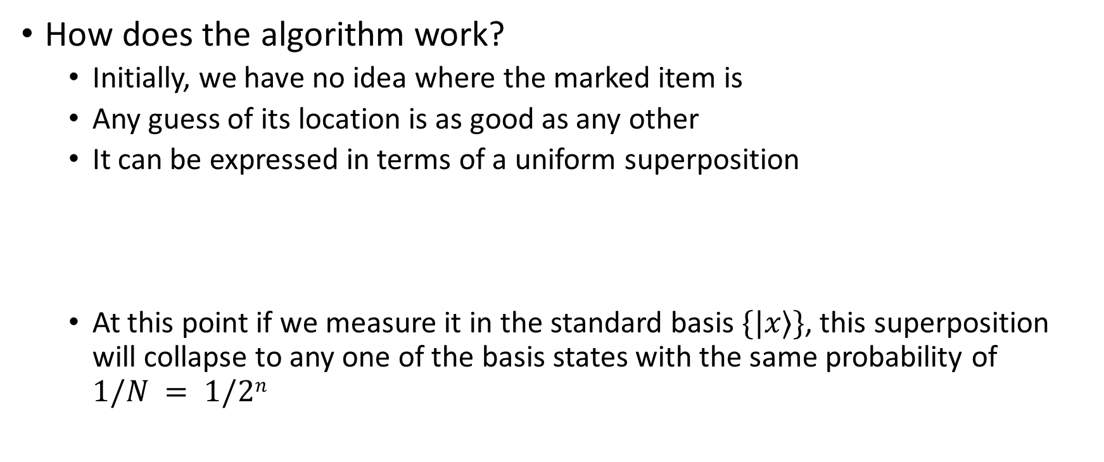
Amplitude Amplification
How does the algorithm work?
Initially, we have no idea where the marked item is
Any guess of its location is as good as any other
It can be expressed in terms of a uniform superposition
At this point if we measure it in the standard basis $\{|x⟩\}$, this superposition will collapse to any one of the basis states with the same probability of $1/N = 1/2n$

Slide 14
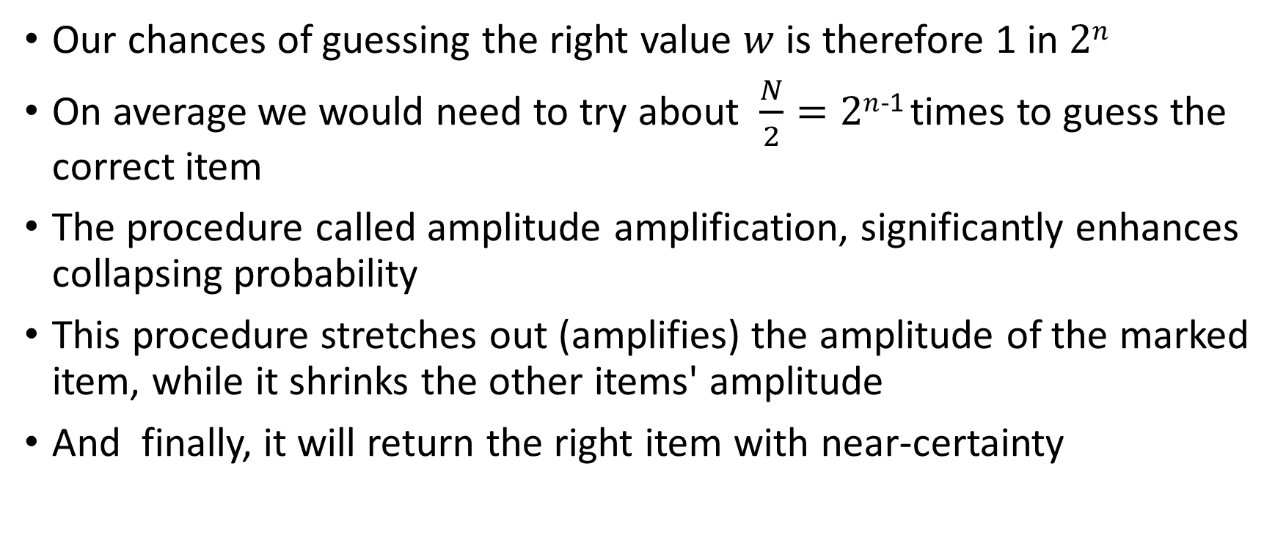
Amplitude Amplification
Our chances of guessing the right value $w$ is therefore 1 in $2n$
On average we would need to try about $\frac{N}{2}=2n$⁻¹ times to guess the correct item
The procedure called amplitude amplification, significantly enhances collapsing probability
This procedure stretches out (amplifies) the amplitude of the marked item, while it shrinks the other items' amplitude
And finally, it will return the right item with near-certainty

Slide 15
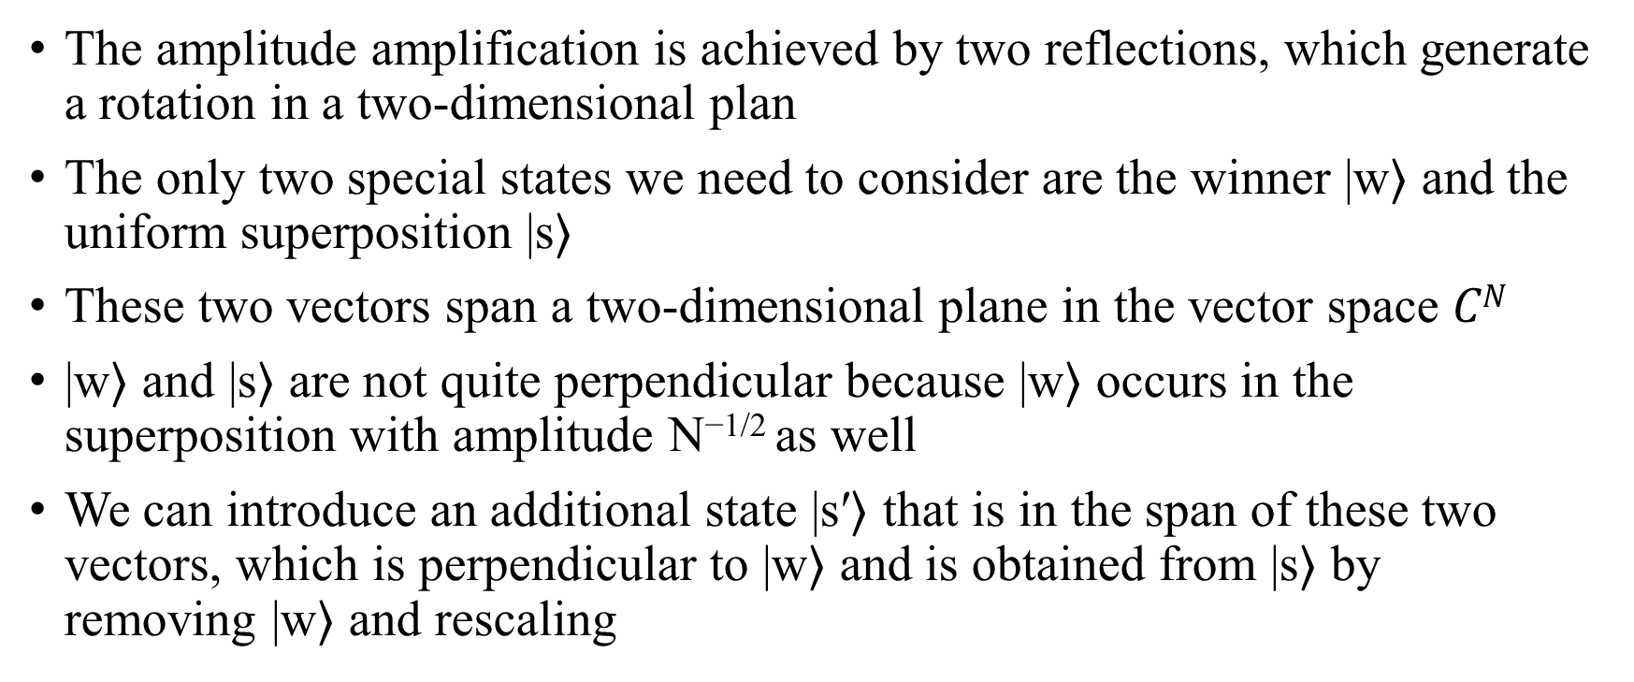
Amplitude Amplification
The amplitude amplification is achieved by two reflections, which generate a rotation in a two-dimensional plan
The only two special states we need to consider are the winner |w⟩ and the uniform superposition |s⟩
These two vectors span a two-dimensional plane in the vector space $CN$
|w⟩ and |s⟩ are not quite perpendicular because |w⟩ occurs in the superposition with amplitude N^{−1/2} as well
We can introduce an additional state |s′⟩ that is in the span of these two vectors, which is perpendicular to |w⟩ and is obtained from |s⟩ by removing |w⟩ and rescaling

Slide 16
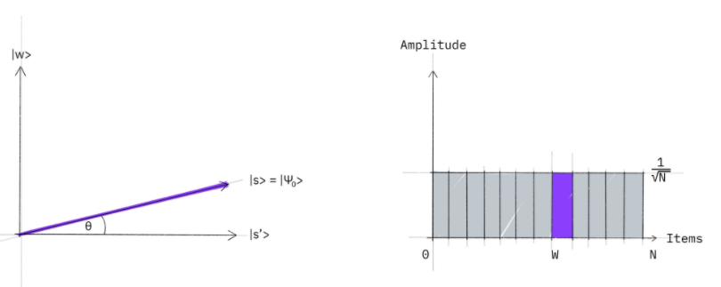
Amplitude Amplification
Step 1:
The amplitude amplification procedure starts out in the uniform superposition |s⟩, which is easily constructed from |s⟩ = H^{⊗n}|0⟩

Slide 17
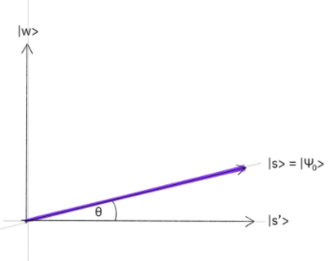
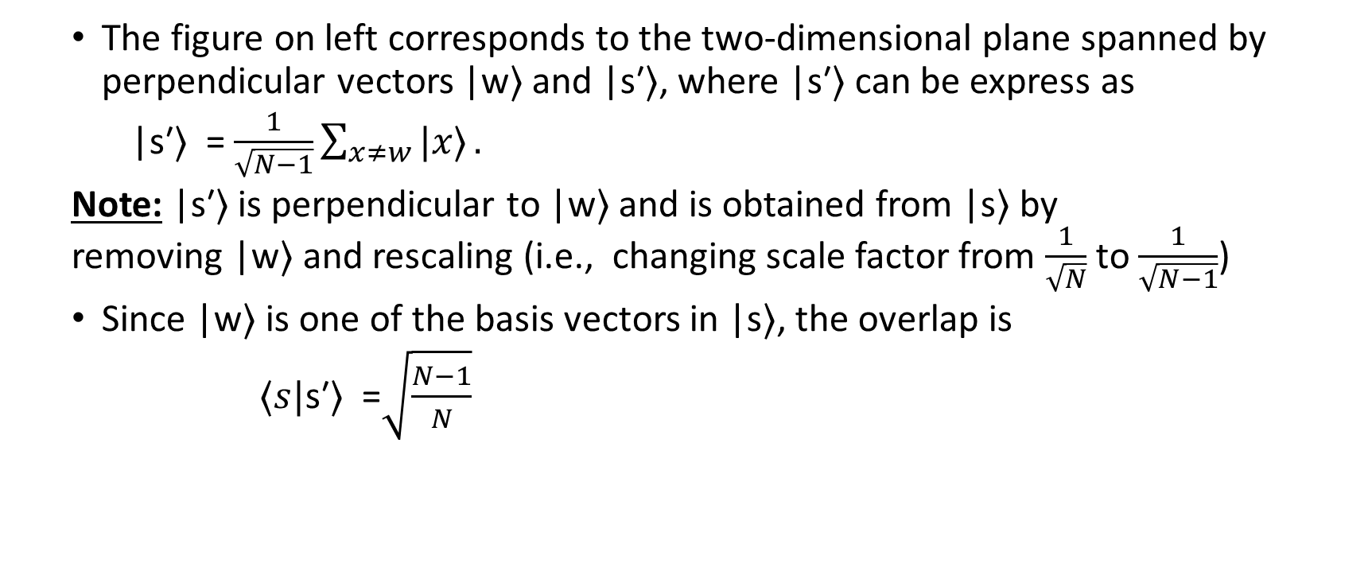
Amplitude Amplification
The figure on left corresponds to the two-dimensional plane spanned by perpendicular vectors |w⟩ and |s′⟩, where |s′⟩ can be express as
|s′⟩ = $\frac{1}{\sqrt{N−1}}\sum_{x≠w}{|x\text{⟩}}.$
Note: |s′⟩ is perpendicular to |w⟩ and is obtained from |s⟩ by removing |w⟩ and rescaling (i.e., changing scale factor from $\frac{1}{\sqrt{N}}$ to $\frac{1}{\sqrt{N−1}}$)
Since |w⟩ is one of the basis vectors in |s⟩, the overlap is
$⁡⟨s|$s′⟩ =$\sqrt{\frac{N−1}{N}}$

Slide 18

Amplitude Amplification
In geometric term, the angle $θ$ between $|s⟩$ and $|s′⟩$ is given by
$sinθ$ = $\frac{1}{\sqrt{N}}$ => $arcsin\frac{1}{\sqrt{N}}$
The figure with a bar graph represents the amplitudes of the state |s⟩

Slide 19
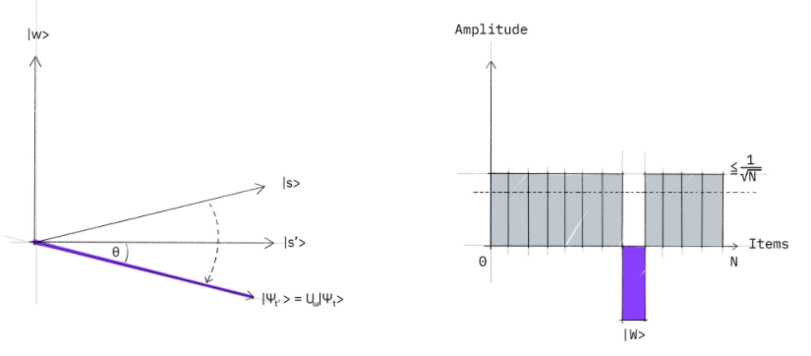
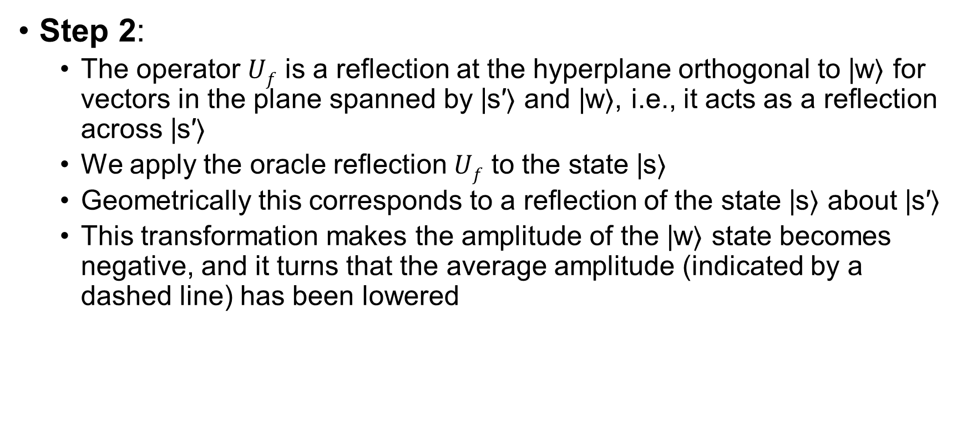
Amplitude Amplification
Step 2:
The operator $Uf$ is a reflection at the hyperplane orthogonal to |w⟩ for vectors in the plane spanned by |s′⟩ and |w⟩, i.e., it acts as a reflection across |s′⟩
We apply the oracle reflection $Uf$ to the state |s⟩
Geometrically this corresponds to a reflection of the state |s⟩ about |s′⟩
This transformation makes the amplitude of the |w⟩ state becomes negative, and it turns that the average amplitude (indicated by a dashed line) has been lowered

Slide 20
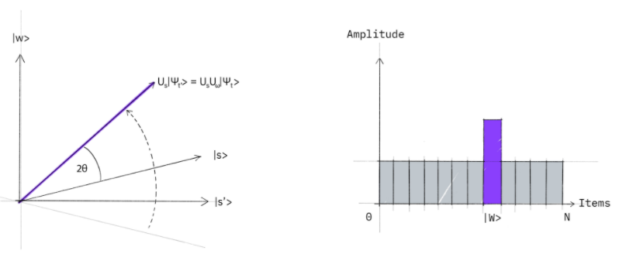
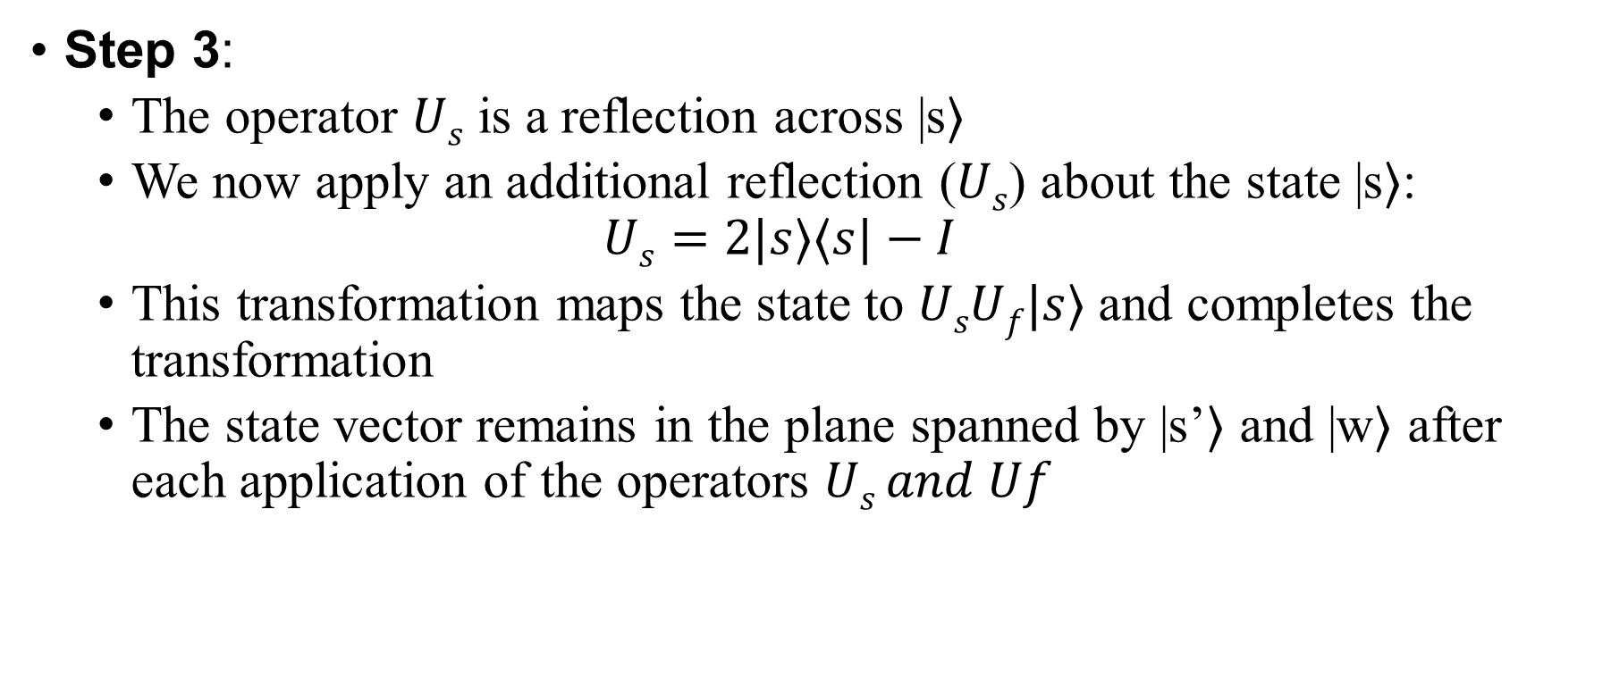
Amplitude Amplification
Step 3:
The operator $Us$ is a reflection across |s⟩
We now apply an additional reflection ($Us$) about the state |s⟩:
$$Us=2|s⟩⟨s|−I$$
This transformation maps the state to $UsUf|s⟩$and completes the transformation
The state vector remains in the plane spanned by |s’⟩ and |w⟩ after each application of the operators $Us and Uf$

Slide 21
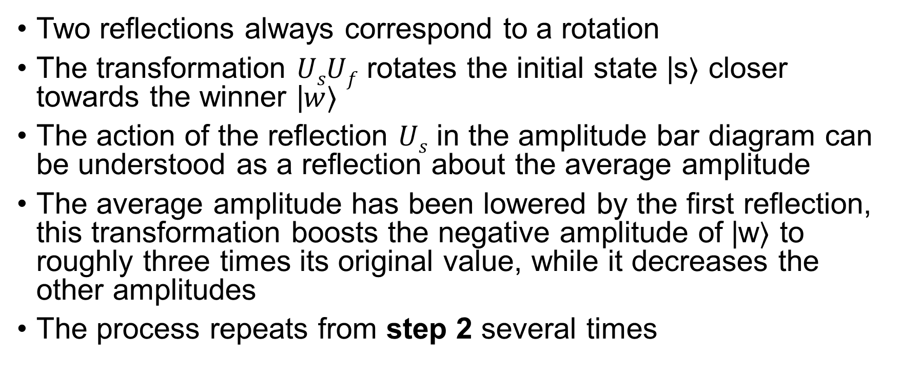
Amplitude Amplification
Two reflections always correspond to a rotation
The transformation $UsUf$ rotates the initial state |s⟩ closer towards the winner |$w$⟩
The action of the reflection $Us$ in the amplitude bar diagram can be understood as a reflection about the average amplitude
The average amplitude has been lowered by the first reflection, this transformation boosts the negative amplitude of |w⟩ to roughly three times its original value, while it decreases the other amplitudes
The process repeats from step 2 several times

Slide 22
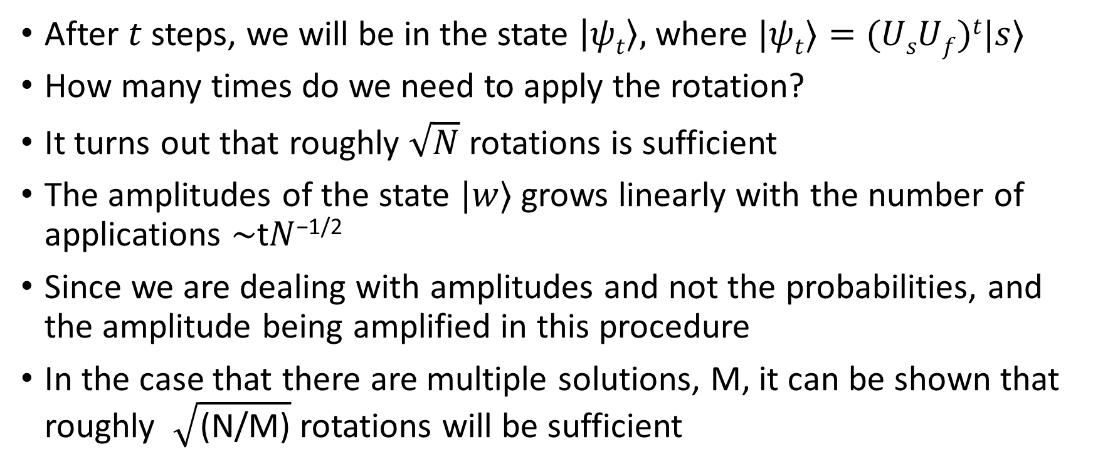
Amplitude Amplification
After $t$ steps, we will be in the state $\left|ψt\right\rangle ,$where $|ψt⟩=(UsUf)t|s⟩$
How many times do we need to apply the rotation?
It turns out that roughly $\sqrt{N}$ rotations is sufficient
The amplitudes of the state $|w$⟩ grows linearly with the number of applications ∼t$N$^{−1/2}
Since we are dealing with amplitudes and not the probabilities, and the amplitude being amplified in this procedure
In the case that there are multiple solutions, M, it can be shown that roughly $\sqrt{\text{(}\text{N}\text{/}\text{M}\text{)}}$ rotations will be sufficient

Slide 23
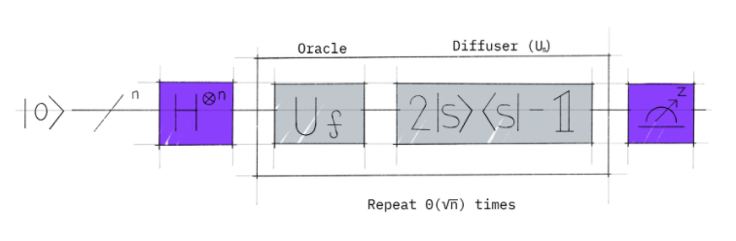
Amplitude Amplification

Slide 24
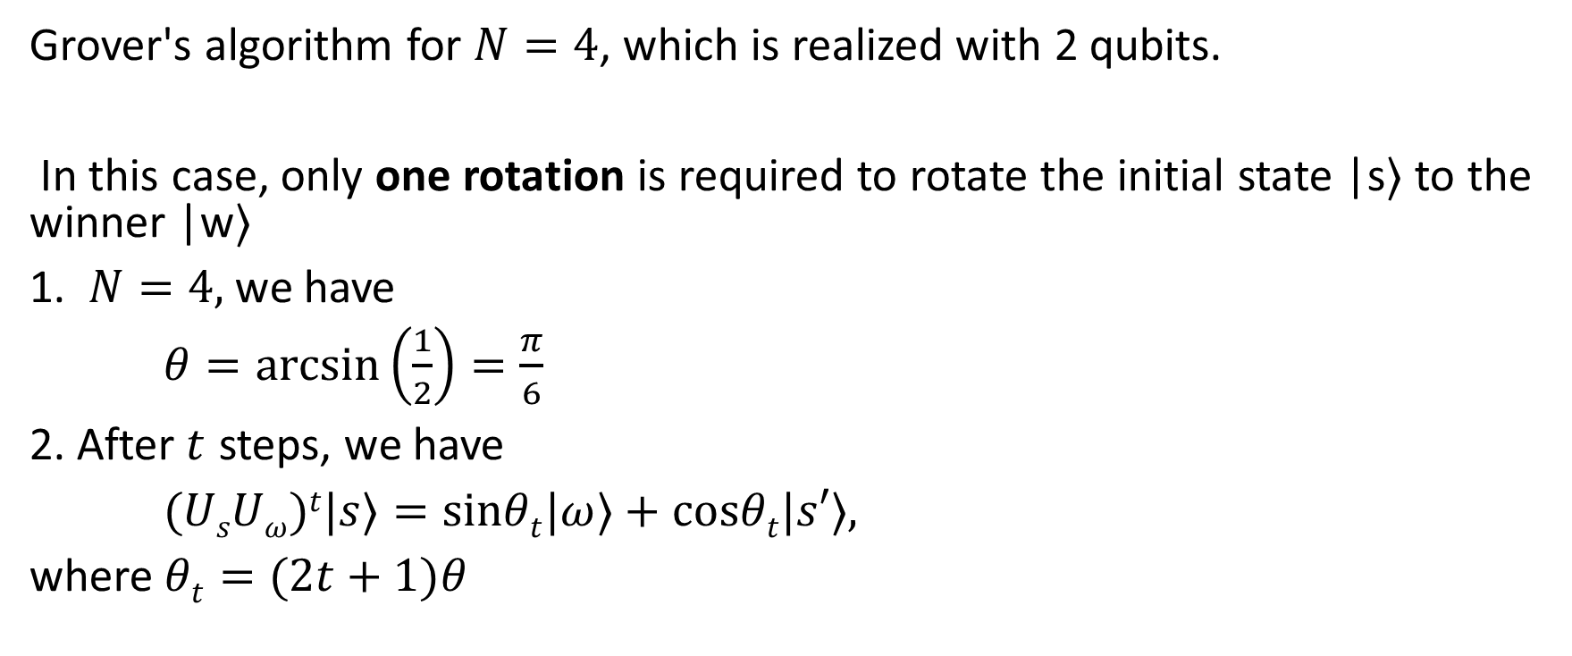
Example: 2 Qubits
Grover's algorithm for $N=4$, which is realized with 2 qubits.
In this case, only one rotation is required to rotate the initial state |s⟩ to the winner |w⟩
1. $N=4,$we have
$θ=arcsin\left(\frac{1}{2}\right)=\frac{π}{6}$
2. After$t$ steps, we have
$(UsUω)t|s⟩=sinθt|ω⟩+cosθt|s′⟩,$
where $θt=(2t+1)θ$

Slide 25

Example: 2 Qubits
In order to obtain |ω⟩ we need $θt=π/2$, which with $θ=\frac{π}{6},$ from the above relation we get $t=1$, and it implies that after $t=1$ rotation the searched element is found.

Slide 26
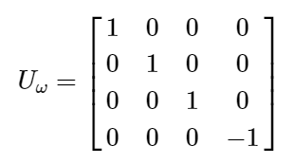
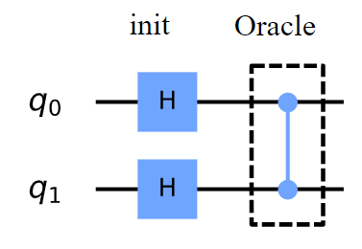

Example: 2 Qubits
Oracle for |ω⟩=|11⟩:
The oracle $Uω$ in this case acts as follows:
or:
which you may recognize as the controlled-Z gate

Slide 27
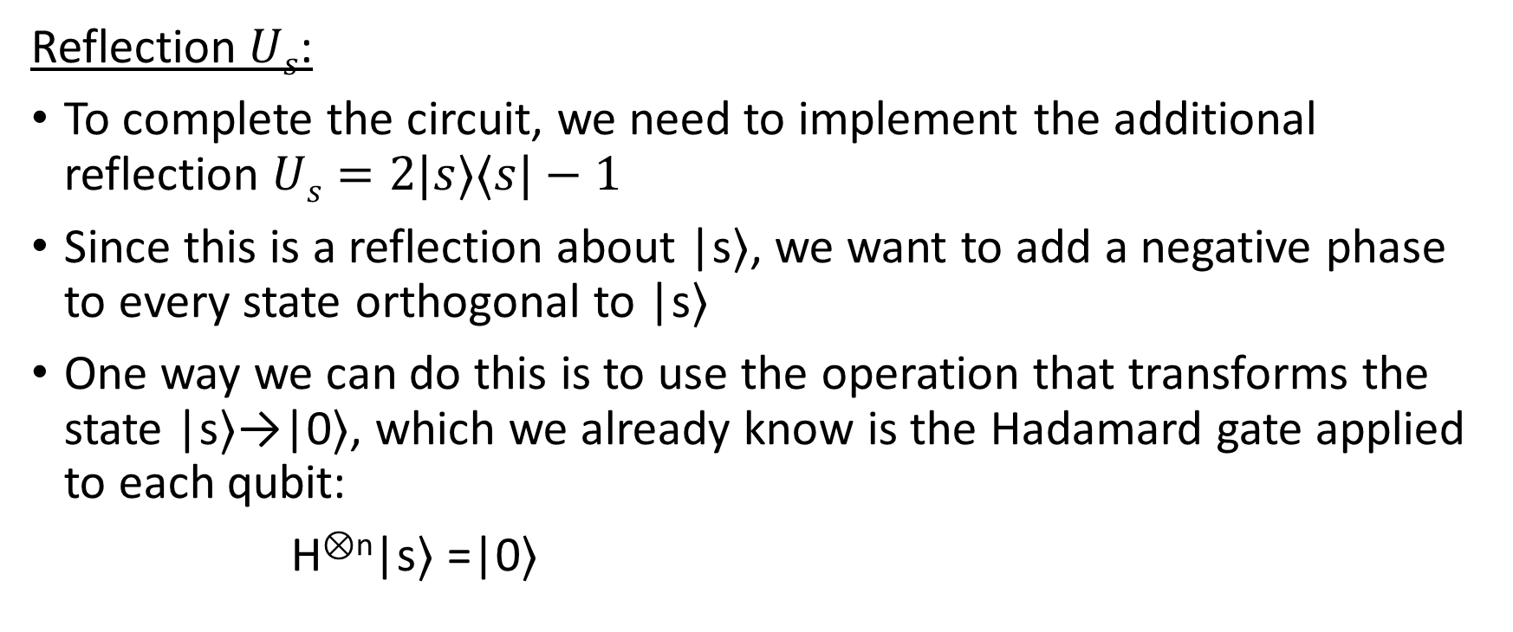
Example: 2 Qubits
Reflection $Us$:
To complete the circuit, we need to implement the additional reflection $Us=2|s⟩⟨s|−1$
Since this is a reflection about |s⟩, we want to add a negative phase to every state orthogonal to |s⟩
One way we can do this is to use the operation that transforms the state |s⟩→|0⟩, which we already know is the Hadamard gate applied to each qubit:
H^{⊗n}|s⟩ =|0⟩

Slide 28

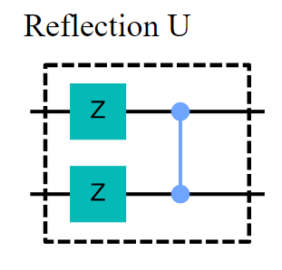
Example: 2 Qubits
Then we apply a circuit that adds a negative phase to the states orthogonal to |0⟩:

Slide 29
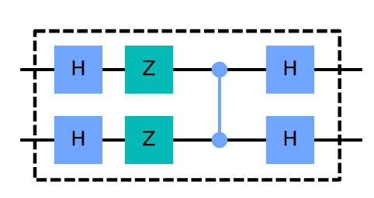

Example: 2 Qubits
Finally, we do the operation that transforms the state |0⟩→|s⟩
H^{⊗n}$U0$H^{⊗n}$=Us$
This complete the circuit for $Us$, and it looks like :

Slide 30
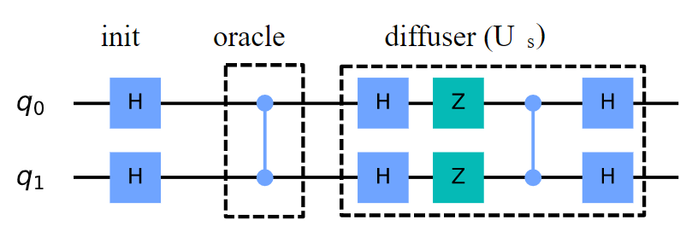
Example: 2 Qubits
Full Circuit for |w⟩=|11⟩

Slide 31
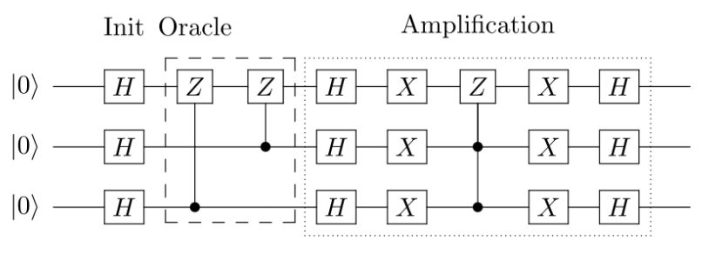
Example: 3 Qubits
Grover's algorithm for 3 qubits with two marked states |101⟩ and |110⟩

Slide 32

Example: 3 Qubits
Apply Hadamard gates to 3 qubits initialized to |000⟩ to create a uniform superposition:
Mark states |101⟩ and |110⟩ using a phase oracle:

Slide 33



Example: 3 Qubits
3. Perform the reflection around the average amplitude:
Apply Hadamard gates to the qubits
Apply X gates to the qubits
Apply a doubly controlled Z gate between the 1, 2 (controls) and 3 (target) qubits

Slide 34


Example: 3 Qubits
Apply X gates to the qubits
Apply Hadamard gates to the qubits
4. Measure the 3 qubits to retrieve states |101⟩ and |110⟩

