Slide 1
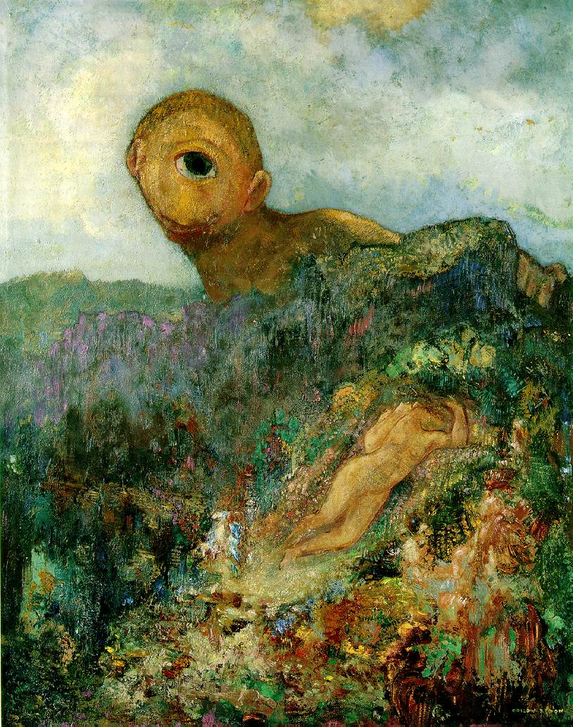
Camera calibration
Odilon Redon, Cyclops, 1914

Slide 2
Overview
Camera calibration
Intrinsic camera parameters
Extrinsic camera parameters
Estimation
First taste of 3D reconstruction: triangulation

Slide 3
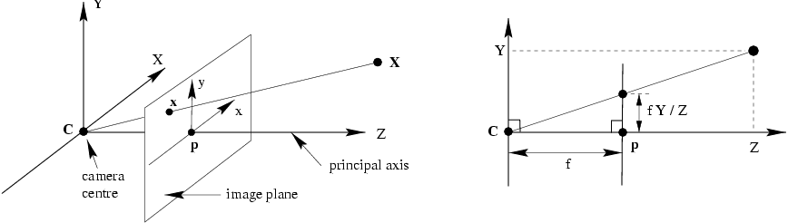
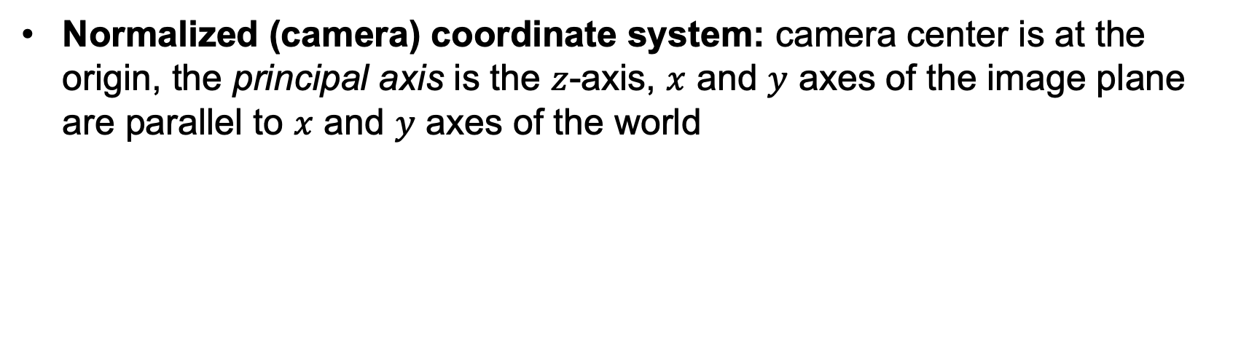
Perspective projection in normalized coordinates
Normalized (camera) coordinate system: camera center is at the origin, the principal axis is the $z$-axis, $x$ and $y$ axes of the image plane are parallel to $x$ and $y$ axes of the world

Slide 4





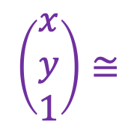
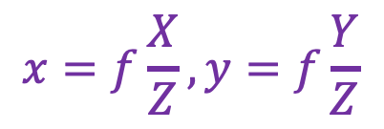
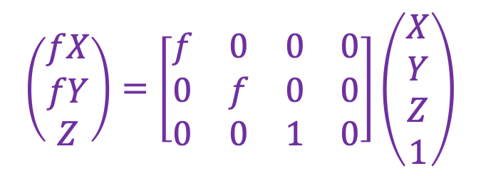

Perspective projection in normalized coordinates
$$(X,Y,Z)$$
$$(x,y)$$
$$x=f\frac{X}{Z}, y=f\frac{Y}{Z}$$
$$\left(\begin{aligned}fX \\ fY \\ Z\end{aligned}\right)=\left[\begin{matrix}f & 0 & 0 & 0 \\ 0 & f & 0 & 0 \\ 0 & 0 & 1 & 0\end{matrix}\right]\left(\begin{aligned}X \\ Y \\ Z \\ 1\end{aligned}\right)$$
$$\left(\begin{aligned}x \\ y \\ 1\end{aligned}\right)≅$$
$$x≅PX$$
$$x$$
$$P$$
$$X$$
Equality up to scale
Homogeneous coord. vec. of image point
Camera projection matrix
Homogeneous coord. vec. of 3D point

Slide 5
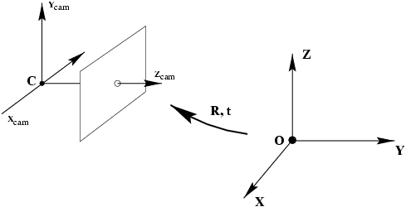


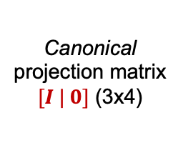



Camera calibration: Overview
world coordinate system
Camera calibration: figuring out transformation from world coordinate system to image coordinate system
World to camera coord. trans. matrix $\left[\begin{matrix}R & t \\ 0^{T} & 1\end{matrix}\right]$ (4x4)
3D point (4x1)
2D
point (3x1)
Camera to pixel coord. trans. matrix $K$ (3x3)
Canonical projection matrix $[I | 0]$ (3x4)
$$≅$$
$$x$$
Intrinsic camera parameters: principal point, scaling factors
Extrinsic camera parameters: rotation, translation
$$X$$

Slide 6

Camera calibration: Overview
world coordinate system
Camera calibration: figuring out transformation from world coordinate system to image coordinate system
World to camera coord. trans. matrix $\left[\begin{matrix}R & t \\ 0^{T} & 1\end{matrix}\right]$ (4x4)
3D point (4x1)
2D
point (3x1)
Camera to pixel coord. trans. matrix $K$ (3x3)
Canonical projection matrix $[I | 0]$ (3x4)
$$≅$$
$$x$$
$$X$$
$$P=K[R|t]$$
General camera projection matrix

Slide 7
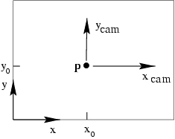
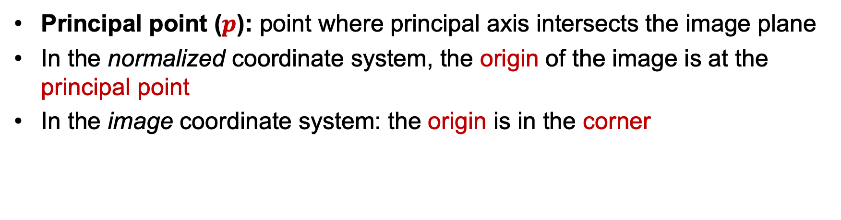
Intrinsic parameters: Principal point
Principal point ($p$): point where principal axis intersects the image plane
In the normalized coordinate system, the origin of the image is at the principal point
In the image coordinate system: the origin is in the corner

Slide 8

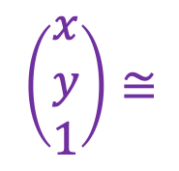
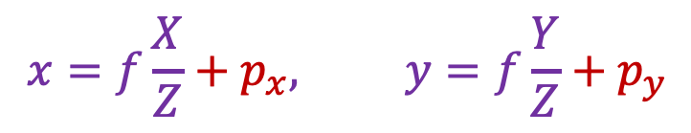
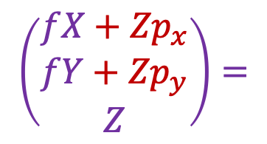
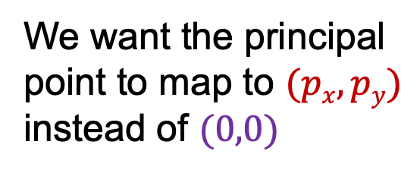
Intrinsic parameters: Principal point
We want the principal point to map to $(px, py)$ instead of $(0,0)$
p_{y}
p_{x}
$$x=f\frac{X}{Z}+p_{x}, y=f\frac{Y}{Z}+p_{y}$$
$$\left[\begin{matrix}f & 0 & p_{x} & 0 \\ 0 & f & p_{y} & 0 \\ 0 & 0 & 1 & 0\end{matrix}\right]\left(\begin{aligned}X \\ Y \\ Z \\ 1\end{aligned}\right)$$
$$\left(\begin{aligned}x \\ y \\ 1\end{aligned}\right)≅$$
$$\left(\begin{aligned}fX+{Zp}_{x} \\ fY+{Zp}_{y} \\ Z\end{aligned}\right)=$$

Slide 9

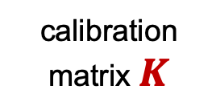
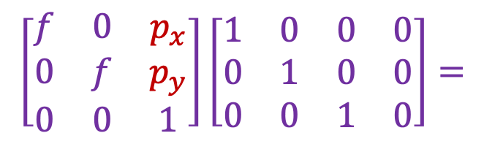
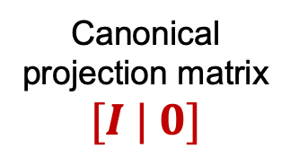

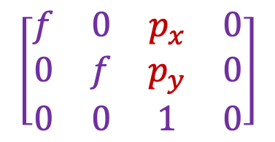
Intrinsic parameters: Principal point
p_{y}
Principal point: $(px, py)$
p_{x}
$$\left[\begin{matrix}f & 0 & p_{x} \\ 0 & f & p_{y} \\ 0 & 0 & 1\end{matrix}\right]\left[\begin{matrix}1 & 0 & 0 & 0 \\ 0 & 1 & 0 & 0 \\ 0 & 0 & 1 & 0\end{matrix}\right]=$$
$$\left[\begin{matrix}f & 0 & p_{x} & 0 \\ 0 & f & p_{y} & 0 \\ 0 & 0 & 1 & 0\end{matrix}\right]$$
calibration matrix $K$
Canonical projection matrix $[I | 0]$
$$P=K[I|0]$$

Slide 10
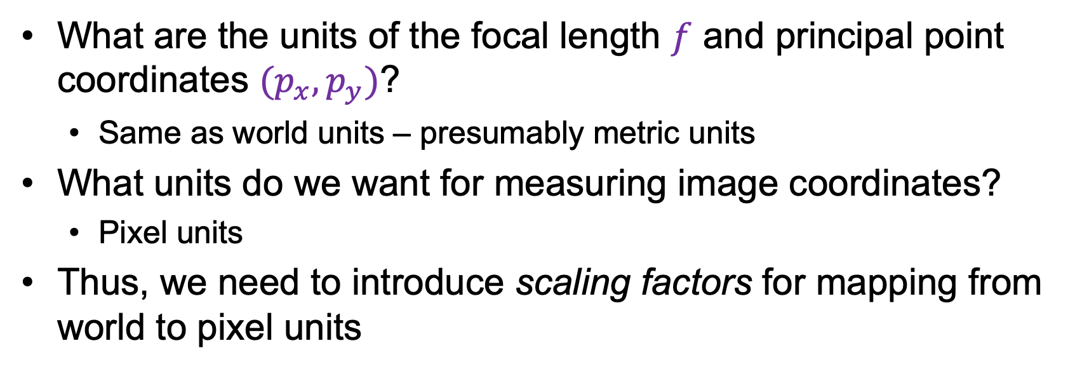
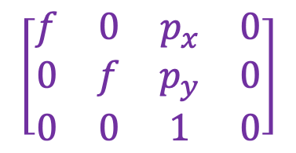
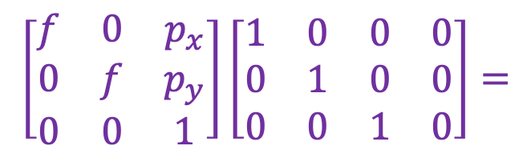
Intrinsic parameters: Principal point
What are the units of the focal length $f$ and principal point coordinates ${(p}_{x},p_{y})$?
Same as world units – presumably metric units
What units do we want for measuring image coordinates?
Pixel units
Thus, we need to introduce scaling factors for mapping from world to pixel units
$$\left[\begin{matrix}f & 0 & p_{x} \\ 0 & f & p_{y} \\ 0 & 0 & 1\end{matrix}\right]\left[\begin{matrix}1 & 0 & 0 & 0 \\ 0 & 1 & 0 & 0 \\ 0 & 0 & 1 & 0\end{matrix}\right]=$$
$$\left[\begin{matrix}f & 0 & p_{x} & 0 \\ 0 & f & p_{y} & 0 \\ 0 & 0 & 1 & 0\end{matrix}\right]$$
calibration matrix $K$
Canonical projection matrix $[I | 0]$
$$P=K[I|0]$$

Slide 11
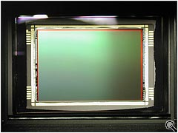
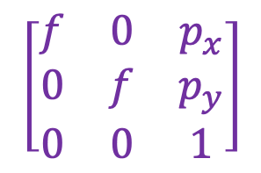
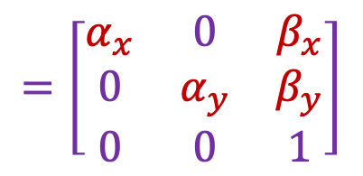
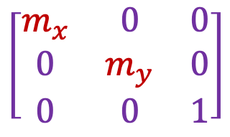
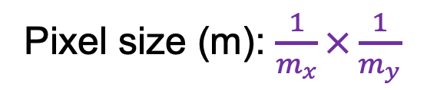
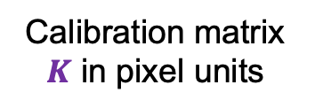

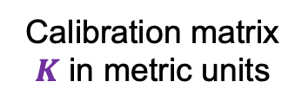
Intrinsic parameters: Scaling factors
Camera sensor
$mx$ pixels/m in horizontal direction, $my$ pixels/m in vertical direction
Pixel size (m): $\frac{1}{m_{x}}×\frac{1}{m_{y}}$
Calibration matrix $K$ in metric units
Calibration matrix $K$ in pixel units
Scaling factors
$$\left[\begin{matrix}m_{x} & 0 & 0 \\ 0 & m_{y} & 0 \\ 0 & 0 & 1\end{matrix}\right]$$
$$\left[\begin{matrix}f & 0 & p_{x} \\ 0 & f & p_{y} \\ 0 & 0 & 1\end{matrix}\right]$$
$$=\left[\begin{matrix}α_{x} & 0 & β_{x} \\ 0 & α_{y} & β_{y} \\ 0 & 0 & 1\end{matrix}\right]$$
pixels/m
m
pixels
Notes:
To convert from metric image coordinates to pixel coordinates, we have to multiply the x, y coordinates by the x, y pixel magnification factors (pix/m)
Beta_x, beta_y is the principal point coordinates in pixels

Slide 12
Extrinsic parameters: Rotation and translation
In general, the camera coordinate frame will be related to the world coordinate frame by a rotation and a translation
camera coordinate system
world coordinate system

Slide 13


Extrinsic parameters: Rotation and translation
In general, the camera coordinate frame will be related to the world coordinate frame by a rotation and a translation
camera coordinate system
world coordinate system
In non-homogeneous coordinates, the transformation from world to normalized camera coordinate system is given by:
$${\tilde{X}}_{cam}=R\left(\tilde{X}−\tilde{C}\right)$$
$$=R\tilde{X}+t$$
coords. of point in normalized camera frame
coords. of camera center in world frame
3x3 rotation matrix
coords. of a point in world frame

Slide 14
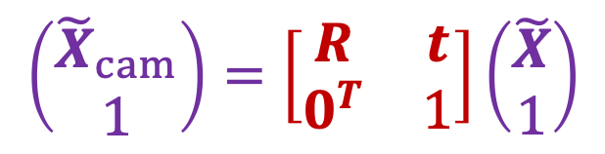

Extrinsic parameters: Rotation and translation
In non-homogeneous coordinates:
In homogeneous coordinates:
$$\left(\begin{aligned}{\tilde{X}}_{cam} \\ 1\end{aligned}\right)=\left[\begin{matrix}R & t \\ 0^{T} & 1\end{matrix}\right]\left(\begin{aligned}\tilde{X} \\ 1\end{aligned}\right)$$
$${\tilde{X}}_{cam}=R\tilde{X}+t$$
3D transformation matrix (4 x 4)

Slide 15

Extrinsic parameters: Rotation and translation
In non-homogeneous coordinates:
In homogeneous coordinates:
$${\tilde{X}}_{cam}=R\tilde{X}+t$$
$$X_{cam}=\left[\begin{matrix}R & t \\ 0^{T} & 1\end{matrix}\right]X$$
3D transformation matrix (4 x 4)

Slide 16
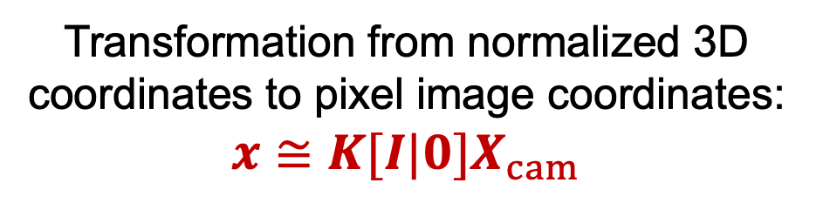
Extrinsic parameters: Rotation and translation
In non-homogeneous coordinates:
In homogeneous coordinates:
$${\tilde{X}}_{cam}=R\tilde{X}+t$$
$$X_{cam}=\left[\begin{matrix}R & t \\ 0^{T} & 1\end{matrix}\right]X$$
Transformation from normalized 3D coordinates to pixel image coordinates:
$$x≅K[I|0]X_{cam}$$

Slide 17

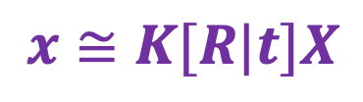
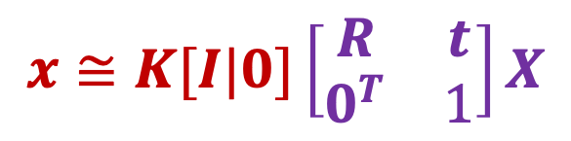
Extrinsic parameters: Rotation and translation
In homogeneous coordinates:
$$x≅K[I|0]\left[\begin{matrix}R & t \\ 0^{T} & 1\end{matrix}\right]X$$
Finally:
$$x≅K[R|t]X$$
$$t=−R\tilde{C}$$

Slide 18

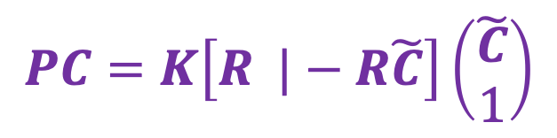


Extrinsic parameters: Rotation and translation
coords. of camera center in world frame
$$x≅K[R|t]X$$
$$t=−R\tilde{C}$$
What is the projection of the camera center in world coordinates?
$$PC=K\left[R |−R\tilde{C}\right]\left(\begin{aligned}\tilde{C} \\ 1\end{aligned}\right)$$
$$=K\left(R\tilde{C}−R\tilde{C}\right)=0$$
The camera center is the null space of the projection matrix!

Slide 19
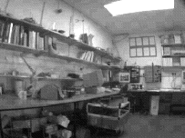
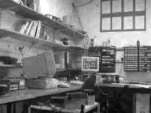
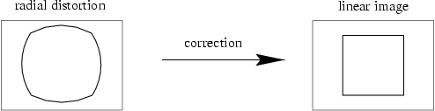
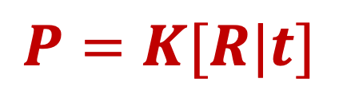
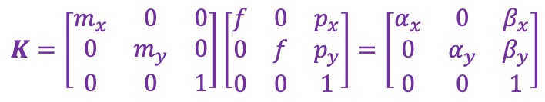
Camera parameters: Summary
$$P=K[R|t]$$
Intrinsic parameters
Principal point coordinates
Focal length
Pixel magnification factors
Skew (non-rectangular pixels) – not important in practice
Radial distortion – important in practice!
$$K=\left[\begin{matrix}m_{x} & 0 & 0 \\ 0 & m_{y} & 0 \\ 0 & 0 & 1\end{matrix}\right]\left[\begin{matrix}f & 0 & p_{x} \\ 0 & f & p_{y} \\ 0 & 0 & 1\end{matrix}\right]=\left[\begin{matrix}α_{x} & 0 & β_{x} \\ 0 & α_{y} & β_{y} \\ 0 & 0 & 1\end{matrix}\right]$$

Slide 20
Overview
Camera calibration
Intrinsic camera parameters
Extrinsic camera parameters
Estimation

Slide 21
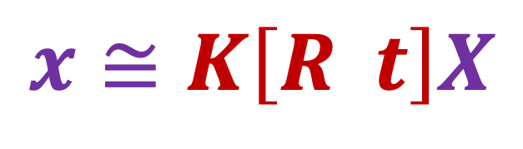
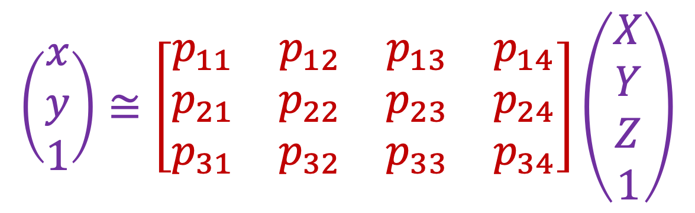
Camera calibration
$$x≅K\left[R t\right]X$$
$$\left(\begin{aligned}x \\ y \\ 1\end{aligned}\right)≅\left[\begin{matrix}p_{11} & p_{12} & p_{13} & p_{14} \\ p_{21} & p_{22} & p_{23} & p_{24} \\ p_{31} & p_{32} & p_{33} & p_{34}\end{matrix}\right]\left(\begin{aligned}X \\ Y \\ Z \\ 1\end{aligned}\right)$$

Slide 22
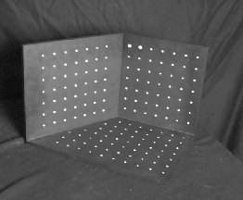




Camera calibration
Given $n$ points with known 3D coordinates $Xi$ and known image projections $xi$, estimate the camera parameters
$$Xi$$
$$xi$$
$$P$$

Slide 23
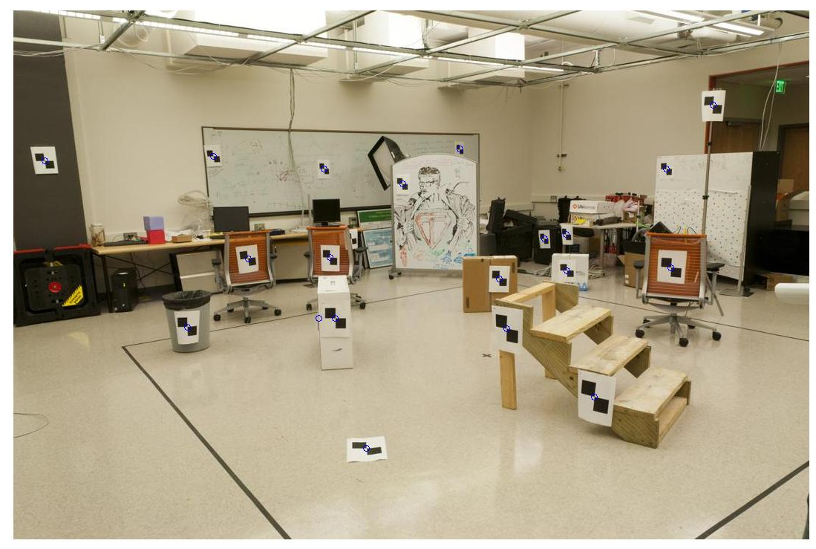
Camera calibration
Given $n$ points with known 3D coordinates $Xi$ and known image projections $xi$, estimate the camera parameters
Known 2D image coords
Known 3D locations
880 214
43 203
270 197
886 347
745 302
943 128
476 590
419 214
317 335
783 521
235 427
665 429
655 362
427 333
412 415
746 351
434 415
525 234
716 308
602 187
312.747 309.140 30.086
305.796 311.649 30.356
307.694 312.358 30.418
310.149 307.186 29.298
311.937 310.105 29.216
311.202 307.572 30.682
307.106 306.876 28.660
309.317 312.490 30.230
307.435 310.151 29.318
308.253 306.300 28.881
306.650 309.301 28.905
308.069 306.831 29.189
309.671 308.834 29.029
308.255 309.955 29.267
307.546 308.613 28.963
311.036 309.206 28.913
307.518 308.175 29.069
309.950 311.262 29.990
312.160 310.772 29.080
311.988 312.709 30.514
Image credit: J. Hays

Slide 24

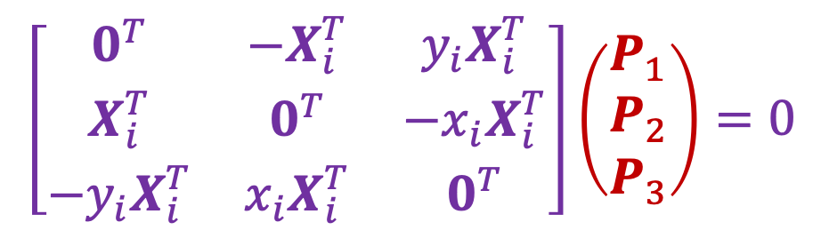


Camera calibration: Linear method
Recall homography fitting:
$$\left(\begin{matrix}x_{i} \\ y_{i} \\ 1\end{matrix}\right)×\left(\begin{matrix}P_{1}^{T}X_{i} \\ P_{2}^{T}X_{i} \\ P_{3}^{T}X_{i}\end{matrix}\right)=0$$
$$x_{i}≅PX_{i}$$
$$x_{i}×PX_{i}=0$$
$$\left[\begin{matrix}0^{T} & {−X}_{i}^{T} & {y_{i}X}_{i}^{T} \\ X_{i}^{T} & 0^{T} & −x_{i}X_{i}^{T} \\ −y_{i}X_{i}^{T} & x_{i}X_{i}^{T} & 0^{T}\end{matrix}\right]\left(\begin{matrix}P_{1} \\ P_{2} \\ P_{3}\end{matrix}\right)=0$$
One match gives two linearly independent constraints

Slide 25
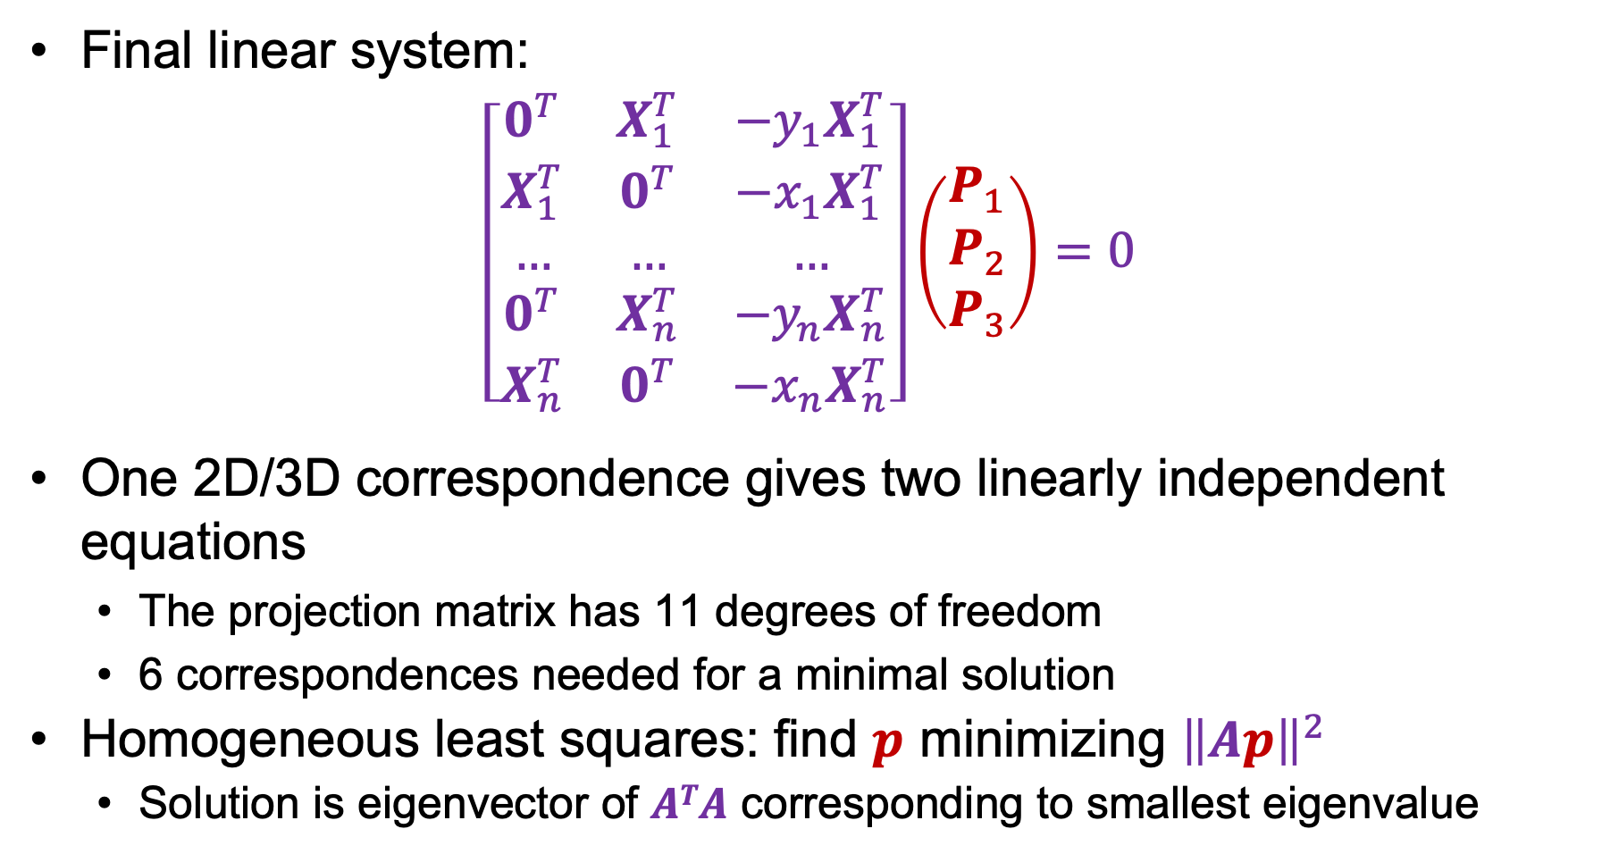

Camera calibration: Linear method
Final linear system:
$$\left[\begin{matrix}0^{T} & X_{1}^{T} & −y_{1}X_{1}^{T} \\ X_{1}^{T} & 0^{T} & −x_{1}X_{1}^{T} \\ … & … & … \\ 0^{T} & X_{n}^{T} & −y_{n}X_{n}^{T} \\ X_{n}^{T} & 0^{T} & −x_{n}X_{n}^{T}\end{matrix}\right]\left(\begin{matrix}P_{1} \\ P_{2} \\ P_{3}\end{matrix}\right)=0$$
One 2D/3D correspondence gives two linearly independent equations
The projection matrix has 11 degrees of freedom
6 correspondences needed for a minimal solution
Homogeneous least squares: find $p$ minimizing ${\left\|Ap\right\|}^{2}$
Solution is eigenvector of $ATA$ corresponding to smallest eigenvalue
$$Ap=0$$

Slide 26
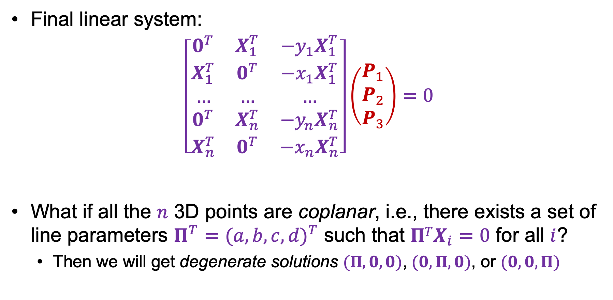
Camera calibration: Linear method
Final linear system:
$$\left[\begin{matrix}0^{T} & X_{1}^{T} & −y_{1}X_{1}^{T} \\ X_{1}^{T} & 0^{T} & −x_{1}X_{1}^{T} \\ … & … & … \\ 0^{T} & X_{n}^{T} & −y_{n}X_{n}^{T} \\ X_{n}^{T} & 0^{T} & −x_{n}X_{n}^{T}\end{matrix}\right]\left(\begin{matrix}P_{1} \\ P_{2} \\ P_{3}\end{matrix}\right)=0$$
What if all the $n$ 3D points are coplanar, i.e., there exists a set of line parameters $Π^{T}={(a,b,c,d)}^{T}$ such that $ΠTX_{i}=0$ for all $i$?
Then we will get degenerate solutions $(Π,0,0)$, $(0,Π,0)$, or $(0,0,Π)$
$$Ap=0$$

Slide 27


Camera calibration: Linear vs. nonlinear
Linear calibration is easy to formulate and solve, but it doesn’t directly tell us the camera parameters
$$\left(\begin{aligned}x \\ y \\ 1\end{aligned}\right)≅\left[\begin{matrix}p_{11} & p_{12} & p_{13} & p_{14} \\ p_{21} & p_{22} & p_{23} & p_{24} \\ p_{31} & p_{32} & p_{33} & p_{34}\end{matrix}\right]\left(\begin{aligned}X \\ Y \\ Z \\ 1\end{aligned}\right)$$
vs.
$$x≅K\left[R | t\right]X$$

Slide 28

Camera calibration: Linear vs. nonlinear
Linear calibration is easy to formulate and solve, but it doesn’t directly tell us the camera parameters
In practice, non-linear methods are preferred
Write down objective function in terms of intrinsic and extrinsic parameters, as sum of squared distances between measured 2D points and estimated projections of 3D points:
$$\sum_{i}{{\left\|proj\left(K\left[R | t\right]X_{i}\right)−x_{i}\right\|}_{2}^{2}}$$
Can include radial distortion and constraints such as known focal length, orthogonality, visibility of points
Minimize error using non-linear optimization package
Can initialize solution with output of linear method (perform QR decomposition to get $K$ and $R$ from $P$)

Slide 29
Overview
Camera calibration
Intrinsic camera parameters
Extrinsic camera parameters
Estimation
First taste of 3D reconstruction: triangulation

Slide 30



Triangulation
Given projections of a 3D point in two or more images (with known camera matrices), find the coordinates of the point

Slide 31

Triangulation
Given projections of a 3D point in two or more images (with known camera matrices), find the coordinates of the point
$$X?$$

Slide 32





Triangulation
Given projections of a 3D point in two or more images (with known camera matrices), find the coordinates of the point
$$X?$$
$$x2$$
$$x1$$
$$O1$$
$$O2$$

Slide 33

Triangulation
We want to intersect the two visual rays corresponding to $x1$ and $x2$, but because of noise and numerical errors, they don’t meet exactly
$$X?$$
$$x2$$
$$x1$$
$$O1$$
$$O2$$

Slide 34


Triangulation: Geometric approach
Find shortest segment connecting the two viewing rays and let $X$ be the midpoint of that segment
$$X$$
$$x2$$
$$x1$$
$$O1$$
$$O2$$

Slide 35




Triangulation: Nonlinear approach
Find $X$ that minimizes
$${\left\|{proj(P}_{1}X)−x_{1}\right\|}_{2}^{2}+{\left\|{proj(P}_{2}X)−x_{2}\right\|}_{2}^{2}$$
$$X?$$
$$P1X$$
$$x2$$
$$x1$$
$$P2X$$
$$O1$$
$$O2$$

Slide 36




Triangulation: Linear approach
$$x_{1}≅P_{1}X$$
$$x_{2}≅P_{2}X$$
$$x_{1}×P_{1}X=0$$
$$x_{2}×P_{2}X=0$$
$$[{x_{1}}_{×}]P_{1}X=0$$
$$[{x_{2}}_{×}]P_{2}X=0$$
Rewrite cross product as matrix multiplication:
$$a×b=\left[\begin{matrix}0 & −a_{3} & a_{2} \\ a_{3} & 0 & −a_{1} \\ {−a}_{2} & a_{1} & 0\end{matrix}\right]\left(\begin{aligned}b_{1} \\ b_{2} \\ b_{3}\end{aligned}\right)=[a_{×}]b$$

Slide 37

Triangulation: Linear approach
$$x_{1}≅P_{1}X$$
$$x_{2}≅P_{2}X$$
$$x_{1}×P_{1}X=0$$
$$x_{2}×P_{2}X=0$$
$$[{x_{1}}_{×}]P_{1}X=0$$
$$[{x_{2}}_{×}]P_{2}X=0$$
Two independent equations each in terms of three unknown entries of $X$

Slide 38



Preview: Structure from motion
Figure credit: Noah Snavely
Camera 1
Camera 3
$$R1,t1$$
Camera 2
$$R2,t2$$
$$R3,t3$$
Given 2D point correspondences between multiple images, compute the camera parameters and the 3D points
Notes:
Structure from motion solves the following problem:
Given a set of images of a static scene with 2D points in correspondence, shown here as color-coded points, find…
a set of 3D points P and
a rotation R and position t of the cameras that explain the observed correspondences. In other words, when we project a point into any of the cameras, the reprojection error between the projected and observed 2D points is low.
This problem can be formulated as an optimization problem where we want to find the rotations R, positions t, and 3D point locations P that minimize sum of squared reprojection errors f. This is a non-linear least squares problem and can be solved with algorithms such as Levenberg-Marquart. However, because the problem is non-linear, it can be susceptible to local minima. Therefore, it’s important to initialize the parameters of the system carefully. In addition, we need to be able to deal with erroneous correspondences.

Slide 39
Preview: Structure from motion
?
Camera 1
Camera 3
$$R1,t1$$
Camera 2
$$R2,t2$$
$$R3,t3$$
Structure: Given known cameras and projections of the same 3D point in two or more images, compute the 3D coordinates of that point
Triangulation!
Notes:
Structure from motion solves the following problem:
Given a set of images of a static scene with 2D points in correspondence, shown here as color-coded points, find…
a set of 3D points P and
a rotation R and position t of the cameras that explain the observed correspondences. In other words, when we project a point into any of the cameras, the reprojection error between the projected and observed 2D points is low.
This problem can be formulated as an optimization problem where we want to find the rotations R, positions t, and 3D point locations P that minimize sum of squared reprojection errors f. This is a non-linear least squares problem and can be solved with algorithms such as Levenberg-Marquart. However, because the problem is non-linear, it can be susceptible to local minima. Therefore, it’s important to initialize the parameters of the system carefully. In addition, we need to be able to deal with erroneous correspondences.

Slide 40
Preview: Structure from motion
Camera 1
?
Camera 3
$$R1,t1$$
Camera 2
?
?
$$R2,t2$$
$$R3,t3$$
Motion: Given a set of known 3D points seen by a camera, compute the camera parameters
Calibration!
Notes:
Structure from motion solves the following problem:
Given a set of images of a static scene with 2D points in correspondence, shown here as color-coded points, find…
a set of 3D points P and
a rotation R and position t of the cameras that explain the observed correspondences. In other words, when we project a point into any of the cameras, the reprojection error between the projected and observed 2D points is low.
This problem can be formulated as an optimization problem where we want to find the rotations R, positions t, and 3D point locations P that minimize sum of squared reprojection errors f. This is a non-linear least squares problem and can be solved with algorithms such as Levenberg-Marquart. However, because the problem is non-linear, it can be susceptible to local minima. Therefore, it’s important to initialize the parameters of the system carefully. In addition, we need to be able to deal with erroneous correspondences.

Slide 41

Multi-view geometry “Bible”

