Slide 1
The New Politics
Notes:
What to take.
laptop
projector,
extension cable
Multi-board
HDMI cable
speakers

Slide 2
Into / Background
Governance Matters
Some ideas
What are we here to do
Discussion
Notes:
Welcome, thanks for coming, agenda, expectations
I’ll try not to preach too long, after all I did say it would be a discussion but having gathered you here it behoves me to lay some kind of rug for this picnic.

Slide 3
Intro / Background
Notes:
My background / Journey
IT Background
TOP
How is it broken
No way for everyday people to direct our country
Parties are focused on getting votes not giving value, not bring people together
Yes I have a vision and some ideas, but I also have a burden, I’m worried about us:
Ideological division
Big decisions – climate, environment, food, water
Likewise democracy is on the decline world-wide, as tensions rise, increasingly authoritarian leaders who will put the other side in their place.
Democracy needs to be nurtured and grown. staying still is going backwards
For along time being passive citizens has been ok but that time is fading,
I fear that if we don’t build a new approach then things are going is disintegrate – especially with the climate squeeze

Slide 4
Three fruitless ways to talk politics:
The feel good conversation
The heated argument
The wasted effort

Slide 5
Governance Matters
Notes:
The process used to make decisions about laws we live under and how we organise our society-
Tax, welfare, environment, education, health it makes a material difference to our lives
Governance underpins everything else, and it needs some serious attention
We talk a lot about the things which governance cares about, but we talk very little about governance itself and our role in it

Slide 6
What might good democratic governance look like?
Everyday people coming together…
in the belief that they are sovereign democratic citizens with the power and responsibility to direct their country;
with the intention of collaborating and listening to each other across worlds and ideologies;
with a humble acceptance that none of us have all the answers, and that issues are complex and require nuanced, open conversations;
to collectively bear the burden of the decision and its outcomes through wide scale participatory process, resulting in concrete action (or inaction) which isn’t then tampered with in the 11th hour by external interests
Notes:
Sovereignty in democratic sense:
Governance is the process – but who has ultimately authority?
It’s not Parliament, it’s us, the buck stops with us
We are the “board of directors“
But to what extent do to we see our selves as that way?
“All the responsibility we abdicate will be taken up by tyrants” – JP

Slide 7
Where are we today?
We don’t see ourselves sovereign citizens with the responsibility to direct our country
We have a culture of buck-passing and blaming politicians
We group together with likeminded people, only opening the door to fire shots at the other side
Parties are myopically focused on getting votes, rather than finding ways to foster collaboration
Our political vehicles (parties) are not fit for purpose
Notes:
A cultural issue as much as a political one
We too often see it as being up to “them” the politicians to fix it, not us.

Slide 8
New Politics, New Vehicle
Some Ideas:
Focused on what it can give (as in value), not on what it can get (as in votes)
Based around a super-ideology of collaboration
Invites people with different views to work together
Offers a framework and meeting place to re-make political culture
Makes participation extremely accessible
Needs a very member base (200k+)
Not direct democracy
Notes:
What do I mean by a political vehicle
A means of getting somewhere politically
A connection between citizens and governance
What does a new political vehicle need to look like.
200k is not out of hubris, just what’s realistically required, 200k is only ~7% of voters:
Legitimacy requires a very large number to participate
5% threshold to get MP in parliament
The 200k is not stated out of hubris, it’s just what’s required as a minimum starting point for this model to be legitimate and as a wild as it sounds, it’s still in my view more realistic than successfully navigating the increasing turbulence in our current political dinghies (i.e. our present unsophisticated parties, who are ever-focused on the getting vote by any means possible).
- The flowing are just a few concepts diagrams with ideas about how it could work.

Slide 9
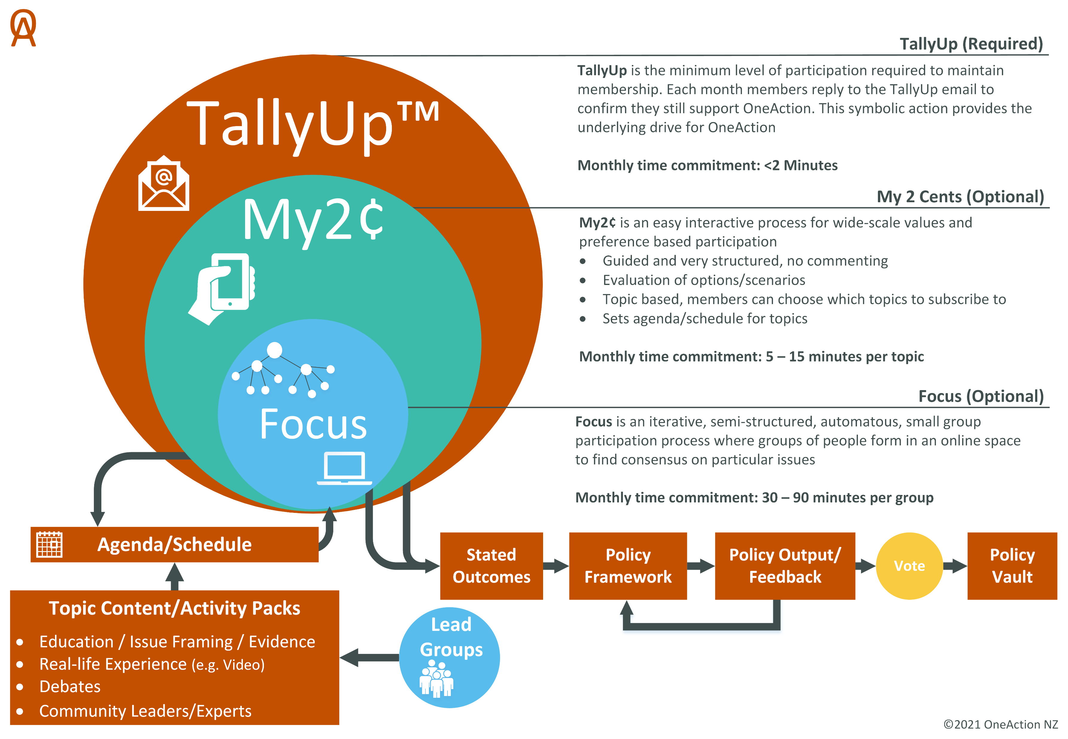

Slide 10
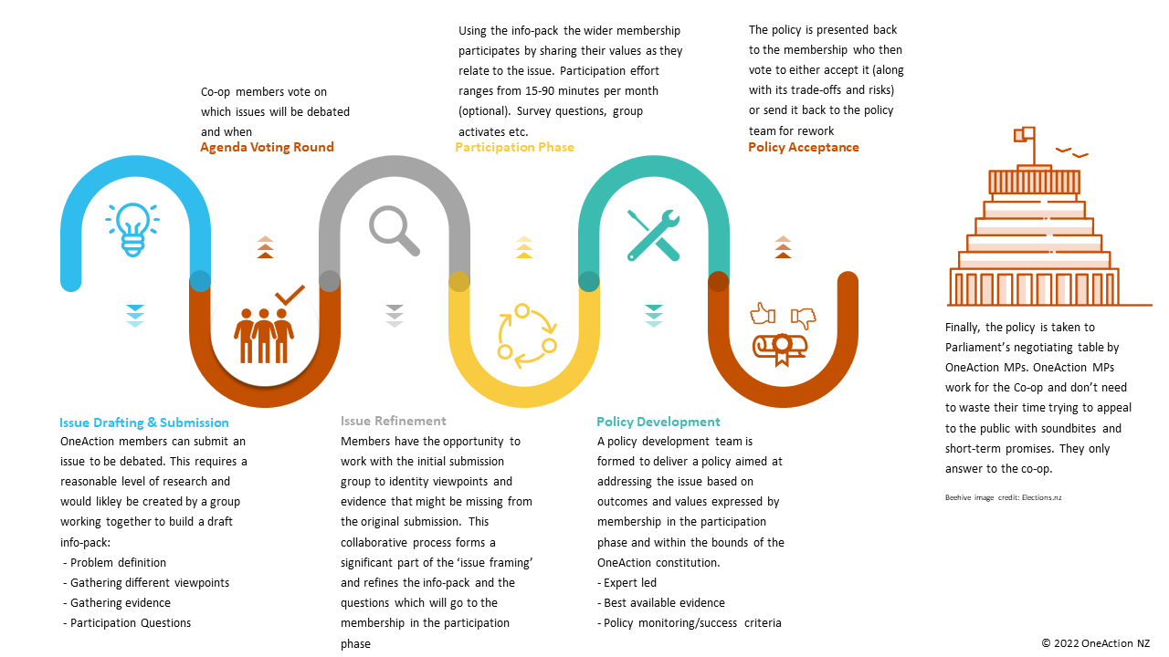

Slide 11
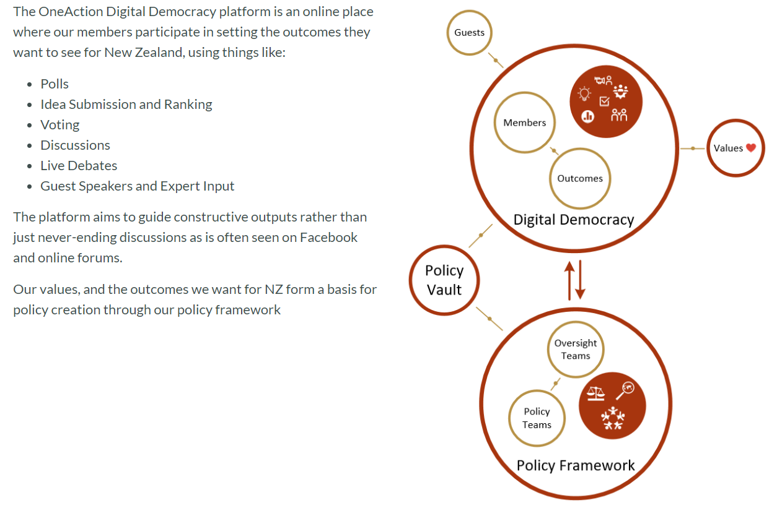

Slide 12
Discussion Points
General Questions/Comments
Start-up Scaffolding
Capacity/limitations/expectations/sustainability
Next steps
Horizon
Internal Governance
Constitution

Slide 13
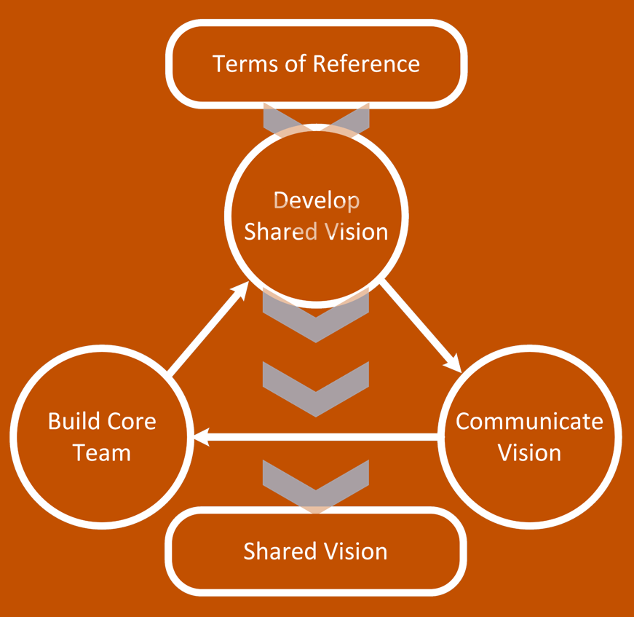
Start-up Scaffolding?
Establish a meeting format
Develop a terms of reference for this group
Develop a shared vision
Communicate vision
Notes:
- Develop a terms of reference for this group – what do we need to focus on in this first state
Establish a meeting format which can simultaneously bring new people up to speed but also make progress. Split session?

Slide 14
A group of people exploring how we might develop a vision for a better way of doing politics
We come together not to ‘talk politics’ but to ‘talk about politics’

