Slide 1

Papadopoulos Nikolaos
Dementia in Greece compared to Europe
Data visualization & Communication
Professors: Karlis D., Platis N.

Slide 2
Know your Data
Data on causes of death (COD) provide information on mortality patterns and form a major element of public health information.
The COD data refer to the underlying cause which - according to the World Health Organization (WHO) - is "the disease or injury which initiated the train of morbid events leading directly to death, or the circumstances of the accident or violence which produced the fatal injury".
Standardized death rates are calculated for the age group 0-64 ('premature death') and for the total of ages. As most causes of death vary significantly with people's age and sex, the use of standardized death rates improves comparability over time and between countries.
The (age-) standardized death rate is a weighted average of age-specific mortality rates. The weighting factor is the age distribution of a standard reference population. The standard reference population used is the European standard population.

Slide 3
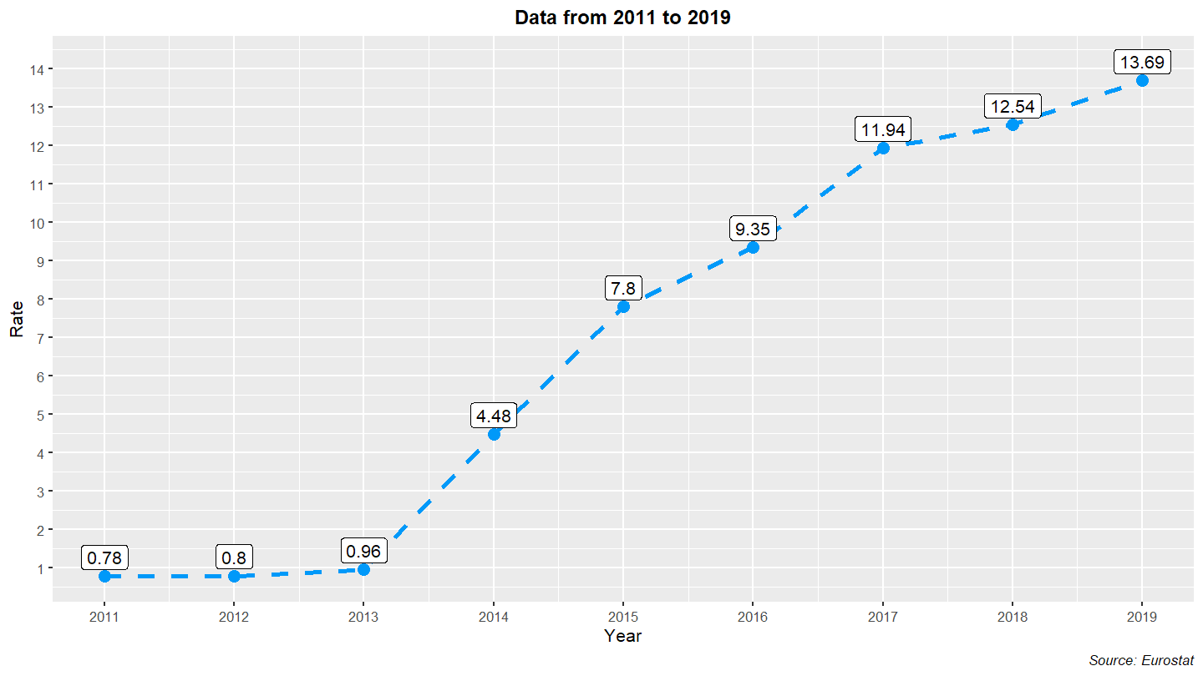
Deaths from Dementia - Trend in Greece

Slide 4
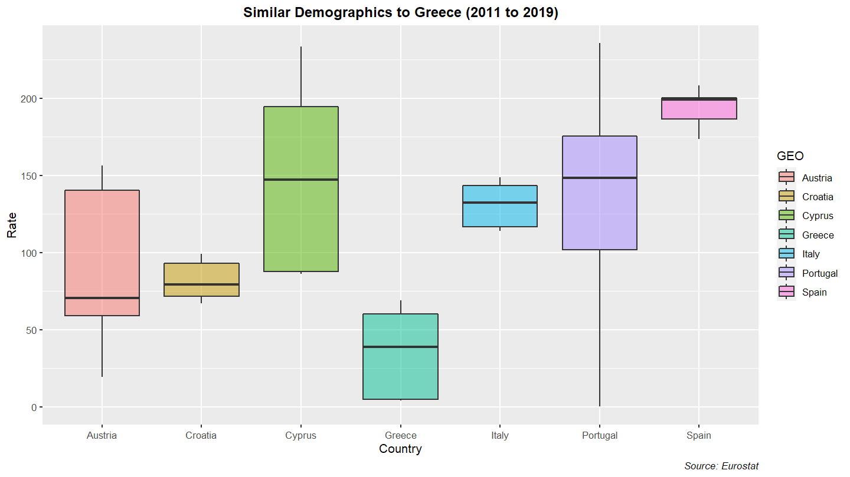
Dementia Death Rate-Distribution of Data

Slide 5
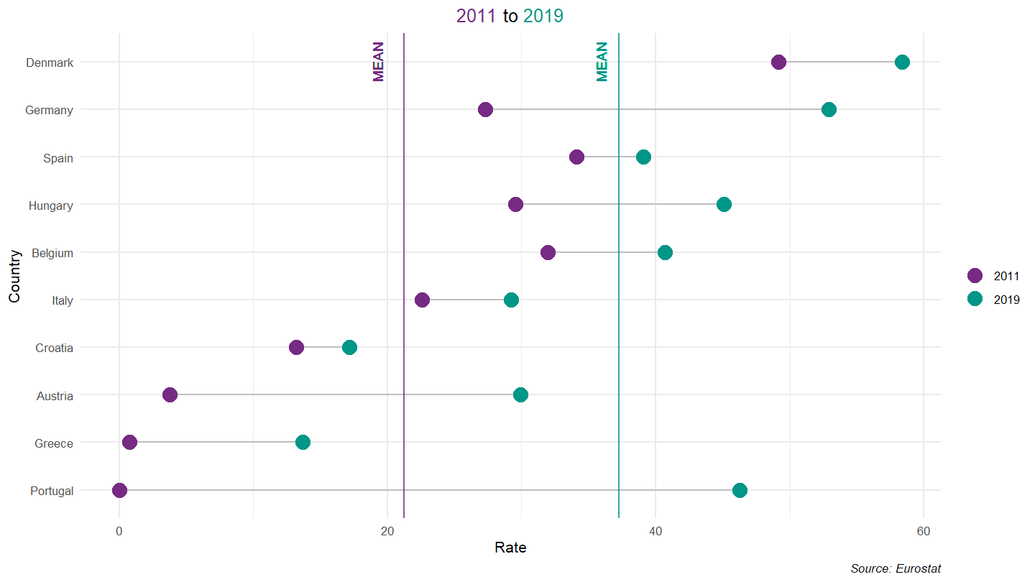
Overall Increase in Dementia Death Rates in EU

Slide 6
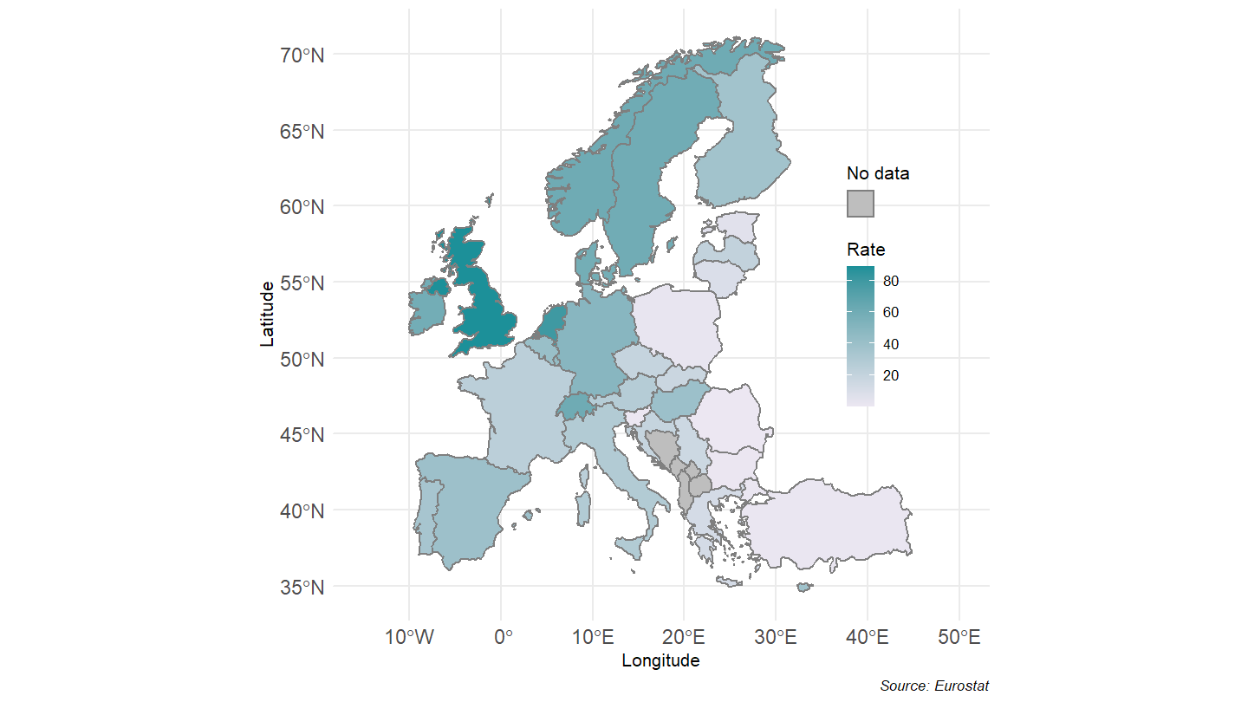
Geographic Heatmap of Dementia death rate in 2017

Slide 7
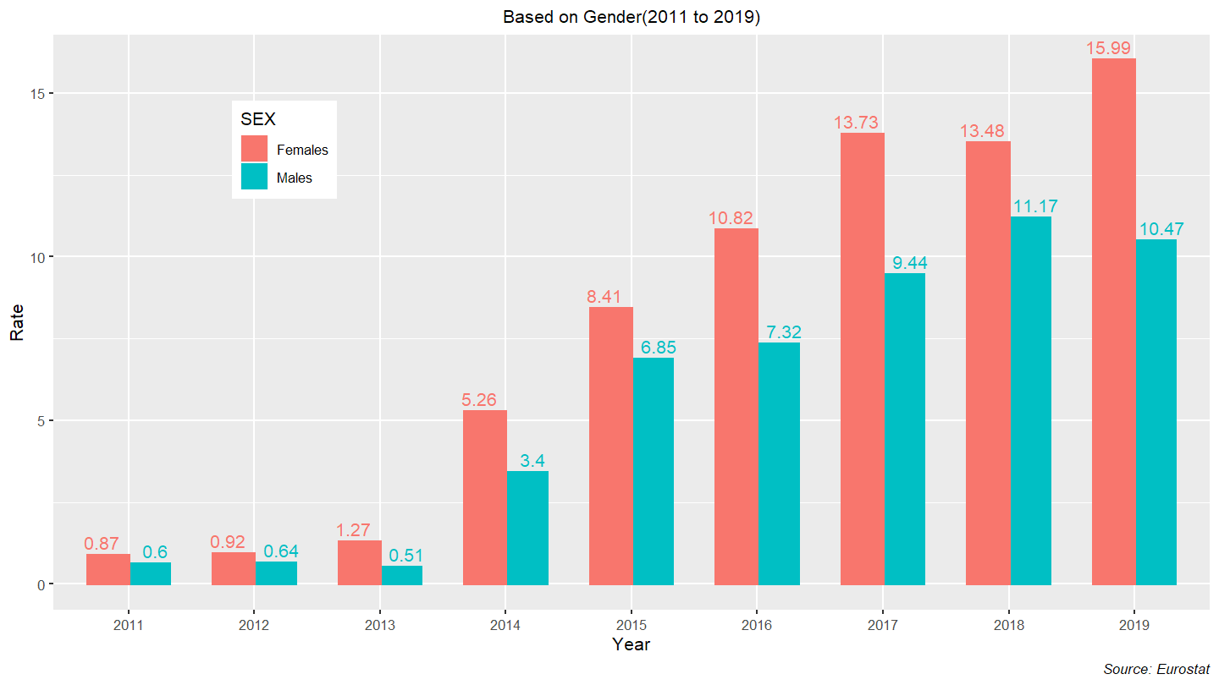
Gender-wise comparison of Dementia Rates in Greece

Slide 8
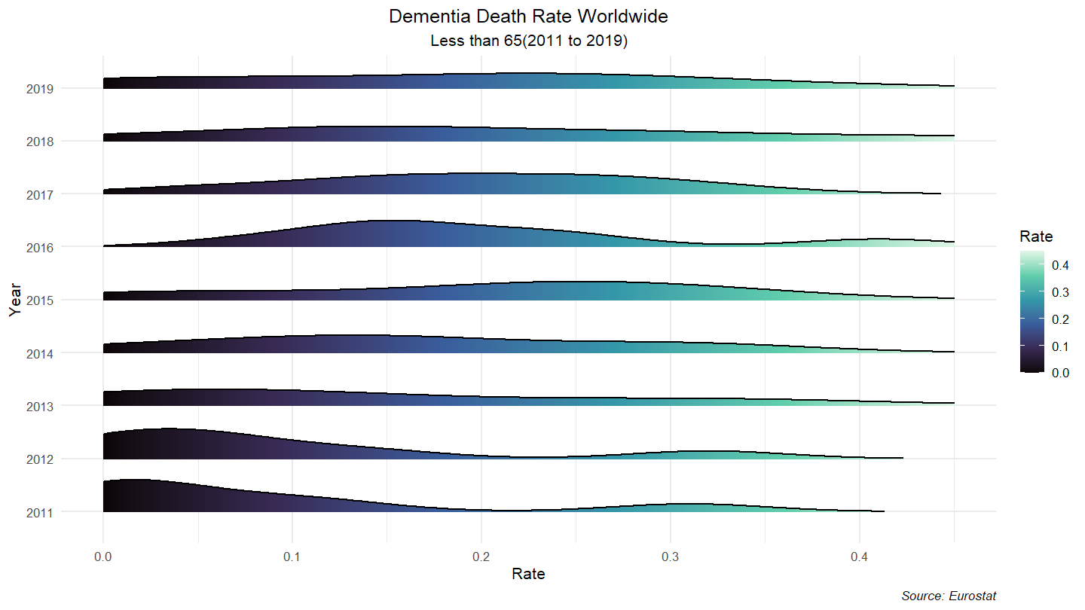
Worldwide Deaths from Dementia in Younger Age Groups

Slide 9
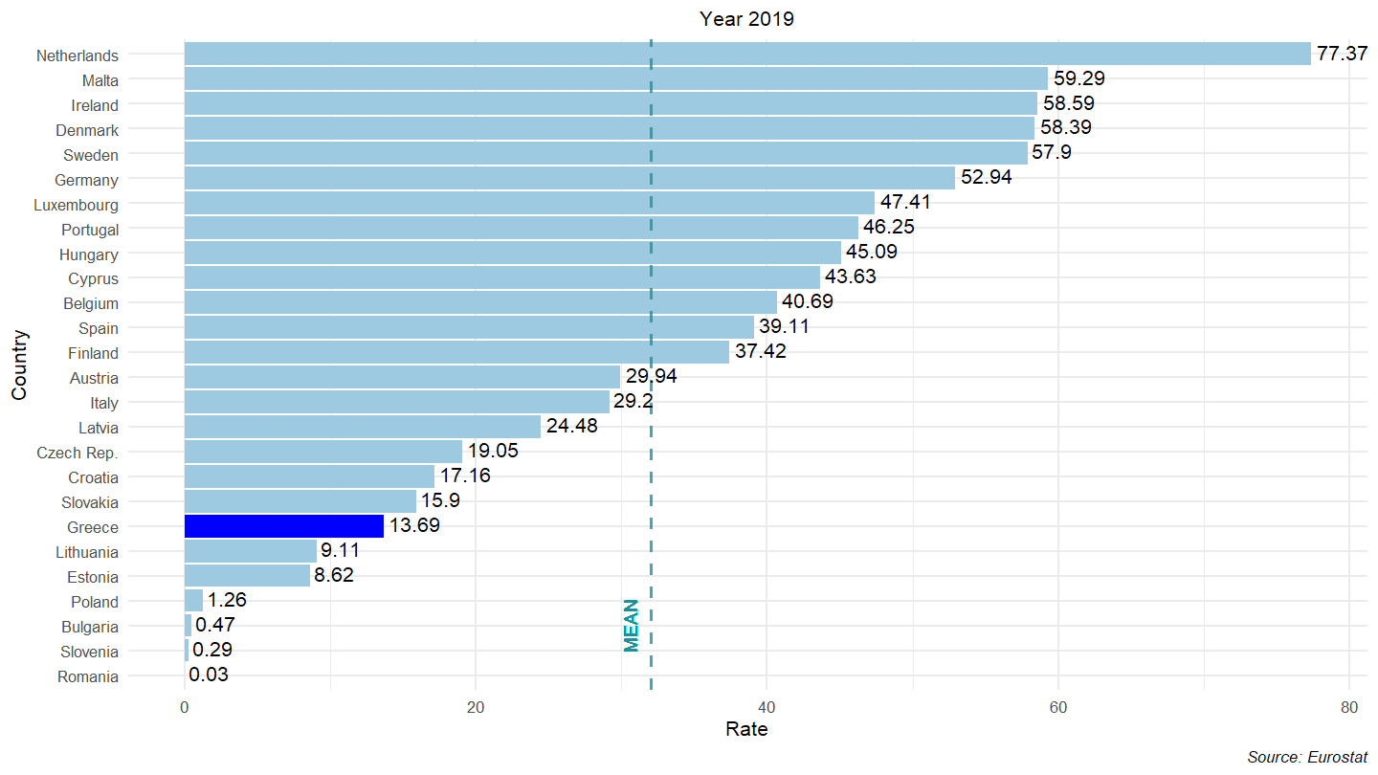
Greece’s Ranking in 2019 amongst EU Countries

Slide 10
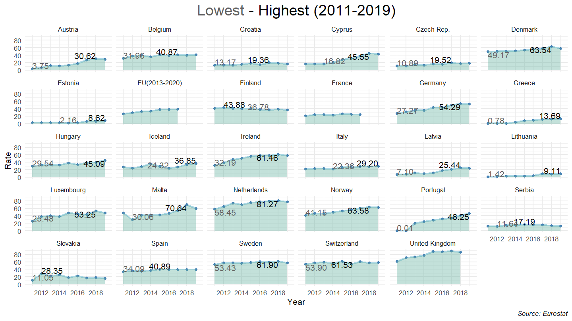
Overall EU Deaths from Dementia Trend (Low–High)

Slide 11
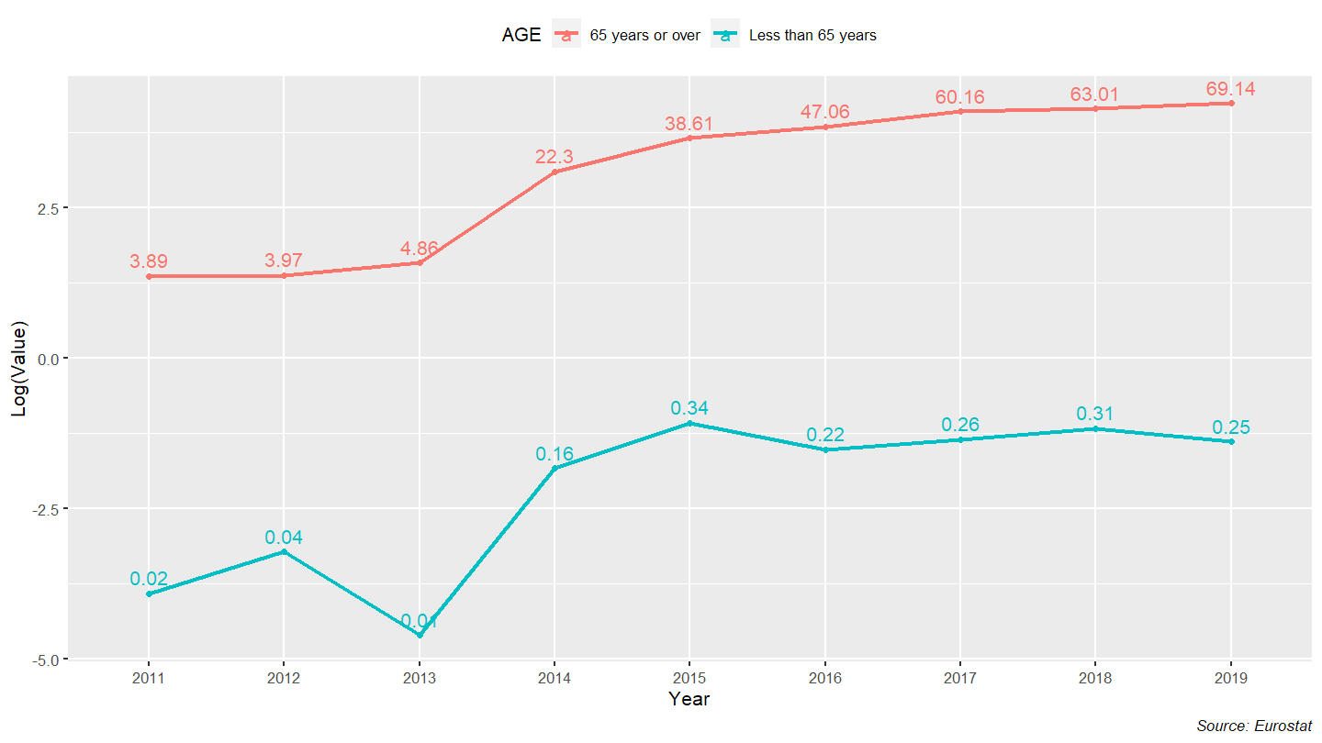
Age-Wise Comparison of Deaths from Dementia in Greece

Slide 12
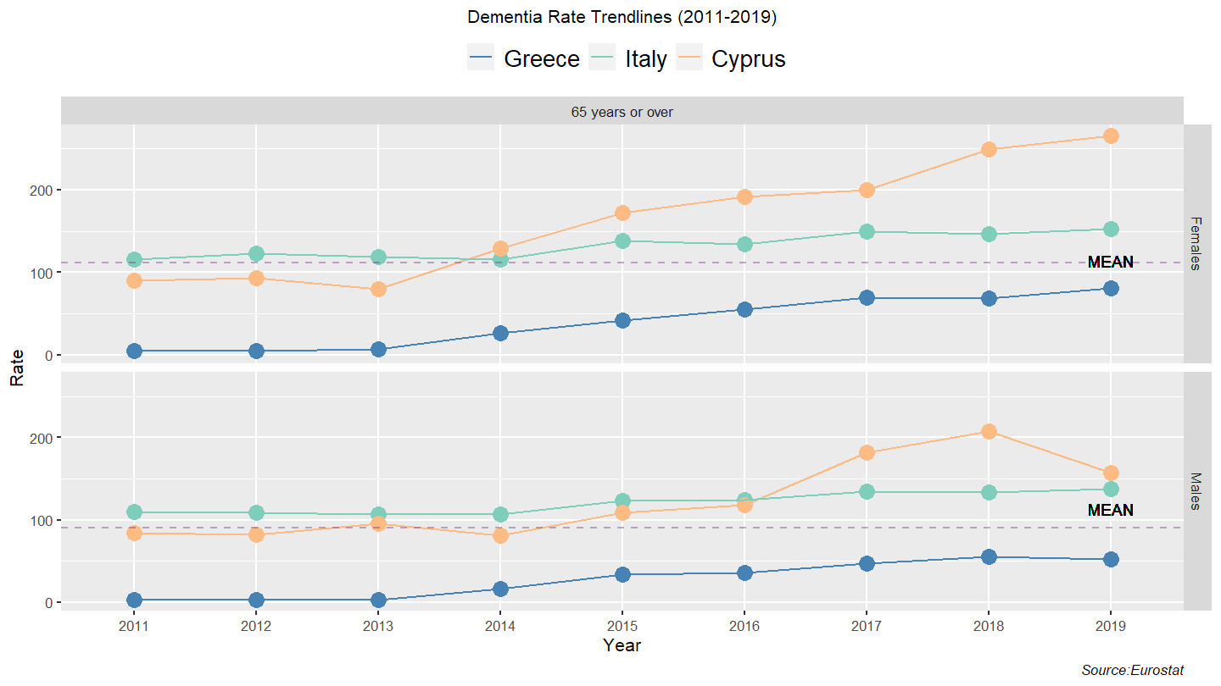
Greece - Italy - Cyprus
(Cultural & Demographic Similarity)

Slide 13
Thank you for your time!

