Slide 1
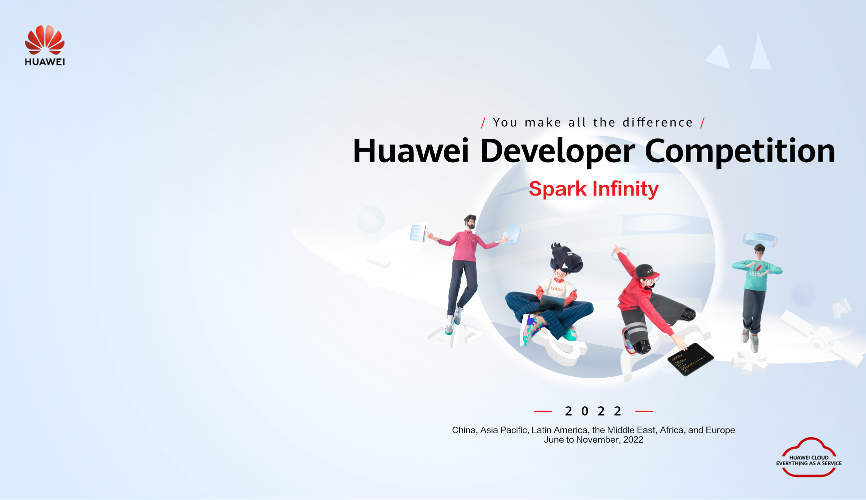
Challenge Name: Cloud Computing Applications Graduation Project
Project Name: PetClinic with Huawei Cloud
Team Name: Fatih Ateş
Organization:
Email/Phone: fatih.ates@ogr.iuc.edu.tr

Slide 2

Cloud Computing Applications Graduation Project
Project Name: PetClinic with Huawei Cloud
Team Name: Fatih Ateş
University: Istanbul University Cerrahpasa
Email/Phone: fatih.ates@ogr.iuc.edu.tr

Slide 3
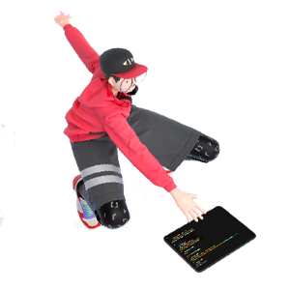

Project Overview
Overview
Project Name | PetClinic
Team Name | Fatih Ateş
Contacts | Fatih Ateş
Technical Field | Web Services
Technologies | ECS, VPC, EIP, RDS, AS, ELB, DevCloud
Keywords | Veterinary medicine with Huawei Cloud Computing
Applicable Fields | in veterinary field
Description | In this project, I designed a project that veterinarians can use in their business life. I implemented this application using Huawei cloud services and I got my app up

Slide 4
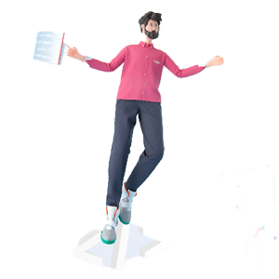
Contents
1
Team Introduction
2
Project Introduction
3
Technical Architecture
4
Business Value
5
Project Planning
6
Achievements

Slide 5
Team Introduction
I received my engineering undergraduate education at Istanbul University Cerrahpaşa. All scopes in this project are mine. I took trainings on frontend web design before and developed them. I wanted to have knowledge and experience about cloud technologies by working on Huawei Cloud.

Slide 6
Project Introduction
I used an open source website project.
This application is a very useful and easy application for veterinarians. The purpose of our application is to record incoming patients and animal owners and keep all information in a database. At the same time, it easily overcomes patient-doctor matching by keeping veterinarians registered in the database.

Slide 7
Technical Architecture
Overview:
ECS, VPC, EIP, RDS, AS, ELB, DevCloud
Thanks to DevCloud, I uploaded, checked, installed and deployed my code.
Thanks to EIP, I opened my ECS to internet access.
Thanks to ELB and AS, I adjusted the input densities of my server.
Thanks to RDS, I have connected my application to a database.
I got my project up and running on a machine thanks to ECS

Slide 8
Business Value
Thanks to the web application and huawei cloud technologies that I have developed, veterinarians will be one step ahead from the others.
Thanks to cloud technologies, it will not be necessary to allocate large amounts of budget to IT units.
It will save time according to the speed of doing business of IT units.

Slide 9
Project Planning
Overall plan is ‘solutions for veterinarians’.
Those working in veterinary medicine must first assign doctors to the database
Later, if there are patients who need to be added before, they should be added.
Subsequently, separate records are created for each incoming patient and their animals are matched with their owners.
Then, the records can be easily checked and changed.
My application is made for veterinarians looking for quick solutions.

Slide 10
Achievements
I learned to use Huawei cloud services.
I learned how to open a web application to the internet using these services.
I learned how important cloud technologies are today and how fast developing technology is.

Slide 11
THANK YOU

