Slide 1
quest-dnsupdate
  Training for Quest Support
  David Leonard, 2008

Slide 2
Slide overview
10,000 ft view
Actors and what they do
Typical and atypical behaviour
Installation of dnsupdate
Troubleshooting examples
Online resources

Slide 3
10,000 ft view
Writeable DNS!
Workstations send their IP and name to DNS
Standard feature in Windows (XP, etc)
Change/creation of IP address means DNS is automatically updated
  Great for large deployments
Can be secure with Kerberos (Active Directory)‏

Slide 4
The cast of actors
The Client
  The host (Microsoft or Unix; workstation or server)‏
The DNS server(s)
The DHCP server
The KDC (Authentication service)
  these 3 actors are usually all in 1 domain controller

Slide 5
What actors say
Client -> DHCP server
  "Give me an IP address“ (DHCPDISCOVER)
Client -> DNS server
  "Who is authoritative for my domain?“ (QUERY SOA)
Client -> KDC
  "Give me a ticket to dns/ns1.example.com“ (AS-REQ)
Client -> authoritative DNS server
  "Update my entry. Here is my name and address"

Slide 6
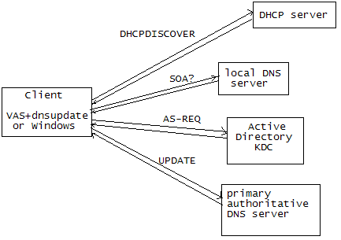
What actors say

Slide 7
Quest-dnsupdate
Available from http://rc.quest.com/
Required parameters:
  local IP address (command line argument)‏
  local nameserver (resolv.conf)‏
  host credentials (host.keytab)‏
What it does:
  Finds an authoritative nameserver
  Sends a DNS UPDATE message (or two)

Slide 8
What quest-dnsupdate doesn’t do
Does not talk to DHCP
Does not look at local interface addresses
Does not retry for hours if network is down
Does not set up the DNS client (resolv.conf)
Does not check for conflicts/duplicates in DNS

Slide 9
DNS records - recap
The DNS is a database of records
Key Value
------------------------ ---------------------
bri100612.prod.quest.corp A 10.20.36.132
132.36.20.10.in-addr.arpa PTR bri100612.prod.quest.corp
prod.quest.corp SOA slcgdcw01.prod.quest.corp
prod.quest.corp NS alvgdcw01.prod.quest.corp
prod.quest.corp NS alvgdcw02.prod.quest.corp
prod.quest.corp NS alvgdcw03.prod.quest.corp
...
prod.quest.corp NS ukbgdcw01.prod.quest.corp
prod.quest.corp NS ukbgdcw02.prod.quest.corp

Slide 10
DNS UPDATE
Normally DNS messages are QUERY reads
  for matching records e.g. www.example.com A
But the UPDATE message is a write request:
  specifies records that must exist before continuing
  specifies records to delete (if they exist)
  specifies new records to insert

Slide 11
Secure Updates
Uses an extension to DNS called DNS-TSIG
A GSSAPI signature is appended to the packet
  Eavesdropper can see the update, but not modify
DNS server may have access controls on entries!
  The signature authenticates the client
  So only the client can update it’s A record
Dnsupdate tries “unsecure" first, and then "secure"

Slide 12
DNS error messages
DNS replies contain a 4 bit response code
  SUCCESS – It worked!
  SERVFAIL – Server failure
  NXDOMAIN – Record not found
  REFUSED – Server refused
  NOTAUTH – Not authorized
Note that REFUSED is often sent instead of NOTAUTH (which is reserved for other msgs)

Slide 13
DHCP integration
“When does dnsupdate run?”
The OS usually has an existing DHCP client
  DHCP is run at boot to get a dynamic IP address
dnsupdate package installs a hook into the DHCP client
DHCP client periodically renews the lease
  DHCP usually client runs as background task
Lease renewal "triggers" dnsupdate to run
=> dnsupdate touches DNS as IP is refreshed

Slide 14
DHCP integration (cont)‏
Details of hook mechanism on web site
An install script helper does the hard work
  /opt/quest/libexec/dnsupdate-install-hooks
  This runs automatically as the package is installed
On most OSs it just modifies an /etc file
  But on Mac OS X, an entire daemon is installed!

Slide 15
No DHCP?
If static IP, then the DNS entry is usually fixed
dnsupdate could be run "manually" from cron
This is unusual situation
  If IP address is fixed, then DNS entry should be too, right?
  But some customers have unusual setups
  The tools are flexible: some bending needed

Slide 16
A and PTR
A is the forward record (name -> address)‏
PTR is the reverse record (address -> name)‏
dnsupdate tries to update both A and PTR
  In the past required special flag (-r)‏
dnsupdate reports error only if A update fails

Slide 17
DHCP server and PTR
Windows hosts usually send DHCP “option 81”
  Also known as the “fqdn” option
Option 81, by default, means:
  The host will send an UPDATE for the A record
  The DHCP server will send an UPDATE for the PTR record!
dnsupdate doesn’t know this!
It’s important that we know this because:
  Permissions on the DNS server may allow only the DHCP server to update PTR records

Slide 18
DNS over TCP
Usually DNS requests are over UDP (port 53)
However, secured updates use TCP
  Because the TSIG Kerberos data is larger than one packet
  Firewalls sometimes pass only DNS-over-UDP
  Both TCP port 53 and UDP port 53 must be open
dnsupdate does most of its queries in TCP
  If using Wireshark to diagnose, remember to capture both udp and tcp ports 53!

Slide 19
Configuration
“Where does dnsupdate get its configuration?”
It reads /etc/resolv.conf
  for the local nameserver
It reads /etc/opt/quest/dnsupdate.conf
  for local policy (see manual page)‏
And it looks at the command line arguments
  again, see manual page for details
  the defaults are sane, I believe

Slide 20
Group Policy
The dnsupdate package installs a VGP ‘xlator’
  Receives group policy settings
  Modifies dnsupdate.conf
  /opt/quest/libexec/vgp/xlators/Machine/quest-dnsupdate
Uses existing MS DNS Client policies
  Uses existing Administrative template
Not all policies are understood!
  See manual page

Slide 21
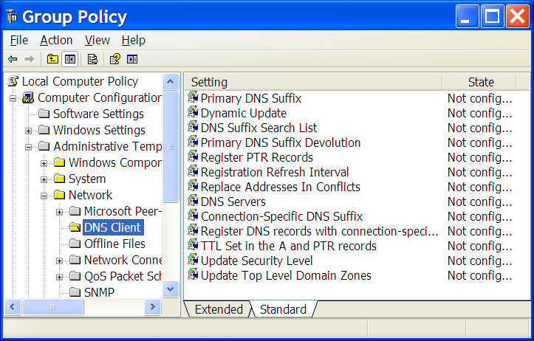
Group Policy

Slide 22
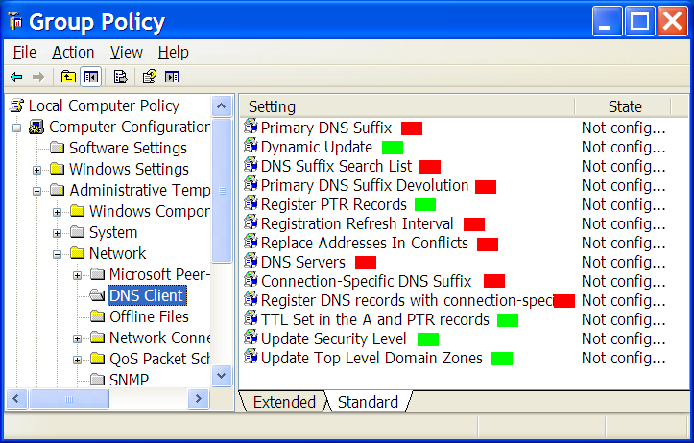
Group Policy

Slide 23
Logs
Logs are written to stderr
Logs are written to syslog
  facility: daemon
  levels: error and warning only
Verbosity of logs enabled with
  multiple -v flags
  VerboseLevel option in dnsupdate.conf

Slide 24
Troubleshooting
First try to run dnsupdate 'manually'
  as root
  with the right IP address as an argument
  with varying numbers of -v flags
    # dnsupdate -v 1.2.3.4
Try specifying parameters to force desired behaviour
  for example, give the target nameserver explicitly
  disable unsecure updates, PTR updates, etc.

Slide 25
Troubleshooting DNS
Learn how to use nslookup or dig
  DNS servers and local caches can get out of sync
    Rare, but that is why we have TTL on entries
    Sometimes wait for cache expires
dnsupdate can dump entire DNS packets
  Enabled with lots of -v
  Wireshark does a better job though
MS DNS server may purge 7-day-old entries
  quest-dnsupdate is driven by DHCP, not cron!

Slide 26
Troubleshooting DHCP client
Skim through the dnsupdate-install script
  Look for which file is hooked for your system
Check the hook is there
Don't re-run the dnsupdate-install script
  It is dumb and will simply insert multiple hooks
Consider if option 81 (fqdn) needs to be set up
Restart the DHCP client
  /etc/init.d/network restart (on Linux)‏

Slide 27
OS X DHCP integration
We install a daemon called ipwatchd
  Watches the System Configuration pool
  Looks for IP changes
  Runs dnsupdate when an IP change is seen
Can see configuration file at
  /Library/LaunchDaemons/com.quest.rc.ipwatchd.plist
See the launchctl tool for how to control the daemon

Slide 28
Online resources
http://rc.quest.com/
  manual pages, installation notes
Google for: microsoft DNS server
  and read the TechNet entries
  They go into detail as to how everything works

