Slide 1
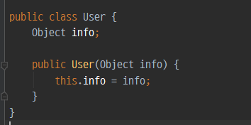
Generic
ArrayList<타입> 객체명 = new ArrayList<타입>();

Slide 2
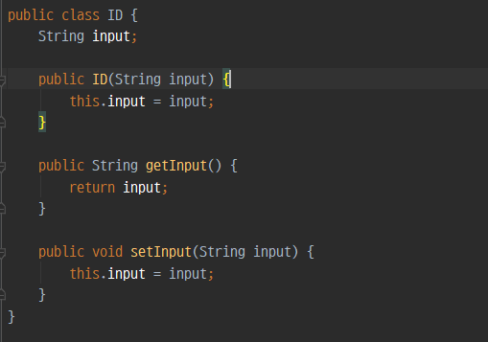
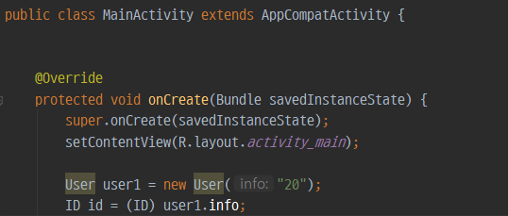

Slide 3
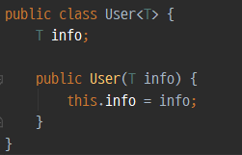
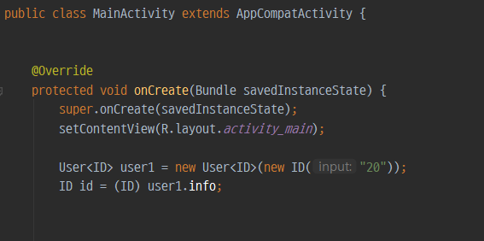
public class 클래스이름<T> {
private T 변수명;
//...
public T 메소드명() {
}
public void 메소드명(T 변수명) {
}
//...
}

Slide 4
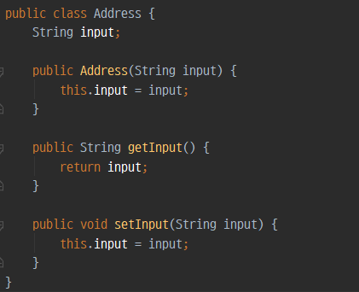
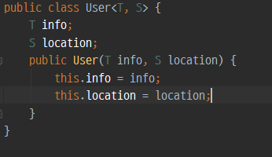
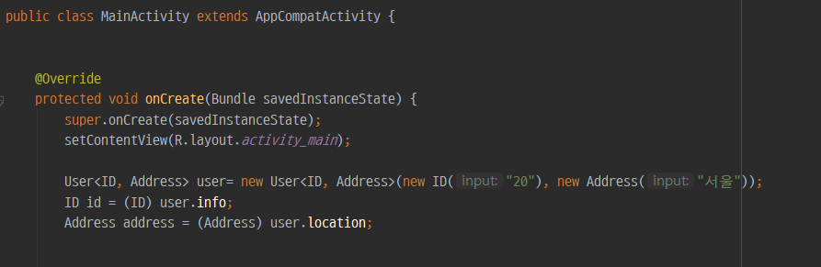
E - Element (used extensively by the Java Collections Framework)
K - Key
N - Number
T - Type
V - Value
S,U,V etc. - 2nd, 3rd, 4th types

