Slide 1

Accelerating Fixed Point Simulation Using Width Reconfigurable Hardware Implementation Chair of Computer Engineering
Keyvan Shahin
Prof. Dr.-Ing. habil. Michael Hübner
Chair for Computer Engineering
Brandenburg University of Technology Cottbus - Senftenberg

Slide 2
Outline
Motivation
Description of the idea
Description of the building blocks
How to continue

Slide 3
Motivation
DSP and Communication Algorithms on Hardware
Floating point on software
Fixed point ➔ less complexity and cheaper implement
Change the algorithm from floating point to fixed point
Analytic approach versus bit-true simulation
All inputs, outputs and intermediate variables
A huge amount of effort and time
Acceleration using hardware?
Shortcomings of Vivado HLS
Notes:
Efficient hardware implementation of digital signal processing and communication algorithms requires using fixed point arithmetic. However, most of these algorithms are developed in floating-point arithmetic.
The automation of floating-point to fixed-point transformation is a key step for high-level synthesis.
Floating point implementation is for systems that deal with very large and very small numbers at the same time
When using fixed-point math functions, the result type must have the same width and integer bits as the input.

Slide 4
Software Based Fixed-point Simulation
With MATLAB as the tool: Quantize / fi / self developed
quant = quantizer(“fixed”, “floor”, “saturate”, [16 8]);
Every line of code is followed by a transformation to fixed point
Evaluation of the error is done based on the code, the fix point error and the experience
Sweeping through the widths can be optimized using algorithms

Slide 5
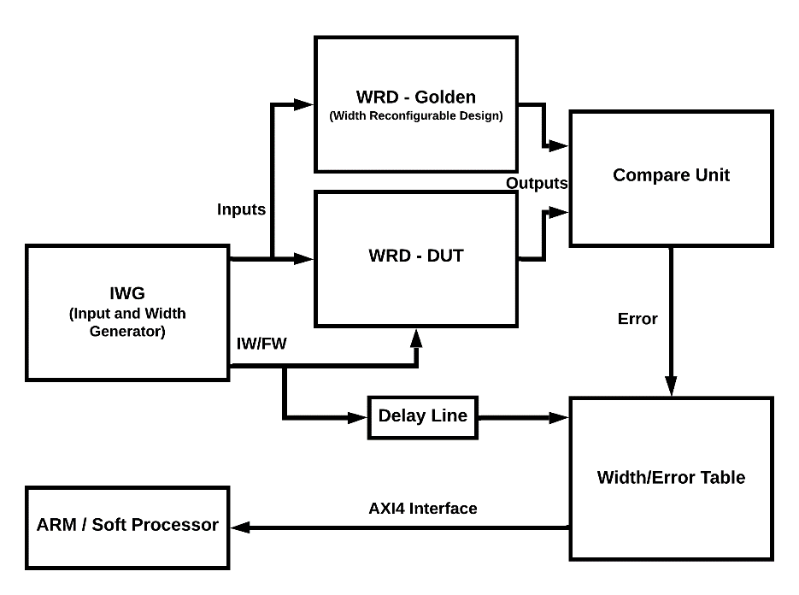
Description of the Idea – Big Picture
IWG
Input generation modes
IW/FW generation mostly based on the software algorithms
WRD
Two instances, one with max widths and one with reconfigurable widths
Compare Unit
Calculation modes
Width/Error Table
Communication with ARM / Soft Processor

Slide 6
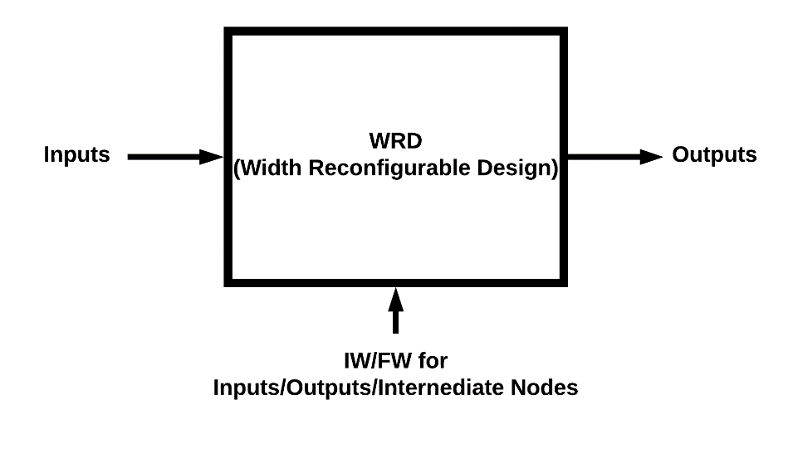
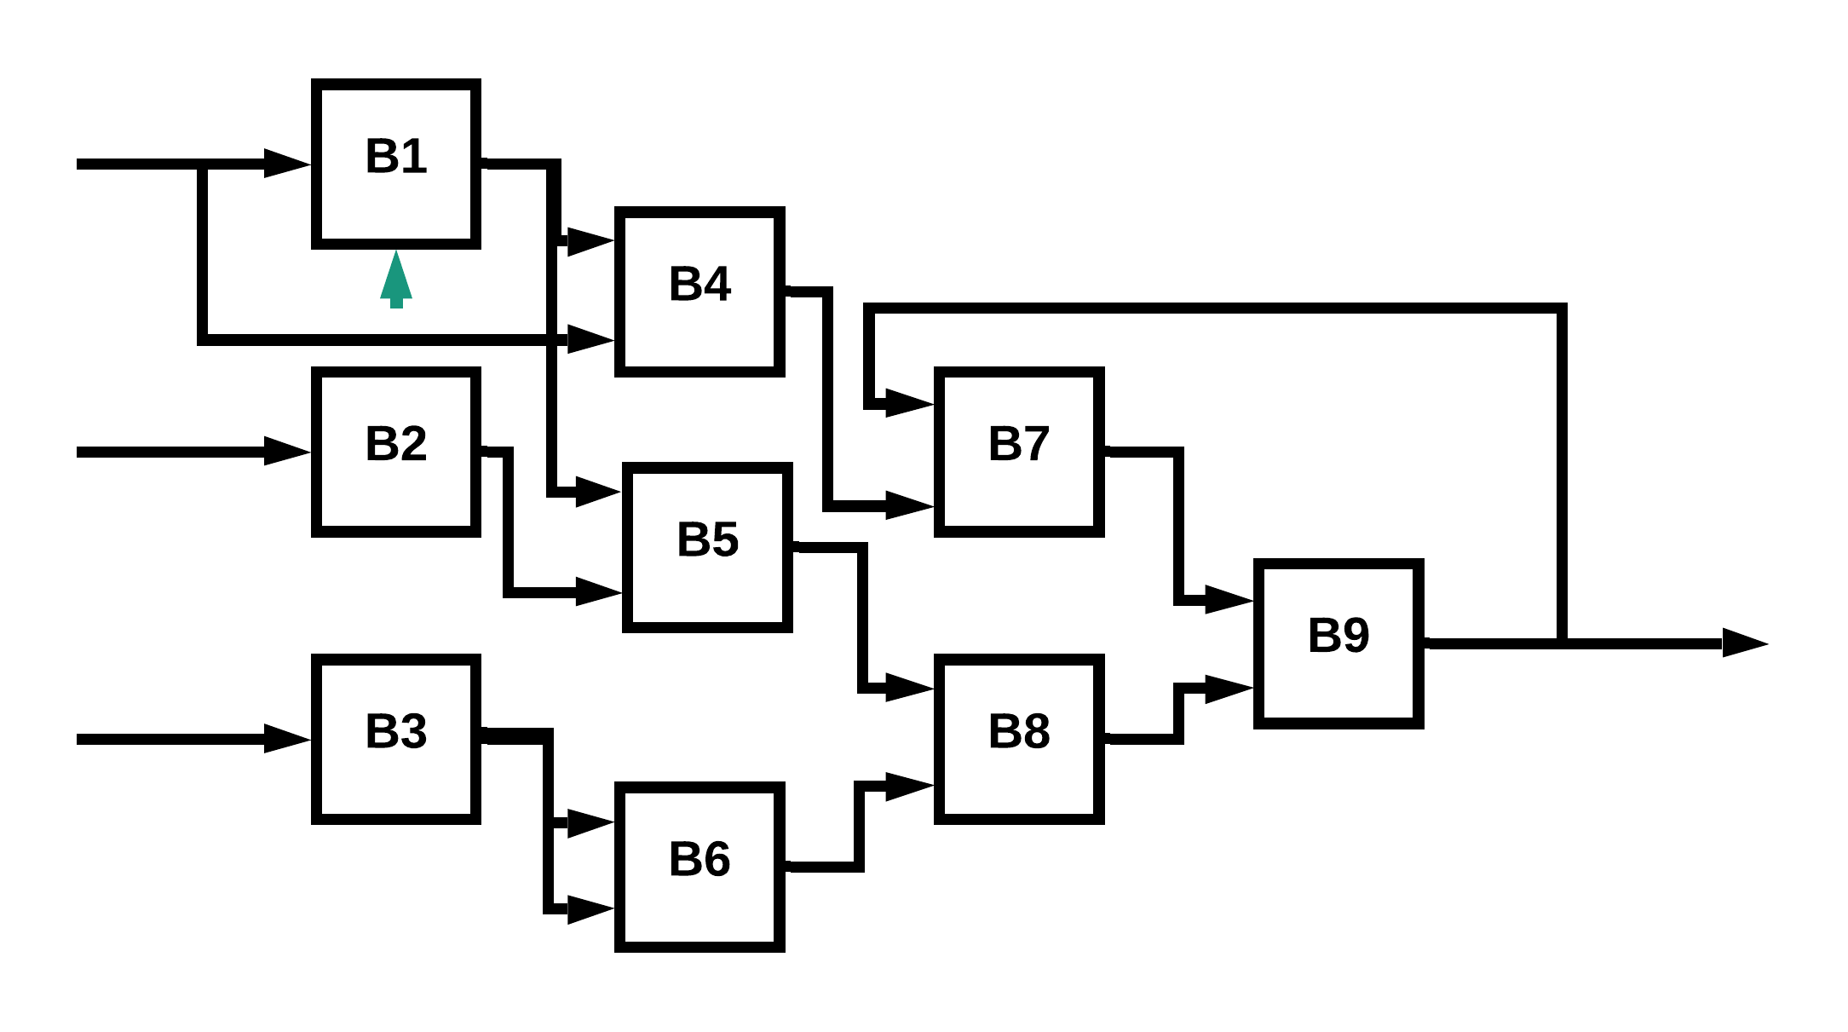
Width Reconfigurable
WRD is the whole design we want to fix point
Inputs, outputs and IW/FW are the arrays of all the blocks inside
The challenge would be to have hardware libraries of different width reconfigurable mathematical IPs

Slide 7
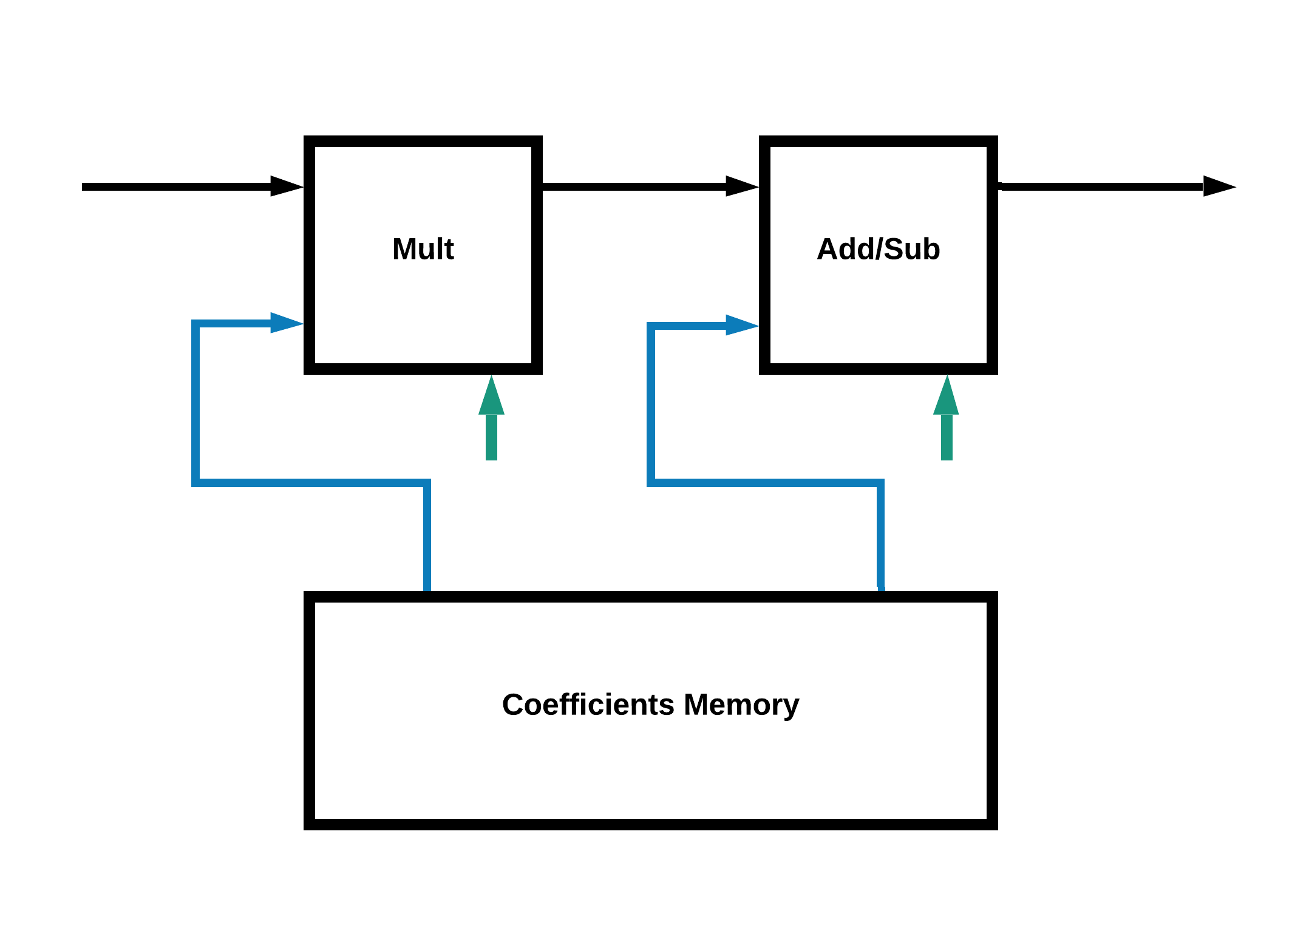
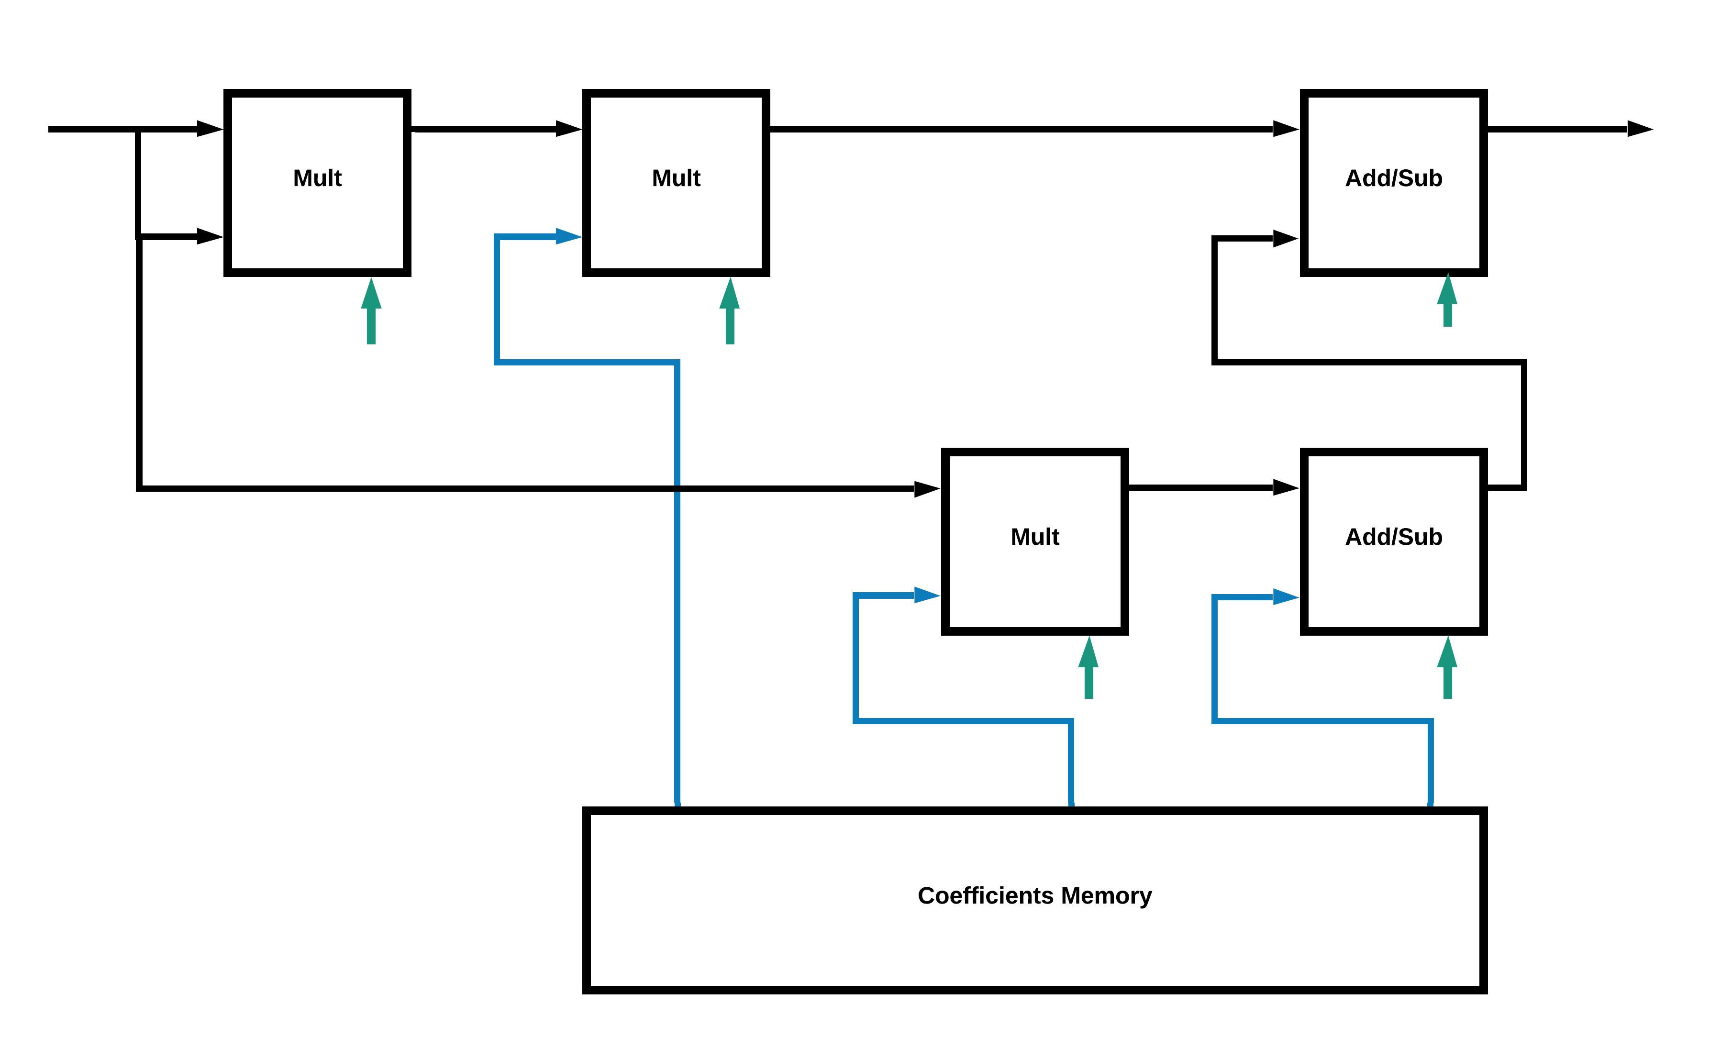
Reconfigurable IPs
Reconfigurable mathematical blocks implementation using polynomial approximation
Adder/Subtractor and Multiplication will be the building blocks of the designs supported by this approach

Slide 8
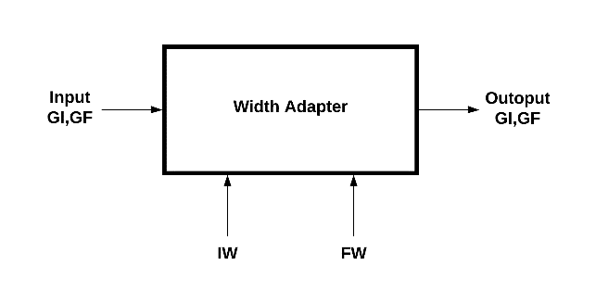
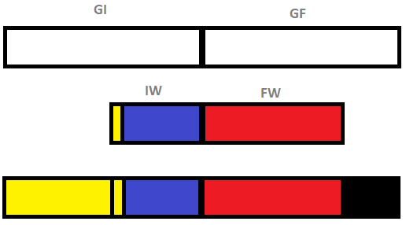
Width Adapter
Global Integer/Float Width (GI/GF)
Local Configurable Integer/Float Width (IW/FW)
All connections between blocks are GI/GF
Inside the blocks, the data should be trimmed to IW/FW to test the outcome
Width adapter
Zero padding and sign extension

Slide 9
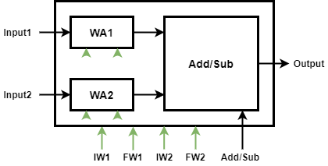
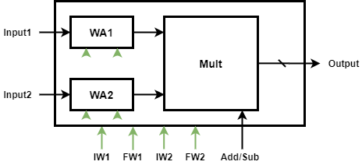
Width Configurable Adder
Each input needs Width Adapter
Outputs don’t need it
These will be the building blocks for other functions

Slide 10
Future Work
Try to implement one function with polynomial approximation and using Width Configurable modules
IWG implementation
Compare unit implementation
Run more complicated designs
Possibility of making the tool for generating the hardware design from software
Evaluation and implementation after fixed point simulation

Slide 11
Thank you for your patience
Questions?

