Slide 1


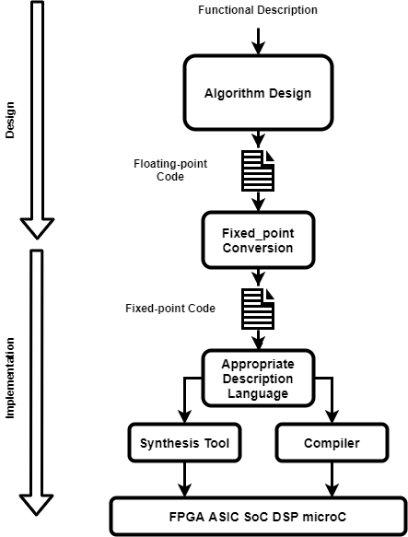
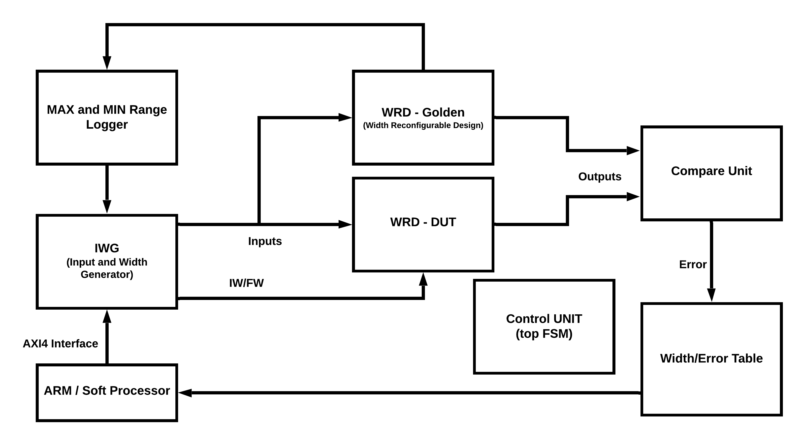
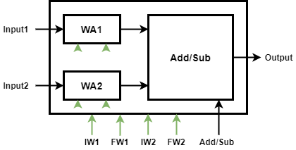
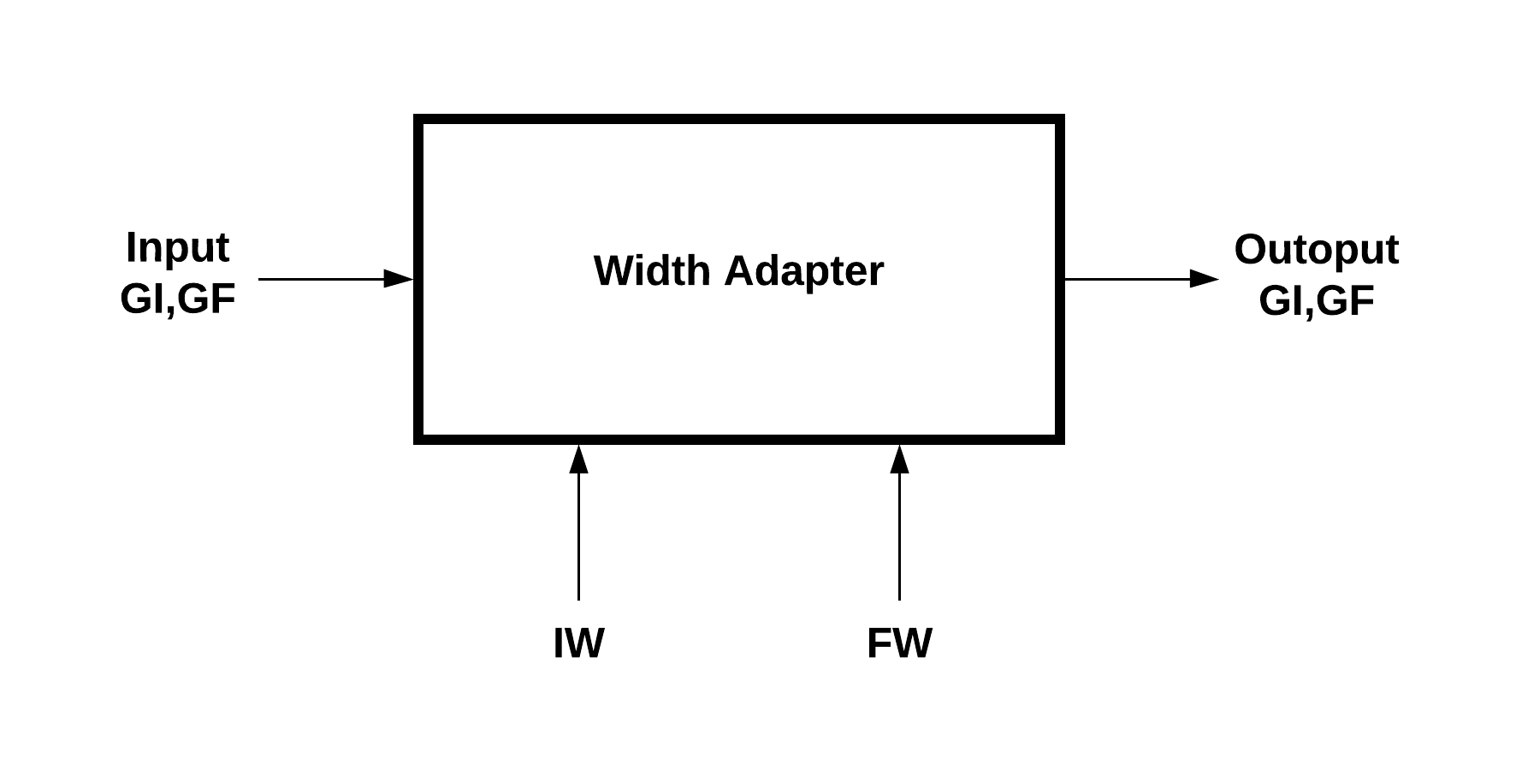
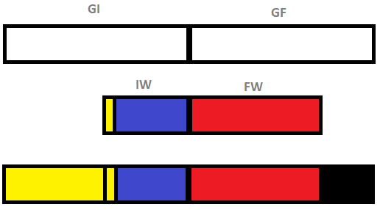
Accelerating Fixed-Point Simulations Using Width Reconfigurable Hardware Architectures Keyvan Shahin Supervisor: Prof. Michael Huebner Chair of Computer Engineering Brandenburg University of Technology Cottbus-Senftenberg Cottbus, Germany keyvan.shahin@b-tu.de
Abstract — this paper presents a new approach to show the possibility of accelerating the conversion of floating-point to fixed-point representation of DSP algorithms. In this approach, width-reconfigurable hardware is used for the first time to accelerate the fixed-point simulation.
Fixed-point simulation
The steps in Digital Signal Processing algorithm design and implementation
Floating-point and Fixed-point representations
Reasons and complexities of floating-point to fixed-point conversion
Hardware-based Floating- to Fixed-Point conversion
Input and Width Register (IWG): setting different integer and fractional widths for intermediate variables in the design and feeding the test inputs to it
Width Reconfigurable Design (WRD): the width reconfigurable hardware implementation of the design, which can take the intermediate variables’ widths on top of its normal inputs. One instance with fixed widths and the other with variable widths, enables us to preform tests to find out the optimal widths for each intermediate variable
Compare Unit: compares the results from two instances of the design to show the effect of changing the widths on the output validity and precision
Width Reconfigurable Design
Benefits of using polynomial approximation for implementing WRD
Using width reconfigurable adder and multiplier
Design of width reconfigurable modules using Width Adapters (WA)
Width Adapter uses zero replacement and sign extension to change the effective width to the desired values while keeping the physical widths intact to make the modules’ connectivity possible
FPL PhD Forum 2021 30 AUG – 03 SEPT 2021

