Slide 1


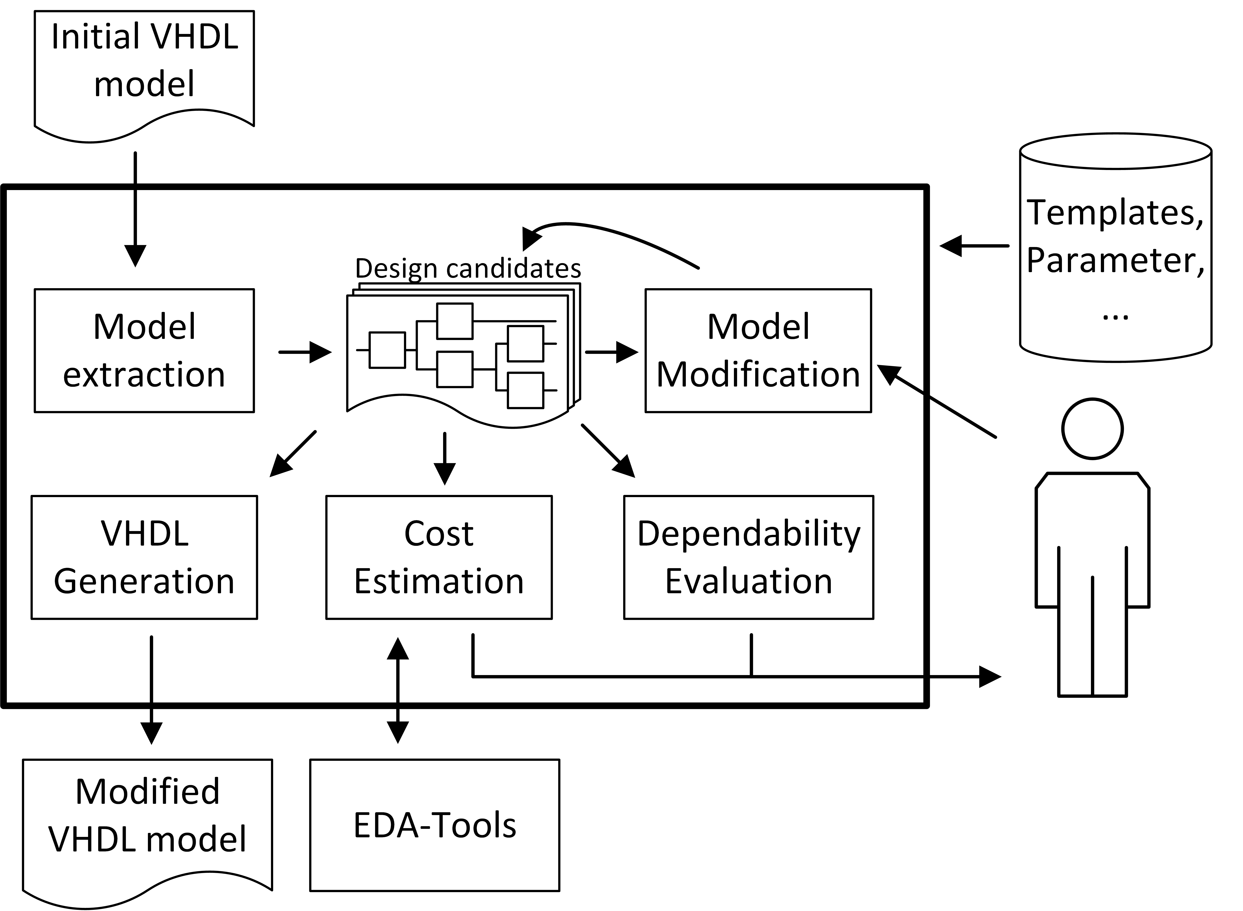
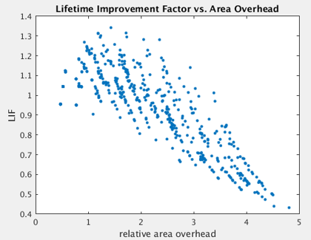
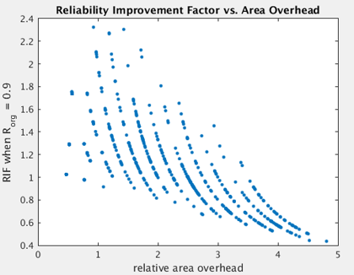
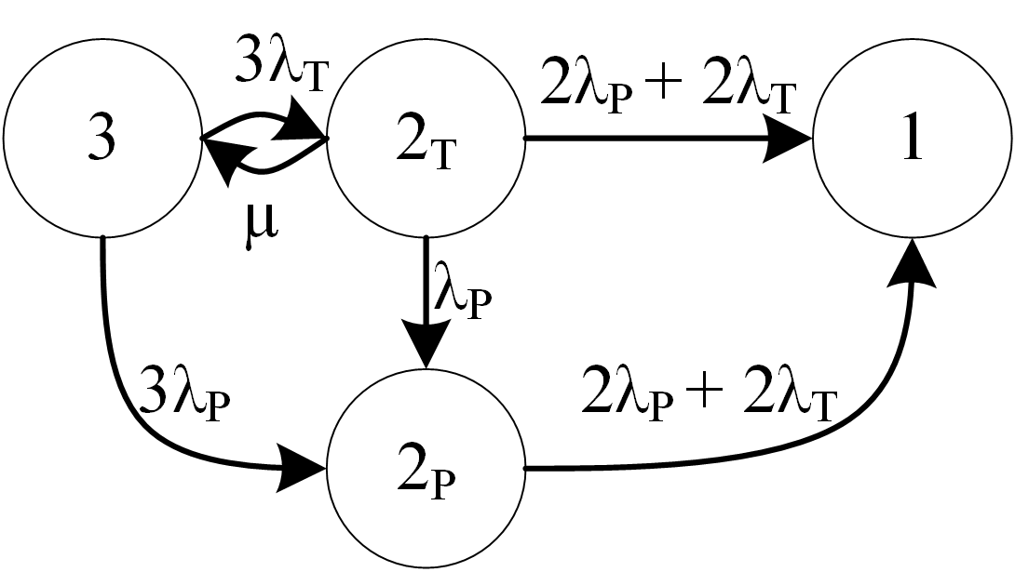
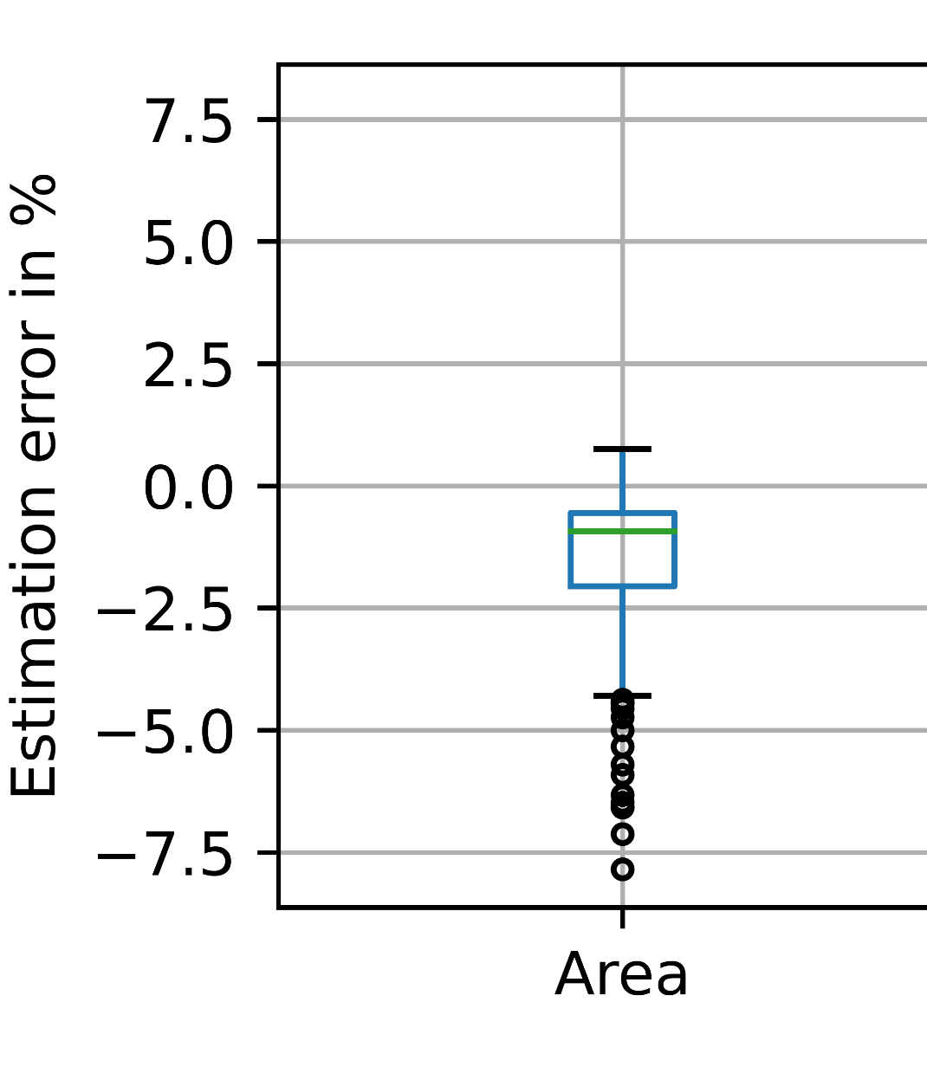

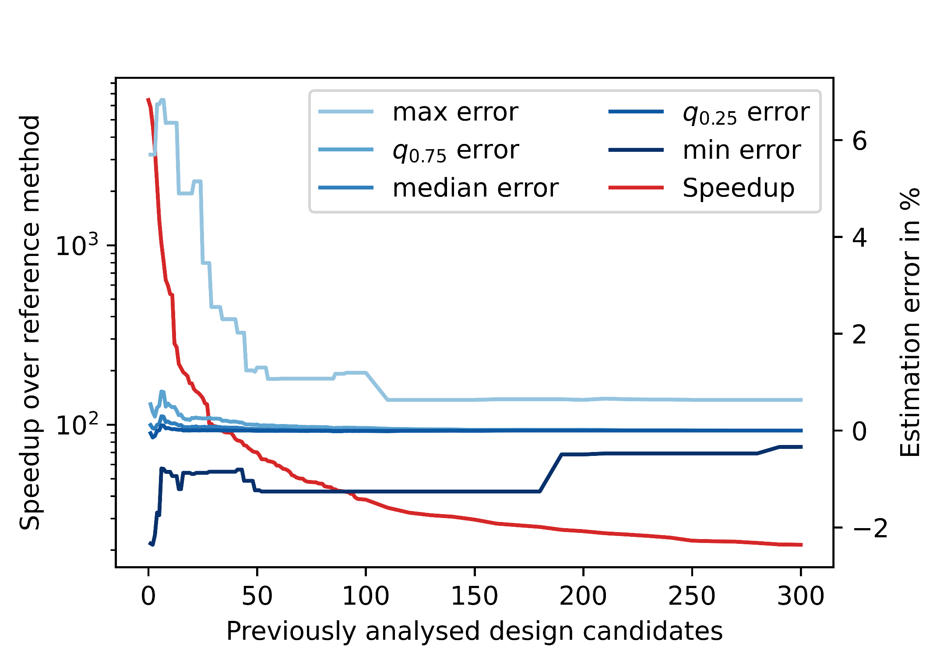
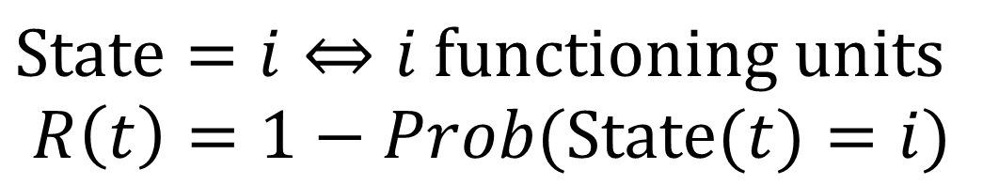
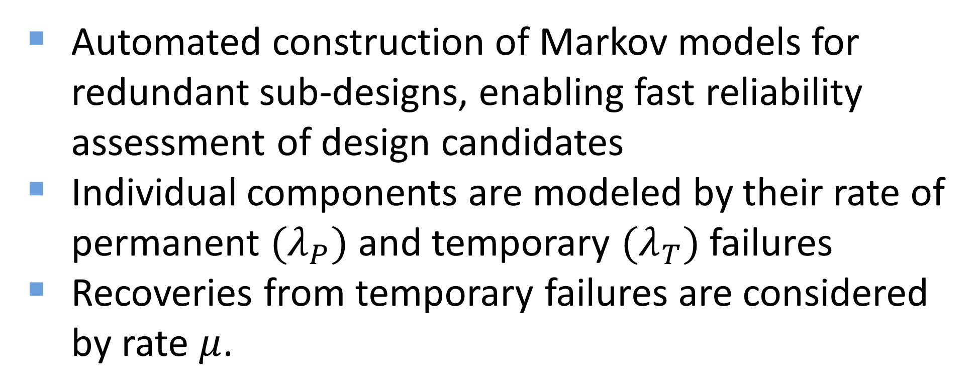
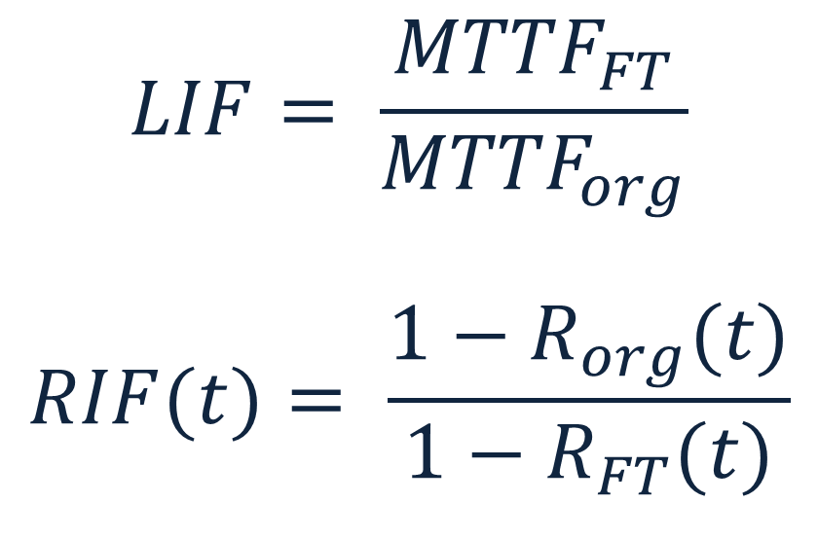
A Computer-Aided Design Space Exploration for Dependable Circuits Stefan Scharoba Chair of Computer Engineering Brandenburg University of Technology Cottbus-Senftenberg Cottbus, Germany scharst1@b-tu.de
Abstract — This thesis presents an automated toolset for exploring design choices which provide fault tolerance by means of hardware redundancy. Based on a given VHDL model, various fault tolerant implementations can be automatically created and evaluated regarding their overhead and reliability improvement.
Contributions
Automated insertion of static and dynamic hardware redundancy including the required administrative logic into a given VHDL model
Evaluation of costs and benefits of resulting fault tolerant design candidates
Reliability modeling considering transient and permanent faults
Estimation of costs in terms of area, power and performance using state of the art synthesis tools
Fast predictions of synthesis results, offering a trade-off between runtime and accuracy
Exploring the Design Space
Reliability Modeling
Evaluation of various redundancy strategies for four ALUs in a superscalar processor
Automated construction of Markov models for redundant sub-designs, enabling fast reliability assessment of design candidates
Individual components are modeled by their rate of permanent ${(λ}_{P})$ and temporary ${(λ}_{T})$ failures
Recoveries from temporary failures are considered by rate $μ$.
Example: Markov model for TMR
$$LIF= \frac{{MTTF}_{FT}}{{MTTF}_{org}}$$
$$RIF(t)= \frac{1−R_{org}(t)}{1−R_{FT}(t)}$$
$State=i⇔i \text{functioning} \text{units}$
$$R\left(t\right)=1−Prob(State(t)=i)$$
Cost Estimation Methods
Accuracy and Runtime Trade-off
Sub-design synthesis (reference method):
Synthesize generated VHDL model of a fault-tolerant sub-design
Component synthesis:
Infer which administrative components are required and only synthesize these
Build a database of results for typical components (e.g., multiplexers with varying structural parameters)
Reuse results for other instances of this component (in the same or other design candidates)
Result interpolation:
After a sufficient number of results are available, properties of new components may be derived by interpolation
Evaluation for 1000 randomly generated design candidates
Component synthesis:
Mean estimation error of 1.4% (area) and 2.6% (power)
13x speedup over reference method (increasing with number of candidates)
Additional error by result interpolation:
Depending on size of result database
Insignificant after component synthesis for ~50 candidates
70x speedup in this case
DATE PhD Forum 2021 01 February 2021

