Slide 1

OneOffixx Schemas

Slide 2









Server Apps & SQL Database
SOAP
& REST APIs
Windows Client
& Office Addins
Statistics
API Services
User Sync Worker
Web App

Slide 3
Install Options

Slide 4


NEW
Windows Server
& IIS, SQL Server
Server Apps
Clients
Active Directory
Database

Slide 5
NEW
Windows Server
& IIS
SQL Server
Server Apps
Clients
Active Directory
Database

Slide 6
NEW
Windows Server
& IIS
SQL Server
Server Apps
Clients
Active Directory
Database

Slide 7
Systemübersicht

Slide 8




















LOB-Apps
AddIn
Offline Cache
<Connect />
Win32 App
Office Addin
Any App or Service
Address Provider/ Data Providers
Address Data Rest/WS/WML/InProc
Client
Windows Client
Windows Auth
WS/Rest
WS/Rest
Named Pipe
Address Data Rest/WS/WML/SQL etc..
<Connect />
Active Directory
Windows Auth
OneOffixx Auth
Service
Address Service
Document Creation
Server
OneOffixx SharePoint Connector
HTTP API /
Via Browser
LDAP / SQL / HTTP
JobHost
SQL Server
WebApp
Admin
AD
SQL
Custom
User Sync Sources
OneOffixx Server Apps

Slide 9



LOB-Apps
AddIn
Offline Cache
<Connect />
Win32 App
Office Addin
Any App or Service
Address Provider/ Data Providers
Address Data Rest/WS/WML/InProc
Client
Windows Client
OIDC
WS/Rest
WS/Rest
Named Pipe
Address Data Rest/WS/WML/SQL etc..
<Connect />
Identity Server
OIDC
OneOffixx Auth
Service
Address Service
Document Creation
Server
OneOffixx SharePoint Connector
HTTP API /
Via Browser
LDAP / SQL / HTTP
JobHost
SQL Server
WebApp
Admin
AD
SQL
Custom
User Sync Sources
OneOffixx Server Apps

Slide 10
Engine – Dokument Erzeugung

Slide 11


Final Document
Template
Document Functions
Document
Commands
+
<Connect /> Arguments & Settings
Snippets
etc.
Template + Sub-Templates
SaveAs
DocumentParameter
Recipient
Sub-Template
ConvertToPdf
etc.
Processing
Main-Template
Output
Sub-Template

Slide 12
Engine – Untervorlagen

Slide 13
Document Functions
Sub-Template Evaluation
Document
Template
…
Snippets
etc.
Sub-Template A
DocumentParameter
Recipient
«Main»-Template
Processing
Sub-Template B
(Not included because of conditions)
Sub-Template C

Slide 14
Engine - Layouting

Slide 15
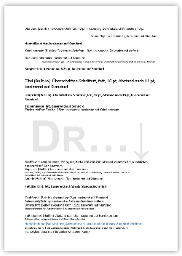
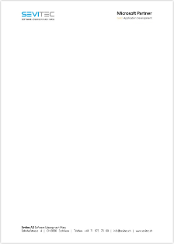
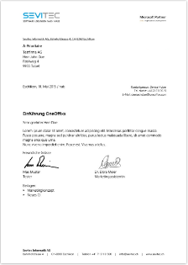
Global Configuration
Style
Fonts & Formatting
Doc Func A
Format
Header & Footer
Doc Func B, C
Template
Main content
Doc Func D
Virtual Template
Configuration container
Doc Func E
Document
GC
A, B, C, D, E

Slide 16
Resources
Icon Set:
https://www.microsoft.com/en-us/download/details.aspx?id=41937

Slide 17
Deprecated / Older Versions

Slide 18








Windows Client
OneOffixx SharePoint Connector
Fachapplikationen
AddIn
WS/WML/Protocol/InProc
WS NP
Adressen/Daten/Doc
Offline Cache
REST
WCF
Web
OneOffixx Document
Creation Server
LDAP
OneOffixx Server
Entity Framework
MS SQL Server
Active Directory
Dashboard
Windows Server

Slide 19
LOB-Apps
AddIn
WS/WML/Protocol/InProc
Win32 App
Office Addin
Any App or Service
NP
Offline Cache
<Connect />
Client
Windows Client
WS
<Connect />
Service
Document Creation Server
LDAP
Active Directory
OneOffixx SharePoint Connector
HTTP API /
Via Browser
SQL Server
Web
Admin
Auth
Windows Server

