Slide 1
Internship Report: Data Analytics Internship at NullClass
- Rishabh Bhatt

Slide 2
Introduction
During my internship at NullClass, I had the opportunity to engage in various data analytics tasks, which helped me develop my data visualization, analysis, and reporting skills. This report provides an overview of the work I completed, the skills and competencies I developed, the challenges I faced, and the outcomes of my internship.

Slide 3
Background
I joined NullClass as a Data Analyst Intern, where I first had my training session as a part of my learning journey.
After completing the training session, my internship started, where my primary role was to analyze and visualize data related to company preferences, work types, and various other metrics.
The goal was to generate meaningful insights that could assist in decision-making processes.

Slide 4
Learning Objectives
1. To gain practical experience in data analysis and visualization.
2. To develop proficiency in using tools like Tableau for creating charts and dashboards.
3. To understand the process of analyzing large datasets and extracting actionable insights.

Slide 5
Activities and Tasks
During my internship, I completed several key tasks, including:
- Data Visualization: Created various charts to represent data on company preferences, work types, company sizes, roles, qualifications, and job titles.
- Data Analysis: Analyzed data from different perspectives, including company size, country-specific data, and job market trends.
- Reporting: Compiled the findings into reports that were presented to stakeholders for strategic decision-making.

Slide 6
Skills and Competencies
Throughout the internship, I developed and enhanced the following skills:
- Data Visualization: Proficiency in creating charts and dashboards using tools like Tableau.
- Data Analysis: Enhanced ability to analyze complex datasets and draw meaningful insights.
- Problem-Solving: Developed the ability to approach data-related challenges creatively and efficiently.

Slide 7
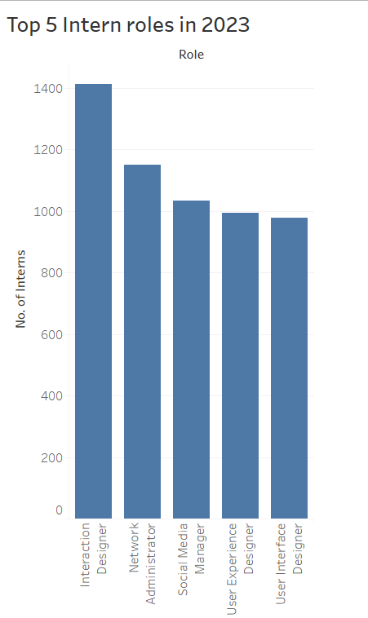
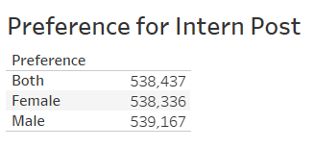
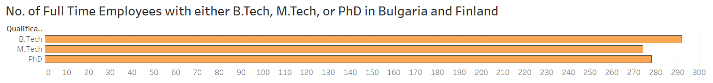
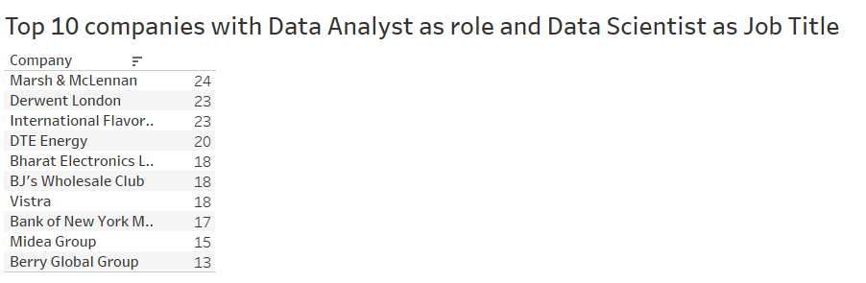
Feedback and Evidence
My experience while working with Nullclass on this internship was great, and I learned so much during my time as an intern.
Attached are a few glimpses of my work during the internship.
The different types of charts and calculated fields created by me for finishing the tasks shows my hard work for the internship.

Slide 8
Challenges and Solutions
One of the major challenges I faced was handling large datasets with numerous variables.
To overcome this, I focused on segmenting the data into manageable chunks and utilized advanced filtering techniques to streamline the analysis process.
A few of the tasks gave me a bit of a problem in the beginning while thinking about how to execute them.
I tried hard to try out different methods to solve the issue and did my best to overcome the challenges.

Slide 9
Outcomes and Impact
The outcomes of my internship include a series of well-structured data visualizations.
The impact this internship had on me was to enhance my skills in the field of Data analysis and visualization.
I learned about different features of Tableau and also got to know where I lacked.
Knowing my lackings, I worked on them and improved

Slide 10
Conclusion
My internship at NullClass was a highly rewarding experience. It allowed me to apply my theoretical knowledge to real-world data analysis problems and develop practical skills that will be invaluable in my future career.
The experience has strengthened my interest in data analytics and has prepared me for more advanced roles in this field.
I would like to thank NullClass for providing me with this opportunity to work with them.

