Slide 1
FY-26: Career Preview Program project Review (CPP-3)
Updated June 2026
College /University Name: Vellore Institute of Technology, Chennai Campus

Slide 2
PROJECT OVERVIEW
Project Participants & Mentors
College / University
Project Participants
Vellore Institute of Technology, Chennai
23BCE1397
Ananta Krishnan B
23BCE1265
Kanad Bhattacharya
HPE Mentors
Chinmay Ghosh
Porno Shome
Shreyas Vinayaka Basri K S
23BCE1554
Priyanshu Kumar Jha
23BAI1190
Samar Singh
23BAI1107
Mishthi Jain
College Mentor
Dr. Suganya G
Github Repository Link

Slide 3





INTRODUCTION
Why a Distributed Key-Value Store?
As data volume and client request rates grow, a single server becomes a performance bottleneck. Distributing data across multiple nodes improves throughput, reduces latency, and maintains availability during failures.
Distributed Caching
Session Management
Metadata Storage
Reduces latency by serving frequently accessed data from memory across the cluster.
Persists user sessions across service instances for stateless, horizontally scalable applications.
Stores configuration and system metadata with low-latency, high-availability access.
Service Discovery
Message & Job Queues
Enables dynamic registration and lookup of microservices in cloud-native environments.
Manages asynchronous task queues and inter-service messaging at scale.

Slide 4


PROBLEM STATEMENT
Limitations of the Original Implementation
The original system uses key % N modulo hashing, creating three critical weaknesses that prevent production-grade deployment.
Inefficient Key Distribution
No Fault Tolerance
Static Cluster Membership
Adding or removing a node redistributes a large percentage of keys with no migration mechanism, causing service disruption during scaling.
Each key exists on only one node. A single node failure makes its data completely unavailable until manual recovery.
The system relies on a static configuration file and cannot automatically detect node joins or failures.
Objective: Replace modulo hashing with a Consistent Hash Ring so node changes redistribute only 1/N of total keys while enabling a fault-tolerant, dynamically managed cluster.

Slide 5



SOLUTION PROPOSAL
Three Pillars of the Redesigned System
The solution introduces three complementary mechanisms that together transform a fragile single-point-of-failure architecture into a resilient, self-managing distributed system.
Consistent Hash Ring
Buddy Replication
Gossip Membership
Uses 150 virtual nodes per physical node to achieve balanced key distribution. Only 1/N of keys are redistributed during node additions or removals.
Replicates every key to a designated buddy node, enabling seamless data retrieval even when the primary node fails, with no manual intervention required.
Continuously exchanges membership state between nodes to detect failures and automatically rebuild cluster topology hence no central coordinator needed.

Slide 6
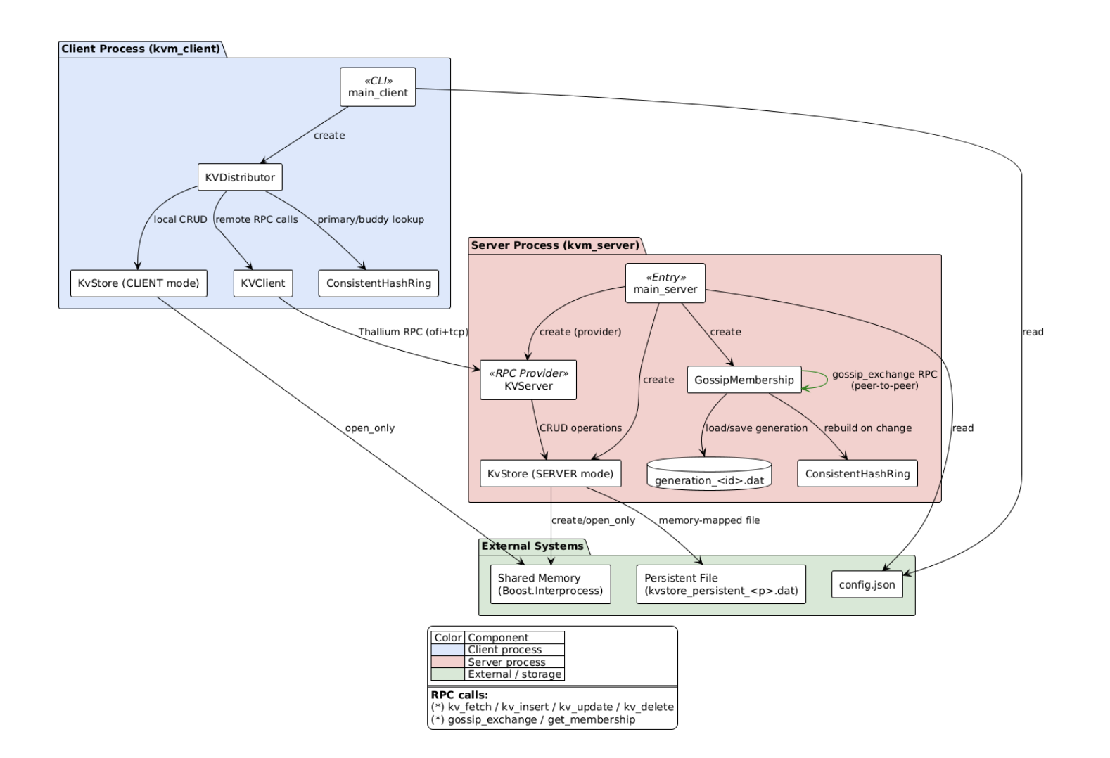
End-to-End System Architecture
Request Flo
Gossip Membership runs continuously in the background, exchanging heartbeat messages between nodes. When a node joins or fails, the ring is rebuilt automatically and buddy assignments are recalculated without service interruption.

Slide 7
Live Demonstration
1
2
3

Slide 8

KEY LEARNINGS
Engineering Takeaways
Building this system provided hands-on experience with the core principles that underpin production-grade distributed systems at enterprise scale.
Efficient Data Distribution
Fault Tolerance by Design
Decentralized Cluster Management
Consistent Hashing minimizes key redistribution during topology changes, dramatically reducing the operational cost of scaling compared to modulo-based approaches.
Buddy Replication ensures data availability during single-node failures without requiring a central recovery coordinator or manual intervention.
Gossip Membership enables automatic node discovery and failure detection, the cluster self-heals without any single point of control.

Slide 9

CONCLUSION
What We Achieved & What's Next
What We Achieved
Future Scope
Successfully replaced modulo-based key distribution with a Consistent Hash Ring, enabling efficient horizontal scaling while minimizing key redistribution during cluster changes.
Hinted Handoff
Temporarily store writes on alternate nodes when the primary is unavailable, then replay on recovery.
High Availability Delivered
Multi-Key Transactions
Buddy Replication and Gossip Membership together ensure continuous data availability and automatic recovery from node failures with zero manual intervention.
Enable atomic operations across multiple keys for stronger consistency guarantees.
HTTP Gateway
Expose a RESTful interface for broader client compatibility.

Slide 10
Thank You

