Slide 1
Roads? Where We’re Going:
the movies promised me flying cars, so I kept score
Andi Sharkey, October 2026
Notes:
Welcome. This talk is about my side project: a hand-built dataset of sci-fi films that name a future year. The paper is called ‘Roads? Where We’re Going: the movies promised me flying cars, so I kept score’.
Two things I look at: how far ahead the films look, and, for the futures that have now arrived, how often they got it right.
Project site, data and paper: https://oneredodd.github.io/scifi-timeline/
Design: my SlidesCarnival hexagon template.

Slide 2
Two questions
1. How far ahead do sci-fi films set their stories?
2. Now that many of those futures have arrived, how often were they right?
I built and scored it all by hand, then checked my own work (twice).
Notes:
Two questions drive everything that follows.
First: how far ahead do sci-fi films set their stories? Second: now that many of those futures have arrived, how often were they right?
I built everything by hand: I collected every film and setting year and scored every prediction myself, then checked my own work (twice).
Rocket and planet icon: part of the SlidesCarnival template artwork.

Slide 3
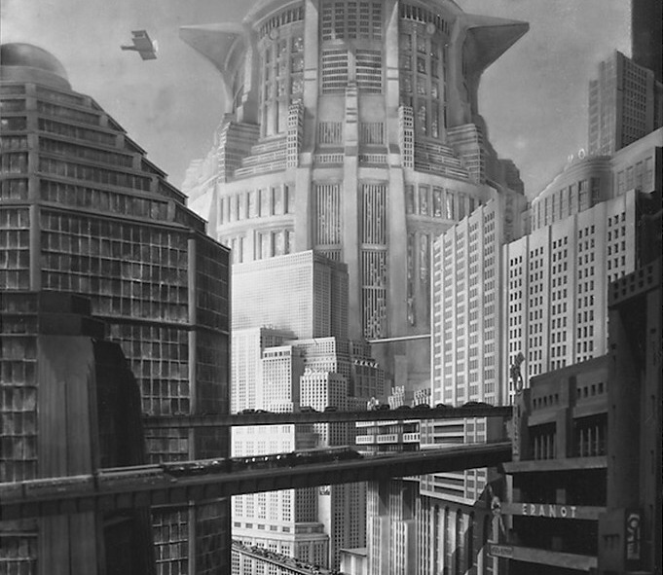
What I collected
233 released films, 1910–2026, each set in a named future year on humanity’s current calendar. Every year is sourced.
Released films only: cinema or streaming
No invented calendars or alternate histories
Ambiguous years flagged, never guessed
Gap = setting year minus release year
Notes:
What went in: 233 released films from 1910 to 2026 (217 theatrical, 15 streaming, 1 non-theatrical), each set in a named future year on humanity’s current calendar.
Every setting year has a source: Wikipedia, AFI, BFI, the Science Fiction Encyclopedia and others; the URL for each film is in films.csv.
My rules: released films only; no invented calendars such as Star Wars, no alternate histories; ambiguous years are flagged with an asterisk (49 films), never guessed.
The gap is simply setting year minus release year. Metropolis (1927), pictured, is set in 2026: a gap of 99 years.
Sources: project stats_summary.md and films.csv; https://oneredodd.github.io/scifi-timeline/
Image: set photograph of the main commercial street in Metropolis (1927), by Horst von Harbou. Licence: public domain (Wikimedia Commons). Source: https://commons.wikimedia.org/wiki/File:Set_photograph_from_%22Metropolis%22_(1927).jpg

Slide 4
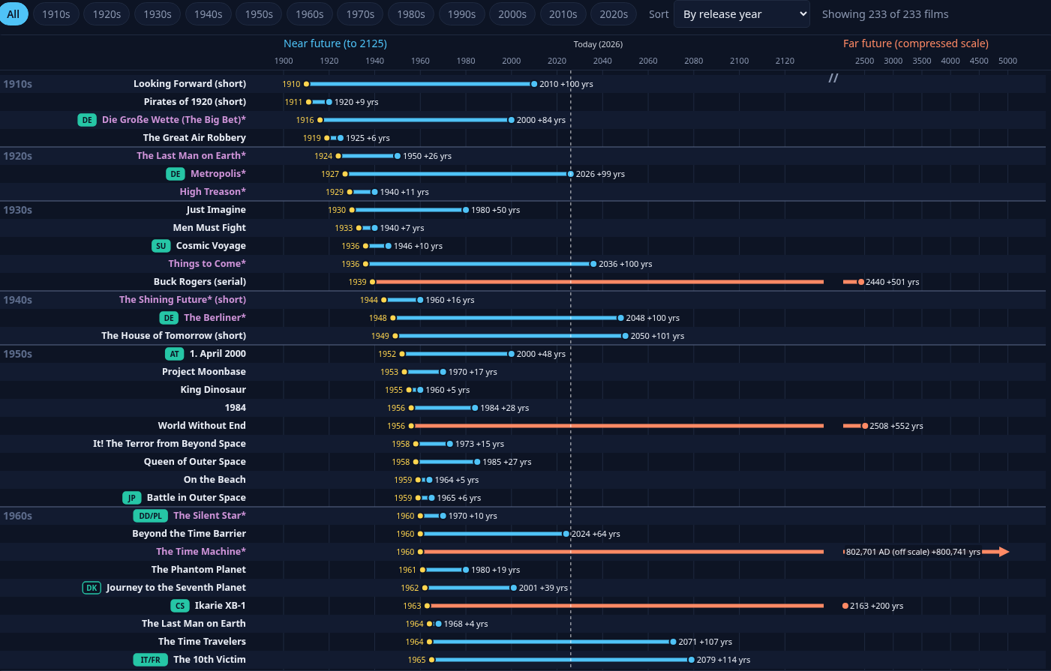
The timeline
Metropolis*
1927 to 2026 (+99), flagged
Back to the Future Part II
1989 to 2015 (+26)
The Time Machine*
1960 to 802,701 (off scale)
Interactive version: oneredodd.github.io/scifi-timeline
Notes:
The full chart: every one of the 233 films is a bar from release year to setting year. The screen shows my live site, sorted by release year, 1910s to 1960s.
Three to look out for. Metropolis (1927) is set in 2026, 99 years ahead, this very year; but I’ve flagged it, because the film itself gives no year: 2026 comes from later material (the 1963 Ace Books edition and the title card of the 1984 Moroder version).
Back to the Future Part II (1989) goes to 2015, 26 years ahead (further down the list, in the 1980s). The Time Machine (1960) goes to 802,701 AD, 800,741 years ahead, so far off the scale that it gets an arrow.
Interactive version: https://oneredodd.github.io/scifi-timeline/
Image: screenshot of my own live interactive timeline (https://oneredodd.github.io/scifi-timeline/). Data: films.csv; figures checked against stats_summary.md (the 233-film update).

Slide 5
34 years
median gap between release and setting year, all 233 films
The mean is meaningless here: The Time Machine (+800,741 years)
drags it to 7,038 years. The median is the honest summary.
Notes:
A typical film looks about 34 years ahead: that is the median gap across all 233 films.
Why not the mean? It is 7,037.9 years, because The Time Machine (1960) jumps 800,741 years. Even without the three extreme outliers (both Time Machines and Vampire Hunter D) the mean is 123.0, while the median barely moves (33). So the median is the honest summary.
Shortest gap: 1 year (Terminator: Dark Fate).
Source: project stats_summary.md (the 233-film update) and films.csv; https://oneredodd.github.io/scifi-timeline/

Slide 6
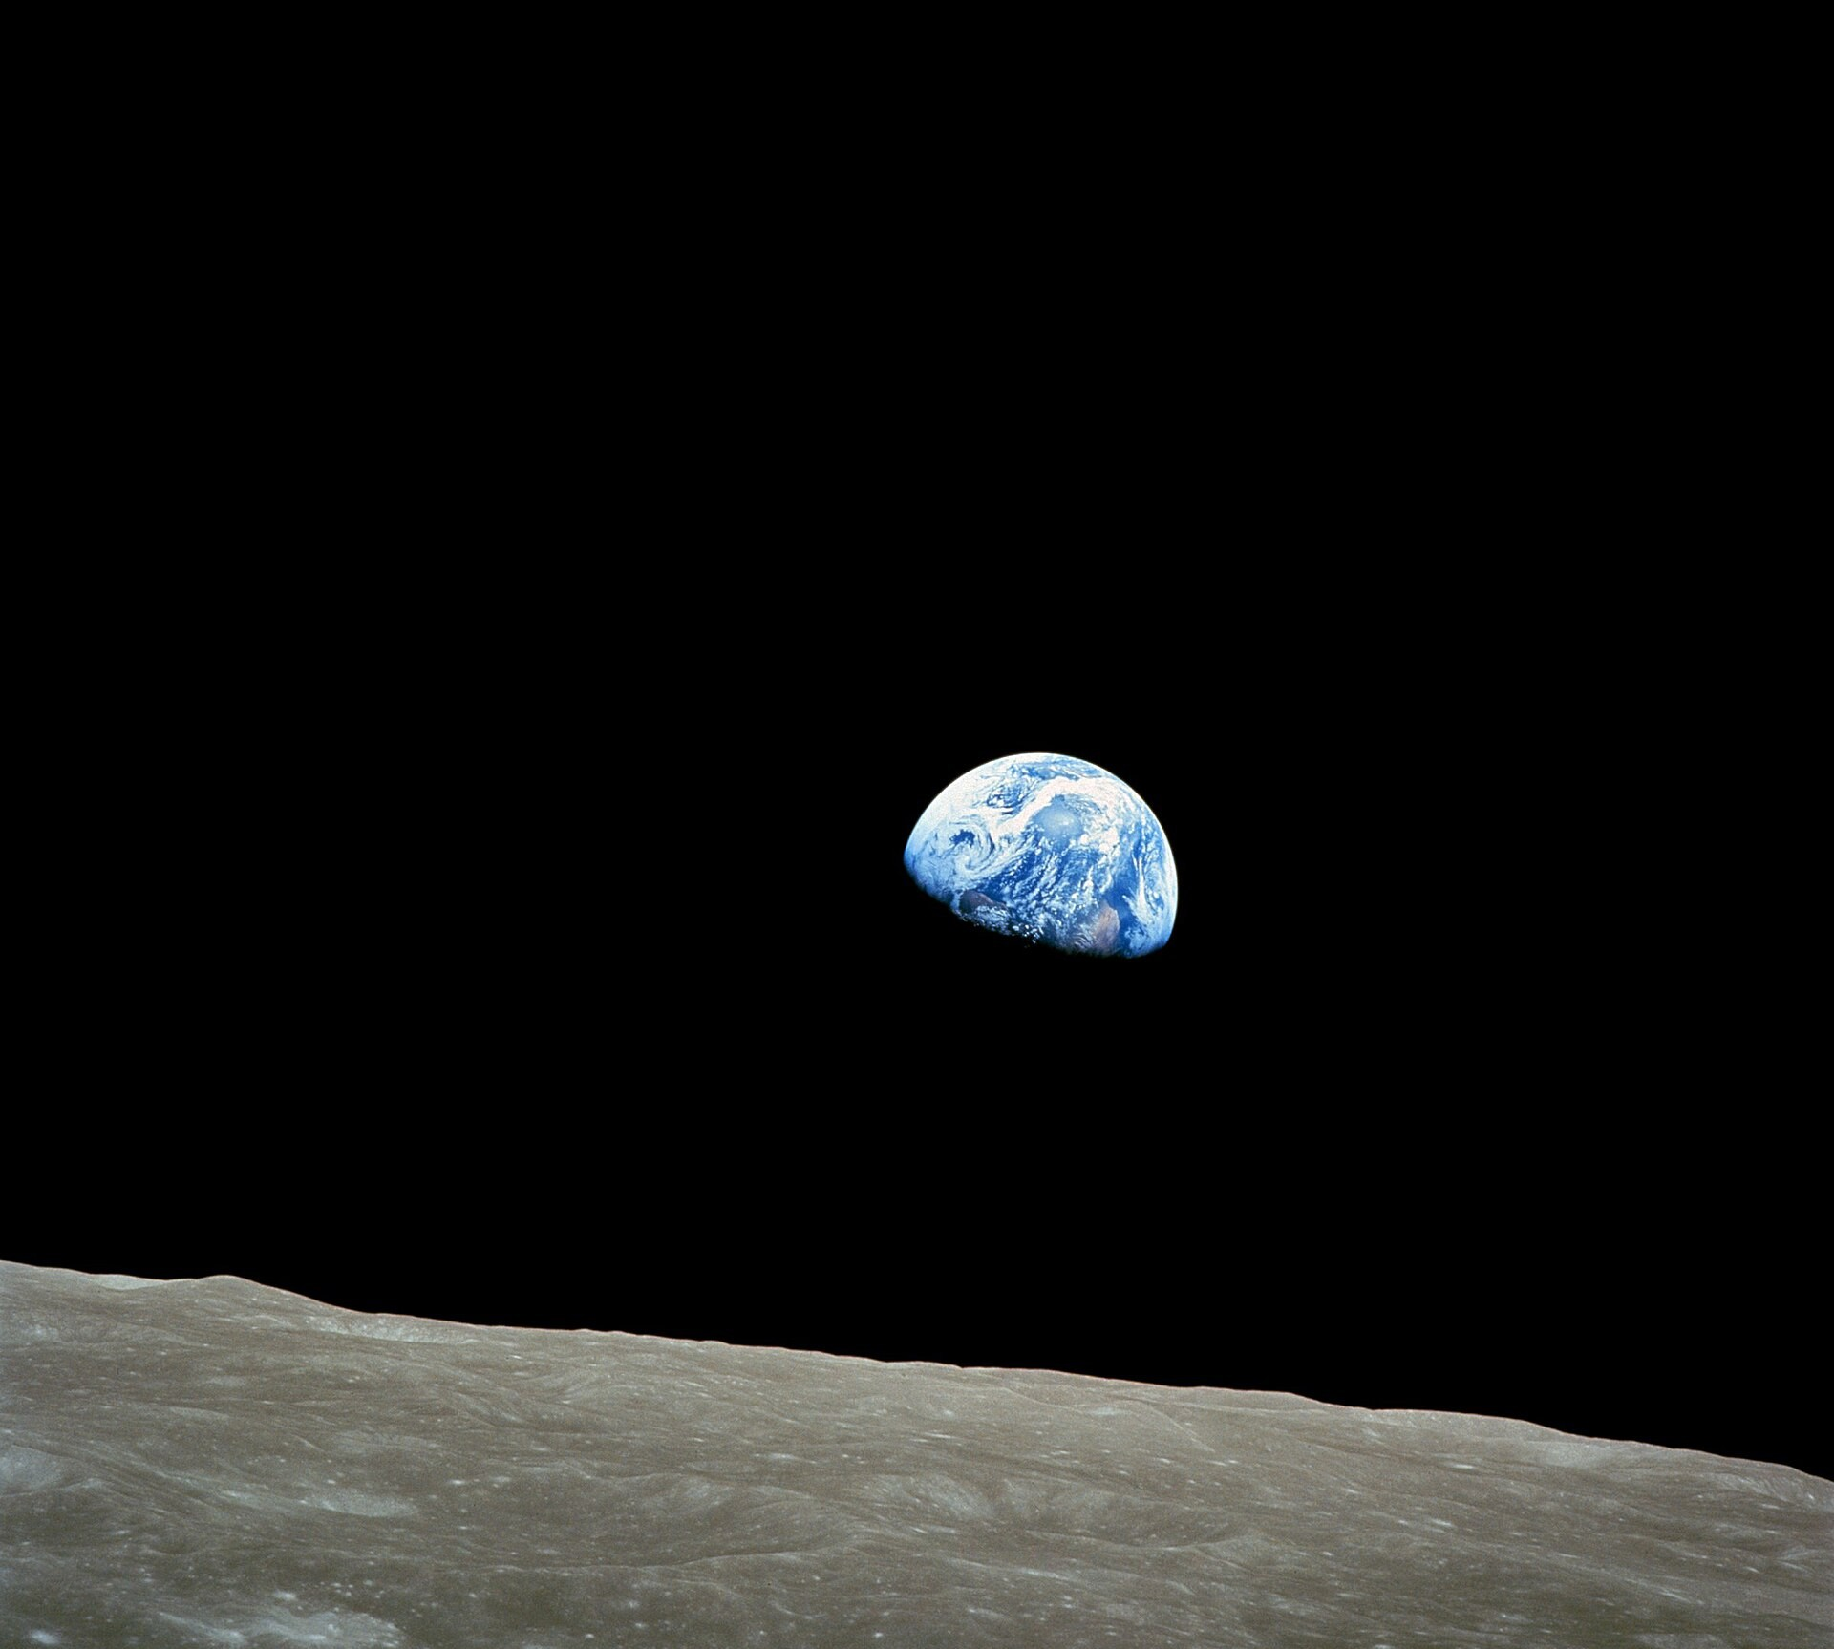
81
films (35%) of 233 are set in a year on or before 2026
Only these can be scored: each prediction is judged by the film’s own setting year.
75 of the 81 have at least one scored prediction.
Notes:
81 of the 233 films (35%) are set in a year on or before 2026, so their future has arrived.
Only these can be scored: each prediction is judged by the film’s own setting year. 75 of the 81 have at least one scored prediction; the other six have only premise items.
The share fell from 42% with the 233-film update, because many of the films I added are set further ahead.
Source: project stats_summary.md (the 233-film update) and films.csv.
Image: Earthrise, Apollo 8, 24 December 1968, NASA / Bill Anders. Licence: public domain (NASA). Source: https://commons.wikimedia.org/wiki/File:NASA-Apollo8-Dec24-Earthrise.jpg

Slide 7
20.2%
11.4%
220
score, counting near-misses as half (about 1 in 5)
came true outright (about 1 in 9)
predictions scored, from 75 films
Judged by each film’s own setting year; tech that already existed and plot devices excluded.
Notes:
So, did they get it right? Mostly not. Of 220 predictions I scored from 75 films, 25 came true outright (11.4%, about 1 in 9) and 39 sort of did. Counting a near-miss as half, the score is 20.2%, about 1 in 5.
My rules: each prediction is judged by the film’s own setting year, so anything that arrived later counts as didn’t. Technology that already existed at release, and plot devices (aliens, time travel), are excluded.
Robustness: dropping the 20 thin-evidence films gives 21.8%; weighting each film equally gives 16.9%.
Sources: project stats_summary.md (the 233-film update) and predictions.csv (220 rows with scored = yes); https://oneredodd.github.io/scifi-timeline/

Slide 8
All three beat the average
35%
2001: A Space Odyssey
1968 to 2001
Hit: voice-print ID
Miss: Moon base
39%
Blade Runner
1982 to 2019
Hit: video calls
Miss: flying cars
45%
Back to the Future Part II
1989 to 2015
Hits: video calls, drones
Miss: hoverboards
Notes:
The three films everyone asks about all beat the 20.2% average.
2001: A Space Odyssey (1968, set 2001): 2 came true, 3 sort of, 5 didn’t: 35%. Hit: voice-print identification. Miss: the permanent Moon base (Clavius).
Blade Runner (1982, set 2019): 3 / 1 / 5: 39%. Hit: video calls from a phone booth. Miss: flying cars (spinners) in everyday use.
Back to the Future Part II (1989, set 2015): 4 / 1 / 5: 45%. Hits: video calls on the home TV, drones. Miss: hoverboards.
Sources: stats_summary.md (the 233-film update) headline films table; predictions.csv rows for each film.

Slide 9
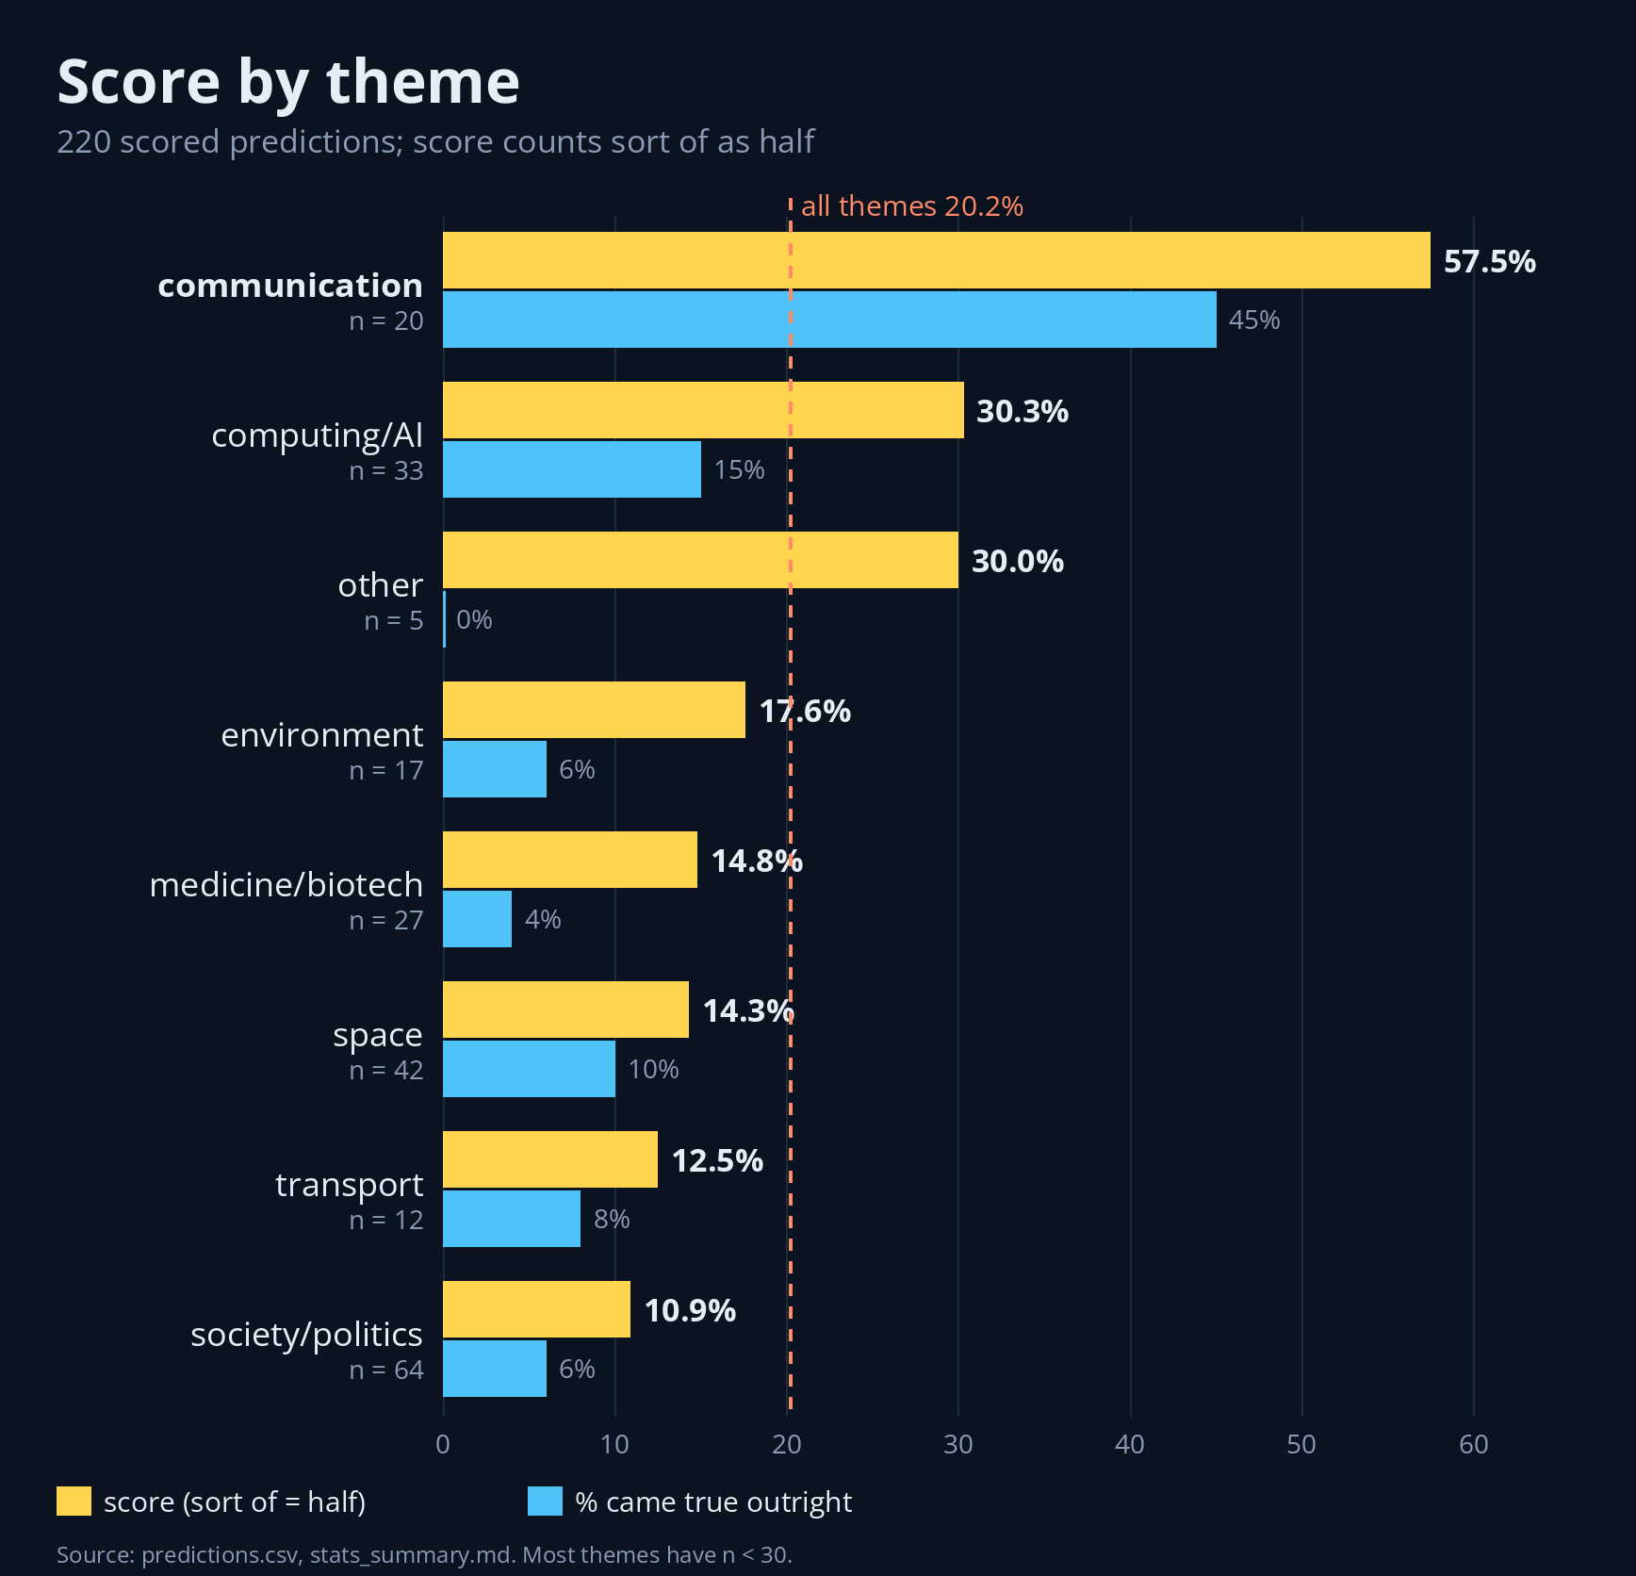
Communication wins
57.5% communication: video calls, flat screens, voice control
30.3% computing/AI, next best
10.9% society/politics, lowest
12.5% transport, from just 12 forecasts
Only communication survives a multiple-comparison correction.
Notes:
By theme, communication is far ahead: 57.5% (20 predictions from 10 films; 45% came true outright). Video calls, flat screens and voice control.
Computing/AI comes next at 30.3% (33 predictions). At the bottom: society/politics 10.9% (64 predictions) and transport 12.5%, from just 12 forecasts.
Caution: most theme cells have fewer than 30 predictions, and only communication survives a multiple-comparison correction (from my first round of checks), so I wouldn’t read much into the order below it.
Sources: stats_summary.md (the 233-film update) by-theme table; predictions.csv; audit_findings.md.
Chart: my own chart, charts/score_by_theme.png (drawn by src/make_theme_chart.py from predictions.csv), a square re-draw of paper/figures/fig_theme_scores.png made for this talk.

Slide 10
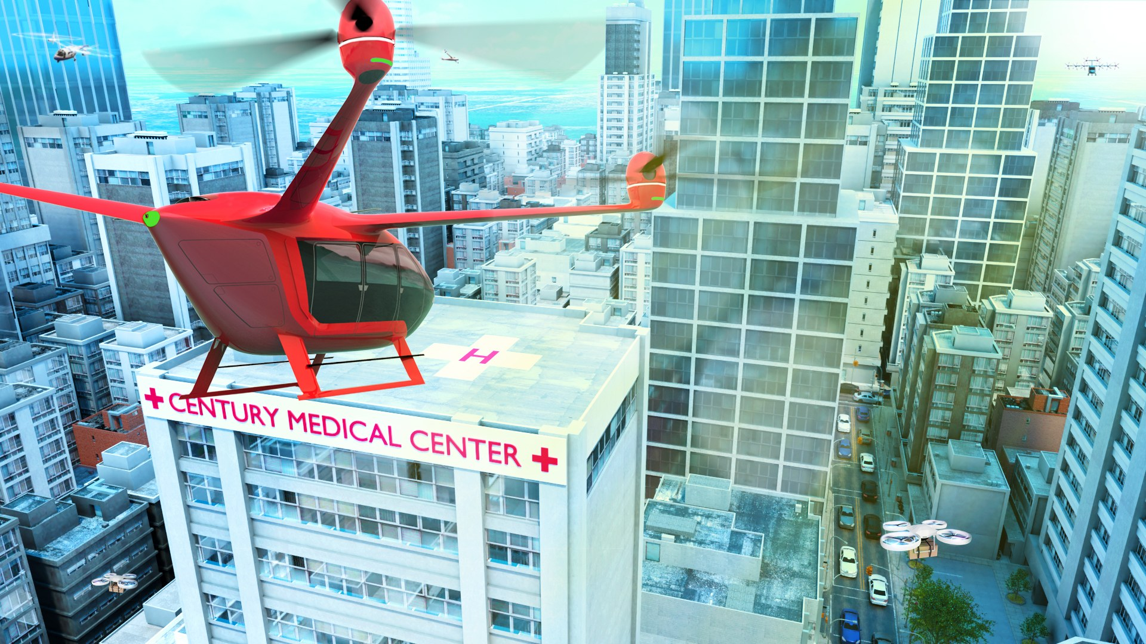
Where’s my flying car?
Transport predictions scored 12.5% from 12 forecasts, and every flying car missed.
Yet eVTOL air-taxi prototypes now fly: the function arrived, the form didn’t.
Notes:
Where’s my flying car? Transport is one of the weakest themes: 12.5% from just 12 scored forecasts (1 came true, 1 sort of, 10 didn’t). The one hit is The Great Air Robbery (1919): night air mail by 1925.
Every flying-car forecast I scored is a miss: Die Große Wette (air cabs by 2000), Just Imagine (personal aircraft by 1980), The Shining Future (family rocket planes and helicopters by 1960), Blade Runner (spinners in 2019) and Back to the Future Part II (2015).
Function versus form: electric air taxis (eVTOL) now fly, but as prototypes, still pre-production. Joby Aviation (11 March 2026), ‘Joby’s first FAA-conforming aircraft takes flight’ [press release], https://www.jobyaviation.com/news/joby-s-first-faa-conforming-aircraft-takes-flight
Sources: stats_summary.md (the 233-film update) by-theme table; predictions.csv (theme = transport, scored = yes); paper/paper.md sections 6.6 and 8.2 (‘Where’s my flying car?’).
Image: NASA Headquarters, ‘Advanced Air Mobility Aids in Healthcare’ (AAM concept art). Public domain (NASA). https://commons.wikimedia.org/wiki/File:Advanced_Air_Mobility_Aids_in_Healthcare_(AAM_Healthcare).jpg

Slide 11
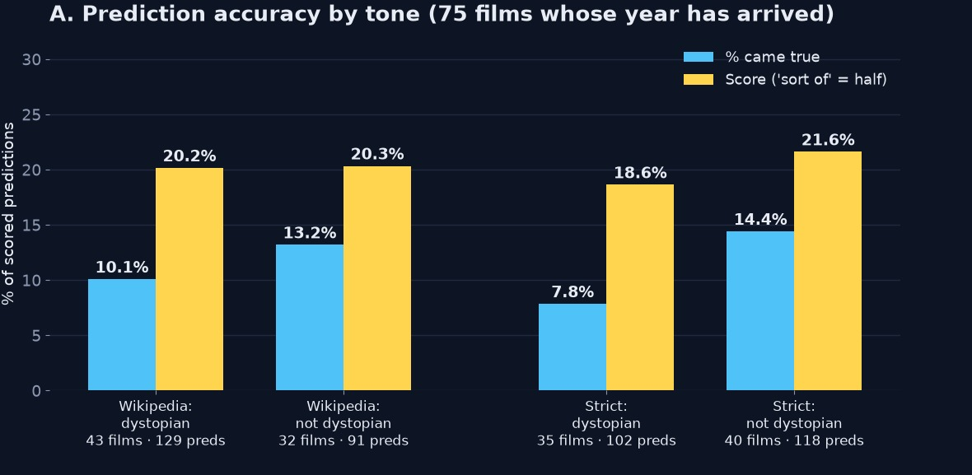
Bleak or bright?
18.6% vs 21.6% strictly dystopian films vs the rest (p = 0.14)
20.2% vs 20.3% on Wikipedia’s labels (p = 0.52)
‘Dystopias are rising’ holds only on Wikipedia’s generous labels
Gadgets right, catastrophes wrong: gadget forecasts scored 41%, but only 2 of 42 plagues, wars and collapses came true.
Notes:
Do bleak films predict better? No. On strict labels (the society on screen is oppressive or collapsed for most of the runtime), dystopian films score 18.6% against 21.6% for the rest (Fisher p = 0.14). On Wikipedia’s labels: 20.2% vs 20.3% (p = 0.52). No specification is significant (all p ≥ 0.10); power is low, with only 25 outright hits.
‘Dystopias are on the rise’ holds only on Wikipedia’s generous labels: 86% of 2010s films, against 63% on the strict rule. The trend since 1950 is significant on Wikipedia labels (OR 1.19 per decade, p = 0.012) but not on strict labels (OR 1.08, p = 0.24).
Takeaway: gadgets right, catastrophes wrong. Gadget forecasts (communication plus computing/AI) scored 40.6% (n = 53). Only 2 of 42 plague, war, collapse and police-state forecasts came true, both interwar films foreseeing a second world war.
Sources: tone_analysis.md and stats_summary.md (the 233-film update). Chart: panel A of my project chart tone_vs_accuracy.png.

Slide 12
Bigger picture
 | Wythoff & Leane | Mine
Scope | 2,552 works, all media | Films only
Films | 960 (959 with a year) | 233
Film median gap | 25 years | 34 years
146 shared films | median 31 years | median 30.5 years
132 of the 146 shared films agree on the year: the gap is which films were picked, not how they were dated.
Data: Wythoff & Leane (2025), Post45 Data Collective, CC BY 4.0
Notes:
How does this compare with a much bigger dataset? Wythoff & Leane (2025) catalogue 2,552 futuristic works across all media, of which 960 are films (959 with a year). Their film median gap is 25 years (n = 959). Mine: 233 films, median 34.
Their films drift nearer over time: median 50 years in the 1960s, 17 in the 2010s. The trend weakens a lot for films whose first genre is SF (49 to 32.5, p = 0.053), and novels show none (56 to 62, p = 0.49).
I ran the comparison on my 163-film snapshot (11 Oct 2026; median 32): 146 of my films were in their data and 132 of those (90%) agree on the year. On the 146 shared films the medians are 30.5 (mine) and 31 (theirs), so the difference is selection, not dating: they include many superhero, horror and comedy films set a year or two ahead. Their data also supplied 51 of the 70 films I added in the 233-film update, each re-sourced.
Data: Wythoff, G. & Leane, T. (2025). Time Horizons of Futuristic Fiction. Post45 Data Collective, doi:10.18737/552626, CC BY 4.0. Sources: wythoff_leane/findings.md, paper/paper.md.

Slide 13
Checking my work
Scoring
Re‑scoring
Two rounds of checks
220 predictions from 75 films, each judged by the film’s own setting year
40 random predictions scored again from scratch: 39 agreed (97.5%)
Round 1: every number recomputed, every hit re-checked. Round 2: 44 later rows, 3 changed
Caveats: famous films that name a year, not a random sample; one scorer; small groups. Akira’s Olympics is coincidence, not foresight.
Notes:
I checked my own work (twice). Here’s how, in three steps.
Scoring: I scored 220 on-screen predictions from the 75 films whose year has arrived, each judged against the film’s own setting year. I don’t score technology that already existed at release, or plot devices. Came true 25, sort of 39, didn’t 156: 11.4% outright, 20.2% counting sort of as half.
Re-scoring: I re-scored 40 random predictions (seed 2026) from scratch and agreed with my original verdict on 39 of 40 (97.5%). The one change was High Treason’s ‘United States of Europe’ by 1940, sort of to didn’t. A random sample flatters agreement, because most rows are obvious misses.
Two rounds of checks. Round 1: I recomputed every published number from the raw CSVs, and all reproduced; I re-checked every ‘came true’ and ‘sort of’ row by hand. 7 of the 30 hits were technology that already existed when the film came out (9 rows in all), and 33 premise rows depended on time travel, aliens, monsters and the like. I took both groups out of scoring. Round 2: I went through the 44 prediction rows added in the 233-film update (13 films) line by line: I kept 41, changed 3, and the headline score moved from 20.1% to 20.2%.
Caveats: well-known films that name a year, not a random sample; just me scoring, no second scorer; most groups under 30 predictions. Akira’s Tokyo Olympics and The Running Man’s faked deaths are coincidences with good stories, not foresight (PolitiFact debunked the Akira pandemic claim).
Sources: audit_findings.md, audit_findings_v2.md, stats_summary.md (the 233-film update), predictions.csv.

Slide 14
Things I might look at later
Two things I’ve parked for now:
Alternate history, set aside to look at on its own (e.g. 2009: Lost Memories)
TV series: 94 already charted; I may score them later
Data, code and paper on the site:
oneredodd.github.io/scifi-timeline
Any questions?
Notes:
Things I might look at later: two things I’ve parked for now.
Alternate history: films like 2009: Lost Memories (2002) set a future on a calendar where history went differently, which breaks my real-timeline rule. I’ve parked the candidates in alt_history_candidates.csv to look at later.
Television: I’ve already charted 94 series (series/series_timeline.png) but not scored them; I may score them the same way later.
Everything is open: the dataset, the code and the paper are on the site, https://oneredodd.github.io/scifi-timeline/
Then questions.
Sources: paper/paper.md (scope section; 94 series), alt_history_candidates.csv.

