Slide 1
Geometry Stage
View
Transform
Projection
Transform
Screen
Mapping
Design the Scene
Vertex Transform
Triangular Assembly
Software Rasterization
Render
Result
Triangular Cutting
Scanline
Algorithm
Fragment
Calculator
Rasterization Stage
www.silvergamer.tech/
Render Pipeline

Slide 2
Point A
Color:(1,0,0,1)
GREEN
BLUE
Point O
Point C
Color:(0,0,1,1)
RED
Point B
Color:(0,1,0,1)
www.silvergamer.tech/

Slide 3
www.silvergamer.tech/

Slide 4



Slide 5
Screen
（B）
（A）
www.silvergamer.tech/

Slide 6
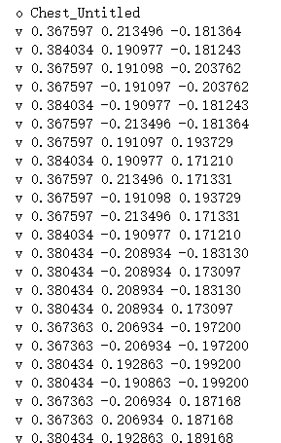
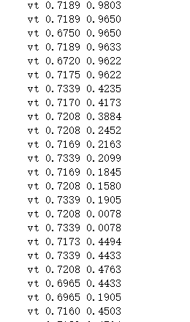
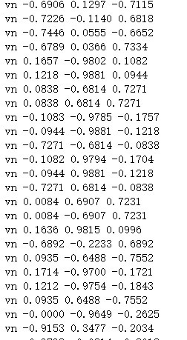
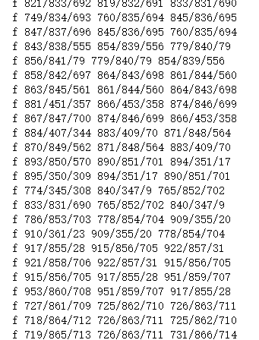
www.silvergamer.tech/
position
uv
normal
face

Slide 7
The Swap Heap View
Basic DirectX12 Data Structure
Depth Stencil
View
IDXGIFactory4
IDXGI
SwapChain
ID3D12CommandAllocator
Render Target View
ID3D12Fence
ID3D12Device
ID3D12CommandQueue
ID3D12CommandAllocator
ID3D12GraphicsCommandList
ID3D12
DescriptorHeap
www.silvergamer.tech/

