Slide 1



Final Presentation

Slide 2


Key Points
Project Overview/Scope
Software Development Process
Challenges
Live Demonstration
Future Enhancements
Lessons Learned
Questions
Notes:
Mike

Slide 3
Project Overview
The application we have developed will be an integral part of Radford University’s D2L course management system. Students will have the ability to stay up to date with course information from anywhere using their mobile Android device.
Notes:
Mike

Slide 4
Original Project Scope
Functional Android Application
D2L Login System
User Course Selection
Grades
Dropbox
Upload and Download
File Presentation
Content
Download
Notes:
Mike

Slide 5
Final Project Scope
Changes with Key:
Functional Android Application
D2L Login System
User Course Selection
Grades
Content
Changes without Key:
Proof of Concept
Concentration on UI Design
Notes:
Mike

Slide 6
Software Development Process
Waterfall Model
Planning
Requirements
Design
c
Notes:
Charlie
Planning
Human Resources
Dr. Tracy Lewis
Lisa McDaniels
Non Human Resources
appcelerator
RU webspace
Davis and Young labs
Wordpress
Kitchensink
javascript
Stakeholders
RU D2L development team
Risks succesfully identified
Password security
Illness
Change of requirements
Requirements
Defined functionality, user objectives, and constraints of the application
Interface
Security
Maintainabilty
Portability
Use case models
Sequence diagrams
Design
Conceptual View
Low level data diagrams
User Interface
application control

Slide 7
Challenges
API Key not Delivered
Meeting Times
No Built in File Viewer for Android
Notes:
Sam
api key – altered scope
File viewer
Meeting times – illness, classes, work
Plan ahead – deadlines were met

Slide 8
Lessons Learned
Plan ahead
Hope for the Best, Plan for the Worst.
Be Flexible
Communication
Teamwork
Project Management is Difficult
Notes:
Sarah

Slide 9
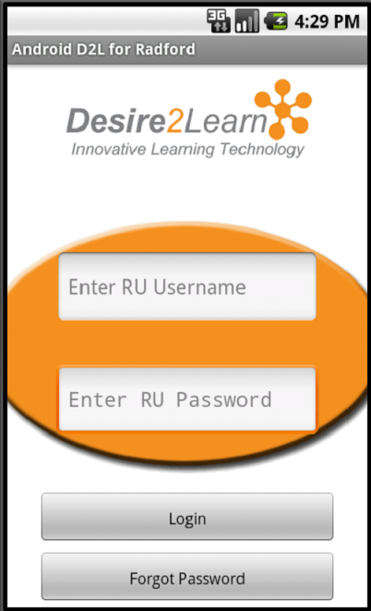

Demonstration
Notes:
Sam

Slide 10
Future Enhancements
Increased Dropbox Functionality
Chat Utility
Grade Statistics
Mobile Calendar Sync
Notifications
Navigational Menu
Instructor Utilities
Notes:
Sarah -revise

Slide 11

Questions
?

