Slide 1

Six-Week
Progress Report

Slide 2


What makes a good app?
What qualities do you look for in an app?

Slide 3
Key Points
Project Overview
Front End Design
Back End Design
Problems
Plan of Action
Questions

Slide 4
Project Overview
What is D2L?
What will the D2L Android app do?
What areas will the D2L app cover?
Automatic login
Improved design vs. mobile website

Slide 5
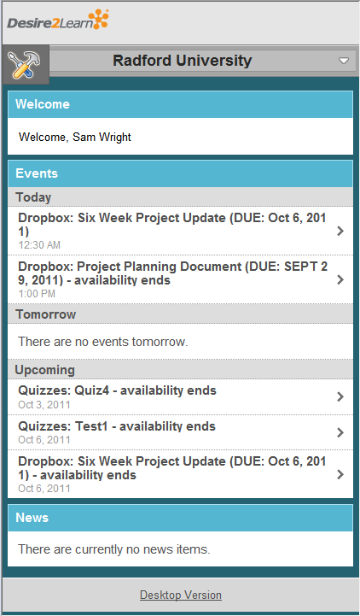

Slide 6
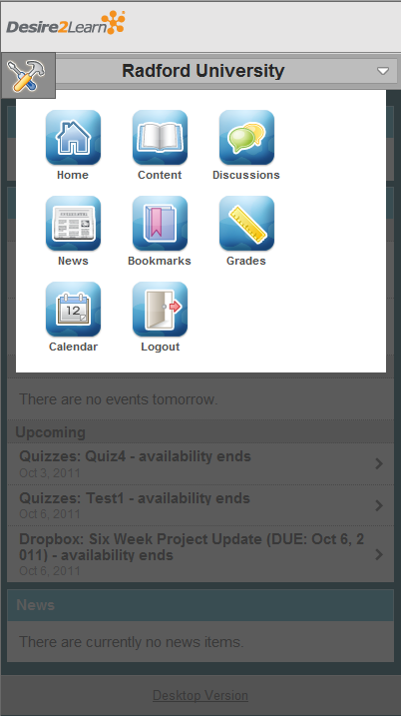

Slide 7
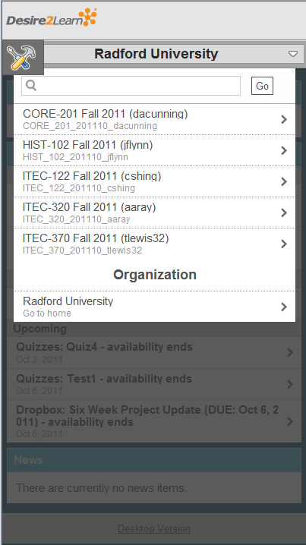

Slide 8
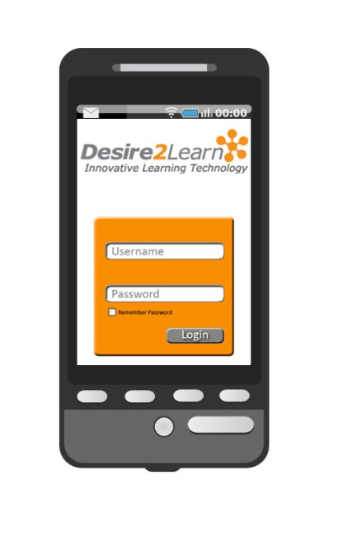

Slide 9
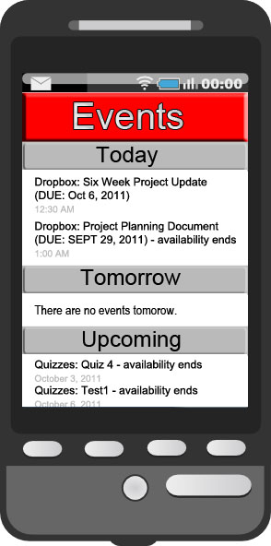

Slide 10
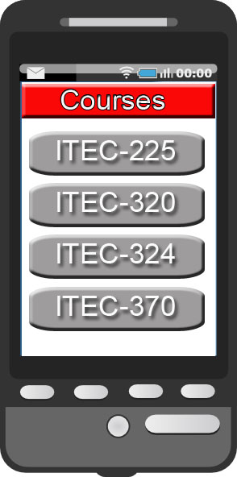

Slide 11
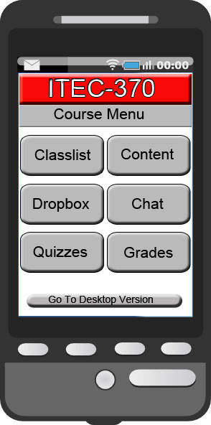

Slide 12
Front End Design
GUI Based
Home
News and Events
Class Selections
Class
D2L Utilities

Slide 13
Back End Design
JavaScript
JSON
HTML
Appcelerator

Slide 14
Problems
Authorization Issues
Contact with D2L Staff
D2L is Still Evolving
Scope Creep

Slide 15
Plan of Action
Develop JavaScript Knowledge
Familiarize Ourselves with Appcelerator
Design Front End System
Code Back End
Polish Product for Release

