Slide 1
CoreLMS-Learning Management System
with Plagiarism Detection Engine
OOP Final Project | C++ | Modular Architecture | File-Based Persistence
Multi-Role Auth
Course Management
Plagiarism Engine
File Submissions
FAST NUCES Peshawar • C++ • OOP

Slide 2
Project Overview
What Is It?
Tech & Concepts
A terminal-based LMS built in C++ that manages the full academic lifecycle:
• Three user roles: Admin, Teacher, Student
• Course creation & enrollment
• Assignment posting & submission
• Grading & feedback system
• Announcement broadcasts
• Query/answer between students & teachers
• Built-in plagiarism engine for submissions
Language
C++17
Paradigm
OOP + Procedural (C)
Persistence
File I/O (.txt)
Arch. Pattern
Modular (auth, user, pleg)
C ↔ C++
extern "C" linkage
Plag Algorithm
N-gram + Dice Similarity
UI Picker
zenity (Linux GUI)
File Support
txt, pdf, docx

Slide 3
System Architecture & Module Structure
main.cpp
Entry Point
auth
Login & User Factory
Admin
Teacher
Student
addUser / addCourse / assign
assignments / grade / queries
enroll / submit / viewResults
data/ Files
Plagiarism Engine
User (Abstract)
users.txt • course.txt
enrollments.txt • submission.txt
input.c + logic.c (C)
plageng.cpp (C++ wrapper)
Base class
virtual menu()

Slide 4
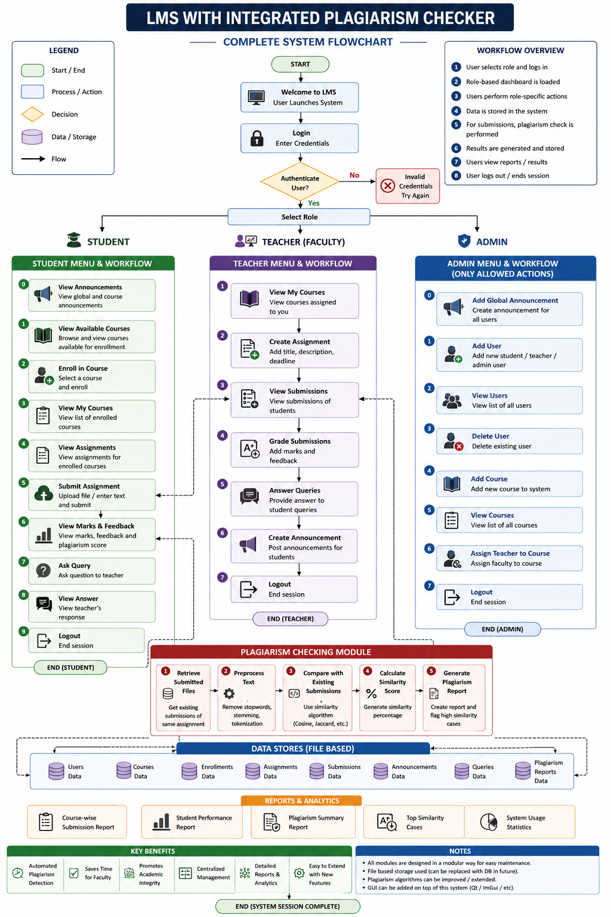

Slide 5
OOP Concepts Applied
▲ Inheritance
◆ Polymorphism
■ Encapsulation
Admin, Teacher, Student all inherit from User (base class). Shared attributes: username, password, role. Each subclass specializes menu().
User declares menu() as a pure virtual function. auth::login() returns User*, and the correct derived class menu() is dispatched at runtime.
Private member data (courseid, username) exposed only via public getters. Menu methods are private, callable only from within the class.
● Abstraction
⟩ C ↔ C++ Link.
⊕ Static Methods
The User class is abstract (cannot be instantiated). Forces all subclasses to implement menu(). auth acts as a factory hiding object creation.
Plagiarism engine written in C (input.c, logic.c). Wrapped by plageng.cpp using extern "C" to expose C functions safely into C++ code.
auth class uses only static methods (init, login, adduser) — no instantiation needed. Clean utility-class pattern.

Slide 6
Plagiarism Detection Engine
1
2
3
File Input
Text Extraction
Clean & Normalize
Accepts .txt, .pdf, .docx
pdftotext / docx2txt
conversion
read_f() reads content
into heap memory
buffer
clean_str(): lowercase,
strip specials,
collapse spaces
4
5
6
N-gram Tokenize
Compare Grams
Dice Similarity
Slide window of 3
consecutive words
= one gram
Match grams from
file A vs file B
with used[] array
score = 2×match /
(g1+g2) × 100
returned as %
Dice Coefficient: similarity = (2 × matching_ngrams) / (total_ngrams_A + total_ngrams_B) × 100%

Slide 7
File & Directory Structure
LMS/
├── main.cpp
├── auth/
│ ├── auth.cpp
│ └── auth.h
├── user/
│ ├── User.cpp / .h
│ ├── admin.cpp / .h
│ ├── teacher.cpp / .h
│ └── student.cpp / .h
├── pleg/
│ ├── input.c
│ ├── logic.c
│ ├── main.c
│ ├── plageng.cpp / .h
│ └── plagiarism.h
├── data/
│ ├── users.txt course.txt
│ ├── enrollments.txt
│ └── submission.txt
└── submission/ (files)
Data File Schemas
users.txt
username password role (space-separated)
course.txt
courseID|courseName|teacherName (pipe)
enrollments.txt
username|courseID
assignments.txt
courseID|assignmentTitle
submission.txt
user|course|assign|path|plag|marks|feedback
query.txt
student|courseID|question|answer

Slide 8
Feature Summary by Role
Admin
Teacher
Student
✓ Add / View / Delete users
✓ Add courses to the system
✓ View all courses
✓ Assign teacher to a course
✓ Post global announcements
✓ View assigned courses
✓ Create assignments per course
✓ View all submissions + plag%
✓ Open & grade submissions (xdg-open)
✓ Answer student queries
✓ Post course announcements
✓ Browse & enroll in courses
✓ View available assignments
✓ Submit files (zenity picker)
✓ Auto-plagiarism check on submit
✓ View marks & class stats
✓ Ask queries → view answers

Slide 9
Key Takeaways
1
OOP Done Right:
Inheritance hierarchy (User → Admin/Teacher/Student) + polymorphic dispatch through pure virtual menu().
2
Cross-Language Integration:
C plagiarism engine linked into C++ via extern "C" — real-world mixed-language project.
3
Modular Architecture:
auth / user / pleg separated into modules with clear responsibilities; easy to extend.
4
Functional Plagiarism:
N-gram + Dice similarity produces a percentage score for every student submission automatically.
5
Persistent State:
All data survives process restarts via plain-text file I/O with consistent pipe-delimited schemas.
FAST NUCES Peshawar • OOP Final Project • C++

