Slide 1
Security and why you need to review yours.
David Busby
Percona Live London 2013

Slide 2

Who am I?
David Busby
Remote DBA for Percona
    January 2013
  13 some years as a sysadmin
    Paranoid when it comes to security, and legal agreements.
  Ju-Jitsu instructor (Ni Dan)
  Helps to teach children computing.

Slide 3

Agenda
What’s an “attack surface” and how to limit it.
Why password complexity is important.
Why rigid grants are important.
SELinux: why you should be using it.
What's a CVE and why should you care?
0-days, and F.U.D
5.6 Security features
Q&A
Notes:
There may be (though hopefully not) some runover there's a lot of material to be covered in a short amount of time, Feel free to catch me after the talk for additional questions / breakout demos.
There's livedemos but just incase there's also videos to fallback on if $something doesn'twork.

Slide 4
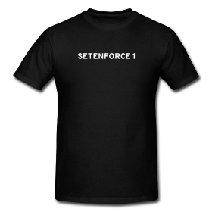

Agenda cont.
Some prizes.
And a disclaimer.
  My opinions expressed may not reflect those of my employer .. and so on
Notes:
T-Shirts
Standard BeagleBone black package,
I've included 8GB microsd card preloaded with Kali linux. (and extended the partition to use all space).
wifi dongle

Slide 5
What’s an “attack surface”?
Points in your system which could be attacked.
  application
  database
  physical systems
  network
  your employees
  hosting provider
    hosting providers employees

Slide 6
Reducing your “attack surface”
Application
  Sanitize ALL user inputs
  CSRF / XSRF tokens
  W.A.F
    e.g. mod_security
  I.P.S
    Do not leave an I.P.S in I.D.S mode.
  security auditing
    Do not rely on scanning software.
      Penetration Testing.
  M.A.C
    SELinux
Notes:
Cross Site Request Forgery
Web Application Firewalls help to block SQL injection for example.

Slide 7
Reducing your “attack surface”
Database
  Limit network exposure (no access from the internet)
    Network segregation from application (hardware or vlan)
  Selective grants
  Complex passwords
  I.P.S
  Avoid “identified by 'the_plain_password'” SQL.
    Appears in history files e.g. ~/.mysql_history
  M.A.C
    SELinux (notice a pattern here?)

Slide 8
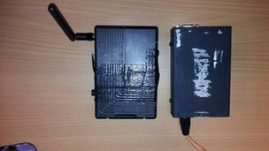
Reducing your “attack surface”
Physical Systems
  Limit physical access.
    Challenge “implied trust”.
      Barclays £1.3m “haul”
        could have been avoided.
      Uniform / badge != identification.
      Security “mantraps”.
    Don't rely on biometrics
      Just ask the MythBusters on “unbeatable fingerprint readers”
    Remove uneeded service / application.
      Your rackmount server really doesn't need bluetooth.
Image credit: http://news.bbcimg.co.uk/media/images/70014000/jpg/_70014486_co607-13device.jpg

Slide 9
Reducing your “attack surface”
Network
  Selective ACL
    Specify which hosts may access the DB network and limit the ports.
      Application nodes do not need access to SSH on the db servers for instance
      iptables -N MySQL
      iptables -I INPUT -j MySQL
      iptables -A MySQL -s <application_node_range> -p tcp --dport 3306 -m comment --comment “application range access to MySQL” -j ACCEPT
  Network isolation
    Application systems separated from DB servers.

Slide 10
Reducing your “attack surface”
Employees (Layer 8 / Meat ware).
  Awareness Training
    Most people want their company to have a high profile.
      Linkedin, Facebook etc ...
        Finding this much information used to be hard.
          Tools (e.g. Maltego) makes information gathering easier.
      Customer relations, Improve sales.
    Makes them easier to target.
      Call $company pretend to be $employee on the road, ask for some otherwise restricted information.
        “Social engineering” Fancy term for conning people.
        “phishing” / “spear phishing”
        “Run this program as root / administrator for free stuff!”
Notes:
Social engineering is just a fancy term for the con, and Con artists have existed well before computers did, e.g. Victor Lustig “The man who sold the eiffel tower twice”
Impersonating “people in authority” aka abusing “implied trust”

Slide 11

Reducing your “attack surface”
Employees (cont)
  B.Y.O.D?
    $employee uses $phone for work.
      $phone is $employee property.
      $employee uses $phone for:
        email, vpn, intranet, sms/ push notifications.
        Bank application, e-payment (e.g. google wallet).
      $phone is now a more attractive target.
        Physical attacks.
          Theft, lock screen bypasses, debug abuse (p2p-adb etc.), N.F.C.
        Remote attacks.
          Karma / Jaessegar
          Bluetooth
image credit: http://securityreactions.tumblr.com/post/65286584262/byod-good-plan
Notes:
As the gif here shows a supposed street performer “has anyone got a phone?” ... “sure here's mine” “k thanx BYE!”
Why would people blindly trust a stranger on the street ? “implied trust” ... I'm performing here look here's a camera everything safe honest ...
Karam / Jassegar attacks (hold up pineapple kit) improsonate wifi networks.

Slide 12

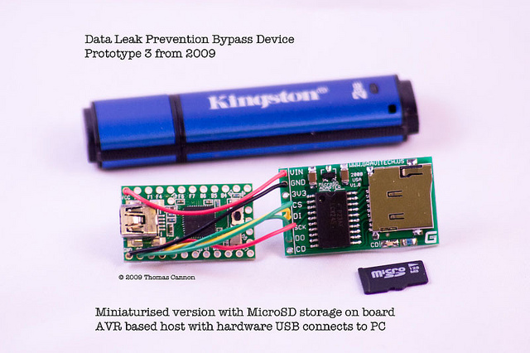
Reducing your “attack surface”
Employees (cont)
  Do not blindly trust devices.
      Malicious H.I.D devices.
        Teensy duino HID prototypes, have evolved.
          DLP Bypass
      Malicious thunderbolt chain devices.
  Challenge identity, and “implied trust”.
    It’s OK to ask for proof of identity!
    We do this for all systems, why not people?
      “Hello I am calling from the computer security centre about the virus on your windows machine...”
        Exploiting “implied trust”
        “Would you like a christmas tree in your bank account sir?” (Fonejacker)
Notes:
DLP (Data Loss Prevention)
If you were to get a free usb device would you think twice about plugging it into your laptop?
You really should.
Hold up teensy, Irongeek gave a great defcon talk on the subject in 2012 on HID abuse I've linked it in this slide.

Slide 13
Reducing your “attack surface”
Certain allowances must be made.
  Trust in Service / Hosting Provider.
    Some steps can be taken.
      Challenge identity if conctated, and verify.
      Documentation on security measures / compliance.
        You get some for a S.L.A ... get one for security!
        Most have some P.C.I compliance at least.
  Trust in mobile networks ... (though note GSM and 3G have been proven to be broken).
Notes:
For 3G Abuse look at the “hotspots” you can buy for around £60 which back onto home broadband; many with default admin passwords which can be abused to perform 3G MITM.

Slide 14
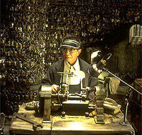
Why rigid grants are important
How often do you see an application with "ALL PRIVILEGES ON *.*" ?
  cacti
  phpmyadmin
How about "WITH GRANT OPTION"?
We also need to be concerned with: Super_priv, Create_routine_priv, Insert_priv
Image credit: http://upload.wikimedia.org/wikipedia/en/8/8c/The_Keymaker.jpg
Notes:
There's no valid reason for a web facing application to have “GRANT OPTION”.
Cpanel, Plesk think of them as the “key maker” from the Matrix revolutions ... if you can compromise them they'll make the keys for you no need to attack anything else.

Slide 15
Why rigid grants are important
Super
  kill any process, stop/reset slaves, write to read only etc (part of all).
FILE && Create routine
  We’re going to abuse this to inject malicious UDF shortly.
Insert_priv
  _could_ be used to create users, and access permissions by inserting into mysql schema tables.
WITH GRANT OPTION
  no application should need to create grants.
Notes:
Super is grants as part of all.
File and creat routines are particuarly evil.
Does your application REALLY need file and create routines ?I don't think so ...
Insert_priv can be a “roundabout” way of injection privleges into MySQL
NO web facing app needs with GRANT OPTION, as I noted before with the keymaker reference.

Slide 16
Why password complexity is important
So let's consider
  I'm an attacker; I've compromised your web application.
  I've been able to grab a "hashdump".
    A dump of the mysql.users table containing the password hashes.
    Or I'm "sniffing" MySQL traffic from the application host hoping to capture the "handshake" of a privileged user.
      More complex requires hash table regeneration due to changing salt.

Slide 17
Why password complexity is important
Authentication handshake in brief.
  client opens tcp connection to server.
  mysqld sends greeting with salt (challenge)
  client uses salt and replies with a sha1 sum "password"
    SHA1(password) XOR SHA1(salt <concat> SHA1(SHA1(password)))
  MySQL 5.5 password hashes
    SHA1(SHA1(password))

Slide 18
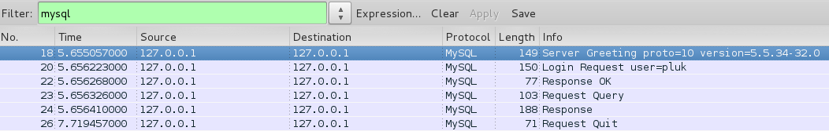
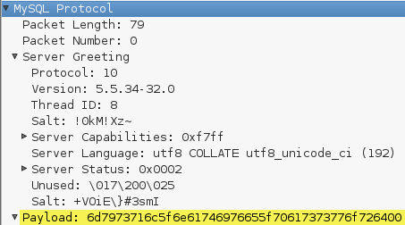
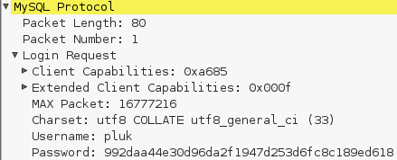
Why password complexity is important

Slide 19
Why password complexity is important
We're going to recover the passwords for the following:
  D306CEB16052CBB8539617888512E58CA68EN1AD1
  CB7DFF0540F8C51BF178A1502A286FB8F4A2691E
  E8820BB0161312465DBB69D9E2A1A73841B63B62
  B415DD9C4FB5EF59FE80C4FEBC1F9C715E6E97C4
Notes:
I was going to demo here disecting the MySQL handshake, had issues getting the software to work consistently however, so we're going to attack the standard Password hashes.

Slide 20

Why password complexity is important
Be honest, who is thinking this right now?
image credit: http://securityreactions.tumblr.com/post/52788324439/when-i-told-a-former-director-i-could-still-crack-his

Slide 21
Why password complexity is important
Demo: oclHashcat mysql5 4 hashes < 1 second
  sha1(sha1(password))
Notes:
Yes sorry this has to be a video, I couldn't get an external GPU for the laptop and as we'll see in a moment GPU vs CPU is a non trivial difference.

Slide 22
Why password complexity is important
Know thy “enemy” (and make them your friend)
  oclHashcat
    uses openCL for GPU based hash calculation.
    easily runs 270M/s+ brute force MySQL5 hashes
      Tested on a Radeon 7750 Fedora 18 x86_64
      Many supported hashes
  pre-computed hash tables
    Stored hashes derived from
      Dictionaries / wordlists
      public password list leaks
    My table has ~151M (and growing) unique words
      Generated from public lists (mostly skullsecurity.org)
        Extended using John the ripper.
      You do not want your password on that list!
Notes:
OclHashcat is but one varient of the hashcat tools.
Since upgraded to Fedora 19 and 2x 7750 crossfire cards, clocks around 340M/s

Slide 23
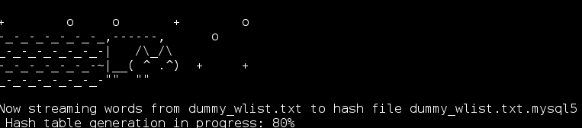
Why password complexity is important
Know thy enemy cont:
  CPU vs GPU
    GPU processing has greater parallelism resulting in much faster hash rates, CPU hashing is still fast.
    John the ripper, hashcat (+variants), pyrit
    Python CPU example (nyancrack)
      Pre computed hash tables != Rainbow tables.
Notes:
Rainbow tables are still something I am working on for MySQL hashes ... if anyone here has a working knowledge please come see me after the talk!

Slide 24
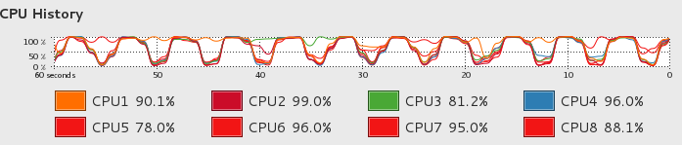
Why password complexity is important
nyancrack
  python multiprocessing (~360K/s MySQL5)
  variable threads
  modular extension
  no openCL support (yet)
  low memory overhead
    peak 1015mb consumed producing a 6.1GB file.
    tuneable memory usage feature planned.
Why not have MySQL calc the hashes?
  SLOW!
    < 500 hash / second in limited testing.
Notes:
Nyancrack ... yes the name is a bit rubbish I was working on it late one night and couldn't think of a name for it, one of my children suggest Nyancat ... of course Nyancrack!

Slide 25
Why password complexity is important
Conclusion?
  Complexity increase time for recovery.
  cost vs reward.
  “most” attackers want the quick win.
  Reduces “exposure”
    If it's going to take N time to recover the password.
      Increased likelyhood of discovering breach before recovery.
        Changing of passwords, renders recovered credentials useless.
          Also remember to “plug the hole”.
Notes:
I can't stress enough if you don't plug the original comprosmise “hole” any remediation you do is completely useless.
Even if you throw a rule in your I.P.S / W.A.F in the interim of developing a fix in the application.
Never ignore the issue it will not go away ...

Slide 26
SELinux: why you should be using it.
Let's deal with the what before the why.
  SELinux is a M.A.C which uses “labels”
  We're going to look at the more common "targeted" policy
    not covering MLS / Strict
  /etc/selinux/config
    SELINUX=enforcing
    SELINUXTYPE=targeted

Slide 27
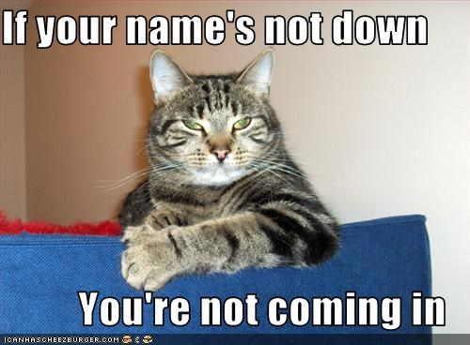
SELinux: why you should be using it.
Labels
  selinux contexts applied to files, ports
    user:role:type:level(optional)
    targeted policy really only looks at the "type"
  Type enforcement (policies)
    A process running with X context
      is allowed to access a resource with the Y context
      but not Z context.
image credit: https://i.chzbgr.com/maxW500/1659454208/hE5C2A3CB/

Slide 28
SELinux: why you should be using it.
You want mysql to be able to access.
  /var/lib/mysql (mysqld_db_t)
  /var/log/mysql (mysql_log_t)
  *:3306 (mysql_port_t)
But you probably do not want MySQL accessing
  /etc/passwd (passwd_file_t)
  /etc/shadow (shadow_file_t)
  http_port_t , ssh_port_t

Slide 29
SELinux: why you should be using it.
So how do I get the current contexts?
  ls -z
    unconfined_u:object_r:mysqld_db_t:s0 /var/lib/mysql/ibdata1
  ps -z
    system_u:system_r:mysqld_t:s0
  Id -z
    unconfined_u:unconfined_r:unconfined_t:s0-s0:c0.c1023
Many standard linux utilities take the -Z arguments.

Slide 30
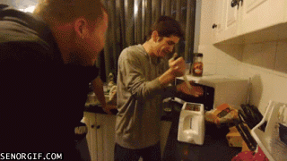
SELinux: why you should be using it.
Most peoples experience of SELinux seems to be: "So I `setenforce 1` and ..."
image credit: http://securityreactions.tumblr.com/post/53675346932/hey-guys-check-out-this-new-exploit
Notes:
SELinux broke my STUFF!
90% of the time this is just mislabeling.

Slide 31
SELinux: why you should be using it.
setenforce 0 == Permissive != OFF
  Useful for debugging.
  Always go back to setenforce 1 == Enforcing
New tools make things easier.
    setroubleshoot-server
    libselinux-python
    e.g. from (coming next) demo:
      “MySQL connection failed Can't connect to MySQL server on '172.16.33.3' (13)”
        OS error code 13: Permission denied

Slide 32
SELinux: why you should be using it.
Using SELinux is easier than you might think.
  A couple of “gotchas” to be aware of.
    New files / dirs inheret contexts
    Moved files / dirs keep their original contexts
  Let’s go over to quick examples.
    PHP Web app can not connect to MySQL on a remote system.
    MySQL fails to start with non standard datadir.

Slide 33
SELinux: why you should be using it.
selinux sebool httpd can network connect db
Notes:
Use the video here to save time.

Slide 34
SELinux: why you should be using it.
  placeholder “none standard datadir location”
Notes:
Use the video here to save time.

Slide 35
SELinux: why you should be using it.
Ok SELinux is useable, still why should I care?
  Additional layer of security.
  Mandatory Access Control
Arrests “out of context” behaviour.
  Discretionary Access Control “trusts running software” - assumes it should access everything the user can.
  Let’s see how bad things could get.

Slide 36
SELinux: why you should be using it.
“Perfect storm” example.
  Webapp has command injection.
    Or has a vulneraility such as CVE-2012-1823
      PHP CGI command injection.
    (Also has SQL injection but we’re not going to attack it in this example).
  SELinux is Permissive / OFF
  Bad grants (ALL PRIVILEGES ON *.*)
  We’re going to.
    Deploy a php shell.
    Deploy a UDF.
    Have some fun with command line via mysql ...

Slide 37
SELinux: why you should be using it.
We're abusing everything we have allready outlined as being “bad”.
Some steps are purposely skipped!
  This isn’t a “how to hack”
Code will be made available @ Github
  Most of it.
LEGAL DISCLAIMER!
  This is on a local VM environment only.
  For informational purposes only.
  Use at your own risk.

Slide 38
SELinux: why you should be using it.
  Demo “PHP cmd injection” -> “PHP CMD Shell” -> “MySQL load UDF”
Notes:
STOP!!! we'll need to setenforce 0 on both web1 and db1 first!

Slide 39

SELinux: why you should be using it.
  Assuming everything went as planned ...
image credit: http://securityreactions.tumblr.com/post/55262226152/when-the-live-demo-works-during-a-talk

Slide 40
What's a CVE and why should you care?
  Common Vulnerabilities and Exposures.
    Common classification and notation of known vulnerabilities.
      CVE-2013-2094 perf_swevent_init() privilege escalation.
    $vendors usually use this to classify vulnerabilities reference in their erratas.
      Not always used as intended however.
        e.g. Oracle filed many CVE’s 2013-10-16 and 2013-07-17
        CVE-2013-3826 -> CVE-2013-5867
          “Unspecified vulnerability in Oracle <product> allows remote/local attackers to affect confidentiality/integrity/availability via unknown vectors”
          No helpful information for ‘J.I.T’ / Vulnerability analysis.

Slide 41
What's a CVE and why should you care?
  Information in an as intended CVE filing can be used to:
    Check $vendor erratas for relevant patches.
    Contact $vendor with relevant information to patch.
    leverage J.I.T methods to mitigate risk.
      e.g. user_u selinux context blocks root shell from CVE-2013-2094

Slide 42
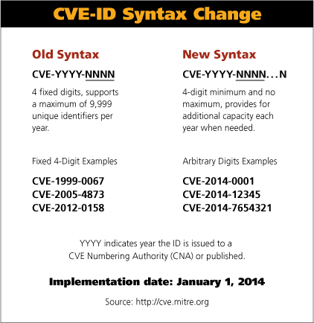
What's a CVE and why should you care?
  Syntax is changing from Jan 2014

Slide 43
What's a CVE and why should you care?
  Additional resources.
    OSVDB
      Open Source Vulnerability Database
    Secunia
    NVD
      National Vulnerability Database

Slide 44
0-days, and F.U.D
0-day
  A attack leveraging an unknown vulnerability.
  Some “claims” are just posturing.
  If concerned search for p.o.c. code and test.
    In a virtual lab environment.
  “Hardening” is the best defense against the unknown. (You lock your doors after all).
    Reducing your attack surface is a good first step.
    Prepare for the worst hope for the best.
    “By failing to prepare, you are preparing to fail.” - Benjamin Franklin.

Slide 45
0-days, and F.U.D
0-days ... it's all about being prepared.
  Be aware of potential unknowns.
    If you use HA you prepare for system failiure after all.
      Not much of a leap to prepare for security.
  Build hardened systems, from the ground up.
    Avoid the “foolish man who built his house on sand”
      Make management easy with $provisioning
        Ansible
        Puppet
        Chef
        Salt

Slide 46
5.6 Security features
  Password Expiration policy
    Drops user into “sandbox” when expired.
  Password Validate password plugin (5.6 docs)
    validate_password_policy = LEVEL
      LOW / 0
        length >= 8 chars
      MEDIUM / 1 (Default)
        LOW +
        >= 1 number && >= 1 lowercase && >= 1 upper case.
      STRONG / 2
        LOW + MEDIUM +
        substrings >= 4 chars must not appear in defined dictionary file.

Slide 47
5.6 Security features
  Password Validate password plugin cont.
    Customizable :-)
      validate_password_disctionary_file = ‘’
      validate_password_length = 8
      validate_password_mixed_case_count = 1
      validate_password_number_count = 1
      validate_password_special_char_count = 1
    Circumventable :-(
      @ another system: select PASSWORD('PLUK');
      @ 5.6 system with validate_password_policy = MEDIUM
        GRANT ALL PRIVILEGES ON *.* TO ‘pluk’@’localhost’ IDENTIFIED BY PASSWORD ‘*D306CEB16052CBB8539617888512E58CA68E1AD1’

Slide 48
5.6 Security features
  Pluggable authentication.
    e.g. sha256_password (docs)

Slide 49
5.6 Security features
  Questions?

Slide 50




Percona Live London Sponsors (TBC)
Diamond Sponsors
Platinum Sponsors

Slide 51





Percona Live London Sponsors (TBC)
Exhibitor Sponsors
Additional Sponsors
Media Sponsors

Slide 52

Annual Percona Live
MySQL Conference and Expo
The Hyatt Regency Hotel, Santa Clara, CA
April 1st-4th, 2014
Visit: http://www.percona.com/live/mysql-conference-2014/

