Slide 1
Web Application Security
Why you need to review yours.

Slide 2

Who am I?
David Busby
  Contracting for Percona since January 2013
  Director of UK company Oneiroi LTD
  17 some years as a sysadmin / devops
  Ju-Jitsu instructor for family run not for profit club
  Volunteer teacher of computing at a UK Secondary school to children. (RasPi, Scratch, Python, Minecraft API, NodeJS car project, currently looking for ideas)
  Security paranoia, and lifetime member of the tinfoil hat “club”
  C.I.S.S.P - 581907

Slide 3
Agenda
What is an “attack surface” ?
Acronym hell
Vulnerability naming, stupidity or driving the message home ?
Detection vs Prevention
Emerging technologies
2014 → 2017 what’s been going on?! (highlights only)
Live compromise demo … (or video if the demo gods are not kind today)

Slide 4
What is an “attack surface” ?
Points at which your system could be attacked.
  Application
  Database
  Physical systems
  Network
  Your employees
  Hosting provider

Slide 5
Reducing your “attack surface”
Application
  Sanitize ALL user inputs
  CSRF / XSRF tokens
  Web Application Firewall (W.A.F) e.g. mod_security
  I.P.S (do not leave in I.D.S. mode!)
  Recurring audit procedures (Chatops works well here)
  Mandatory Access Controls (e.g. SELinux)
  Ingress and Egress controls (Firewall rules)

Slide 6
Reducing your “attack surface”
Database
  Network segregation from application where possible
  Selective GRANT
  Complex passwords
  Avoid “... IDENTIFIED BY 'plaintext_password'” SQL
  Mandatory Access Controls (e.g. SELinux)
  Ingress and Egress controls

Slide 7
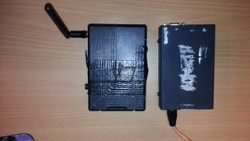
Reducing your “attack surface”
Physical systems
  Limit physical access to hardware
  Barclays £1.3M “haul” could have been avoided (2014 Image credit BBC UK)
  “Social engineering” just a new term for con artistry.
  Challenge “implied trust” a Badge / Uniform != identification
  Don't rely only on biometrics
    just ask the Mythbusters about “unbeatable fingerprint readers”
  Remove unneeded service and devices from your hardware
  Your rack-mount system probably doesn't need bluetoothd...
Notes:
Image is a K.V.M over WiFi device, installed by thieves pretending to be IT technicians servicing computers at the branch.
BBC Called this “high tech gadgets”they really are not, they are purely commodity gadgets if you know where to look …
Social engineering is just a fancy term for con artistry; an infamous example of con artistry would be Victor Lusting the many whom sold the Eiffel tower for scrap … three times, as the story goes on the third time he was caught but he managed to convince the officers to let him go … social engineering at its best ladies and gentleman

Slide 8
Reducing your “attack surface”
Network
  Selective ACL (even if it's only iptables)
  iptables -N MySQL
  iptables -I INPUT -j MySQL
  iptables -A MySQL -s aaa.bbb.ccc.ddd/CIDR -p tcp –dport 3306 -m comment –comment “application range access to MySQL” -j ACCEPT
  MySQL doesn't need to be accessible from everywhere on the internet
    Lest we forget CVE-2012-2122 (for I in {1..1000}; do mysql -u root -pbadpass; done)
  Segregation
  Intrusion Prevention System
  Intrusion Detection System
Notes:
ACL: Ensure Only hosts that need access to a service have it.
ACL: Recurring audits of access
Segregation: Hardware and/or VLAN
CVE-2012-2122: Nasty bug where rapidly using invalid password allowed login, akin to children and parents “please no please no please no but please ... oh fine here you go ...”
Intrusion Prevention – File integrity enforcement, Network based e.g. Suricata a NIDS can run in IPS mode.
Intrusiomn Detection – File integrity monitoring, e.g. AIDE, OSSEC

Slide 9

Reducing your “attack surface”
Employees (Layer 8 / Meat ware)
  Awareness training
  Social media betrays a wealth of information
  B.Y.O.D your “smart” phone is perhaps the single largest repository of personal information you own.
  Physical attacks: Theft “Wanna see a magic trick with your phone?”, lock screen bypasses, debug abuse (p2p-adb, vendor “hidden” USB host debug, Rubber ducky brute force), NFC
  Remote attacks: Karma / Jassegar, App (e.g. crafted apk) malware, Bluetooth (android remote bluetooth (bluedroid) crash)
Notes:
Awarenesseness: social networks are gold mine for information which used to be hard to retrieve; Linkedin, Facebook etc ... tools have been written to aid this such as Maltego.
Gif: As per the animated gif above “implied trust” can be a powerful thing to abuse, fictional scenario of performing magic which is being recorded on camera “has anyone got a phone?” ... “sure here's mine” ... “k thanks BYE!”
Remote attacks: Karma / Jassegar abuse WiFi inherent functionality when looking for known networks, “I'm looking for these networks are any of you them” ... Jassegar replies yes to all of these requests.”
If anyone wants a demo on Karam / Jassegar see me after the talk I have some “toys”

Slide 10
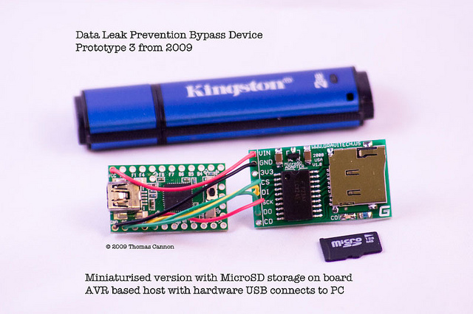
Reducing your “attack surface”
Employees (Layer 8 / Meat ware) cont.
  Malicious H.I.D devices
  Teensy Duino HID , DLP Bypass , Rubber Ducky, Bash bunny etc ...
  Malicious Thunderbolt chain devices (Thunderstrike2).
  Challenge identity and “implied trust”
    It's OK to ask for ID!
  “Hello I'm calling from the computer security center we're receiving alerts about the virus on your windows machine ...”
Notes:
Malicious human interface devices, I've included links in the slides which will be made available.
Irongeek gave a great talk on malicious HID devices, even went to far as ot embed one in a mouse with RGB led to pose as a litteral trojan horse device.
DLP: Data Leak Prevention

Slide 11
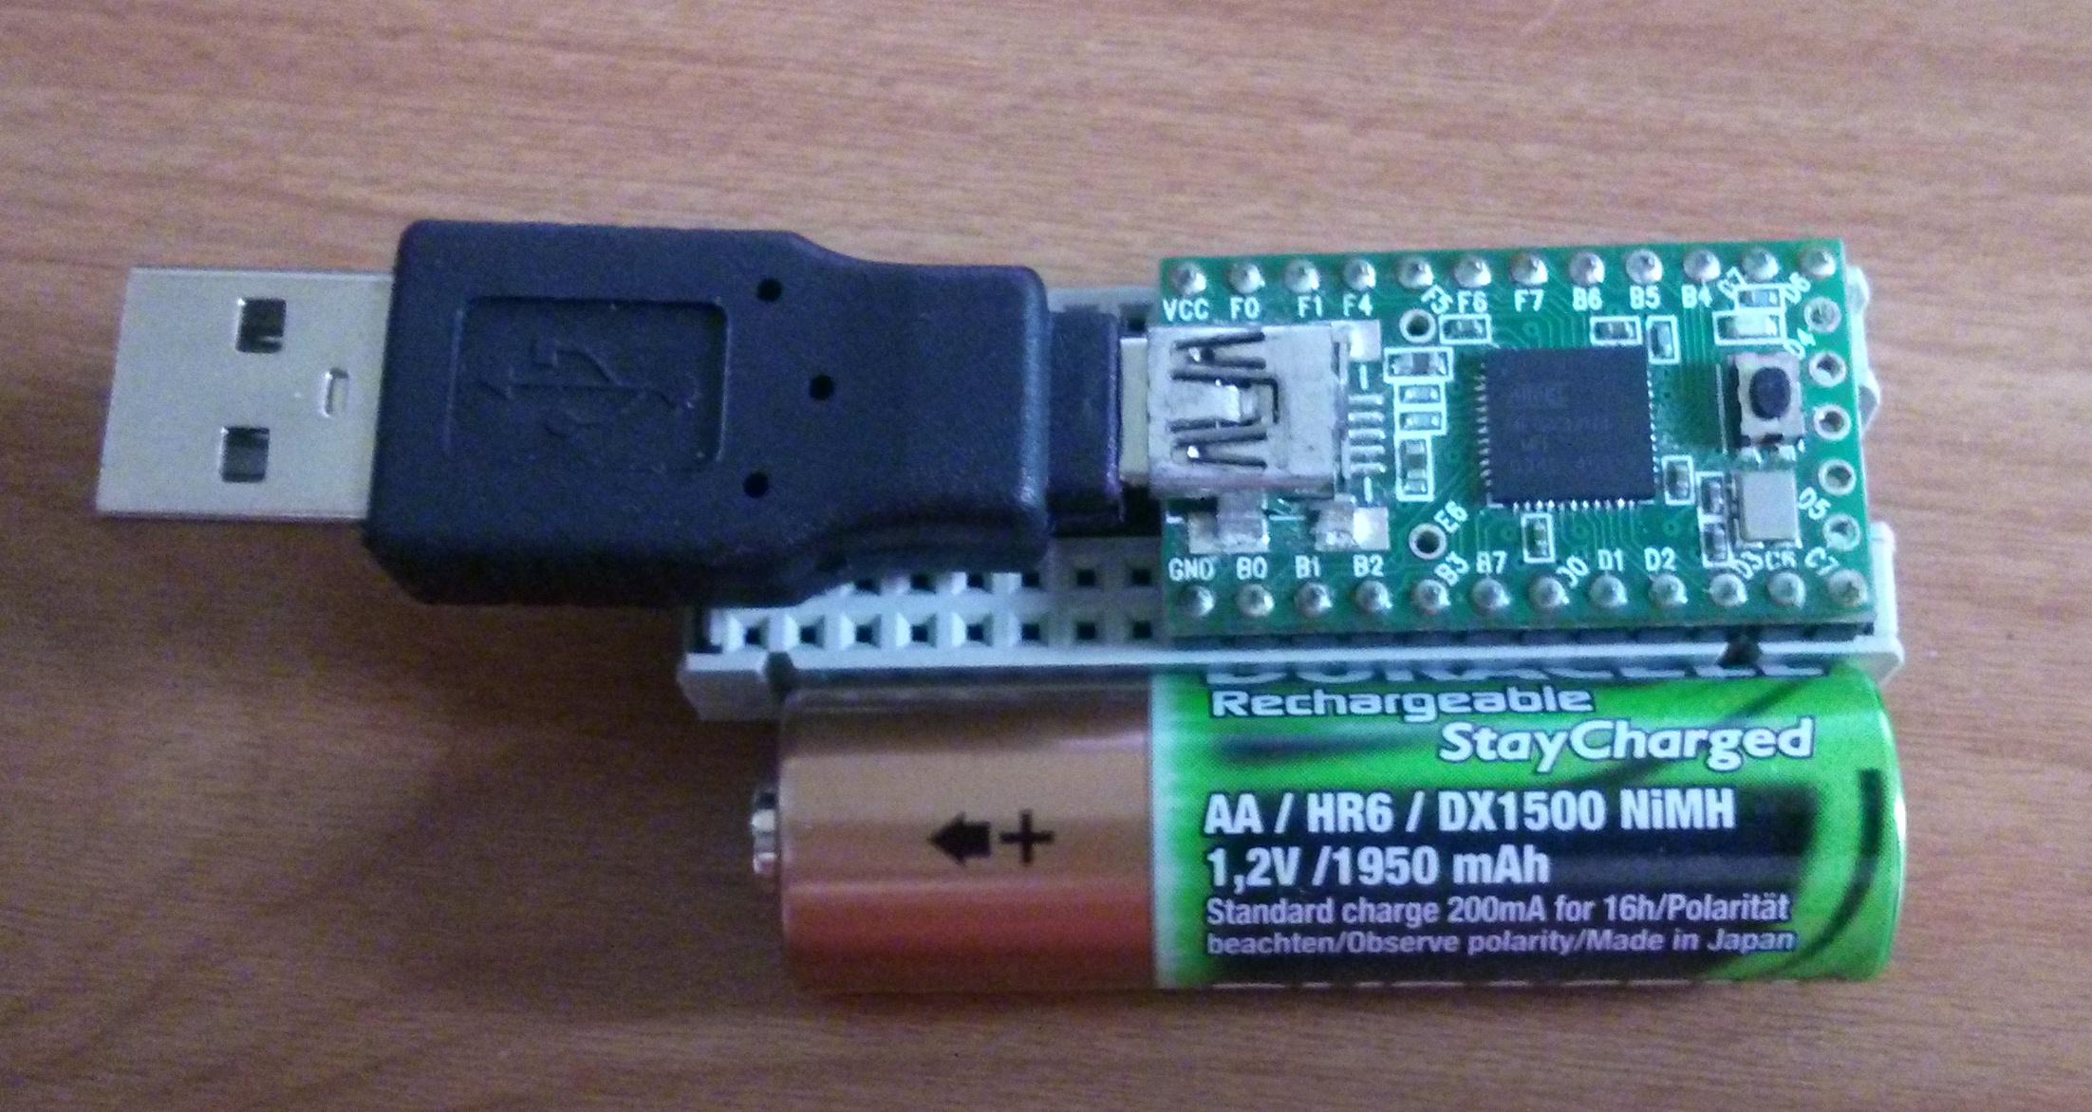
Reducing your “attack surface” - “high tech gadgets”
Teensy Duino H.I.D
Notes:
This is my very own Teensy HID device I have it with me if anyone wants to discuss after the talk.
Alt tab out to word processor, plug in teensy

Slide 12
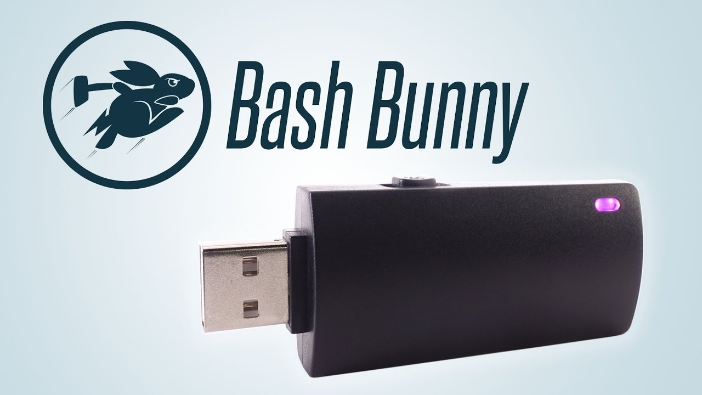
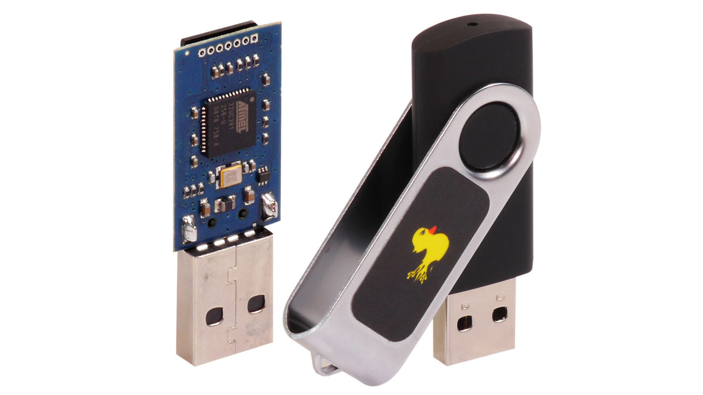


Reducing your “attack surface” - “high tech gadgets”
Pic of usbarmory here
Notes:
Demo rubbery ducky & bash bunny here

Slide 13
Reducing your “attack surface” - “high tech gadgets”
Certain allowances must be made.
  Trust in Service / Hosting provide (ensuring you're done your own due diligence).
  You want to know about their uptime S.L.A.
  Why not ask about any regulatory compliance they have been subject to as well?
    PCI, SOX, HIPAA ... etc.
  Trust in mobile networks .. however GSM is broken and there's lots of “fun” to be had with femtocells.
    (Which is why we have signal & wikr ;-) )

Slide 14
Acronym hell
I.D.S / I.P.S
  HIDS, HIPS, NIDS, NIPS
W.A.F
S.C.A.D.A (Hydroelectric Dams, Metal foundries, all on the Internet …)
IoT (Internet of things WiFi enabled lightbulb … /me facepalm)
A.C.L && P.O.L.P
M.A.C && D.A.C

Slide 15
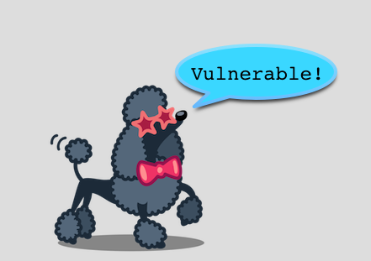
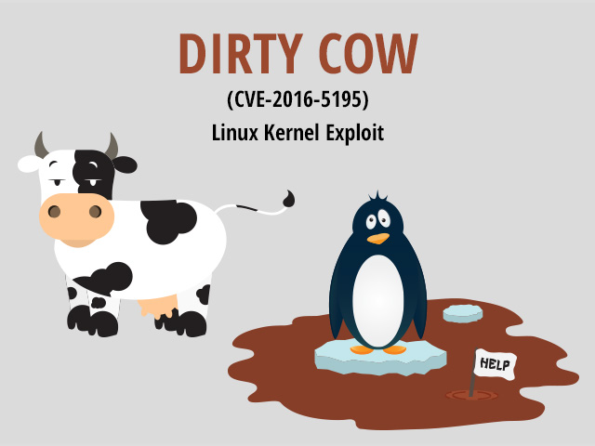
Vulnerability naming stupidity or driving the message home ?
P.O.O.D.L E - CVE-2014-3566
C.R.I.M.E - CVE-2012-4929
B.E.A.S.T - CVE-2011-3389
Heartbleed - CVE-2014-0160
DirtyCow - CVE-2016-5195
Notes:
BEAST – Browser Exploit Against SSL TLS
Targets CBC Ciphers; padding oracle attack to obtain plaintext; requires MITM control over the connection
CRIME – Compression Ratio Info-leak Made Easy
Exploited compression optimization to reveal encrypted plaintext such as cookie data.
Poodle – Padding Oracle On Downgraded Legacy Encryption
Padding oracle attack on CBC SSLv3 ciphers;

Slide 16



Vulnerability naming stupidity or driving the message home ?

Slide 17
2014 → 2017 What has been going on?!
iCloud breach
Hospira drug pump vulnerability
Ransomware hitting Elasticsearch, MongoDB, MySQL
Data breaches (Ashley Madison, Wonga.com, Geekedin, Adobe, the list goes on...)
Windows DoubleAgent un-patchable vulnerability (Feature!)
Vault 7 documents “dropped” (NSA ANT Catalog)
IoT vulnerabilities (too many to list … a webserver on a dishwasher … WHY?!)

Slide 18

2014 → 2017 What has been going on?!
Broadcom WiFi vulnerability (Affects most popular phones, iPhone, Nexus etc)
Target breach (via the H.V.A.C system)
Internet of Things
Where minimum viable product is the main driving force … (until we have to recall the product...)
S.C.A.D.A online for anyone to play with (Hydro electric dams, Foundries no I’m not making this up ...)
“STOP PUTTING SH*T ON THE INTERNET!” - Viss

Slide 19
Detection vs Prevention
We are seeing a _slow_ shift toward better security
But still we have some “hold outs” whom are fearful measures preventing a sale / submission / other functionality e.g. IPS
Or an IDS which overwhelms their team with useless information
Let’s go over that a little...

Slide 20
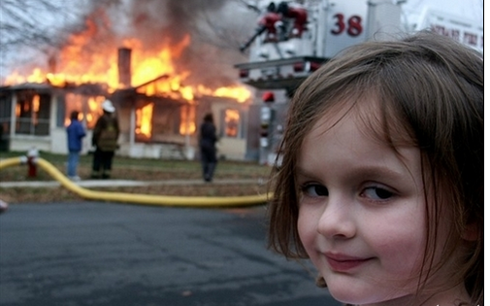
Detection!
I.D.S

Slide 21
Detection vs Prevention
And IDS only logs an attack it does not prevent it taking place
You need to
  Regularly review the logs (time consuming)
  Alert based on certain events (information overload?)
Avoid “boy who called wolf”
  Reduce the “noise”
  Provide only known important events to your team
Ensure you’re getting regular signature updates

Slide 22
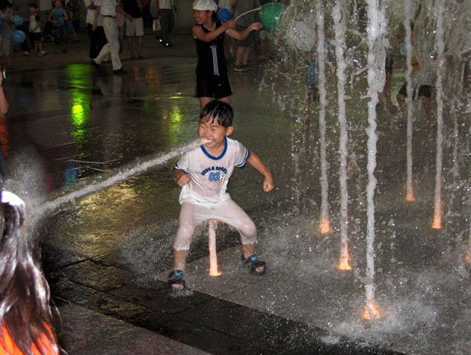
Prevention?!
I.P.S

Slide 23
Detection vs Prevention
An IPS takes preventative action against a suspected attack
IF it does prevent known good traffic add an exception (aka False positive)
DO NOT JUST DISABLE IT
Review the logs!
Reduce the “noise” and provide only known bad contextual alerts to you team!
Ensure you’re getting regular signature updates

Slide 24
Emerging technologies
Vaultproject.io
  AES GCM 256bit, API Driven access, Dynamic secrets, Highly available, Audit logging backend, Encrypt/Decrypt service, Leasing & Renewal, Many integrations AWS MySQL PostgreSQL SSH etc.
Haka-security.org
  “Software defined security” - LUA DSL Object Orientated, can run against offline pcap files allowing Q&A before deployment or integration into CI chain
Fidoalliance.org
  Universal second factor, Universal authentication framework, extensive membership list,

Slide 25
Emerging technologies
Keybase.io
  Socializing encryption, eases PGP adoption, support OTR chats using “paper key” and secured file sharing (https://keybase.io/oneiroi/)
Suricata
  Opensource NIDS/NIPS, JSON output support (useful for ELK), Claims 10Gbe support with no ruleset sacrifice, File extraction from network stream, Open Information Security Foundation, works with SNORT rulese

Slide 26
Emerging technologies
OSQuery
  Facebook opensource project, extensible, can be used to check for compliance with policies (among other data) e.g.
    Is AV running ?
    Is Encryption enabled ?
    What browser version is installed ?
    What browser plug-ins are installed ?
    What OS version & patch level is running ?

Slide 27
The live demo … or video if the demo gods are not kind today.
“Perfect storm” example
  Command line injection present in web app (RCE) or CVE-2012-1823 PHP CGI cli injection.
  `setenforce 0` (SELinux set to permissive)
  “BAD” MySQL Grants: ALL PRIVILEGES ON *.*
  “BAD” File (D.A.C) Permissions (plugin dir is set to 0777)
  Attack flow:
  1. Deploy PHP payload to webserver, establish a reverse_tcp meterpreter shell
  2. Deploy UDF “tool” to the MySQL server and use that to “pop” a reverse shell

Slide 28
The live demo … or video if the demo gods are not kind today.
DISCLAIMER!
  We're showing abuse of everything we have already noted as being “bad”
  This isn't a “how to hack” legal wouldn't let me do that :-(
  You can repeat everything here yourself! (GPL code + resources @ Github (current code will be committed after the conference))
  This demo is on a local VM environment purposely made vulnerable only.
  For informational purposes only.
  Use at your own risk.
  If all else fails I have a backup video … /me crosses fingers
Notes:
Swap to linux machine out and run live compromise demo

Slide 29

If $success then ...

Slide 30
Q&A
Thank you for attending.
Questions?
(I have a lot of “high-tech” gadgets with me if you want to see a demo / play with any of them then please ask!)
Notes:
Circumventable: Pass a pre generated sha1(sha1()) hash of a weakpassword and it goes right through.

