Slide 1
MySQL 101
Security Basics
David Busby
2015-04-16

Slide 2

`whoami`
David Busby
  Information Security Architect
  Percona since Jan 2013
  Several talks on Security

Slide 3
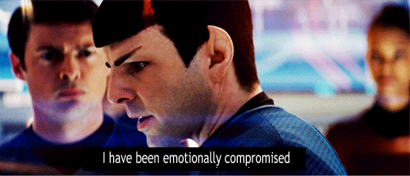
You will be compromised
Let's talk about
  Kübler-Ross model
  Acceptance
  Damage Limitation
  Mitigation
  Focus on what can be controlled
Notes:
Kübler-Ross model for grief.
- Denial
- Anger
- Bargaining
- Depression
- Acceptance

Slide 4

You will be compromised
Let's NOT talk about
  $three_letter_agencies
  $govt
  $espionage
  $doomsday_scenario
Notes:
Kübler-Ross model for grief.
- Denial
- Anger
- Bargaining
- Depression
- Acceptance

Slide 5
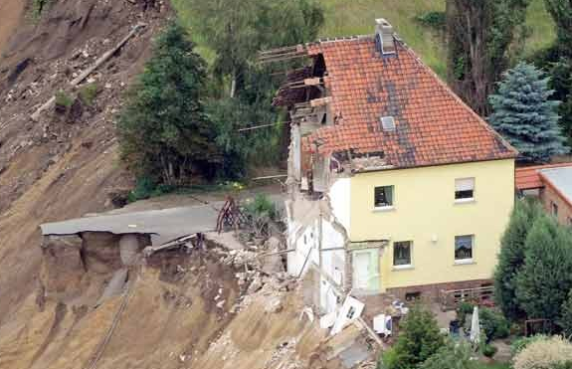
Security from the ground up
Let's talk about
  A solid foundation
  VM, Baremetal
  Side channel attacks
  Phishing, Spear Phishing
  Social Engineering
  Unintentional emissions

Slide 6
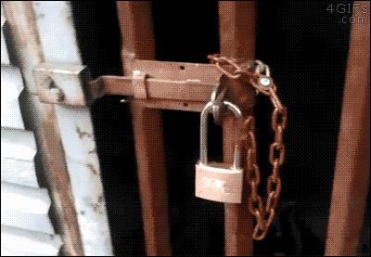
Because … acronyms!
Let's talk about
  A.C.L
  P.O.L.P
  M.A.C
  D.A.C
  I.D.S / I.P.S
  W.A.F

Slide 7
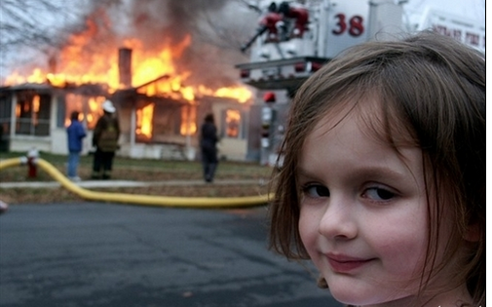
Because … acronyms!
I.D.S

Slide 8
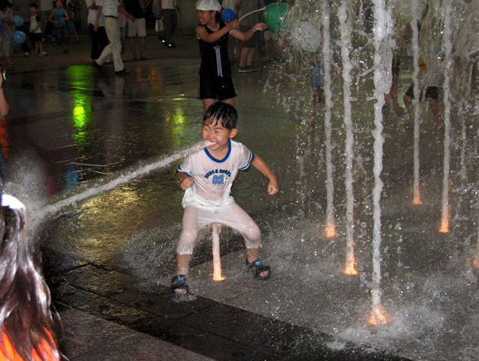
Because … acronyms!
I.P.S

Slide 9
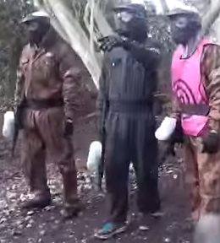
Plugging the holes
Let's talk about
  Attack surface
  Reduce avenues of access
  Reduce visibility
  Remove Bad ACLs
    ANY ↔ ANY:ANY
    GRANT ALL
  Bad file permissions
  0640 files, 0750 dirs

Slide 10
Plugging the holes
Let's continue to talk about
  Attack surface
  Remove redundant packages
  Remove redundant services
  Isolate the DB system via network ACL
  Don't be the guy in the “target vest”

Slide 11
Plugging the holes
Let's talk about
  MySQL security features
  sha256_password
  auth_pam
  Proxy groups
    Requires MySQL >= 5.7.7
    Or use of auth plugin

Slide 12
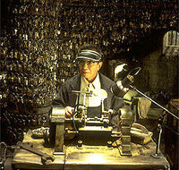
Plugging the holes
Let's talk about
  Selective grants
    NO: “ALL on *.*”
    NO: “SUPER”
    NO: “WITH GRANT OPTION”

Slide 13
Plugging the holes
Let's talk about
  MySQL auth handshake && passwords (default 5.x)
  Password storage: sha1(sha1(password))
  Auth: SHA1(password) XOR (salt + sha1(sha1(password)))
  Strong passwords are KEY!

Slide 14
Plugging the holes

Slide 15
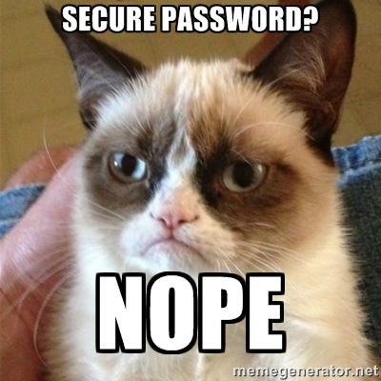
Plugging the holes

Slide 16

Why password complexity is important
We've “recovered” the passwords
  MUCH: ACA068D24BC58DB72E9D3C2D8D29D43FB6F674D9
  PASS: B415DD9C4FB5EF59FE80C4FEBC1F9C715E6E97C4
  SUCH: F469EBEEF4AD5F9DE9A0703EABF87DD88A7AF52D
  BAD: CB7DFF0540F8C51BF178A1502A286FB8F4A2691E
  WOW: F49091CCA44CEC66E65D3D97EA2C3F92D7636734

Slide 17
Plugging the holes
Let's talk about
  REQUIRE SSL
  Auth takes place over SSL connection
  Overhead
  ssl_cipher

Slide 18
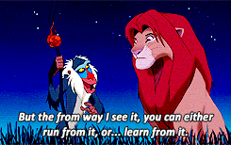
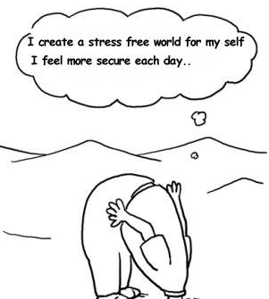
Plugging the holes
Let's talk about
  Training your employees
  Train yourself
  No “head in the sand”
  Be aware of potential threats

Slide 19
… more acronyms
Let's talk about
  B.Y.O.D
  I.o.T
  Malicous H.I.D
  Abusing / Malicious WiFi

Slide 20
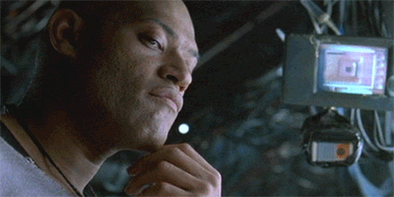
Because … Demos

