Slide 1
What Every DBA Needs to Know About MySQL Security
David Busby
Percona Managed Services
EMEA Lead
Security Lead

Slide 2

Who am I?
David Busby
  Working at Percona since January 2013
  Currently
    Percona Managed Services
      EMEA Lead
      Security Lead
  14 some years as a Sysadmin
    “Devops” as it's now being called.
  Volunteer work
    Help teaching computing at a local school
    Ju-Jitsu instructor for local not for profit club
Notes:
There may be (though hopefully not) some runover there's a lot of material to be covered in a short amount of time, Feel free to catch me after the talk for additional questions / breakout demos.
There's livedemos but just incase there's also videos to fallback on if $something doesn'twork.

Slide 3
Agenda
Security above the MySQL layer
How to identify and limit an attack surface
The critical importance of password complexity
Rigid grants and selective grants
Deploying SELinux
Security-related changes in MySQL 5.6
The importance of CVEs
Q&A
Notes:
There may be (though hopefully not) some runover there's a lot of material to be covered in a short amount of time, Feel free to catch me after the talk for additional questions / breakout demos.
There's livedemos but just incase there's also videos to fallback on if $something doesn'twork.

Slide 4
Security Above the MySQL Layer
Security is applied in layers
  Think from the outside in
  As such you need to be aware of each “layer” of your deployment.
  e.g.
    ISP ingress
      Do they have IDS / IPS at their network edge
        What's their incident response program?
    Your network ingress
      e.g. dedicated hardware firewall
      SSL terminators
      OS Level packet filtering / control
        IPTables, netfilter, Haka
    Your application ingress
      In code sanitization, WAF etc.
    Your organization controls

Slide 5
Security Above the MySQL Layer
Security is applied in layers
  “a chain is only as strong as it's weakest link”
    ISP
      Network ingress
      Personnel
        Identity verification processes
        Internal security controls
        Compliance certifications
        Staff background checks
      Incident response program
        With dedicated team
        With S.L.A
      Recurring audits
        Pentests with available reports
        User ACL audits

Slide 6
Security Above the MySQL Layer
Security is applied in layers
    Your systems
      Cloud
          Are the hypervisors secured?
            H.I.D.S / H.I.P.S
            M.A.C
            Physical security measures
          Is the block storage encrypted?
          How is the block storage sanitized (if at all) when you “delete” a vm.
        How are guests securely isolated.
            Network
              “in flight” encryption, SSL, VPN (e.g. n2n) etc.
            Memory

Slide 7
Identify and limit your an attack surface
What is an “attack surface”?
  Points in your system which could be attacked.
    application
    database
    physical systems
    network
    your employees
    hosting provider
      Including hosting providers employees

Slide 8
Identify and limit an attack surface
Limit your attack surface
  Application
    Sanitize ALL user inputs
    CSRF / XSRF tokens
    Follow SSL Best practices e.g. mozilla wiki
      P.F.S + DHParam
      OSCP Stapling
    W.A.F && I.P.S (with dedicated people).
      Protect the “Audit Trail”
    Regular recurring audit procedures
    Ingress and Egress controls
    Mandatory Access Controls e.g. SELinux

Slide 9
Identify and limit an attack surface
Limit your attack surface
  Application
    Fail securely / safely
      Catch application exceptions and log, do not render to the user / attacker screen
      Think carefully about error messages
        A login form displaying invalid user / invalid password
          Can be used to enumerate users
        A page error “you do not have access to this page”
          Can be used to enumerate “points of interest” for attacking later
    Miss direction
      Intentionally “sour the milk” for automated tools data collection
        Suppress version numbers, X-Powered-By, Error pages
        Purposely return incorrect response codes
        Utilize tarpits
        Don't “hack back”

Slide 10
Identify and limit an attack surface
Limit your attack surface
  Database
    Logical / Physical network segregation from application nodes.
    Ingress and Egress controls
    Selective GRANT
    Complex passwords
    Avoid “... IDENTIFED BY 'the_plain_password'” SQL
    Mandatory Access Controls e.g. SELinux

Slide 11
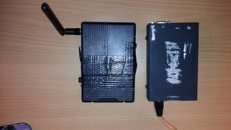
Identify and limit an attack surface
Limit your attack surface
  Physical systems
    Limitation of access to hardware
    “Social engineering” is just a new term for con artistry
    Challenge “implied trust” a Badge / Uniform != ID
    Never rely on singular control methods, esp not biometrics
    Remove unneeded services and devices.
      e.g. bluetoothd, gcc, gdb, X, gnome, kde, etc.
    Barclays £1.3M “haul” could have been avoided (image credit BBC UK)
    OS Level hardening
      C.I.S, R.H.E.L Security Guide, M.A.C.

Slide 12

Identify and limit an attack surface
Limit your attack surface
  Employees (Layer 8 / Meat ware)
    Awareness training
    Social media betrays a wealth of information
      (safeinternetbanking.be youtube video)
    B.Y.O.D, a persons “smart” phone is perhaps the single largest repository of personal information you own.
    “implied trust”: “Wanna see a magic trick with your phone?”
      Lock screen bypass / debug abuse / NFC
    Remote attacks: Karma (Jassegar), Malware apps, bluetooth (android remove (bluedroid) crash youtube)

Slide 13
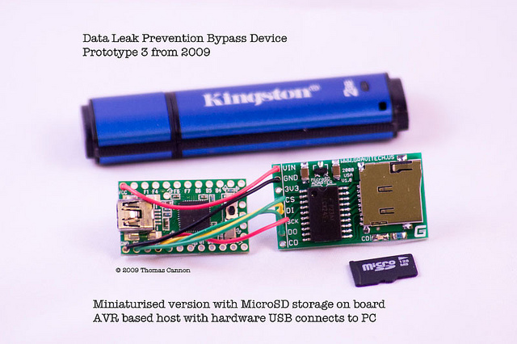
Identify and limit an attack surface
Limit your attack surface
  Employees (Layer 8 / Meat ware)
    Malicious H.I.D. devices
      Teensy Duino HID
      Data Leak Prevention Bypass
    Challenge identity and “implied trust”
      It's OK to ask for ID! (seriously we have systems do this all the time)
      “Hello I'm calling from the computer security center regarding the virus on your windows machine ...”
      “Hello I'm some_person_from_hr ...” Defcon Youtube

Slide 14
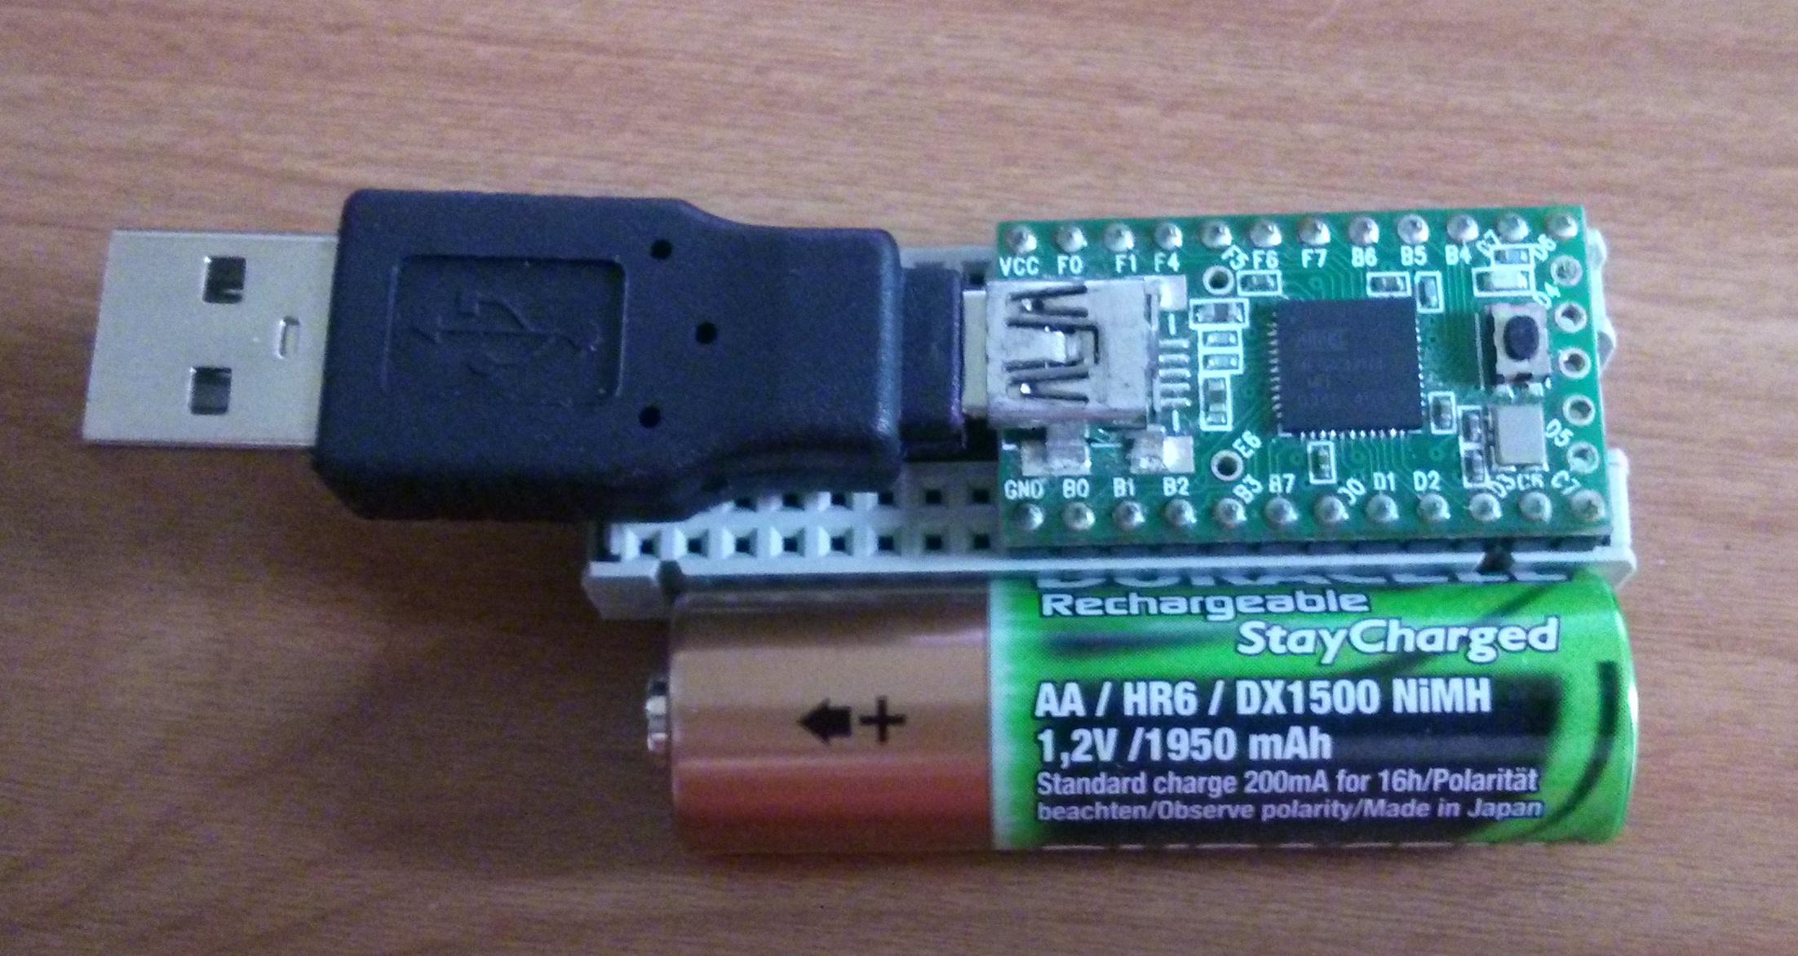
Identify and limit an attack surface
Limit your attack surface
  Employees (Layer 8 / Meat ware)
    Malicious H.I.D's are tiny, and easily made

Slide 15

Identify and limit an attack surface
Limit your attack surface
  Certain allowances must be made.
  Trust in Service / Hosting provider.
    Do your own due diligence
    You ask for S.L.A's
      Why not ask about their security and compliance?
        PCI
        HIPAA
        Even if you don't think you need it now.

Slide 16
Identify and limit an attack surface
Network
  Selective ACL (even if it's only iptables)
    e.g. MySQL doesn't need to be accessible from everywhere!
    Lest we forget CVE-2012-2122
    Logical / Physical segregation
    H.I.P.S, H.I.P.S
    N.I.D.S, N.I.P.S
    Ensure you have staff looking at the logs!
      Writing IPS && WAF rules.
      Doing anaylsis.

Slide 17
The Critical Importance of Password Complexity
MySQL 5.5 password standard is just
  SHA1(SHA1(password))
  Auth handshake
    SHA1(password) XOR SHA1(salt + SHA1(SHA1(password)))
    New salt for every connection
Assume an attacker can grab a hashdump
Or packet cap of a privileged account logging in
The mitigation becomes time vs reward
As with encryption we want to make it computationally expensive to retrive the original passwords

Slide 18
The Critical Importance of Password Complexity
Some sample hashes
  ACA068D24BC58DB72E9D3C2D8D29D43FB6F674D9
  B415DD9C4FB5EF59FE80C4FEBC1F9C715E6E97C4
  F469EBEEF4AD5F9DE9A0703EABF87DD88A7AF52D
  CB7DFF0540F8C51BF178A1502A286FB8F4A2691E
  F49091CCA44CEC66E65D3D97EA2C3F92D7636734
A simple brute force will retrieve the original passwords

Slide 19
The Critical Importance of Password Complexity

Slide 20

The Critical Importance of Password Complexity
Retrieved! (oclHashCat brute force in ~1.38s)
  ACA068D24BC58DB72E9D3C2D8D29D43FB6F674D9
    MUCH
  B415DD9C4FB5EF59FE80C4FEBC1F9C715E6E97C4
    PASS
  F469EBEEF4AD5F9DE9A0703EABF87DD88A7AF52D
    SUCH
  CB7DFF0540F8C51BF178A1502A286FB8F4A2691E
    BAD
  F49091CCA44CEC66E65D3D97EA2C3F92D7636734
    WOW

Slide 21
The Critical Importance of Password Complexity
Trivial to get weak passwords of privileged accounts.
  “Budget setup” 2 x 7750 Radeon
    Software crossfire
    270 Million hashes per second
Wordlists / properly configured patterns result in high hash rates
Same as most “passwords were hacked” disclosures
  Relatively weak hashing
  MySQL only uses SALT on the network auth side
    MySQL_NA

Slide 22
The Critical Importance of Password Complexity
Conclusion?
  The greater the complexity of a password
    The more computationally expensive it is to retreive
    Reduces the likelihood of being on any pre-computed hash list
    Increases time needed for privilege escalation (via the demoed method)
    Increases the likelihood of re-mediation “before things get worse”

Slide 23
Rigid grants and Selective grants
A Rigid grant or a Selective grant is an interchangeable term
  Principle Of Least Privilege
    Think of ACL audits (which are a PCI requirement)
      What access does the user have?
      Does the user really need that level of access?
        What are the reasons?
      Does the user really need access from %?
        Most likely you can restrict this
      Your application really doesn't need
        ALL PRIVILEGES ON *.* WITH GRANT OPTION
        Equally Super_priv, Create_routine, Insert_priv, FILE ... etc.

Slide 24

Rigid grants and Selective grants
Understand “WITH GRANT OPTION” is “The Keymaker”
Understand that Super_priv
  Can kill any process
  Can write even when read_only = 1
  Can stop / reset slaves
  Is part of “ALL”
Understand that FILE && Create_routine
  Can be abused to stage malicious UDF's
  Youtube link to my PLMCE live demo
Understand that Insert_priv could
  Allow insert directly into mysql.user

Slide 25
Rigid grants and Selective grants
Understand “WITH GRANT OPTION” is “The Keymaker”
Yes this has appeared twice it's that crucial
It's the “keys to the kingdom”
You're applications user REALLY should not have this.
  Seriously
  Don't
  Do
  It

Slide 26
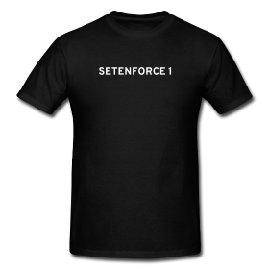
Deploying SELinux
Performance overhead
  Variable Y.M.W.V
  Test!
The What before the Why
  Mandatory Access Control
Turn it ON!
  /etc/selinux/config
    SELINUX=enforcing
    SELINUXTYPE=targeted
Also works on AMI
  Blog link

Slide 27
Deploying SELinux
Labels
  Contexts applied to files, ports, etc.
    User:role:type:level
      “targeted” policies look at the type
  Type Enforcement (policies)
  Example
    Process A runs in context B
    Context B is allowed access to
      Context C, D, E
      Not F

Slide 28
Deploying SELinux
mysqld_t
  You want to allow access to
    mysqldb_t /var/lib/mysqld
    mysql_log_t /var/log/mysql
    mysql_port_t *:3306
  But not
    passwd_file_t /etc/passwd
    shadow_file_t /etc/shadow
    http_port_t, ssh_port_t, etc ...

Slide 29
Deploying SELinux
D.A.C vs M.A.C
  Discretionary Access Control (POSIX permissions)
  Allows access to whatever resource the user it is running as has access to
  Software still runs as a user
  Unlikely you want software to have the same rights as a user
    Viruses, Malware etc ...
  D.A.C chmod 777 == Shotgun + Foot
    A chmod 777 on the plugins dir allows malicious UDF staging in my PLMCE live demo

Slide 30
Deploying SELinux
Debugging
  `setenforce 0` == Permissive != OFF
    ALWAYS ensure you go back to `setenforce 1`
  New tools make everything easier
    setroubleshoot-server, libselinux-python
  9/10 issues are “incorrect labeling”
    Common gotchas
      New files / Dirs inherit labels
      Moved / copied files KEEP their original context

Slide 31
Deploying SELinux
Arrests “out of context” behaviour
My live demo malicious UDF is blocked by SELinux
  By default!
Additional layer of security
  Not a replacement for multiple layers
    CVE-2013-2094 was not blocked by default
      perf_swevent_enabled -> priv escalation
      J.I.T patching possible using SELinux
        Change user context to user_u from unconfined_u
        RH BZ Link #962792

Slide 32
Deploying SELinux
Living with SELinux
  Most common tools have the -Z option
    ls -Z
      unconfined_u:object_r:user_home_t:s0
    ps -z
      unconfined_u:unconfined_r:unconfined_t:s0-s0:c0.c1023
  MySQL / Percona Server / MariaDB work “out of the box”
    For the defaults
      /var/lib/mysql
      *:3306 etc.

Slide 33
Deploying SELinux
Living with SELinux
  Install the tools
    policycoreutils
    setools-console
    setroubleshoot-server
    setroubleshoot-plugins
  SELinux booleans
    mysql_connect_any
      Allow mysqld to connect to all ports
    allow_user_mysql_connect
      Allow users to connect to mysql socket (not mysql users, local system users)

Slide 34
Deploying SELinux
Living with SELinux
  Change the datadir
    semanage fontext -a -t mysqld_db_t “/path/to/mysql(/.*)?”
  Change the port
    semanage port -a -t mysqld_port_t -p NNNN
  orchestration frameworks can ease your use of SELinux
    Ansible
      file: dest=/path/to/mysql state=diesctory owner=mysql group=mysql mode=0755 seuser=system_u serole=object_r setype=mysqld_db_t selevel=0
      seboolean: name=httpd_can_network_connect_db state=yes persistent=yes

Slide 35
Security Related Changes in 5.6
Password expiration
  default_password_lifetime
    default 360 days
    0 == disable auto expiry
  dissconnect_on_expired_password
    NO
      Drop to sandbox on expiry to allow change
    YES
      Disconnect
  Force an expiry
    ALTER USER 'user'@'host' PASSWORD EXPIRE;
    mysql.user.password_expired
  Not available Maria DB 10 “to be implemented in later 10.x versions”
    Tested against 10.0.12

Slide 36
Security Related Changed in 5.6
Password validation plugin
  validate_password_policy = LEVEL
    LOW
      >= 8 Chars
    MEDIUM
      All requirements of LOW
      >= 1 number
      >= 1 upper case
    STRONG (unsure why this isn't called HIGH)
      All requirements of MEDIUM
      Substrings >= 4 chars must not appear on defined dictionary

Slide 37
Security Related Changed in 5.6
Password validation plugin
  Customizable
    validate_dictionary_password_file = “/path/to/file”
    validate_password_length = 8
    validate_password_mixed_case_count = 1
    validate_password_number_count = 1
    validate_password_special_char_count = 1
  Circumventable
  Not yet available in MariaDB 10 see: MDEV-6431 planned for 10.1
Pluggable authentication
  sha256_password plugin
    mysql.users.authentication_string
  Opens the possibility for stronger algos
  Not yet available in MariaDB 10 see: dev list thread “to be implemented in later 10.x version”

Slide 38
Security Related Changed in 5.6
SSL
    Tunable cipher spec
      --ssl-cipher=DHE-RSA-AES256-SHA:AES128-SHA
      MariaDB 10 does support this tested against 10.0.12
    High performance overhead
      Mostly due to connection handshake overhead
      Connection pooling helps to reduce this “cost”
    Client can not “force” an SSL / TLS connection :(
      Silently fails

Slide 39
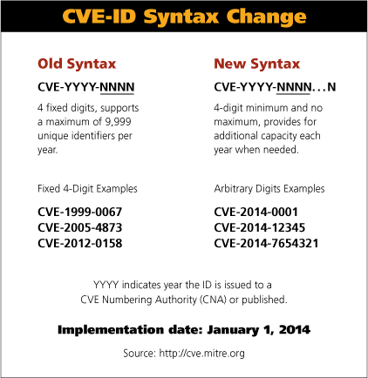
The Importance of CVE's
Common Vulnerabilities and Exposures
Common classification and notation of known vulnerabilities
$vendors and $researcher alike use this to classify vulnerabilities
  Along with CVSS scoring
Used in changelogs to note when a patch has been applied.
  Syntax changed in January to allow for >9999 filings per year.
Additional resources
  Open Source Vulnerability Database
  Secunia
  National Vulnerability Database
  ExploitDB
  Reddit /r/netsec
  news.ycombinator.com
  Full disclosure list (has re-opened!)

Slide 40
Percona Services
Consulting
  Typically short term engagements
  For security projects, we'd assess gaps in MySQL and infrastructure and implement changes in collaboration with the customer.
  Available for remote and on-site activities
Managed services including Remote DBA
  The Long term solution
  Fix problems present today and operate using best practices for the future in collaboration with Percona
  Manage security as well as other DBA Ops needs
    backup
    Recovery
    Etc ...

Slide 41

Percona Live London 2014
November 3-4, 2014
Learn what works from leading companies who use MySQL
Hear how to drive down costs and improve performance with innovative solutions.
Discuss your unique challenges and discover options for solving them
Early bird pricing available now: http://www.percona.com/live/london-2014/

Slide 42
Questions?
Q&A
And thanks for attending!

