Slide 1
Web Application Security And Why You Need To Review Yours
David Busby
Percona

Slide 2
Who am I?
David Busby
  Contracting for Percona since January 2013
  18+ years as sysadmin / devops / security
  Volunteer work:
    Assistant Scout Leader
    Assistant Instructure (computing for children)
    ex-Assistant coach Ju-Jitsu (Nidan)
  Security “nut”
  Lifetime member of the “tinfoil hat” club
  C.I.S.S.P
    581907

Slide 3
Talk Agenda
What we will cover
  What is an “attack surface”?
  Acronym hell, just what do those mean ?
  Vulnerability naming, new trend or benefit ?
  Detection, Prevention, or both ?
  Emerging technologies / projects.
  2014 -> 2018 highlights
  Live compromise demo covering everything we’ve discussed as ‘bad’
    Or most likely the backup video (if anything goes wrong or we’re out of time).

Slide 4
What is an attack surface ?

Slide 5
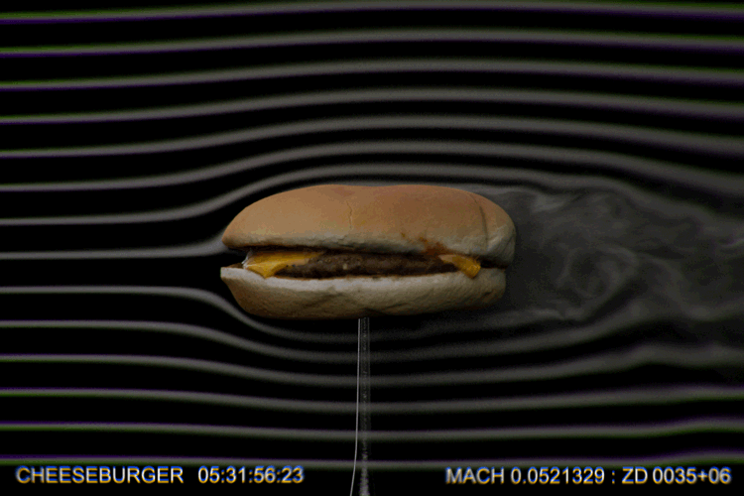
What is an attack surface ?
Assessing your attack surface can feel like...

Slide 6
What is an attack surface ?
What it really is ...
I built an awesome SaaS everyone will like!
Failed to consider data privacy
Fined in EU court for GDPR violation
Built an awesome web application for hosting cat pictures
unaware of the dangers of user-content
Web app now full of ‘adult’ content.
Just ship it now!
Who cares about security anyway ?
Breach / hack ? We’ve got insurance!

Slide 7
What is an attack surface ?
An attack surface is any point in which your org, person, application, provider may be attacked.
  Your web application
  Your database
  Your physical systems
    Yes we’re also including your laptops, cellular device and the all B.Y.O.D
  Your network
  Your staff!
  Your hosting, processing, other providers.
    You’re only insured if you can prove you have taken commercialy reasonable measures to protect your organisation.

Slide 8
What is an attack surface ?
Application
  Sanitize ALL user inputs.
  Implement audit logs!
    An audit log should contain enough detail to reverse the actions taken.
    An audit log should contain accurate time keeping.
    An audit log MUST be shipped OFF the device on which it is generated.
  Recurring audit procedures.
    Logs are GREAT! Unless no one is looking at them ...
  Mandatory access controls
  Ingress and Egress filtering
  Web Application Firewalls
    Layer 7 firewall
  Intrusion Prevention Systems
  Implement CSRF / XSRF protections
    E.g. csrf_tokens in cookies.

Slide 9
What is an attack surface ?
Database
  Network Isolation!
    Only allow access form known web app nodes!
    Default (on most RDBMS) is to bind to 0.0.0.0:$DB_PORT (which is listen to all interfaces)
    ~5M MySQL hosts noted on shodan.io
      5.0, 5.1, both forks are EOL!
  Selective permissions
    STOP giving “ALL ON *.*” Please!
  Password complexity
    Still important today!
    Unless you have a kick-a** PKI setup and are using client certs or vault with ephemeral credentials
  Mandatory Access Control
    SELinux in enforcing mode please!
    GRSecurity, AppArmor etc.

Slide 10
What is an attack surface ?
Physical Systems
  LIMIT physical access to your systems
  Barclays bank 2014 had £1.3m stolen
    Adversaries used KVM over 2.4Ghz wifi after posing as a service company
    No one checked, and they were allowed unchallenged access to workstations.
    Social engineering ? This is nothing new this is con-artistry.
  Deploy multiple layers of protection for physical assets.
    2FA - (yes even on laptops)
    Encryption (LUKS,eCryptFS,Bitlocker,Filevault) - especially on laptops!
  Disable unneeded services / functionality
    Your 1u rackmount likely does not need bluetoothd!
  Do not rely on a single measure for protection such as biometrics.
    The mythbusters defeated a >$10k biometric lock with a photocopier ...
  Challenge “implied trust” a badge or uniform != ID
    It is OK to ask for ID and check for authorization, we do this with systems without thinking about it, we should apply this to people too!

Slide 11
What is an attack surface ?
Network
  Isolation! (A.C.L)
    Your web app needs to talk to your database service.
    It doesn’t need to talk to SSH on the server.
    Iptables, if nothing else works!
  Your chosen DBMS DOES NOT need to be accessible from everywhere!
    MongoDB, Elasticsearch -> Ransomware ?
      No! Malicious users taking advantage of DBMS left open!
  Network Intrusion Detection System - NIDS / Network Intrusion Prevention System (NIPS)
    Suricata, Bro, Snort, are all great and OSS!
      (I use suricata)
  Segregation
    Implement vlans and ACLs that prevent cross-vlan traffic unless implicitly allowed!

Slide 12
What is an attack surface ?
Your staff (layer 8, meatware, P.E.B.K.A.C ...)
  Awareness training
  Social media training and policy
    It _used_ to be hard to find out about an organisation now it’s all open for all to see in most cases.
  B.Y.O.D
    Your “smart” phone is the single most valuable asset to an adversary as.
      It’s unlikely to have any hardening, D.L.P protection upon it
      It’s likely to have access to Mail, Cloud files, calendars, VPN, SSH, RDP, VNC, etc ...
      It’s likely to be running an out of date OS
  Remote (wireless) attacks
    WiFi: Karma (was Jasager), Rogue A.P. (hostapd), etc...
    Bluetooth: bluesnark, snoopi, BtleJuice, etc ...

Slide 13
What is an attack surface ?
Your staff (layer 8, meatware, P.E.B.K.A.C ...), continued
  Malicious USB devices
    Malicious H.I.D., rubberDucky, BadUSB, pwnpi, malduino, bashbunny, usbninja
    Think twice before plugging that USB device into your system ...
      USB ‘condoms’ exist, more known as USB Data blockers.
  Malicious peripheral devices.
    Thunderstike2 targeted Thunderbolt devices.
    PCILeech - D.M.A. access via Thunderbolt allowed recovery of filevault2 passwords.
  Social engineering...
    “Hello I’m calling from the windows support centre about your windows PC...”
    “Do you have a phone? Could I borrow it for a magic trick? ... BYE!”
Notes:
BadUSB concepts were originally discussed by Adrian crenshaw of IronGeek, where he discussed embedding this in RGB mice, attaching a photo sensor etc.
This was ‘evolved’ into the ‘RubberDucky’ tool by HAK5, which commoditized this and made th eprogramming of such decies much easier through ‘ducky script’ text based language.
badUSB came from researchers at SR Labs present as a blackhat talk; this discussed taking off the shelf USB thumb drives and repurposing them to delivery malicious payloads, this has since evolved into attacks which are embedded in charging cables etc. pwnpi from sammy kumar implement abuse of the Windows Proxy Auto Discovery ‘feature’ to capture credentials, such attacks have been also implement on the LanTurle, USB Armory etc.

Slide 14
“High tech gadgets”
The BBC Article on the Barclays £1.3m “haul” noted the use of “high tech” gadgets.
  They are now commodity gadgets
    RubberDucky $45
    bashBunny $100
    Maldunio £13.00 / £24.00 (Elite)
    usbNinja $99
    WiFi pineapple
      Nano $100
    You also can use a PiZero and some soldering for all this.
  Accessing the tools to demonstrate “Edge case black hat nonsense” has never been easier.
  Use a wireless mouse / keyboard ? About that ...

Slide 15
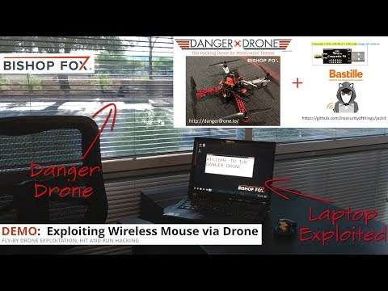
“High tech gadgets”

Slide 16
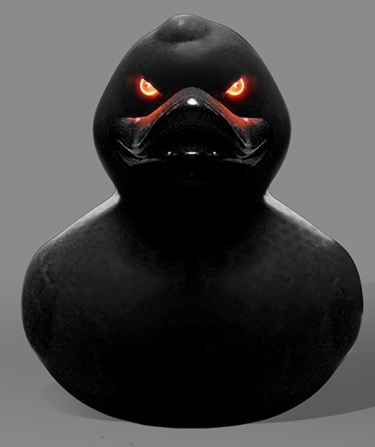
“High tech gadgets”
Let’s talk about malicious HID...
  Because I didn’t want to fly my quad in here...
    Or try to fly with it.
    Live demo time!
Notes:
Plug rubber ducky -> HID key pressing example with ASCII art ...

Slide 17
Acronym Hell
Just what do they mean?

Slide 18
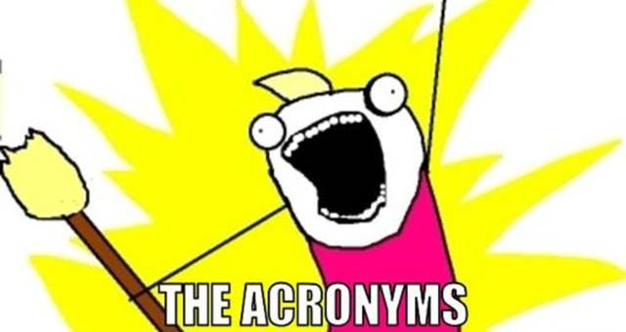
Acronym hell?

Slide 19
Acronym hell?
In Security we <3 acronyms as much (if not more) than DevOps, Sysadmins, DevSec ...
  I.P.S
    Intrusion Prevention System (Can be Host based, Network Based or both)
      H.I.P.S, N.I.P.S
    Host Based:
      File Consistency Enforcement
  I.D.S
    Intrusion Detection system (Again can be host based, network based or both)
      H.I.D.S, N.I.D.S
    File Consistency Monitoring
      Auditd can do this!
      Inotify events
  W.A.F
    Web Application firewall
      Layer 7 protection against SQLi, XSS, and other known attacks
      mod_security

Slide 20
Acronym hell?
Continued ...
  S.C.A.D.A
    Supervisory Control And Data Acquisition
      Industrial foundries, nuclear power plants, hydroelectric dams, diesel engine testing facilities, point of sale, Hospital beds ...
    I.o.T
      Internet of Things
      If there can be a thing, and you can put a webserver on the thing; should you put a webserver on the thing ? - Viss
    A.C.L
      Access Control Lists
    P.O.L.P
      Path of Least Privilege
    M.A.C + D.A.C
      Mandatory Access Control
      Discretionary Access Control
  There’s plenty more ...

Slide 21
Vulnerability naming
Stupidity or ... ?

Slide 22
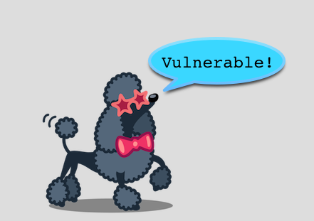
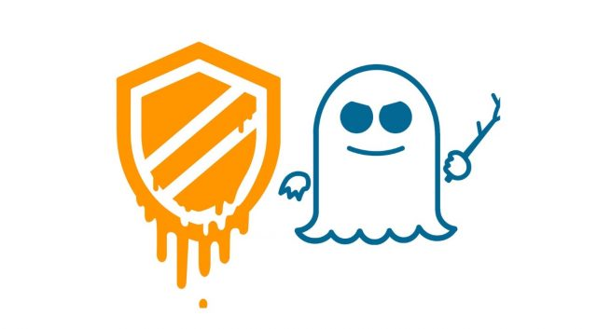
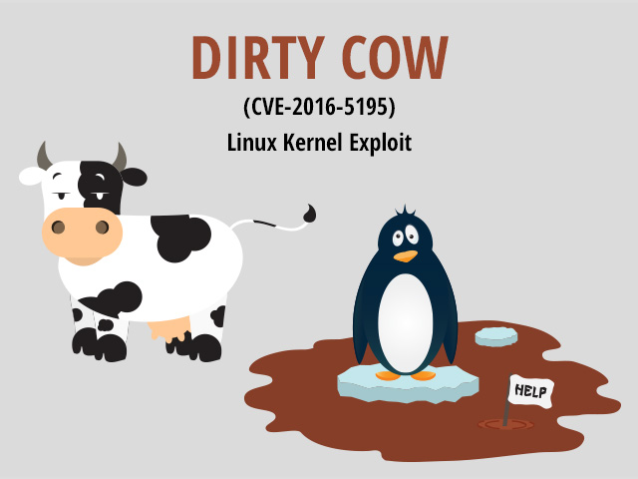

Vulnerability naming
MeltDown
  CVE-2017-5715,CVE-2017-5753
Spectre
  CVE-2017-5754
P.O.O.D.L.E
  CVE-2014-3556
C.R.I.M.E
  CVE-2012-4929
B.E.A.S.T
  CVE-2011-3389
HeartBleed
  CVE-2014-0160
DirtyCow
  CVE-2016-5195
Notes:
POODLE - Padding Oracle On Downgrade Legacy Encryption
CRIME - Compression Ratio Infoleak Made Easy
BEAST - Browser Exploit Against SSL TLS

Slide 23

Vulnerability naming
Naming _can_ help ...
  There are of course some exceptions such as:
    When $media completely fail to understand the problem e.g. “Heart Bleed Virus”
    When $expert uses this for satire and is taken seriously by $media instead.
Notes:
POODLE - Padding Oracle On Downgrade Legacy Encryption
CRIME - Compression Ratio Infoleak Made Easy
BEAST - Browser Exploit Against SSL TLS

Slide 24
Detection, Prevention, Both ?

Slide 25
Detection, Prevention, Both ?
Detection
  I.D.S
    Can be on your hosts / servers
      Hostbased Intrusion Detection System
      Aka File consistency monitoring
    Can be on your hosts / servers / firewalls network
      Monitors network for known intrusions
      Rule based.

Slide 26
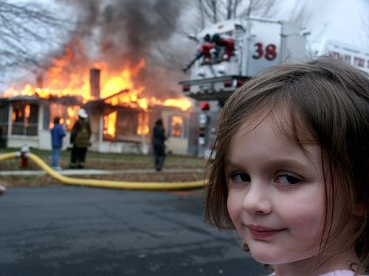
Detection, Prevention, Both ?
Detection
  I.D.S

Slide 27
Detection, Prevention, Both ?
Prevention
  I.P.S
    Can be on your hosts / servers
      Hostbased Intrusion Prevention System
      Aka File consistency enforcement
    Can be on your hosts / servers / firewalls network
      Monitors and prevents network for known intrusions
      Rule based.

Slide 28

Detection, Prevention, Both ?

Slide 29
Detection, Prevention, Both ?
On single solution is going to cover all your use cases.
I.D.S is great
  _IF_ someone/something is watching the logs 24x7 and responding to them
I.P.S is great
  _until_ it blocks your staff trying to do something and they use an insecure network to do it anyway.
Choose what fits your use case
  I.P.S on webapps makes sense if you don’t expect file edits.
    They are really easy to write (I wrote one in python using gamin to hook inotify events, to work with SCM to produce diff and revert php files ON_WRITECLOSE)
  I.P.S makes sense on the network edge
    RUN RECURRING TESTS!
    Aka. tabletop exercises, simulate an attacker and observe the effectiveness of the IPS & (blue)team.

Slide 30
Emerging technologies

Slide 31
Emerging Technologies
Hashicorp - vault
  AES256-GCM, API
  Highly available secrets store, with third party testing now completed!
  Key:value storage for secrets (now supports versioning!)
  Full audit logs
  LDAP, DUO, Okta, Github, etc ..., support for user auth.
  _MANY_ secret backends for ephemeral credentials supported
    AD, AliCloud, AWS, Azure, Consul, Cubbyhole, Databases (many support in MySQL, MongoDB, PostGres, MSSQL ...), GC + KMS, K:V, Identity, Nomad, PKI, RabbitMQ, SSH, TOTP, Transit (send data, get encrypted /decrypted data).
    Pluggable secrets backend!
    Percona Server 5.7 has vault keyring plugin available!

Slide 32
Emerging Technologies
Haka security
  LUA DSL Syntax ‘devops’ firewall project.
    Can be run against pcap files for integration tests!
Fidosecurity.org
  Universal Second Factor (U2F)
    Google has their own named ‘Titan’ (only available in US at this time)
Keybase.io
  Social identities as proof of ID, E2E encryption, Encryption git repositories, OTR chats, Slack-like chats with rooms, groups etc
Suricata
  OSS NIPS & NIDS, JSON Output (easily imported into ELK stack), packet craving features, works with SNORT ruleset.
OSQuery
  Powerful endpoint metrics collection, used by facebook.

Slide 33
2014 -> 2018
Highlights in security (or lowlights depending on your perspective)

Slide 34

2014 -> 2018

Slide 35
2014 -> 2018
iCloud breach
  2014 iCloud copies of photos & videos are leaked to the public this includes many celebrities more intimate photos / videos.
Hospira drug pump
  2015 admin credentials allowed researchers to access complete control over the device which in normal operation would control doses of IV drugs for the patient.
Data Breaches (various years)
  Ashley Madison, Wonga.com, Geekdin, Adobe, Facebook cambridge analytica, Facebook 50m accounts exposed 2018, Google kills google+ was this due to a breach? ... MANY more ...
NSA spying exposed.
  Vault 7 documents, NSA ANT Catalog etc...
GCHQ spying deemed violation of human rights
  2018 EU court rules GCHQ spying a violation of human rights

Slide 36
2014 -> 2018
Ransomware
  WannaCry, EternalBlue, MySQL, Elasticsearch, MongoDB, etc ...
BroadPwn
  2017 affects almost all cellular devices, allows remote code execution.
Target breach
  Malware came in through a laptop used to service the H.V.A.C system.
May 25th 2018 GDPR became law
  The privacy rights for all EU citizens made into a common legal framework.
    I am not a lawyer; but I will happily answer questions on how best-practises can help with GDPR.

Slide 37
Live Compromise
(Or backup video if everything goes wrong...)

Slide 38
Live Compromise
DISCLAIMER
  This is not a ‘how to’ though this exploits everything we’ve covered as ‘bad practise’
  This will use _some_ automation ‘toys’ (USB HID)
    Just so that I can speak about what’s going on.
  Everything you will need to recreate this is on Github!
    Hooray for open source!
  This whole demonstration is run on local virtual machines and does not touch anyone else’s network or infrastructure
  NOTHING SHOWN HERE CAN BE DIRECTLY APPLIED TO A PRODUCTION WEB APPLICATION
    This requires multiple failures to exploit
    Setting SELinux to enforcing also prevents this from working (` setenforce 1` )

Slide 39

Live Compromise
Notes:
Plugin bashbunny to execute duckyscript to stage msfvenom & metasploit; run through (in another tab) attempts to reach DB on 3306/tcp showing firewall isolation, discuss how attack abuses known bad PHP usage and is intentionally vulnerable, DVWA has RCE within that _could_ be used; note Drupal recently patched RCE vuln so this is a known atack vector; stage UDF into mysql loading UDF payload, creating functions show bash shell over mysql protocol, discuss POSIX permissions being incorrect for plugin dir and that SELinux prevents this attack entirely and is intentionally disabled. Oorrrrr ... use video in next slide and discuss each point wihtin.

Slide 40
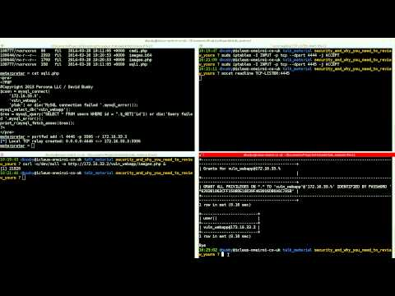
Live Compromise

Slide 41
Live Compromise
Everything wrong
  Application has Remote Code Execution
    No compensating controls
  M.A.C is in permissive mode (setenforce 0)
  MySQL permissions too broad
  D.A.C permissions on plugin directory too broad
  Attack Flow:
    Generate PHP malicious payload, stage and execute on webserver to connect back to CnC(C2) system
    Setup port forwarding to use web app server as pivot to reach DB server from CnC system (as direct 3306/tcp is not possible)
    Stage sys_eval UDF into schema table, abuse FILE permissions to write this data out to a file in the global plugin directory
    Abuse CREATE_ROUTINE permissions to setup the sys_eval UDF for use
    Abuse lack of Egress controls to execute a reverse shell back to CnC system

Slide 42

Live Compromise
Attack evolution
  RCE -> MySQL access -> MySQL shell execution access -> Reverse Shell on both web application and database server to CnC system.
    “Post Exploitation Lateral Movement”
  Noted old kernels running, exploit old kernel gain root level access install persistence of access moving from exploitation to Advanced Persistent Threat.
    Install cryptominer and ...

Slide 43
Thank You
For attending this talk
  For not going insane
  For not breaking down sobbing uncontrollably
Questions
  Please see me after this talk, believe or not I am a friendly person!
    I can also go over the live demo in greater detail should want to discuss.
  You can also reach me:
    email : david.busby{at}percona.com,
    Twitter: https://twitter.com/icleus
    Keybase: https://keybase.io/oneiroi

Slide 44
Join the Percona Product Managers for Lunch!
With Tyler Duzan, Michael Coburn, and Alexander Rubin
Share feedback
Get to see the product roadmaps
Wednesday @ the reserved area in back of Gaia Restaurant

Slide 45


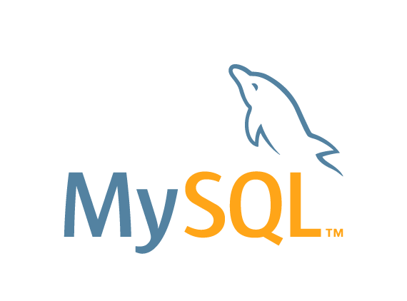
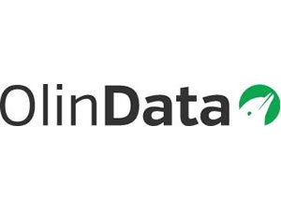








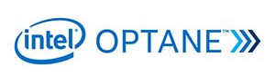






Thank You Sponsors!!

Slide 46
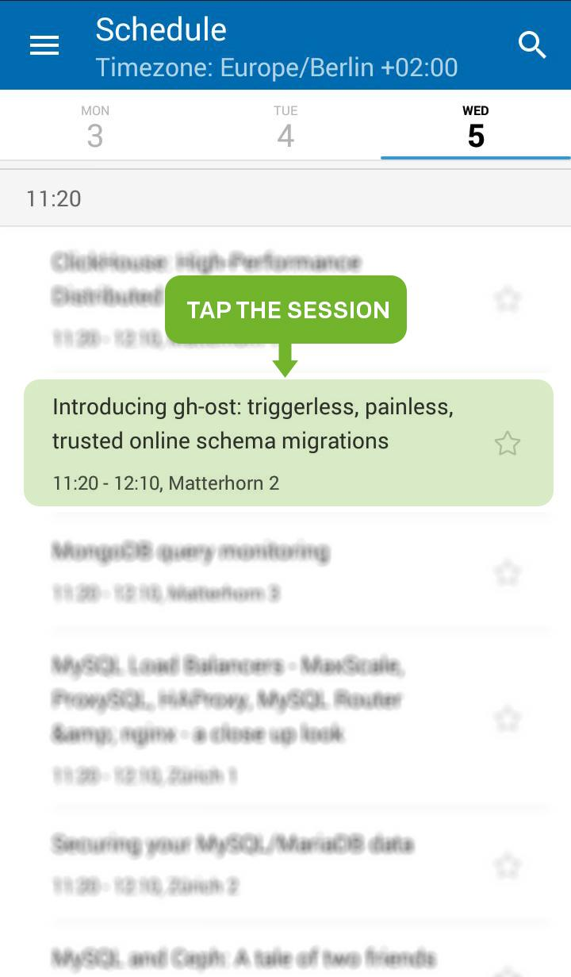
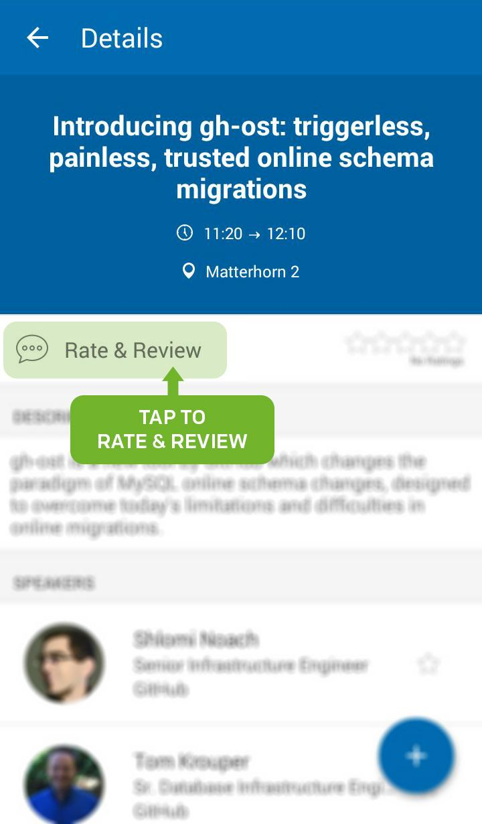
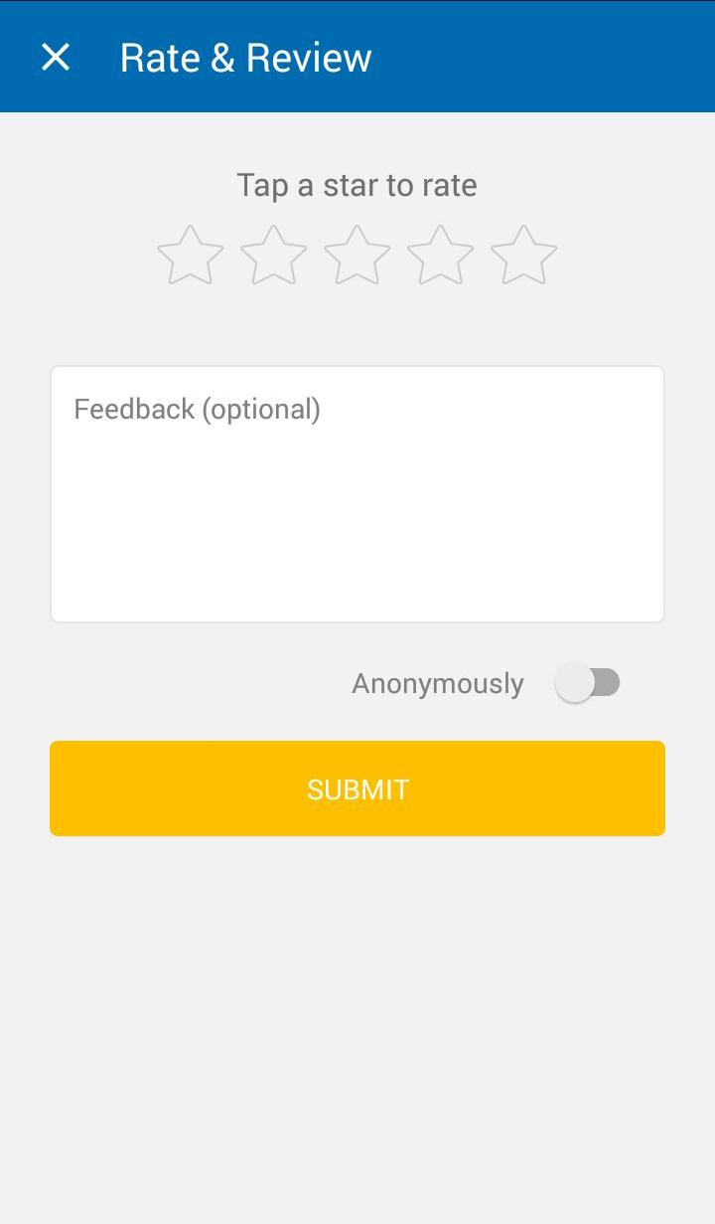
Please Rate My Session

