Slide 1
Introduction: The Dawn of a Sustainable Era
Global energy demand is soaring, fueling the urgency for cleaner alternatives.
  Renewable Energy: Solar, Wind, Hydro, Geothermal, Biomass – powering a sustainable future.
  Objective: Analyze the 2024 global renewable energy market: current state and future trends.
  Key Drivers & Challenges: Unveiling the forces shaping market growth and potential roadblocks.
Notes:
Good morning, everyone. We're here today to discuss a critical topic: the global renewable energy market. Global energy demand is rapidly increasing, placing immense pressure on existing resources and exacerbating environmental concerns. This highlights the urgent need for cleaner, more sustainable energy solutions.
When we talk about renewable energy, we're referring to sources that are naturally replenished. These include solar power derived from the sun, wind energy harnessed from the wind, hydropower generated from moving water, geothermal energy tapped from the Earth's heat, and biomass energy created from organic matter. These diverse sources represent the future of energy production.
The primary objective of this presentation is to provide a comprehensive analysis of the global renewable energy market in 2024. We will examine its current state, identify emerging trends, and forecast future growth. We will also analyze the key drivers that are propelling the market forward.
Finally, we will acknowledge the challenges that the renewable energy sector faces, such as technological limitations, infrastructure needs, and policy hurdles. Understanding these challenges is crucial for developing effective strategies to overcome them and accelerate the transition to a sustainable energy future. Let's begin.

Slide 2
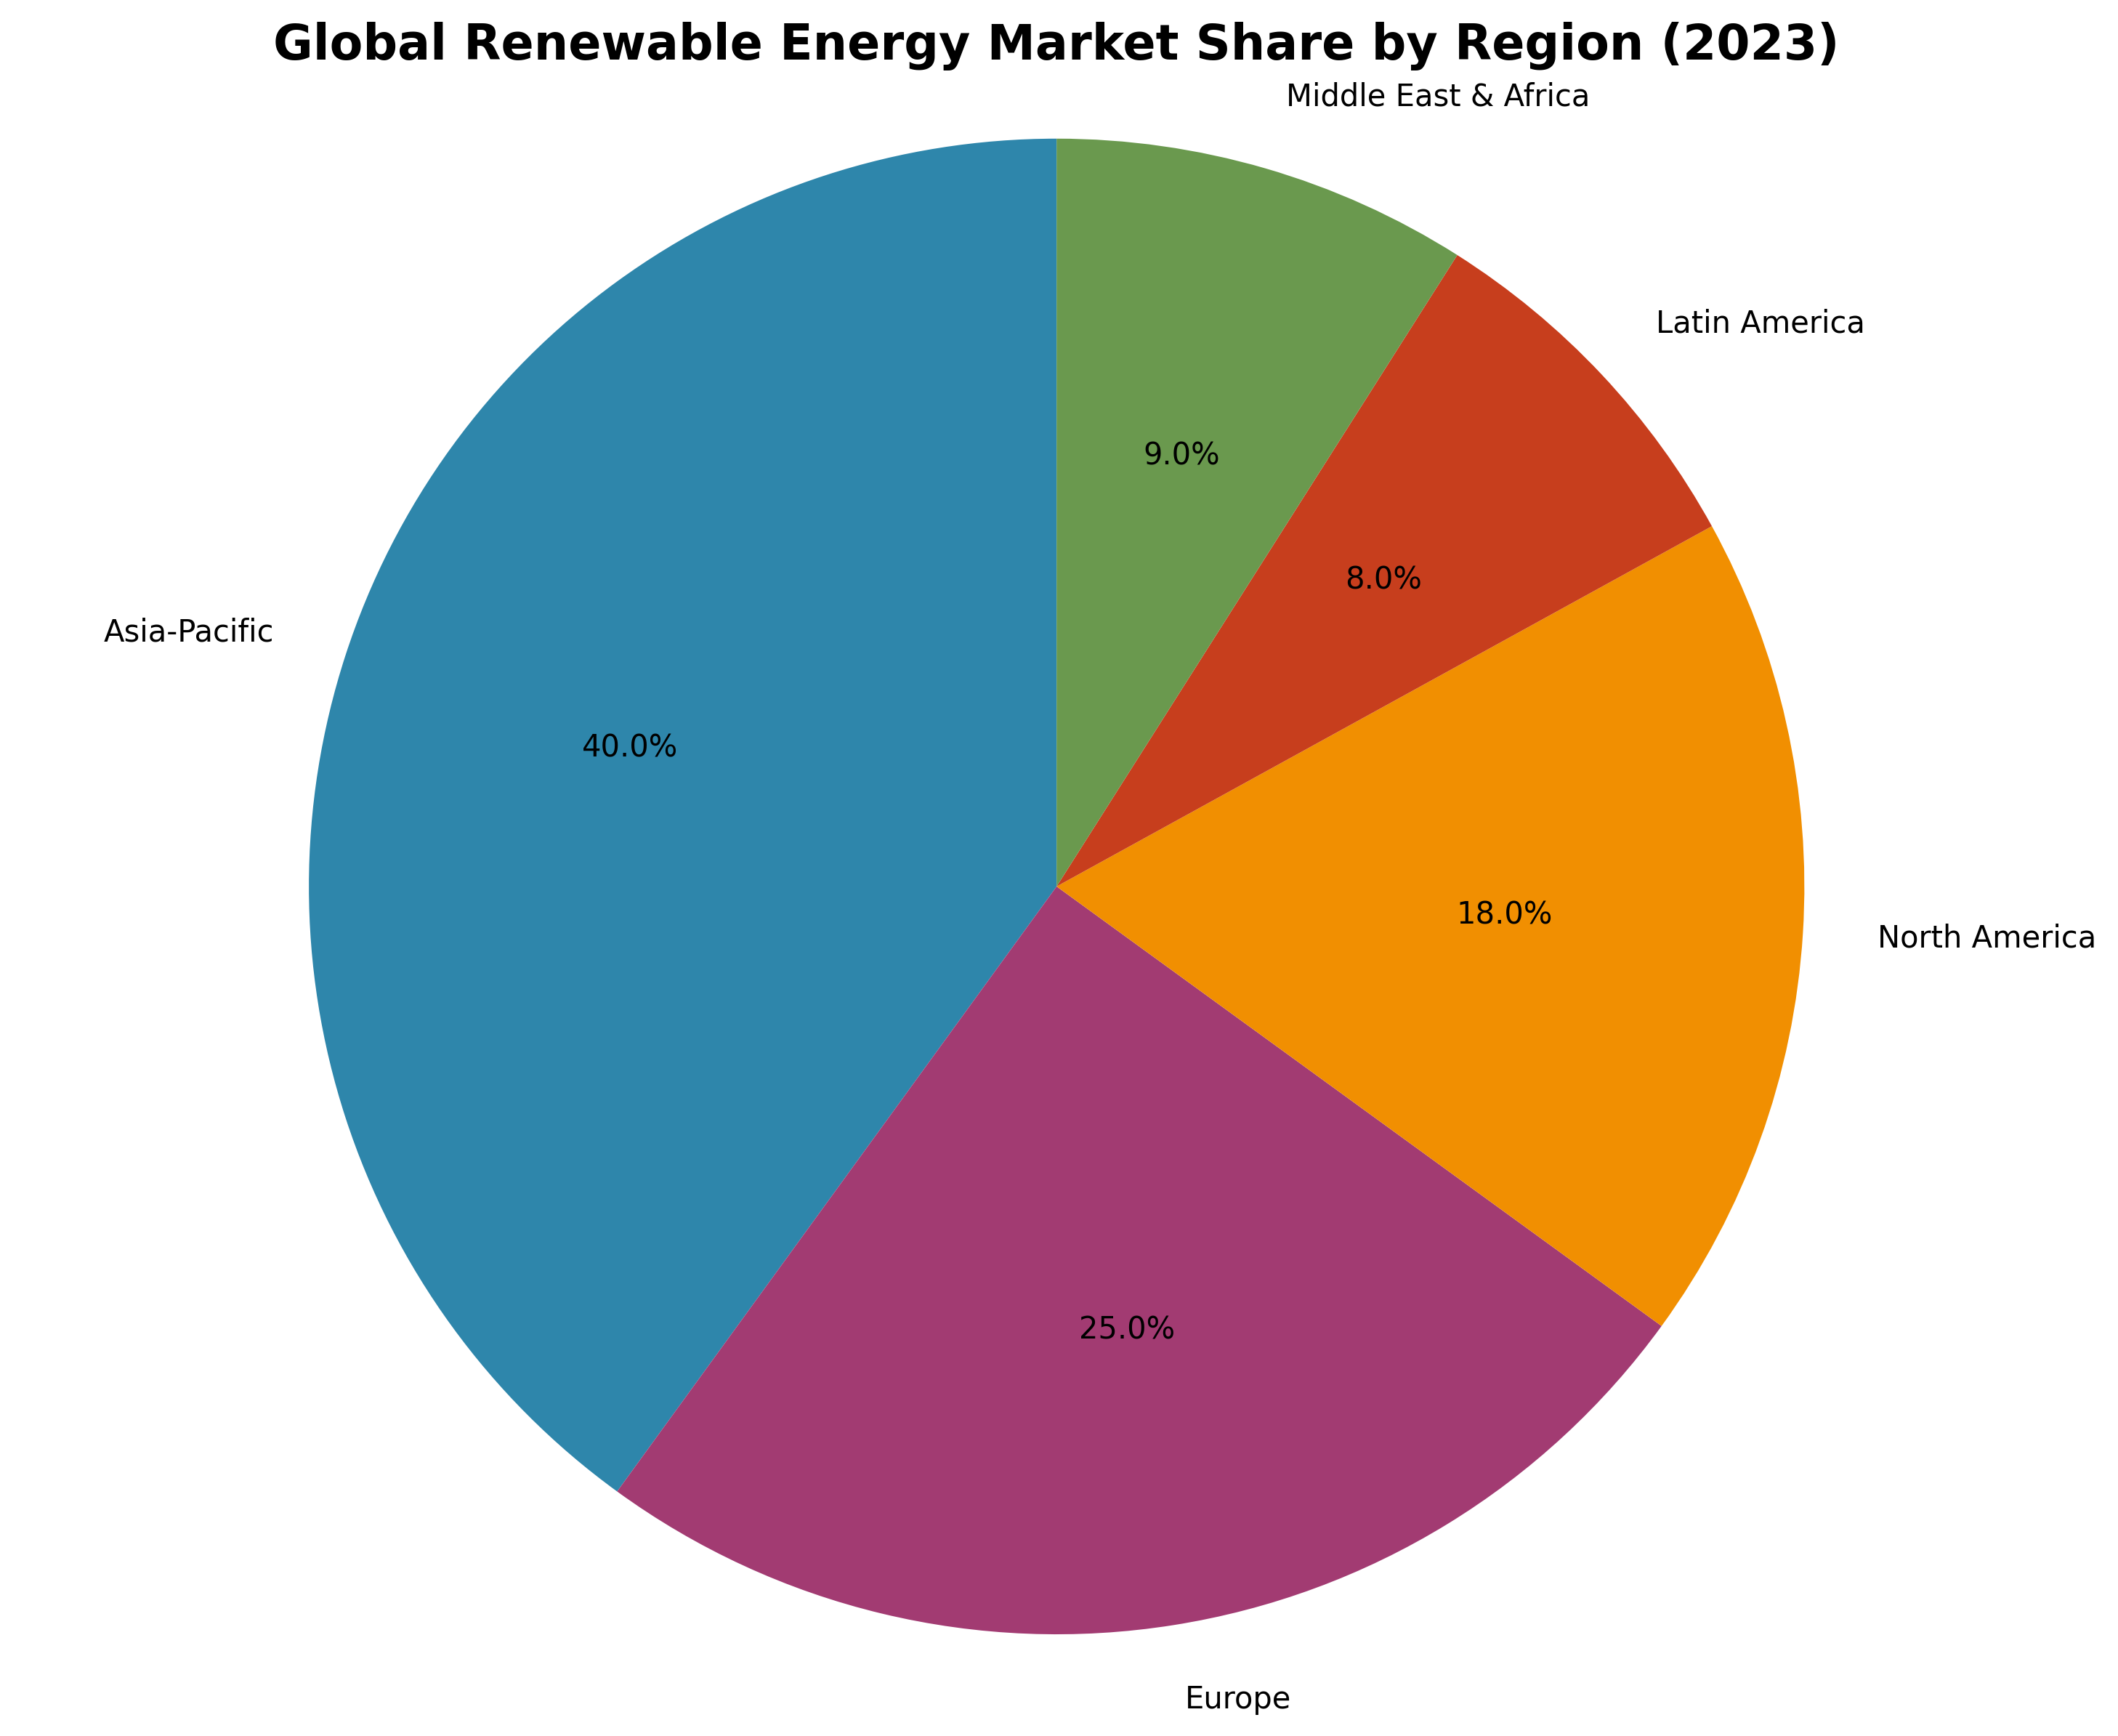
Market Overview: Current State and Key Statistics
Global Installed Renewable Energy Capacity (2023): Reached an estimated 3,870 GW, driven by increased investments and policy support.
  Market Size & Growth: Estimated at USD 1.4 Trillion in 2023, exhibiting a 17.5% growth rate compared to 2022, indicating strong momentum.
  Regional Market Breakdown: Asia-Pacific leads with over 40% share, followed by Europe (25%), North America (18%), Latin America (8%), and Middle East & Africa (9%).
  Dominant Technologies: Solar PV holds the largest market share (49%), followed by Wind (28%), Hydro (15%), and other renewables (8%) including biomass and geothermal.
Notes:
Good morning, everyone. This slide provides a high-level overview of the global renewable energy market's current state. As you can see, we reached approximately 3,870 GW of installed capacity in 2023. This growth is primarily attributed to increasing investments in renewable energy projects and supportive government policies worldwide. The market size is estimated at USD 1.4 Trillion, representing a substantial 17.5% growth compared to the previous year, indicating a strong positive trend. Asia-Pacific continues to lead the way in terms of market share, accounting for over 40%, driven by significant investments in China and India. Europe and North America are also significant players. Finally, looking at the dominant technologies, Solar PV holds the largest market share, followed by Wind, highlighting the increasing affordability and efficiency of these technologies. Hydro remains a crucial component, while other renewable sources like biomass and geothermal contribute to the overall energy mix. This positive trajectory underscores the growing importance of renewable energy in meeting global energy demands and combating climate change.

Slide 3
Key Drivers & Restraints Shaping the Market
**Government Policies & Incentives:** Subsidies, tax credits, and mandates are accelerating renewable energy adoption.
  **Environmental Awareness & Climate Concerns:** Growing public awareness fuels demand for clean energy alternatives.
  **Declining Renewable Energy Costs:** Solar PV and wind power are becoming increasingly competitive with fossil fuels.
  **Intermittency & Storage Needs:** The variable nature of renewables necessitates advanced energy storage solutions.
  **High Initial Costs & Infrastructure Limitations:** Significant upfront investments and grid infrastructure upgrades are required.
  **Geopolitical Factors & Supply Chain Vulnerabilities:** Global events and supply chain disruptions impact material availability and project costs.
Notes:
Good morning/afternoon everyone. This slide highlights the key forces shaping the global renewable energy market. Let's start with the drivers. Firstly, government policies are playing a crucial role. Subsidies, tax credits, and renewable energy mandates are incentivizing investment and accelerating deployment. For example, many countries have feed-in tariffs guaranteeing a price for renewable energy, making projects more financially viable.
Secondly, growing environmental awareness and concerns about climate change are driving demand for cleaner energy sources. Consumers are increasingly demanding sustainable products and services, putting pressure on businesses to reduce their carbon footprint.
Thirdly, the costs of renewable energy technologies, particularly solar PV and wind power, have declined dramatically in recent years, making them increasingly competitive with fossil fuels. This cost competitiveness is a major factor driving adoption.
However, there are also significant restraints. Intermittency is a major challenge. Solar and wind power are inherently variable, requiring advanced energy storage solutions to ensure a reliable electricity supply. Investing in large-scale battery storage or other grid-balancing technologies is essential but adds to the overall cost.
Secondly, high initial investment costs and infrastructure limitations remain a barrier in many regions. Building new renewable energy plants and upgrading grid infrastructure requires significant upfront capital. In some developing countries, access to financing can be a major obstacle.
Finally, geopolitical factors and supply chain vulnerabilities can disrupt the market. The availability and cost of key materials, such as lithium for batteries, can be affected by global events and trade tensions. Diversifying supply chains and securing access to critical resources is crucial for ensuring the long-term growth of the renewable energy sector.

Slide 4
Future Trends and Opportunities
Energy Storage Revolution: Enhanced grid stability and renewable dispatch.
  Emerging Market Boom: Untapped potential in developing nations.
  Smart Grids & Digitalization: Optimized integration and efficient energy management.
  Corporate PPA Surge: Driving demand and accelerating renewable deployment.
  Green Hydrogen Potential: New energy carrier for decarbonizing industries.
  Circular Economy Focus: Sustainable manufacturing and resource efficiency.
Notes:
This slide highlights key future trends and opportunities in the global renewable energy market.
* **Energy Storage Revolution:** Advancements in battery technology and pumped hydro storage are crucial for addressing intermittency issues associated with renewable energy sources. This enables more reliable grid operation and allows renewables to be dispatched on demand, much like traditional power plants. Emphasize the cost reductions and performance improvements in battery storage.
* **Emerging Market Boom:** Developing countries present significant growth opportunities due to increasing energy demand, abundant renewable resources, and supportive government policies. Highlight specific regions or countries with high potential (e.g., Sub-Saharan Africa, Southeast Asia) and mention initiatives that support renewable energy deployment in these areas. Point out challenges like financing and infrastructure limitations that need to be overcome.
* **Smart Grids & Digitalization:** Smart grids, powered by advanced sensors, data analytics, and communication technologies, are essential for optimizing the integration of variable renewable energy sources. They enable real-time monitoring, predictive maintenance, and demand response, leading to more efficient and reliable energy systems. Discuss the role of artificial intelligence and machine learning in grid optimization.
* **Corporate PPA Surge:** Corporate Power Purchase Agreements (PPAs) are becoming increasingly popular as companies seek to reduce their carbon footprint and secure long-term energy costs. This trend is driving significant investment in renewable energy projects. Mention specific examples of companies procuring renewable energy through PPAs and highlight the benefits for both the buyer and the renewable energy developer.
* **Green Hydrogen Potential:** Green hydrogen, produced using renewable energy, has the potential to decarbonize hard-to-abate sectors such as transportation, industry, and heating. Discuss the various applications of green hydrogen and the challenges associated with its production, storage, and transportation. Mention key pilot projects and government initiatives supporting green hydrogen development.
* **Circular Economy Focus:** Adopting circular economy principles, such as recycling and reusing materials, can significantly reduce the environmental impact of the renewable energy sector. This includes developing sustainable manufacturing processes for solar panels, wind turbines, and other renewable energy technologies. Emphasize the importance of responsible sourcing of raw materials and end-of-life management of renewable energy components.

Slide 5
Conclusion: Powering a Sustainable Future
Error generating content.
Notes:
Error: 429 You exceeded your current quota, please check your plan and billing details. For more information on this error, head to: https://ai.google.dev/gemini-api/docs/rate-limits. To monitor your current usage, head to: https://ai.dev/usage?tab=rate-limit.
* Quota exceeded for metric: generativelanguage.googleapis.com/generate_content_free_tier_requests, limit: 15, model: gemini-2.0-flash
Please retry in 22.618886712s. [links {
description: "Learn more about Gemini API quotas"
url: "https://ai.google.dev/gemini-api/docs/rate-limits"
}
, violations {
quota_metric: "generativelanguage.googleapis.com/generate_content_free_tier_requests"
quota_id: "GenerateRequestsPerMinutePerProjectPerModel-FreeTier"
quota_dimensions {
key: "model"
value: "gemini-2.0-flash"
}
quota_dimensions {
key: "location"
value: "global"
}
quota_value: 15
}
, retry_delay {
seconds: 22
}
]

