Slide 1
Introduction: The Importance of Quality and Root Cause Analysis
Material
Measurement
Environment
Poor Quality
**Defining Quality:** Consistently exceeding customer expectations to build loyalty and trust.
  **The High Cost of Poor Quality:** Experience significant financial losses, reputational damage, and operational inefficiencies.
  **Root Cause Analysis (RCA):** Dive deep to uncover the *true* sources of problems, preventing recurrence instead of just treating symptoms.
  **RCA: The Backbone of Quality Management:** A proactive approach that strengthens Quality Management Systems by addressing systemic issues.
Man
Machine
Method
Notes:
Good morning/afternoon everyone. Today, we're diving into the vital relationship between Quality Management and Root Cause Analysis. First, let's define what we mean by 'Quality'. It's not just about meeting the minimum requirements; it's about consistently *exceeding* customer expectations. This builds loyalty, encourages positive word-of-mouth, and ultimately drives business growth.
Next, consider the alternative: the high cost of poor quality. This cost isn't just monetary; it encompasses everything from wasted resources and rework to damaged reputations and lost customers. Think about product recalls, warranty claims, or even just the time spent fixing errors. It all adds up and significantly impacts the bottom line.
This brings us to Root Cause Analysis, or RCA. RCA is a problem-solving method focused on identifying the *underlying* causes of problems, rather than simply treating the symptoms. Think of it like treating a disease versus masking the symptoms. If you only treat the symptoms, the problem will inevitably resurface.
Finally, RCA isn't just a standalone tool; it's an integral part of a robust Quality Management System. By systematically identifying and eliminating the root causes of defects and errors, RCA strengthens the entire system, ensuring continuous improvement and preventing future occurrences. It allows us to move from reactive fire-fighting to proactive problem-solving, ensuring that our quality management efforts are truly effective.

Slide 2
Quality Management Systems: A Foundation for Excellence
Common QMS: ISO 9001, Six Sigma, Lean Manufacturing - Frameworks for structured quality.
  Key QMS Principles: Customer focus, leadership, process approach - Driving consistent results.
  Data & Metrics: Track performance, identify trends, fuel improvement - Fact-based decisions.
  RCA Integration: Core element for continuous improvement - Proactive problem solving.
1. Establish QMS (e.g., ISO 9001, Six Sigma, Lean)
2. Implement Key QMS Principles (Customer focus, leadership, process approach)
3. Collect Data & Metrics (Track performance, identify trends)
4. Perform Root Cause Analysis (RCA) for deviations
5. Implement Corrective Actions
Notes:
Good morning, everyone. This slide sets the stage for our discussion on Quality Management Systems and how they form the foundation for excellence.
Firstly, let's acknowledge some widely adopted QMS frameworks: ISO 9001, which provides a standardized approach to quality management; Six Sigma, a data-driven methodology for reducing variation and defects; and Lean Manufacturing, focused on eliminating waste and maximizing efficiency. (Pause) Think of these as toolkits – each with its own strengths, but all aiming for improved quality.
Secondly, we must understand the core principles that underpin any successful QMS. These include a strong customer focus – understanding and meeting customer needs; effective leadership – providing direction and commitment; engaging people – empowering employees to contribute to quality; a process approach – managing activities as interconnected processes; a commitment to continuous improvement – always striving for better; evidence-based decision making – relying on data for informed choices; and effective relationship management – collaborating with suppliers and partners.
Next, data and metrics are the lifeblood of any QMS. They allow us to track performance against targets, identify emerging trends, and ultimately, drive improvement. Without data, we're just guessing! (Pause) Regular monitoring and analysis of key performance indicators are crucial for making informed decisions.
Finally, and most importantly for this presentation, we’ll emphasize how to integrate Root Cause Analysis (RCA) into your QMS. RCA should not be a reactive measure after something goes wrong; it needs to be a proactive element woven into the fabric of your system. This allows us to systematically identify and eliminate the root causes of problems, preventing recurrence and ensuring continuous improvement. This is the key to sustained quality and excellence.

Slide 3
The Root Cause Analysis Framework: A Step-by-Step Approach
**1. Define the Problem:** Clearly state the issue and its impact.
  **2. Gather Data:** Collect relevant information from all available sources.
  **3. Identify Possible Causes:** Brainstorm potential root causes (5 Whys, Fishbone Diagrams).
  **4. Test Possible Causes:** Validate or eliminate causes with data analysis.
  **5. Identify Root Cause(s):** Determine the fundamental reason(s) for the problem.
  **6. Implement Corrective Actions:** Develop and execute targeted solutions.
  **7. Monitor and Evaluate:** Track effectiveness and adjust as needed.
1. 1. Define the Problem
2. 2. Gather Data
3. 3. Identify Possible Causes
4. 4. Test Possible Causes
5. 5. Identify Root Cause(s)
Notes:
This slide outlines a systematic approach to Root Cause Analysis (RCA). Each step is crucial for effectively identifying and addressing the underlying issues contributing to a problem. Let's break down each stage:
* **1. Define the Problem:** This is the crucial first step. If you don't clearly define the problem, you'll waste time and resources chasing the wrong leads. Be specific and quantifiable. What happened? Where did it happen? When did it happen? What is the impact (e.g., financial loss, customer dissatisfaction)?
* **2. Gather Data:** Once the problem is defined, gather all available information. Look at incident reports, customer feedback, process documentation, and any other relevant sources. The more data you have, the better equipped you will be to identify potential causes. Don't rely on assumptions; verify information.
* **3. Identify Possible Causes:** This is where brainstorming comes in. Use techniques like the 5 Whys (repeatedly asking "Why?" to drill down to the root cause) and Fishbone Diagrams (also known as Ishikawa diagrams, which help visualize potential causes in different categories) to generate a list of potential root causes. Encourage diverse perspectives.
* **4. Test Possible Causes:** Don't just guess at the root cause. Use data and analysis to validate or eliminate each potential cause. This might involve statistical analysis, process mapping, or controlled experiments. Focus on evidence-based decision-making.
* **5. Identify the Root Cause(s):** After testing, you should be able to pinpoint the fundamental reason or reasons why the problem occurred. This is the true root cause, not just a symptom.
* **6. Implement Corrective Actions:** Develop and implement solutions that address the root cause(s) directly. These actions should be specific, measurable, achievable, relevant, and time-bound (SMART). Consider both short-term and long-term solutions.
* **7. Monitor and Evaluate:** After implementing corrective actions, it's essential to track their effectiveness. Monitor key metrics and evaluate whether the problem has been resolved. If not, you may need to revisit the RCA process and identify new root causes or refine your corrective actions. Continuous improvement is key.

Slide 4
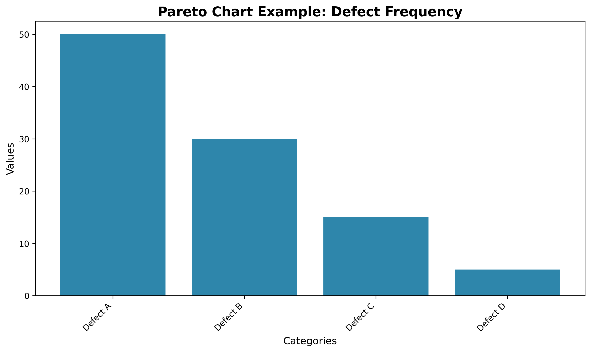
RCA Tools and Techniques: Empowering Your Analysis
**5 Whys:** Uncover root causes by repeatedly asking 'Why?' (typically 5 times) to drill down past surface-level symptoms. Excellent for simple problems and fostering deeper understanding.
  **Fishbone Diagram (Ishikawa Diagram):** Visually map potential causes, categorized (e.g., Man, Machine, Method, Material, Measurement, Environment), facilitating brainstorming and comprehensive analysis. Ideal for complex, multifaceted issues.
  **Pareto Chart:** Prioritize improvement efforts by identifying the most frequent defects/problems. The '80/20 rule' often applies – focus on the 'vital few' causes with the greatest impact.
  **Fault Tree Analysis (FTA):** Systematically identify potential failures and their contributing factors using a top-down, deductive approach. Crucial for high-risk systems where understanding potential failure modes is paramount.
  **Scatter Diagram:** Explore relationships between two variables to identify potential correlations. Useful for generating hypotheses about cause-and-effect and guiding further investigation.
Notes:
This slide introduces some of the most common and effective tools and techniques used in Root Cause Analysis. Let's briefly discuss each one:
* **5 Whys:** This is deceptively simple but remarkably effective. The core idea is to ask 'Why?' repeatedly – typically around five times – until you reach the underlying cause, rather than just treating the symptoms. Emphasize that it's a team effort and requires open and honest communication. For example, 'The machine stopped.' Why? 'The motor overheated.' Why? 'The cooling fan malfunctioned.' Why? 'The fan belt was worn.' Why? 'Preventive maintenance schedule was inadequate.'
* **Fishbone Diagram (Ishikawa Diagram):** This visual tool helps structure brainstorming sessions. Each 'bone' of the fish represents a category of potential causes, like Manpower, Materials, Methods, Machinery, Measurement, and Environment (6Ms). This allows you to systematically explore all possible contributing factors. Explain that the categories may need to be adjusted based on the specific problem.
* **Pareto Chart:** This tool is based on the Pareto principle, often called the 80/20 rule, which states that roughly 80% of effects come from 20% of causes. The chart visually displays the frequency of different problems or defects, ranked from highest to lowest. It helps you prioritize your improvement efforts by focusing on the 'vital few' causes that have the greatest impact.
* **Fault Tree Analysis (FTA):** This is a more complex, deductive approach, used primarily in situations where failure can have serious consequences. FTA starts with a top-level 'undesired event' (e.g., a system failure) and then works backward, identifying all the possible events that could lead to that failure. It uses logical gates (AND, OR) to show the relationships between events. Emphasize its importance in risk management for critical systems.
* **Scatter Diagram:** Also known as a scatter plot, this diagram helps you visualize the relationship between two variables. By plotting the data points, you can see if there's a correlation (positive, negative, or no correlation). This can help you generate hypotheses about cause-and-effect, which you can then investigate further. Explain that correlation doesn't necessarily mean causation, but it can point you in the right direction.
It's important to remember that these tools are not mutually exclusive. You can use them in combination to get a more complete understanding of the problem and its root cause. The choice of which tool to use depends on the nature of the problem, the available data, and the expertise of the team.

Slide 5
Conclusion: Embedding Quality and RCA for Sustained Success
**Quality & RCA: Foundational to Organizational Excellence:** Quality Management and Root Cause Analysis are not just processes; they are cornerstones of sustainable success and competitive advantage.
  **Unlock Tangible Benefits with Effective RCA:** Drive impactful improvements in product quality, cost reduction, customer loyalty, and operational efficiency through diligent root cause identification and resolution.
  **Actionable Steps for Lasting Change:** Integrate RCA seamlessly into your Quality Management System, empower your workforce to be proactive problem-solvers, and cultivate a culture deeply rooted in continuous improvement.
1. Integrate RCA into Quality Management System
2. Empower Workforce for Proactive Problem-Solving
3. Cultivate a Culture of Continuous Improvement
Notes:
This slide summarizes the core message: that Quality Management and Root Cause Analysis are inseparable components of organizational success. Emphasize that these are not merely tasks but strategic imperatives.
For the first bullet point, reiterate that integrating Quality and RCA results in a more robust and resilient organization, prepared to meet challenges and capitalize on opportunities.
Expand on the second bullet point by giving specific examples of how RCA can achieve each benefit. For instance, mention how RCA can identify design flaws leading to improved product quality, or pinpoint inefficient processes leading to cost reduction. Quantify these benefits whenever possible with real-world examples (if you have them).
For the third bullet point, provide practical advice on implementation. Mention that integrating RCA into the QMS might involve updating procedures, providing training, and establishing clear reporting mechanisms. Empowering employees requires equipping them with the tools and knowledge to conduct RCA effectively. Cultivating a culture of continuous improvement requires leadership commitment and the creation of a safe space for employees to identify and report problems without fear of reprisal.
End with a strong call to action: encourage the audience to take the next step and implement the RCA framework in their own organizations, promising them significant and sustainable benefits.

