Slide 1

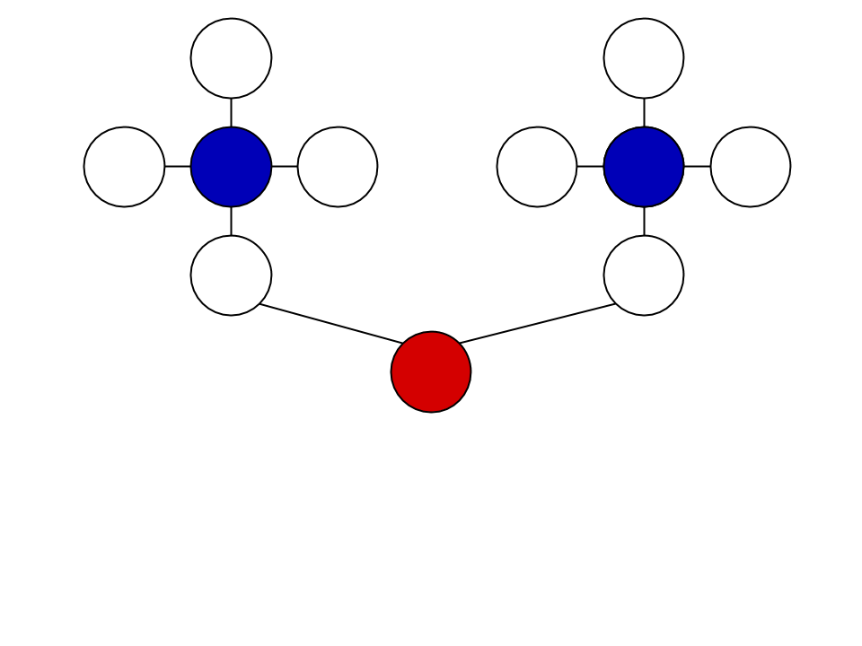
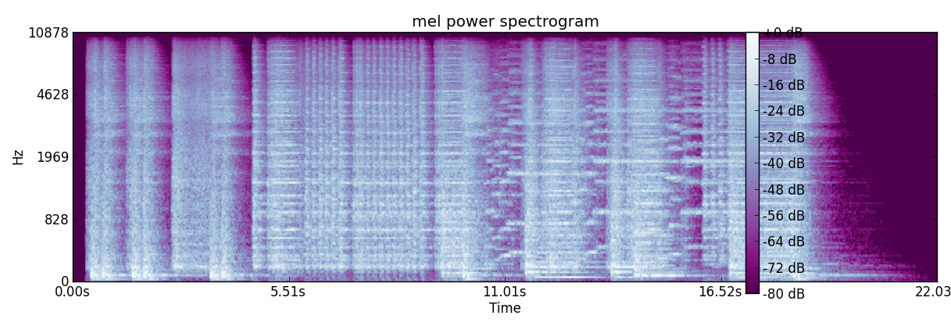
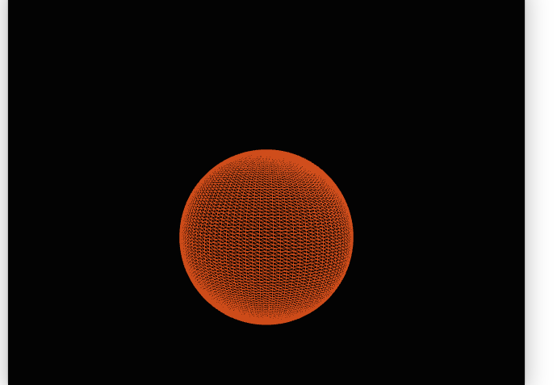
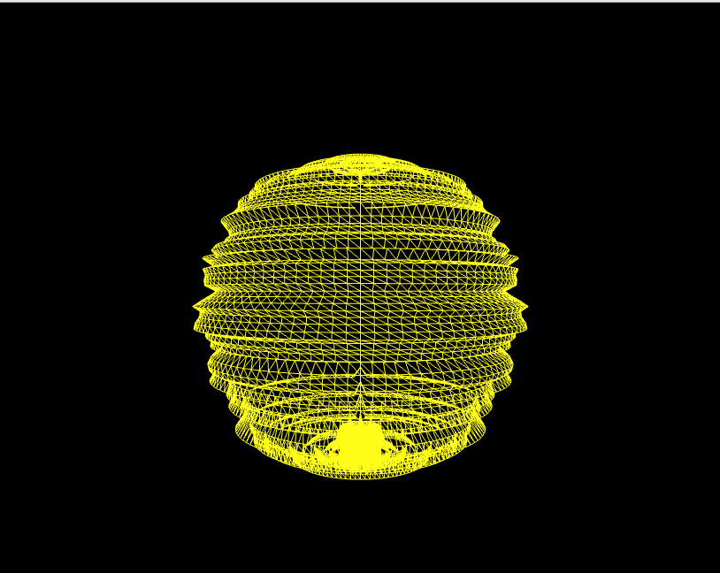
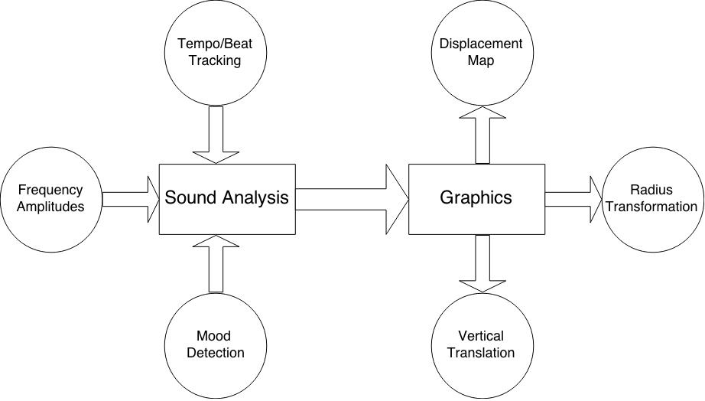
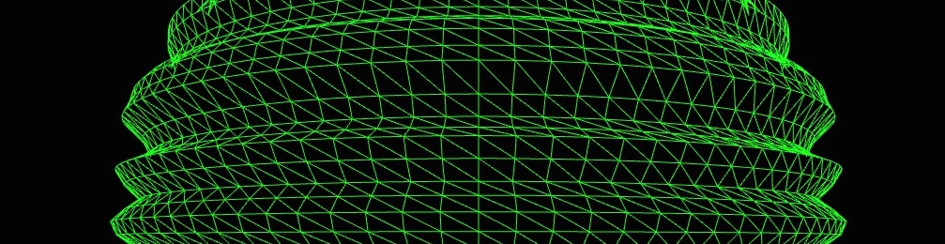
A#: Music Visualizer
Emre Fındık, Shane Moore, Joseph Vinegrad, Zachary Zimmerman
Overview
Sound Analysis
We find that the typical music visualization does fine at looking good alongside the music, but fails to go beyond and provide actual interpretation or insight into the song. The goal of our project is to create a visualizer that accurately represents the characteristics of music.
The main question we set out to answer are:
What shapes/surfaces should we use to model our visualizer?
How can we use animation to represent features of a song?
What features of a song should we consider?
Each song is analyzed in a variety of ways:
Tempo/Beat tracking
Frequency Amplitudes
Mood Detection
Chart 1. Label in 24pt Calibri.
Figure 3. A mel spectrogram showing frequency amplitudes over time
Modeling/Animation
We decided to model a single sphere using a triangle mesh in our visualizer. Animations on the sphere include:
Radius growth/shrinking
Displacement Mapping
Vertical Translations
Figure 1. On the left: our visualizer at rest (no music). On the right: our visualizer at work!
Implementation/Software Design
Our codebase is divided into two main parts:
Sound Analysis – the specified song file is loaded and various data about features of the song are obtained
Graphics – data from the sound analysis is used to determine the appearance of the sphere
Figure 4. An illustration of a dynamically generated texture map (for frequency amplitudes)
Conclusions & Further Steps
Our visualizer does a good job of representing volume and beat tracking. It also provides an accurate (and really cool) visualization of amplitudes of different frequencies in a song.
In the future, we would like to extend our visualizer to include color as a representation of the mood of a song. We would also like to come up with a better way to integrate translations of the sphere to characterize musical features.
Figure 2. An illustration of our software architecture
Figure 3. A melspectrogram showing frequency amplitudes over time
Contact
References
<your name>
<your organization>
Email:
Website:
Phone:

