Slide 1

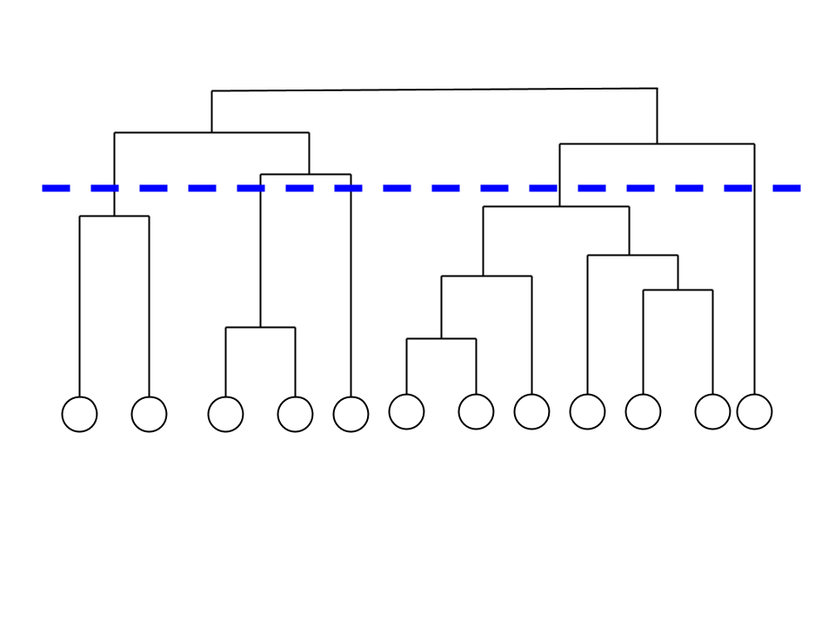
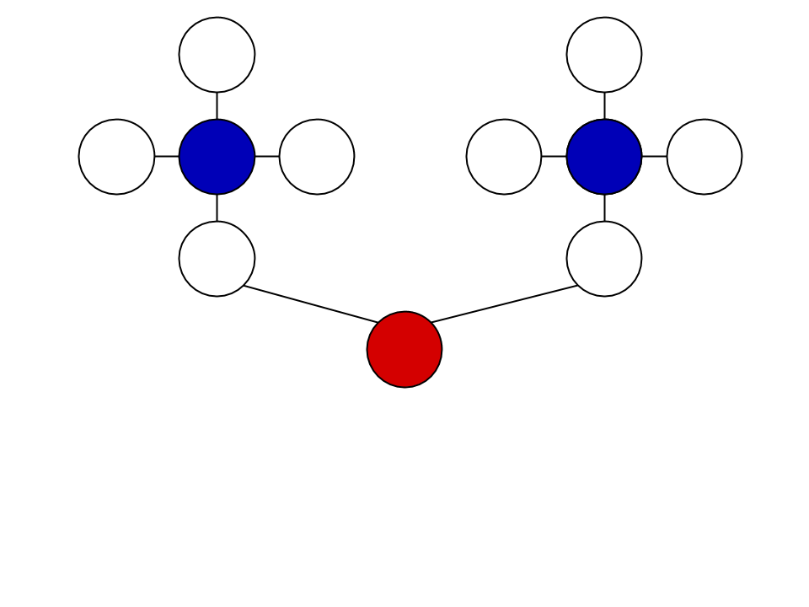
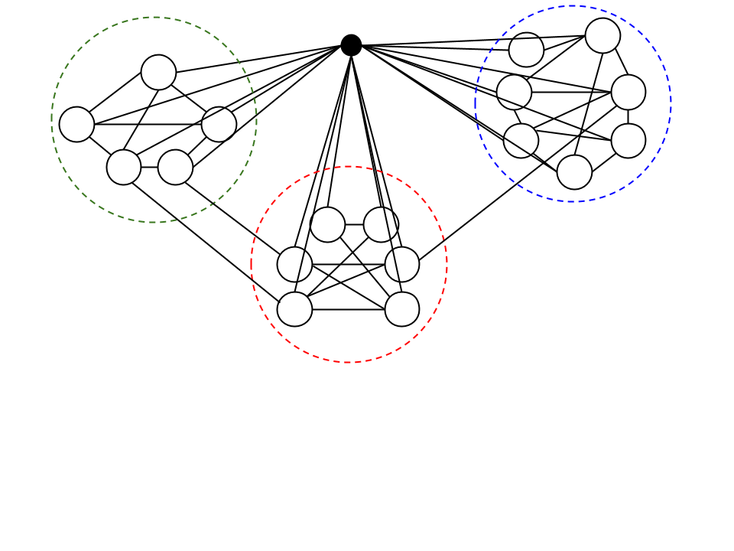
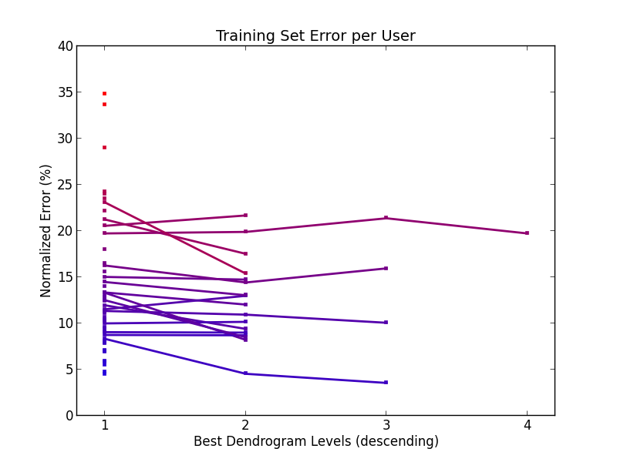
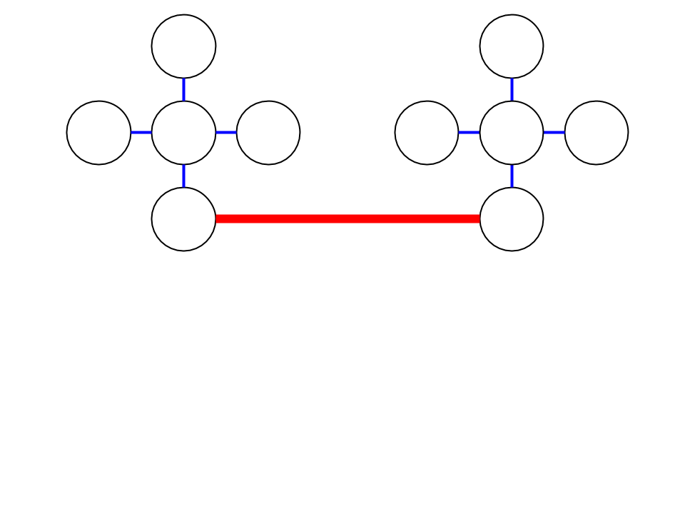
18: Model Friend Memberships to Multiple Circles
Ameya Acharya, Steven Dourmashkin, Shane Moore
Modeled off Finding and evaluating community structure in networks: Newman, Girvan, 2003.
Motivation
Methodology
Our social networks are constantly growing and there is no good way to organize them.
Current options are to:
Manually sort connections into circles.
Select friends that share one feature (e.g., university or hometown).
Identifying social circles is important for both users and social networking sites.
Divisive algorithm
Calculate betweenness
At each step, we remove the edges that connect many other pairs of vertices (i.e. high betweenness).
Form dendrogram
Choose the optimal level of splits by computing modularity.
Figure 3. A sample dendrogram with the optimal split level highlighted.
Chart 1. Label in 24pt Calibri.
Preliminary Evidence
Our preliminary approach has reasonable training set accuracy.
Figure 1. An example ego network and division into clusters.
Research Questions
An ego network is a user’s direct friends, and any connections between these friends.
A social circle is a highly-connected subset of a user's friends.
How can we infer users’ social circles based on their ego networks and Facebook profiles?
However, our algorithm for selecting appropriate dendrogram levels isn’t performing as expected. We have proposed solutions in our conclusions section.
Conclusions & Further Steps
Our algorithm has fairly high runtime complexity, although this was to be expected. There are still more time optimizations that may be necessary, particularly in calculating betweenness.
We would like to incorporate shared features into our social circle calculations.
Our current method does not account for overlapping clusters, which is something that we need to take into account. This will likely improve our dendrogram-level-selection.
Figure 2. An illustration of betweenness; colored edges have higher betweenness.
Contact
References
References
Easley, D., & Kleinberg, J. (2010). Networks, crowds, and markets: reasoning about a highly connected world. New York: Cambridge University Press.
2. Leskovec, J., & McAuley, J. J. (2012). Learning to discover social circles in ego networks. In Advances in neural information processing system (pp. 539-547).
3. Palla, G., Derenyi, I., Farkas, I., & Vicsek, T. (n.d.). Uncovering the overlapping community structure of complex networks in nature and society. Nature, 435(7043), 814-81.
4. Newman, M. E. J & Girvan, M. (2004). Finding and evaluating community structure in networks. Phys. Rev. E 69, 026113.
<your name>
<your organization>
Email:
Website:
Phone:

