Slide 1
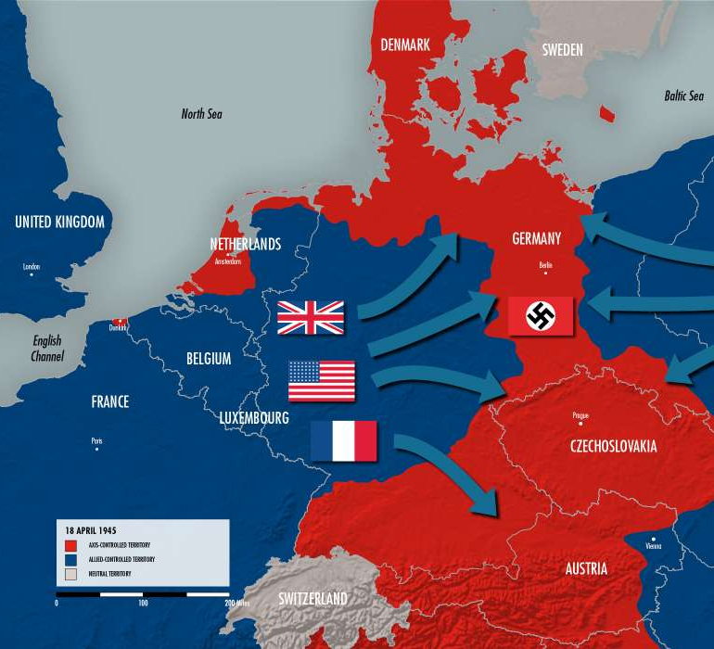
Causes of WWII
What caused WWII?

