Slide 1
Advanced Techniques with Large Language Models Lecture 4
Northeastern University
College of Engineering
Multidisciplinary Graduate Engineering Department
INFO 7374 – Fall 2025
Instructor: Abdolreza Mosaddegh

Slide 2
Announcement
TA: Haoqi Shen
Email / Teams : shen.haoq@northeastern.edu
Office Hours: Mondays and Tuesdays (10:00-12:00)

Slide 3
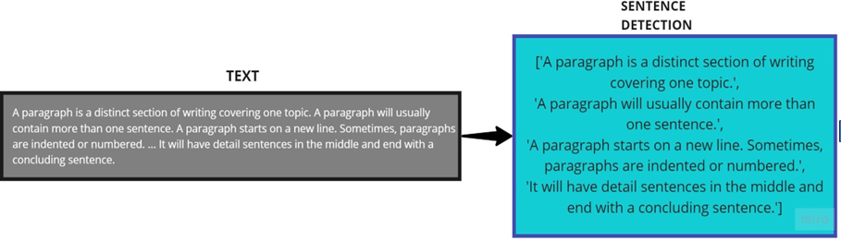
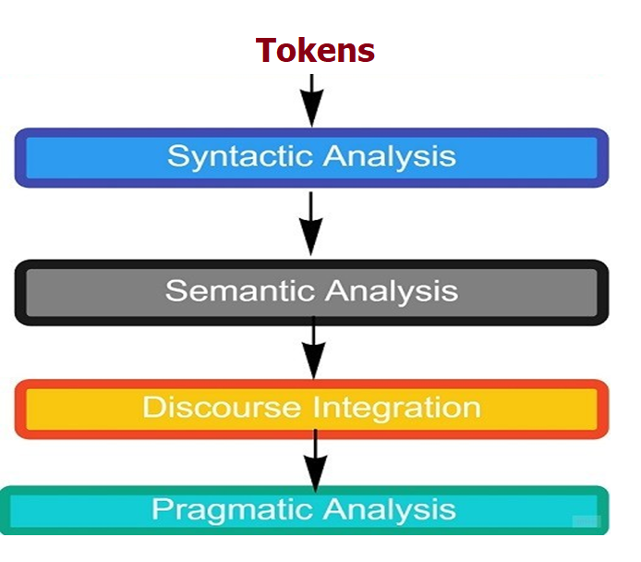
Deep Learning Approach for NLP
After tokenizing, NLP phases includes capturing syntactic dependencies and meaning of the words/tokens in different contexts besides discourse integration and pragmatic analysis.
Tokenization
(e.g., BPE)
Tokens needs to be processed by deep neural networks to realize NLP phases

Slide 4
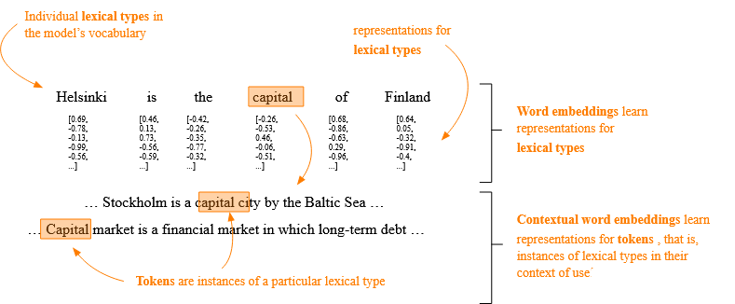
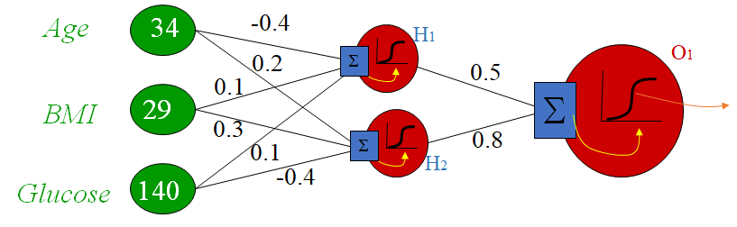
Problem Statement
We need to convert tokens to numbers to process them with neural networks
These numbers should present meanings of the words
Meaning of words can be different in various contexts (e.g., capital)
1,2,3 → We need a mechanism to encode contextual meaning of words with numbers
Neural networks process features represented by numbers

Slide 5
Describing Meaning of Words using Features
We can use characteristic (features) of words to represent their meaning in a context.
E.g., Describing word Capital (in a specific context): Administrative center city of a country.
Describing word King: The top rank person (male) in a monarchy political system ...
We can also use characteristic (features) of a text to represent the meaning or context
E.g., Describing sentence “Antimicrobial resistance is growing in recent years”
Structured Representation
of Features
 | Gender | Political Rank | Political System | …
King | M | Top | Monarchy
 | Type | Category | Topic | …
Antimicrobial resistance is growing in recent years | Scientific | Medicine | Antimicrobial Resistance

Slide 6
Words as Vectors
Each value of a feature of a word / concept can be encoded by a number
A word can be represented by a vector as an ordered list of numbers in which each position represents a feature
Features of a word are dimensions of the vector
 | Encoding
Gender | F=1, M= 2
Political Rank | Between 1 to 10
Political System | Monarchy=1, Republic =2
 | Gender | Political Rank | Political System | …
King | M | Top | Monarchy
 | 2 | 10 | 1
Gender
Vector representation of ‘King’ using ordered encoded values: [2, 10, 1]
Vector representation of a word / text is called Embedding:
E(King) = [2, 10, 1]
2
1
1
10
Political System
Political Rank

Slide 7
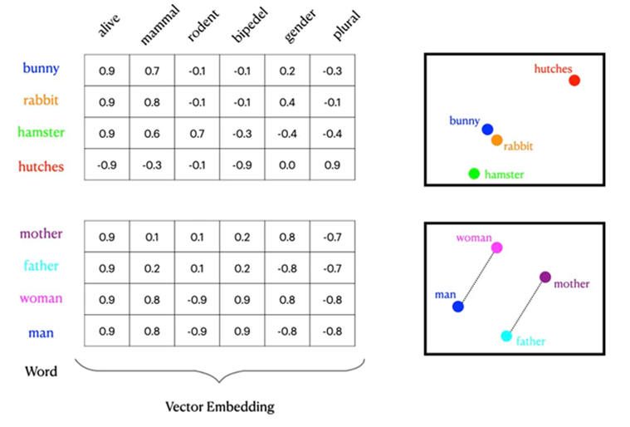
Why Vectors?
Vectors represent relationships and similarities between concepts
Vectors can represent distance between meanings
Vectors (meaning of words) can be transformed based on context
Vectors can be scaled to represent different types of data

Slide 8
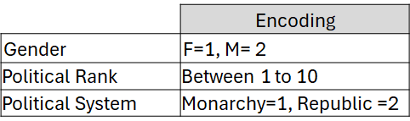
Representing Distance
Vectors can preserve distance between meanings:
 | Gender | Political Rank | Political System | …
King | M | Top | Monarchy
Queen | F | Top | Monarchy
Prince | M | High | Monarchy
Princess | F | High | Monarchy
Gender
E(King)= [2, 10, 1]
Prince
King
2
1
E(Queen)= [1, 10, 1]
E(Prince)= [2, 9, 1]
Queen
Princess
E(Princess)= [1, 9, 1]
9 10
Political Rank
E(King) - E(Queen)= E(Prince)- E(Princess) = [1,0,0]
E(King) - E(Prince) = E(Queen) - E(Princess) = [0,1,0]

Slide 9
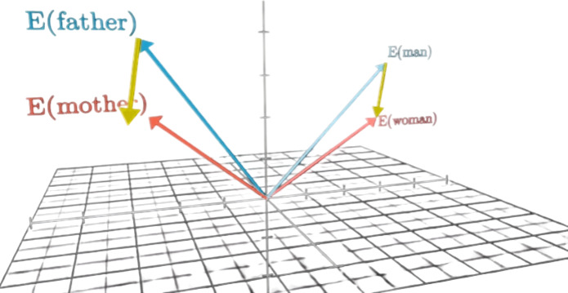
Transforming Vectors
Vectors can be transformed using other vectors.
A vectors can represent the meaning of a word
1,2 -> It is also possible to transform the meaning of a word using vectors
Gender
King
2
1
Queen
9 10
Political Rank
E(Queen) + [1,0,0] = E(King)

Slide 10
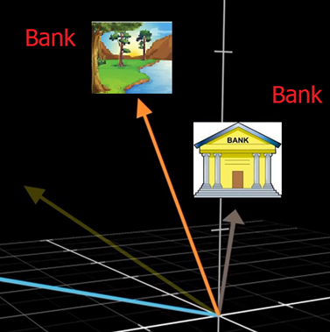
Transforming Vectors - Usage
Transform vector representation of a word in different contexts (e.g., bank as financial institution vs bank as land alongside a river)
Transform vector representation of a word to a different languages in translation tasks (e.g., Hello to Bonjour)
Transform to add new characteristic to an embedding
Plural_Transform = E(cats)-E(cat)
E(student) + Plural_Transform = E(students)

Slide 11
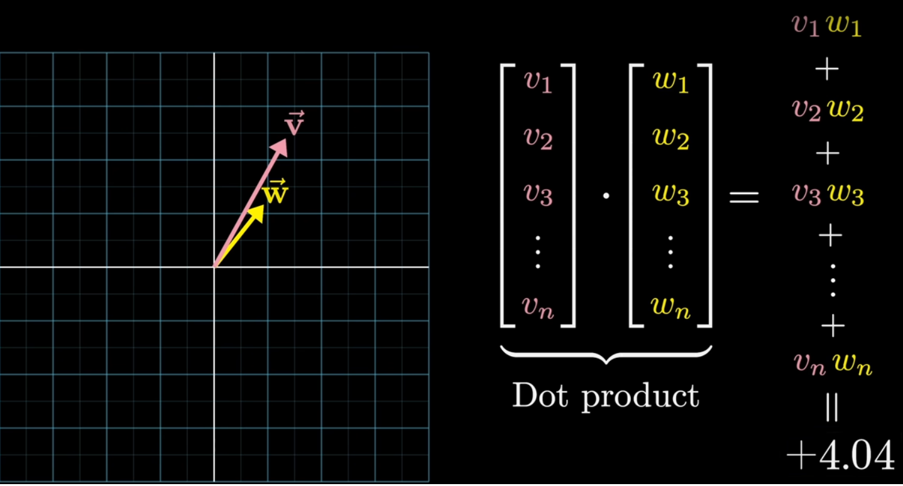
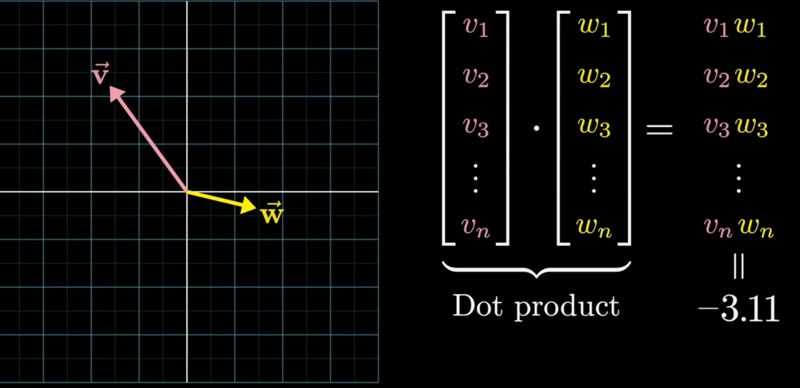
Similarity in Vectors
1-The dot product of vectors provides a measure of their alignment and magnitude:
If two vectors are in the same direction, their dot product is positive and maximized.
If two vectors are in opposite directions , their dot product is negative and minimized.
2- Cosine Similarity (normalized dot product) can measure similarity of vectors (-1 to 1)
similarity of word vectors indicates similarity of meaning (or some aspects) of words

Slide 12
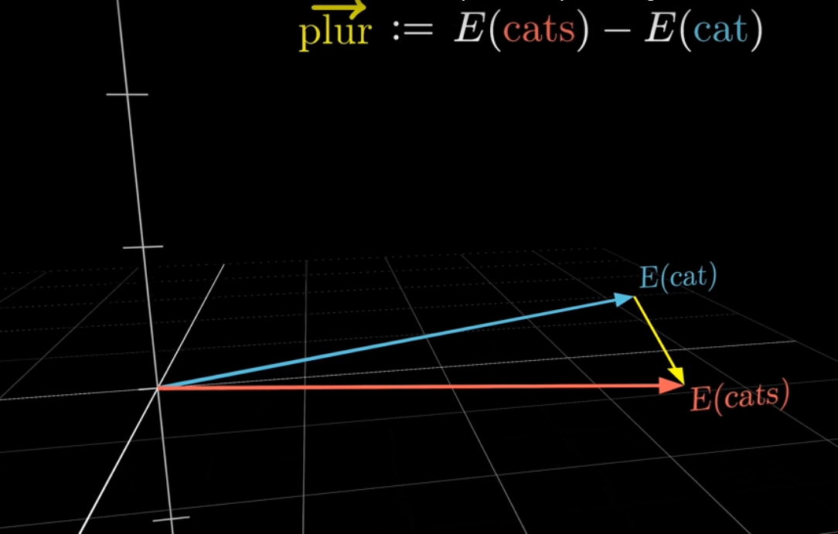
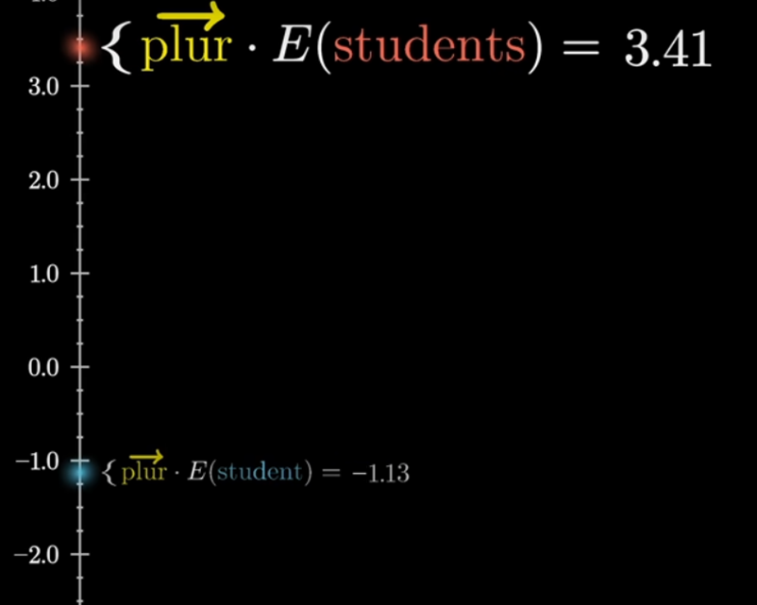
Similarity - Example
The plural vector is more aligned with plural words rather than singular ones.
Therefore, the result of dot product operation or Cosine similarity is bigger for plural words:
Plural_Vector . E(students) > Plural_Vector . E(student)
Cosine (Plural_Vector, E(students)) > Cosine(Plural_Vector, E(student))

Slide 13
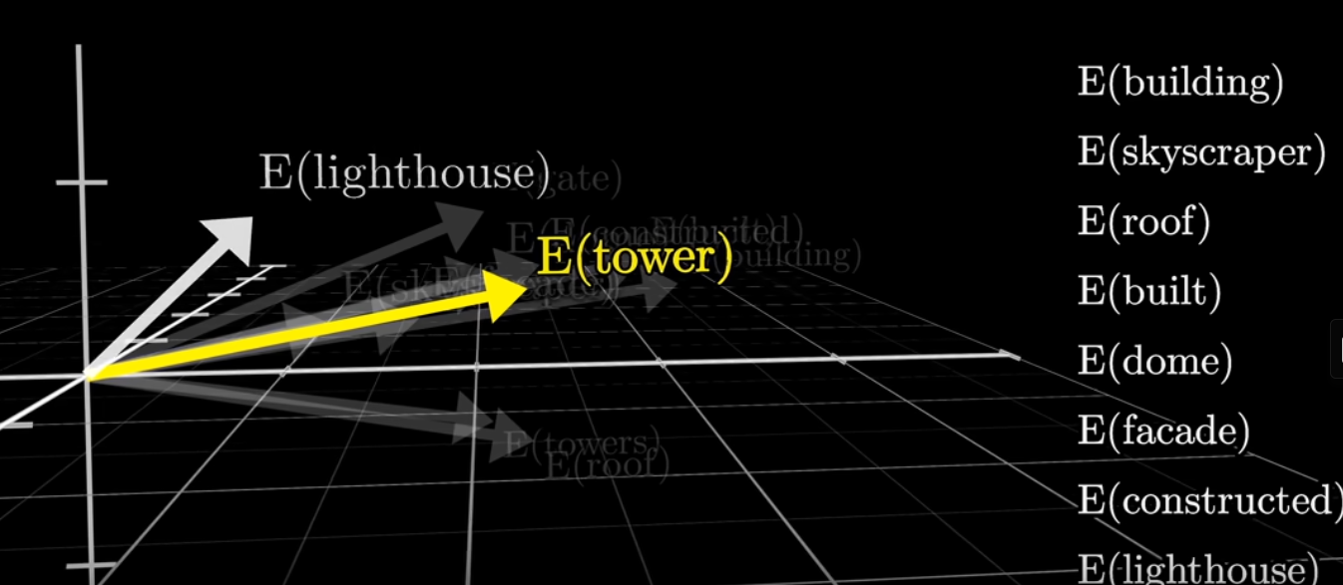
Relationships Between Concepts
Vectors can capture the relationships between different pieces of data.
Word that have similar meanings are represented by vectors that are close to each other in the vector space.
This spatial relationship encodes semantic meaning, which is useful for tasks like natural language processing (NLP).

Slide 14
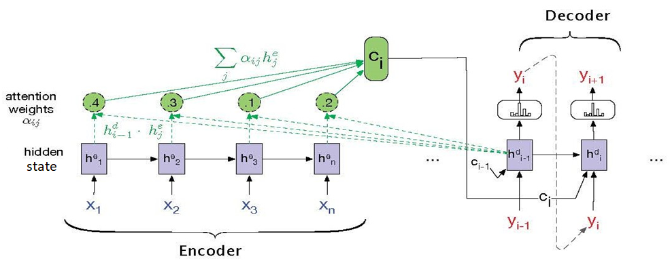
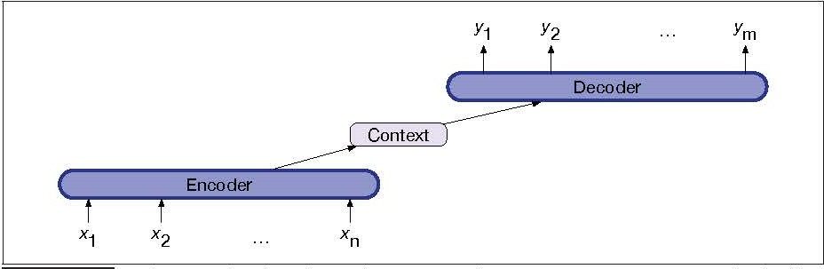
Vectors in RNN
The inputs are embeddings (vectors) representing tokens
At each step, an RNN hidden state is a vector that summarizes the input token at together with information from previous time steps
In simple encoder–decoder RNN, context vector is the last hidden state of encoder conveys information of tokens in encoder
In RNN with attention mechanisms, there are several context vectors as weighted combinations of all encoder hidden states

Slide 15
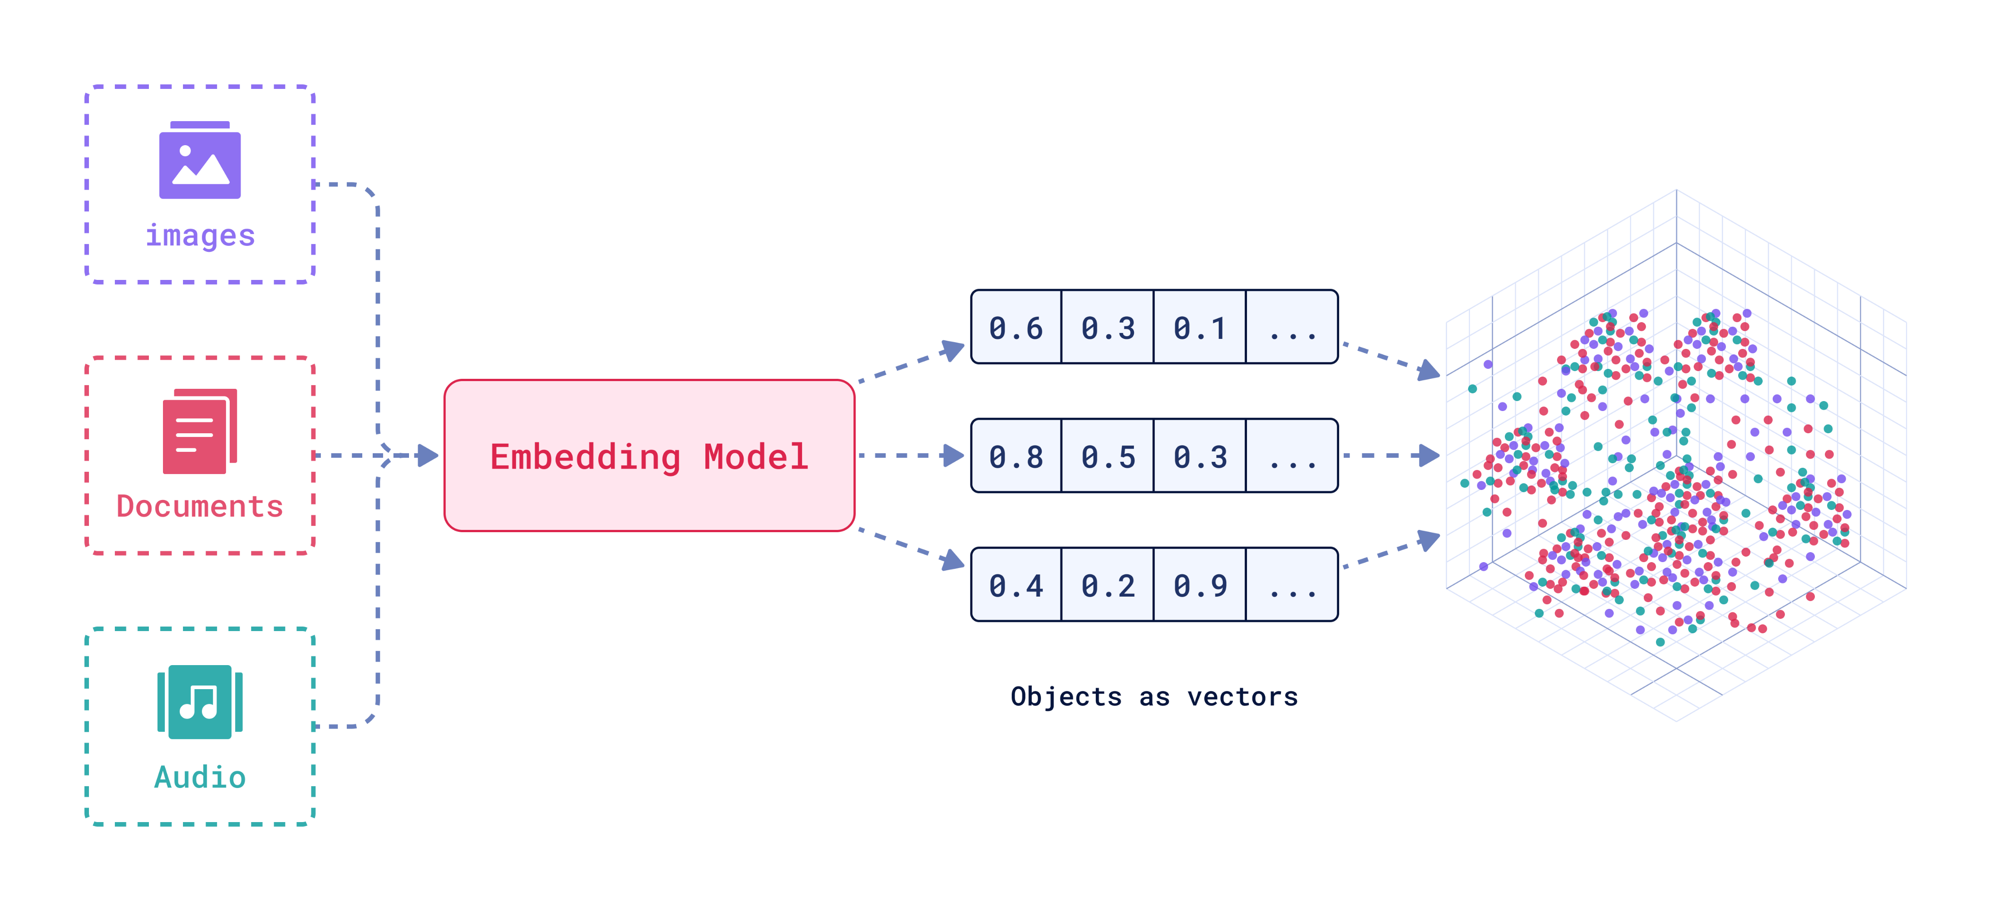
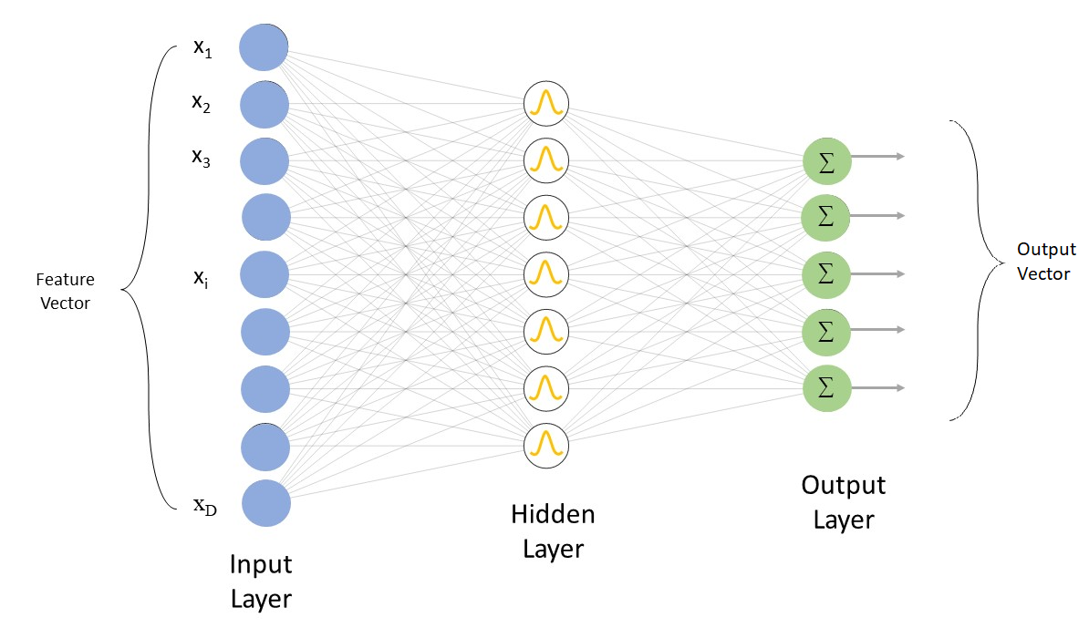
Multi-Modal Data in Vectors
Vectors can represent different types of data, whether it's text, images, or audio.
Neural networks, particularly deep learning models, are designed to work with vectorized data.
The input, weights, and outputs of neural networks can be represented by vectors, making vectors a natural choice for any type of neural network.
Multi-modal neural network can process different types of data using vectors
qdrant

Slide 16
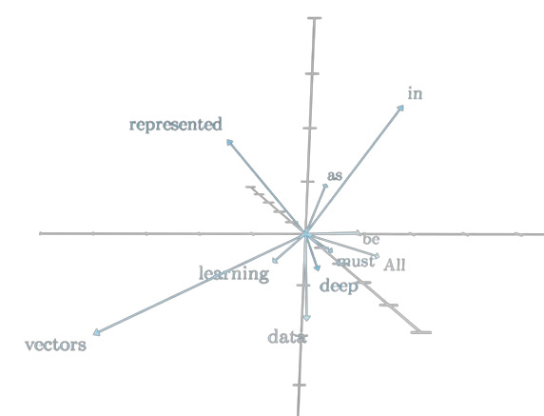
High Dimensional Embeddings
Embeddings capture the semantic meaning of the word/text.
Since there are many attributes for each word / context, there are many dimensions for embeddings which represent words
The vectors are usually of fixed dimensions, depending on the model (e.g., 12288 in GPT-3-175B)
Higher-dimensional embeddings can capture more nuanced meanings but also require more computational resources.
Embeddings are foundational to how LLMs process and generate human-like text.
Problem: Needs a method to create embeddings(vectors) from tokens

Slide 17

Embedding using One-hot Encoding
One way to create embedding is to create a vocabulary of all the words in a text
Each word is a vector of the same dimensions of the vocabulary.
Each dimension can be considered as a word in the vocabulary.
Resulting vectors contain a single “1” besides zeros and represent the corresponding words in the vocabulary.
This encoding technique is called one-hot encoding:
Example:
Suppose that we have a vocabulary made from the tokens in “the quick brown fox jumps over the lazy dog” → Vocabulary=[“the”, “quick”, “brown”, “fox”, “jumps”, “over”, “lazy”, “dog”]
the word “the” is represented by this vector: [ 1, 0, 0, 0, 0, 0 ,0 ,0],
the word “quick” is represented by this vector: [ 0, 1, 0, 0, 0, 0 ,0 ,0],
the word “brown” is represented by this vector: [ 0, 0, 1, 0, 0, 0 ,0 ,0],
…

Slide 18
One-hot Encoding - Problems
Distance between word embeddings using one-hot encodings always the same
Embeddings can not capture meaning since they are not representing any dimension
Embeddings cannot represent meaning in different context
The vectors will be sparse (not many information) and long (equal to vocabulary size)
dog
cat
person
1
2
3
$$[1 0 0 0 0 0 0 0 0 0 …]$$
$$[0 1 0 0 0 0 0 0 0 0 …]$$
$$[0 0 1 0 0 0 0 0 0 0 …]$$
Sparse (most are 0’s) and long (vocabulary size) vectors
Problem: Methods to create meaningful vectors from tokens based on context
Solution: Meaning and context of words can be understood by surrounding words
What we see

Slide 19
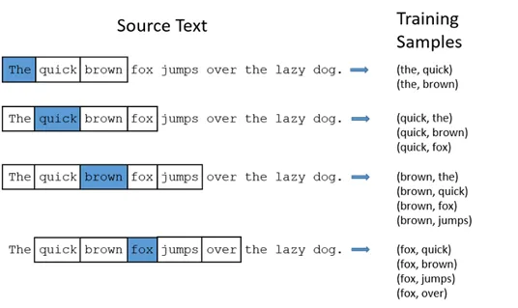

Word2vec
Word2vec is a technique for obtaining meaningful vector representations of words.
These vectors capture information about the meaning of the word based on the surrounding words.
To limit the number of words in each context, a parameter called “window size” is used.
The word2vec algorithm estimates these representations by the likelihood (probability)
There are two main methods to realize Word2Vec: CBOW, Skip-gram
window size of two

Slide 20
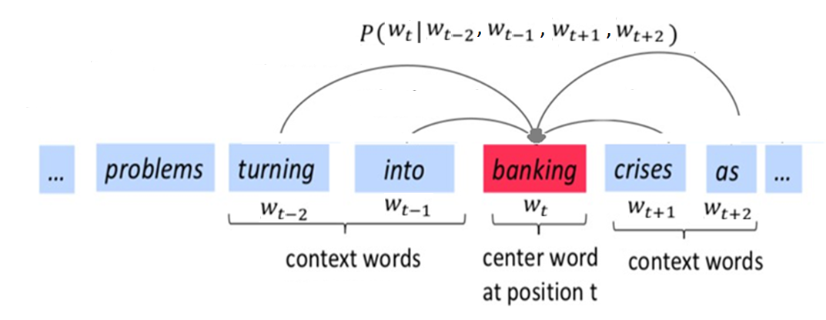
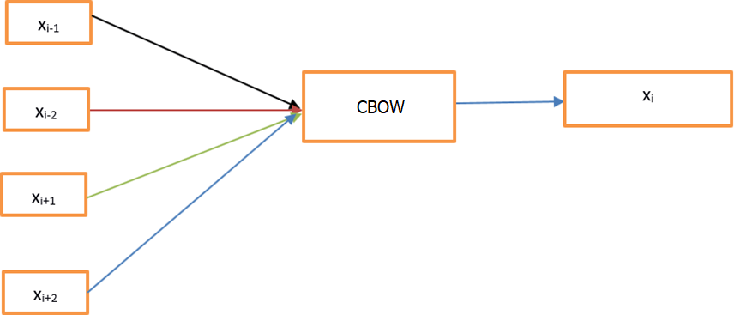
Continuous Bag of Words
The primary goal of the CBOW model is to predict a target word using its surrounding context words.
A prediction model (Neural Network) is trained to predict target word by surrounding words. Since the real output exists in the text the training is self-supervised.
Size of vectors are fixed (e.g., 100, 200, or 300 dimensions)
The context is treated as a "bag of words“, meaning the order of the words doesn't matter.

Slide 21
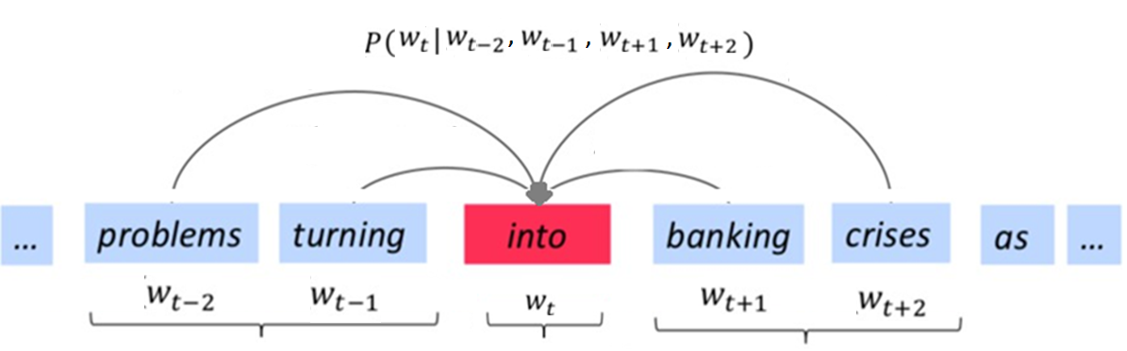
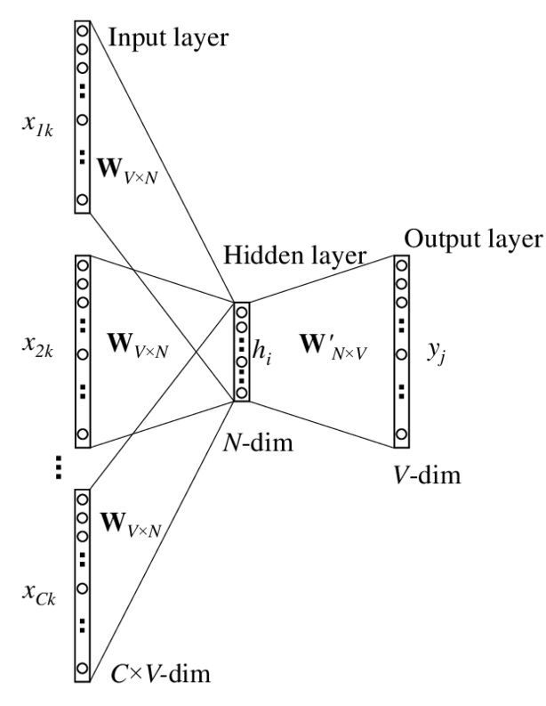
Continuous Bag of Words - Training
The model consists of a single hidden layer neural network
At the beginning of training, weights are usually initialized with small random values.
The model takes surrounding words of a target word (context words) from a corpus as input and uses them to predict the target word as output
One-hot encoding is used for word representation at the input and output layers
For each occurrence of a word in a text, backpropagation happens once to update weights slightly
The model is trained on a large corpus to learn meaning of the word in different contexts
After training, embeddings are the average of weights that connect the input layer to the hidden layer
N: Embedding size
V: Vocab size
C: Context Size

Slide 22
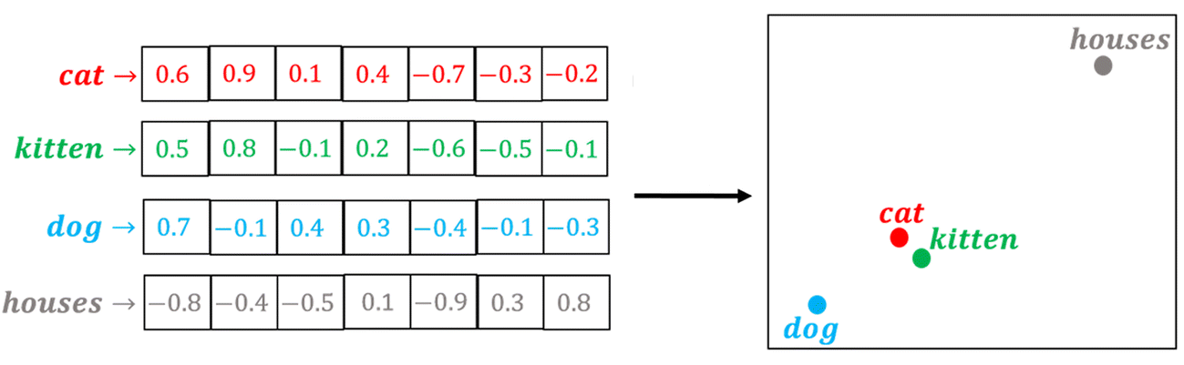
Mechanism of CBOW
In large corpus, words with similar meanings often appear in similar contexts, meaning they tend to have the same surrounding words(e.g., both words “cat" and “kitten“ appear with words like "pet," "fur," "meow," etc.)
Over many training iterations, their weights in the model become close
This allows to capture word relationships without explicit human intervention
The dimensions of these embeddings are not necessarily interpretable in human terms because they are learned automatically based on statistical patterns (e.g., the vector for "cat" might encode some information about pet, fur, etc., but these features are spread across multiple dimensions rather than being assigned to specific ones.)

Slide 23
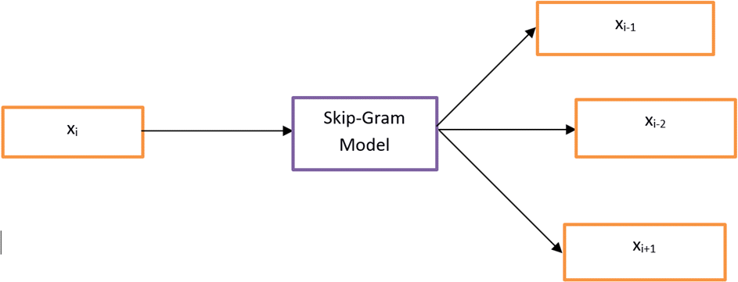
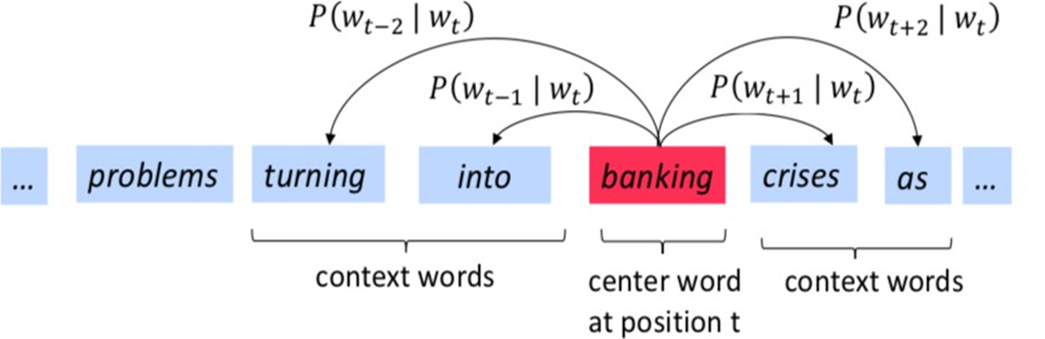
Skip-Gram
Using contextual meaning of a word, predicts possible surrounding words
A Neural Network is trained to predict surrounding words by target word

Slide 24
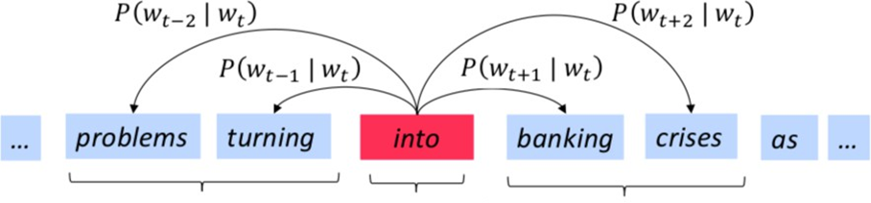
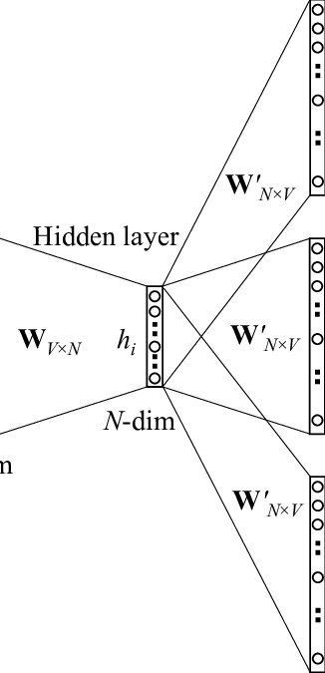
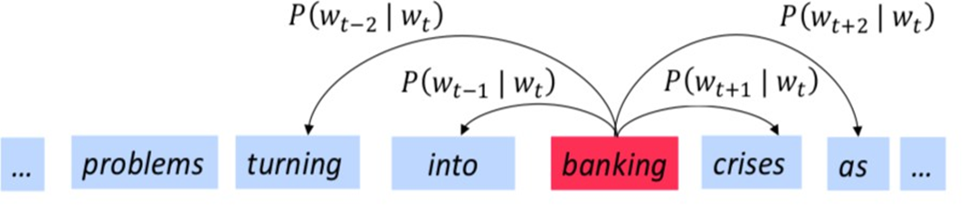
Skip-Gram Training
The model consists of a single hidden layer neural network.
At the beginning of training, weights are usually initialized with small random values.
The model takes a target word from a corpus as input and uses it to predict the words that appear within a certain window around it (context window) as outputs
One-hot encoding is used for word representation at the input and output layers
For each occurrence of a word in a text, backpropagation happens once to update weights slightly
The model is trained on a large corpus to learn meaning of the word in different contexts
After training, embeddings are the weights that connect the input layer to the hidden layer

Slide 25
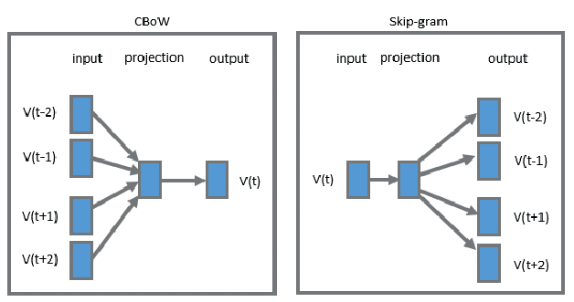
CBOW vs Skip-Gram
CBOW:
Generally, more efficient and faster to train. This is because it predicts one word (the target) from a set of context words, reducing the number of predictions per training instance.
Tends to perform better with frequent words. Produces smoother word embeddings because it uses several context words to predict target.
Skip-gram:
Slower to train because it predicts multiple context words for each target word, increasing the number of predictions required.
Performs better with rare words. Captures fine-grained semantics because it focuses on each word individually.

Slide 26
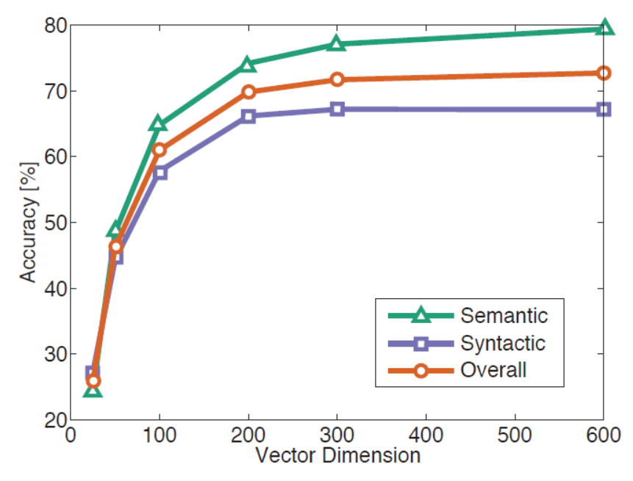
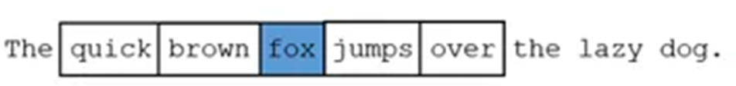
Hyper-parameters
A smaller window size (less than 5) focuses on capturing local context (short-range dependencies )
Larger window sizes (more than 10) capture a more extensive context. However, they may also introduce noise.
Smaller vector (Less than 100) sizes are less computationally intensive, but they might not capture rich semantic
Larger vector sizes (more than 300) can capture more features, but computationally expensive

Slide 27
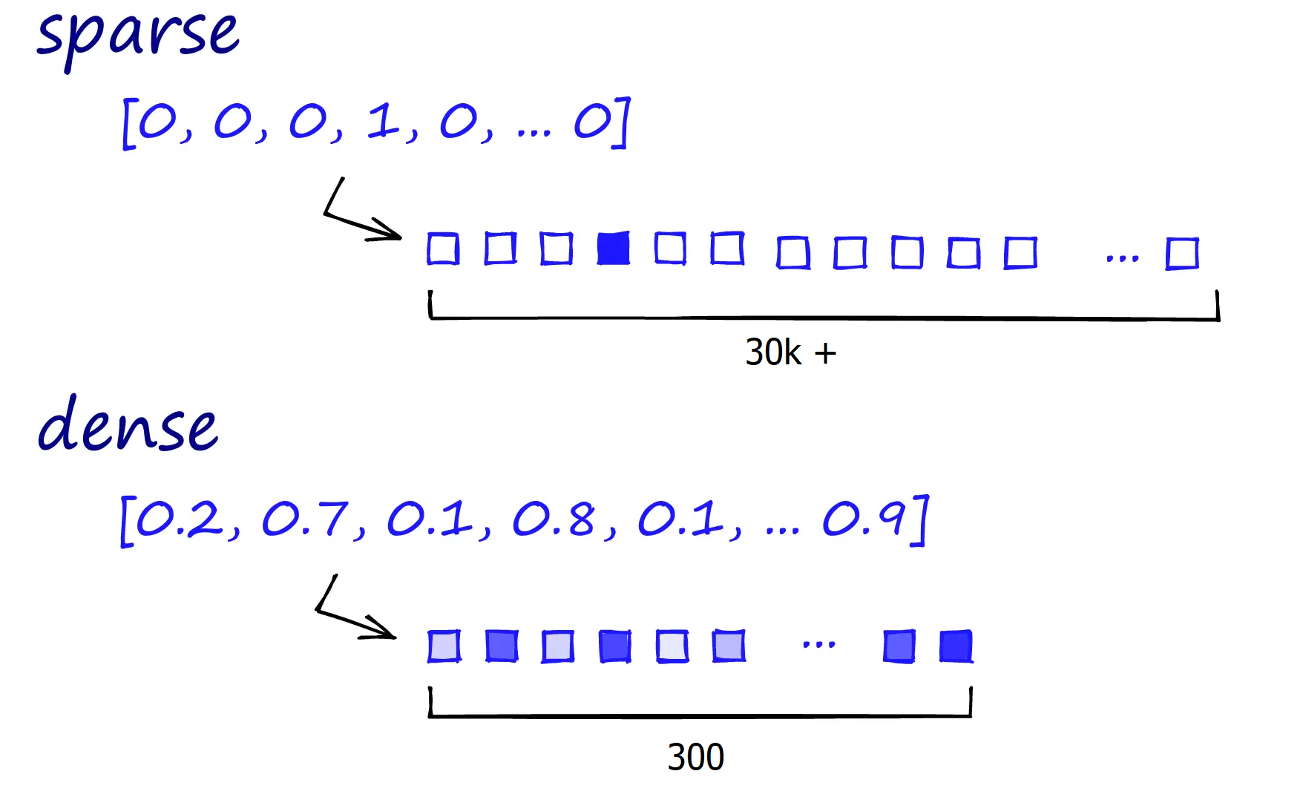
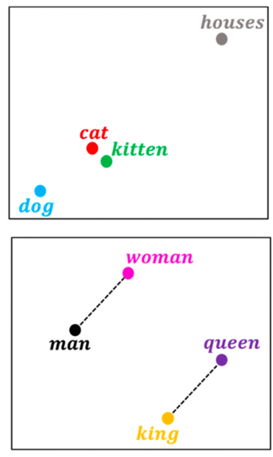
Word2Vec Advantages
Dense Vector:
Represents each word as a dense vector in a continuous vector space (e.g., 100 or 300) encode more information with less size comparing sparse vectors.
Semantic Similarity:
Words with similar meanings are mapped to nearby points in the vector space (e.g., cat and kitten)
Capture Relationships:
Captures distances between words ( e,g., difference between "king" and "queen" is similar to the difference between "man" and "woman.“)

Slide 28


Word2Vec Limitation
In Word2Vec word embeddings are applied in a context free manner
open a bank account on the river bank
[0.3, 0.2, -0.8, …]
One vector for each word
Problem: To Include contextual representation, we need different embeddings in different context:
[0.9, -0.2, 1.6, …]
[-1.9, -0.4, 0.1, …]
open a bank account
on the river bank

Slide 29
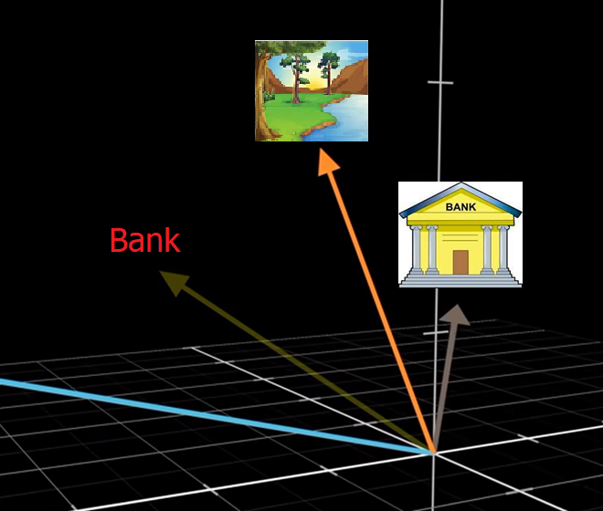
Contextual Representations of Words - Idea
Meaning of a word is different in various context
A general embedding is the average of embeddings of a word in different contexts
In different context we need to transform this general embedding
Problem: We need a mechanism to change embeddings based on context

Slide 30
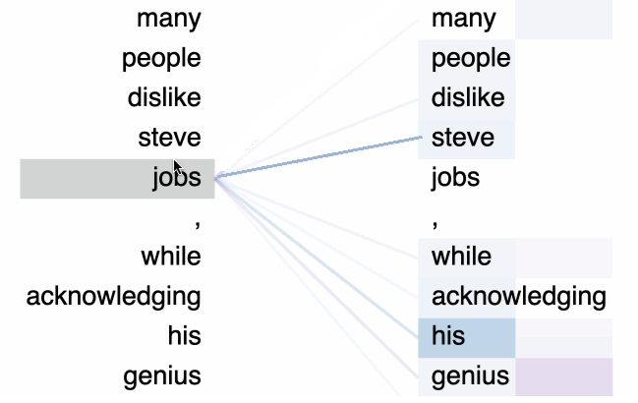
Attention - Idea
Idea: contextual meaning of a word can be understood by surrounding words
Query about contextual meaning of a word based on surrounding words in a text
Determine the relevance of other words regarding meaning of the word
Transform the word embedding by applying effect of relevant words
Process all the words in the text in the same way to extract contextual meanings
“jobs” queries about the context
“steve” is the most relevant for contextual meaning of “jobs”
“steve” attends in the meaning of “jobs” and transform it

Slide 31
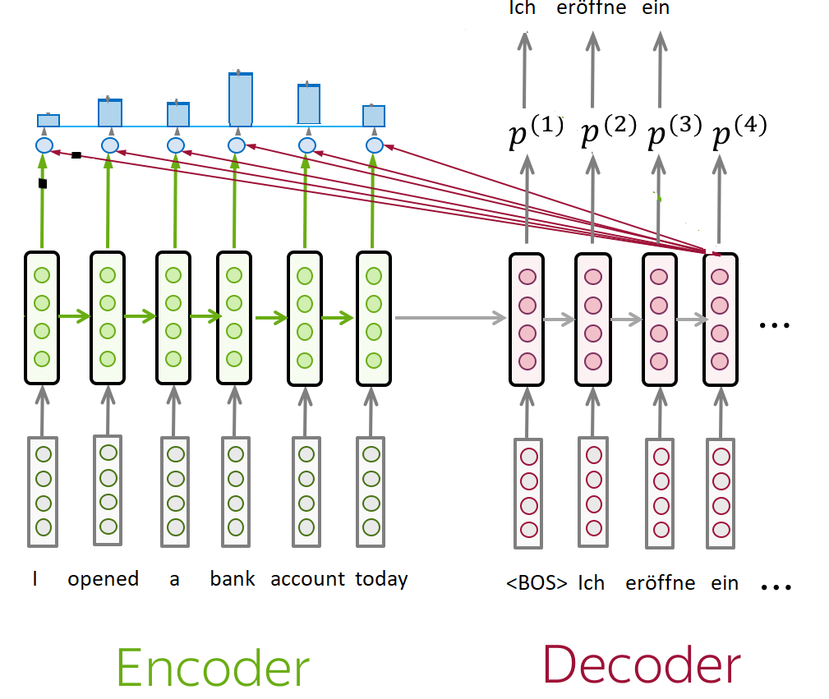
Attention in RNN
For generating token in each step of decoder, it queries about context
The relevant tokens for each step attend more in the context vector of that token
Computes weights (relevance) for context of tokens (hidden states) in encoder based on alignment with the context of decoder step (hidden state of decoder)
To compute relevance (weights), dot product is applied on context vectors
For generating a token in decoder, the weighted sum of all the encoder hidden states adds to context of decoder
I opened a bank account
I walked by the river bank

Slide 32
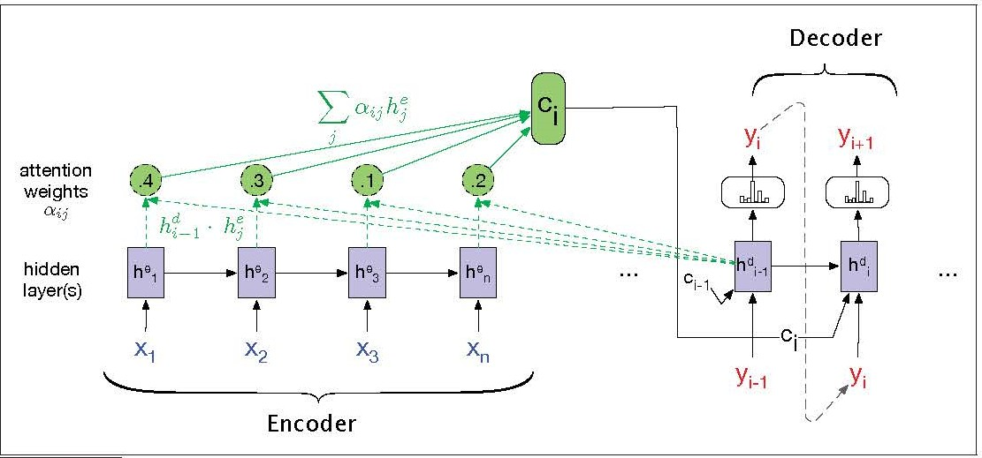
Attention in RNN - Challenges
RNN with attention need to compute the hidden state of token t before moving to token t+1 (sequential processing) and it is not scalable
For each token one context vector is created which can include context of most relevant tokens, but it contains limited information
Solution: We need a more scalable and comprehensive mechanism to transform each aspect of a word by other words

Slide 33
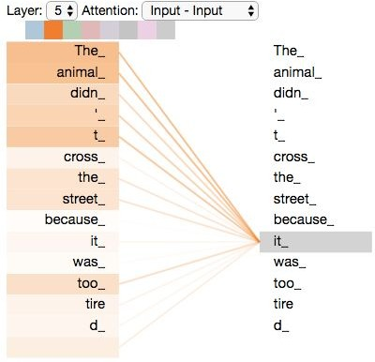
Self-Attention
Self-attention was introduced in 2017 in the paper “Attention is All You Need” which proposed the Transformer architecture:
Each words attends to every other words to add effect based on relevance
Despite the attention in RNNs this attention is not between encoder and decoder (just encoder side), so it is called self-attention
Unlike parallel nature of RNN attention, in self-attention each token attends to all tokens at the same time (parallel and scalable)
To extract context of each token a set of queries, keys and values are used (can be extended to cover different aspects)
jalammar
https://arxiv.org/pdf/1706.03762

Slide 34
Queries, Keys, and Values
We need to transform the embedding of each word based on surrounding words:
Extract different aspect (syntactic, semantic, etc.) of a word. (Query)
Find relevant words for that specific aspect. (Key for that Query)
Apply a transformation to the word based on relevant words (Value)
Example: I opened a bank account
Query about bank → Query1: What is the meaning of bank in this context?
Account is very relevant to the bank (Key to Query1)
Now the general embedding of bank needs to transform to embedding of bank in financial context using embedding of account (Value of transformation by Key)

Slide 35




Self-Attention Components
For each attention head each word (token) has three vectors of Query, Key and Value
Query and Keyes are like Question and Answers about different aspects of the word
Relevance: alignment of each key with the query (using dot product of key and query)
Value: Transform made by a word to embeddings of other words
Softmax: Normalizing results
queries keys
values
outputs
.
=
softmax
Inputs
Wq
A
Female
Monarch
Who
…
Wk
Wv

Slide 36
Attention - Intuitive example
Text: A female monarch who was a princess formerly …
What is the impact of other words on embedding of monarch in this context?
 | Gender | Political Rank | Political System | …
King | M | Top | Monarchy
Queen | F | Top | Monarchy
Monarch | - | Top | Monarchy
Princess | F | High | Monarchy
Female | F | - | -
Gender
E(King)= [2, 10, 1]
King
E(Queen)= [1, 10, 1]
E(Monarch)= [0, 10, 1]
Queen
E(Princess)= [1, 9, 1]
Monarch
E(Female)= [1, 0, 0]
Political Rank
Suppose that all queries, keys, and values are just focused on the gender feature:
Query : Query about Gender Key: Gender Related Information

Slide 37
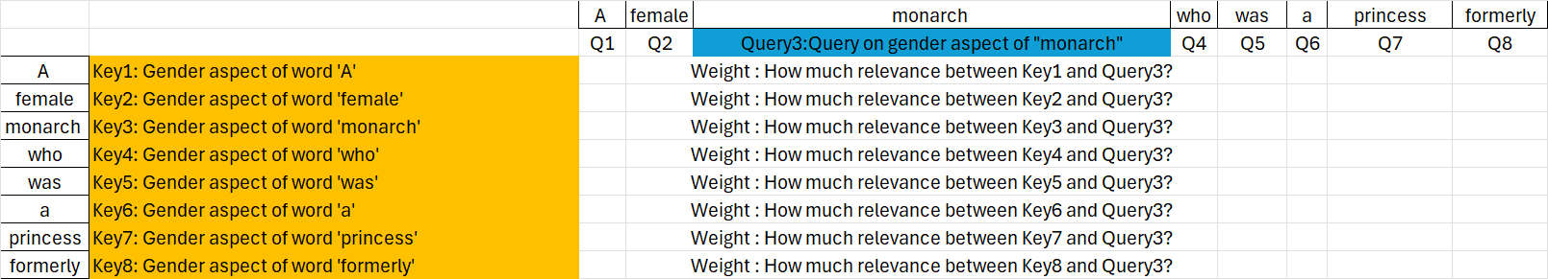
Attention - Intuitive example
In this simple example, effect of other words on monarch regarding one feature (gender) is considered.
In practice each set of query, key, and value contains more information about a word, however, it is focused on one aspect of a word (e.g., semantic)
In this intuitive example we simplified the Key and Query concepts

Slide 38
Attention - Intuitive example
Wk should extracts the gender attributes of the words describing monarch, if there is any
It means dot product by the Wk vector should change embedding in a way that the result vector be aligned with gender dimension and strip other embedding of the words not relevant to key
Gender, …
[0, 0, 0,..]
[1, 0, 0,..]
[0, 10, 1,..]
[0, 0, 0,..]
[0, 0, 0,..]
[0, 0, 0,..]
[1, 9, 1,..]
[0, 0, 0,..]
Wk
Key7
Wk
Key3
1 | 0 | 0
0 | 0 | 0
0 | 0 | 0
[1, 9, 1] * = [1, 0, 0]
[1, 0, 0] * = [1, 0, 0]
1 | 0 | 0
0 | 0 | 0
0 | 0 | 0
[0, 10, 1] * = [0, 0, 0]
Key2
1 | 0 | 0
0 | 0 | 0
0 | 0 | 0

Slide 39
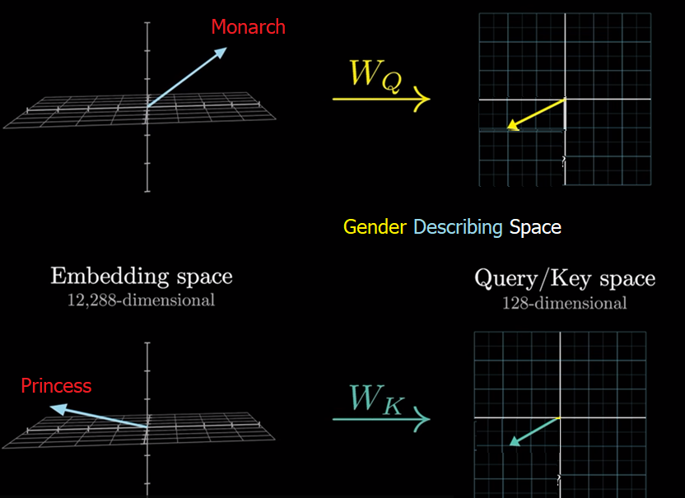
Self-Attention - Relevance
Wq and Wk vectors should act in a way that Query and Key will be in a same direction just if a key is relevant to query, so the dot product of them creates a big value showing the relevance of the words. And for cases which are not relevant dot product will be small
Wq and Wk should just extract those dimensions which are relevant (e.g., gender) which are smaller set of dimensions comparing dimensions of embeddings
Q.K will be high if a word is relevant to query

Slide 40
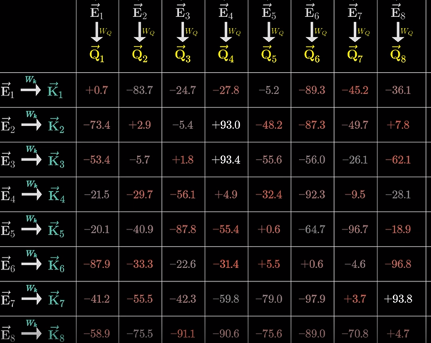
Self-Attention - Normalizing
Bigger dot product showing more relevance (similarity between vectors)
the values are divided by the square root of the dimension of the key vectors.
Then normalized using Softmax
If the dimension of the key vectors is large, the dot product can result in very large values. These large values can cause the softmax function to produce very sharp distributions. A sharp distribution means that the model might become overly confident in certain positions, effectively ignoring other relevant parts of the sequence.

Slide 41
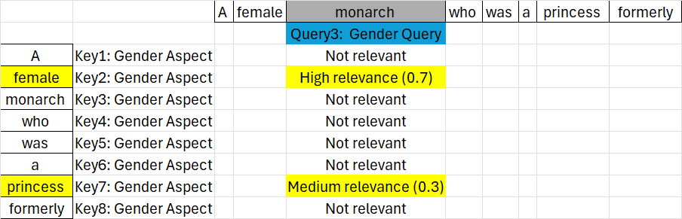
Attention - Intuitive example
The relevance is based on alignment of key and query (e.g., Key2 * Query3)
The results is normalized using Softmax

Slide 42
Attention - Intuitive example
We need also to add values that transform the vector of embeddings based on related dimensions (e.g., gender),therefore, the value vector is another parameter of the model
[0, 0, 0,..]
[1, 0, 0,..]
[0, 10, 1,..]
[0, 0, 0,..]
[0, 0, 0,..]
[0, 0, 0,..]
[1, 9, 1,..]
[0, 0, 0,..]
Based on relevance and value each word attend on embedding of the target word
Wv
Value7
1 | 0 | 0
0 | 0 | 0
0 | 0 | 0
[1, 9, 1] * = [1, 0, 0] → [1, 0, 0] * 0.3 = [0.3, 0, 0]
[1, 0, 0] * = [1, 0, 0] → [1, 0, 0] * 0.7 = [0.7, 0, 0]
1 | 0 | 0
0 | 0 | 0
0 | 0 | 0
Value2

Slide 43
Attention - Intuitive example
Embedding of target word will be transformed using total weighted values of other embeddings which reflect the context
 | Gender | Political Rank | Political System | …
King | M | Top | Monarchy
Queen | F | Top | Monarchy
Monarch | - | Top | Monarchy
Princess | F | High | Monarchy
Female | F | - | -
Gender
E(King)= [2, 10, 1]
King
E(Queen)= [1, 10, 1]
E(Monarch)= [0, 10, 1]
Queen
E(Princess)= [1, 9, 1]
Monarch
E(Female)= [1, 0, 0]
Political Rank
E(Monarch) + [0.7, 0, 0] + [0.3, 0, 0] = [0, 10, 1] + [1,0,0] = [1,10,1] = E(Queen)
Monarch in this context is equivalent to the concept of Queen

Slide 44
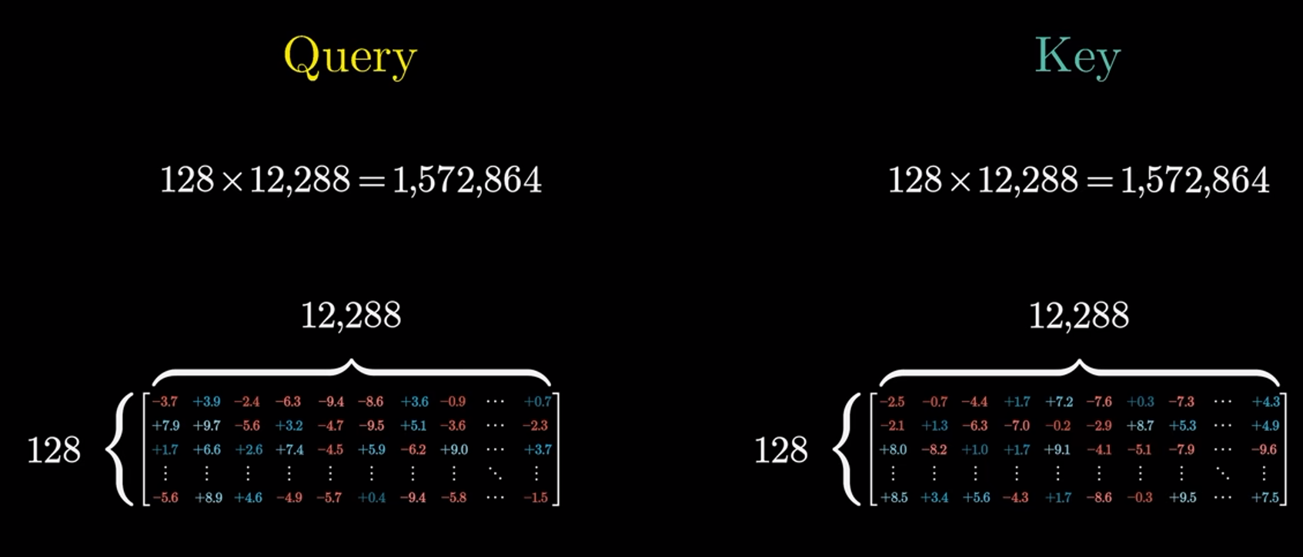
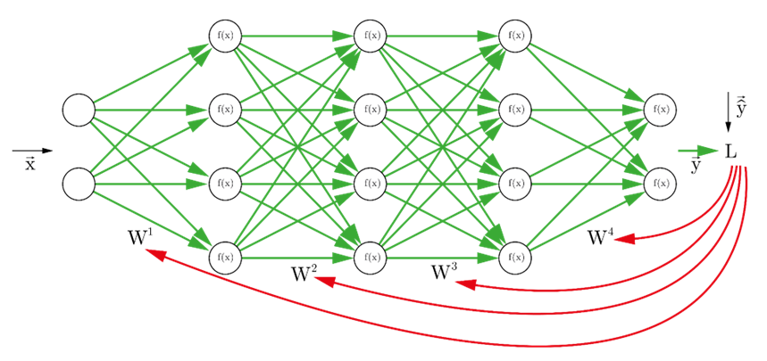
Learning Parameters
Wq, Wk, Wv are weights (learnable parameters) which will be adjusted during training process using back-propagation
Despite our intuitive example, Queries, Keyes ,and Values are not interpretable easily and contain complex concepts and meanings
Neural networks are blackbox models. We cannot easily interpret queries, keys and context inside self-attention layer

Slide 45
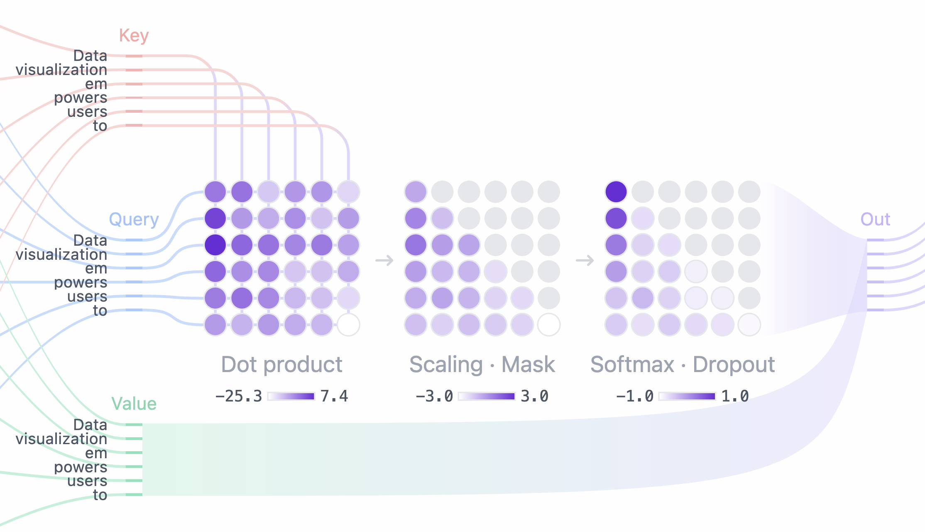
Self-Attention in Inference - Steps
The input is typically a sequence of initial word embeddings (using general embeddings), where each token in the sequence is represented as a vector.
For each input embedding, three different vectors are extracted: Query (Q), Key (K), and Value (V). These vectors are computed by three learned weight matrices (Wq, Wk, Wv).
The alignment(relevance) between the Query vector of a token and the Key vectors of other tokens in the sequence is computed using a dot product for each pair.
The similarity scores are normalized, which converts them into a set of attention weights that sum to 1.
The output for each token is computed as a weighted sum of the Value vectors, where the weights are the attention weights obtained from the previous step.
The result is a new set of embeddings where each embeddings include a weighted combination of all the input embeddings to capture the context
E(Monarch) ← E(Monarch) + 0.3 * V (Princess) + 0.7 * V (Female)

Slide 46
Role of Self-Attention in Semantic Analysis
Lexical Ambiguity: Self-attention plays a crucial role in disambiguating word meanings in different contexts since it adds contextual embedding to general embeddings
Referential Ambiguity: A word could refer to multiple entities but in self-attention the contextual information of the most relevant words will be added to the token.
bank
[0.3, 0.2, -0.8, …]
[0.9, -0.2, 1.6, …]
[-1.9, -0.4, 0.1, …]
open a bank account
on the river bank
The animal didn’t cross, because it was too tired

Slide 47
Self-Attention in NLP Phases
Handling NLP Phases:
Self-attention can address semantic analysis
In addition to semantic analysis, NLP contains other aspects such as syntactic, pragmatic analysis , etc.
Problem:
A single attention head = one set of WQ,WK,WV
WQ,WK,WV typically focused in one kind of relationship or pattern (e.g., semantic).
Solution: Multiple queries, keys and values are required for each token

Slide 48
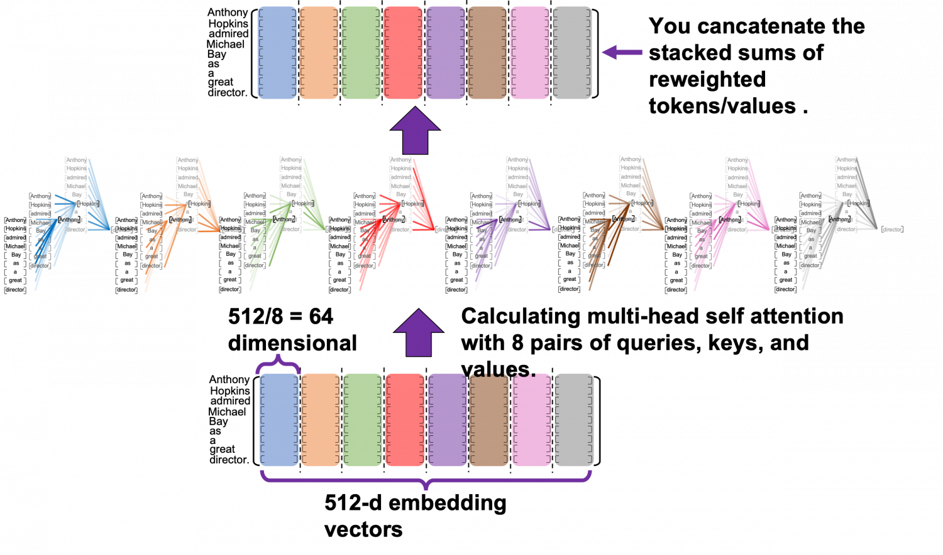
Pragmatic Analysis
In one attention head, all queries generally focus on the same aspect of meaning across different tokens
For pragmatic analysis of a text, many other aspects of a text should be extracted:
Meaning of content regarding type of content (e.g. scientific, story , ..)
Meaning of content regarding topic of content
etc.
Example: Sentence 1 : Prince…UK…Harry → Type: News → News about prince Harry
Sentence 2 : Prince…Magic…Harry → Type: Story → Story about Harry Potter
Single-head attention focuses on one specific aspect (one set of Wq,Wk,Wv)
To extract information on several aspects of a token, we need several sets of Q,K,V
Each sets of Q,K,V of a token can focus on one aspect (e.g., syntactic , semantics, etc.)
Understanding multiple contextual clues can facilitate pragmatic analysis

Slide 49
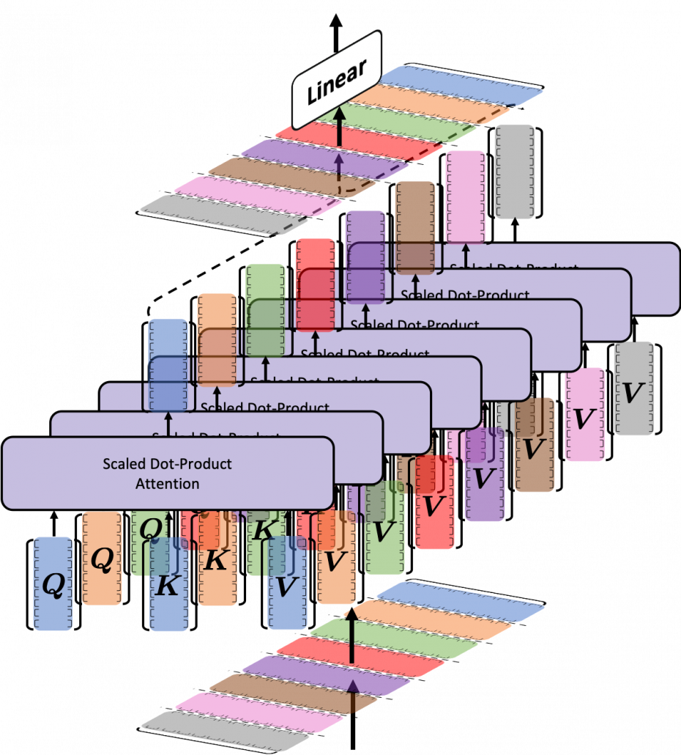
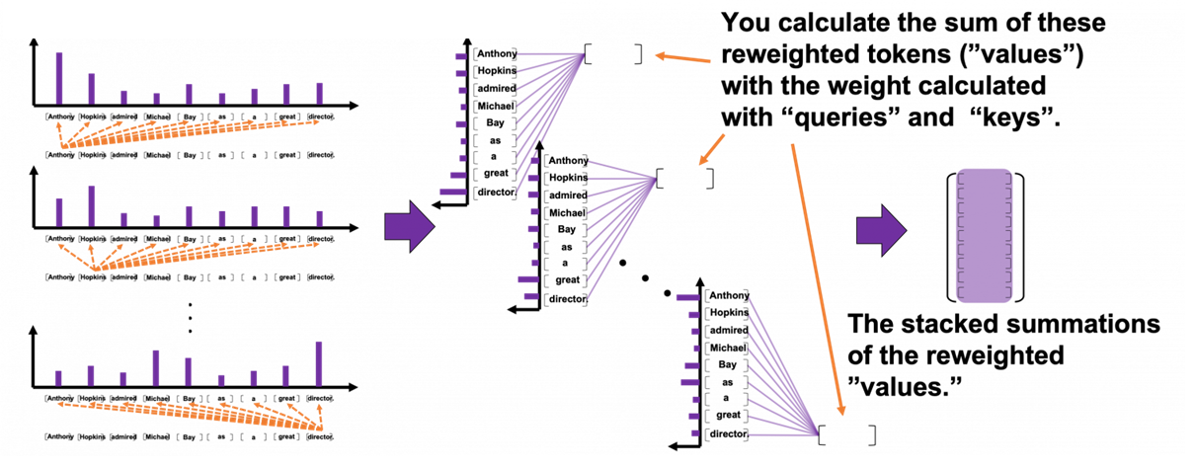
Multi-Headed Attention
Capturing different aspects of a token can be done multiple times in parallel
Several attention heads in a block (Multi-head attention)
Each attention head is focused on one aspect
Need to combine the resulting output sums
GPT-3 has 96 and Deepseek R1 has 128 attention heads.
Multi- head Attention can be handled in parallel

Slide 50
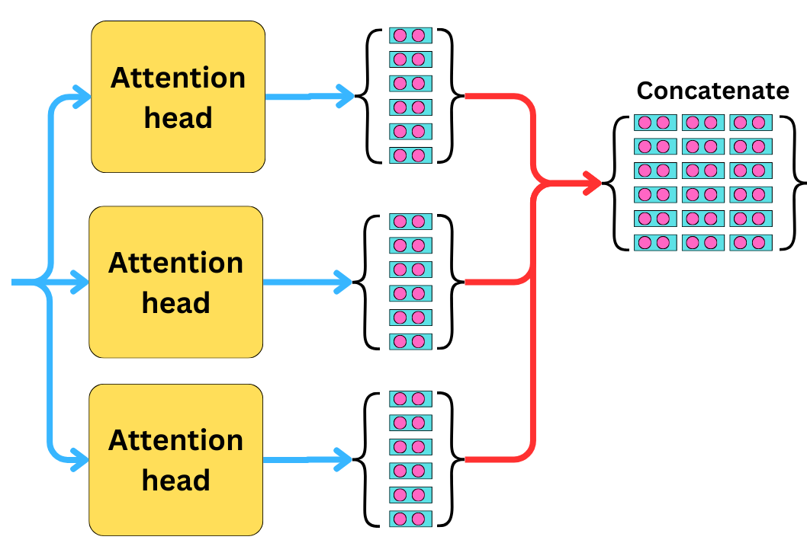
Dimension Reduction in Multi-head Attention
in multi-head attention, each head typically focuses on a subset of the dimensions of the embedding.
This allows the model to capture different types of relationships in the data while keeping the overall computational cost manageable.
Example:
d model​ = 12288 (input embedding size),
ℎ = 96 (number of heads),
𝑑𝑘=𝑑𝑚𝑜𝑑𝑒𝑙/ℎ = 128 (embedding size per head).
Embedding

Slide 51

Syntactic Analysis
Some Attention heads often learn to specialize in detecting grammatical structure.
Wq, Wk, and Wv of these heads can be used to extract syntactic structure of the sentence:
Query : Is there an adjective (describes this noun)?
Key : This is an adjective (which describes the noun)
Query : Is there a verb (showing the act of this subject)?
Key : This is a verb (showing the act of the subject)
A query vector from a word reflects what that word needs to know from the rest of the sentence about one aspect
The key vectors from other words reflect what those words offer in terms of that aspect.

Slide 52

Specialty of Heads
Some studies shows that many attention heads specialize in particular syntactic or semantic roles (e.g., head A might focus on verb- subject relationship and head B might focus to noun-adjectives relationships)
In training, if the model finds that learning a specific relationship in one head reduces loss (e.g., improves predictions), then: That head's WQ,WK, and WV will evolve to focus on that relationship / pattern.
But in practice there is also overlap and redundancy. A head also might have a minor impact on other aspects other than the focused one
Attention distribution over Part-of-Speech (POS) tags for the top three specialized syntactic decoder heads. Large peaks appear at nouns and punctuation.
https://arxiv.org/pdf/1911.03898

Slide 53

Redundancy in Attention Heads
Problem: Even with different subspaces, redundancy can still occur (Multiple heads focus on similar aspects)
Solutions:
Diversity-Promoting Regularization: add a penalty to loss function which penalizes similarity between head outputs (e.g., using Cosine Similarity)
Attention Dropout: Randomly drop individual attention heads during training (similar to dropout in NN).Forces heads to become individually useful, reducing over-reliance on a few heads.
Pruning: Train with all heads, but prune redundant heads based on similarity to other heads or low contribution to final output of the model
Gating: Add a controller layer that learns to route different information types to different heads (similar idea to MoE)
https://arxiv.org/pdf/1905.09418

Slide 54


Multi-Layer Attention - Discourse Integration
One refers to road
Problem: Capturing dependencies between sentences that might be far apart is critical for discourse integration
Solution:
Stacking multiple layers (Multi-layer Attention) allows the model to build a hierarchical understanding of the text
Early layers focus on simple and syntactic relationships, while deeper layers capture higher-level semantics and more complex and abstract relations
GPT 3 has 96 attention layers

Slide 55

Specialty of Layers
One research studied BERT layer by layer to determine where BERT encodes different types of information:
Lower layers (closer to input): contain syntactic information (e.g., POS tags, dependency structure).
Middle layers: show entity-level information (like NER, semantic roles).
Upper layers: capture deeper semantics, and relationships including coreference resolution
Hierarchical Encoding Emerges Naturally: BERT, despite not being explicitly programmed for these tasks, learns them in order, stacking them from low-level syntax to high-level semantics.
https://aclanthology.org/P19-1452.pdf

Slide 56

Self-Attention vs RNN
In RNN, information is conveyed by the hidden state vector which acts as a bottleneck
Self-attention captures different aspects of information and long-range dependencies that cannot be captured by RNN-based attention
Despite the sequential processing in RNNs, self-attention is order agnostic

Slide 57

Order Agnostic vs Sequential - Example
In sequential approach previous words attend in the context of the next word
In an order agnostic approach every words attend the contextual meaning of every other words
Example: Meaning of “bank” in the following context:
“I got to the west bank. It is a region in the west side of a river.”
RNN : Sequential processing doesn't work well since there is no indication of the meaning of the bank in the first sentence
Self Attention: Transforms general embedding of “Bank” word regrading all other words in the context window

Slide 58

Long-Range Dependencies - Context Window
The context window refers to the maximum number of tokens that the model can consider simultaneously in its attention mechanism
It defines the scope within which the self-attention mechanism can operate.
BERT: Typically uses a fixed context window size of 512 tokens
Standard GPT-4 : Uses a fixed context window size of 8192 tokens
GPT-4 with Extended Context Version: Up to 32,768 tokens
DeepSeek-R1: Offers a context window of 131,072 token
Claude Opus 4: Up to 200K tokens
Grok 4 : Up to 256k tokens
GPT 5: Up to 400K tokens
Gemini 2.5 Pro: Up to 1M tokens

Slide 59
General Embeddings using LLMs – Training Phase
Token embeddings in LLMs are trainable parameters
During training, the initial values of embeddings are randomly initialized
The model is trained on huge textual data (pre-training)
During training on each training text, each input embedding related to that text is updated using backpropagation in a way that it can represent the meaning of the token in self-attention mechanism efficiently
By the end of training, each embedding reflects a general representation based on all contexts it appeared in (e.g., bank reflects both financial and river contexts)
Randomly initialize embedding matrix E (all tokens)
For each training sample:
Tokenize → token IDs
For each token ID:
Look up the embedding from E
Process embeddings in the LLM using self-attention and produce outputs
During backprop, update embeddings (and other params) to reduce loss

Slide 60

Processing Queries using LLM – Inference Phase
A user query is first tokenized using a tokenizer (e.g. , using PBE) and each token is mapped to an integer id from the vocabulary
Tokens are converted to embeddings based on general learned embeddings from training using an embedding lookup matrix (id represents a row in the matrix)
The embedding lookup is a matrix of size: Vocab size × Embedding dimension
The input sequence of embeddings are processed using the self attention mechanism and other sections inside the transformer block
The output is a sequence of embeddings, each corresponding to an input token, presenting the contextual meaning of that token
embedding_layer = Embedding(50257, 12288) # vocab=50k, dim=12288 vector = embedding_layer(token_id) # one row in the matrix: [1, 12288]

Slide 61
Order of Words in NLP Tasks
Without position of words, language models would lose the ability to distinguish the arrangement of tokens, leading to incorrect or poor text generation.
Relative and absolute positions of tokens in a sequence, allowing the model to understand their order.
Problem: Self-attention is order agnostic. it needs a mechanism to add positions
Example: Same words with a different order may have a different meaning:
Sentence1: King likes the queen
Vs.
Sentence2: Queen likes the king

Slide 62

Positional Embedding
Positional embedding (PE) is a vector that represents position of each token
For each position in a sequence, a PE value is added to corresponding word embedding
Using PE, the model can learn the position and order of tokens
PE can be a fixed function that produces unique values for each position (e.g., sine and cosine), or a set of learnable parameters, as used in most LLMs like GPT new series.
Some models use Rotary Positional Embeddings to encode position in self-attention
Even though that the size of PE and word embedding is the same, usually the magnitude of the word embedding is larger.

Slide 63

Different Types of Embeddings
Token Embeddings: These are the embeddings corresponding to each word (or subword token) in the input sequence.
Position Embeddings: These embeddings indicate the position of each token within the sequence, allowing to understand the order of the tokens.
Segment Embeddings: These embeddings indicate which sentence (or segment) each token belongs to (in some models like BERT)
Example:
For a pair of sentences like “my dog is cute." and “he likes playing.", the input would include:
Token Embeddings: Vector representations of each token like “my", “dog", “is", etc.
Position Embeddings: Indicating the position of each token in the sequence.
Segment Embeddings:
All tokens from " my dog is cute." would get a Segment A embedding.
All tokens from " he likes playing." would get a Segment B embedding.

Slide 64

LLM vs Word2vec
Contextual Understanding:
LLM can capture the meaning of each word in different contexts.
Word2vec is not capable to capture contextual meaning of the words so that it generates static embeddings only.
Out-of-Vocabulary Handling:
LLM can use sub-word tokens which effectively handle out-of-vocabulary (OOV) words
Word2vec doesn’t has any sub-word tokenization feature so, it can’t handle OOV effectively.

Slide 65

Assessment of Embedding Model
By decoding vector embeddings, it is possible to evaluate performance of the embedding model (E.g., if words like "king" and "queen" are close together in the vector space, it suggests that the model understands their semantic relationship)
Visualizing:
When visualized, embeddings where semantically similar is near together:
Principal Component Analysis (PCA)
Linear Discriminant Analysis (LDA)
Detecting Near Embeddings:
To detect near embeddings, a similarity measure is typically used to compare the similarity between vectors.

Slide 66



Detecting Near Embeddings
Cosine Similarity: Measures the cosine of the angle between two vectors. It's widely used in NLP since it emphasizes the direction of the vectors.
Embedding Clustering
Another approach for detecting near embeddings involves clustering algorithms like K-means ​.
Embeddings where semantically similar form a cluster
Cosine similarity is the normalized dot product:

Slide 67

Debiasing Embeddings
Debiasing embeddings refers to techniques used to reduce or eliminate bias in word embeddings or contextualized embeddings produced by large language models (LLMs).
Word embeddings often capture societal biases, such as gender, racial, and cultural stereotypes
Common Debiasing Techniques:
Hard Debiasing
Soft Debiasing

Slide 68

Hard Debiasing
Goal: Remove bias by projecting the embeddings to a subspace where the biased information (e.g., gender bias) is removed.
Method: First, identify a "bias subspace" (e.g., the direction corresponding to gender in the embedding space). Then, neutral words (e.g., "doctor," "nurse") are projected onto a plane orthogonal to this bias subspace, effectively eliminating the bias.
Removing bias entirely can sometimes result in a loss of important semantic information

Slide 69

Soft Debiasing
Rather than completely eliminating bias, soft debiasing aims to reduce bias while preserving as much information as possible.
Similar to hard debiasing but instead of entirely removing the bias component, soft debiasing involves partially reducing its impact to maintain semantic richness while still reducing bias.
During training, sentences or phrases that reflect biased assumptions are rephrased to counter the bias. For example, for "he is a doctor" from the training data, it would provide an augmented example like "she is a doctor" to balance the gender association.

Slide 70
Future Directions in LLM Embeddings
Efficient Embedding Techniques: Developing techniques that balance precision with computational efficiency. This includes exploring methods to reduce the size of embeddings without compromising their quality.
Domain-Specific Embeddings: Developing embeddings tailored to specific industries or applications. For example, embeddings designed for medical data can capture the unique characteristics and relationships of medical terminology, improving the performance of models in healthcare applications.
Multi-Modal Embeddings: Vector representations that integrate information from multiple modalities, such as text, images, audio, and video. These embeddings aim to create a unified representation that captures semantic relationships across different types of data.

Slide 71

Multi-Modal Embedding
Uni-modal Embeddings:
Generated from a single type of input data (e.g., text), capturing the semantic context within that modality.
Uni-modal embeddings are used in tasks specific to one type of data.
Multi-modal Embeddings:
Generated same vector space from multiple types of input data (e.g., text and images), capturing the relationships and interactions across different modalities.
Multi-modal embeddings are crucial for tasks that require understanding the interplay between different types of data. For instance, in a video with subtitles, multi-modal embeddings can help the model understand the relationship between the visual content and the accompanying text.
Text + Images (CLIP)

Slide 72
Assignment 4
Train Word2Vec models on text8 data using all combinations of the following hyper-parameters (16 models):
win_size = [3,7,13,25]
vector_size = [20,70,100,300]
For each model, perform the following tasks:
Define Transform as Embedding('man') - Embedding( 'woman')
Use similar_by_vector method to find the most similar embedding to (Transform + Embedding('daughter’))
Cluster the following embeddings created by the model using K-means (K=3):
'yen', 'yuan', 'spain', 'brazil', 'africa', 'asia’
By assessment of the results of transformation and clustering, choose the best set of hyper-parameters to capture relationships between the concepts.

