Slide 1
Advanced Techniques with Large Language Models Lecture 5
Northeastern University
College of Engineering
Multidisciplinary Graduate Engineering Department
INFO 7374 – Fall 2025
Instructor: Abdolreza Mosaddegh

Slide 2
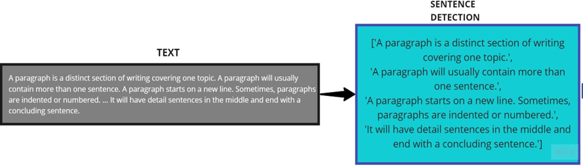
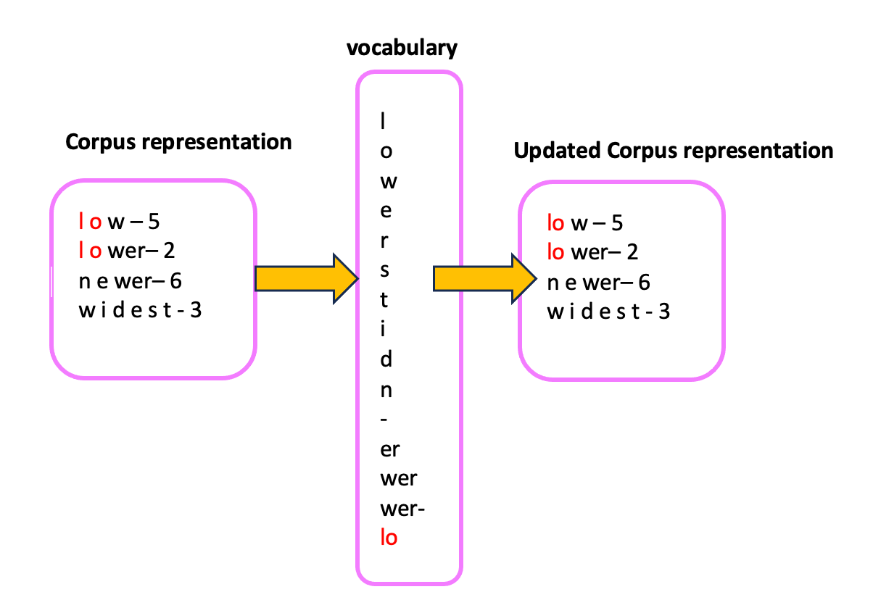
NLP by Neural Networks
NLP primarily focuses on processing textual data
The first step in NLP is to break-down text to processable meaningful units
Tokenization methods(e.g., BPE) can be used to convert textual data to tokens
Tokens needs to be prepared to be processed by neural networks
Tokenization
(e.g., BPE)

Slide 3
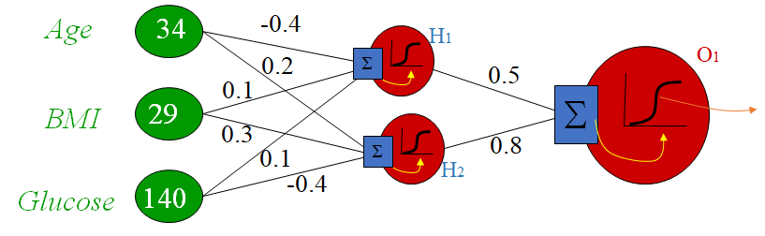
Requirements of Neural Networks
Problem:
We need to convert tokens to numbers to process them with neural networks
These numbers should present meanings of the words
1,2: Needs to encode different aspects (dimensions) of words with numbers
Neural networks process features represented by numbers
Describing King: The top rank person (male) in a monarchy political system
 | Gender | Political Rank | Political System | …
King | M | Top | Monarchy
 | 2 | 10 | 1
King is encoded using: [2, 10, 1]

Slide 4
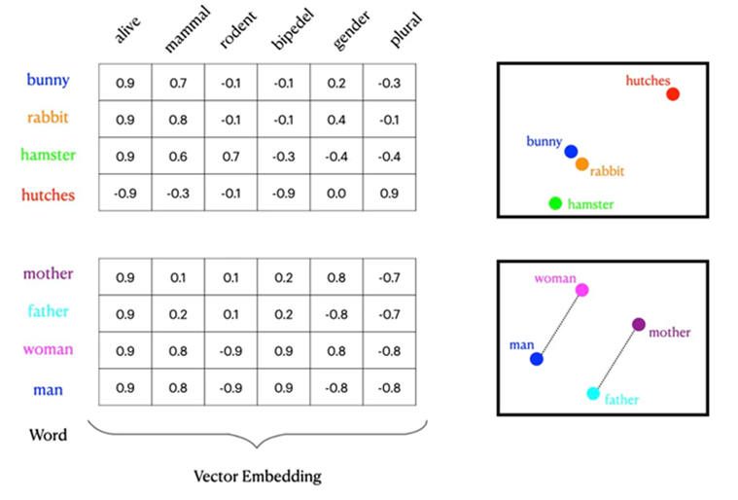
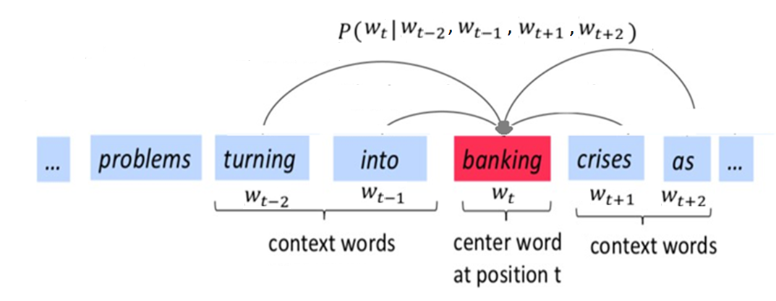
Encoding Tokens Using Vectors
Embeddings (vectors) represent the meaning of a word/text:
Vectors covers different aspects of a word (e.g., 12288 dimensions in GPT3)
Vectors represent similarities between concepts
Vectors can be transformed to different embeddings
Vectors can be scaled to represent different types of data (text, image, etc. )
Word2vec is a technique for obtaining meaningful vector representations of words using surrounding words

Slide 5
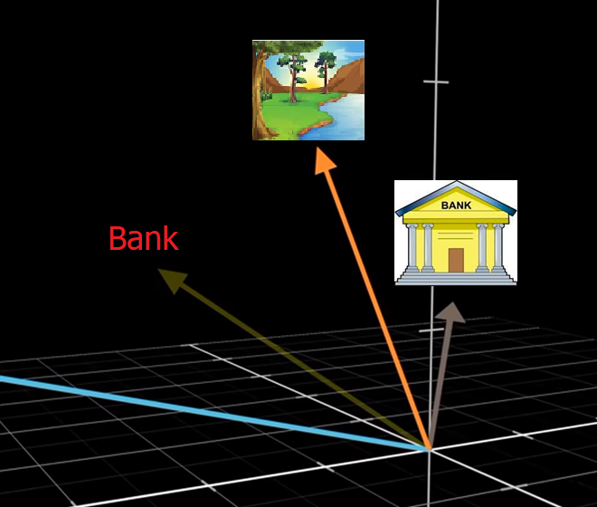
Contextual Meaning
Problem: Meaning of words can be different in various contexts (e.g., bank)
Solution: Transforms embedding of a word based on surrounding words (context):
Use general embedding of a word as input
Extract the semantic aspect of a word. (Query)
Extract the sematic aspect from surrounding words (Keys)
Find relevance of other words ( similarity of Keys with Query)
Apply a transformation to the general embedding using relevant words (Value)
bank
[0.3, 0.2, -0.8, …]
[0.9, -0.2, 1.6, …]
[-1.9, -0.4, 0.1, …]
open a bank account
on the river bank

Slide 6

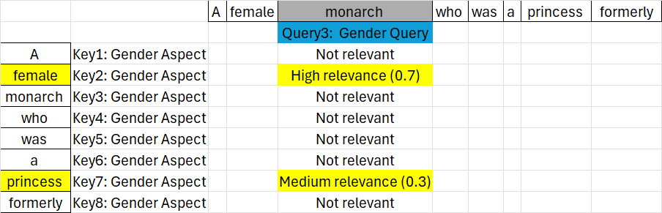
Self-Attention (Single-Head)
Self-attention mechanism is introduced in 2017:
One set of weights (Wk, Wq, and Wv) is trained to extract keys, queries, and values of all tokens, therefore, it is focused on one aspect (e.g., semantic)
A separate query, key, and value is extracted for each token
Relevance of keys to each query is calculated using dot product then normalized
Values of relevant words transform the embedding of each word in context window
E(monarch) ← E(monarch) + 0.7 V(female) + 0.3V(princess)
Problem: A single head focuses only on a specific relationship (e.g., semantic), but in NLP we also need other aspects (e.g., syntactic)

Slide 7
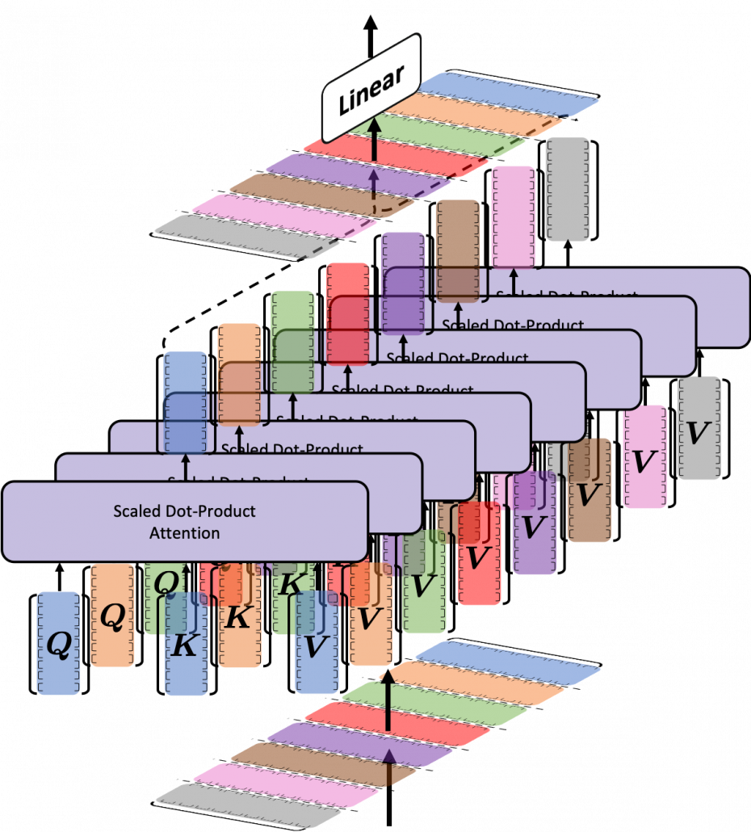
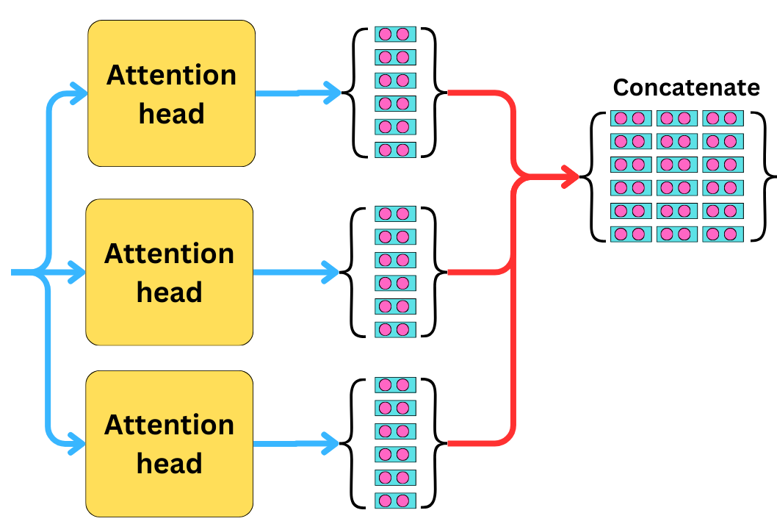
Multi-Head Attention
Solution: capturing various aspects using multiple attention heads:
Each head is focused on one specific aspect (e.g., syntactic, semantic, etc.)
Each head extracts a different set of Q, K, and V vectors for each word
Each head processes a subset of dimensions then results of heads are concatenated
Each head handles the processing independently and in parallel
GPT3:
dimensions ​ = 12288 (input embedding size),
heads = 96,
𝑑𝑘= dimensions /heads = 128 (embedding size per head).
Embedding

Slide 8
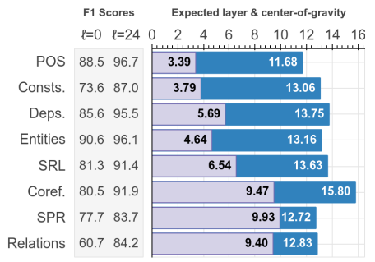
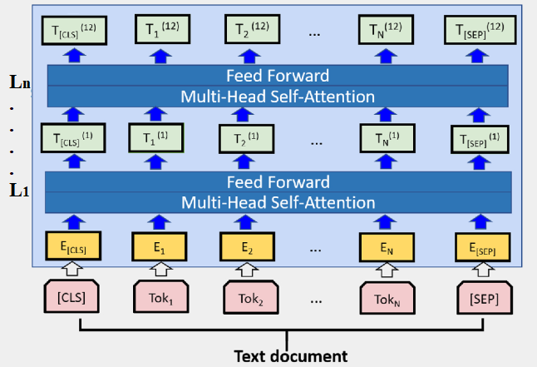
Multi-Layer Attention
Problem: Capturing long-range dependencies (e.g., in discourse integration), complex hierarchical relationships, and abstract concepts cannot be handled by one layer
Solution:
Stacking allows the model to build a hierarchical understanding of features
Early layers focus on simple and syntactic relationships (e.g., noun / adjective)
Middle layers focus on named entity recognition and word disambiguation
Deeper layers capture abstract concepts and long-range relationships
GPT 3 has 96 attention layers
https://aclanthology.org/P19-1452.pdf

Slide 9
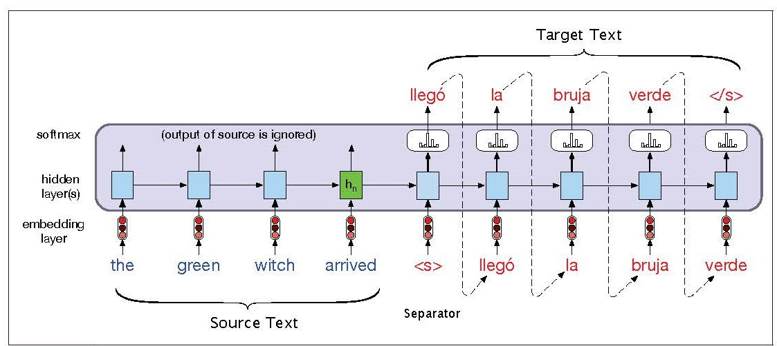
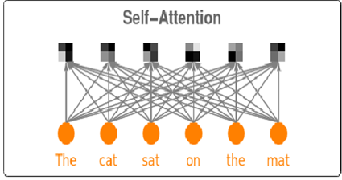
Problems of Self-Attention for NLP
Arrangement of words in NLP tasks
Self-Attention is order-invariant
Arrangement of words is important in many NLP tasks (e.g., in language understanding)
Lack of non-linearities
In Self-Attention linear combination of other embeddings attends in each embedding
Most real-world relations are non-linear
Autoregressive text generation
In generation tasks in decoder (e.g., text generation), the model doesn’t look at the future parts of a sequence, but self-attention requires the entire sequence

Slide 10
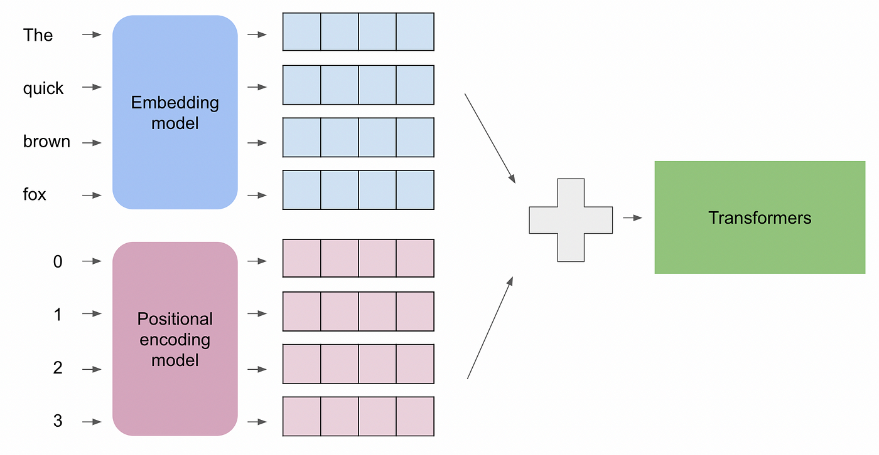
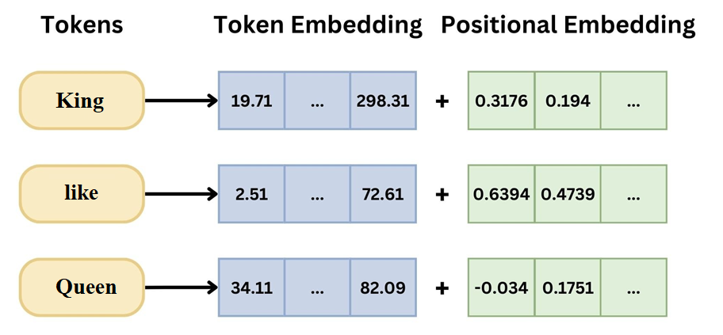
Word Positions using Positional Embedding
Positional embedding (PE) is a vector that represents position of each token
For each position in a sequence, a PE value is added to corresponding word embedding
Using PE, the model can learn the position and order of tokens
Typically, PE is a set of parameters learned during training
With enough training, the model learns meaningfully different positional embeddings

Slide 11
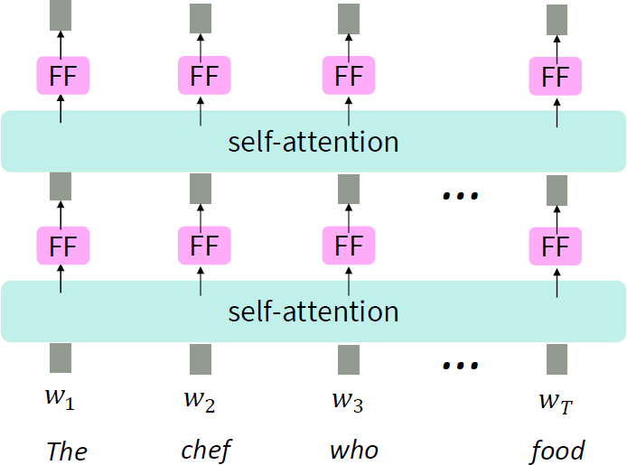
Combine Self-Attention with Nonlinearity
Vanilla self-attention
In Self-Attention linear combination of other embeddings attends in each embedding
Most real-world relationships are non-linear
Solution:
Add a Feed Forward Neural Network contains non-linear activation function
Example of linear combination:
E(monarch) ← E(monarch) + 0.7 V(female) + 0.3V(princess)
Each FF typically consists of two fully connected layers one layer as hidden layer with activation and output layer without activation:
FFN(x)=GELU(xW1+b1)W2+b2
In a dense Transformer (not MoE), the feed-forward (FF) layer parameters are the same for all token within one block

Slide 12
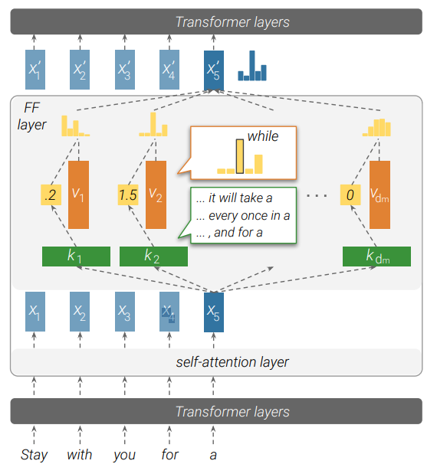
Feed-Froward Layer
After each self-attention block, all embeddings are processed separately using an FF network in parallel (matrix operation)
The first transformation expands the dimensionality of the input (e.g., 4 to 8 times) to decode complex features in embeddings
The second transformation reduces the dimensionality back to the original size (encodes features in embedding)
FF layer usually has about twice parameters as the entire multi-head attention block (majority of parameters in transformers)
Due to huge number of parameters and non-linear nature (like real-world relationships), most factual info is memorized in FF
Some studies show FF layer is like a key–value memory system (input tokens as query, W1 as key, W2 as value, and activation as similarity matching).
k2 in is triggered by inputs that describe a period of time and end with “a”. the corresponding value v2 represents a distribution that puts most of its probability mass on the word “while”
https://arxiv.org/pdf/2012.14913

Slide 13
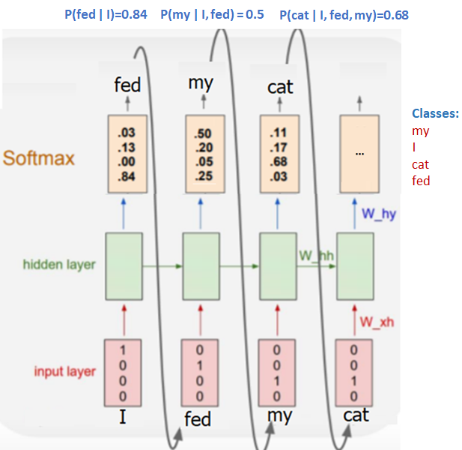
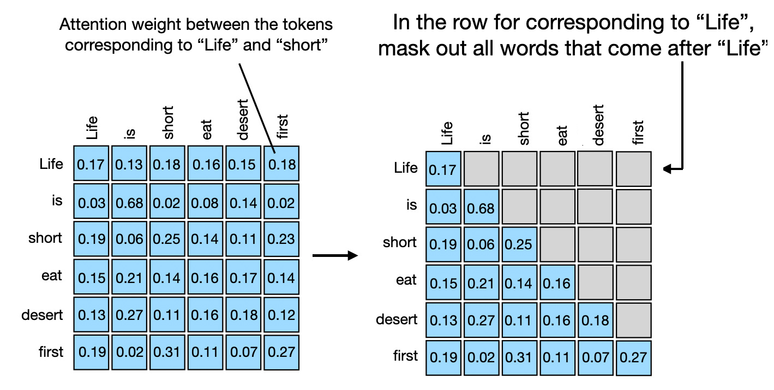
Masked Attention for Text Generation
In autoregressive text generation, the decoder model generates one token at a time by considering previous tokens. During training, the model should not look ahead at future tokens when making predictions about the current token:
A mask is applied to the attention mechanism, ensuring that the model only attends to previous tokens, but not any future ones.
To realize mask, a matrix with very large negative scores for future token positions is added to relevance scores, preventing them from attending to other tokens (mask).

Slide 14
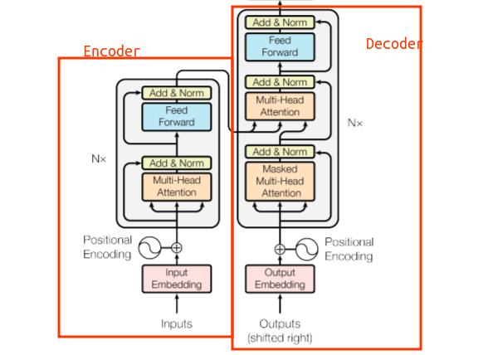
A Transformer Architecture
The Transformer architecture is a deep learning model
It introduced in the paper “Attention is All You Need” (Vaswani et al. in 2017).
It revolutionized natural language processing (NLP) tasks
It is the foundation for most modern LLMs
It may contain a decoder and / or an encoder
It uses various attention mechanisms

Slide 15
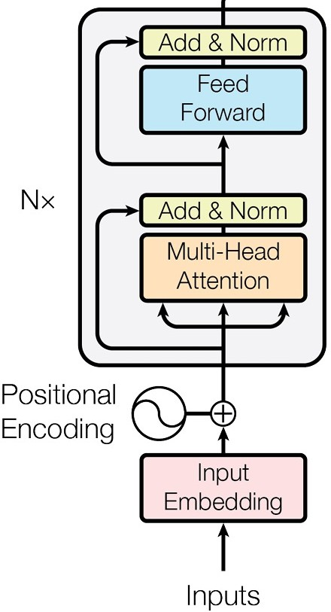
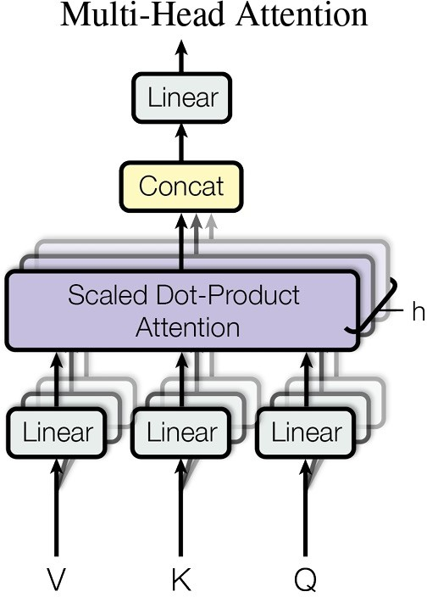
Encoder Model
Self-attention mechanism is used to encodes context and multi-head attention blocks capture information from different aspects
Feedforward network is used to provide non-linearity for attention blocks
Stacking many attention blocks and FF layers one after each other to improve hierarchical learning and extract complex and abstract concepts
Problems:
The original information might be lost due to passing through many stacked transformer layers and non-linear transformation.
Stacking many layers creates very deep networks in which vanishing gradient is a problem

Slide 16
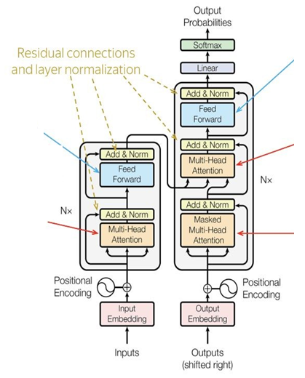
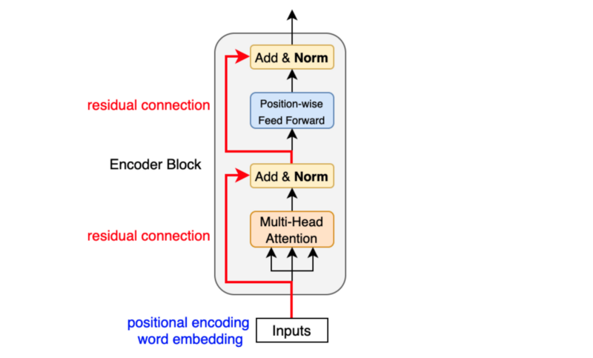
Residual Connections & Norm Layer
Original input of the attention layer (residual connection) is added to the attention output
Helps in preserving the original information while incorporating the context using attention
It also provide a direct path for gradients to flow backward, avoids vanishing gradients.
This sum is then passed through a layer normalization step, which helps in stabilizing the training by normalizing the input to have zero mean and unit variance. Inputs to activation functions stay in a range where the gradient signal is strong
In newer models (e.g., GPT4) normalizing happens before attention block and FF network to facilitate training :
Emb + FF(Norm(Emb + Attention(Norm(Emb)))

Slide 17
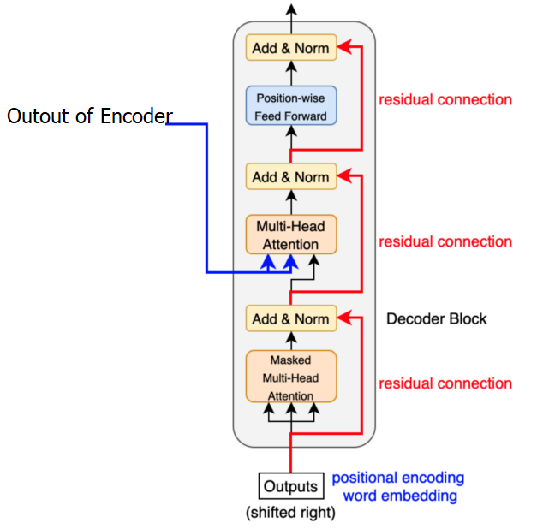
Decoder Model
For generation tasks, mask attention mechanism is used
Like encoder, decoder contains FF and Add&Norm layers
Like encoder, decoder contains several layers of multi-head attention blocks
Problem:
Needs a mechanism to receive the context from encoder side

Slide 18
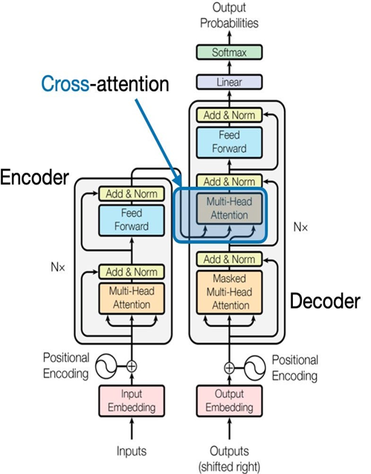
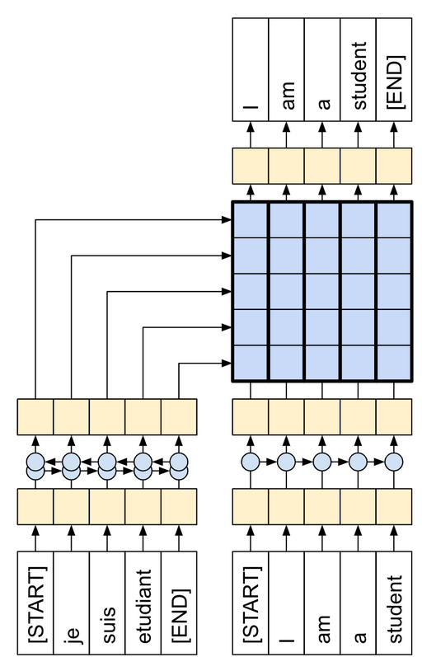
Cross attention (Decoder-Encoder)
In self-attention and masked attention, the model focuses on different parts of a single sequence.
Cross attention involves two sequences, where the model attends to elements in decoder side sequence based on information from encoder side sequence
Cross-Attention required for tasks like translation, where the model needs to align words in a source sentence with words in a target sentence.
The decoder takes the encoded context of the source words (e.g., in source language) and uses it to generate or modify the target words (e.g., in target language)
The queries come from the decoder
The keys and values both come from the encoder

Slide 19
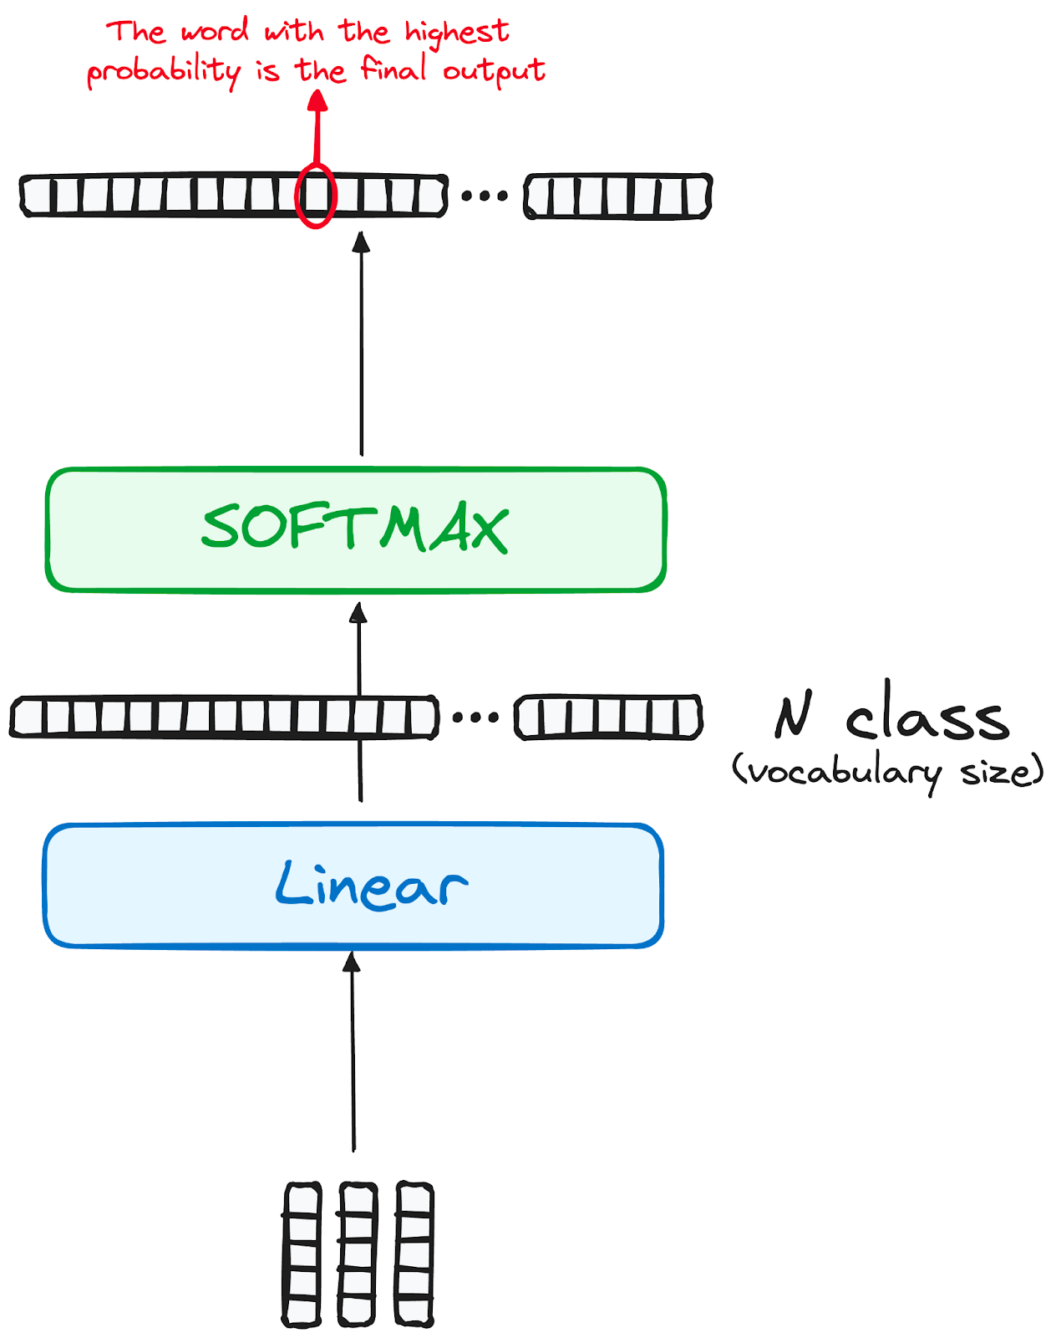
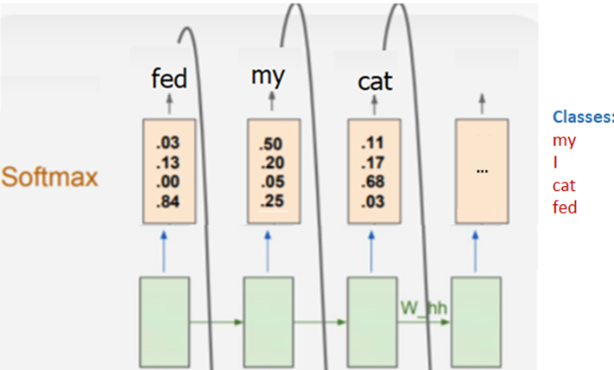
Linear Layer and Softmax
For each output of final self-attention, the model needs to predict a token based on the contextual information of that position
The output of the final self-attention is an embedding (same size as input) representing the context of the next token
A linear fully connected layer produces a vector of size equal to the vocabulary (e.g., 50k), one value per token in the vocabulary, called logits (logits=XW+b)
The linear layer learns (during training) to assign biggest value to the most probable tokens based on the contextual information of each output of the final attention block.
The numbers in logits are not normalized. A softmax is used to convert them to the probabilities (add to 1)

Slide 20
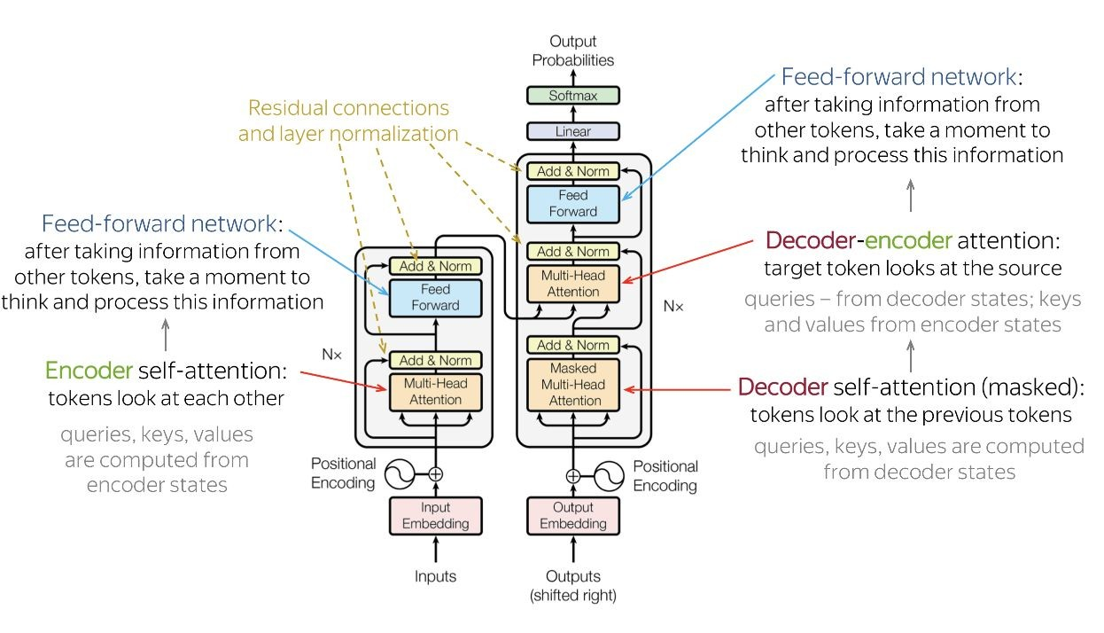
Transformer Model - Full Architecture

Slide 21
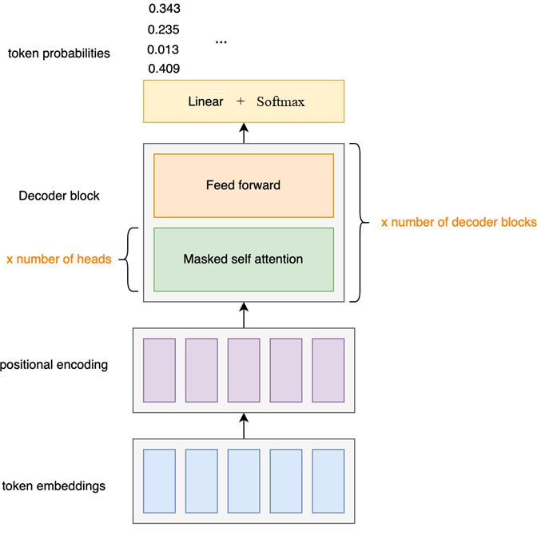
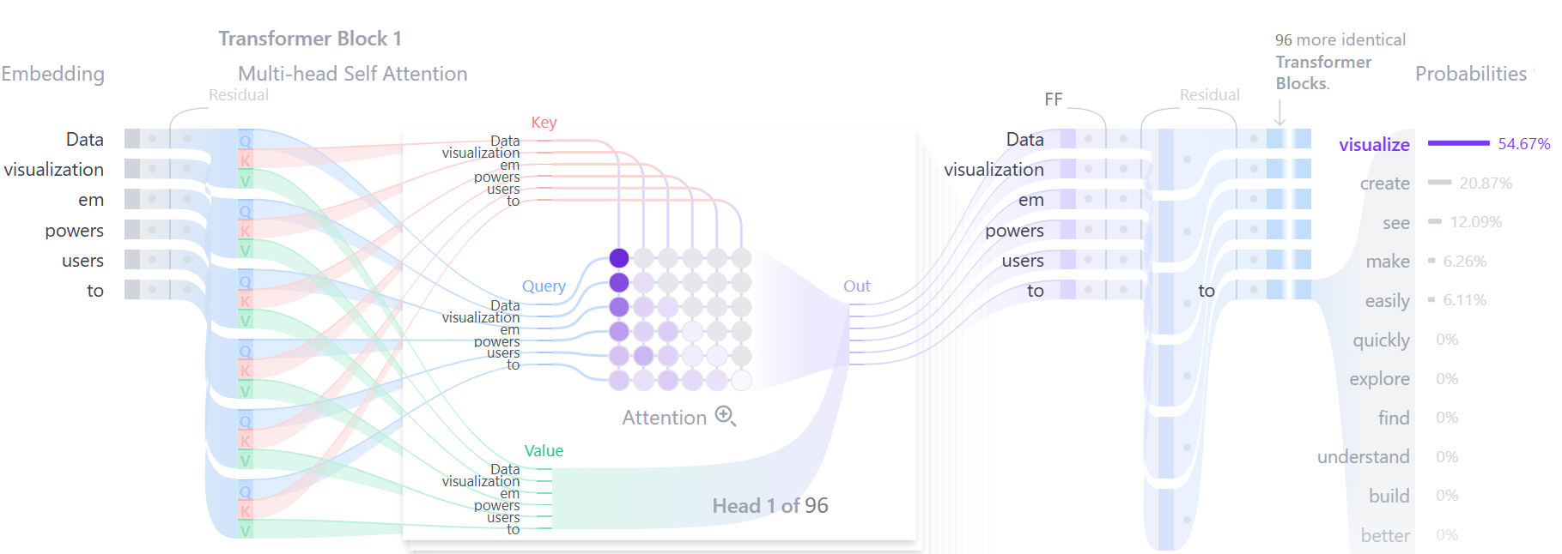
Text Generation
Decoder does not directly produce tokens
Decoder calculate probabilities assigned to every possible token in their vocabulary.
There should be a decoding strategy to choose best choice

Slide 22
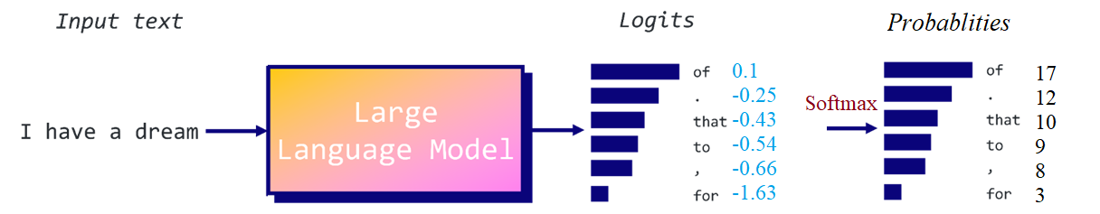
Why Decoding Strategy?
Decoding strategies are methods used to generate a sequence of text from a trained model.
Transformers predict the next word based on the previous words, but they don’t necessarily optimize for the quality of the entire sentence or paragraph:
Text generation needs to consider syntactic and semantic structure (coherence)
Also, different tasks need different levels of creativity in the output (e.g., translation needs accuracy, story writing needs creativity)
P(of ∣ I have a dream)=%17

Slide 23
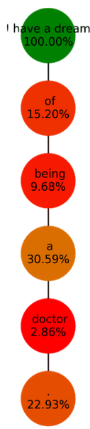
Decoding Strategy - Greedy Search
Greedy approach select the best choice at each step:
Takes the most probable token at each step
Example:
Step 1: Input: “I have a dream” → Most likely token: ” of”
Step 2: Input: “I have a dream of” → Most likely token: ” being”
Step 3: Input: “I have a dream of being” → Most likely token: ” a”
Step 4: Input: “I have a dream of being a” → Most likely token: ” doctor”
Step 5: Input: “I have a dream of being a doctor” → Most likely token: “.”
Problems:
It doesn’t consider the overall sequence
It's fast, but it is short-sighted (doesn’t guarantee optimal)

Slide 24
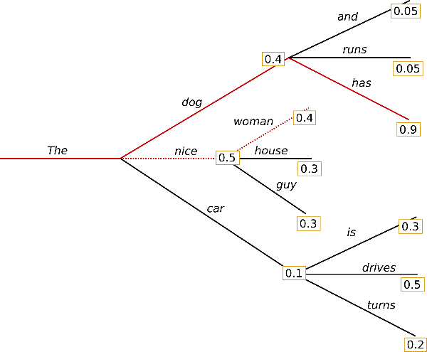
Decoding Strategy - Beam Search
Beam search select the best sequence of words (rather than individual tokens)
Considering the N (Beam Width) most likely tokens at each step
Creates a tree of all paths using these most probable tokens
Selects the best path in the tree
Higher Beam Width → More exploration, better accuracy, but slower inference.
Lower Beam Width → Faster decoding but may miss the best sequence.
Beam Width=3

Slide 25
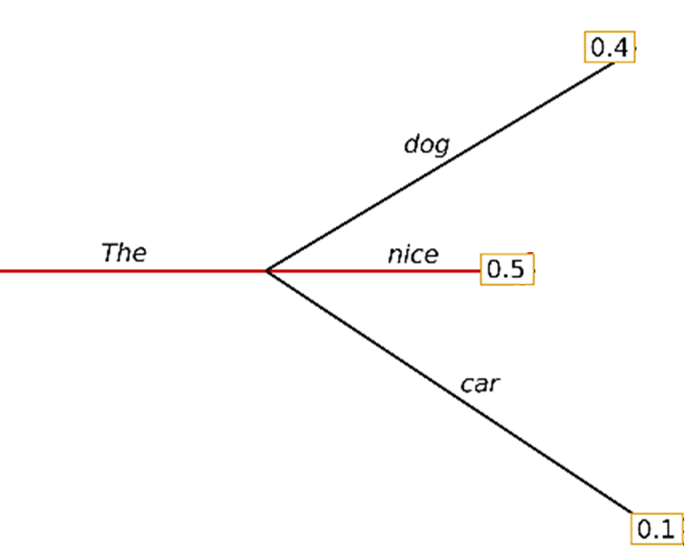
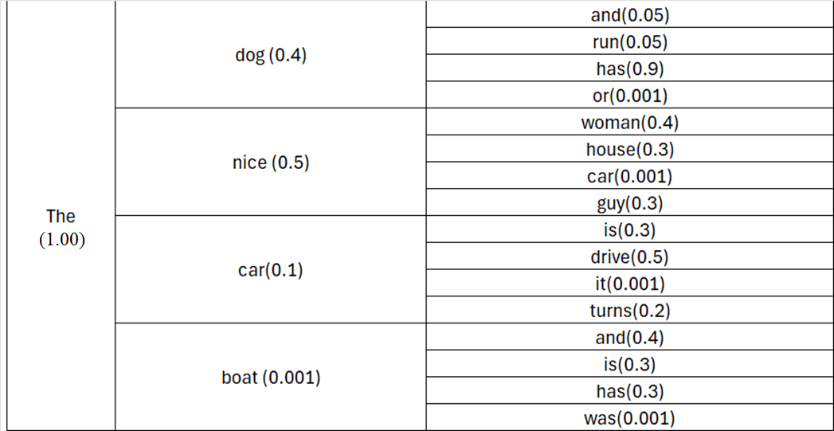
Beam Search – Tree Structure
Identify N tokens (beam width) with the highest probabilities (scores)
For each of N tokens, identify next N tokens with the highest probabilities
The process generates a tree structure using possible tokens and their probabilities
Example: Beam Width=3

Slide 26
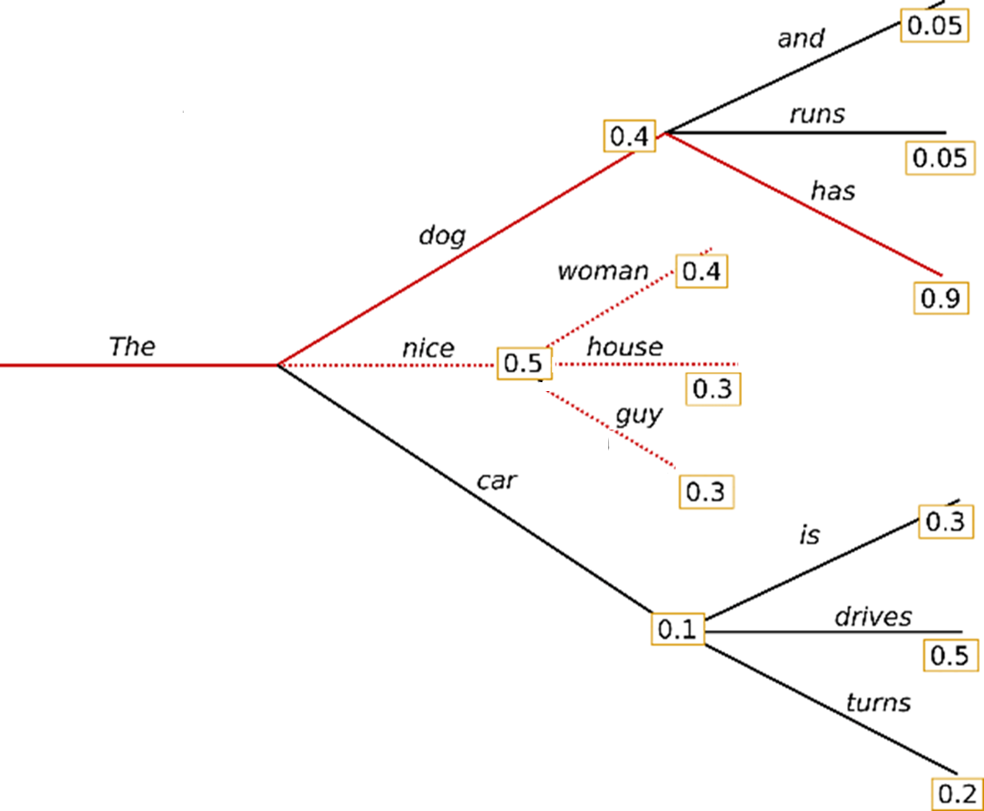
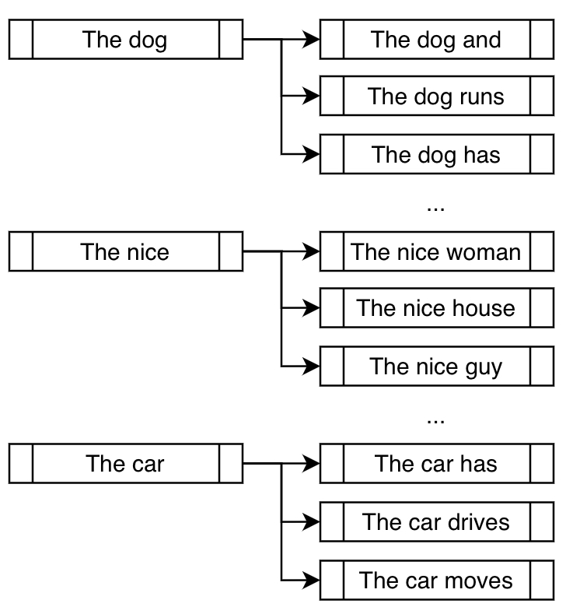
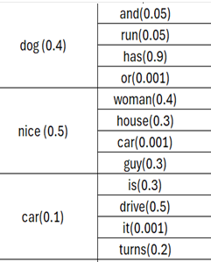
Beam Search – Finalize Tree Structure
Beam search might stop when a certain percentage of beams reach the end token or after a fixed number of steps.
Beam Width=3
Maximum Length = 3

Slide 27
Beam Search - Best Sequence
Identify the path with the highest sequence score (a sequence with the maximum probability)
p("The","dog",“and")= 1 * 0.4 * 0.05 = 0.02
p("The","dog",“runs")= 1 * 0.4 * 0.05 = 0. 02
p("The","dog","has")= 1 * 0.4 * 0.9 = 0.36
p("The",“nice",“woman")= 1 * 0.5 * 0.4 = 0.20
…
Sequence ("The","dog","has"), with 0.36 has the highest probability

Slide 28
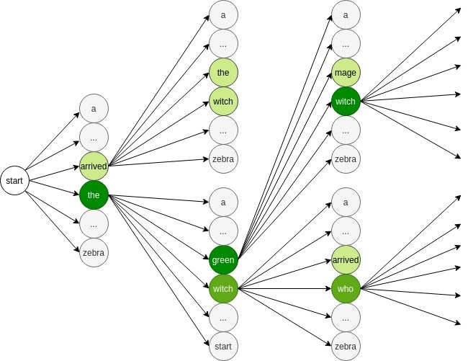
Beam Search - Steps
Start with the start token (<BOS>).
Get probabilities for all tokens from the decoder.
Pick the top-k (beam width) tokens
For each of these tokens:
Feed the whole sequences into the decoder to get the next step’s probabilities
Pick the top-k
Expand the beam
Repeat until end-of-sequence token <EOS> or length limit.
Pick the best overall score
Problem :
For each step, it keeps multiple paths, not just one like greedy decoding.
For each path, it must run the decoder (all layers) which is computationally expensive

Slide 29
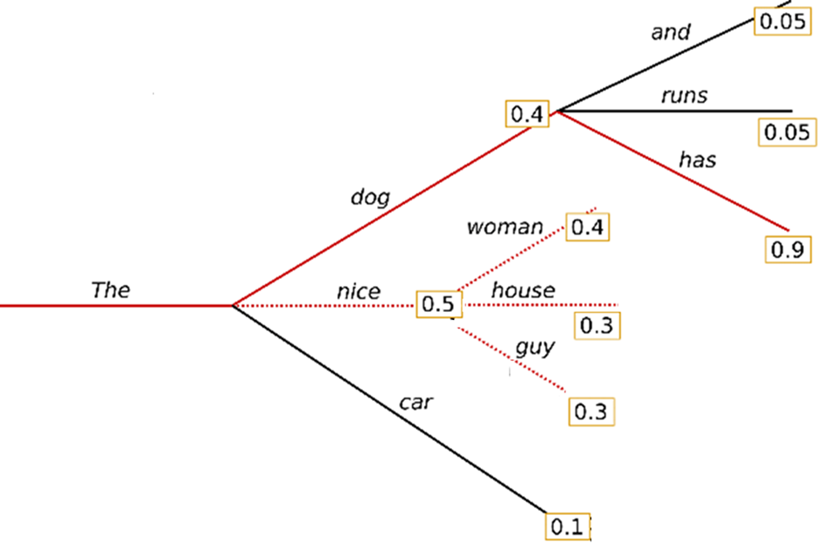
Beam Search - Pruning
Typically, a beam width of 4 to 6 is used in beam search
By branching out, number of branches will be beam-width^n for n steps (beam-with of 4 after 10 steps is 1,048,576 paths).
Pruning involves discarding sequences that have low scores, which are unlikely to lead to optimal solutions.
Pruning aggressively might discard some sequences that could lead to a good final output, but careful threshold tuning can mitigate this.
e.g., (Path-Score/Best-Score) > 0.3

Slide 30
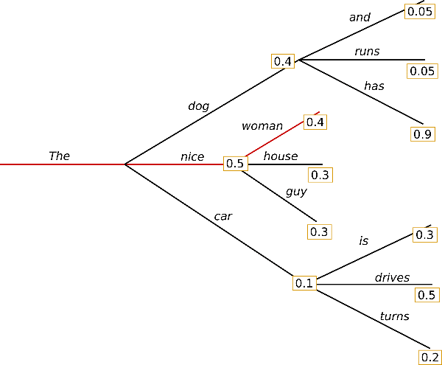
Greedy vs Beam
Greedy search selects the highest-probability token at each step which is fast but can lead to suboptimal sequences.
Beam search mitigates this by considering multiple candidates, increasing the chance of finding a more optimal sequence.
P = 0.36
P = 0.2
Result of Beam Search
Result of Greedy Search
Problem: Both Greedy and Beam searches focus on selecting the sequence with the highest probability, which often leads to less diverse outputs (no creativity)

Slide 31
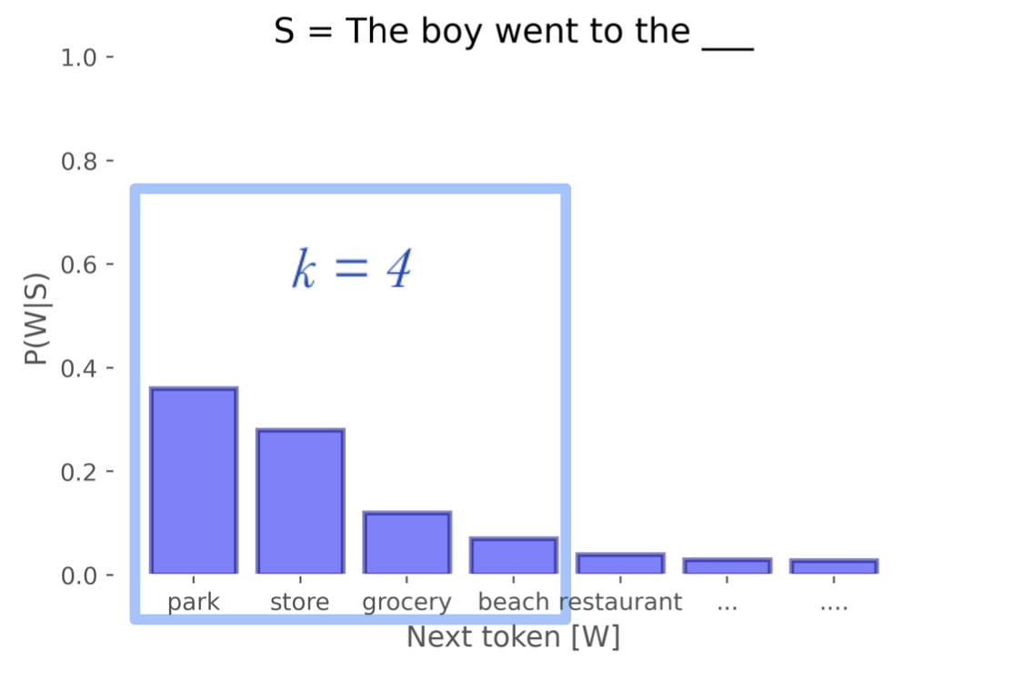
Decoding Strategy - Top-k Sampling
Select a token randomly from the k most likely options proportional to probabilities
This approach ensures that we prioritize the most probable tokens while introducing an element of randomness in the selection process.
Randomness allows for more diversity and creativity and avoids repetitive results
Example:
P(park)=35%, P(store)=30%, P(grocery)=10% and P(beach)=5%, P(restaurant)=4 %, …
In top-4 sampling, “restaurant” is disregarded, and the remaining will be normalized:
park 35/80 = 44% of the time, store 30/80=37% of the time, etc.
Higher k → More diversity (includes more words to choose from).
Lower k → More deterministic (closer to greedy decoding).

Slide 32
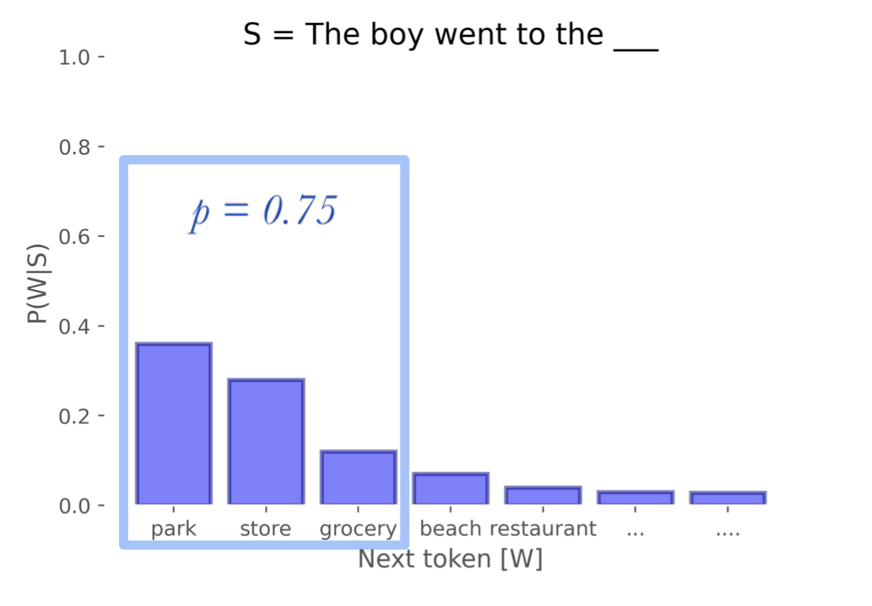
Decoding Strategy - Nucleus Sampling
Nucleus sampling( top-p sampling), picks top probable tokens until the total probability surpasses the threshold p.
Unlike top-k sampling, the number of tokens included in the nucleus can vary from step to step.
Better than top-k in selecting important tokens

Slide 33
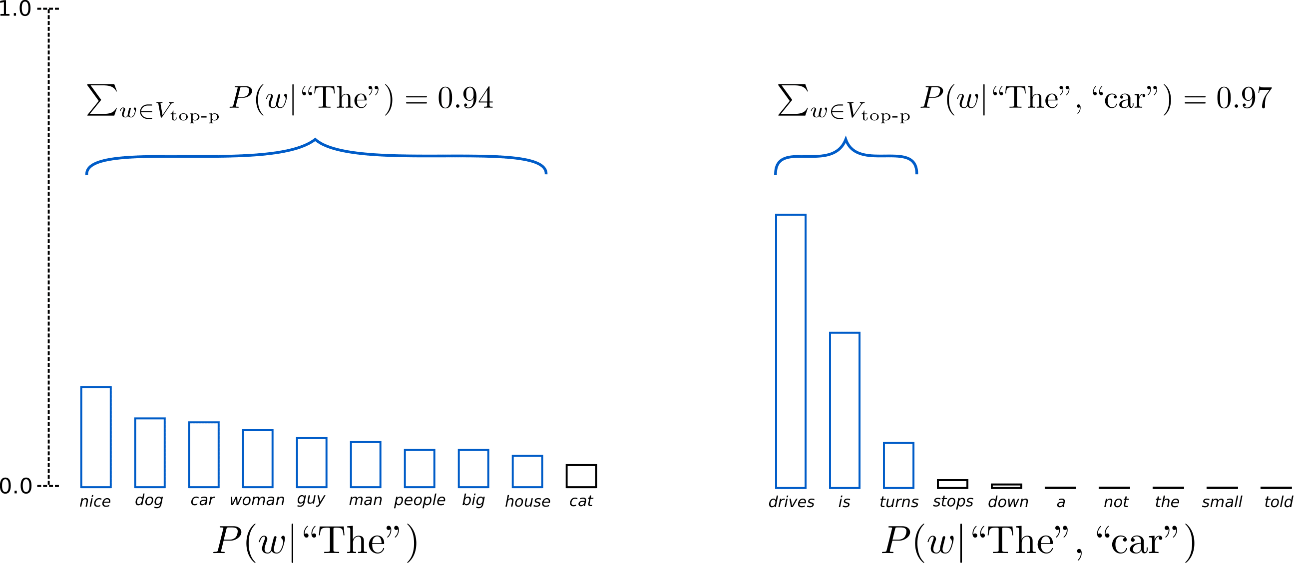
Nucleus - Example
Set the value of p to 0.92
Include a minimum number of tokens satisfies the threshold (p)
In the first example, top 9 most likely words are selected to satisfy the threshold, whereas it only has to pick the top 3 words in the second example to exceed 92%.

Slide 34
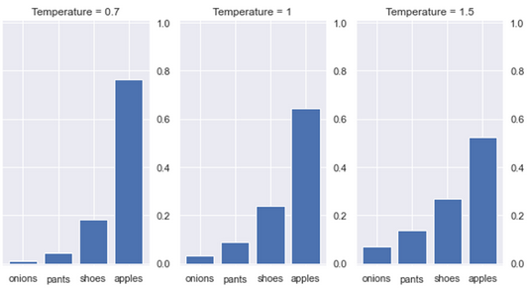

Temperature
Another way of introducing randomness is the concept of temperature
The temperature is a parameter that affects the probabilities generated by the softmax function
Temperature scaling doesn't change the relative order of token probabilities but sharpens or flattens the probability distribution

Slide 35
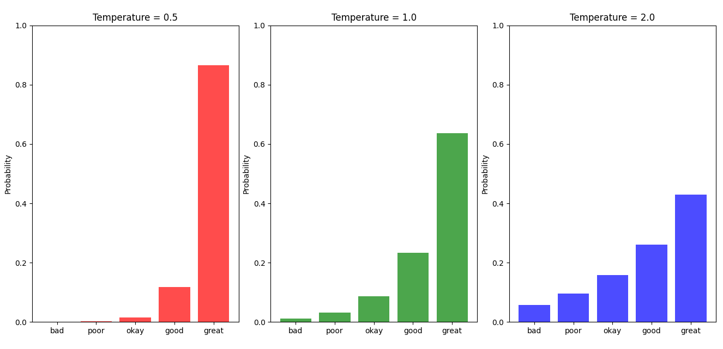
Temperature Value
A temperature of 1.0 is equivalent to a default softmax with no temperature
A low temperature (e.g., 0.1) sharpens the differences between probabilities (less chance for smaller probabilities and less diversity)
A high temperature (e.g., 1.5) flattens out the differences between probabilities (more chance for smaller probabilities and more diversity)
By adjusting the temperature, we can influence the extent to which the model produces more creative (diverse) or predictable responses.

Slide 36
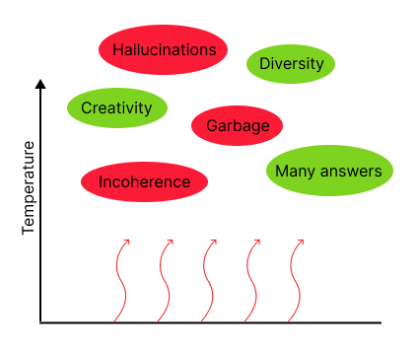
High Temperature - Impact
At higher temperatures, we see more hallucinations and lower quality of responses on average, but also more creative and diverse responses
Frequency and presence penalties can also add diversity by penalizing the reuse of tokens that have already occurred in the text, while reducing hallucinations more effectively than temperature scaling

Slide 37
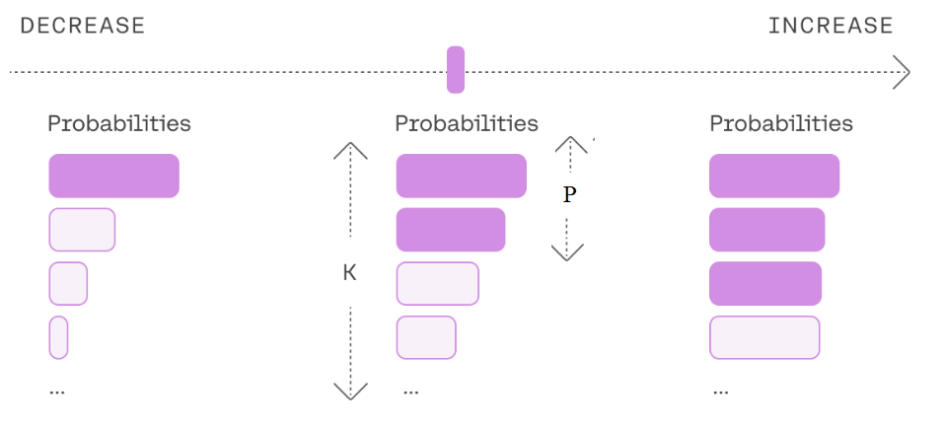
Temperature with Sampling Methods
Temperature is often used together with Top-K and Top-p in decoding strategies:
1- Temperature is used to change sharpness and flatness of the probabilities (0-0.7 for deterministic, 0.7-1.2 balanced , 1.2-1.5 for creative)
2- keep only the K most likely tokens and discards the long tail (1-20 for deterministic, 40-60 balanced, 60-100 for creative)
3- Sample from the most likely tokens whose cumulative probability is bigger than p (0.8 – 0.9 for deterministic, 0.9 – 0.95 balanced, 0.95-0.97 for creative)

Slide 38



Beam Search with Sampling Methods
Higher probabilities do not always lead to more realistic or natural sentences.
Instead of selecting the highest probabilities (as in regular beam search), use Top-k sampling . We can also use the nucleus parameter for sampling.
The sampling, making more diverse choices and avoids redundant generations
Beam-width = 2 with Top-4 sampling
(two random branch from top 4)
Example:
In regular Beam Search “The” and “It” should be selected but here “The” and “A” are selected randomly from top 4

Slide 39

Choosing Decoding Strategy
Choice between the methods depends on the specific requirements and constraints of tasks:
Some tasks like medical diagnosis needs more deterministic results and some tasks like writing stories needs more creativity.
Use Greedy for tasks needs speed and determinism
Use Beam Search for better quality of text
For creativity add sampling methods (Top-K, Top-P, Temp) to beam search.
For common NLP tasks, combination of beam search and sampling methods is a reasonable choice

Slide 40

Foundation Models
Language understanding and generation can be used across many tasks
Foundation models are large-scale, general-purpose pre-trained models that serve as a base (foundation) for various tasks across multiple domains.
The general knowledge learned through pre-training transfer well to various tasks (transfer-learning) with minimal task-specific fine-tuning
Transformer architecture is the dominant architecture for foundation models
humanloop

Slide 41

GPT Series of Models
GPT: Generative Pre-trained Transformer
A transformer model architecture
Stack of transformer decoder layers (only decoder part of transformer)
Goal: Text generation
GPT is a commercial LLM from OpenAI
GPT Pre-training:
GPT series are pre-trained on a large corpus of text from the internet, and data licensed from third-party providers (in GPT4 +) learning to predict the next word in a sentence.
A general-purpose model capable of generating text that mimics human writing, performing tasks like translation, summarization, and question answering.

Slide 42


GPT Model Architecture
Multi-layer transformer decoder model:
The number of attention heads in GPT3 is 96.
The number of attention layers in GPT3 is 96.
175 billion parameters in GPT3
Dimensions of each attention head in GPT3 is 128, which means that the total attention head size per layer is 96×128=12,288 (size of embedding)
Only masked attention (no cross-attention and self-attention since there is no encoder)
BPE embedding
DeepSeek R1, Grok and Claude are also decoder only models

Slide 43

Why No Encoder?
An encoder processes input text for understanding phase (NLU)
The main task of GPT is text generation.
GPT merges the understanding and generation roles into decoder
User input generates context using attention (understanding), then it adds to the input text token by token to complete the text (a text completion task)
For tasks like translation with two separate stages of understanding and generation, encoder-decoder models are better (e.g., MarianMT or BART)
GPT can also translates since trained on massive text including translations and learned the syntactic and semantic relationships between different languages.
Having two towers (encoder + decoder) and cross attention doubles parameters. Empirical evidence show that decoder-only models scale better with data and parameters for general-purpose tasks

Slide 44

BERT
BERT : Bidirectional Encoder Representations from Transformers
A transformer model architecture
Stack of transformer encoder layers (only encoder part of transformer)
Task-Specific Layers: linear and softmax layers for word prediction and fully connected layer for classification,…
Goal: Understanding context / classification
BERT is an open source LLM from Google
BERT Pre-training:
BERT is pre-trained on large amounts of Wikipedia + BooksCorpus (11,000+ books).
BERT present high performance on a variety of NLP benchmarks including classification and sentiment analysis.

Slide 45


BERT Model Architecture
Multi-layer Transformer encoder model:
Bert-base: 12 layers, 12 attention heads, 110M parameters
Bert-large: 24 layers, 16 attention heads, 340M parameters
Context window of 512 tokens
Bidirectional: each token can attend to its left and right context for self-attention (more computational cost comparing mask-attention)
WordPiece embedding (segment + positional + token embeddings)

Slide 46

BERT - Classification
BERT can perform classification by adding a simple classification layer on top of the encoder.
Input sequence to BERT starts with a special token called [CLS] (classification token).
The [CLS] token collects information from the rest of the sequence by attending to all other tokens during training.
This hidden state of [CLS] is expected to capture the semantic representation of the entire input sequence.
A simple feedforward layer (fully connected layer) with a softmax is added on top of the [CLS] token's hidden state to produce probabilities for the target classes.

Slide 47

BART
BART : Bidirectional and Auto-Regressive Transformers
A transformer model architecture
Both encoder and decoder components
Tasks: Question answering, summarization, translation
BART is an open source LLM from Meta
BART Pre-training:
BART is pre-trained on English Wikipedia, a massive web corpus and Books Corpus
BART present high performance on translation, and summarizing.

Slide 48

BART Model Architecture
Multi-layer Transformer Encoder and Decoder Model
Bart-base: 6 encoder layers, 6 decoder layers, 12 attention heads, 140M parameters
Bart-large: 12 encoder layers, 12 decoder layers, 16 attention heads, 400M parameters
Self-attention , mask-attention and cross-attention (multiple attention mechanisms increases the computational cost, both in terms of processing and memory usage)
Context window of 512 tokens
BPE embedding
MarianMT and Google’s T5 are also encoder-decoder models
Encoder-decoder models fit better for some tasks like translation and summarizing

Slide 49

Vision Transformer (ViT)
Transformers can also be used for processing images since images can be presented by vectors
ViT is one of the most popular implementations of image transformers.
The image is divided into patches, which are flattened and converted to vectors.
Vectors of patches are processed like tokens with self-attention layers capturing the relationships between them.
Example:
Suppose each patch is 16×16 with RGB color:
(16×16×3)=768 dimensions of each vector representation of a patch
Pixels flattens as vectors

Slide 50

Images in VIT
Self-Attention: Image transformers allow for global relationships between patches, enabling the model to understand broader patterns in the image.
For each patch embedding, Q,K,V vectors are created

Slide 51


VIT vs CNN
Feature exploration
CNNs are good at finding local features through convolutions, but not long-range features. Self-attention is good at finding long-range features, since self-attention in ViT allows each patch to interact with every other patch globally.
Computational complexity
Self-attention has quadratic computational complexity with respect to sequence length, which can make it slow for very long sequences.
Data Requirements:
CNNs need relatively small to medium-sized datasets since they exploit local spatial structures.
VITs require much larger datasets since they need to extract all global patterns.

Slide 52

CLIP (Contrastive Language-Image Pre-training)
Transformers can also be used for processing multimodal data
CLIP is a multimodal LLM that learns to associate images with textual descriptions.
It is trained on paired text and images and can perform tasks like image recognition and classification without task-specific fine-tuning.
CLIP can be used for multimodal search systems where users can search for images using natural language queries.
It has been used to generate visual content guided by textual descriptions

Slide 53

CLIP - Image Classification (Inference)
Input: An image and a set of possible textual descriptions (such as class names or full sentences).
Text Encoder: Converts textual descriptions into contextual embeddings.
Image Encoder: typically, a ViT to encode images into image embeddings.
Similarity Matching : The similarity between the image embedding and each text embedding is computed (vector alignment).
Prediction: The text description (or label) with the highest similarity score is chosen as the prediction for the image.
A joint embedding (multimodal embedding) is a learned representation that brings elements from different modalities (e.g., images and text) into the same vector space.

Slide 54
Large Language Models
Large Language Model (LLM): Deep neural networks (mostly transformers) trained on massive amounts of text data to understand and generate human language.
Problem: As LLMs scaling up, training LLMs requires enormous computational resources, specialized hardware, and massive datasets, making them accessible only to organizations with significant financial and technical resources (e.g., big techs).
Solution: Fine-tuning pre-trained LLMs rather than training from scratch
Year | Model | Parameters | Notes
2018 | GPT-1 | 117M | First transformer-based LLM from OpenAI.
2019 | GPT-2 | 1.5B | Not initially released due to concerns about misuse.
2020 | T5-11B | 11B | Google's Text-to-Text Transfer Transformer (T5).
2020 | GPT-3 | 175B | First LLM to gain widespread adoption in AI applications.
2022 | PaLM | 540B | Google's dense transformer model.
2023 | GPT-4 | 1.7T (Estimate) | Uses Mixture-of-Experts (MoE)
2025 | Grok-3 | 2.7T (Estimate) | xAI's multimodal LLM

Slide 55

Training Large Language Models
LLMs undergo a two-stage training process:
Pre-Training: The model learns general patterns from a vast corpus of data. This phase helps the model encode generic linguistic features and knowledge which can be effectively transferred to the target applications
Fine-tuning: The pre-trained model is fine-tuned on a smaller, task-specific dataset, adjusting its general knowledge to perform well on specific task (downstream tasks), improving its performance.

Slide 56

Pretraining LLM
LLM needs huge data for pre-training
Labeled data is very limited
Annotating data can be expensive
Solution: Self-supervised Learning
In self-supervised learning, the labels are derived from the data itself, rather than relying on manually labeled data.
Unlabeled data: Capital of France is Paris
Labeled data: Capital of France is […] , Label = Paris

Slide 57

Self-Supervised Learning - Advantages
Most of available data is unlabeled and unstructured (e.g., free format text)
SSL can be used on massive unlabeled and unstructured data (e.g., web)
LLMs can learn general representations of language from textual data using SSL
Using SSL, LLMs can learn general knowledge from large amounts of unstructured data (e.g., Wikipedia), which can be used across various tasks
Three main approaches of Self-supervised Learning:

Slide 58

Self-Supervised Pretraining - CLM
Causal Language Modeling (CLM):
Used to train text generation in models like GPT and other autoregressive models, where the model is trained to predict the next word in a sequence, given the previous words.
If the training sentence is: "The dog chased the ball.“
The model learns to predict each word one by one:
Predict "dog" given "The.“
Predict "chased" given "The dog.“
Predict "the" given "The dog chased.“
Predict "ball" given "The dog chased the.“

Slide 59




Pre-Training – Objective Function
For each token generation, softmax generates probabilities for possible tokens
Cross-entropy loss is calculated using predicted probability of the true token $x_{t}$ (label)
If the model assigns high probability to the correct token (label), $ℓ_{t}$is small.
If model predicts a wrong token, correct token is fed to the next step (teacher forcing)
Typically, the average (or sum) of loss across all generated tokens is calculated
During backpropagation, weights are adjusted in a way that minimize the loss
Example: vocab = {I, like, dogs, cats} , Training text: "I like dogs".
Model predicts probabilities at each step:
Step 1 (correct token: "I"): p = [0.6, 0.2, 0.1, 0.1]
Step 2 (correct token: "like"): p = [0.1, 0.7, 0.1, 0.1]
Step 3 (correct token: "dogs"): p = [0.1, 0.1, 0.3, 0.5]
Loss =$\frac{1}{3}(−\log{0.6}−\log{0.7}−\log{0.3}) = 0.69$

Slide 60

Self-Supervised Pretraining - MLM
Masked Language Modeling (MLM):
Used to train language understanding in models like BERT, where random words in a sentence are masked, and the model is trained to predict them based on the context
Typically, around 15% of the tokens in a sequence are masked.
Different aspects of language understanding can be learned using MLM:
I put [MASK] fork down on the table. [syntax]
I deposited some money into my [MASK] account. [contextual meaning]
It was very long and boring. Overall, the movie was [MASK]. [sentiment]
I was thinking about the sequence that goes 1, 1, 2, 3, 5, 8, 13, 21, [MASK]. [basic reasoning ]

Slide 61


CLM vs MLM
CLM:
Suitable for text generation tasks (decoder part) like writing stories, articles, and dialogues, where each new word depends on the previous words.
The information flows unidirectional (masked attention). The model can only rely on previous tokens to predict the next one, ensuring that predictions respect the causal structure of language
MLM:
Better for language understanding tasks (encoder part), such as text classification or question answering because it captures bidirectional relationships.
The model is trained to predict the masked tokens based on both the preceding and following tokens (self-attention).

Slide 62

Self-Supervised Pretraining - NSP
Next Sentence Prediction (NSP): Used to train relationships between sentences in models like BERT (encoder model), by predicting whether one sentence logically follows another.
Sentence A: "I went to the park this morning.“
Sentence B: "I saw many people walking their dogs.“
The sentences could appear next to each other in a text. So, Label = IsNext (+)
Sentence A: "I went to the park this morning.“
Sentence C: "The stock market crashed in 2008.“
The sentences are not likely to occur next to each other in a text. So, Label = NotNext (-)

Slide 63

Training using NSP
Sentence pairs are sampled from the training data using a self-supervised approach:
50% of the time, the second sentence is the actual next sentence in the original text (positive sample).
50% of the time, the second sentence is a random sentence from the corpus (negative sample).
The model learns to classify whether the two sentences are related or not based on aggregate information across the entire input.

Slide 64

NSP Advantages and Limitations
Sentence Coherence: By understanding the logical flow between sentences, the model improves its ability to handle tasks that require multi-sentence reasoning (e.g., question answering, text summarization).
Document-Level Understanding: NSP enables the model to better understand how ideas and topics develop across sentences, which is important for tasks like information retrieval and dialogue systems
Limitations: Some studies found that NSP isn't always useful for performance, and some later models (like RoBERTa) excluded NSP from pre-training and still achieved state-of-the-art results using MLM
https://arxiv.org/pdf/2010.01694

Slide 65
Assignment 5
1- Using trained models from pipeline in the transformers library, first translate the following text from French to English, then summarize the translated text, and finally apply sentiment analysis to the summarized text:
J'apprécie le sérieux avec lequel ce restaurant prend les allergies alimentaires. En tant que personne allergique aux noix, je me sentais complètement en sécurité en dînant ici. De plus, leurs options sans gluten et végétaliennes ont été une agréable surprise. Fortement recommandé à toute personne ayant des restrictions alimentaires Community Verified icon
2- Using each of the temperatures 0.1 and 1.4, repeat the following query on GPT4 five times. Which of these temperatures are more reliable for diagnosis of diseases?
“a patient has a low blood pressure and a high heart rate. just give me names of three most probable diseases without any other word.”

