Slide 1
Advanced Techniques with Large Language Models Lecture 3
Northeastern University
College of Engineering
Multidisciplinary Graduate Engineering Department
INFO 7374 – Fall 2025
Instructor: Abdolreza Mosaddegh

Slide 2
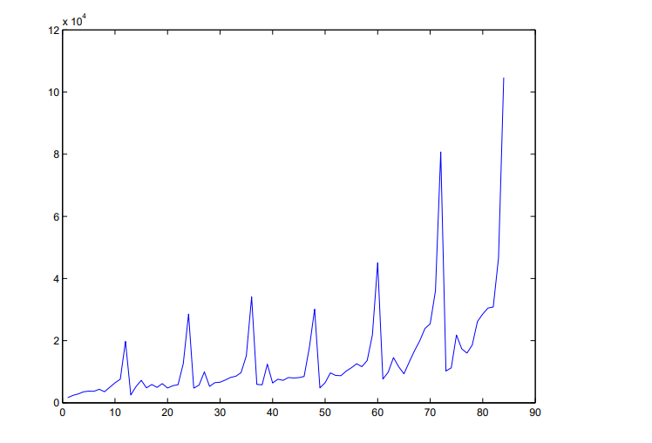
Time Series
A time series is a sequence of data points indexed in time order.
Most commonly, a time series is a sequence taken at successive equally spaced points in time. Thus, it is a sequence of discrete-time data.
Time series types:
Stationarity
Non-stationary
Monthly sales for a shop

Slide 3
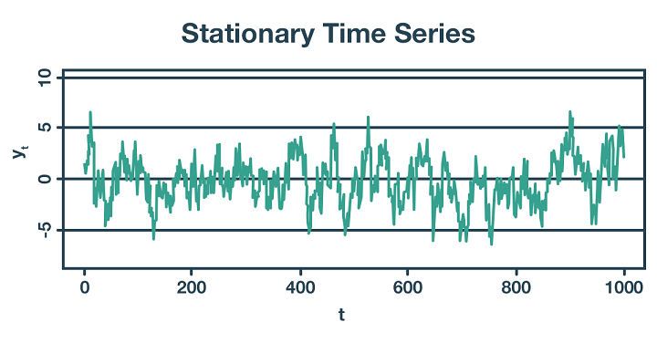
Stationarity Time Series
A stationary process has the property that the mean, variance and autocorrelation structure do not change over time, implying that the probability lies in a particular interval is the same now as at any point in the past or the future.
Prediction on this type of data can be done regardless of previous conditions (e.g., noise in a sensor)

Slide 4
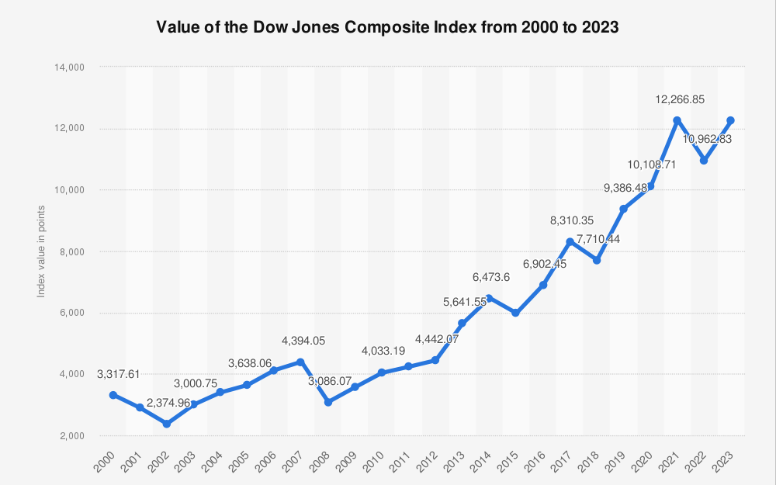
Non-stationary Time Series
A non-stationary time series is one whose statistical properties, such as the mean, variance, or autocorrelation, change over time.
Prediction on this type of data should consider a sequence of data over time (e.g., sequence of changes in a stock market).

Slide 5
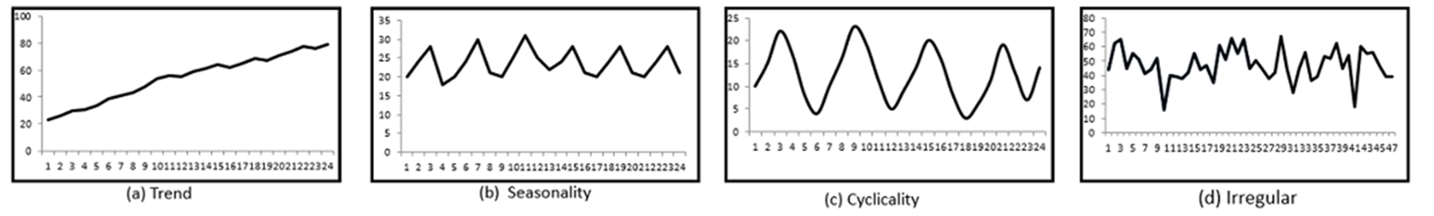
Components of Time Series
In general, any time series may be decomposed into four components:
Trend : increasing or decreasing long term pattern
Seasonal : regular fluctuations during the same time periods
Cyclical: rises and falls that occur over irregular, long-term intervals
Random: every time series has some unpredictable component (random variable).

Slide 6
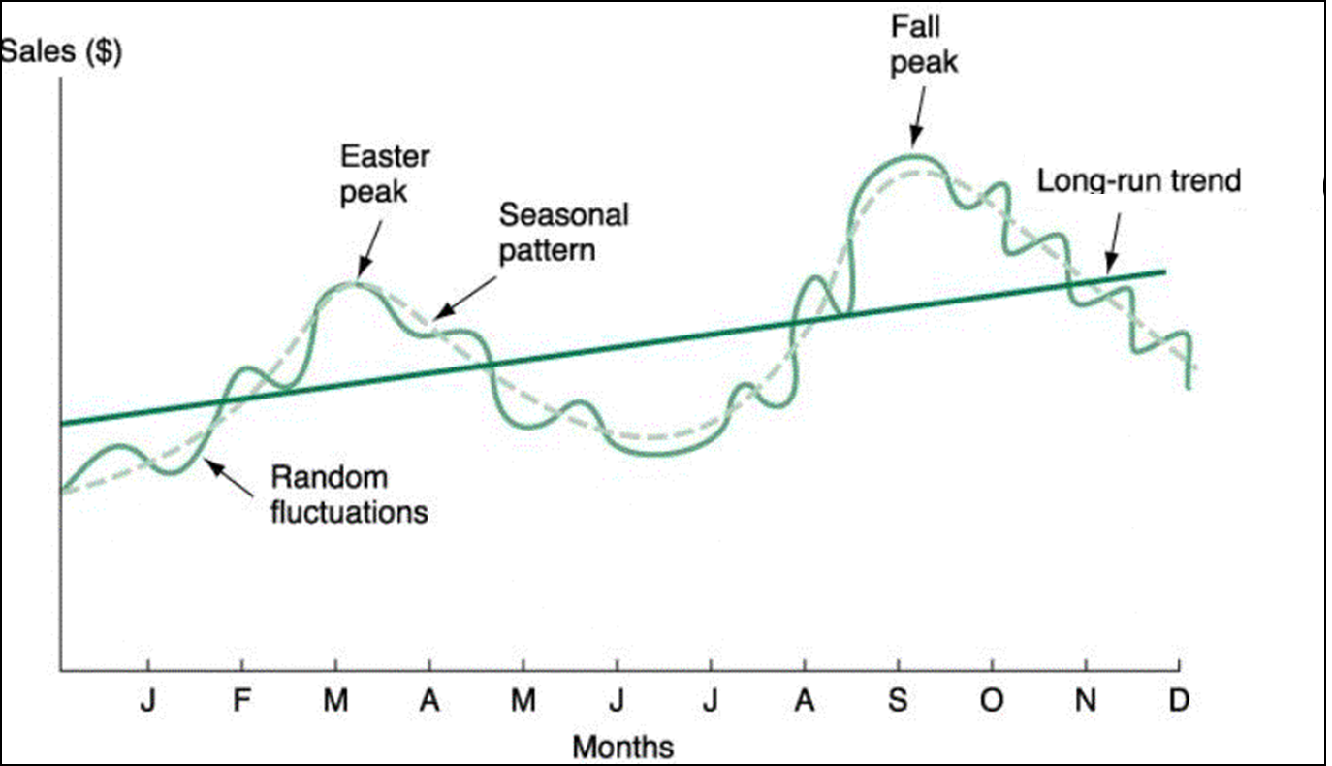
Prediction of Time Series
In prediction, the objective is to model all the components to the point that the only component that remains unexplained is the random component.
Many models can be used for modeling time-series data including Autoregressive models, Markov Chains, and Neural Networks
For prediction in time-series data using neural networks we need a type of NN which can predict based on a sequence of data over time

Slide 7
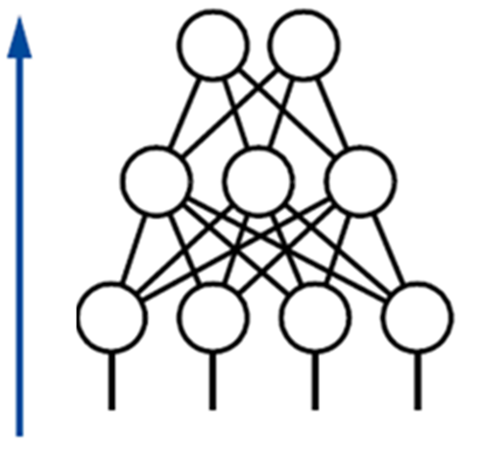
Limitations of Feed Forward Neural Networks
Time series data have a temporal order where each data point is related to its previous values
A feedforward neural network treats all inputs independently
FF cannot explicitly model temporal relationships across time
To capture dependencies among inputs over time, a structure capable of modeling temporal relationships is required.

Slide 8
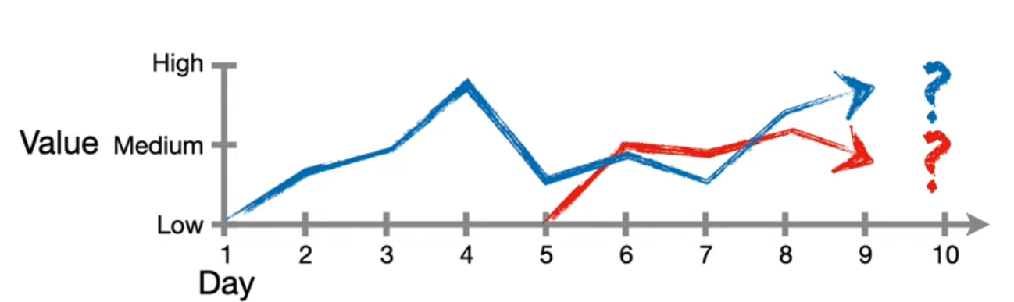
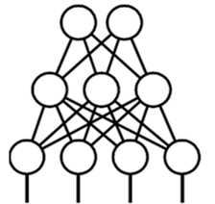
Requirements of Time Series in Neural Networks
In time-series data, a sequence of data is used for prediction / classification. The length of the sequential data can vary across different datasets or even among individual samples.
The architecture of NN for time-series should be adaptable to different sequence lengths (FF requires a fixed number of inputs)

Slide 9

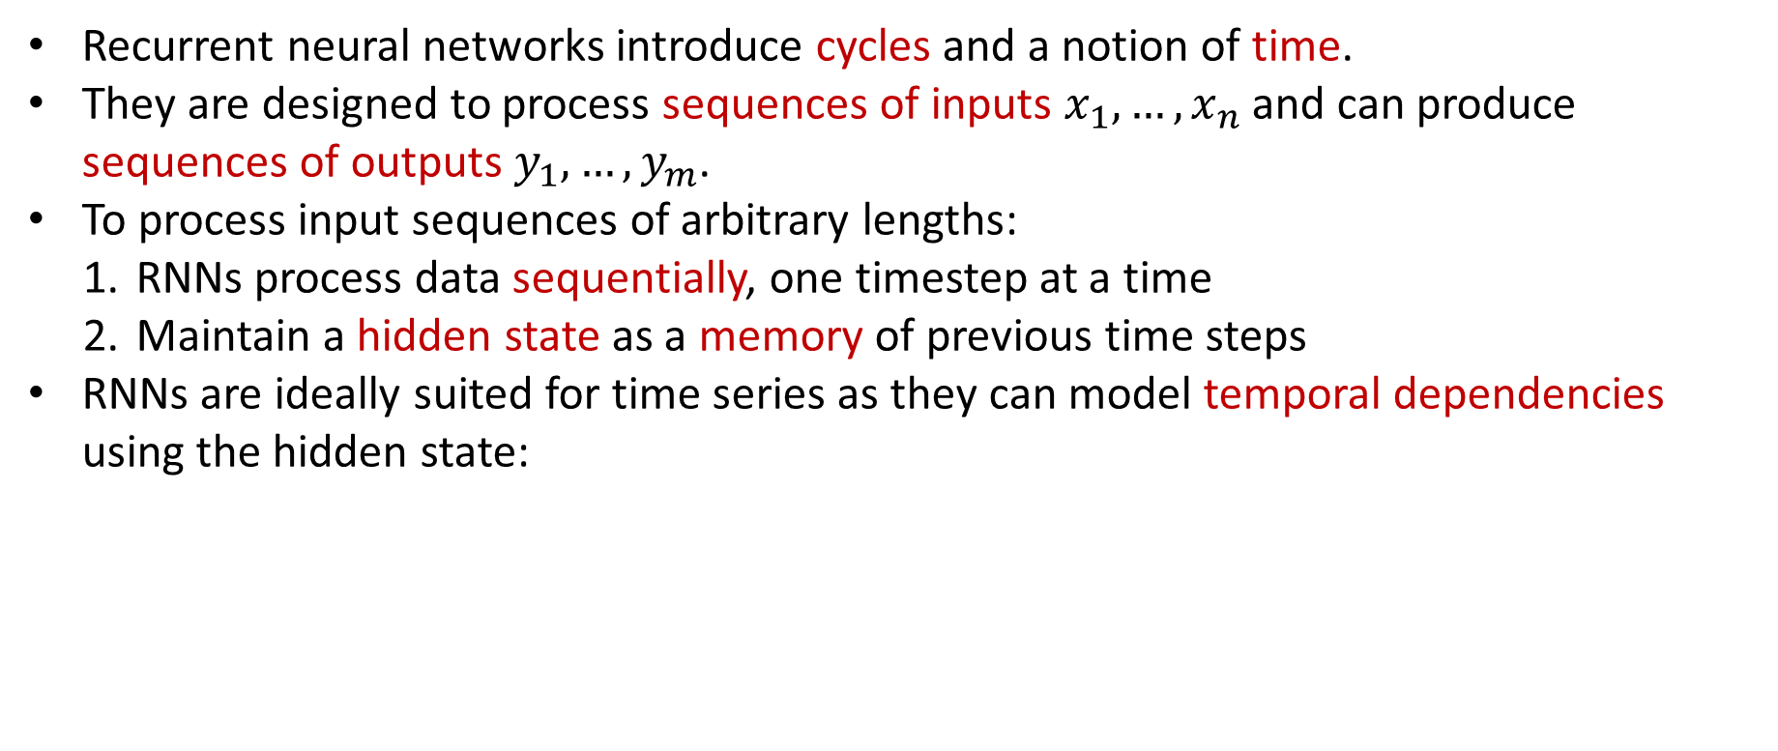




Recurrent Neural Network
Recurrent Neural Networks (RNNs)
Recurrent neural networks introduce cycles and a notion of time.
They are designed to process sequences of inputs $x_{1},…,x_{n}$ and can produce sequences of outputs $y_{1},…,y_{m}$.
To process input sequences of arbitrary lengths:
RNNs process data sequentially, one timestep at a time
Maintain a hidden state as a memory of previous time steps
RNNs are ideally suited for time series as they can model temporal dependencies using the hidden state:
$$x_{t}$$
$$y_{t}$$
$$h_{t−1}$$
$$h_{t}$$
new
hidden
state
Last
hidden
state
Function
for modeling
temporal
dependencies
input at
some
time step
One-step delay

Slide 10
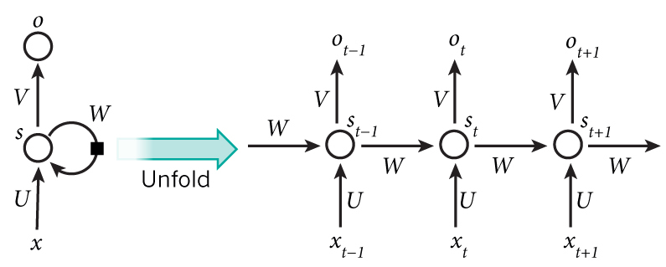













Recurrent Neural Network
Unrolling RNNs
RNNs can be unrolled across multiple time steps.
Since these steps represent a same function over time, the parameters of all step are the same
When RNN learns parameters during training (backprop) they are applicabale to different sequence lengths
$$y_{0}$$
$$x_{0}$$
$$h_{0}$$
$$y_{1}$$
$$x_{t}$$
$$y_{t}$$
$$x_{1}$$
$$h_{1}$$
$$h_{t−1}$$
$$h_{t}$$
$$y_{2}$$
$$x_{2}$$
One-step delay
$$h_{2}$$
Parameters to be learned: U, V, W
Same parameters for all time points

Slide 11
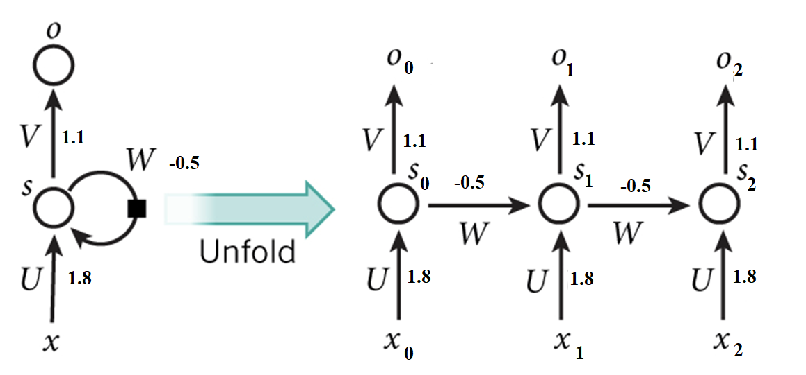
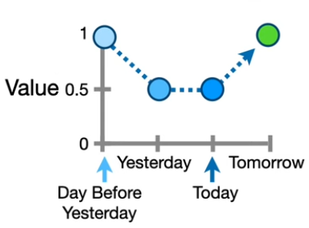
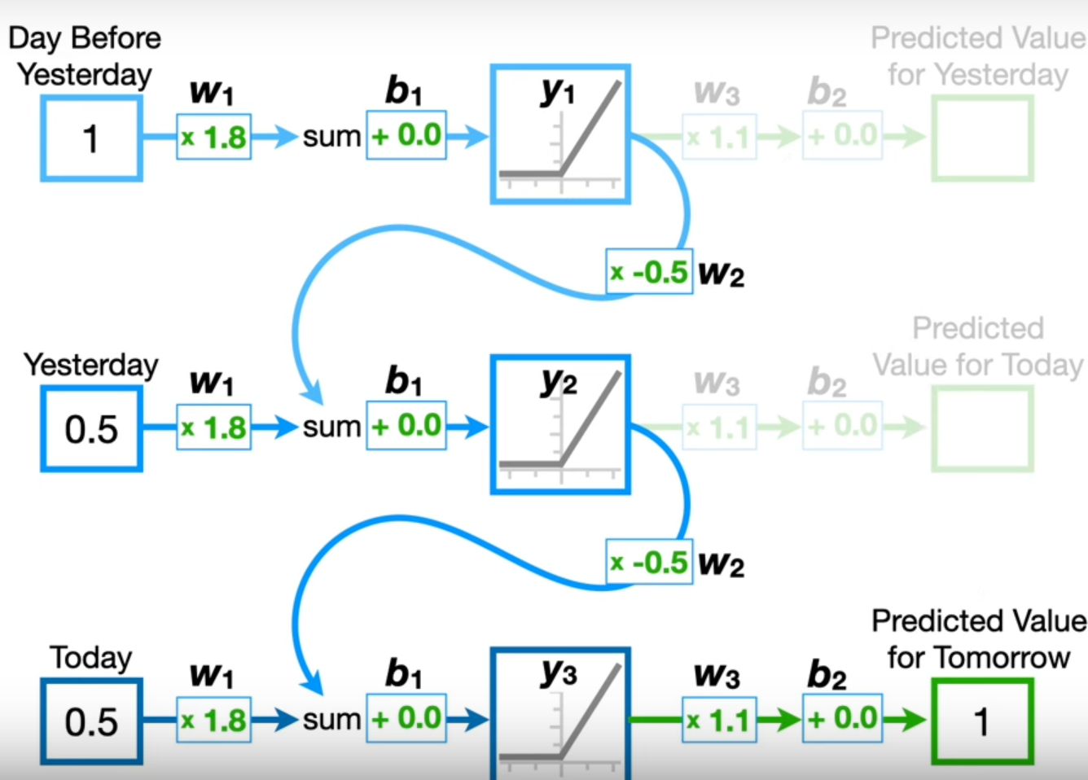
RNN - Example
H0 = Relu (1 * 1.8 + 0) = 1.8
H1 = Relu (0.5 * 1.8 + 1.8 * -0.5 + 0) = 0
H2 = Relu (0.5 * 1.8 + 0 * -0.5 + 0) * 1.1 = 1

Slide 12
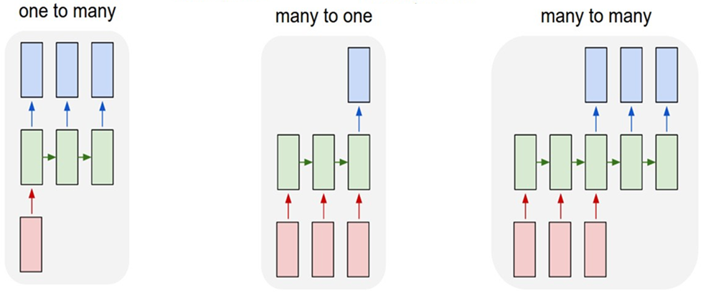
Recurrent Networks offer a lot of flexibility:
Text as a Sequence of Words
RNNs are designed to handle sequential data, and other than time-ordered data (e.g., time series), they can also process other types of ordered sequences
e.g. Image Captioning
image -> sequence of words
e.g. Stock Prediction
seq of stock prices -> future stock price
e.g. Machine Translation
seq of words -> seq of words

Slide 13
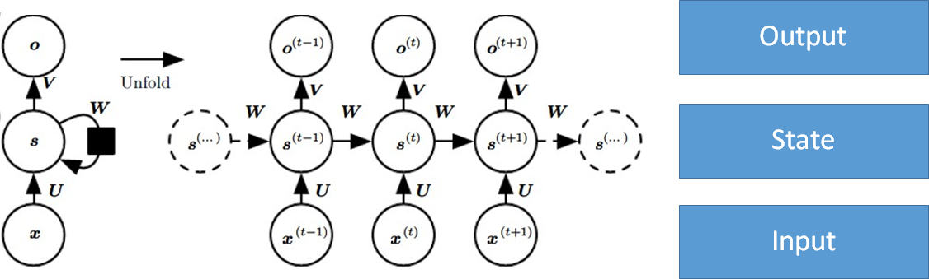
RNN for Processing Text
A text is an ordered sequence of words and it’s meaning depends on relationships between words.
RNNs can process a sequence of words and capture dependencies between them
RNNs can store information about previous words in the hidden state, allowing them to model relationships between words.
The same weights (parameters) are used for each input, making RNNs efficient for processing texts with different length.
RNNs was the first Neural Network widely used for Language Modeling (LM)

Slide 14
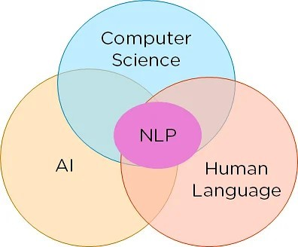
Natural Language Processing
NLP is the field at the intersection of Artificial intelligence and linguistics
Natural language processing (NLP) is the set of methods for making human language accessible to computers
The goal of NLP is to provide computational capabilities around human language using language understanding (NLU) and language generation (NLG)
NLU focuses on interpreting and extracting information from text
NLG focuses on generating coherent and meaningful text
Before introduction of deep Leaning models, early NLP systems used rule-based and probability-based models

Slide 15
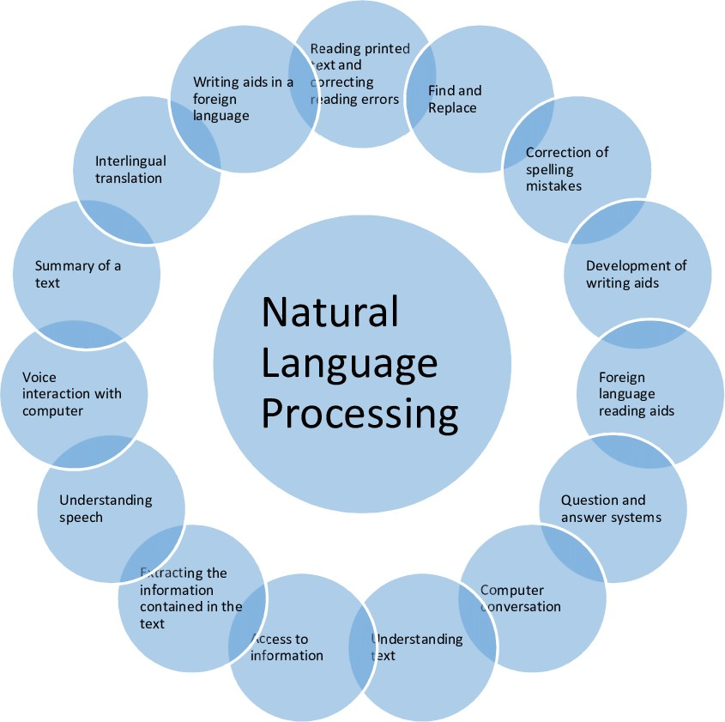
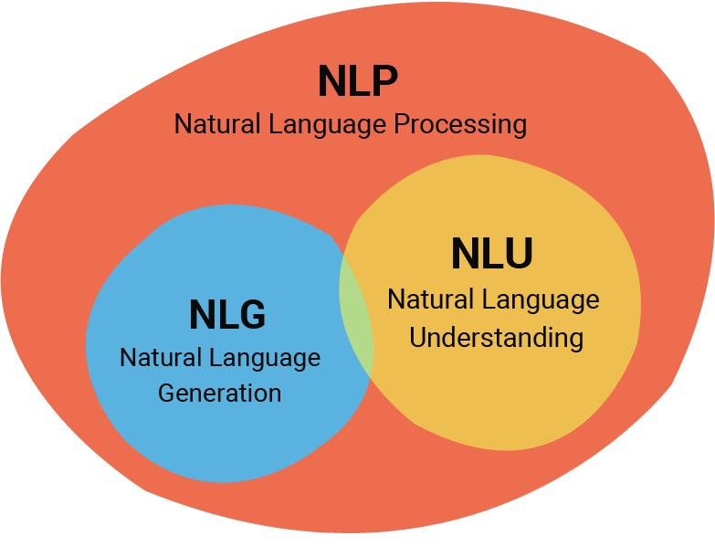
Applications of NLP
Question Answering
Text Summarization
Machine Translation
Chatbots / Conversation
Sentence Completion
Sentiment Analysis
…

Slide 16
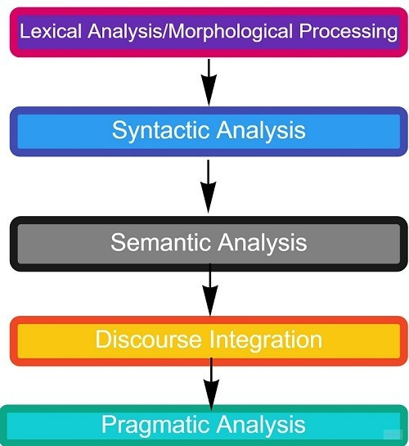
Phases of Natural Language Understanding
NLU involves extracting meaning, intent, and context from text
NLU can be broken down into five phases, each focusing on different aspects of language understanding and manipulation.
These phases make it possible that a machine can interpret and process language
These phases are required for NLU phase of NLP tasks and applications such as:
Machine Translation
Question Answering
Sentiment Analysis
…

Slide 17
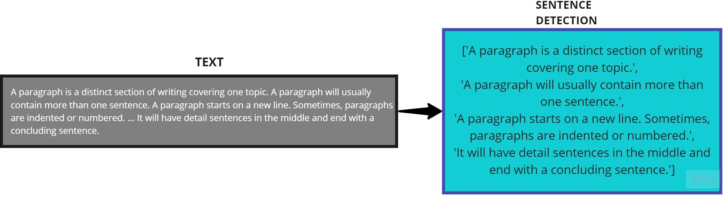
Lexical Analysis
Breaking down the input text into words, symbols, or other meaningful elements (called tokens).
Tokens are the smallest unit of text for processing in NLP. For example, The sentence “He came at 6 PM.” is divided into ["He", "came", "at", "6", "PM", "."] tokens.
Text can be divided hierarchically before tokenization. E.g., a paragraph may also be divided into sentences, etc.
Tokens
a
paragraph
is
…

Slide 18
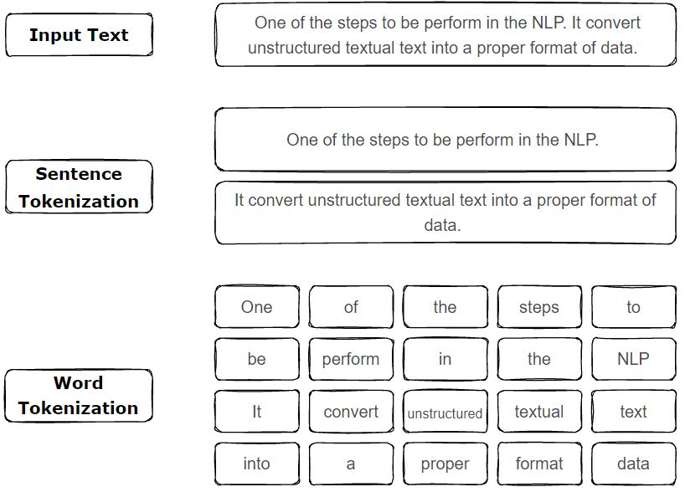
Word-based Tokenization
Each word in the text is considered a token
Splitting the text by spaces
Advantages:
Easy to implement
words are natural units in most languages
Disadvantages:
Languages without spaces between words (e.g., Chinese)
Misspelled words will be considered as a new token (Out of Vocabulary)
Huge vocabulary size

Slide 19
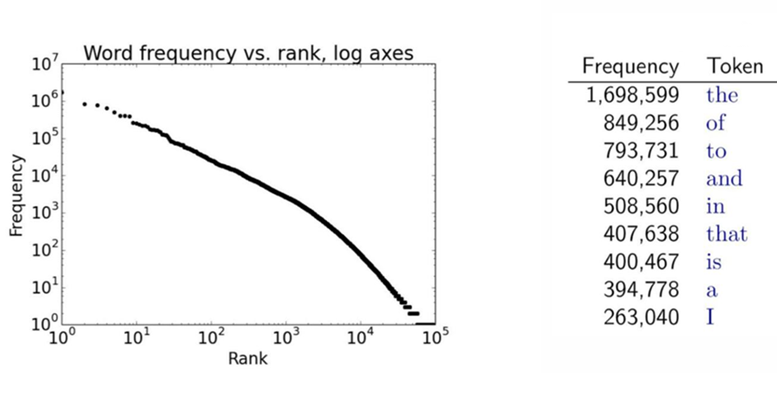
Challenges of NLP - Sparsity
Usually there are a lot of infrequent words in languages
Linguists often refer to the core vocabulary of 5,000–10,000 words for English language, which includes almost all words people use in daily conversation and writing
The Oxford English Dictionary (OED) contains about 600,000 words, including archaic and obsolete terms.
Infrequent Example: Antidisestablishmentarianism

Slide 20
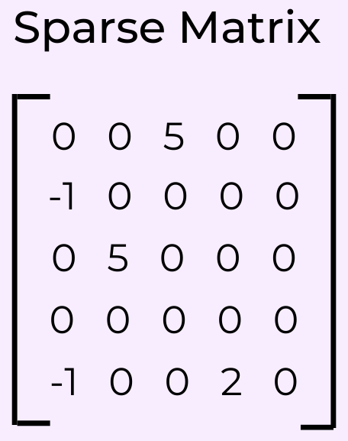
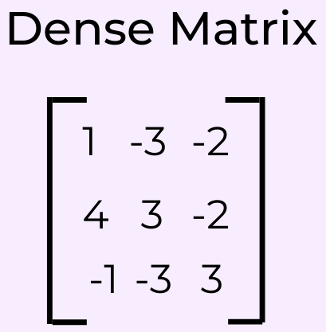
Challenges of NLP - Sparsity
Infrequent words make vocabulary large, and most words do not appear in any given document and training will be difficult.
Operations like matrix multiplications become slower when the matrices are large and sparse
One solution: Break down words into more frequent sub-word units
Each token has a row in the embedding matrix
Each token in vocabulary is a class for Softmax

Slide 21
Character-based Tokenization
Splitting the text into individual characters
Finest level of granularity
Advantages:
Usually small size of vocabulary (letters, digits, special characters , etc.)
Since every character is a token, there will be no Out Of Vocabulary (OoV)
Easy to implement
Can handle languages without spaces
Disadvantages
Larger sequence to be processed by models require more computational resources.
Doesn't inherently capture word-level semantics
The model may struggle to understand the overall context
One solution:
Frequent meaningful subword units
"hello“ →
["h", "e", "l", "l", "o"]

Slide 22
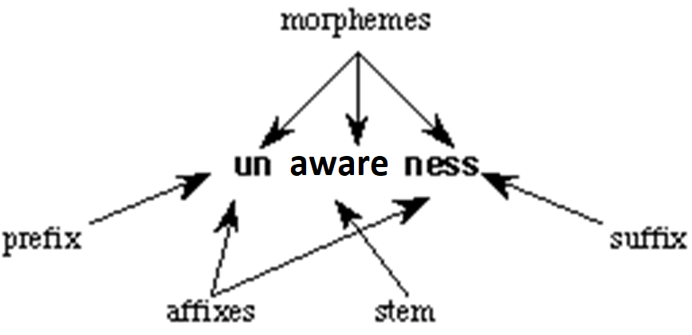
Morphological Processing
Morphemes are the smallest units of a word that carry meaning and cannot be further divided.
Morphological analysis can help address sparsity by collapsing related words into a single representation
Types of Morphemes
Free Morphemes: Text elements that carry meaning independently and make sense on their own. For example, “aware” is a free morpheme.
Bound Morphemes: Elements that must be attached to free morphemes to convey meaning. For example, the suffix “-ness” is a bound morpheme.
The vocabulary only needs free and bound morphemes, not every possible word using combination of them.

Slide 23
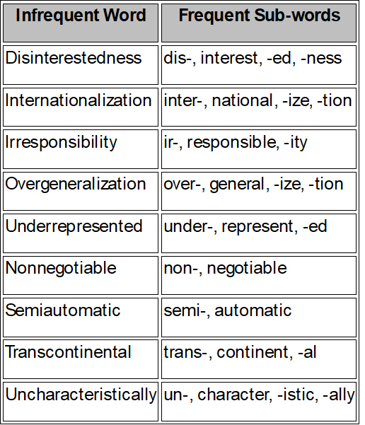
Subword Tokenization
Text is broken down into smaller units than words but larger than characters:
Frequently used words should not be split into smaller subwords
Rare words should be decomposed into meaningful subwords
Advantages
Capturing meaningful chunks of words while avoiding the excessive sequence lengths
Models can generalize across different forms of the same root word by breaking them down into common sub-words
Out Of Vocabulary words can be handled
Manageable vocabulary sizes
Disadvantages
Requires more complex algorithms
Problem: How recognize frequent subwords?
Greedy methods: Byte Per Encoding (BPE), WordPiece , etc.
Example: Antidisestablishmentarianism
-> Anti-, Dis-, Establish, -ment, -arian, -ism

Slide 24
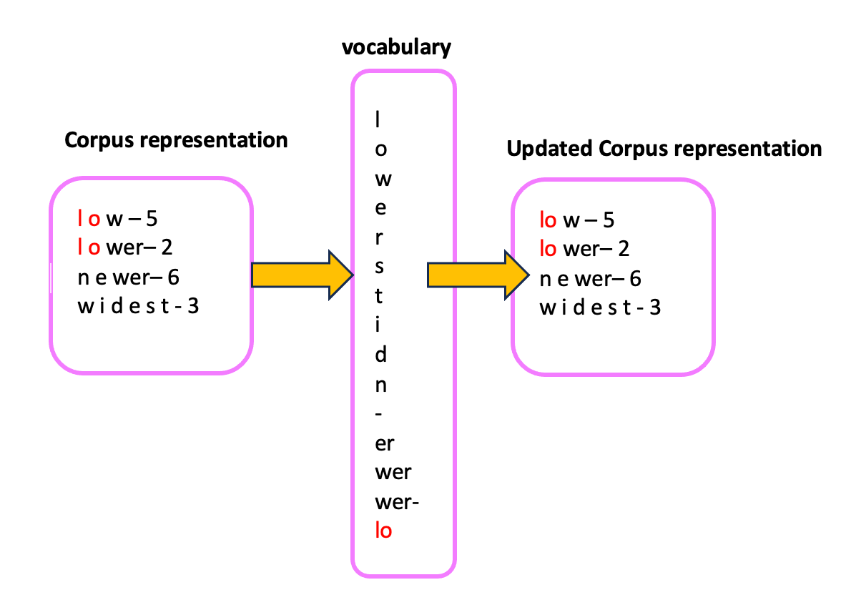
Byte-Pair Encoding (BPE)
BPE find common words/ sub-words based on frequency statistics on training data
Introduce new sub-words by merging the most frequent adjacent pairs of sub-words
Preserve frequent words since it merges common adjacent.
Handle rare or unknown words by breaking them down into smaller, more frequent sub-word units.
It helps create a fixed vocabulary size by representing words as a combination of their frequent sub-word components, thus improving the ability of the model to handle large vocabularies efficiently.
Main Hyperparameters of BPE:
Min-Frequency (for merging)
Max-Vocab-Size (maximum number of tokens)

Slide 25
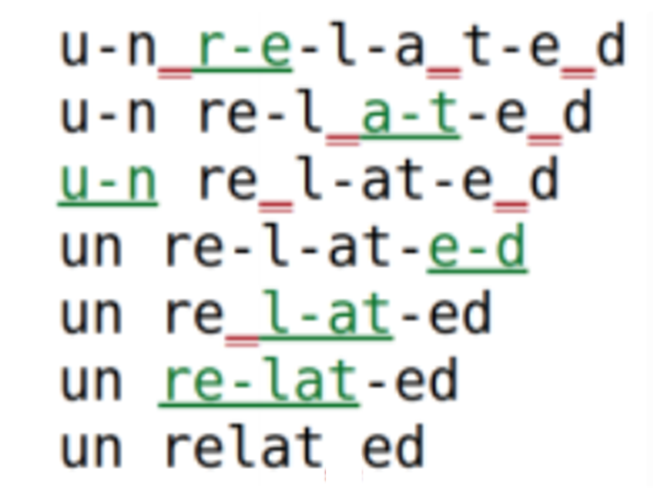
Byte-Pair Encoding (BPE) Steps
Starts with splitting the input words into single characters and add each of characters to the vocabulary
Find the most frequent occurring pair from the current vocabulary having a minimum frequency to merge and add them to the vocabulary
Repeat step 2 till the predefined number of tokens in the vocabulary are built or no new combination of symbols exist with required min-frequency
During inference, the model tries to match largest possible tokens that exist in the learned vocabulary (largest frequent token)

Slide 26
BPE Training- Example
Training data contains ["low", "lower", "lowest“] , min-frequency = 3:
1- Initial representation (characters):
low = ['l', 'o', 'w']
lower = ['l', 'o', 'w', 'e', 'r']
lowest = ['l', 'o', 'w', 'e', 's', ‘t’] (7 tokens in vocabulary)
2- Find and merge the most frequent character pairs in the corpus:
"l" and "o" are the most frequent pair:
low = ['lo', 'w']
lower = ['lo', 'w', 'e', 'r']
lowest = ['lo', 'w', 'e', 's', ‘t’] (8 tokens in vocabulary)
“lo" and “w" are the most frequent pair:
low = ['low']
lower = ['low', 'e', 'r']
lowest = ['low', 'e', 's', ‘t’] (9 tokens in vocabulary)
3- Repeat till maximum number of tokens or there is no frequent pair (based on minimum frequency threshold)

Slide 27
BPE Inference- Example
Tokenizing a text: “…lower level ….”
1- Finding longest match in vocabulary for “lower”
low = ['low’, ‘e’, ‘r’]
2- Finding longest match in vocabulary for “level”
level = [‘l’, ‘e’, <unknown>, ‘e’, 'l’]
Representing tokens with numbers:
Each token in vocabulary has a specific ID (e.g., 'l’ = 1, 'low’ = 4 , etc.)
Since BPE is a greedy algorithm sometimes the results are not optimum, especially if the training data is limited (e.g., here, “er” is not recognized as a token)

Slide 28
Advantages and Limitations of BPE
Efficient Vocabulary Size:
BPE limits the vocabulary size while still being able to represent a vast number of words by breaking rare words into sub-word units.
Handling Out-of-Vocabulary (OOV) Words:
BPE can break down unseen or rare words into smaller known sub-words, helping the model handle any words using the vocabulary. At the worst case they can represented by characters.
Flexibility:
BPE ensures that common words are treated as whole units, while rare or complex words are split into meaningful sub-words.
Suboptimal for Morphologically Rich Languages:
BPE can sometimes produce unnatural sub-word splits in languages with complex morphology.

Slide 29
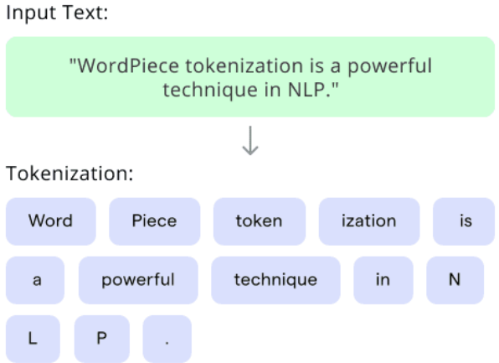


Word-Piece Tokenization
WordPiece is a subword tokenization technique which merges characters and subwords in a way that preserves semantic meaning
WordPiece algorithm is a greedy method similar to BPE
WordPiece chooses subword merges that maximizing the likelihood of the existing sequence in the training data.
WordPiece tends to result in subword tokens that are more meaningful in languages with complex morphology
$$P\left(\text{Training} \text{corpus}\right)=\prod_{i=1}^{N}{P}\left(w_{i}\right)$$

Slide 30
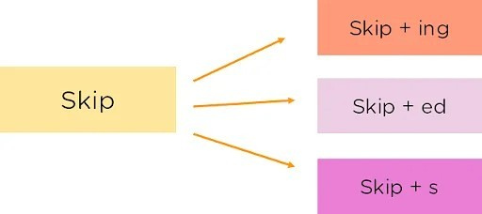
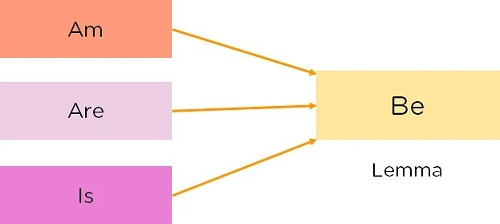
Lexical Analysis - Stemming and Lemmatization
One approach for reducing the size of vocabulary is to reduce words to their base or root form:
Stemming is a process that extract stems by removing suffixes from a word
Lemmatization considers the context and converts the word to its meaningful base form, which is called Lemma
These techniques are used mostly in classical NLP pipelines (e.g., SVM) rather than modern LLMs, since LLMs try to capture full syntax and semantics
Stemming

Slide 31
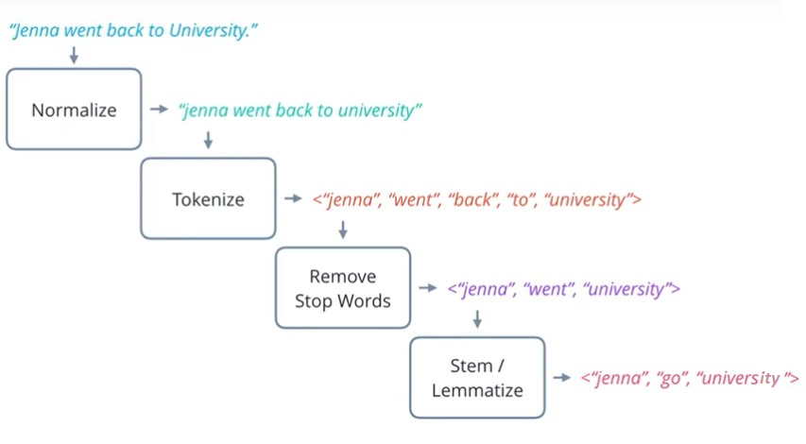
Lexical Analysis - Normalization
Lowercasing, removing punctuation and stop-words and handling special characters.
Stopwords Removal: Eliminating Words that are function words helping form sentence structure: the, of, and, …
For an application, an additional domain specific stop words list may be constructed
Pros:
Reduces the complexity of the text, helping focus on the more meaningful parts of the content
create a more uniform text
Cons:
Can sometimes cause issues for NLP tasks: e.g., phrases: “to be or not to be”

Slide 32
Limitations of Normalization
Normalizing reduces the number of unique tokens, vocabulary size, feature space, and computation power in classic NLP models (shallow models)
In deep learning NLP models (e.g., LLMs) most of normalizing steps are not common:
Lowercasing: May not be ideal for named entity recognition (NER). (e.g., "Apple“ as company and "apple“ as fruit)
Some LLMs such as BERT-Uncased which uses lowercase version of WordPiece employ lowercasing
GPT models preserve case information because they use Byte-Pair Encoding (BPE) tokenization
Removing stopwords: LLMs do not remove stopwords since contextual meaning may depend on them (e.g., To be or not to be)
Removing special characters: LLMs do not remove special characters since might lose important formatting for code processing, etc. (e.g., s=“a string”)

Slide 33
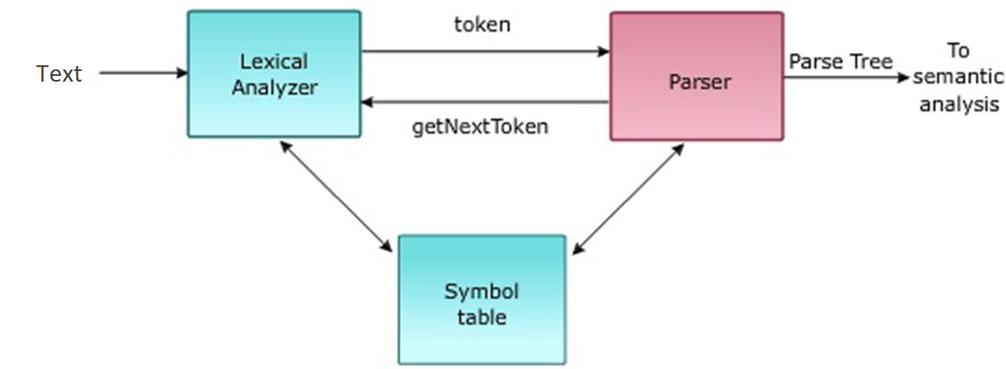
Syntactic Analysis
Structural relationships between words
Grammatical structure of a sentence is analyzed
Syntactic parser checks for word arrangements and grammar:
Find the roles played by words in a sentence (e.g., noun, verb, etc.)
Interpret the relationship between words (e.g., adjective describing a noun)
Interpret the grammatical structure of sentences (sentence-level structure)
Correct Syntax: “John eats an apple.”
Incorrect Syntax: “Apple eats John an.”

Slide 34
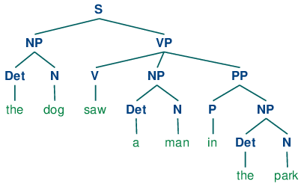
Syntactic Analysis
Traditional Approach:
Part-of-Speech (POS) Tagging: Assign a grammatical category (noun, verb, adjective, etc.) to each word (e.g., using Hidden Markov Models)
Chunking: Identify noun phrases, verb phrases, etc. (e.g., using regular expression)
Parsing: Build a parse tree (e.g., using graph-based parsing)
Grammar Checking: Identify syntactic errors (e.g., using rule-based grammar check)
Deep Learning-Based Methods:
Use deep neural networks to capture syntactic dependencies without relying on explicit grammar rules (e.g., capturing words relationships using hidden state in RNN and self-attention in Transformers)

Slide 35
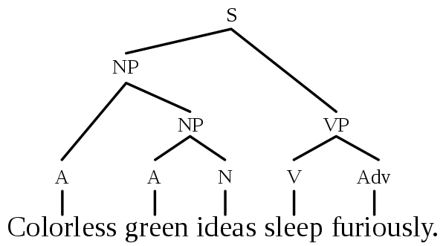
Semantic Analysis
Derive the meaning of the sentence (words together).
Unlike syntactic analysis, which deals with grammatical structure, semantic analysis is concerned with the literal and contextual meaning of words, phrases, and sentences.
Example: “colorless green idea.” This would be rejected by the semantic analysis as colorless green doesn’t make any sense.
Correct Syntax: “ Colorless green ideas sleep furiously”
Incorrect Semantic: “ Colorless green ideas sleep furiously”

Slide 36
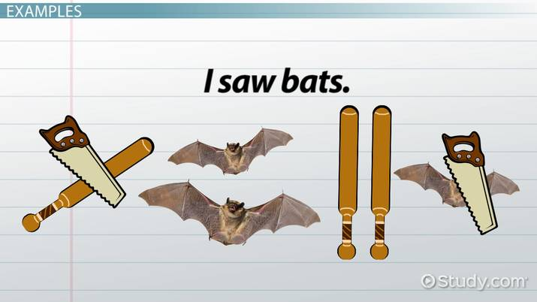
Some Challenges of Semantic Analysis
Lexical Ambiguity: Different meaning of a word in different context
Example: The word “bat” can refer to a flying mammal or a piece of sports equipment.
Referential Ambiguity: A word or phrase could refer to multiple entities
Example: In the sentence, "John told David he was late," the word he could refer to John or the David
NFR, WSD, and Coreference Resolution can be used to address these issues

Slide 37
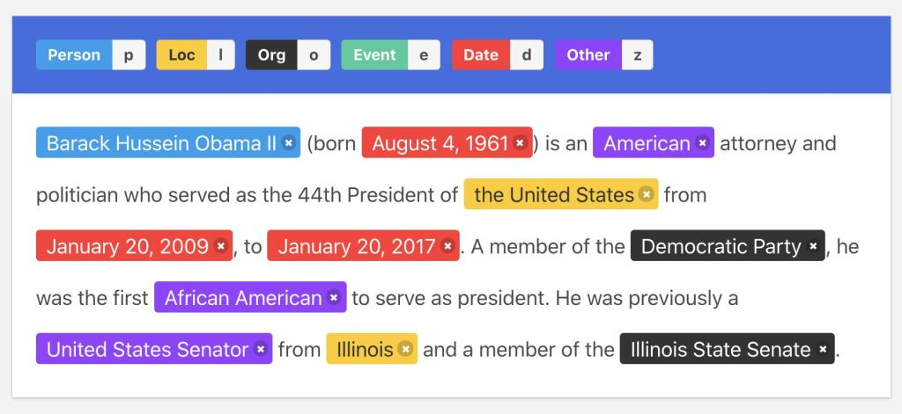
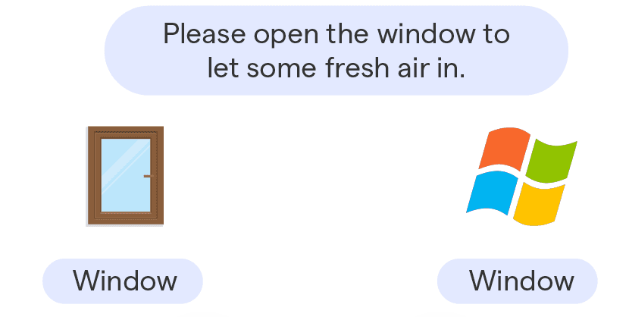
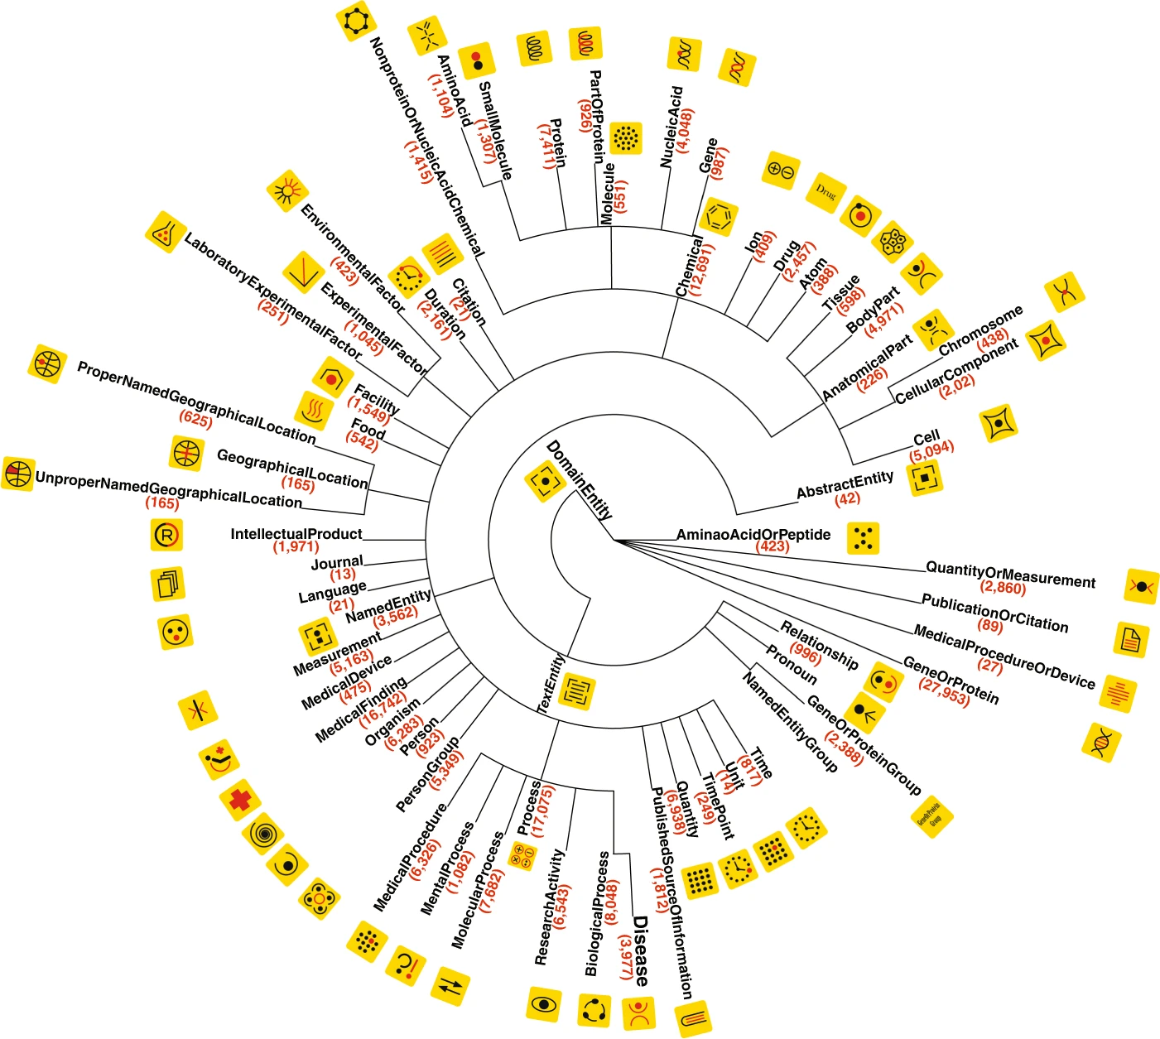
Semantic Analysis - Traditional Approach
Word Sense Disambiguation (WSD): Choose the correct meaning of words based on the context (e.g., using surrounding words in Knowledge-bases like WordNet)
Named Entity Recognition (NER): Detects and classifies entities like persons, organizations, locations, dates, etc. (e.g., using Hidden Markov Models)
Coreference Resolution: Finds expressions that refer to the same entity (e.g., using classifiers like SVM, DT, etc.)

Slide 38
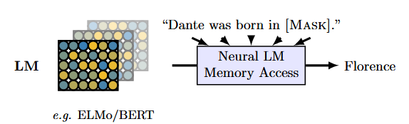
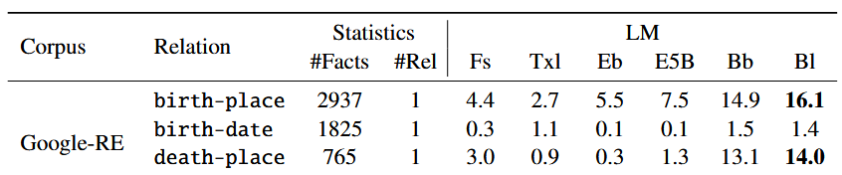
Semantic Analysis - Deep Learning-Based Methods
Word Sense Disambiguation (WSD): Deep neural networks capture word senses using the context (hidden states in RNNs, self-attention in Transformers)
Named Entity Recognition (NER): LLMs are pre-trained on huge data, which makes them strong at recognizing named entities patterns also recalling information (LLMs as knowledge bases)
Coreference Resolution: LLMs learns resolution patterns from pre-training on large text data
https://arxiv.org/pdf/1909.01066

Slide 39
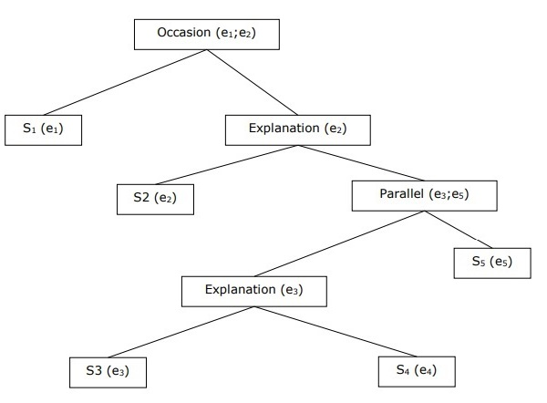
Discourse Integration
Understand how individual sentences are connected to form a coherent message.
Semantic analysis focuses on sentence-level meaning but discourse integration handles multi-sentence context
Example: “It rained heavily. Therefore, the match was canceled.”
Relation = Explanation
Example: “She studied hard. However, she didn’t pass.”
Relation: Contrast
S₀ and S₁ represent the two related sentences

Slide 40
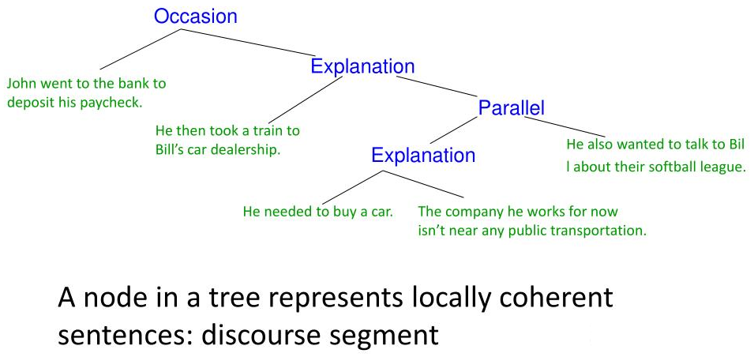
Discourse Integration
Traditional NLP Approach:
Coreference Across Sentences: Identifying coreference across multiple sentences (e.g., using shallow classifiers like Naïve Bayes). For example, “John likes pizza. He and his friend went to a restaurant”
Discourse Relations: Identify logical connections between sentences like explanation, contrast, temporal order, etc. e.g., using a parse tree where:
Nodes represent sentences
Edges define relations
Deep Learning-Based Methods:
Deep neural networks are trained to learn dependencies between sentences from raw text (e.g., capturing long range dependencies using self-attention in Transformers and hidden state in RNNs)

Slide 41
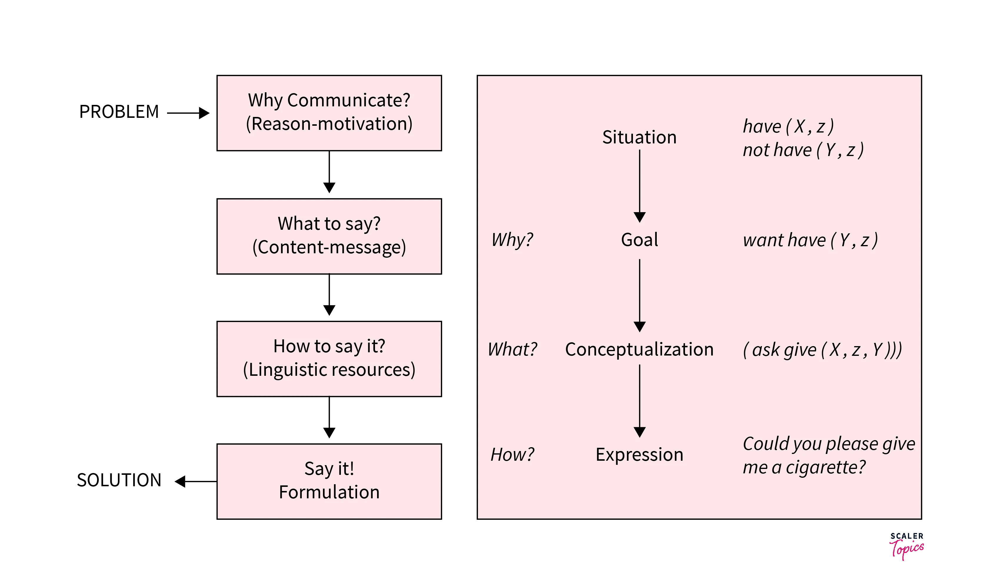
Pragmatic Analysis
Interpret the text considering the context and implied meanings.
Understanding implied meanings, user intent, and tone.
Handling idiomatic expressions and conversational maxims.
Example: "Can you open the door?" is interpreted as a request, not a question about ability (Politeness & Indirectness)
Expressivity as a challenge of NLP: the same meaning can be expressed with different forms

Slide 42
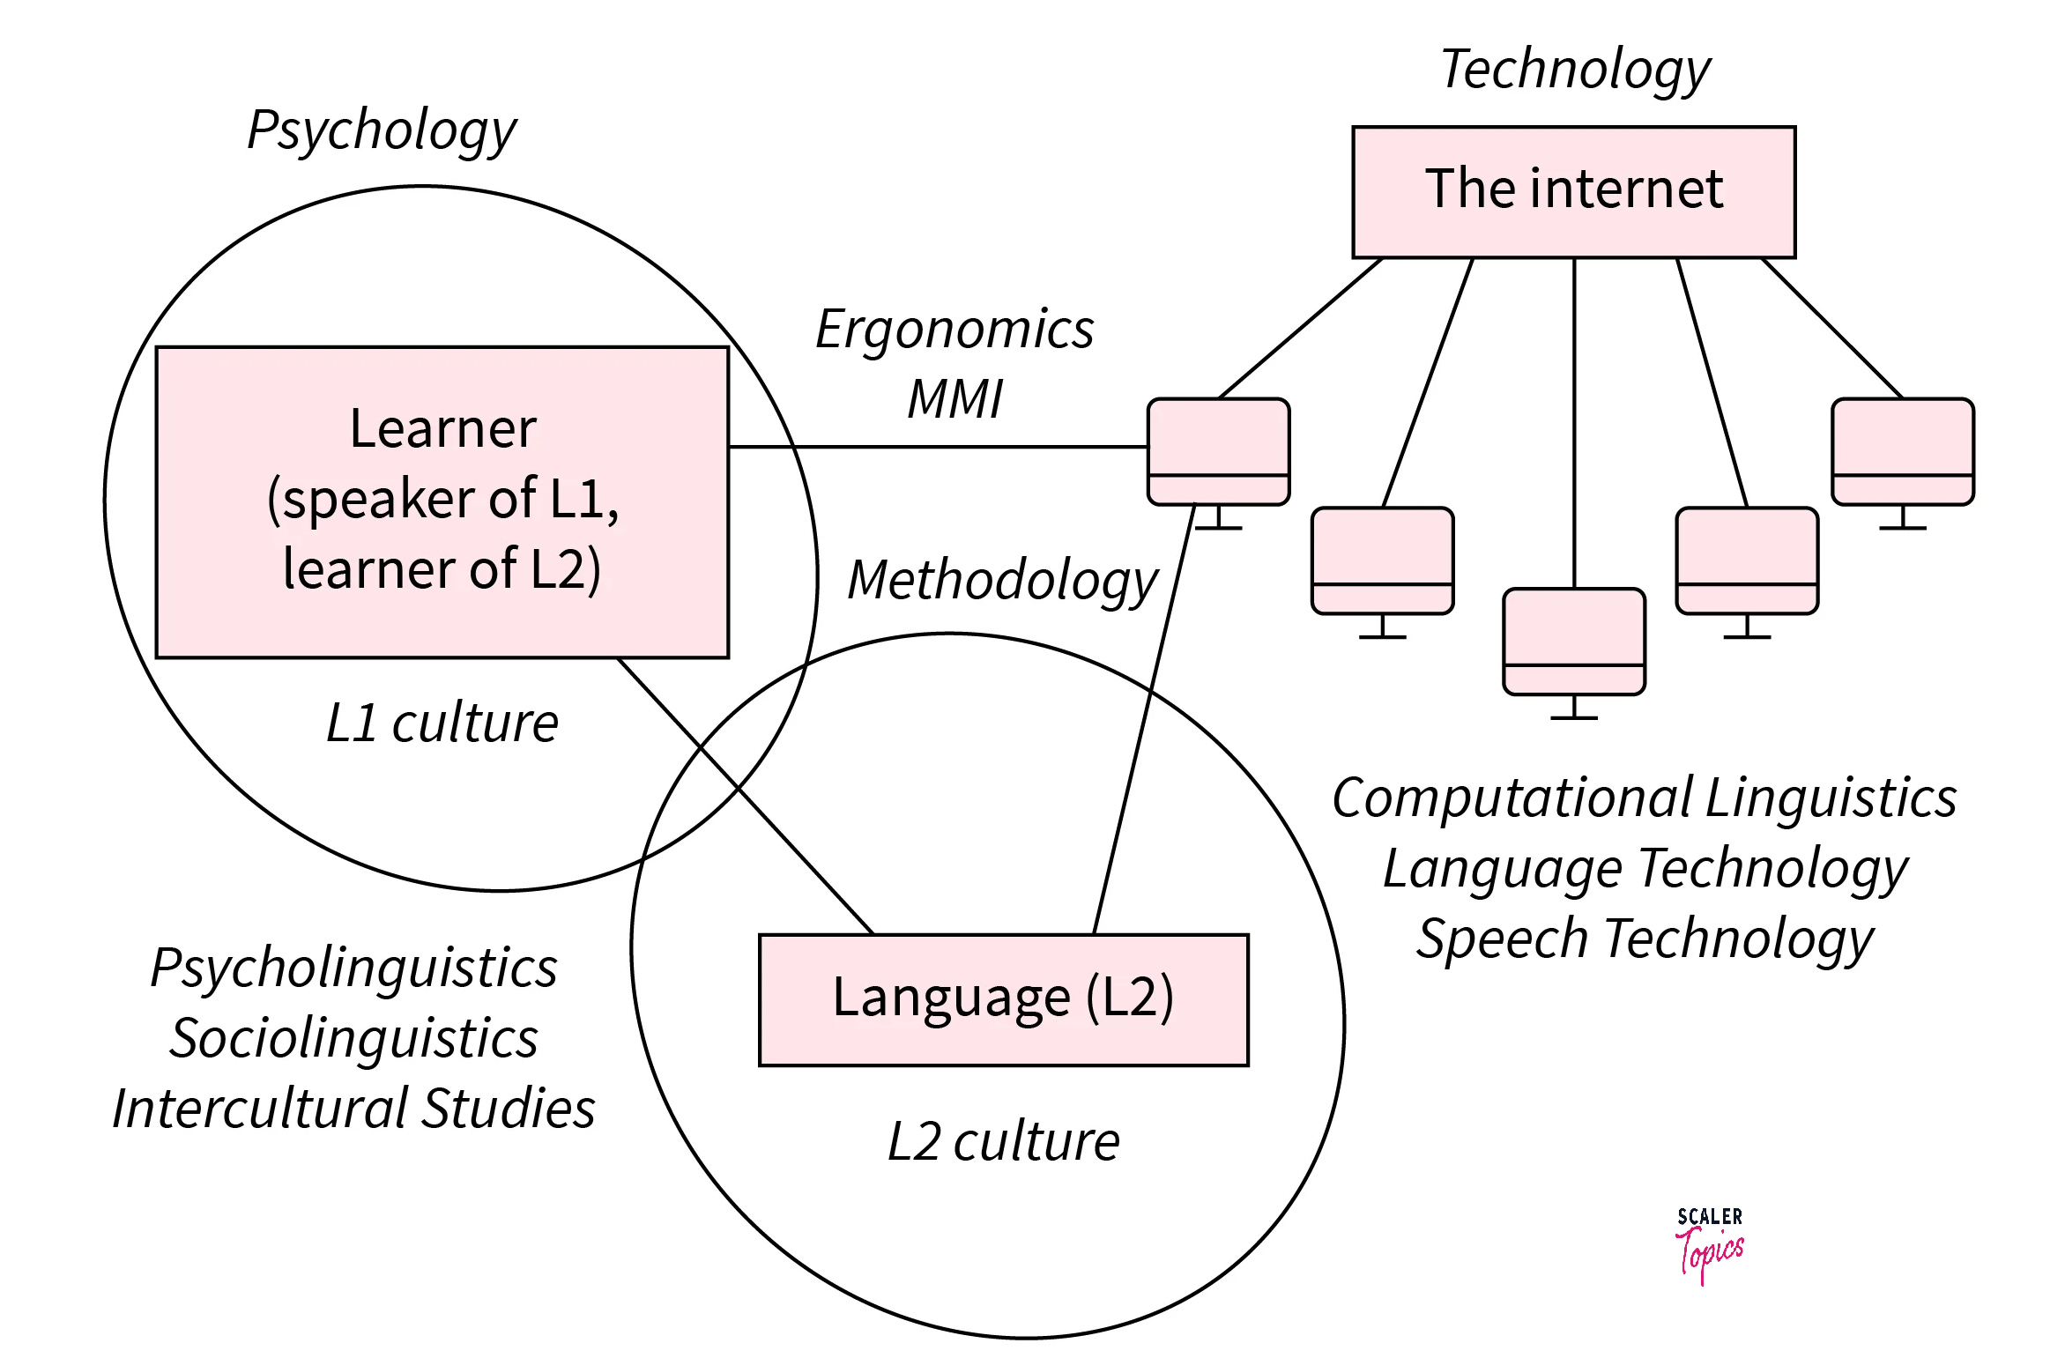
Pragmatic Analysis - Some Methods
Traditional NLP Approaches:
Knowledge Graphs: Use ontologies (e.g., domain-specific information) to interpret text within the context of a specific field or situation.
Rule-Based Models:
Detect common linguistic markers and patterns.
Deep Learning-Based Methods:
Deep neural networks are trained on huge data to learn the intent of text in different contexts using long-term dependencies and context shifts (e.g., capturing long range dependencies using self-attention in Transformers and hidden state in RNNs)

Slide 43
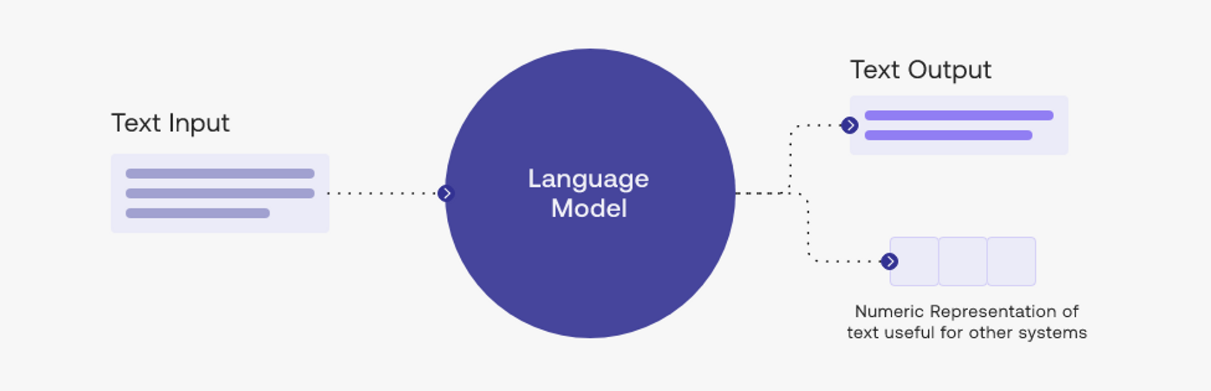
Natural Language Generation (NLG)
Generate human-like text based on certain inputs
It involves the use of language models to generate coherent and contextually appropriate text
Text generation typically relies on context extracted from the input (NLU)
Examples: Generating answer for a question, generating translation of an input text, generates a story based on a user prompt, etc.
Input can be a text from different language (in translation)
A Question (in question answering)
Etc.

Slide 44
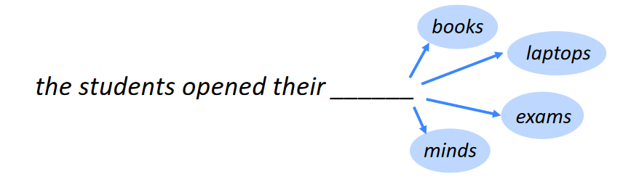
Language Model
Independently choosing the most likely word based on the last word doesn’t guarantee that the individual choices make sense together
A language model can predict the likelihood of a sequence of words in a context based on pattern learned during training
E.g., probabilities of different combination of the same words for the following question:
Q: What do you feed your cat? (context)
A1: I fed my cat with meat: P(I, fed, my, cat, with, meat) = 0.03
A2: My cat fed I with meat: P(My, cat, fed, I, with, meat) = 0.000005

Slide 45

Autoregressive Language Models
A class of models in NLP that generate text by predicting the next token in a sequence, based on the previously generated tokens and the context
Given a sequence of words 𝑤1,𝑤2,...,𝑤𝑛 , an autoregressive model estimates the probability of the next word :
The joint probability of a sentence:
P(I, fed, my, cat, with, meat) =
P(I) *
P(fed | I) *
P(my | I, fed) *
P(cat | I, fed, my) *
P(with | I, fed, my, cat) *
P(meat | I, fed, my, cat, with) *
Probability that the first word is “I” (based on the context)
Probability that the second word is “fed” if the first word is “I” (based on the context)
Probability that the third word is “my” if the first and second words are “I fed” (based on the context)

Slide 46
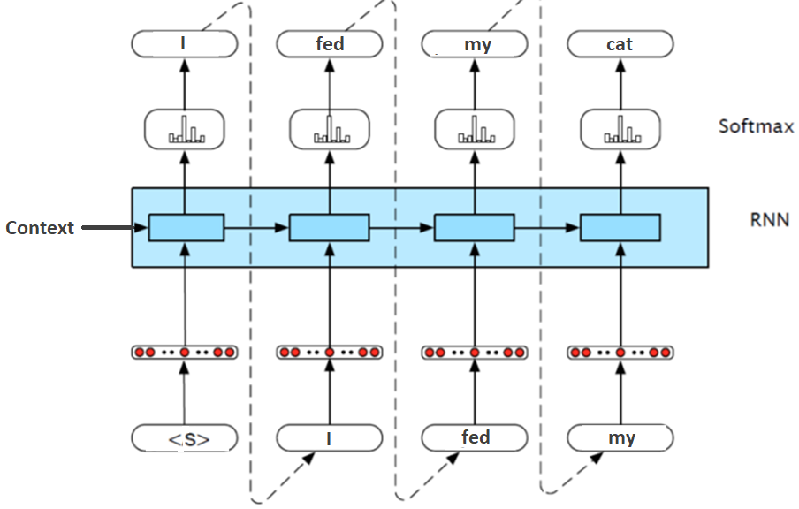
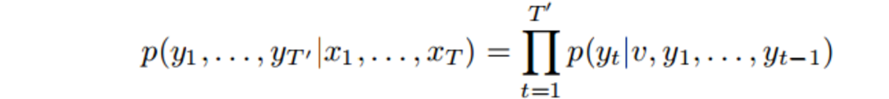
Autoregressive Models
We can use an RNN to generate text
At each step, predicts the next token in a sequence using previous steps.
This is a classification using softmax on a vocabulary
Hidden state conveys the information of all previous words and context

Slide 47
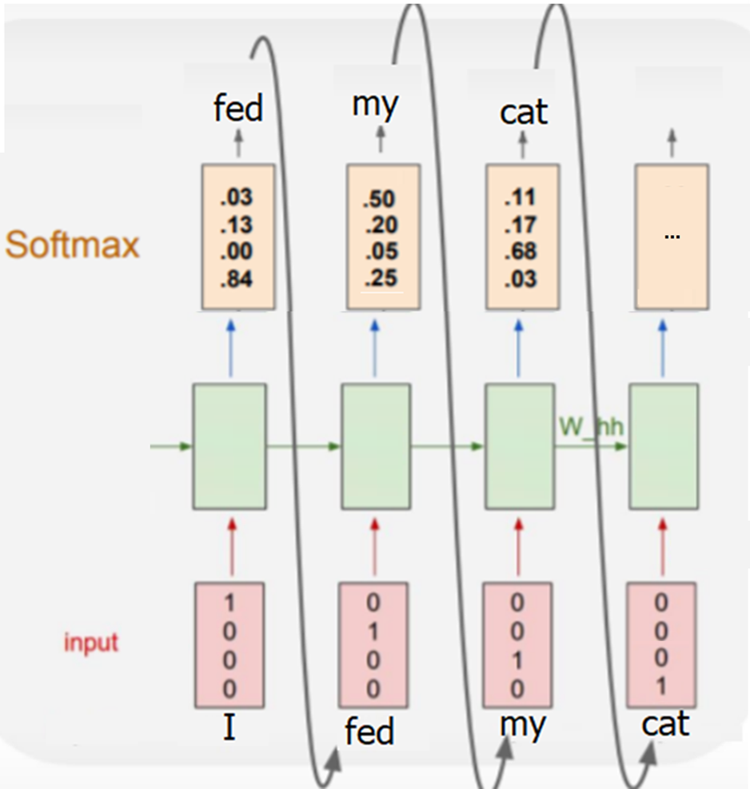
Example
(my | I, fed) = 0.5
P(fed | I)=0.84
P(cat | I, fed, my)=0.68
Suppose that our vocabulary just has 4 words (classes) :
[I, my, cat, fed]
The model is trained on diverse text as training data to learn the probability of each word following a sequence of others in different contexts.
Classes:
my
I
cat
fed
Context

Slide 48



NLP Tasks - Sentence Completion
Trained RNN can be used to complete a given sequence of words:
The last hidden state of prefix encoded the context of information of all previous states in a vector
The model predicts the most likely next word based on the context and the last predicted word
$Most probable word=softmax$(V$h_{t}$)
$h_{t}=$g($h_{t−1}$+W${∗x}_{t}$)

Slide 49

NLP Tasks - Translation
A text in source language, enters into the network to generate context (hidden states)
Autoregressive, generates a word in the context of the hidden state in target language
Subsequent words are conditioned on the previous hidden state and the last word generated

Slide 50


Encoder and Decoder
Many NLP tasks are a combination of language understanding and language generation:
Encoder models can be used to understand input sentences, and decoder models can be used to generate output sentences.
An encoder that accepts an input sequence and generates a context vector, conveys the information of the input to the decoder.
A decoder receives context as input and generates an arbitrary length sequence of outputs

Slide 51


Encoder‐Decoder Networks - Challenge
The hidden state conveys both information of encoder context and previous words in the decoder:
Problem: the influence of the context information in hidden state wanes as the output sequence is generated (only short-term memory of last words rather than long-term memory of context)
Solution: make the context vector available at each step in the decoding process by adding it as a parameter to the computation of the current hidden state.

Slide 52

Long Term vs Short Term Memory
Long term memory is needed to represent the context of the source text
Short term memory is needed to represent of previous words in target language
trained on sentences in first language
trained on sentences in second language
Translation
Task
Hidden state in decoder (short memory)
Encoder context (long memory)

Slide 53


Encoder Decoder Networks - Improved
Encoder: takes an input sequence and generates a contextualized representation of the inputs.
Context vector: conveys the information of the input to the decoder.
Decoder: takes the context vector and autoregressively generates a sequence of outputs based on the context, last hidden state, and last predicted output

Slide 54

NLP Tasks – Conversation
Encoder: Processes the input message in a conversation and generates a contextualized representation (context vector) that conveys its meaning.
Decoder: Generates the response one token at a time autoregressively, based on the encoder’s context and previously generated tokens.
Problem: Different tasks needs different type of generations / responses (e.g., translation generation is different with conversation)
Solution: different training

Slide 55

Encoder‐Decoder Training
Encoder‐decoder architectures are trained end‐to‐end
Each training example is a tuple of paired strings, a source and a target (e.g., for machine translation, the training data typically consists of sets of sentences and their translations)
During the training (backpropagation) the weight are adjusted in a way the minimize loss (minimize difference between model’s output and target)

Slide 56

Training - Teacher Forcing
During forward propagation in training the model predict one token at each decoding step which can be aligned with target text or not
Teacher forcing involves feeding target sequence values (i.e. ground-truth samples) back into the RNN after each step, thus forcing the RNN to stay close to the true sequence.
During training, the model is given the actual target (correct) sequence as input at each step instead of its previously generated tokens.

Slide 57

Exploding and Vanishing Gradient Problem
In backpropagation, the recurrence multiplication of gradients can result in difficulties called exploding and vanishing gradient problem
In vanishing gradients, the gradient of a long-term interaction has exponentially smaller magnitude than the gradient of a short-term interaction therefore, it might take a very long time to learn long-term dependencies
Output = Relu(Relu(Relu(x1*w1) * W2 + x2*W1)* W2 + x3*w1)
W1 = w1 - Learning Rate * $\frac{∂E}{∂w_{1}}$
Chain Rule : $\frac{∂E}{∂w_{1}}$ = $\frac{∂E}{∂output}$ * $…$
$\frac{∂E}{∂W_{1}} includes$ many multiplications of $W_{2}$ and the activation derivative
If $∣w_{2}f^{′}\left(u\right)∣<1$ (typical) then $\frac{∂E}{∂W_{1}}$ would be very small (vanishing)
If $∣w_{2}f^{′}\left(u\right)∣ >1$ then $\frac{∂E}{∂W_{1}}$ would be very large (exploding)
Error (E)
Real Output

Slide 58


Vanishing Gradient Problem
Slow or stalled learning in vanishing gradients (stop learning)
Overshoots the optimal point in exploding gradients (unstable learning)
Inability to learn long-term dependencies
Some Solutions:
Use non-saturating activation functions
Careful weight initialization: e.g., Xavier
Batch / Layer Normalization: Keeps inputs in sensitive range
Residual connections: Help gradients to bypass some time steps
Use Gated Architectures: e.g., LSTM, GRU, etc.
Use Attention Mechanisms
$W_{}=W_{} − LearningRate∗\frac{∂E}{∂W_{}}$

Slide 59




Activations Functions
In backpropagation, If the activation function is saturated (very flat), it produces near-zero gradients:
Sigmoid is saturated for large positive or negative values (derivatives are small)
In traditional RNN, Tanh activation function was used instead of sigmoid
Tanh saturates slower and has a maximum derivative of 1 (0.25 for Sigmoid)
Even Tanh is saturated for large positive or negative values
Rule Chain: $\frac{∂E}{∂w_{1}}$ = $\frac{∂E}{∂output}$ * $\frac{ ∂output}{∂input}$

Slide 60



Non-Saturating Activations
ReLU:
Not flat for positive inputs but 0 for negative values
For negative values, the weights stop updating (dead neuron)
Leaky ReLU, ELU, GeLU handle negative values better
GeLU (Used in Transformer Architecture)
Not flat for moderate negative values
Smooth and differentiable, but more expensive

Slide 61

Batch Normalization
BatchNorm is typically applied to the weighted sum of inputs of neurons before applying the activation function, during training
For each neuron, BatchNorm computes the mean and variance over the batch of data (mini batch) for each feature, and normalizes data using these values
Since the input of the activation function is within sensitive range (high-gradient region) the gradient would not be flat
Step 1: Compute the pre-activation outputs zi=Wxi+b
Step 2: Compute mean and variance of Zi for the batch
Step 3: Normalize zi
Step 4: Apply the activation function

Slide 62


Gated Architectures - Long Short-term Memory (LSTM)
LSTM introduces a set of gates (forget, input, output) that regulate the flow of short-term and long-term information to deal with vanishing / exploding gradients
Just like a simple RNN, an LSTM also has a hidden state of the previous timestamp, known as short term memory.
The cell state is known as long term memory carries the information along with all the timestamps.
LSTM is efficient for NLP applications need processing long sequences

Slide 63

NLP Tasks Without NLG - Sentiment Analysis
Sentiment Analysis is an NLP task that determines whether a given text expresses a positive or negative (or sometimes neutral) sentiment
Encoder: Receives positive or negative reviews as input text and generate a contextualized representation of the text.
Classifier: The final hidden state (contextualized representation) is passed to a fully connected layer to classify sentiment (there is no decoder)

Slide 64

NLP Tasks - Text Summarization
Encoder: Receives a long text (articles, paragraphs) as input and generate a contextualized representation of the text.
Decoder: Receives the information of articles from encoder and autoregressively create summaries based on the input context
Problem: The source text may contain a lot of information that needs to be encoded in the context

Slide 65

Encoder‐Decoder Bottle-Neck
This context vector is the hidden state of the last time step of the source text.
This final hidden state is thus acting as a bottleneck:
It must represent absolutely everything about the meaning of the source text
Information at the beginning of the sentence, especially for long sentences, may not be equally well represented in the context vector.

Slide 66

Attention in RNN
Instead to use the same context for all steps in decoder, generates a new context for each decoder step
The relevant tokens for each step attend more in the context of that step
Compute weights (relevance) for context of each token (hidden state) in encoder based on alignment with the context of decoder step (hidden state of decoder)
To compute relevance (weights), dot product is applied on context vectors
For generating a token in decoder, the weighted sum of all the encoder hidden states adds to context of decoder
The context value 𝑐_{i} is one of the inputs to the computation of ℎ^{d}. It is computed by taking the weighted sum of all the encoder hidden states, each weighted by their dot product with the prior decoder hidden state ℎ^{d} .

Slide 67

Attention - Example
Most relevant world in source text are attending in the context of target words
Example: machine translation
Encoder
Decoder
For generating each token in decoder, the model computes attention weights (relevance) by comparing the context o$f it (\text{which} \text{queries}) with context of each token in encoder ($attending context)

Slide 68


Attention - Example
Translating an English sentence into French:
“The quick brown fox jumps over the lazy dog”
To translate the word "renard" (French for "fox"):
Input Word | Attention Weight
The | 0.10
quick | 0.10
brown | 0.25
fox | 0.45
jumps | 0.01
over | 0.01
lazy | 0.01
dog | 0.01

Slide 69
Attention - Advantages
Long-Range Dependencies:
Instead of relying on a single final hidden state from the encoder, attention allows the decoder to dynamically focus on relevant parts of the input sequence, regardless of how far back they are.
Bottleneck Problem:
In standard RNNs, all the information from the input sequence is compressed into a single hidden state, which can lead to information loss for long sequences. Attention avoids this by considering all hidden states during decoding.
Encoder-Decoder Attention:
In RNNs, the attention is typically between encoder and decoder, so it is called the encoder-decoder attention. There are also other types of attention such as self-attention which is used in transformer neural networks.

Slide 70
Assignment 3
Train three BPE tokenizer models on training text using the following hyper-parameters:
min_frequency=2, vocab_size=20
min_frequency=2, vocab_size=50
min_frequency=3, vocab_size=50
Use each of the trained models to encode the following sentence:
“he is unfair and unaware and unresponsive”
Which set of hyper-parameters creates best results?
Training Text:
is he fair and aware and responsive ?
he is fair and aware and responsive
he is unhappy and unkind and unpleasant

