Slide 1
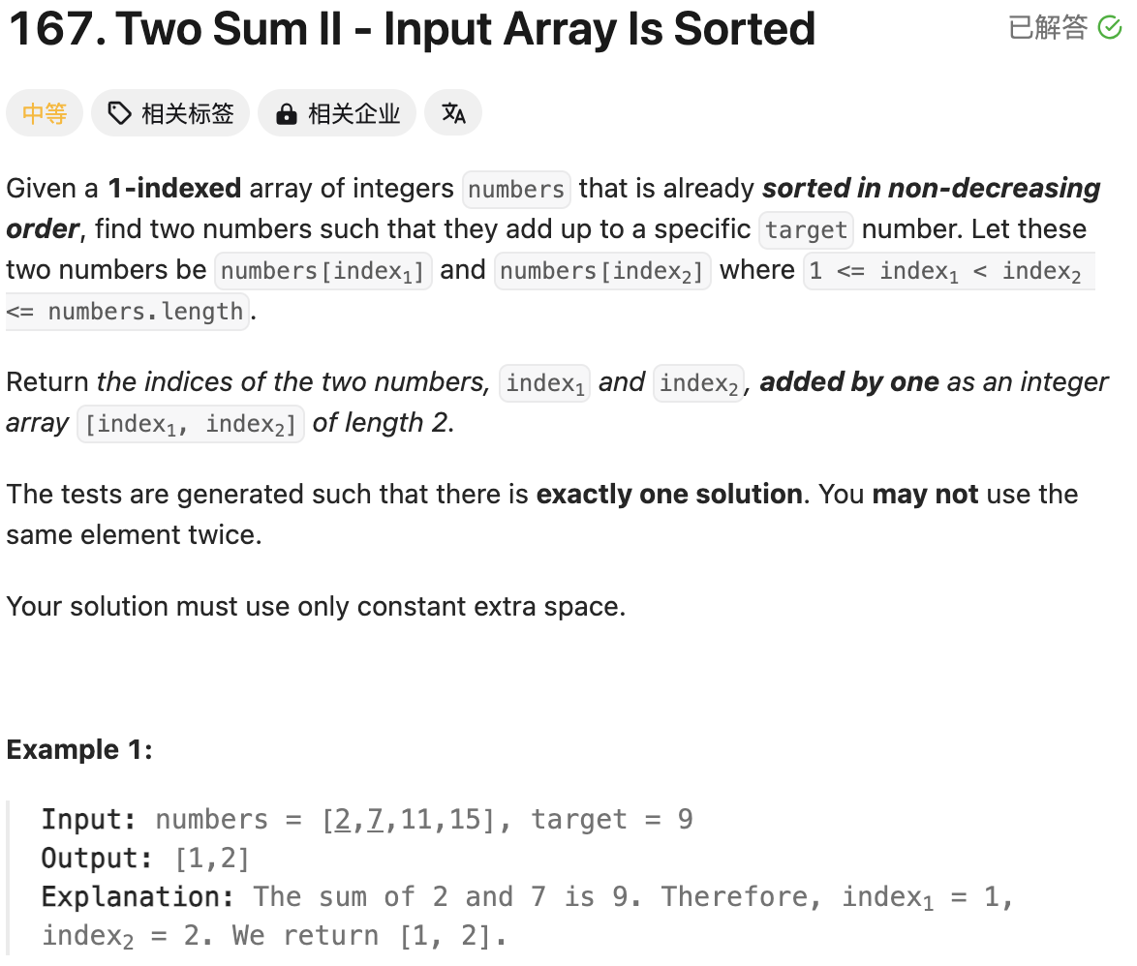
2 | 7 | 11 | 15 | 17
Bidirectional double pointer
Question tells us that it is already sorted in non-decreasing.
Brutal Force: Running time is O(n^2); Space is n
Bidirectional double pointer: Running time is O(n); Space is 1
class Solution(object):
def twoSum(self, numbers, target):
"""
:type numbers: List[int]
:type target: int
:rtype: List[int]
"""
# Double Pointers
left = 0
right = len(numbers) - 1
while left < right:
s = numbers[left] + numbers[right]
if s == target:
break
elif s < target:
left += 1
else:
right -= 1
return [left+1, right+1]

Slide 2
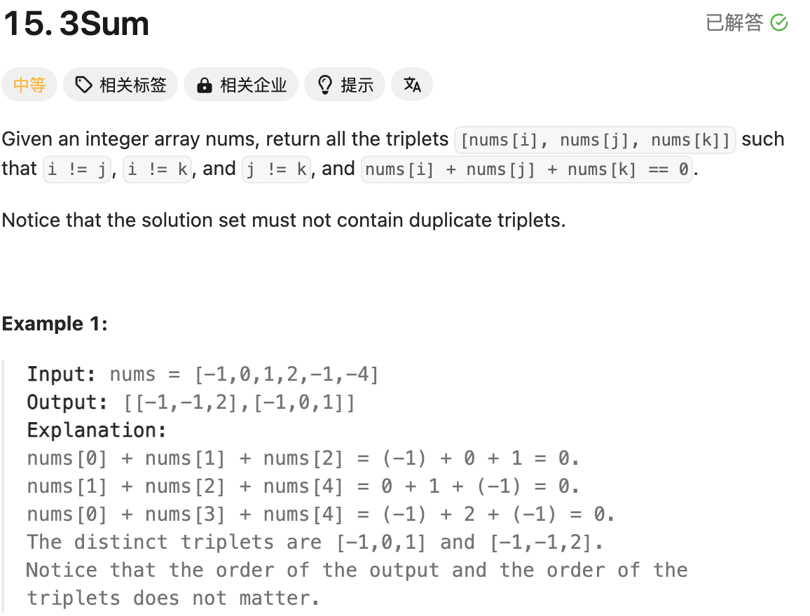
2 | 7 | 11 | 15 | 17
x + y + z = 0
X 为外侧循环指针，y 为左侧指针， z为右侧指针，同上面Two Sum思路一致
另外，Not Contain Duplicate Triplets, 需要判断x/y/z与之前是否相同
优化细节：
num[i] + num[i+1] + num[i+2] >0 break
num[i] + num[n-1] + num[n-2] <0 continue
class Solution(object):
def threeSum(self, nums):
"""
:type nums: List[int]
:rtype: List[List[int]]
"""
# Running time is O(nlogn)
nums.sort()
n = len(nums)
ans = []
# Running time is O(n^2)
# Space complexity is O(1)
for i in range(n-2):
x = nums[i]
if i > 0 and nums[i-1] == x:
continue
if x + nums[i+1] + nums[i+2] > 0:
break
if x + nums[n-1] + nums[n-2] < 0:
continue
left = i + 1
right = n - 1
while left < right:
s = x + nums[left] + nums[right]
if s > 0:
right -= 1
elif s < 0:
left += 1
else:
ans.append([x, nums[left], nums[right]])
left += 1
while left < right and nums[left] == nums[left-1]:
left += 1
right -= 1
while right > left and nums[right] == nums[right+1]:
right -= 1
return ans

