Slide 1
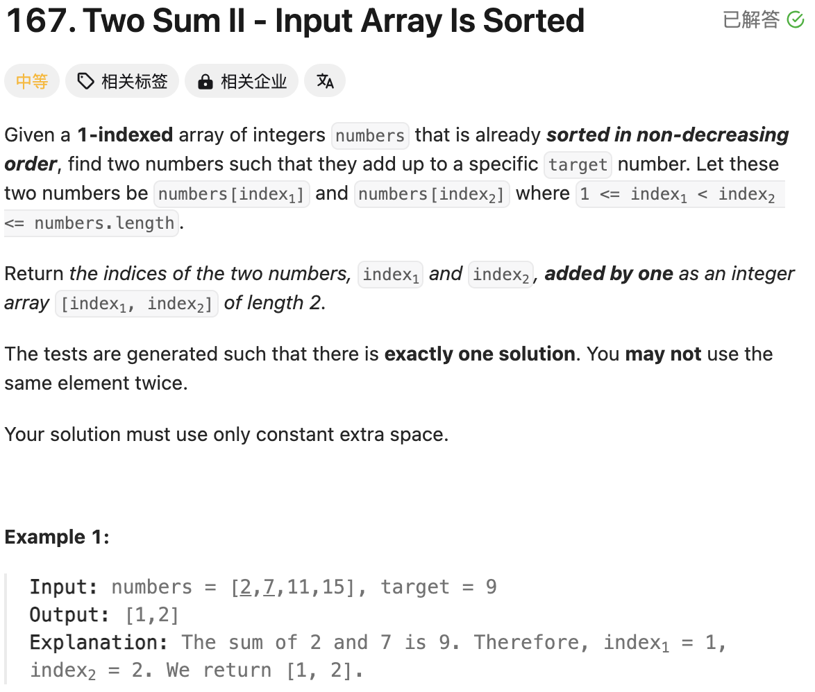
2 | 7 | 11 | 15 | 17
Bidirectional double pointer
Question tells us that it is already sorted in non-decreasing.
Brutal Force: Running time is O(n^2); Space is n
Bidirectional double pointer: Running time is O(n); Space is 1
class Solution(object):
def twoSum(self, numbers, target):
"""
:type numbers: List[int]
:type target: int
:rtype: List[int]
"""
# Double Pointers
left = 0
right = len(numbers) - 1
while left < right:
s = numbers[left] + numbers[right]
if s == target:
break
elif s < target:
left += 1
else:
right -= 1
return [left+1, right+1]

Slide 2
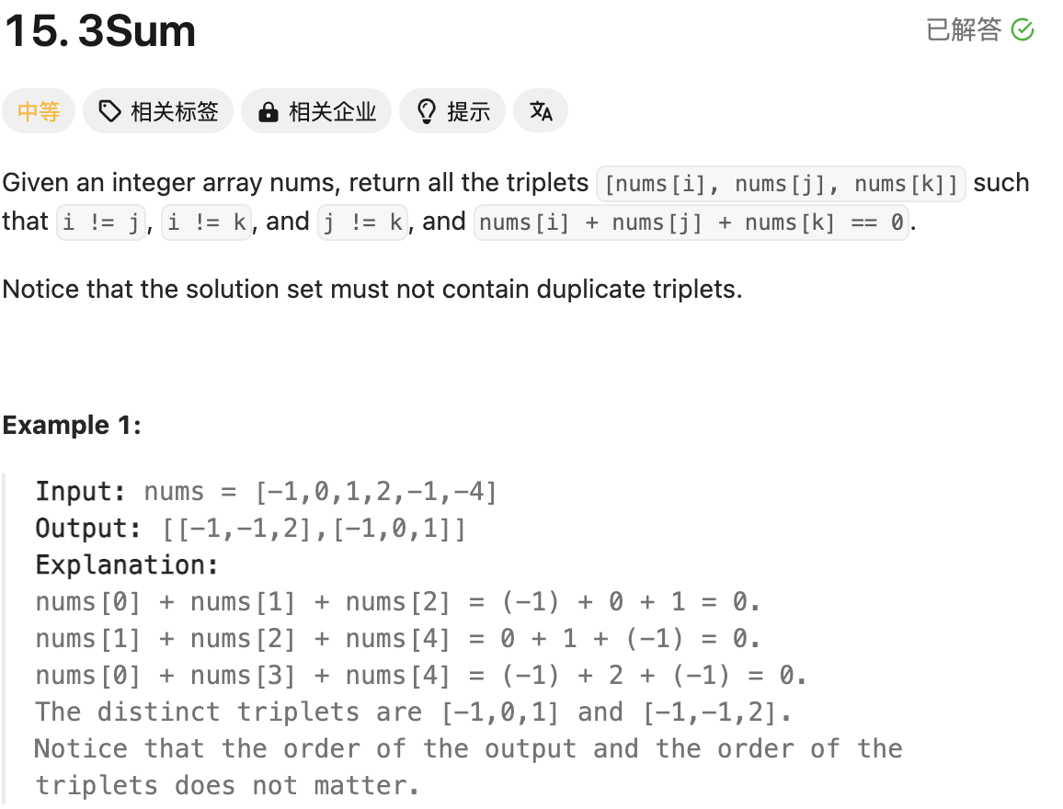
2 | 7 | 11 | 15 | 17
x + y + z = 0
X 为外侧循环指针，y 为左侧指针， z为右侧指针，同上面Two Sum思路一致
另外，Not Contain Duplicate Triplets, 需要判断x/y/z与之前是否相同
优化细节：
num[i] + num[i+1] + num[i+2] >0 break
num[i] + num[n-1] + num[n-2] <0 continue
class Solution(object):
def threeSum(self, nums):
"""
:type nums: List[int]
:rtype: List[List[int]]
"""
# Running time is O(nlogn)
nums.sort()
n = len(nums)
ans = []
# Running time is O(n^2)
# Space complexity is O(1)
for i in range(n-2):
x = nums[i]
if i > 0 and nums[i-1] == x:
continue
if x + nums[i+1] + nums[i+2] > 0:
break
if x + nums[n-1] + nums[n-2] < 0:
continue
left = i + 1
right = n - 1
while left < right:
s = x + nums[left] + nums[right]
if s > 0:
right -= 1
elif s < 0:
left += 1
else:
ans.append([x, nums[left], nums[right]])
left += 1
while left < right and nums[left] == nums[left-1]:
left += 1
right -= 1
while right > left and nums[right] == nums[right+1]:
right -= 1
return ans

Slide 3
Two sum or Three sum firstly should sort and double points.

Slide 4
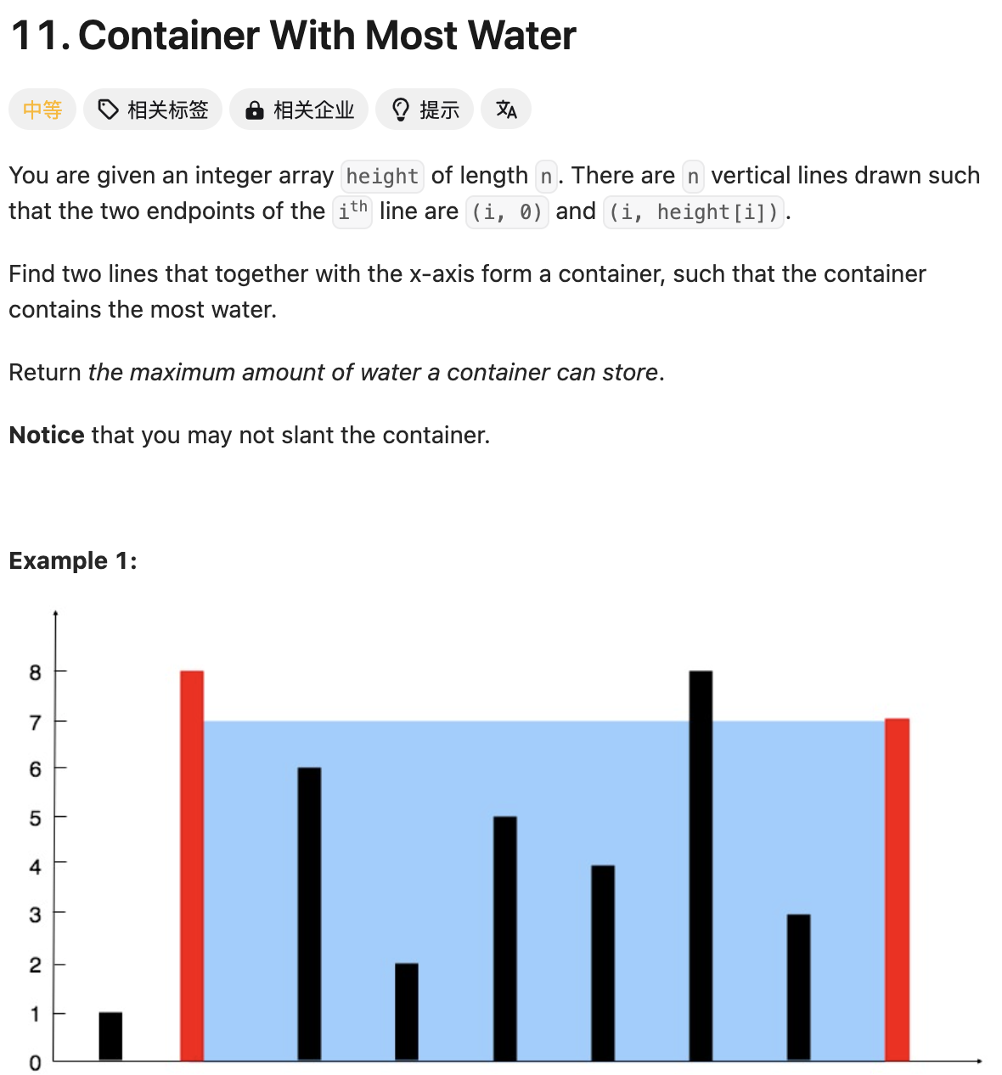
整体思路依然是双向双指针
如果左侧小于右侧，左侧指针向右侧移动一位
如果左侧大于右侧，右侧指针向左移动一位
每次对比左右两侧，最小值*宽度
Running time O(n)
Space complexity O(1)
class Solution(object):
def maxArea(self, height):
"""
:type height: List[int]
:rtype: int
"""
n = len(height)
left = 0
right = n - 1
ans = 0
while left < right:
h = min(height[left], height[right])
ans = max(ans, h * (right - left))
if height[left] < height[right]:
left += 1
else:
right -= 1
return ans

Slide 5
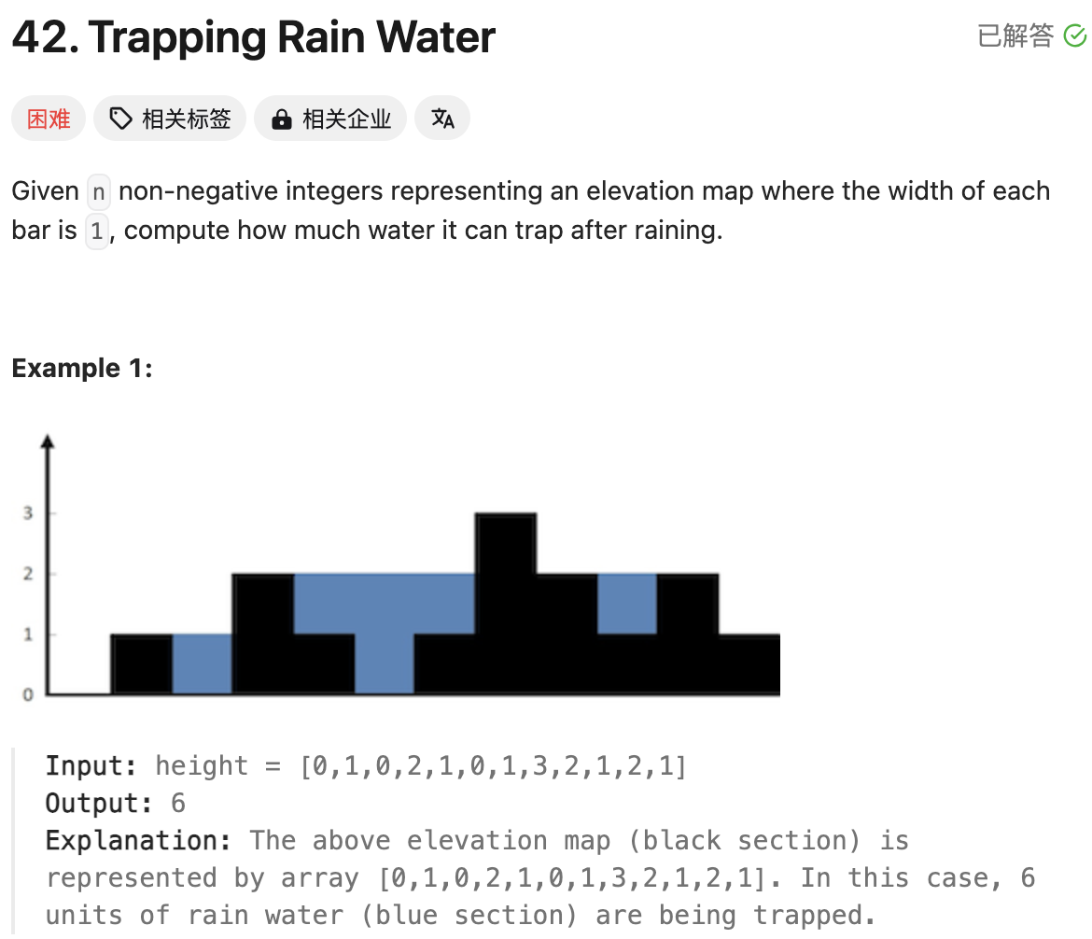
Pre-max 和Suf_max分别为前序和后续，遍历求出不同梯度的最大高度
在Pre-max 和Suf_max中取最小值，并与height进行计算
class Solution(object):
def trap(self, height):
"""
:type height: List[int]
:rtype: int
"""
n = len(height)
pre_height = [0] * n
pre_height[0] = height[0]
suf_height = [0] * n
suf_height[n-1] = height[n-1]
for i in range(1, n):
pre_height[i] = max(pre_height[i-1], height[i])
for i in range(n-2, -1, -1):
suf_height[i] = max(suf_height[i+1], height[i])
ans = 0
for i in range(n):
ans += min(pre_height[i], suf_height[i]) - height[i]
return ans

