Slide 1


Slide 2
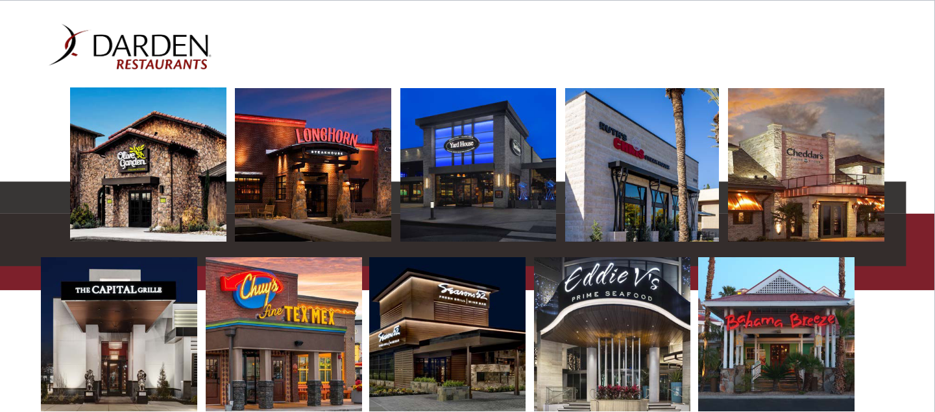
Business overview

Slide 3
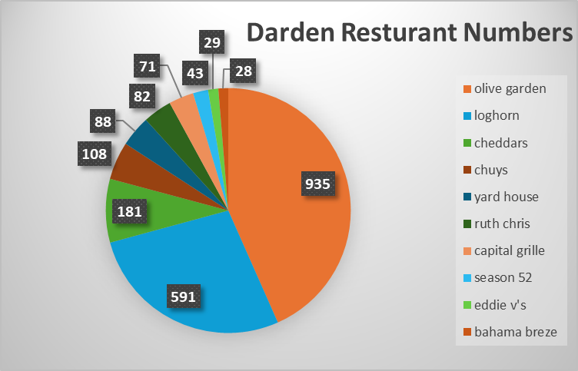
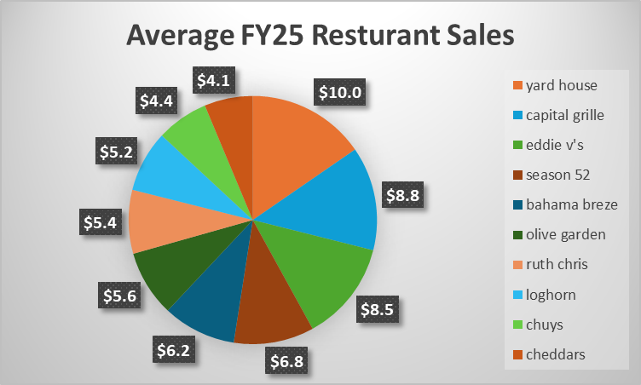
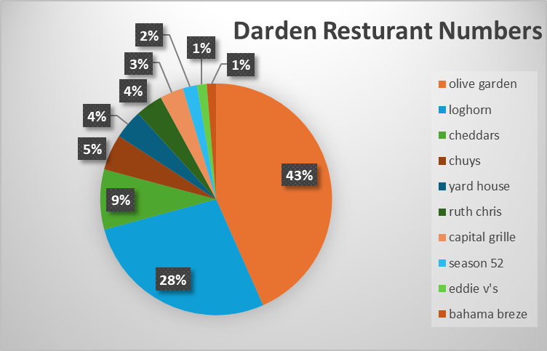
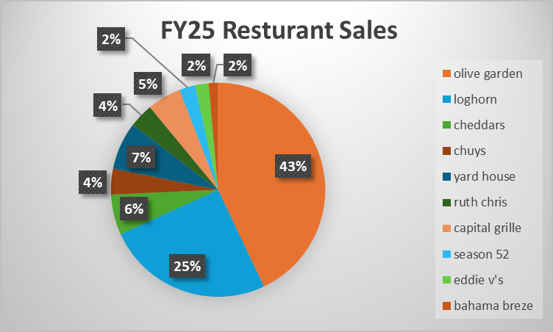
Business overview-rOGER

Slide 4
Business overview-rOGER
Gross margin- 30.11%
Net profit margin- 8.69%
Sales growth- 6.03%

Slide 5
Business overview notes

Slide 6
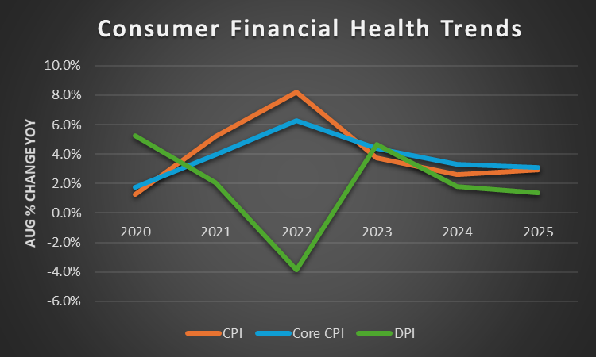
Industry-ROGER
On a month-over-month basis, inflation has been creeping up modestly; food and shelter costs remain notable drivers
Per Capita DPI has also increased year-over-year. For example, as of July 2025 it's up 4% from a year ago.
The Fed’s recent rate cuts and projections show they believe inflation has moderated enough to consider easing

Slide 7
Industry-ROGER
CPI rose 2.9% as of August 2025.
Core inflation (excluding food & energy) is still a bit higher, around 3.1% annually.
On a month-over-month basis, inflation has been creeping up modestly; food and shelter costs remain notable drivers
Real Disposable Income has been more constrained. When adjusting for inflation, gains have been modest (or sometimes flat) because rising prices (especially for food, shelter, etc.) eat into what people can actually spend or save.
Consumer spending
Per Capita DPI has also increased year-over-year. For example, as of July 2025 it's up 4% from a year ago.

Slide 8
Industry notes

Slide 9
Segments (will)
*fine dining, casual, longhorn, olive garden
*risk/competitors
-bloomin'brands, texas road house inc, brinker int
*Financial info comparing segements to comp
*future plans

Slide 10
Segments notes
*fine dining, casual, longhorn, olive garden
*risk/competitors
-bloomin'brands, texas road house inc, brinker int
*Financial info comparing segements to comp
*future plans

Slide 11
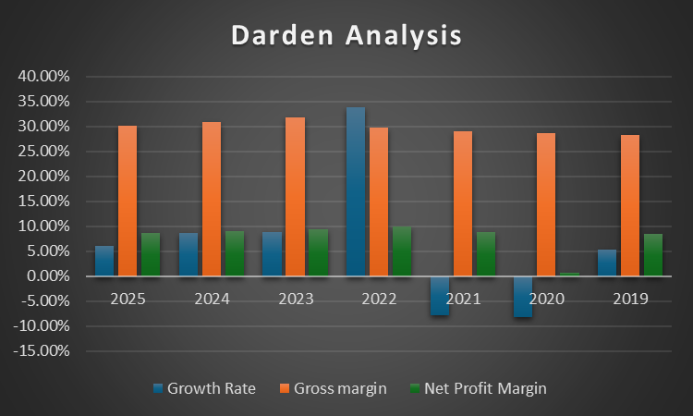
Financial analysis (Roger)

Slide 12
Financial analysis (Roger)
*performance over years(is this covered with financial metrics?)
*graphs of performance
*compare competitors some that are not ex. Mcdonalds,

Slide 13
Financial analysis notes
*performance over years(is this covered with financial metrics?)
*graphs of performance
*compare competitors some that are not ex. Mcdonalds,

Slide 14
Recent news (Brady)
*closing 20 including 15 bahama breeze
*looking for strategic alternatives for bahama breeze
*stock analysis
*pressures? - beef cost and seafood tariffs
*huge drop in stock –13.62%

Slide 15
Recent news notes
*closing 20 including 15 bahama breeze
*looking for strategic alternatives for bahama breeze
*stock analysis
*pressures? - beef cost and seafood tariffs
*huge drop in stock –13.62%

Slide 16
Summary /SWOT (Brady/Jack)

Slide 17
Summary /SWOT notes

