Slide 1
Experiments on Dimension Reduction
Speaker : Oniontow
Mentor : Rick Huang
Advisor: Prof. An-Yeu (Andy) Wu / Dr. Hsiang-Yun Cheng
Date : 2026/01/26

Slide 2
Outline
Embedding dimension reduction
Analysis of PCA (Principle Component Analysis)
Analysis of quantization methods
Modification of AutoEncoder method

Slide 3
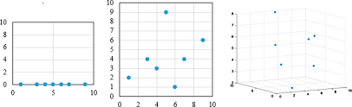
Curse of Dimensionality
As dimensions increases, data become increasingly sparce, causing traditional algorithms to struggle
The number of dimensions should meet the HW provided by MXIC
  64-dimensional INT3 L2-norm search
Input
64D
Input
64D
Input
64D
IMS Macro
IMS Macro
IMS Macro
……

Slide 4
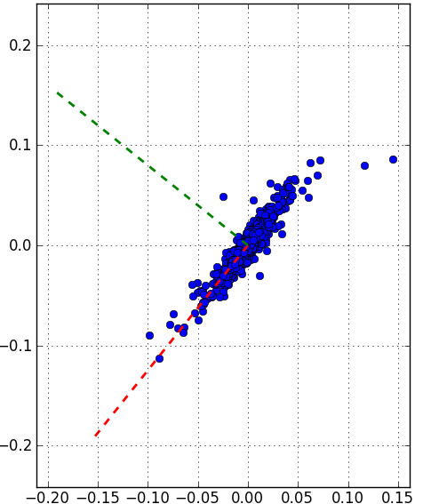
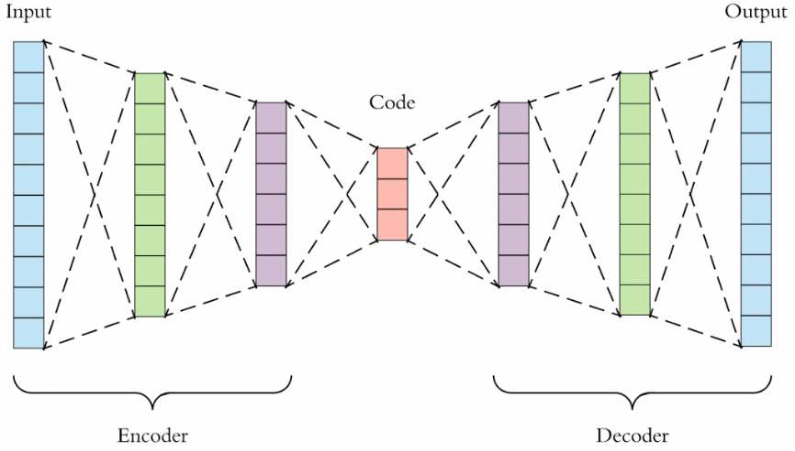
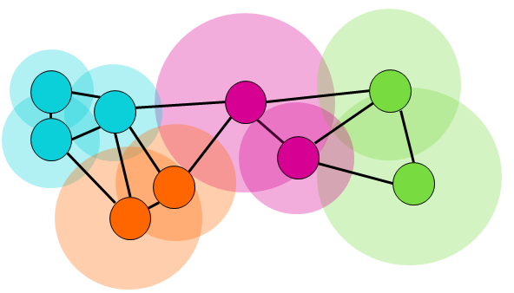
Methods of Dimension Reduction
3
3
Linear
  Pooling
    Average Pooling
    Magnitude Pooling
  Principle Component Analysis
Non-Linear
  UMAP
  Autoencoder (AE)
1
1
9
2
9
3
5
77
5
97
4
3
4
4
2
4
2
8
8
8
0
0
Average Pooling
Magnitude Pooling
PCA
UMAP
Closer points -> exponential decay to maintain local distance
Farther points -> inverse-polynomial to maintain global distance
Autoencoder

Slide 5
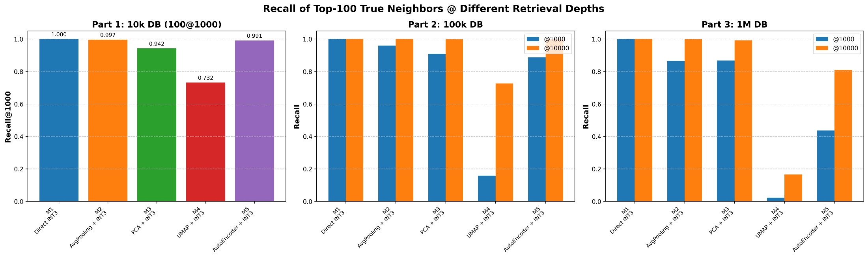
Experimental Results (SIFT-1M)
Using SIFT-1M dataset
  Vector dimension: 128 -> 64
  Quantization method: min-max quantization
  Avg. Pooling > PCA >= AE > UMAP

Slide 6
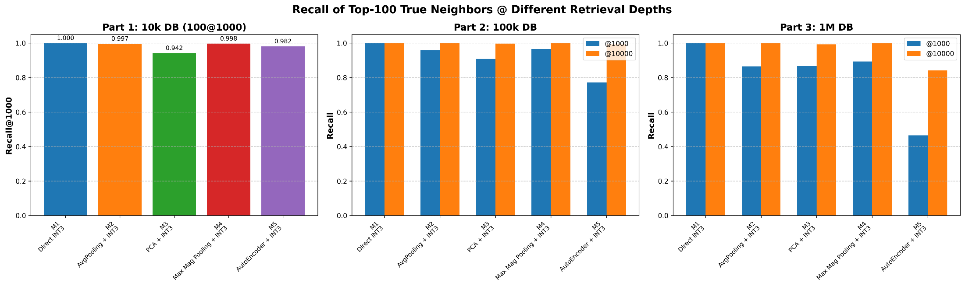
Experimental Results (SIFT-1M)
Using SIFT-1M dataset
  Vector dimension: 128 -> 64
  Quantization method: min-max quantization
  Since the performance of UMAP is worst, it is replaced by magnitude pooling
  Avg. Pooling = Mag. Pooling >= PCA >= AE

Slide 7
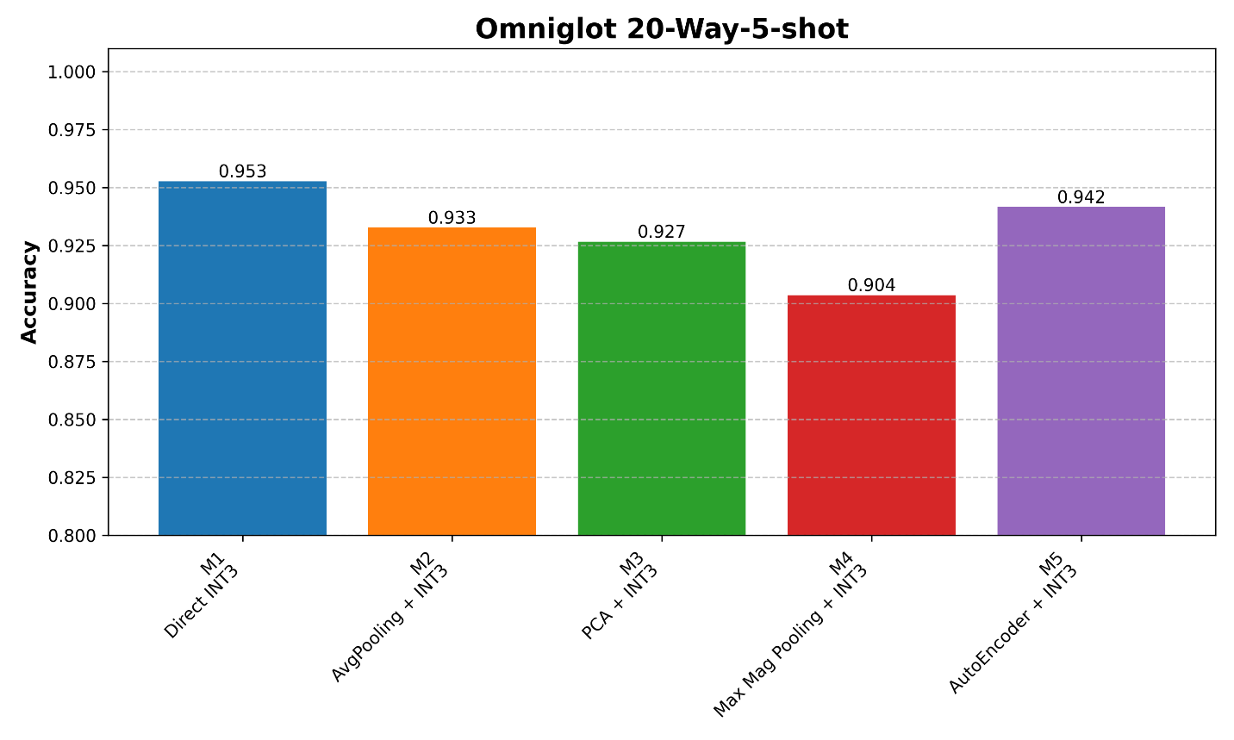
Experimental Results (Omniglot)
Using Omniglot 20-way-5-shot experiment
  Embedding dimension: 128 -> 64
  Quantization method: min-max quantization
  AE = Avg. Pooling = PCA >= Mag. Pooling

Slide 8
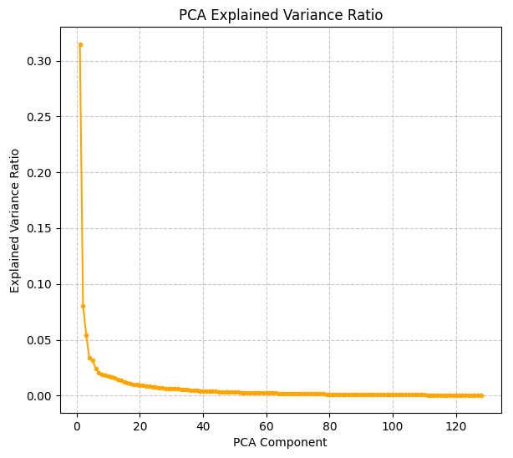
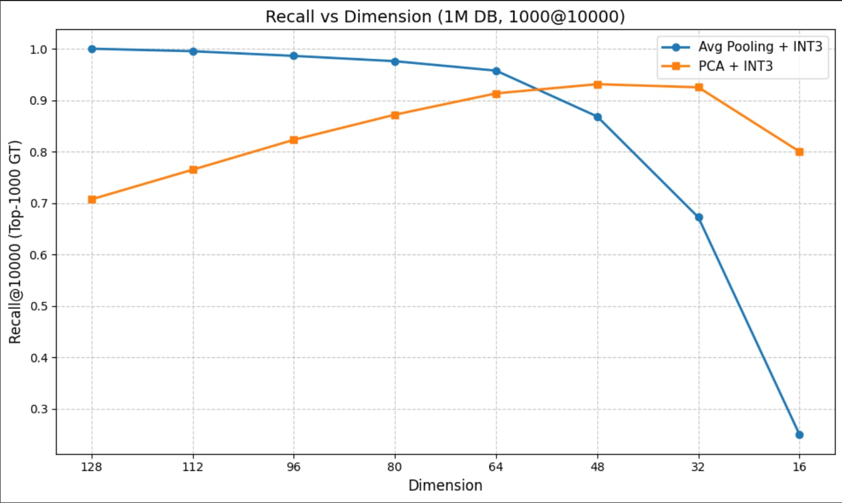
Analysis of PCA
PCA seems cannot win against average pooling
  Is this true for all dimensions?
  Why PCA achieves better recall rate when dim < 60
  Too much noise from less representative dimensions
  Low explained var. from dim 60 to 128

Slide 9
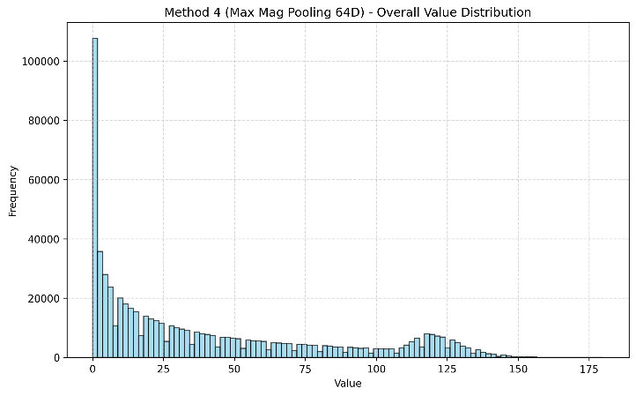
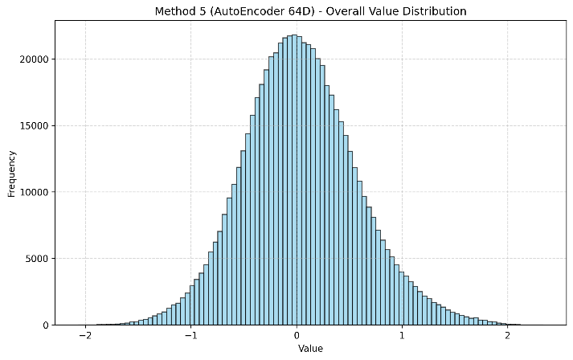
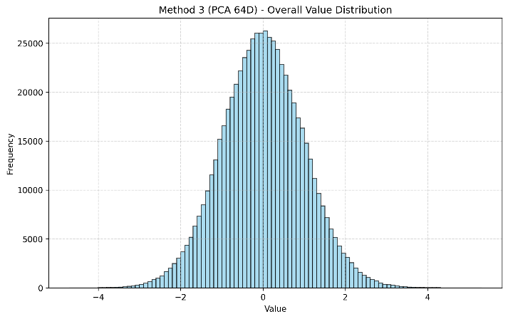
Data Distribution under Different Methods
What does the distributions look like after different dimension reduction methods
  Pooling produces long-tail distributions
  PCA/AE produces bell-shaped distributions
  Can our quantization method fit all of these distributions?
Pooling
PCA
AutoEncoder

Slide 10
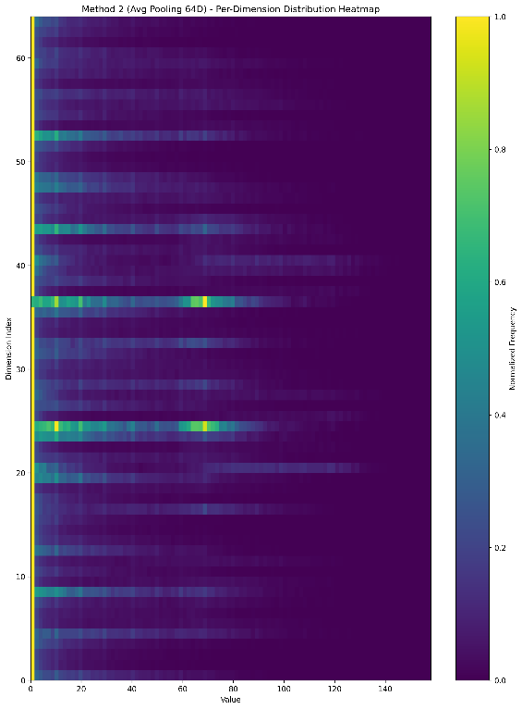
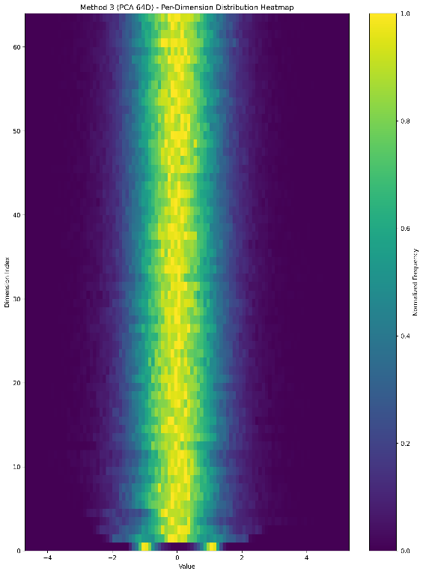
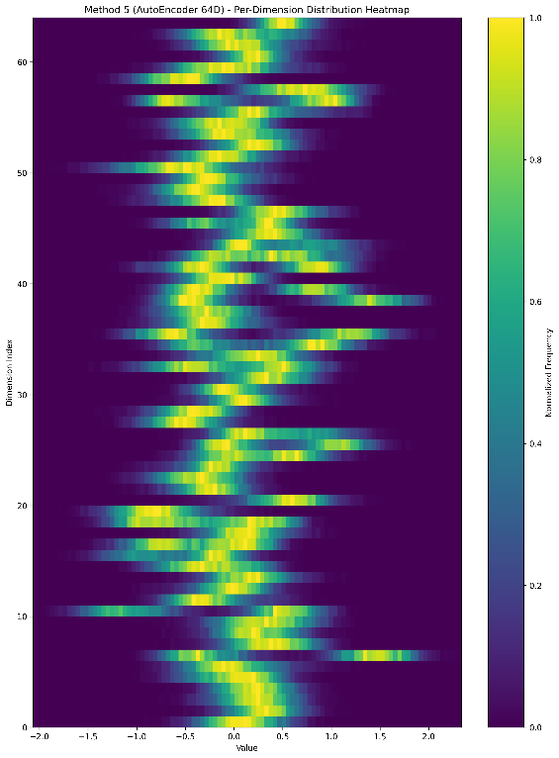
Data Distribution under Different Methods
What does the distributions look like after different dimension reduction methods
  Pooling produces long-tail distributions
  PCA/AE produces bell-shaped distributions
  Can our quantization method fit all of these distributions?
Pooling
PCA
AutoEncoder

Slide 11
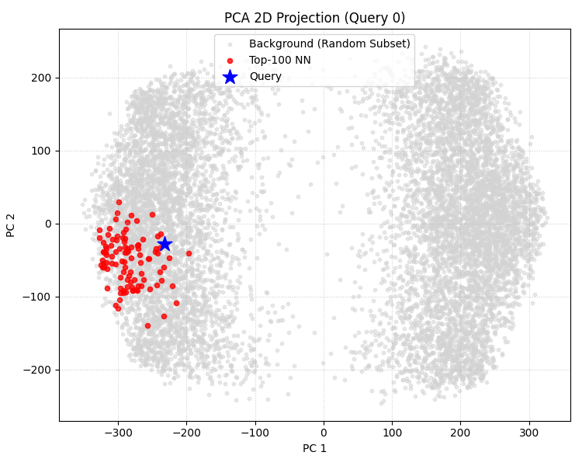
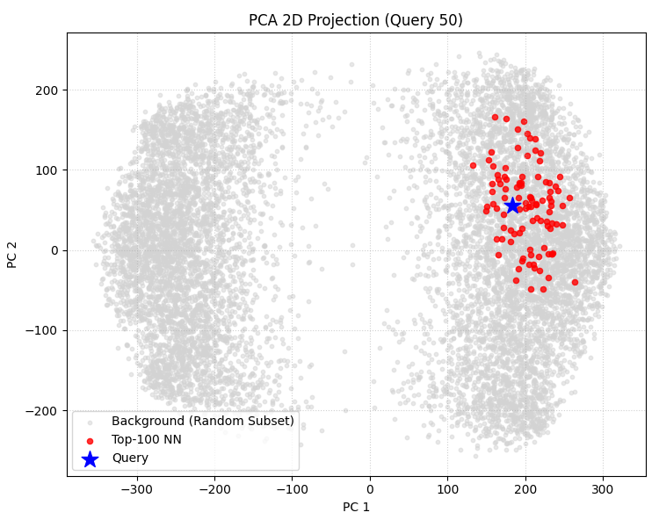
Distribution of Top-100 Neighbors
Top-K Neighbors locate close to query
  Discrminating top-K neighbor from others is the key
Where we focus
Don’t care
Don’t care
Where we focus

Slide 12
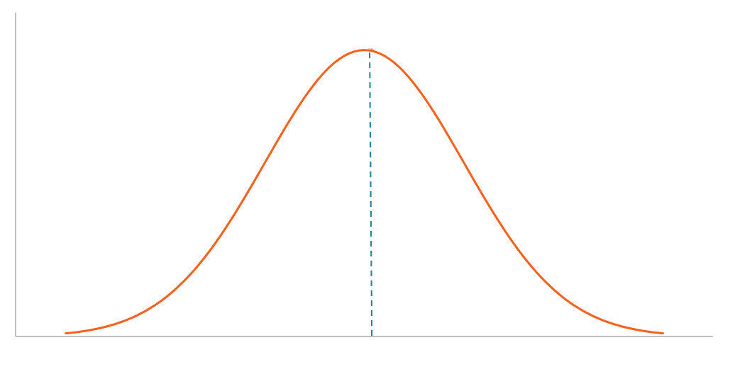
Quantization Makes Big Differences
New quantization method : Percentile Quantization
  Quantize data according to its percentile among all data
  Non-linear quantization
  Better to distinguish top-k nearest neighbors
17%
33%
33%
17%
25%
25%
25%
25%
Min-max quantization
Percentile quantization

Slide 13
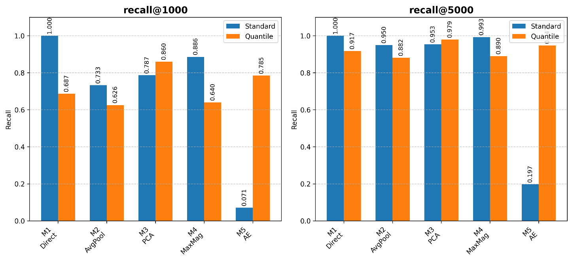

Experimental Results
Percentile quantization boosts the recall rate of AutoEncoder method
  Embedding dimension: 128 -> 64
  Blue: Min-max Quantization. Orange: Percentile Quantization.
  Min-max -> better for long-tail distribution
  Percentile -> better for bell-shaped distribution

Slide 14

Modification of AutoEncoder
Original AutoEncoders consider reconstruction loss as loss function
  Construct a low dimension space
  Can it preserve distance information?
New loss function
  Distance loss = MSE(distance before and after dimension reduction)
  k $×$ reconstruction loss + (1 - k) $×$ distance loss
Reconstruction loss
Distance loss

Slide 15
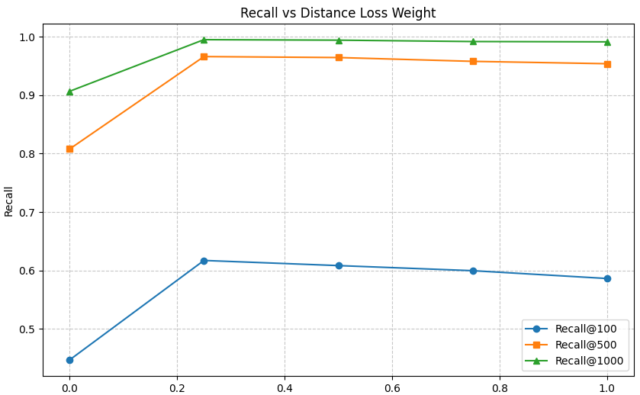

Experimental Results
New loss function
  k $×$ reconstruction loss + (1 - k) $×$ distance loss
  Recall rate increased significantly by adding distance loss into loss function
  Considering both reconstruction and distance info achieves best recall rate
Best
k

Slide 16
Conclusion
Embedding dimension reduction
  Average pooling is simple but effective
Analysis of PCA (Principle Component Analysis)
  PCA outperforms average pooling when dimensions < 60
Analysis of quantization method
  Min-max quantization is better for pooling methods
  Quantile is better for PCA and AutoEncoders
Modification of AutoEncoder method
  Preserving distance information increases recall rate
  Best recall @ reconstruction : distance = 3 : 1

