Slide 1
Title
Speaker : B11901027 王仁軒
Mentor : Rick Huang
Advisor: Prof. An-Yeu (Andy) Wu
Date : 2025/06/??

Slide 2
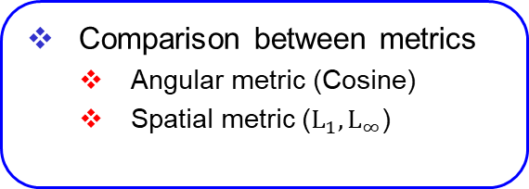
Outline
Method to tackle analog non-idealities in IMS architecture
Noise-aware training
Bayesian neural network
Comparison between metrics
Angular metric (Cosine)
Spatial metric ($L_{1}, L_{∞}$)
Part 1
Part 2
Locality sensitive hashing
Approximation of cosine similarity
2-D projection of high-dimensional embedding with t-SNE
Part 3
View metric difference as noise
Approximation of cosine similarity
2-D projection of high-dimensional embedding with t-SNE
Part 4

Slide 3
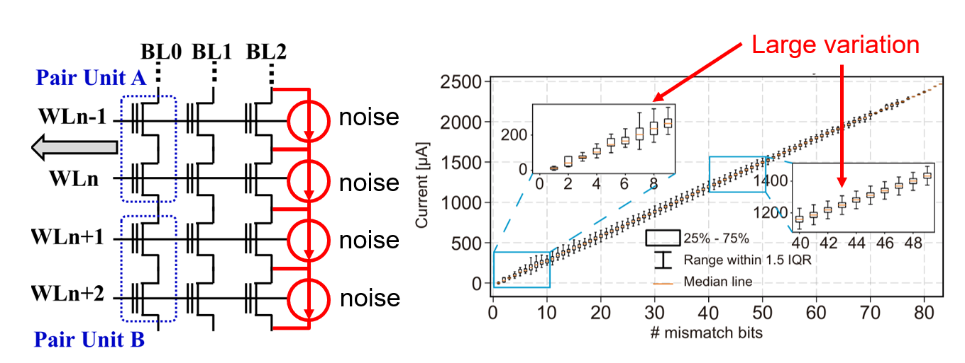
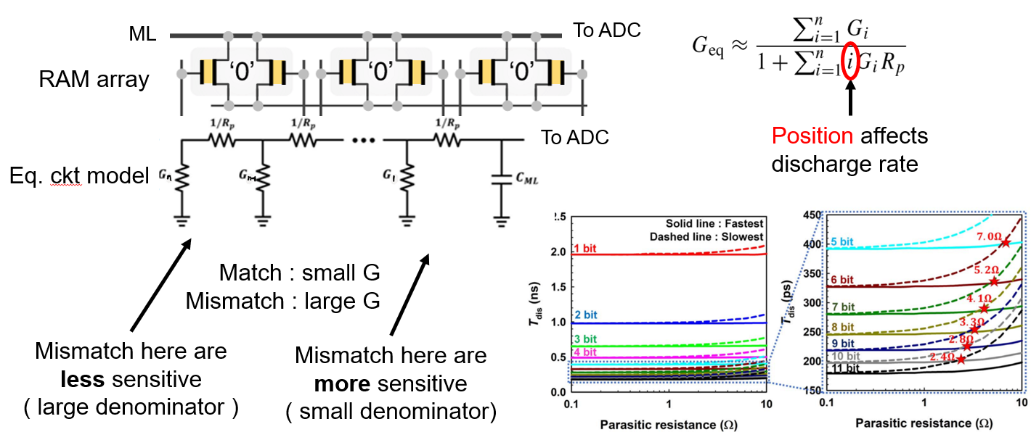
Analog Non-Ideal Effects of TCAM
TCAM : Ternary content addressable memory
Analog non-ideal effects of in-memory-search
Noise from memory device
Thermal noise
Flicker noise
Leakage current
Parasitic effects of lump elements
Resistance
Capacitance

Slide 4
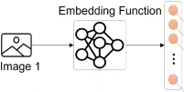


Method 1 : Noise-Aware Training
Noise-Aware Training
Inject simulated noise into embeddings while training the model
Evaluate the Trained model on different noise levels
Training
Model
+
+
+
Train on cloud server
Simulate noisy device by injecting noise to embeddings
+
Embedding
Testing
Model
Deploy the model to device
Simulate the device on server
Noisy Embedding

Slide 5
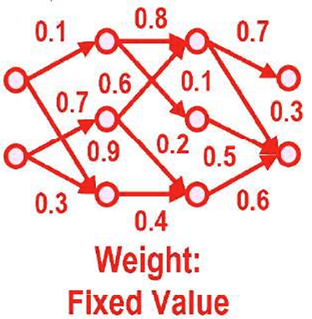
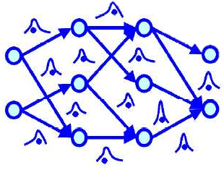
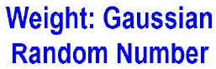
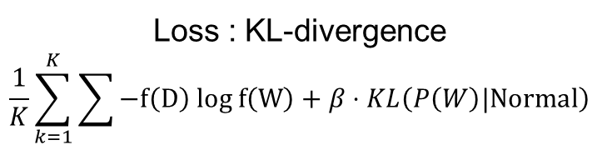

Method 2 : Bayesian Neural Network
Bayesian Neural Network (BNN)
Train a robust model that embraces noise
BNN minimizes KL-divergence (maximize Evidence Lower Bound, ELBO)
CNN
BNN
Loss : Cross Entropy
$$\sum{−P\left(D\right) log P\left(W\right)}$$
Loss : KL-divergence
$$\frac{1}{K}\sum_{k=1}^{K}{\sum{−f\left(D\right) log f\left(W\right)}}+β⋅KL\left(P\left(W\right)|Normal\right)$$
Mean of cross entropy loss acorss samples
Ensure robustness against noise

Slide 6
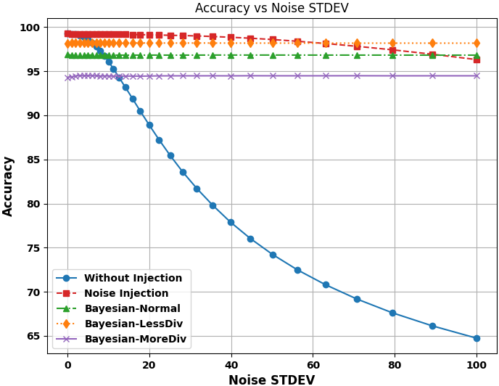
Robustness Against Noise
Both method works well on different datasets
Trade-off between accuracy on clean data & noise tolerance
Tolerance against large noise
Little noise has great effect
High acc.
large noise

Slide 7
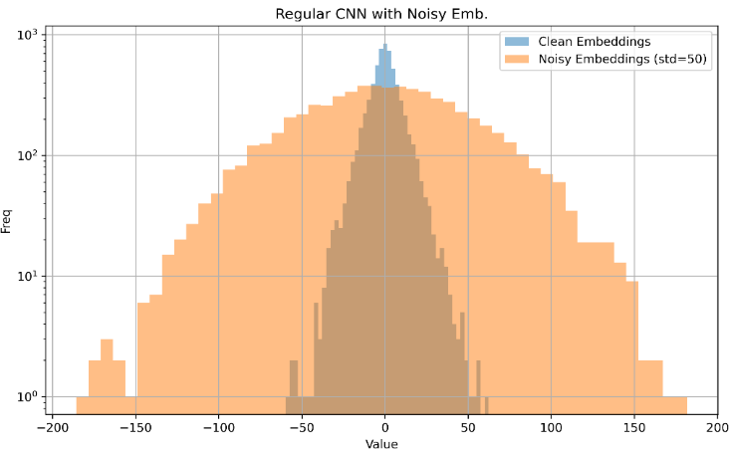
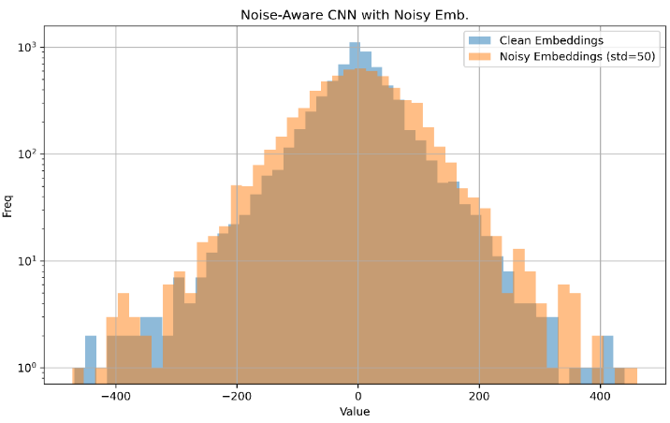
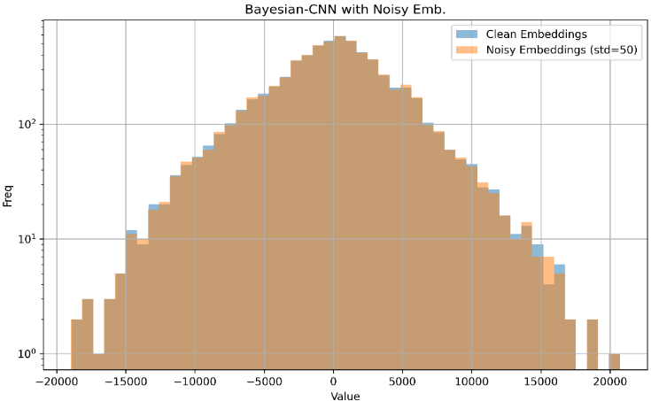
Origin of Noise Resilience in NN
Collect the value of every embeddings
Blue : Original embedding value distribution
Orange : New distribution on simulated noisy device
Model learns to against noise by amplifying magnitude of embeddings
Baseline
Noise-Aware Training
Bayesian NN
27 % accuracy
Noise dominates the embedding
92 % accuracy
Noise has little impact on embedding
88 % accuracy
Noise has almost no impact on embedding

Slide 8
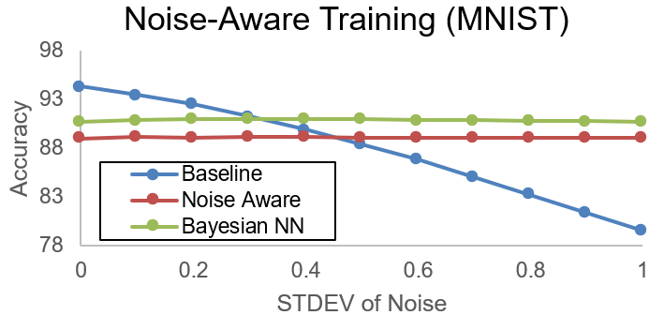
Conclusion 1
Accuracy drop
Original CNN model has higher acc. on clean device, but accuracy drops on noisy device
Both noise-aware model and Bayesian NN resists noise by amplifying the mag. of embed.
Trade off between model-robustness and accuracy on ideal device
One small noise for training model, one giant leap for noise-tolerance
Little perturbation in training
Great effect in testing

Slide 9

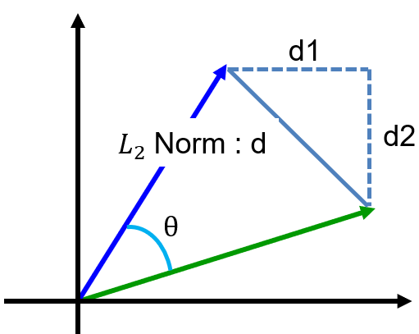





Impact of Metric Selection on Accuracy
Cosine similarity is too complicated to implement in memory cell
Spatial metric is used to calculate similarity in memory
Simple hardware, but at what cost?
The performance may vary slightly between different metrics.
$L_{1}$ norm
$L_{∞}$ norm
$L_{2}$ norm is non-normalized cos-sim
d1
d1
d2
d2
d
d
$$\left\|L_{2}\right\|<\left\|L_{1}\right\|<\sqrt{D}\left\|L_{2}\right\|$$
$$\frac{1}{\sqrt{D}}\left\|L_{2}\right\|<\left\|L_{∞}\right\|<\left\|L_{2}\right\|$$
Approximation (Upper/Lower bound) of $L_{2}$ norm

Slide 10
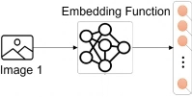
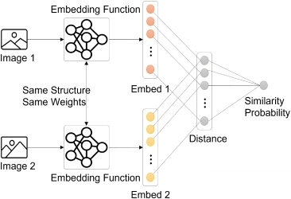
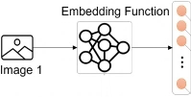
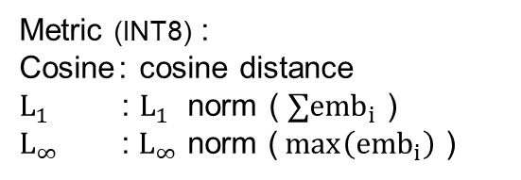
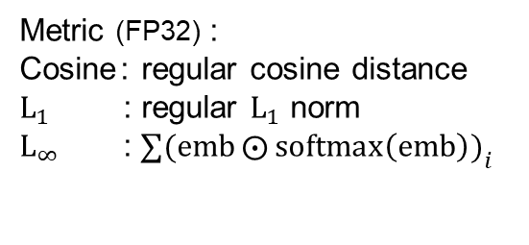

Experiment Setup
Evaluate accuracy of a model trained with different distance metric
Training : Approximated metric ($L_{∞}$norm has no gradient for back prop.)
Testing : Regular metric on quantized embeddings
Training
Model
Metric (FP32) :
Cosine : regular cosine distance
$L_{1}$ : regular $L_{1}$ norm
$L_{∞}$ : $∑(emb{⨀{softmax\left(emb\right))}}_{i}$
Distance
metric
Query
Data
Testing
Model
Metric (INT8) :
Cosine : cosine distance
$L_{1}$ : $L_{1}$ norm ( $∑{emb}_{i}$ )
$L_{∞}$ : $L_{∞}$ norm ($\max\left({emb}_{i}\right)$ )
Quantized distance
metric
Query
Data

Slide 11
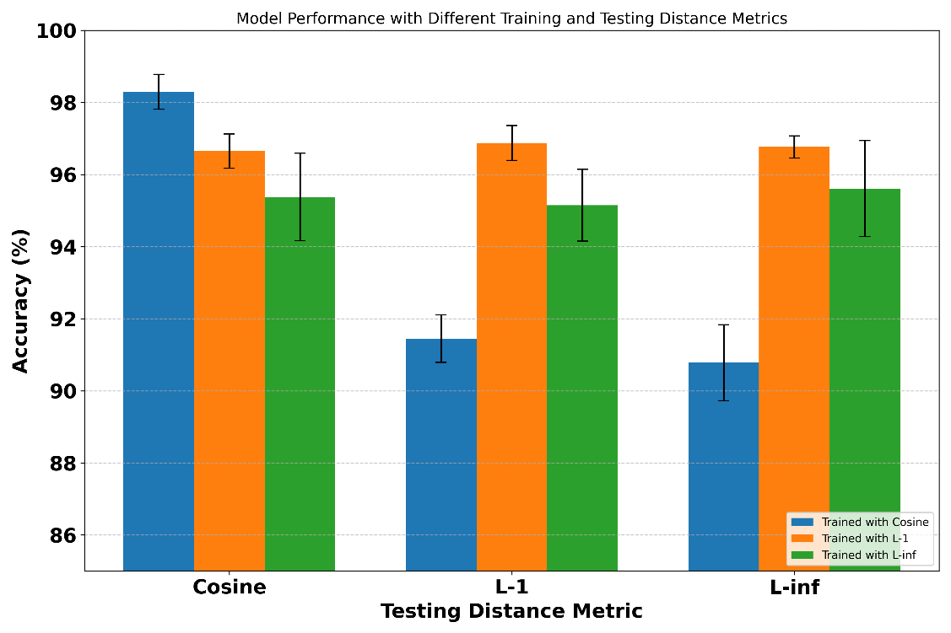

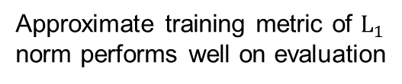
Evaluate Accuracy with Different Metrics
Compare accuracies across models trained with different metrics
Dataset Omniglot and MNIST is used in the experiment
Blue : Trained with cosine distance (angular metric)
Orange : Trained with $L_{1}$ norm (spatial metric)
Green : Trained with $L_{∞}$ norm (spatial metric)
Approximate training metric of $L_{1}$ norm performs well on evaluation
Using angular metric for training results in lower accuracy under spatial metric evaluation

Slide 12

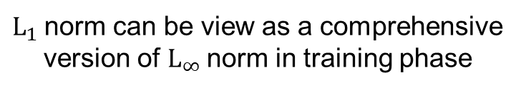




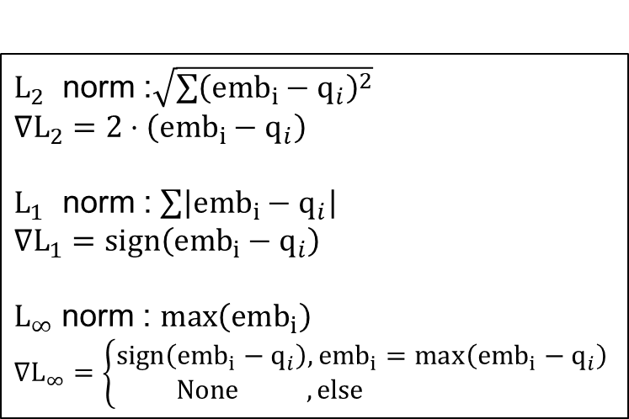
Observation Across Distance Metrics
Model trained with $L_{1}$ norm outperforms model trained with $L_{∞}$ norm in evaluation under all metrics
$L_{2}$ norm :$\sqrt{\sum{{\left({emb}_{i}−q_{i}\right)}^{2}}}$
$∇L_{2}=2⋅\left({emb}_{i}−q_{i}\right)$
$L_{1}$ norm : $\sum{\left|{emb}_{i}−q_{i}\right|}$
$∇L_{1}=sign\left({emb}_{i}−q_{i}\right)$
$L_{∞}$ norm : $\max\left({emb}_{i}\right)$
$∇L_{∞}=\left\{\begin{aligned}sign\left({emb}_{i}−q_{i}\right),{emb}_{i}=\max\left({emb}_{i}−q_{i}\right) \\ None , else \end{aligned}\right.$
Quantize to 1 bit
>
$$L_{1}$$
$$L_{∞}$$
$L_{1}$norm can be view as a comprehensive version of $L_{∞}$norm in training phase
$L_{1}$ norm is a better metric?

Slide 13
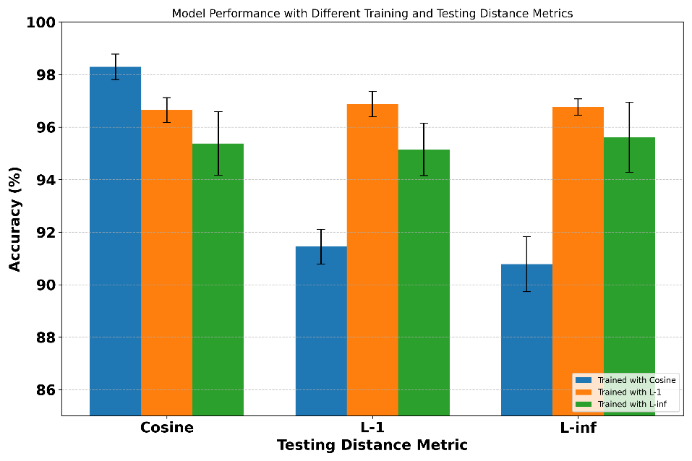
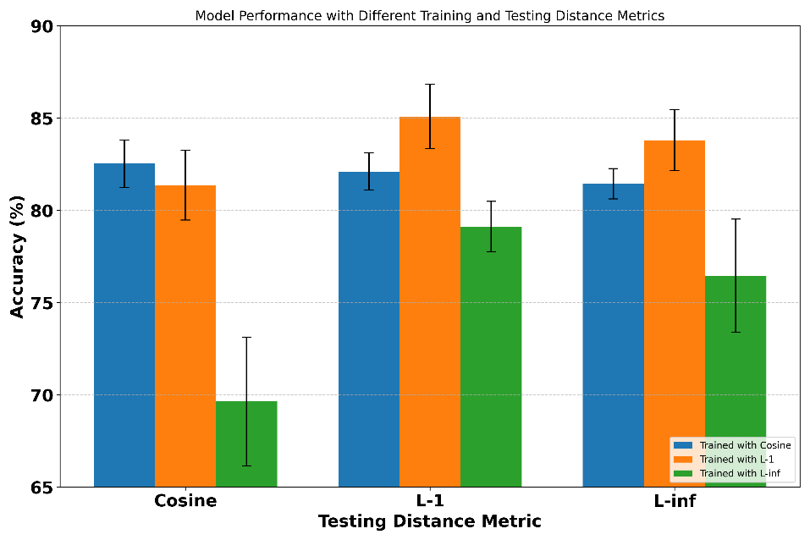

Conclusion 2
Search function implemented in memory uses distance metric
Train the model with distance metric can achieve better performance
Use differentiable approximated distance function that allows backpropagation
Using $L_{1}$ norm for training may have higher accuracy than using $L_{∞}$ norm
Model Trained with $L_{1}$ norm may achieve higher accuracy than model trained with $L_{∞}$ norm when evaluating the performance with $L_{∞}$ norm

Slide 14
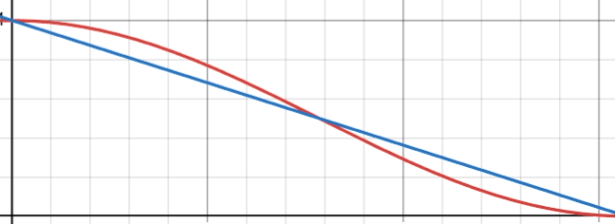


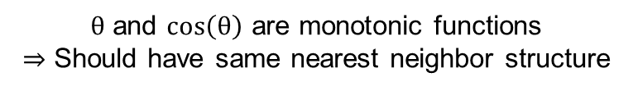
Approximation of Cosine Similarity
Sometimes we can only use a pretrained model
Cannot customize distance metric used in training
Locality-Sensitive Hashing
A stochastic technique for finding neighbor with highest cosine similarity
Similar items map to the same buckets with high probability.
Closer data has similar hashed result
1
Random
hash vectors
0
1
Similarity $∝θ$
0
1
0
0
0
$θ$ and $cos\left(θ\right)$ are monotonic functions
$⇒$ Should have same nearest neighbor structure
－$cos⁡(θ)$
－$θ$

Slide 15
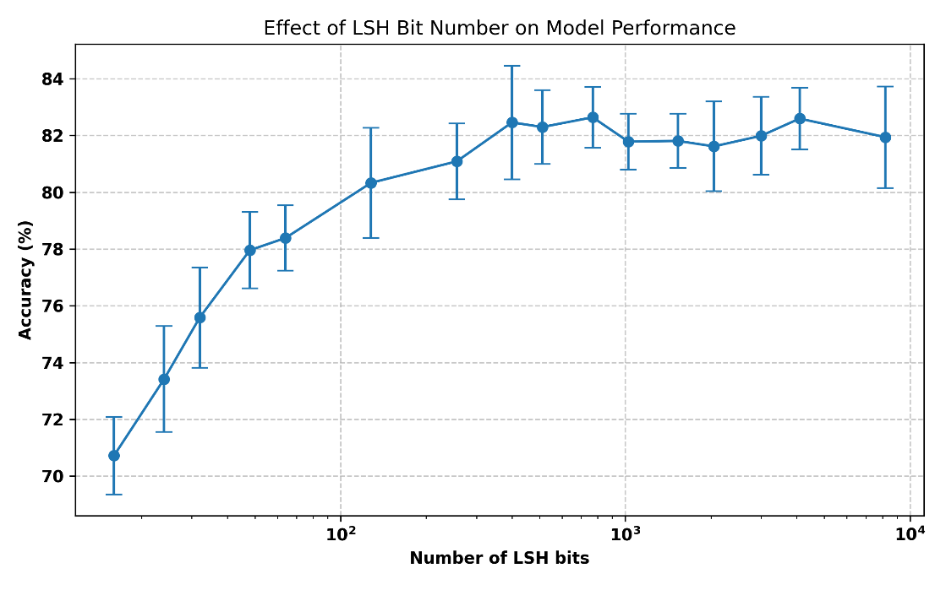
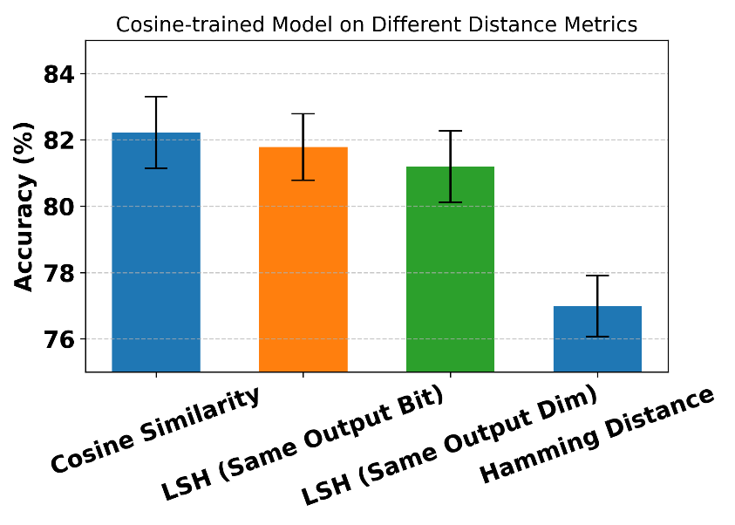
Effect of Locality-Sensitive Hashing
Hashing vectors of LSH perform partitioning in Hilbert space.
Hamming distance is a special case of LSH (hashing vectors are normal vector of coordinate planes)
LSH can generally performs better than Hamming distance
Good choice
Bad choice

Slide 16
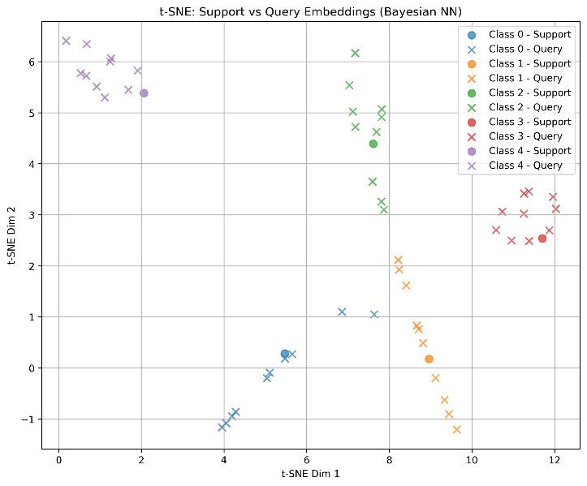
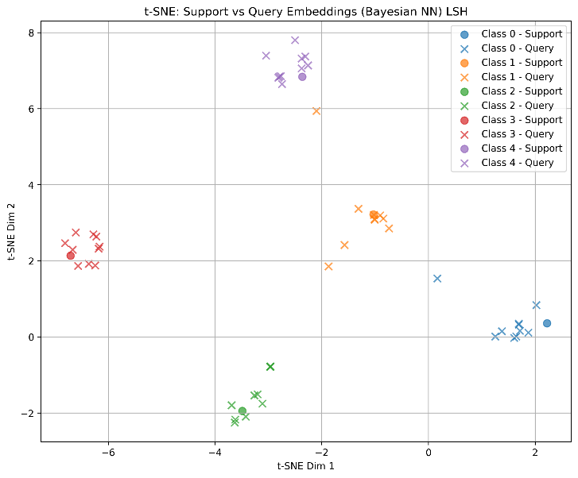
What Else Can LSH Do
2-D data visualization using t-SNE method
Visualization method that maintains distance in Hilbert space
Locality-Sensitive Hashing maps angular distance to spatial distance
Non-normalized distance results in linear distribution
Use embeddings generated by model trained with cosine distance directly
Do LSH on embeddings

Slide 17
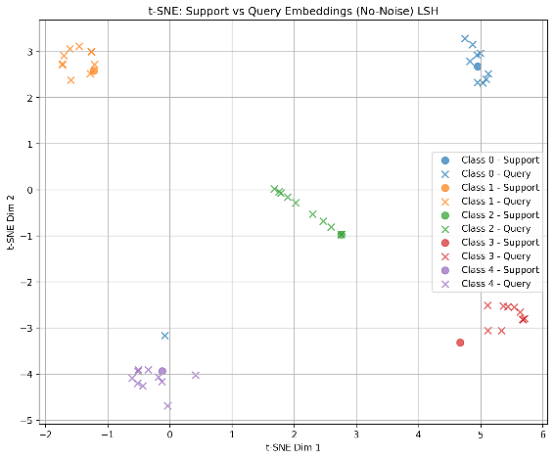
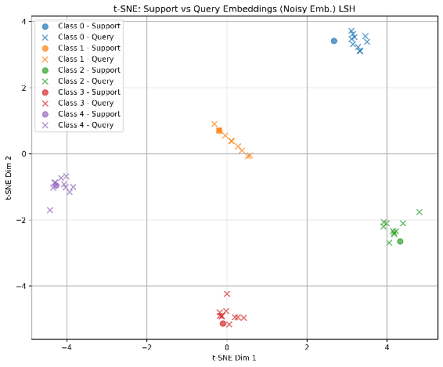
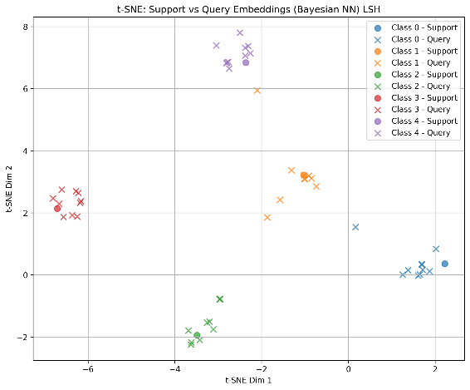
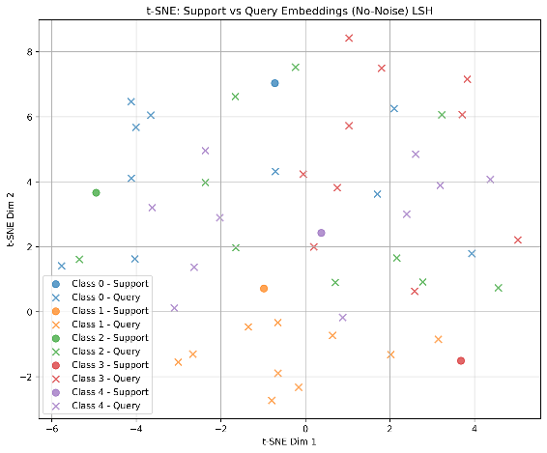
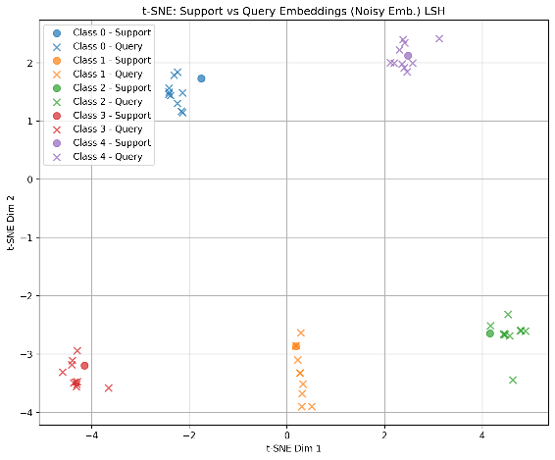
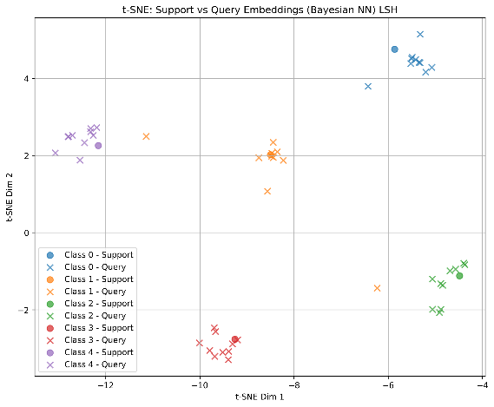
2-D Data Visualization with LSH
Visualize clean and noisy data in experiment 1 using LSH & t-SNE
Baseline
Noise-Aware Training
Bayesian NN
Zero Noise
Large Noise
Low accuracy

Slide 18

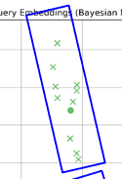
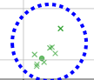
Conclusion 3
Approximation of cosine similarity
Locality sensitive hashing is an alternative method if we can only get a model trained with cosine similarity which IMS does not support
2-D data visualization
LSH converts angular metric to spatial metric which is better for t-SNE

Slide 19
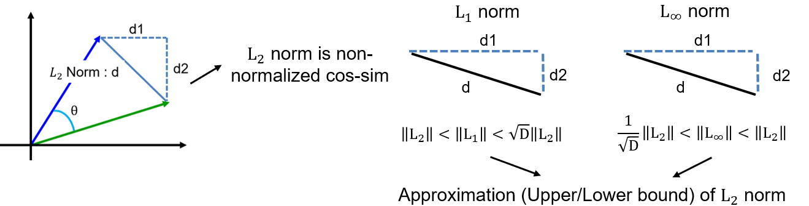
A General Way to Resolve Metric Issue
Can we train a general model that has acceptable accuracy on each distance metric?
View different metric as a noisy version of cosine similarity
Train a noise-resilient model using cosine similarity
Noise-aware model
Bayesian NN

Slide 20
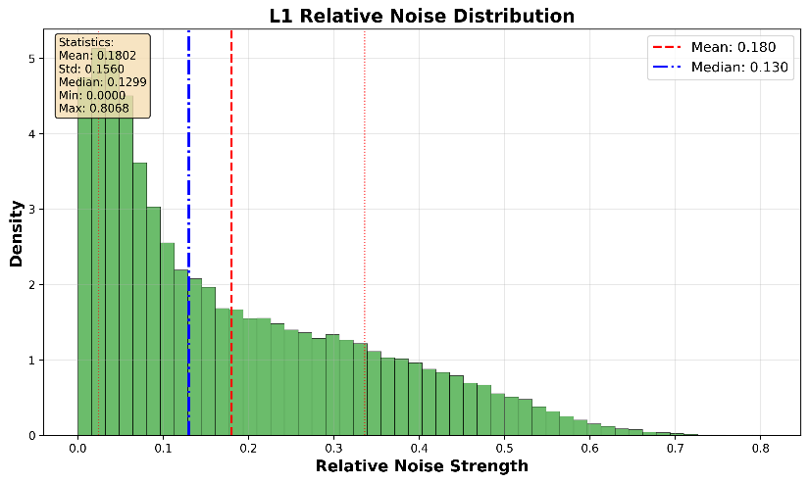
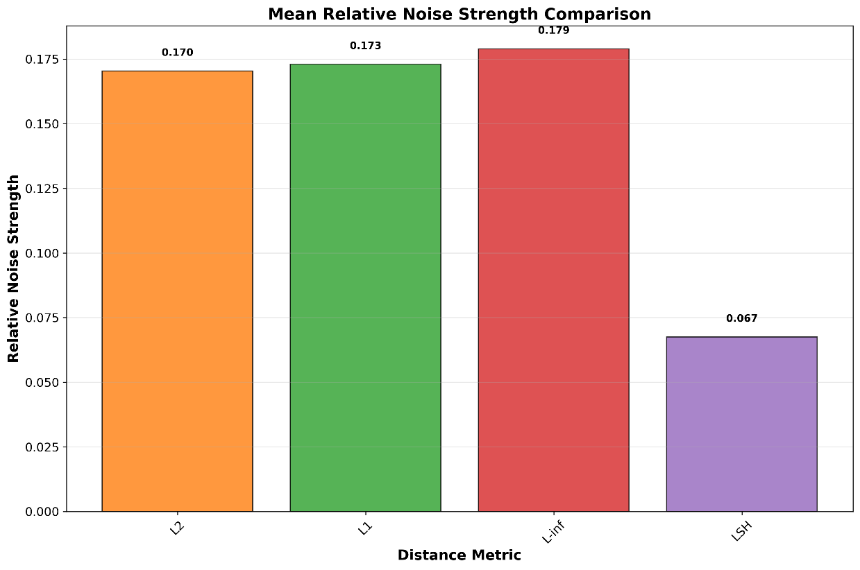
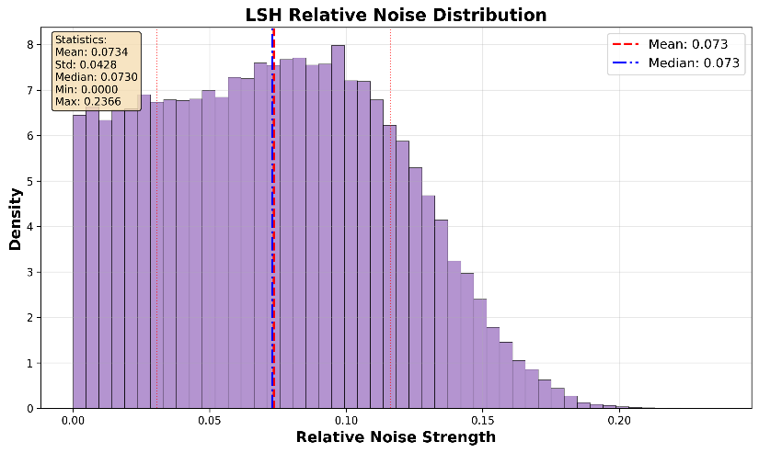

Noise Strength of Metrics
Observation of the magnitude of each distance metric if we regard them as the source of noise
Clean signal : cosine similarity
Relative noise : LSH < $L_{2}$ < $L_{1}$ < $L_{∞}$
Spatial metric has larger noise

Slide 21

Noise-Resilient Model Resolves Metric Issue
Noise-Resilient Model achieves higher accuracy when distance metric is not cosine distance
Original CNN model has highest accuracy on cosine similarity
noise-aware model has highest accuracy on other metric
Bayesian model has similar results, but has lower accuracy in general

Slide 22


Conclusion 4
View different metrics as inaccurate versions of cosine similarity
$L_{2}$ norm : Non-normalized cosine distance
$L_{1}$ norm : Upper bound of $L_{2}$ norm
$L_{∞}$ norm : Lower bound of $L_{2}$ norm
Train a model that performs well on general distance metrics
Noise-aware model can achieve better performance in general cases
Bayesian model has similar behavior
$$\left\|L_{∞}\right\|<\left\|L_{2}\right\|<\left\|L_{1}\right\|$$

Slide 23
Conclusion of All Experiments
Let the model get used to noise in training phase
Train a model that uses same metric as IMS device
Part 1
Part 2
LSH can simulate the performance of cosine similarity with Hamming distance as metric
Part 3
We can regard different metric as a noisy version of cosine similarity, thus use the method in part 1 to resolve this problem
Part 4

