Slide 1
Survey on In-Memory Search Architecutre & Algorithm for Few-Shot Learning
Speaker : B11901027 王仁軒
Mentor : Rick Huang
Advisor: Prof. An-Yeu (Andy) Wu
Date : 2025/05/02

Slide 2
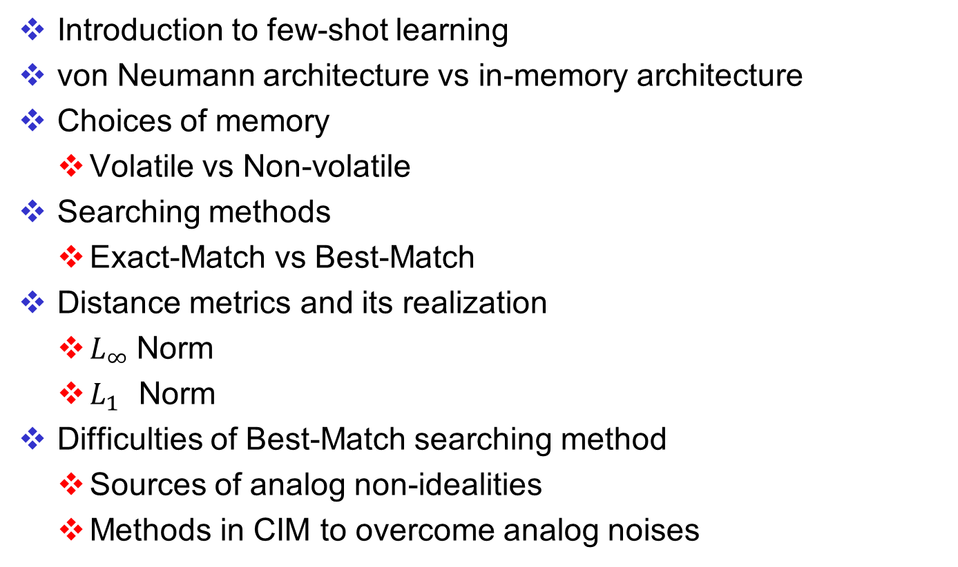
Outline
Introduction to few-shot learning
von Neumann architecture vs in-memory architecture
Choices of memory
Volatile vs Non-volatile
Searching methods
Exact-Match vs Best-Match
Distance metrics and its realization
$L_{∞}$Norm
$L_{1}$ Norm
Difficulties of Best-Match searching method
Sources of analog non-idealities
Methods in CIM to overcome analog noises

Slide 3
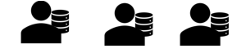




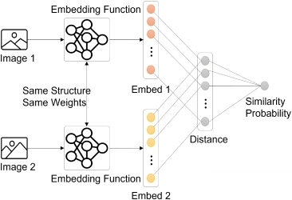
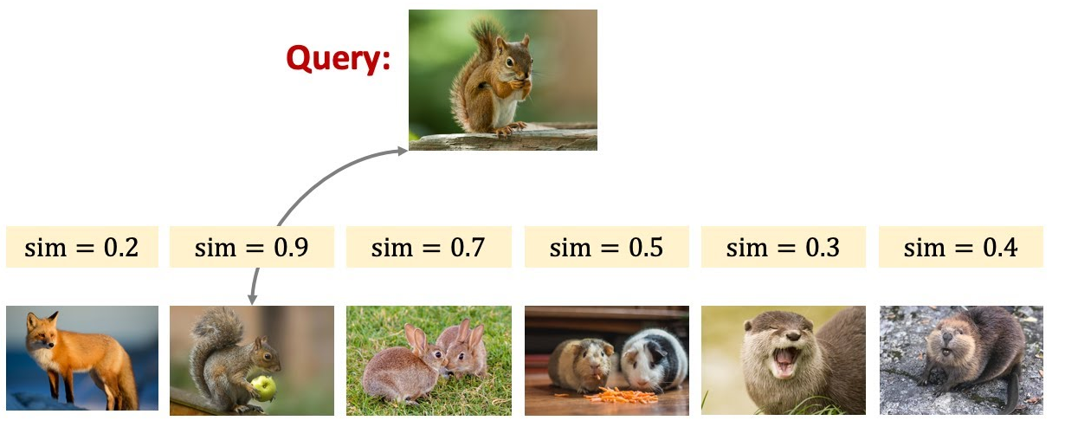
Few Shot Learning
Traditional classification models suffers from catastrophic forgetting when learning new domains
Tackle the forgetting issue
Search ALL data stored in the memory
Classfier
Forgets about cats
Cosine similarity!
Cosine similarity

Slide 4
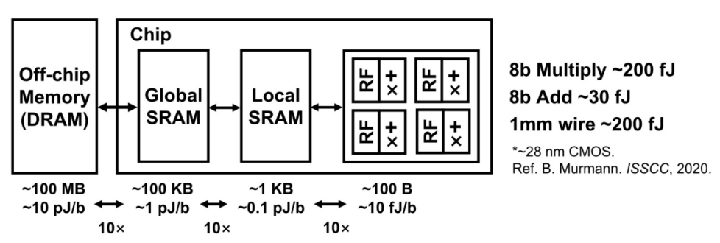

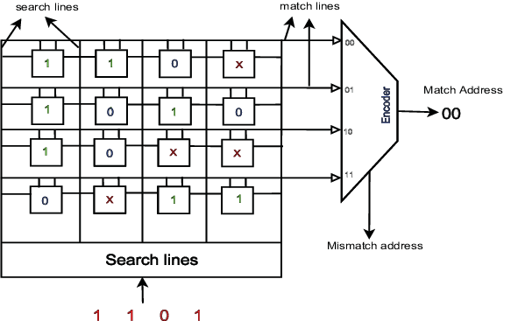
Von Neumann Architecture
Traditional computer requires frequent data transfer between CPU and RAM for ML tasks
In memory search structure
60%↑power
von Neumann bottleneck
1
Parallel !
0
Scalable !
0
Need extra ckt to perform “Search” and represent “don’t cares”
0

Slide 5
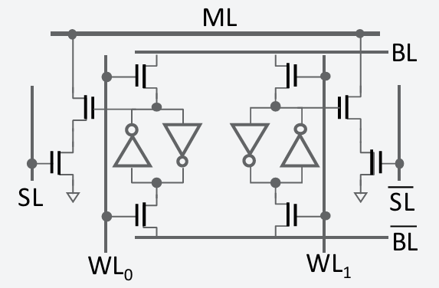
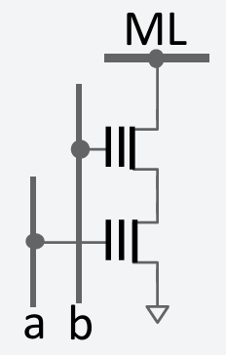
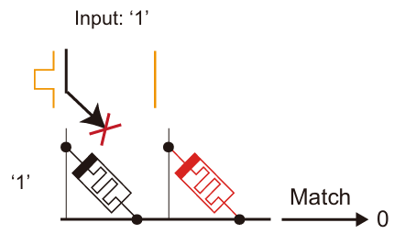
Types of Memory (TCAM)
TCAM : Ternary content addressable memory
Volatile vs Non-Volatile
16T CMOS
2T Flash/FeFET
2T RRAM Crossbar
SRAM
Cannot cut off power
More transistors
LEAKAGE!!!
Low power
Compact design
Low leakage
Low power
Compact design
Acceptable leakage

Slide 6
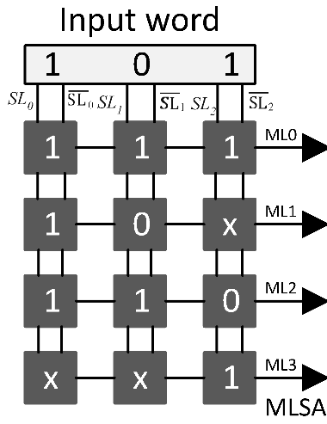

Types of Searching
Exact-match vs Best-match TCAM
Difference
0
1
1
HIT !
0
HIT !
0
2
1
0
Don’t require complex circuit | Require analog circuit (ADC…)
Can scale up to MB/GB | Scale is limited to kB due to analog non-idealities and area
Functionality is restricted (need Special Encoding) | Finds the most similar entry (bitwise hamming distance)
Used in large scale tasks
Used in small scale tasks

Slide 7

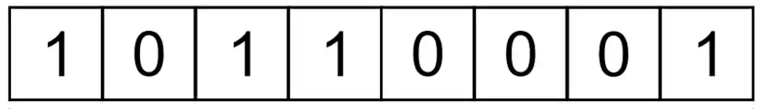

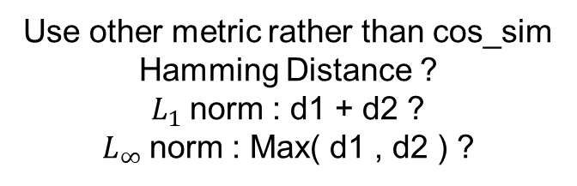

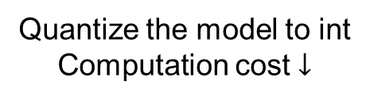


From Angular to Distance Metric
Cosine similarity
Compute floating-point value is costly
$$D$$
$$\{$$
$$\}$$
Quantize the model to int
Computation cost $↓$
Int8 for each dimension
d1
Use other metric rather than cos_sim
Hamming Distance ?
$L_{1}$norm : d1 + d2 ?
$L_{∞}$norm : Max( d1 , d2 ) ?
$L_{2}$Norm : d
d2
$$θ$$

Slide 8






Exact-Match Search with $L_{∞}$ Norm
$L_{∞}$ norm – Using exact-match search
Find the smallest square containing the query
Encode ranges into ternary vector $V={\left\{0, 1, ∗\right\}}^{D}$
Represent a square using ranges
If query is in the range: HIT !
$$y=\left[c,d\right]$$
$$x=\left[a,b\right]$$
$$Q=\left( \left[2,2\right] ,\left[4,4\right] \right)$$
$$→\left( \left[1,3\right] ,\left[3,5\right] \right)$$
$$→\left( \left[0,4\right] ,\left[2,6\right] \right)$$
Iteratively expand from query
1
Iterative !
Less space Long time
3
2
$∋$ Class green
query
$$G=\left\{\left( \left[1,1\right] ,\left[6,6\right] \right),\left( \left[0,2\right] ,\left[5,7\right] \right),\left( \left[0,3\right] ,\left[4,8\right] \right)\right\}$$
Create squares from existing data
$$B=\left\{\left( \left[5,5\right] ,\left[3,3\right] \right),\left( \left[4,6\right] ,\left[2,4\right] \right),\left( \left[3,7\right] ,\left[1,5\right] \right)\right\}$$
1
query
More space Short time
Ref: Encoding Short Ranges in TCAM Without Expansion: Efficient Algorithm and Applications

Slide 9
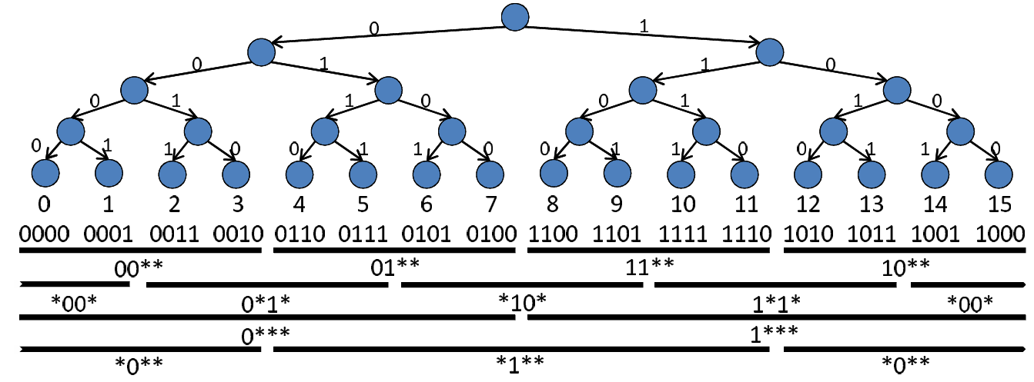


Range Encoding
$L_{∞}$ norm
Realization of “Squares”
Gray code varies 1b for neighbors
Good for encoding ranges
But has some restrictions
Range Starts from $a⋅2^{n}$
length = $2^{n (or +1)}, n<\frac{precision}{2}$
4-bit example
Gray code
Gray code + offset ( postfix ) + Intersection
0
1
2
3
00
01
11
10
Offset
0
1
0*
1*
2
*0
*1
*0
3
4
**
5
Range = 2 OK
Range = 3 Fail
[3,5] = [2,5] $∩$ [3:6]
Ref: Encoding Short Ranges in TCAM Without Expansion: Efficient Algorithm and Applications

Slide 10

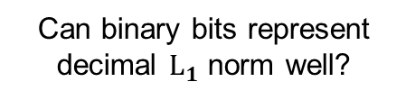

Best-Match Search with $L_{1}$ Norm
$L_{1}$ norm ( Hamming distance) – Using best-match search
Regular method : Use 8-bit ADC
Method to avoid using ADC : cut the data into segments
Avoids using 2-bit ADC
Can binary bits represent decimal $L_{1}$ norm well?
1 0 1 1 0 0 1 1
1 1 0 0 0 0 1 1
High Vt Sence Amp
B
15-11=4 but 1111–1011 = 1
V
A
1
2
0
0
Thermometer code
Low Vt Sence Amp
0 -> 00000000
3 -> 00000111
5 -> 00011111
+
AB = 00 / 10 / 11
Diff = 2 1 0
3
Ref: SAPIENS: A 64-Kbit RRAM-Based Non-Volatile Associative Memory for One-Shot Learning and Inference at the Edge

Slide 11
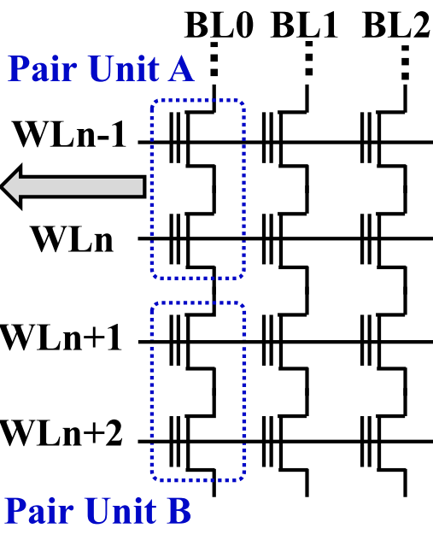
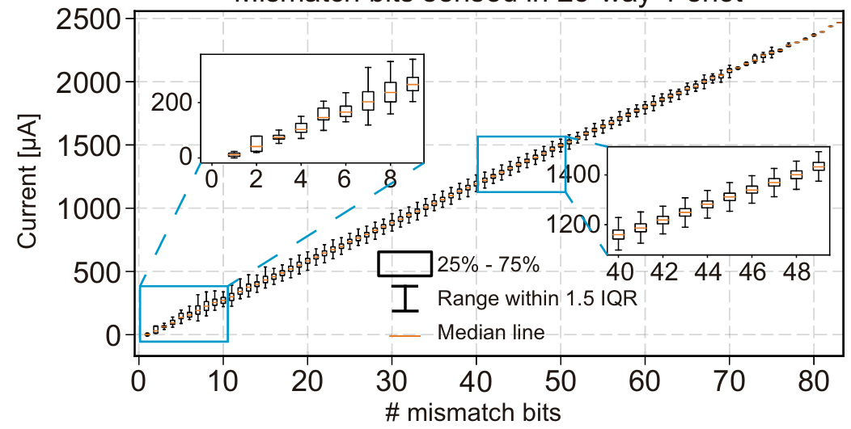
Problems of Best-Match TCAM
Analog non-idealities
Noise of storage elements accumulates
Parasitic effects of Match-Line
Large variation
noise
noise
noise
noise
Ref: Experimentally validated memristive memory augmented neural network with efficient hashing and similarity search

Slide 12
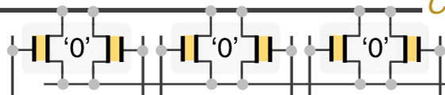
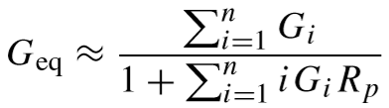
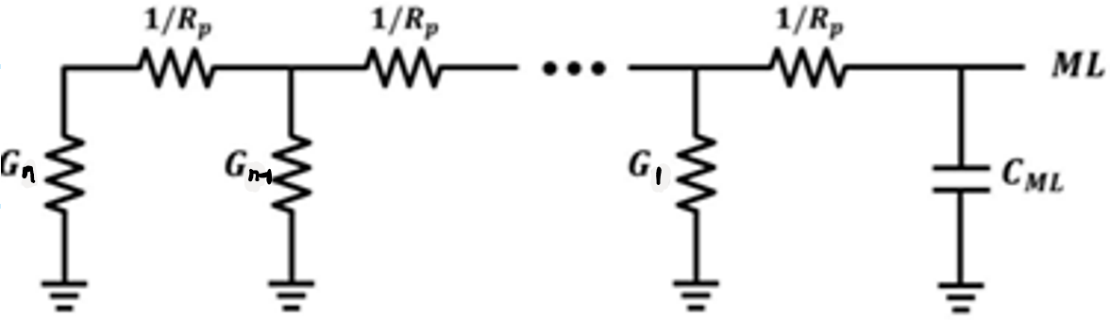
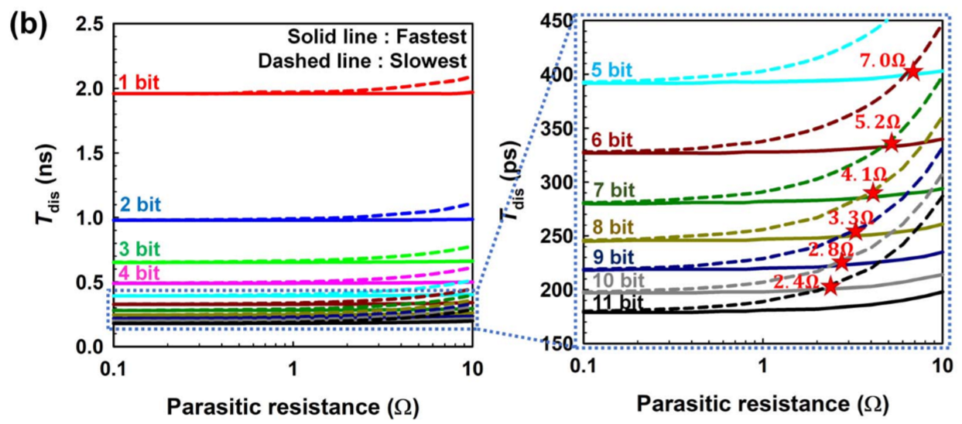
Problems of Best-Match TCAM
Analog non-idealities
Noise of storage elements accumulates
Parasitic effects of Match-Line
ML
To ADC
RAM array
To ADC
Position affects discharge rate
Eq. ckt model
Match : small G
Mismatch : large G
Mismatch here are less sensitive
( large denominator )
Mismatch here are more sensitive
( small denominator)
Ref: In-Memory Nearest Neighbor Search With Nanoelectromechanical Ternary Content-Addressable Memory

Slide 13
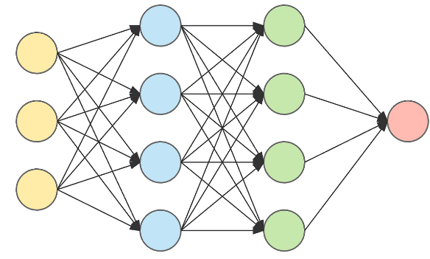

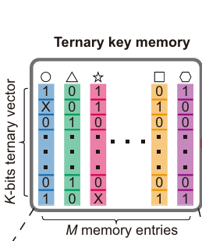
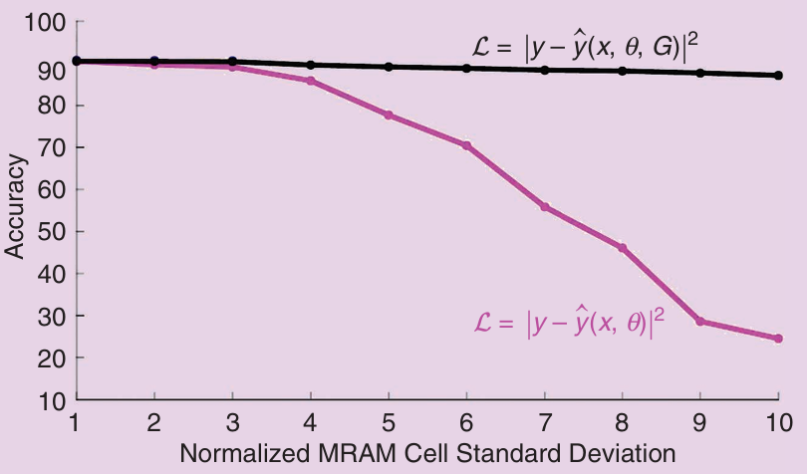

Overcome Analog Non-Ideal Effects
Analog non-idealities
Noise-aware training (Compute-in-memory case)
Noise of analog circuits could hazard our performance
Inject noise into model to make it noise-resistant
What if we inject noise into embeddings?
w/ noise
injection
$$f\left(θ\right) \sim Gaussian\left(0,σ\right)$$
w/o noise injection
or more complicated
device noise model (costly)
Ref: In-Memory Computing Advances and Prospects

Slide 14
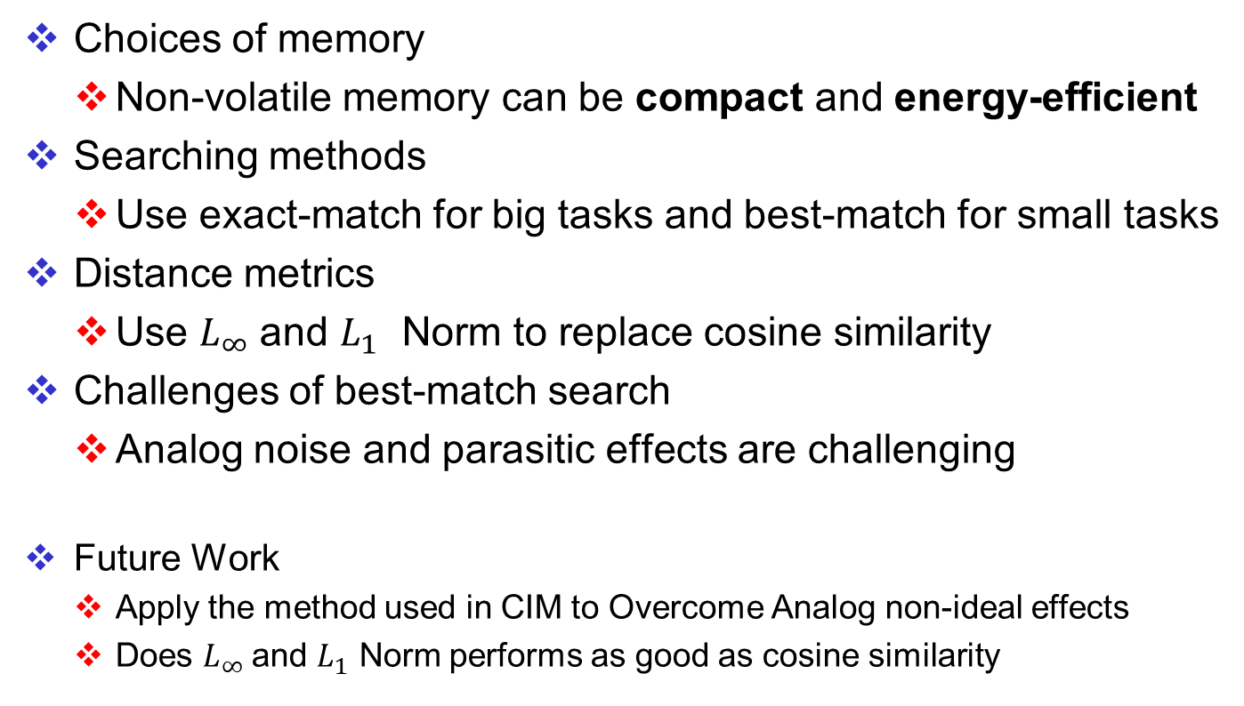
Conclusions and Future Work
Choices of memory
Non-volatile memory can be compact and energy-efficient
Searching methods
Use exact-match for big tasks and best-match for small tasks
Distance metrics
Use $L_{∞}$and $L_{1}$ Norm to replace cosine similarity
Challenges of best-match search
Analog noise and parasitic effects are challenging
Future Work
Apply the method used in CIM to Overcome Analog non-ideal effects
Does $L_{∞}$and $L_{1}$ Norm performs as good as cosine similarity

