Slide 1
Title
Speaker : B11901027 王仁軒
Mentor : Rick Huang
Advisor: Prof. An-Yeu (Andy) Wu
Date : 2025/05/02

Slide 2
Outline

Slide 3
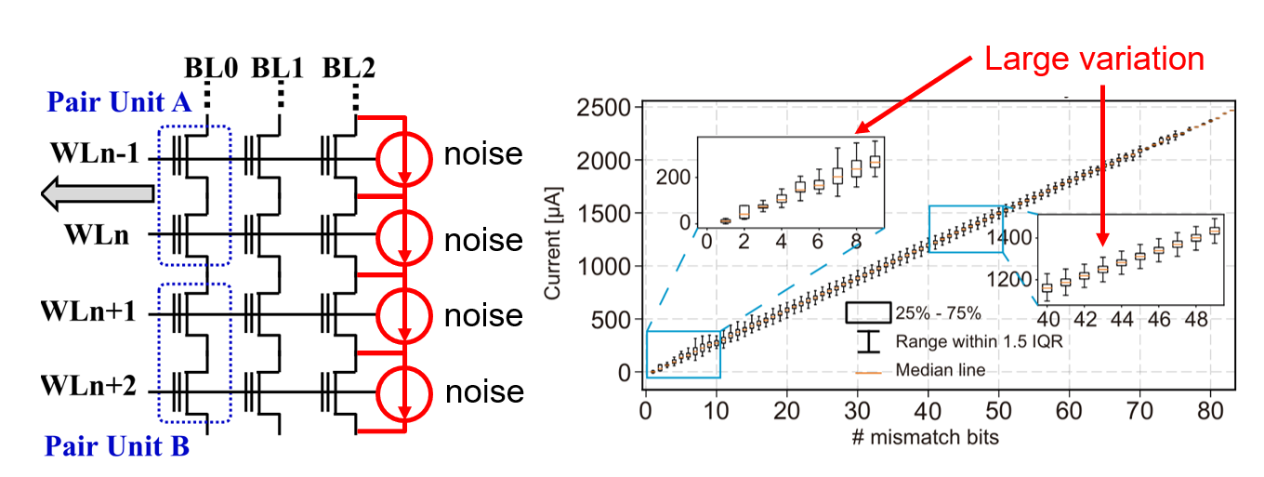
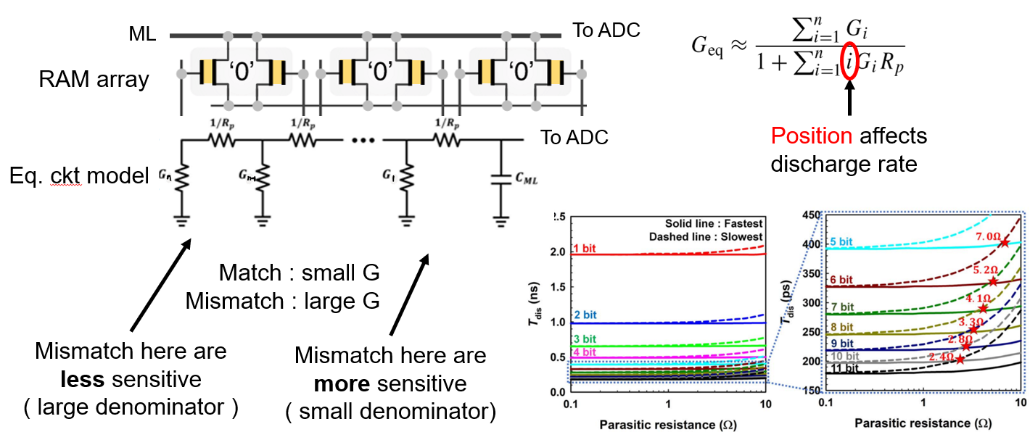
Analog Non-Ideal Effects of TCAM
TCAM : Ternary content addressable memory
Analog non-ideal effects of in-memory-search
Noise from memory device
Thermal noise
Flicker noise
Leakage current
Parasitic effects of lump elements
Resistance
Capacitance

Slide 4
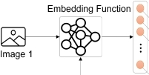

Method 1 : Noise-Aware Training
Noise-Aware Training
Inject simulated noise into embeddings while training the model
Evaluate the Trained model on different noise levels
Training
Model
+
+
+
Train on cloud server
Simulate noisy device by injecting noise to embeddings
+
Embedding
Testing
Model
Deploy the model to device
Simulate the device on server
Noisy Embedding

Slide 5
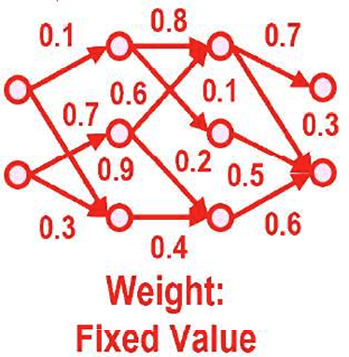
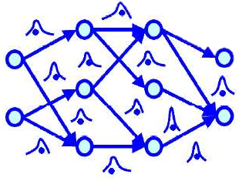
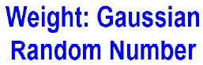
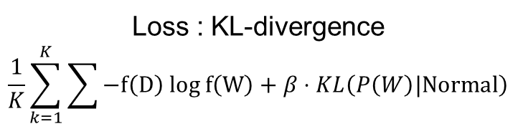

Method 2 : Bayesian Neural Network
Bayesian Neural Network (BNN)
Train a robust model that embraces noise
BNN minimizes KL-divergence (maximize Evidence Lower Bound, ELBO)
CNN
BNN
Loss : Cross Entropy
$$\sum{−P\left(D\right) log P\left(W\right)}$$
Loss : KL-divergence
$$\frac{1}{K}\sum_{k=1}^{K}{\sum{−f\left(D\right) log f\left(W\right)}}+β⋅KL\left(P\left(W\right)|Normal\right)$$
Mean of cross entropy loss acorss samples
Ensure robustness against noise

Slide 6
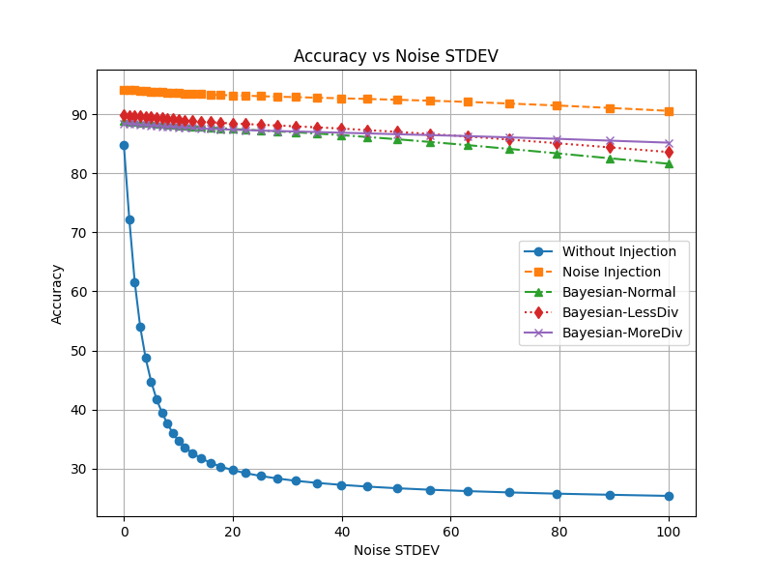
Robustness Against Noise
Both method works well on different datasets
Trade-off between accuracy on clean data & noise tolerance
Tolerance against large noise
Little noise has great effect
High acc.
large noise

Slide 7
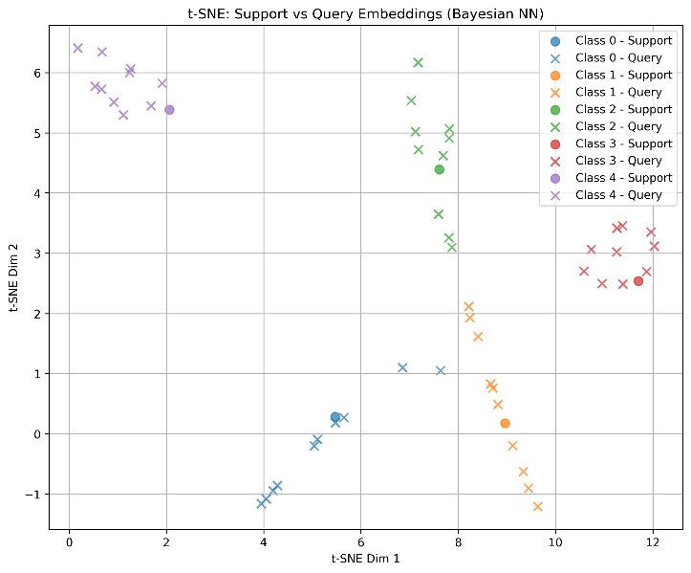
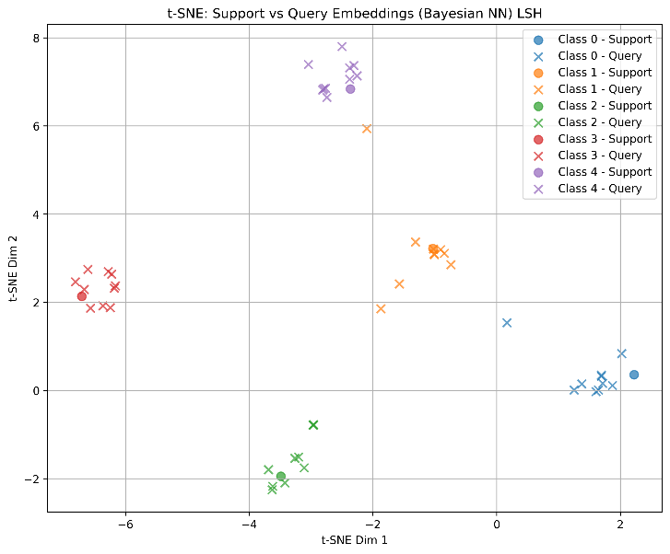
2-D Data Visualization
Visualize data using t-SNE
Visualization method that maintains spatial distance
Map angular distance to spatial distance using Locality-Sensitive Hashing
1
Random
hash vectors
0
1
Closer data has similar hashed result
0
1
0
0
0
Unwanted behavior due to cosine distance

Slide 8
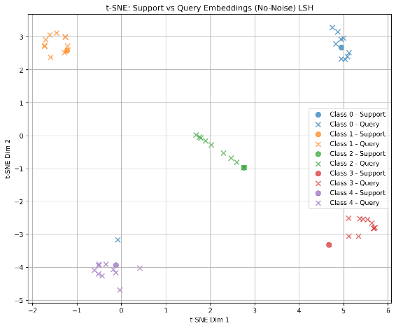
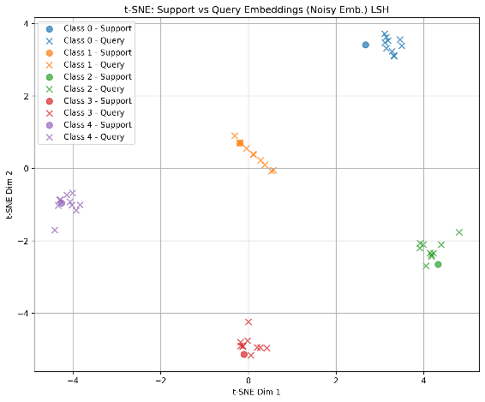
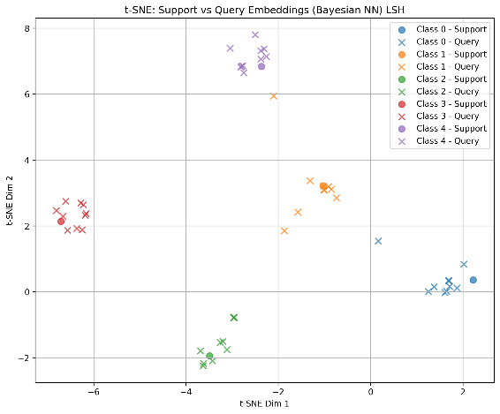
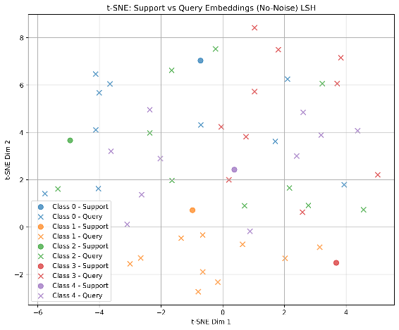
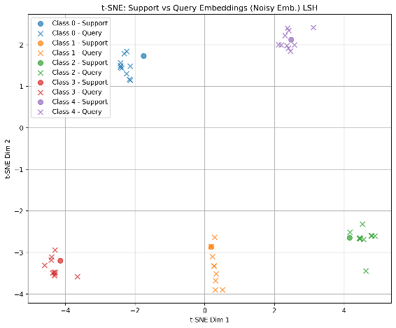
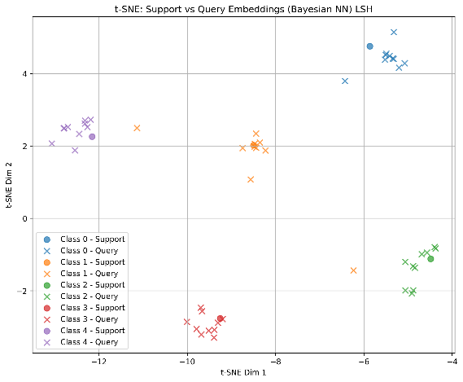
2-D Data Visualization with LSH
Visualization Result
Baseline
Noise-Aware Training
Bayesian NN
Zero Noise
Large Noise
Low accuracy

Slide 9
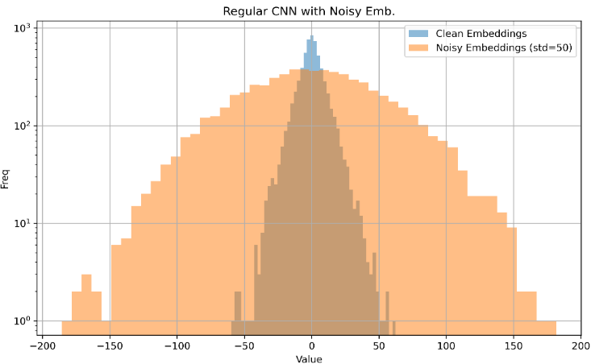
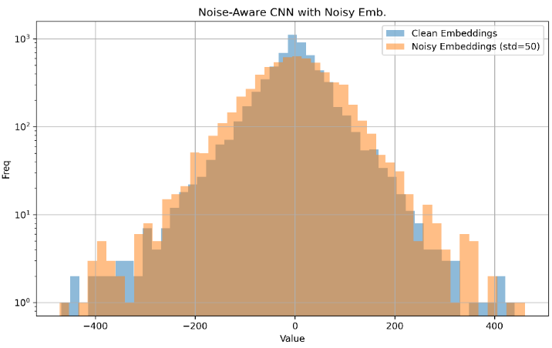
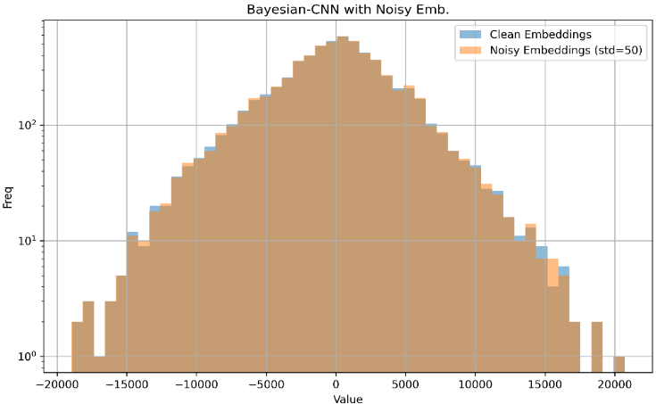
Origin of Noise Resilience in NN
Collect the value of every embeddings
Blue : Original embedding value distribution
Orange : New distribution on simulated noisy device
Model learns to against noise by amplifying magnitude of embeddings
Baseline
Noise-Aware Training
Bayesian NN
27 % accuracy
Noise dominates the embedding
92 % accuracy
Noise has little impact on embedding
88 % accuracy
Noise has almost no impact on embedding

Slide 10

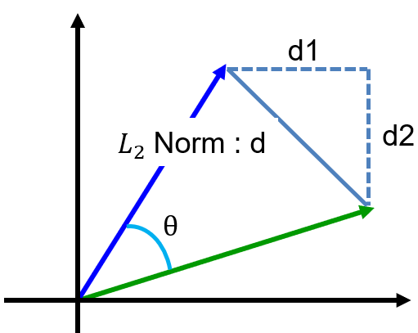





Impact of Metric Selection on Accuracy
Cosine similarity is too complicated to implement in memory cell
Spatial metric is used to calculate similarity in memory
Simple hardware, but at what cost?
The performance may vary slightly between different metrics.
$L_{1}$ norm
$L_{1}$ norm
$L_{infinity}$ norm
$L_{2}$ norm is non-normalized cos-sim
d1
d1
d2
d2
d
d
$$\left|\left|L_{2}\right|\right|<\left|\left|L_{1}\right|\right|<\sqrt{D}\left|\left|L_{2}\right|\right|$$

Slide 12
Conclusion
Accuracy drop
Original model has higher acc. on clean device, but acc. drops on noisy device
Noise-aware model and Bayesian NN resists noise by amplifying the mag. of embeddings

