Slide 1
Design Technology Co-Optimization for In-Memory Search
Speaker: B11901027 王仁軒

Slide 2
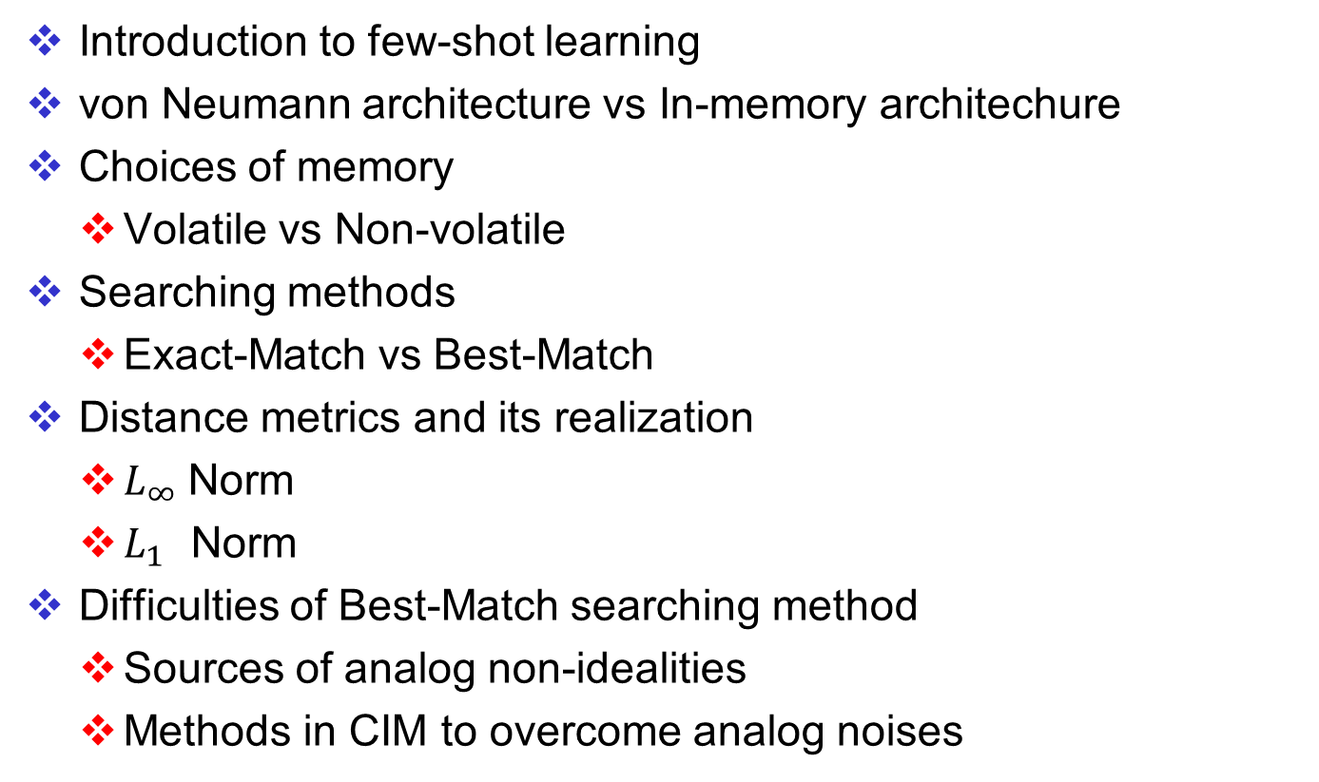
Outline
Introduction to few-shot learning
von Neumann architecture vs In-memory architechure
Choices of memory
Volatile vs Non-volatile
Searching methods
Exact-Match vs Best-Match
Distance metrics and its realization
$L_{∞}$Norm
$L_{1}$ Norm
Difficulties of Best-Match searching method
Sources of analog non-idealities
Methods in CIM to overcome analog noises

Slide 3
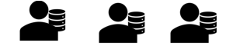




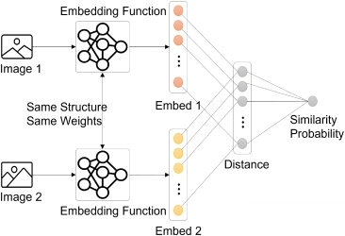
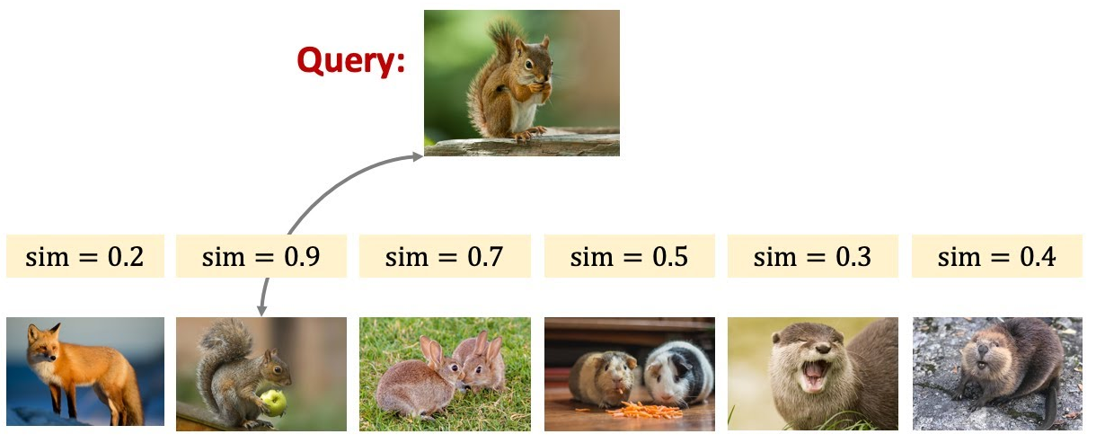
Few Shot Learning
Traditional classification models suffers from catastrophic forgetting when learning new domains
Tackle the forgetting issue
Search ALL data stored in the memory
Classfier
Forgets about cats
Cosine similarity!
Cosine similarity

Slide 4
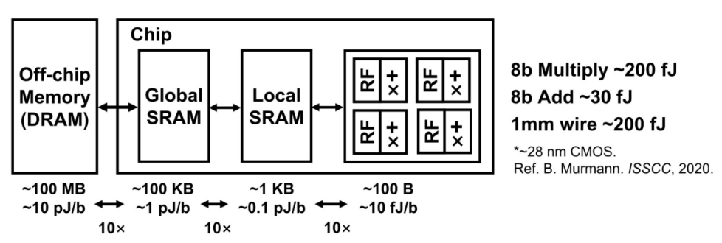

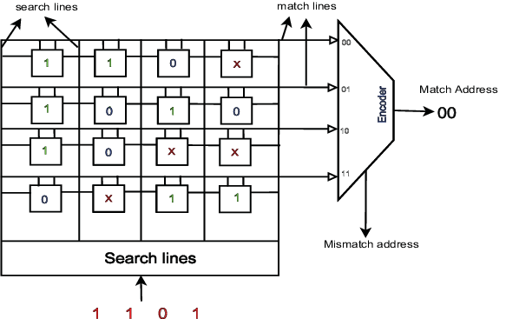
Von Neumann Architecture
Traditional computer requires frequent data transfer between CPU and RAM for ML tasks
In memory search structure
60%↑power
von Neumann bottleneck
1
Parallel !
0
Scalable !
0
The array structure of memory allows us to lower the complexity of computing
0

Slide 5
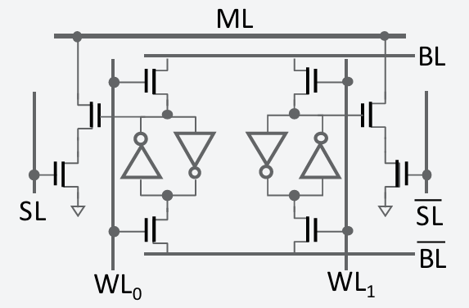
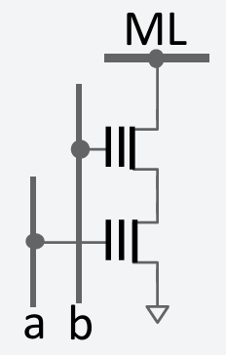
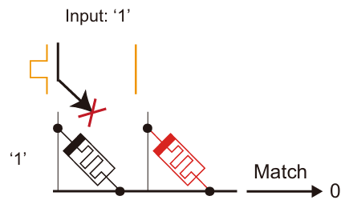
Types of Memory
Volatile vs Non-Volatile
16T CMOS
2T Flash/FeFET
2T RRAM Crossbar
Cannot cut off power
LEAKAGE!!!
Low power
Low leakage
Low power
Acceptable leakage

Slide 6
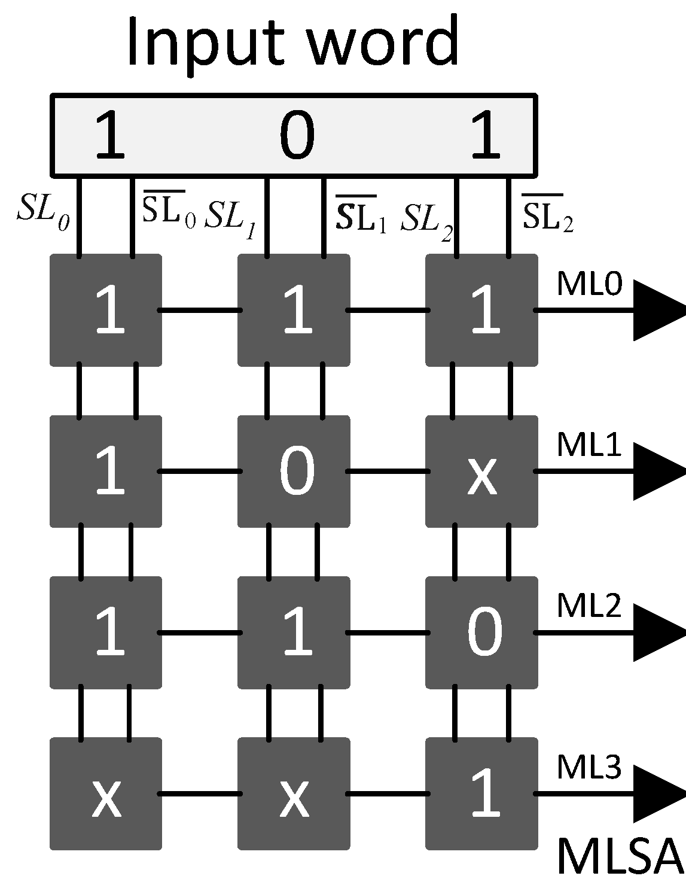

Types of Searching
Exact-match vs Best-match TCAM
Difference
0
1
1
HIT !
0
HIT !
0
2
1
0
Don’t require complex circuit for post processing | Require other analog circuit (Winner Take All ckt, ADC…)
Can scale up to MB/GB | Scale is limited to kB due to analog non-idealities and area
Functionality is restricted (need Special Encoding) | Finds the most similar entry (hamming distance)

Slide 7

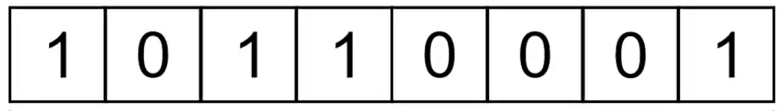


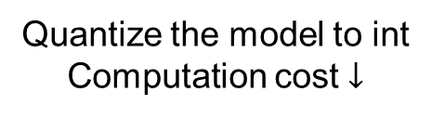

From Angular to Distance Metric
Cosine similarity
Compute floating-point value is costly
$$D$$
$$\{$$
$$\}$$
Quantize the model to int
Computation cost $↓$
d1
Use distance metric for int
Hamming Distance ?
d1 + d2 ?
Max( d1 , d2 ) ?
d2
d
$$θ$$

Slide 8

Distance Metric
L-infinity norm – Using exact-match search
Find the smallest square containing the query
Encode ranges into ternary vector $V={\left\{0, 1, ∗\right\}}^{D}$
If query is in the range: HIT !
Iterative !
Less space Long time
$$Q=\left( \left[2,2\right] ,\left[4,4\right] \right)$$
$$→\left( \left[1,3\right] ,\left[3,5\right] \right)$$
$$→\left( \left[0,4\right] ,\left[2,6\right] \right)$$
Iteratively expand from query
1
3
2
$∋$ Class green
query
$$G=\left\{\left( \left[1,1\right] ,\left[6,6\right] \right),\left( \left[0,2\right] ,\left[5,7\right] \right),\left( \left[0,3\right] ,\left[4,8\right] \right)\right\}$$
Create squares from existing data
$$B=\left\{\left( \left[5,5\right] ,\left[3,3\right] \right),\left( \left[4,6\right] ,\left[2,4\right] \right),\left( \left[3,7\right] ,\left[1,5\right] \right)\right\}$$
1
query
More space Short time
Using both methods
$$G=\left\{\left( \left[1,1\right] ,\left[6,6\right] \right),\left( \left[0,2\right] ,\left[5,7\right] \right)\right\}$$
Less space Short time
But require range-to-range encoding
1
$$B=\left\{\left( \left[5,5\right] ,\left[3,3\right] \right),\left( \left[4,6\right] ,\left[2,4\right] \right)\right\}$$
2
query
$$Q=\left( \left[2,2\right] ,\left[4,4\right] \right)→\left( \left[1,3\right] ,\left[3,5\right] \right)$$

Slide 9
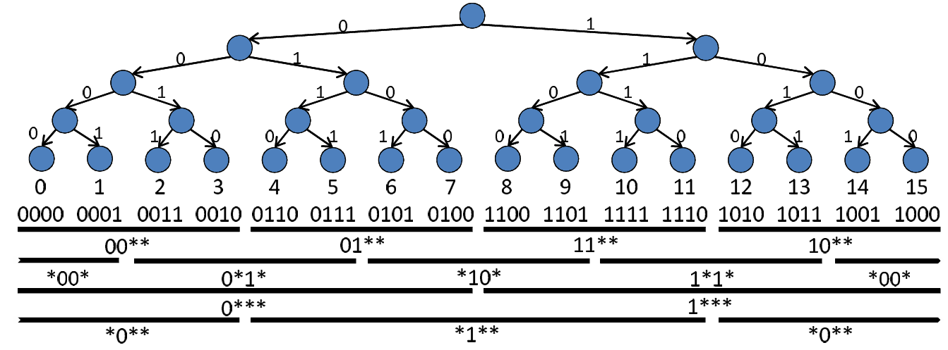

Distance Metric
L-infinity norm – Using exact-match search
Realization of “Squares”
Gray code varies 1b for neighbors
Good for encoding ranges
But has some restrictions
Range Starts from $a⋅2^{n}$
length = $2^{n (or +1)}, n<\frac{precision}{2}$
4-bit example
Gray code + offset ( postfix ) + Intersection
Gray code
0
1
2
3
Offset
00
01
11
10
0
1
0*
1*
2
3
*0
*0
4
*1
5
[3,5] = [2,5] $∩$ [3:6]
Query
Hit!
Postfix grows with maximum range linearly !

Slide 10
Distance Metric
L-1 norm ( Hamming distance) – Using best-match search
Finds the difference of bit data
Avoids using ADC
Can binary bits represent integer L-1 norm well?
1 0 1 1 0 0 1 1
1 1 0 0 0 0 1 1
High Vt Sence Amp
B
15-11=4 but 1111–1011 = 1
V
1
2
0
0
A
Thermometer code
Low Vt Sence Amp
0 -> 00000000
3 -> 00000111
5 -> 00011111
+
AB = 00 / 10 / 11
Diff = 2 1 0
3

Slide 11
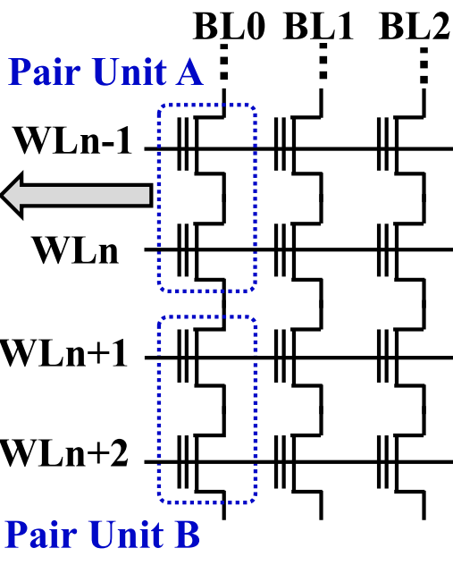
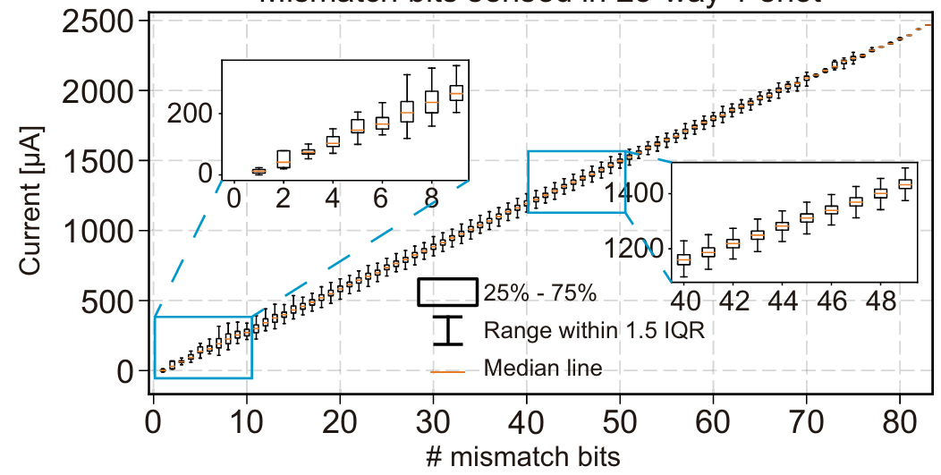
Problems of Best-Match TCAM
Analog non-idealities
Noise of storage elements accumulates
Parasitic effects of Match-Line
Large variation
noise
noise
noise
noise

Slide 12
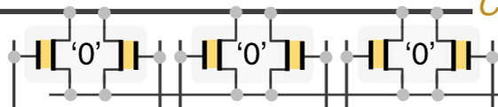
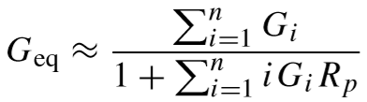
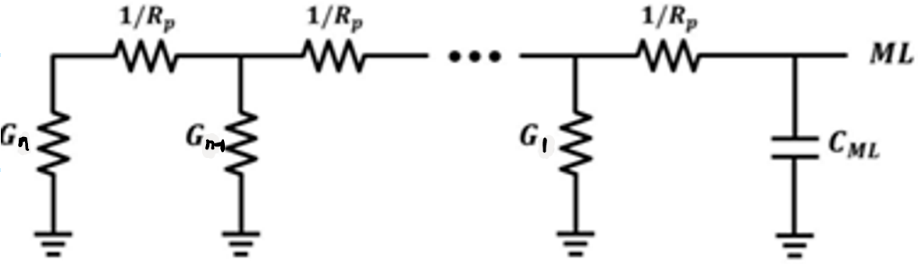
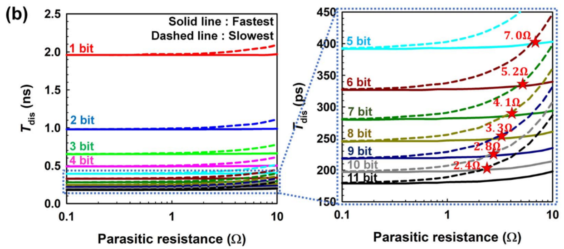
Problems of Best-Match TCAM
Analog non-idealities
Noise of storage elements accumulates
Parasitic effects of Match-Line
ML
To ADC
RAM array
To ADC
Position affects discharge rate
Eq. ckt model
Match : small G
Mismatch : large G
Mismatch here are less sensitive
( large denominator )
Mismatch here are more sensitive
( small denominator)

Slide 13
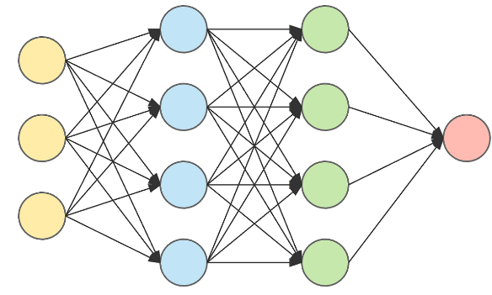

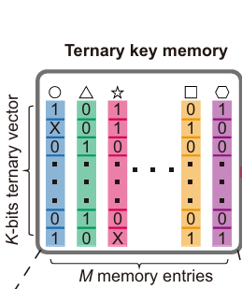
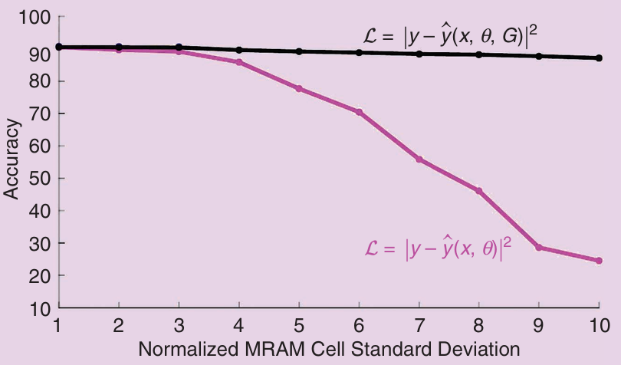

Problems of Best-Match TCAM
Analog non-idealities
Noise-aware training (CIM case)
Noise of analog circuits could hazard our performance
Inject noise into model to make it noise-resistant
What if we inject noise into embeddings?
w/ noise
injection
$$f\left(θ\right) \sim Gaussian\left(0,σ\right)$$
w/o noise injection
or more complicated
device noise model (costly)

